Slide 1
Object Orientated Security Policy
Graeme Burnett
Jan 2011

Slide 2
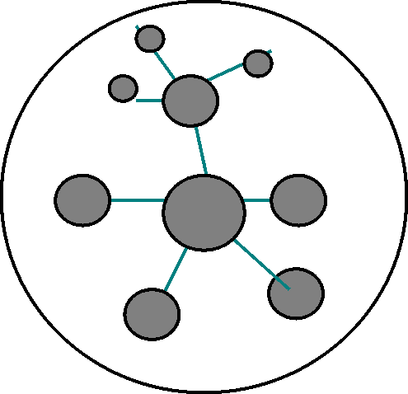
OO Security Policy - Quad Chart
Current State
New Ideas
Invisible policy framework
Loose collection of abstract policies
Rarely if ever read, understood or referred to
Complex & technical v. functional & clear
No business rules (BPML)
Monolithic & centralised v. global and federated
Uncertain legal status
Audit/accountancy driven v. business focused
Control rather than functionality
Inheritance applied to Security Policy
General and abstract to specific and detailed
Data, event and process centred
Detailed and technical to minimal and clear
Navigable framework
Process catalogue
  human readable
  machine executable
Components
Compliance
Policy framework – (BITS SIG++)
Hierarchal process catalogue (BITS AUP++)
Security Architecture Capture
- subset of BITS SIG
- concentrates on data flows
- asset, data, risk classes
- business value and application complexity
- operational impact analysis
Standardised Information Gathering (SIG)
  ISO 27002:2005, COBIT, PCI-DSS 1.1
Agreed Upon Procedures (AUP)
  GLB, HIPPA, COSO, SysTrust, SOX
Employment Law

Slide 3

Problems with Current Infosec Policy Frameworks
Framework is intangible and abstract
No one reads policies unless they have to (the board, new employees and policy wonks.)
Policies are not contracts. Contracts are for pre/post event. Policy is dynamic.
Policy written Abstract, domain-specific terminology
Poor context - self-contained, large incomprehensible documents
Sign and forget (hopefully.)
Awareness, let alone use, difficult to measure

Slide 4

The Big Idea
Tangible, visual Framework, easy to navigate
Separate the general and abstract from the specific and detailed
Context specific, declarative, imperative rule sets
Easily readable, plain English, simpler legal endorsement
Map entities assets and risk to Regulatory Framework
Machine readable/executable
Dynamic Policy SLA monitoring

Slide 5
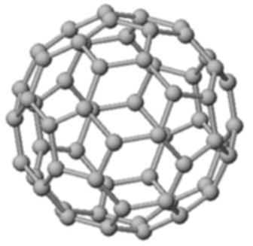
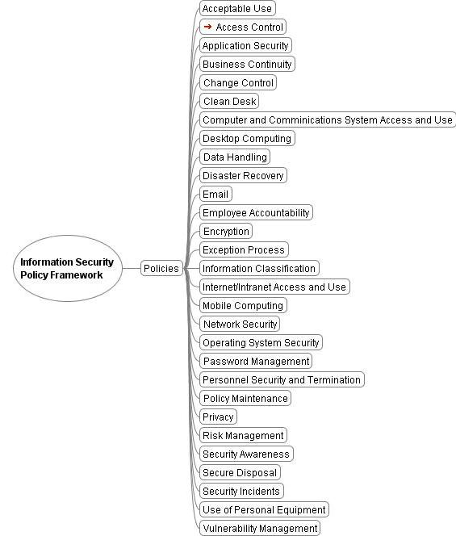
Regulatory Information Security Framework

Slide 6

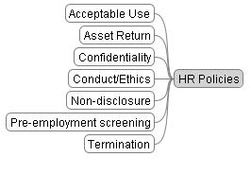
Regulatory HR/Business Policy Framework
Acceptable Use Policy – value protection
Asset return – asset and information control
Confidentiality – IP/reputation protection
Conduct/Ethics – reputation - treating customers fairly. Vendor liaison
Non-disclosure – IP/reputation protection of third parties
Pre-screening – Employee fidelity
Termination policy – Protection against retaliation claims

Slide 7

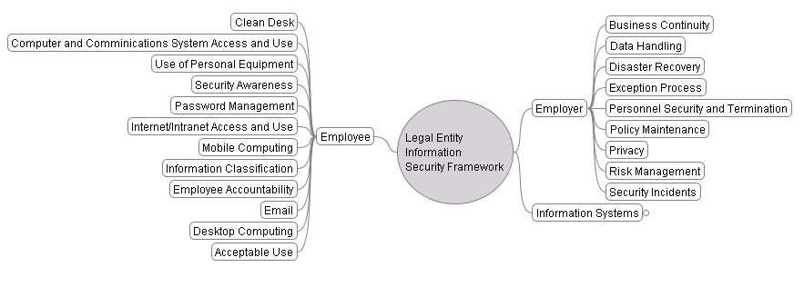
ISO27002 Framework Legal Entity Mapping

Slide 8
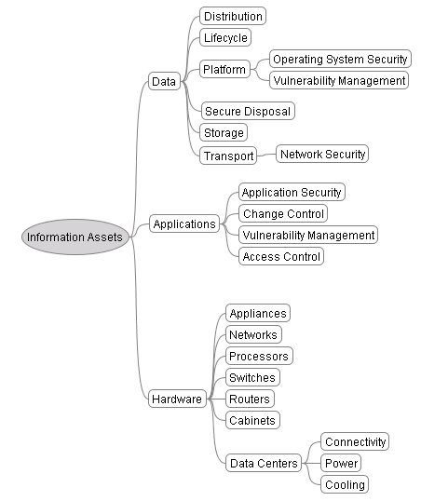
ISO27002 Framework Asset Mapping

Slide 9
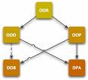
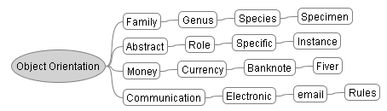
Why Object Orientation?
Inheritance - hide the abstract/conceptual
Context – dependencies and interrelations
Rules – clear, understandable and machine readable/executable

Slide 10

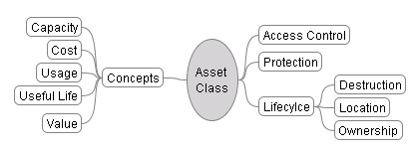
00 Classes - Asset Class

Slide 11

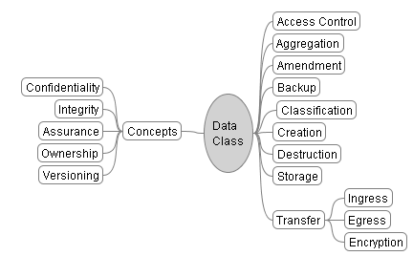
Data

Slide 12
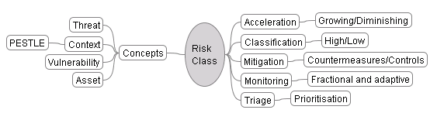
Risk Class

Slide 13
Clean Desk Policy
Policy Name - Clean Desk
Synonyms - Asset Protection
Inherits from - Assets, Data, Employee, Risk
Synopsis
  Employees MUST take steps to have a minimum set of assets on their desk that can be lost or stolen when they are not present
Risk Scenarios
  Fire alarm - high threat
  Emergency evacuation - medium threat
  Explosion - low threat
Rules
  Lock physical assets in secure storage when you are away for significant periods of time.

Slide 14
Email Policy
Policy Name - Email
Synonyms - none
Inherits from - Data, Employer, HR
Synopsis
  Email is for bona fide company business and MUST not be used for personal affairs.
Risk Scenarios
  Company reputation damage - high risk
  Confidential content - medium risk
  Erroneous contract - low risk
Rules
  Your email address is for bona fide company business
  No blogging, social networking or newsgroups without approval

Slide 15
System X Policy
Policy Name - System X
Synonyms -
Inherits from - Data, Risk,Events
Synopsis
  System X is used to place client orders directly with the market.
Risk Scenarios
  Unknown clients - high risk
  Limits exceeded - medium risk
  Unknown clients - low risk
Rules
  Clients must be known before trading on this system
  Portfolio Exposure must be calculated at frequency x
  Exposure must not be greater that 20% in any one sector

Slide 16
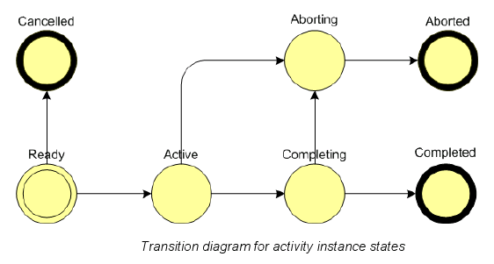
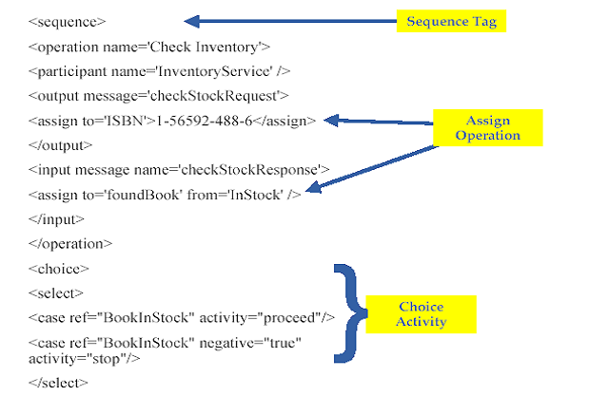
Executable Policy in BPML

Slide 17
BPML Features
End-to-End Flow Modeling
Flow-Control/Data-Flow Separate
Product Consume Messaging
Dynamic Control Flow
Transparent Persistence
Embedded Business Rules
Nested Processes
Distributed Transactions
Process Oriented Exception Handling

Slide 18

Conclusion
Policy Simplification
Policy relevant to the users system
Executable Policy with measurable SLA
Designed for Change
  Concepts are static and abstract
  Systems adapt to the environment quickly

