Slide 1
Open Source Intelligence in Finance
Graeme Burnett
Dec 2005 graeme.burnett@acm.org
© Enhyper Ltd

Slide 2
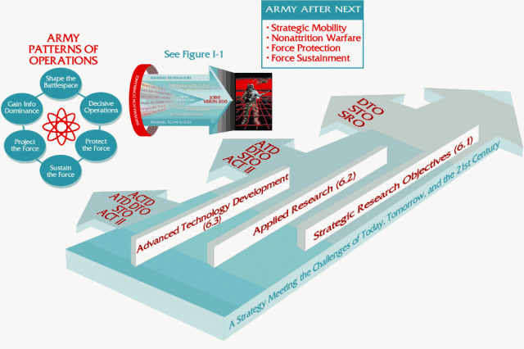
Trends In Investment Banking 2005/6
Increasingly sophisticated boutique, hedge fund and algorithmic trading clients are demanding:
  DMA - requires sophisticated pre and post-trade analysis and real-time VAR to manage risk
  Pre-trade Analytics
  Access to execution, routing, and internalisation
  Flow analysis
  IOI’s, Trade Ideas and Idea Clustering
  Algo Trading – 27 % of US equities in 2006, average 8bps cheaper than other methods
Increasingly Sophisticated Trading Techniques
  News analysis: categorisation, sentiment, enrichment
  Business Intelligence: social network analysis, trader and trading strategy analysis, algorithmic analysis, signal analysis
Regulatory Pressures – MiFID from a technology perspective is particularly misunderstood
  Pre Trade Analytics: near real time prices quotes
  Quote publication and historical retention
Algorithms are the Future
  Increasing pressure of automation isolating removing the trader from the equation

Slide 3
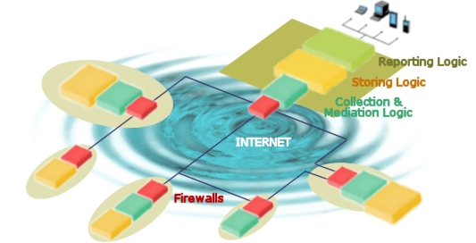
Sell-Side Players and Control Techniques
Market Makers
  A market maker is a person or a firm which quotes a buy and sell price in a financial instrument or commodity hoping to make a profit on the turn or the bid/offer spread.
  Covers a small universe of stocks
  Several firms potentially involved
  Well connected to other market makers in order to satisfy demand
Prop Desk
  Proprietary trading on firms account.
Boutique Traders
  Specialist investment firms working a particular strategy
Market Control Techniques
  Bid/Offer Spread
  Normal Market Size
  Tree-shaking- blipping the price to shake out investors with naive strategies
  Client Targeted Research
    Market, sector, stock analysis
  Trade Ideas
    Mechanism to publish reputation based trading strategies/ideas based on a stock, sector or country.

Slide 4

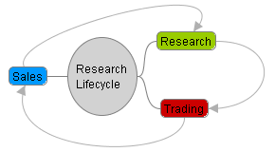
Research Lifecycle
Trading
  Underwrite research, sales and technology
  Strategy Formulation
  Profitability: quarterly cycle of profit delivery
Research
  Write buy-side targeted research reports based on (mainly) closed and open source information
Sales
  Push research materials to the buy-side and gather tacit and explicit human intelligence which is rarely subject to knowledge management

Slide 5
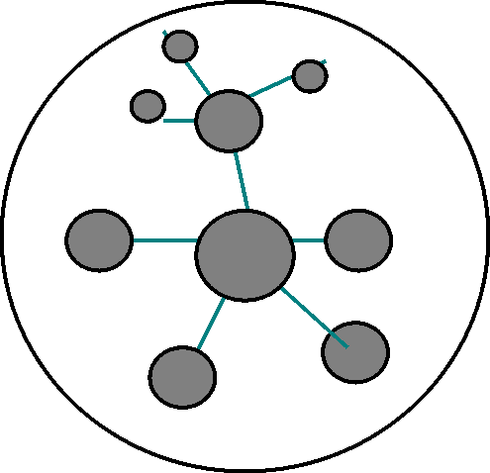
OSINT - Open Source Intelligence
Definition: OSINT refers to an intelligence gathering based on information collected from open sources, i.e. information available to the general public. This includes newspapers, the internet, books, phone books, scientific journals, radio broadcasts, television, and others [wikipedia].
Financial Information Sources:
  Tier 1 - Reuters, Bloomberg are the key players.
    Delivered to the desktop using proprietary technology
    Very expensive, used in tier 1 investment banks
  Tier 2 - Thomson Financial, Dow Jones, etc.
    Less expensive, niche players
    Used in tier 2 investment banks
  Tier 3 – Edgar, Financial Times, Google, Hoovers, Yahoo etc.
    Free or inexpensive
    Day traders, investment clubs
    Increasingly used to for back testing and by boutique trading shops

Slide 6
HUMINT – Human Intelligence
Definition: Intelligence gathering discipline involving collecting information either by interviewing or tracking a subject of investigation [wikipedia]
Client Relationship
Regulated Trading Practise
  Phone calls are recorded
  Chinese walls to separate research and trading and other business areas
  Restriction of research
Covert Channels
  Instant Messenger
  Closed and open user groups, Day trading sites
  Mobile phones – only recently banned on the trading floor
  Recording devices: cameras, voice activated
  USB devices – 2GB and rising - not banned – yet.
  Human interaction
  Social Networks

Slide 7
News-driven Algo. Trading Strategy
Hypothesis: News Drives Volatility, Sentiment influences Price
  More News, more volatility?
  Sentiment analysis gives heuristic prediction of price trend
Probabilistic Clustering
  Outlier elision solves the Bayesian problem
  Greater provenance due to multiple independent sources
Implementation:
  Systemic analysis of news from multiple dynamic and static sources
  Cross-document Structure Theory discovers statistical clustering and intra and inter-document relationships
  Domain ontology maps are applied to clusters
  Augmented map tunes cluster selectivity
Application
  Automatic trading – before human analysis - trend acceleration
  Trading agent for assisted decision making
  Automatic news summarisation and news generation

Slide 8
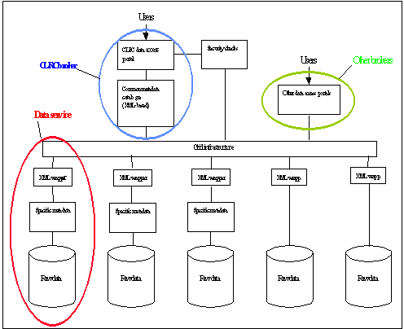
News Driven Human Trading Strategy
Break the Trading Driven Research Cycle
  Key point: paradigm shift from trading and sales-driven research to business intelligence
  Impartiality: No need to broadcast business intelligence to meet regulatory requirements
Benefits for Prop Desks
  Differentiation: no longer a level playing field
  Reduced Costs: Less research effort, less publication expense
  Reduced regulation
Benefits for Individual Traders
  Sell-side Idea Generation – a reason to call the client
  Development of specialisation/domain expertise via custom filtering
  Market Making by promulgation of “Trade Ideas” for profit and reputation enhancement

Slide 9

Business Intelligence - Same Old Story?
Business Intelligence Has Been Tried Before
  Proprietary tools based on Bayesian methods were woeful
  Heuristics are used to defeat Bayesian nets
  Tools could not scale to corporate let alone internet volumes of data
  GA’s went awry through time – became untrained and unstable
Statistical Methods
  Del.icio.us
  www.dulance.com
  www.google.com
Advances in Operational Research
  Knowledge Management has improved greatly in the last 5 years
Hardware and Software
  Highly performant platforms are now easily affordable
  Operating systems are now 64 bit

Slide 10
Conclusion
Paradigm shift from trading and sales-driven research to business intelligence
Provenance: accurate information
Less Regulation: No need to broadcast business intelligence

