Slide 1
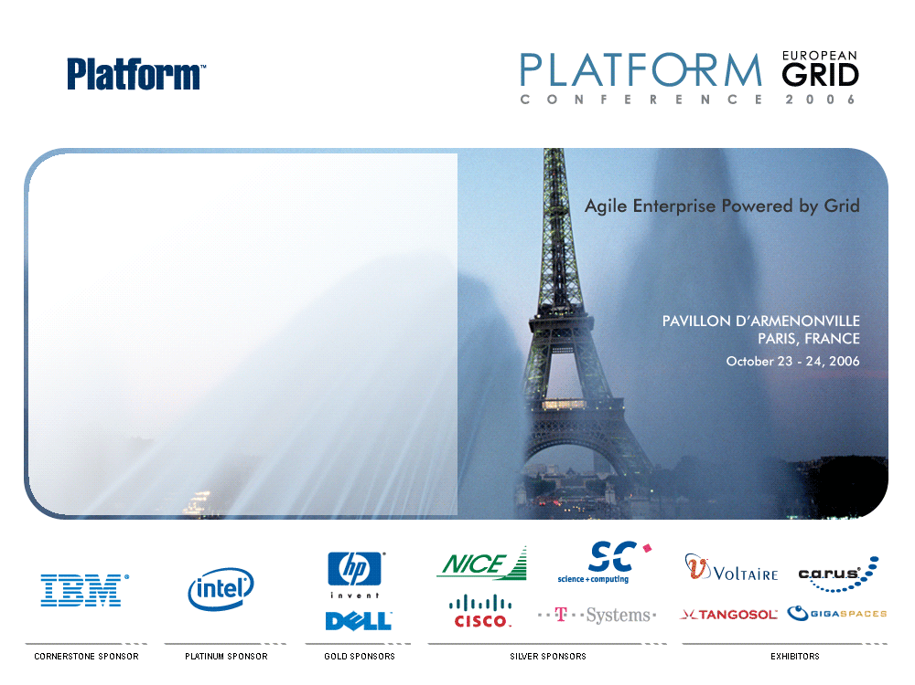
HPC = Grid + Data + FPGA
Graeme Burnett

Slide 2
HPC=Grid+Data+FPGA
High Performance Computing

Slide 3
Trends in Investment Banking
Increasingly sophisticated Boutique, Hedge Fund and Algo Trading Clients demanding:
  Direct Market Analysis – requires high speed pricing, sophisticated post trade analysis, real-time limits and VAR
  Pre-trade Analytics - high performance pricing, portfolio/basket optimisation
  MiFID: IOI/pricing, routing, internalisation (crossing), execution – high speed/low margin
High-Frequency Analytics
  High performance computing, high data volumes, low latency
  Market depth analysis
  IOI flood-attacks, algorithmic sniffing
Business Intelligence
  Flow analysis
  Trade Ideas – monetisation of cross-federated research
  News analysis: filtering, provenance, summarisation, categorisation, distribution, enrichment, visualisation, entity extraction, social network analysis, trader and trading strategy analysis, algorithmic analysis.
Conclusion
  Exponential requirement for computational power, data bandwidth and high performance analytics

Slide 4
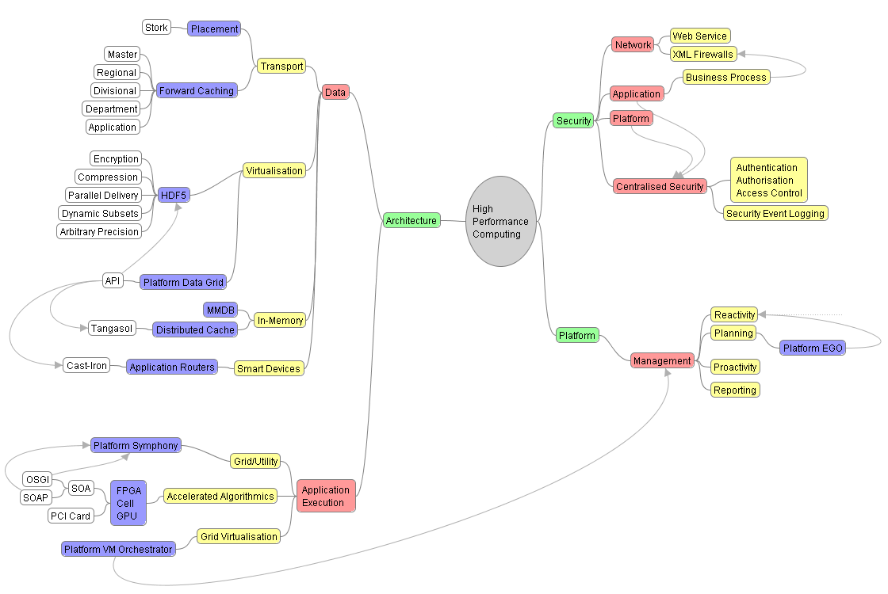
High Performance Computing

Slide 5
HPC=Grid+Data+FPGA
GRID

Slide 6
Infrastructure and Data Trends
Centralised Data Centres
  Centralised data means centralised risk.
  Extreme risk events would render business continuity planning ineffective.
  Huge energy requirements (15MW, 5MW of which is cooling)
Data is Mobile - Not All Data Needs Enterprise Class Persistence
  An enterprise Data Grid makes it easy to forward cache static/reference data calved from master data sets
    Master/Regional/Divisional/Departmental/Workgroup
  Real-time computational derivation using virtual grids combined with accelerated computing
  Reduced cost whilst maintaining regulatory compliance
Master/Micro-hosting - Crisis Resilient Grid Architecture
  Master data stored in nuclear bunker data centre, multiple micro data centres close to the application/markets
  Ideal for Grid - Platform EGO chooses the most appropriate execution environment and marshals data accordingly using it’s data virtualisation APIs
  Each site operational has 20-30 low cost COTS nodes, minimal cooling, energy footprint up to 15KW, multiple network connections.
  KNURR Secure 10/20KW Water cooled cabinets located across the enterprise

Slide 7
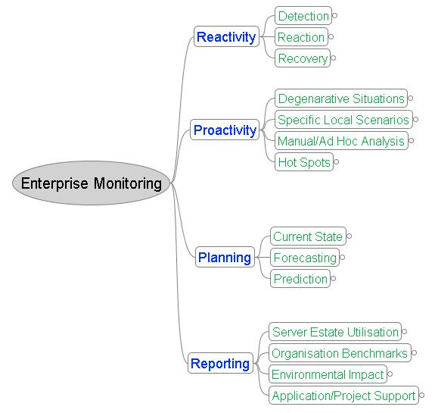
Logical Platform Management

Slide 8
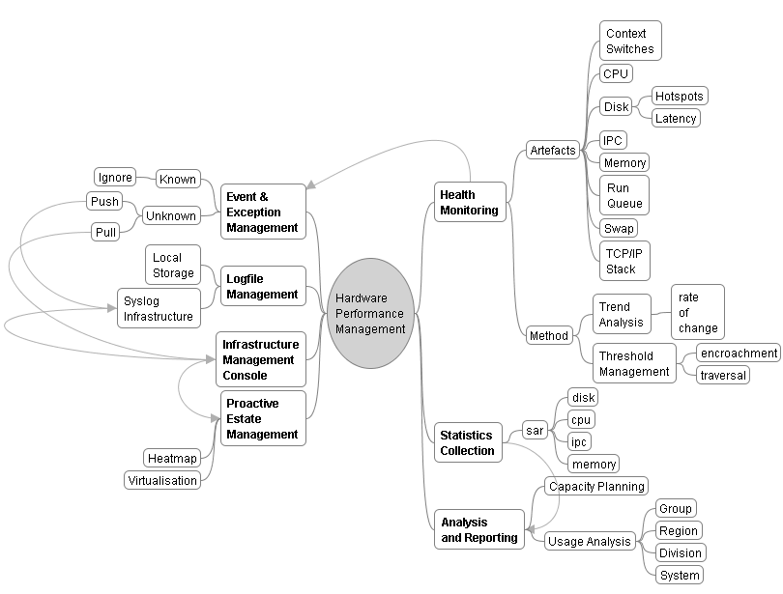
Physical Platform Management

Slide 9
Virtualisation
Hardware
  OS and chip manufacturers are set in providing virtualisation (and containers) support everywhere.
  Xen, VMWare, Virtuoso
  Downside: Licence cost? Open source support models? Complexity? Reliability? Vendor Support?
Grid as Middleware
  Dynamic VM allocation and separation based on business policy - crucial to grid success
  Achieved at the application layer – no longer reliant on OS separation - crucial for regulatory compliance
  Platform EGO is the first and only grid platform that will deliver the power of virtualisation, automation and the sharing of all IT resources to every application type.
Data Virtualisation
  SAN technology - slow, expensive, single point of failure
  Platform Data Grid API abstracts the physical data infrastructure whilst interfacing other data APIs
  Open source - HDF5, Lustre – data delivery by configuration
  Easily integrated to grid and memory caching solutions

Slide 10
HPC=Grid+Data+FPGA
DATA

Slide 11
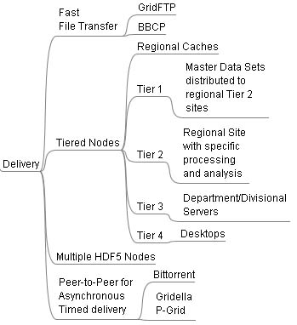
Data Architecture
Tier 1 - Master Data Sets
  Enterprise grade persistence
  Satisfy Data Retention Regulations:
    Gramm-Leach-Bliley - security and confidentiality
    Sarbanes-Oxley - the need for data retention
  I/O profile per data set to suit predefined SLA
Tier 2 - Derived Regional Data sets
  Geo-legislative Data Partitioning
Tier 3 - Divisional/Departmental Data Sets
  Reduced infrastructure requirements
  Forward Caching - data near point of consumption
  Dataset Enrichment - pattern recognition, aggregation, data set generation
Tier 4 – Workstation
  Spare-cycle computing
  Specialist enrichment

Slide 12
HPC=Grid+Data+FPGA
Field Programmable Gate Array

Slide 13
Grid+FPGA
Grid and FPGAs together become the ideal technology for most cases:
  Grid can run parallel complex applications and enhance their performance
  Grid provides error management and policy based execution control (Platform VM Orchestrator)
  Grid provides nearly unlimited scalability to the system
  FPGAs multiply (typically by 20-1000) the performance of applications based on mathematical functions
  Both FPGAs and Grid are very well suited for Monte Carlo methods

Slide 14
Price Calculation and Risk
Monte Carlo Simulation
  Computationally intensive simulation algorithms that are based on generating uniform pseudo or quasi-random numbers. These numbers are used as the basis for generating sample paths for financial instruments. Given a large number (~10000+) of simulations the paths can be used to determine statistically accurate fair prices of derivative securities.
  Monte Carlo is useful for high-dimensional problems e.g. BGM CDO, CDO squared.
Performance Characteristics
  Latency proportional to degree of parallelisation
  Parallelisation is a function of the number of nodes and their capability
  Number of nodes are limited by data centre and cost constraints
Current Implementations
  1-2000 node blade clusters per business area which operate for ~1 hour/day
  CAP. EX.: $5-8K == $5 - $16 Million
  Operation: Assuming $10K per annum/blade == $10-20 Million
  Data Centre Space: Theoretically between 5 and 10 fully populated racks (if you could dissipate the heat)
  3 Year TCO: $35-76 Million per division
Projected Requirements (tier 1 bank)
  Simulation volume expected to grow exponentially (200 X the above)

Slide 15
Hardware Accelerated Algorithms
FPGA is a mature, non-disruptive, commodity technology
  High Performance, Low Cost, Low risk
  Used in engineering, medical, geophysics
  Implemented as part of an SOA strategy as a web service
  Part of a Grid solution to provide redundancy
Monte Carlo in SCIMARK 2.0 Benchmark on FPGA
  Benchmark: Monte Carlo algorithm delivers 500MFlops per implementation
  Uses 4% of the FPGA - without optimisation i.e 12.5GFlops per FPGA chip.
  AMD Opteron delivers 140MFlops/single core
Implementation
  2 x FPGA Chips per PCI Card == 25GFlops == 178 AMD CPUs
  PCI Backplane cabinet can host 100+ FPGA PCI cards including controlling Linux/PC host.
  Footprint of 2 PCs
  Effectively a theoretical 17,800 node computer with ~2500GFlops performance
3 Year TCO
  CAP. EX: <$200K, Operation: <$250K, Data Centre Space: 21U (half rack)
  Equivalent conventional cost: $623 – $1353 Million

Slide 16
Empirical Results
Celoxica DK – The bridge between analytics and hardware
  Standard Developer IDE paradigm
  Compiles C-like language (Handel-C) to EDIF/VHDL
  Handles multiple FPGA/GPU/Cell chips
  Integrates to Matlab/Simulink for rapid model development/deployment
Project at tier 1 Investment Bank - BGM Conversion to FPGA (Oct 2006)
  Double precision library developed for FPGA by University
  Monte Carlo ported to FPGA
  Performance uplift 15-24x over based on existing in-house code
Future State
  Integration to Platform grid technology – provision of controlled and monitored fan-out
  Algorithmic enhancement - realistically 100x improvement achievable without hand crafting VHDL
  SOI – Service Orientated Infrastructure - Algorithmic Appliance

Slide 17
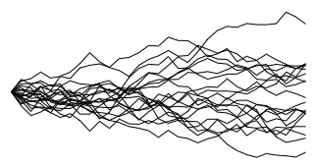
FPGA Enabled Risk Architecture
Real Time Exposure Analytics
Pre-generated scenarios
Scenario distribution
To each engine instance
OSGI Container
Pre generated scenarios
Platform VM Orchestraator control interface
Functionality
≈70/30 math Split
Configuration data
Time
FPGA
VCV Correlation Matrices
To each engine instance
Calculation Engine(Java)
Data Grid
Trading Platform
Platform Web services layer
Push work units/Push results
Engine simulation parameters and results interface
Audit data
Leased Interface
Platform Virtual Machines
Pull work units/Push results
Platform API
Trade details(Pushed to spaces)
Hardware Layer NT/Unix/Linux
VM 1
OSGI Container
Configuration data
VM 2
FPGA
Data Grid
…..
Calculation Engine(Java)
Exposure results at t1..tn (Pushed to trading platform)
Leased Interface
Audit data
Jini Wrapper
VM n
Hardware Layer NT/Unix/Linux
Hardware Layer NT/Unix/Linux
Exposure
t1
t2
t3
OSGI Container
Time steps
Configuration data
FPGA
Calculation Engine(Java)
HDF5 file system
Audit data
Leased Interface
Jini Wrapper
Hardware Layer NT/Unix/Linux

Slide 18
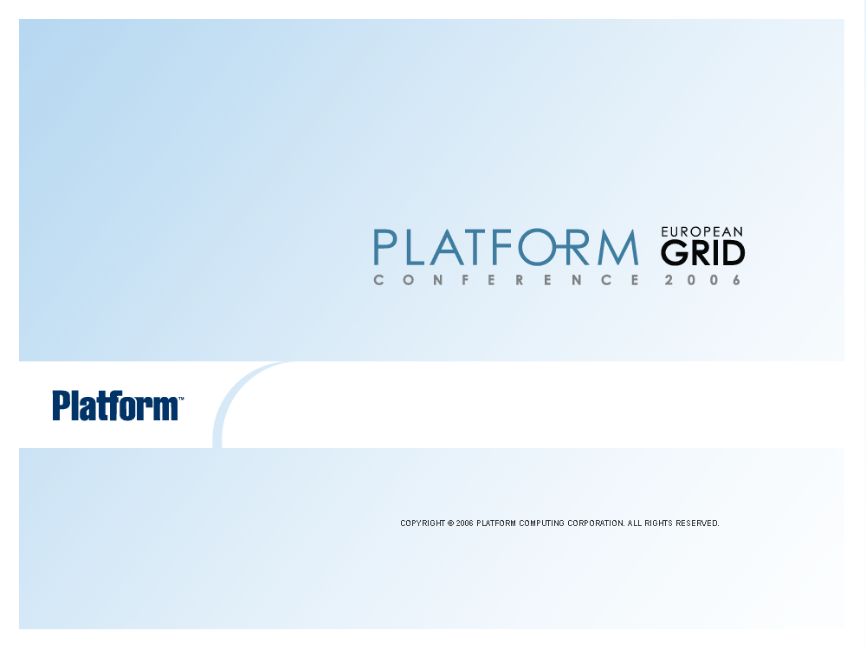
Thank You.

