Slide 1




OCCF – The Realtime Grid

Slide 2
Characteristics of Current Grid Computing
Static data sets
  Generally from fixed length experiments
  Statistical measurements of error
Early bound computations
  Shared Memory
  Compiled into calculation
Point to Point TCP messaging
  PVM
  MPI

Slide 3
Challenges of The Realtime Grid
Data sampling is Non Stop
  Cannot turn off the markets
  Bad Prices and mistakes may have significant effect
    Do errors fit statistical models ?
  Volumes & Rates are growing – (OPRA etc)
  Cascade effects of derivatives
Combination of time and event series
  News is stimulus rather than a value

Slide 4




Sponsors/Components
Unlikely Bedfellows ?
  The Industry Standard Data Feed
  Collection – The Real Time Loader
  Storage - Object Relational Database
  The Grid Hardware and Engine
  Optimized Computational Functions

Slide 5
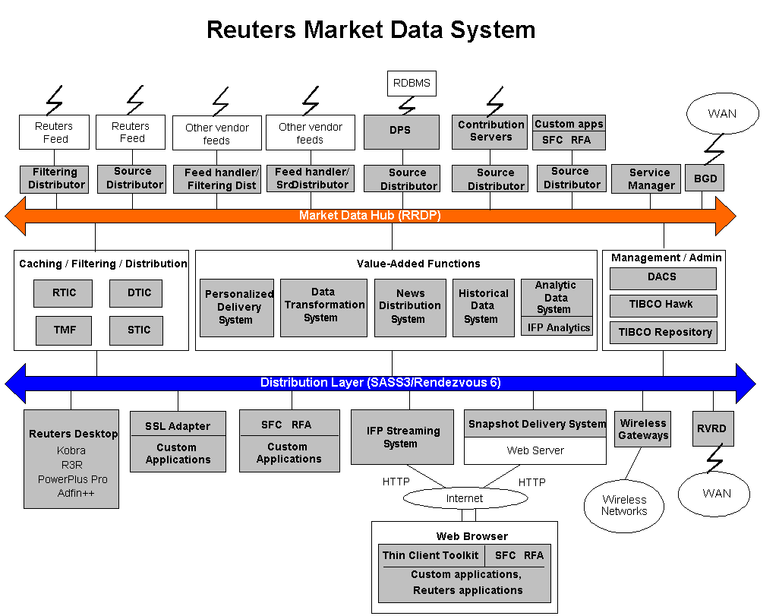
RMDS – The Industry Standard Feed Infrastructure

Slide 6
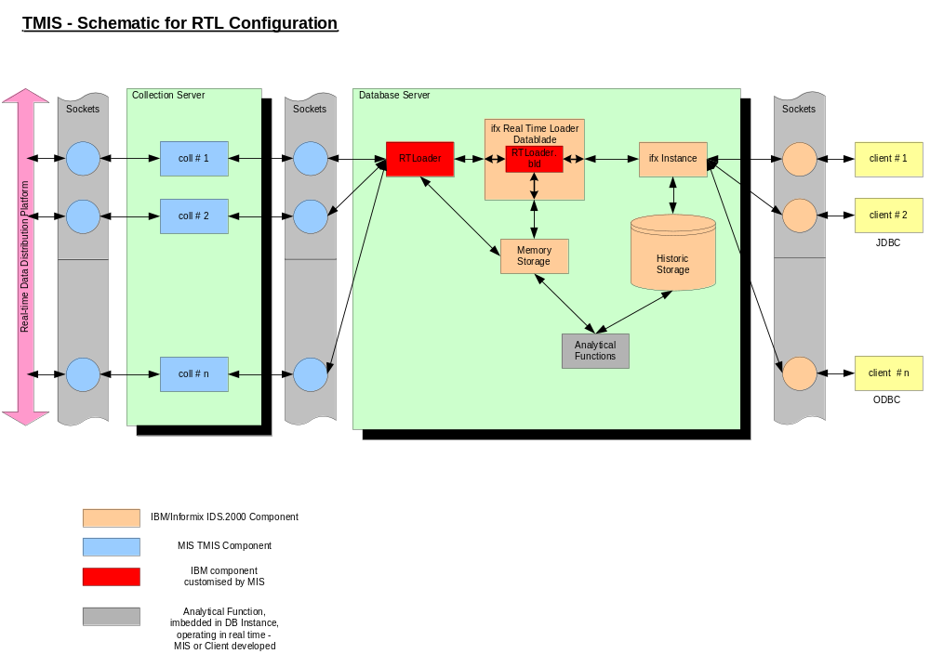
Collection – The Real Time Loader

Slide 7
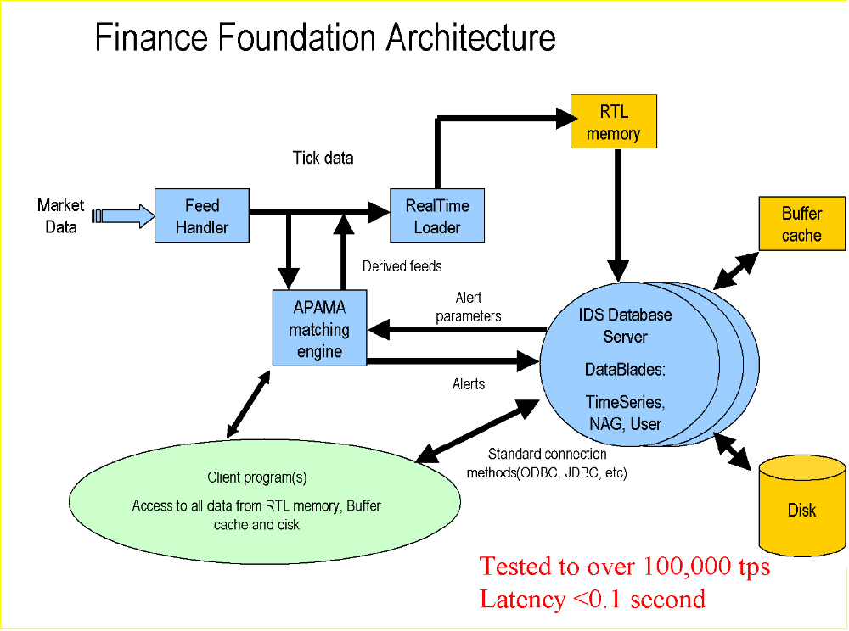
Storage – Object Relational Database

Slide 8
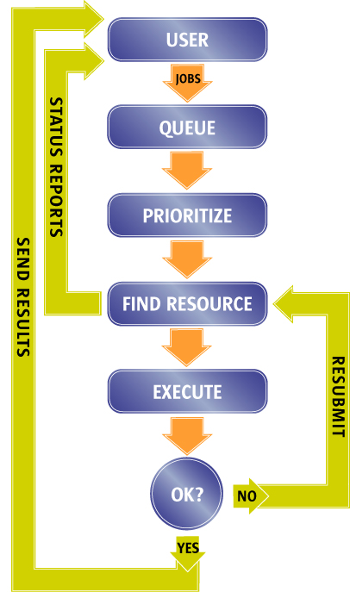

Sun Grid Engine 1- The problem space
Basic workflow of compute Grids is mechanical
Problems exist around resource allocation/prioritization
  Difficult to introspect tightly bound IPC
What about stalled/looping computations or failures ?
May have mixed resource platforms
Open Source for bespoke enhancements

Slide 9

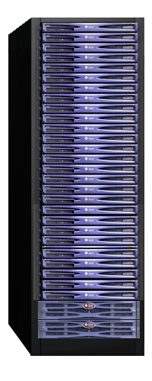



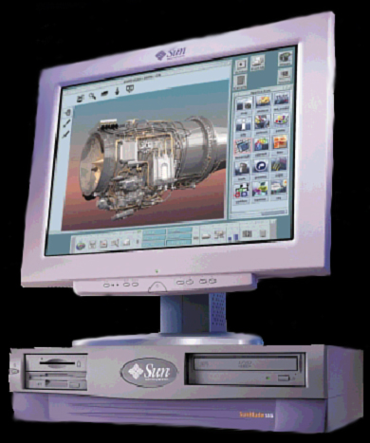

Sun Grid Engine 2 – Key Components
SGE components & compute resources transparent to users
Master/Scheduler failover provided if required
Master/Scheduler nodes can be sited on Compute Resource systems
Compute Resources
Launch job,
Manipulate job
Deliver results,
exit status, accounting..
SGE Master
Submit, monitor,
delete, migrate jobs
Where to ?
When ?
Output files
Load license
reports
Choice
Licenses ?
Load ?
Policy ?
Weekend ?
Parallel ?
...
SGE
Scheduler
User Environment
Master/Scheduler Nodes

Slide 10
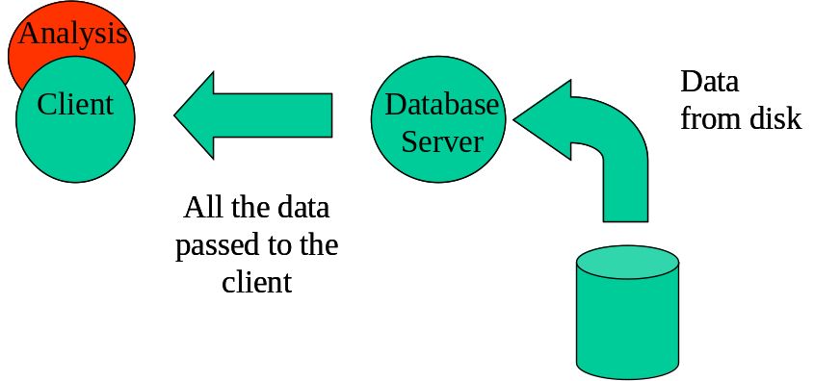
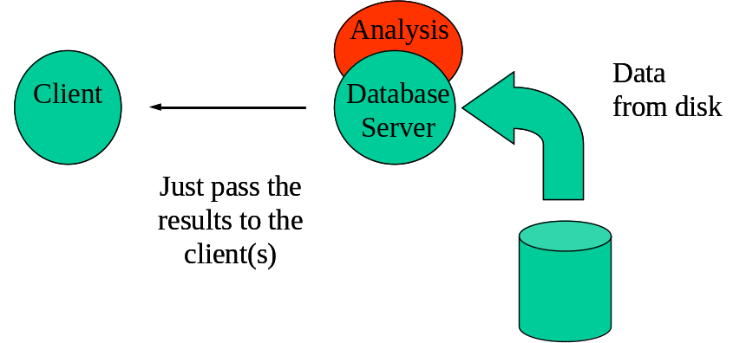
Optimized Computational Functions
Traditional Client/Server mechanism
Large raw data volumes passed across the network
Data blade approach
Extension of traditional RDBMS stored procedures
Analysis performed in DB memory
Reduced network traffic
Fan out results 1-N…

Slide 11

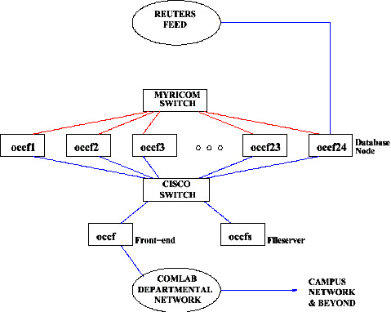
Putting it all together

Slide 12
Build Process
Offsite prototype at Reuters Integration Lab
  Full set of exchanges
  Most sponsors in London
Benchmark tests for H/W and S/W validation
  Sponsored student projects
Standard Reuters small site install at Oxford Comlab
Remote build of multicast addressing
Remote maintenance of collection S/W

Slide 13
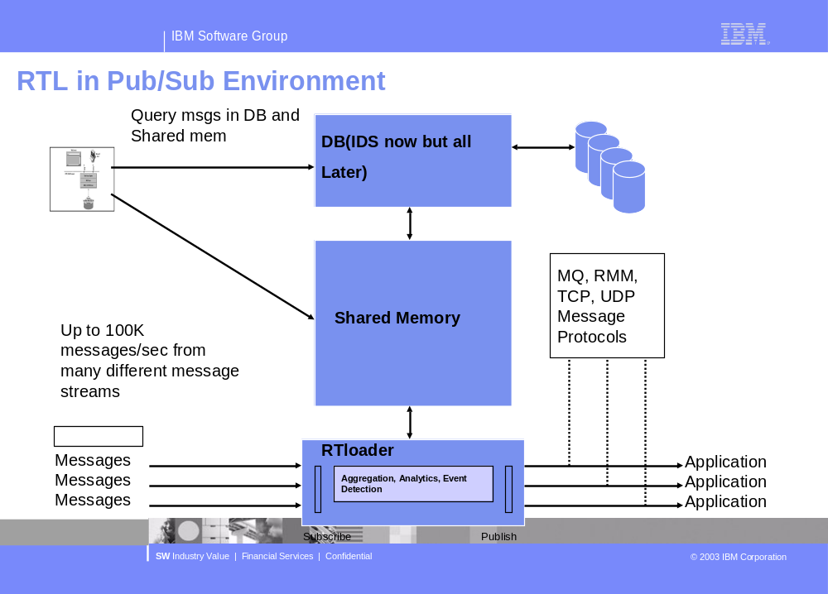
Next Steps – 1: Other middleware

Slide 14

Next Steps – 2: Fast Forward to RAPID
Reuters feed infrastructure and site equipment will change in 2004
Growing exchange/derivatives tick volume
Richer Object-Based API
Extended Analytics
Fundamental and Reference data built in

Slide 15
Summary
We started this post Dot Com
Sponsors have maintained their commitments despite downturn
Has proven all sponsors commitments to Open Computing standards
No competitive barriers to implementation
A unique industry collaboration

