Slide 1
Security Architecture Patterns
An Overview
Graeme Burnett Aug 2003
http://www.enhyper.com

Slide 2
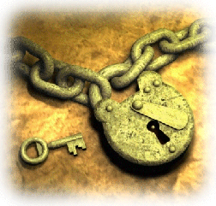
Emerging Application Landscape
Disappearing Security Perimeter
  XML over HTTP based protocols have opened up corporate networks
  Application level attacks are the new threat
  Hardened platforms are increasingly necessary
  Proactive and sophisticated patch management
  XML “firewalls” - a nascent market
Developer Community Lack Knowledge and Expertise in Security
  Much application development is still client/server with ftp as the transport mechanism
  Security always an add on
  Java has improved access to cryptographic toolkits
  Misconfiguration and performance are major issues
  Lack of key management infrastructure
  Kerberos: Inter-host trust does not mitigate risk

Slide 3

Open Source Techniques
Open Source Development Methodology
  Development portals: Sourceforge.net has been a great success
  Web-based code repositories lead to increased quality and developer education
  Management can assess quality and remain hands on
  “Code Snippets” - effective white box reuse.
Pre Risk Assessed Patterns and Configuration
  Bazaar Development: farmed from current solutions, experts and industry best practise over time.
  Pre-risk assessed - improving risk assessment performance and regulatory compliance
Building Social Capital via Experts
  Communities of practise
  Feedback into technology strategy
  Retention of knowledge
  Effective development and deployment

Slide 4

The Regulatory Framework - Business Governance
All Business operates within a legislative framework
  Nation state and local legislation, employment law, third party liability, customer privacy, Data Protection Act, E-Signatures directive, Data Protection Act 1998, Computer Misuse Act, Copyright Designs and Patents Act, Action by the BSA, FAST, BS 7799.
  Some organisations are self-regulating, publishing a code of conduct.
Legal requirements on business are to mitigate risk
  Government legislation is designed to ensure continuity of service and fair trading practices.
  It’s in the interest of business to ensure they take reasonable measures to mitigate business risk
Regulatory requirements dictate:
    “…insure the security and confidentiality of customer records and information, protect against any anticipated threats or hazards to the security of those records, and protect against unauthorised access to or use of customer records which could result in substantial harm or inconvenience to any customer.”

Slide 5

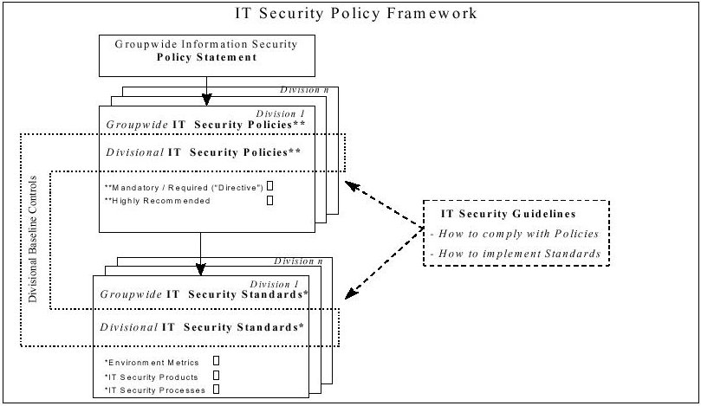
Security Risk Policy Framework

Slide 6

Security Policies and Design Standards
Physical
  Building ergonomics: perimeter security, blast proofing, skinned construction
  Physical access controls: passes, biometrics
  Surveillance: CCTV, biometrics (face, gait, anomaly)
Infrastructure
  Hardened OS, DMZ (firewall architecture), management and monitoring, intrusion detection, intrusion prevention.
  Network: Business Continuity/Disaster Planning
Application
  Platform and Application Design: unix, windows, network design, seldom application level
  Manual Risk Assessment
  Occasional Penetration Testing
Third Party
  Legal Agreements: Non-disclosure, Duty of Care
  Service Level Agreements

Slide 7

Secure Application Design - Current Practise
Application Risk Assessment
  Driven by regulatory compliance not by engineering discipline
  Necessitated by the disappearing security perimeter
  Highly subjective and heuristic process
  Paper shuffling exercise by the wrong type of personnel
Occasional Penetration Test
  Snapshot security
  Driven by customer expectations
  Post design intervention
Need for Application Level Security Architecture
  Security Architecture: multidisciplinary teams requiring knowledge of:
    Enterprise application architecture, cryptographic algorithm knowledge, PKI, payment mechanisms, network architecture, legislature.
  Working with developers and programme management
  Using Automation: Code inspection tools (flawfinder, MOPS, RATS, BOON)

Slide 8

Security Architecture Framework
Hierarchically Structured Framework
  Architectural Principles
    High-level guidance on technology Infrastructure
  Technical Positions
    Justified choices of competing technical alternatives
  Patterns
    "blueprints" or models of security architecture
    Pre-risk assessed - risk assessment by pattern recognition
Knowledgebase, Forums and Blogging
  Web based repository with rating and automatic ranking
  Knowledge creation and peer review
  Social Capital via weekly newsletter and blog
  Support via forum

Slide 9

Business Benefits of Security Architecture Patterns
Regulatory Compliance
  Audit requirements are exceeded.
Secure Solutions Lead to Asset Protection
  Secure Infrastructure and applications
  Data encryption via correct use of ciphers
  Better authentication, authorisation and data protection
Risk Assessment
  More efficient and less subjective process
  Repeatability
  Performance metrics

Slide 10

Ontology, Aliases and Examples
Ontology
  How things relate to each other
  General.less general.specific.more specific
  Generic Security Concept.Application Context.Application Instance.Configuration
  Leading the mind logically to the solution via hierarchical decomposition.
Aliases
  User friendly – two part name
  DataTransfer.BBCP
Examples
  Secrecy_Jurisdiction.Authentication.SSH.PasswordlessCertificate
  Authentication.Application.Java_Client.Oracle_OID
  DataTransfer.SSH.BBCP
Pattern Template
  Minimal - based on “Antipatterns” template

Slide 11
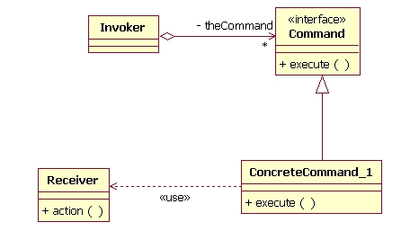
Pattern Discovery and Management Tools
Pattern Repository
  Web-based hierarchal link repository
  Rating feature
  Newsletter
  For example Links 2.0 from Gossamer Threads
Security Weblog
  Information dissemination
  Security Awareness
  For example Movable Type
Forum
  Discussion and development
  User support FAQ
  Self-Service

Slide 12
Resources
Security Engineering
  http://www.enhyper.com/Security_Engineering
Code Auditing
  http://www.enhyper.com/Security_Engineering/Source_Code_Analysis/
Antipatterns
  http://www.antipatterns.com/
Financial Crytopgraphy in 7 Layers
  http://www.iang.org/papers/fc7.html
Knowledge Management Tools
  http://www.movabletype.org - Movable Type
  http://www.gossamer-threads.com - Links 2.0
  http://invisionboard.com - Invision Forum

