Slide 1
Web Services - ‘Extraware’
Market Developments
Graeme Burnett, UBS Warburg

Slide 2
Objectives
Provide an Insight into Web Services Market Developments
  Technology Players
  Service Providers
  Business Models & Revenue Models
Identify the Key Business Drivers for implementing Web Services based business models

Slide 3
Objectives
Distil this information to derive the characteristics and ‘shape’ of Web Services Business Models in two Distinct Areas
  Internal Business Models
    Cost Benefits
    Ability to Execute
    Cost Transparency
  External Business Models
    Revenue Models
    Charging Models
    Tradable Assets
Provoke the imagination and stimulate debate

Slide 4
Definitions

Slide 5
Definitions
What are Web Services?
What are Business Models?

Slide 6
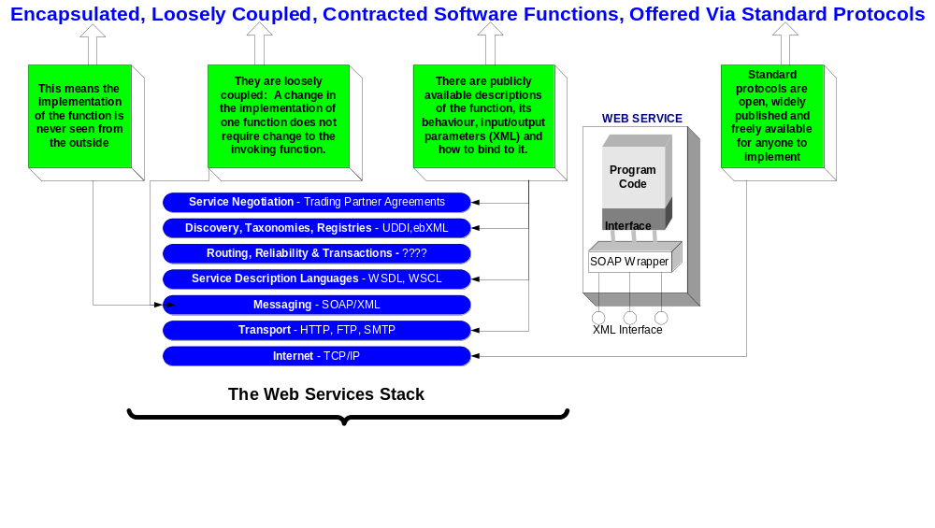
Definitions – Web Services

Slide 7
Definitions – Web Services
Using web services a business can transform assets into licensable, traceable and billable products, running on their own or partner computers
To transform an internal asset into a web service, the asset must be made accessible, electronically and securely
Then published in a directory (UDDI) and made available to subscribers
The subscribers can be other applications or end users

Slide 8
Definitions – Business Models
A distinct system of suppliers, distributors, commerce service providers, infrastructure providers and customers that use the Internet for their primary business communication and transactions — Digital Capital, page 4
In b-webs internetworked, fluid — sometimes highly structured, sometimes amorphous — sets of contributors come together to create value for customers and wealth for their shareholders. In the most elegant of b-webs, each participant focuses on a limited set of core competencies, the things that it does best — Digital Capital, page 17

Slide 9
Definitions – Business Models
Other influences include:
Alvin Toffler as long ago as the 70's in FutureShock foretold the emergence of an "adhocracy" — an organisation without borders in which individuals self-organise and operate against a set of shared goals.

Slide 10
Definitions – Business Models
Metaphors & Paradigms have changed
  Changes in the perception of value
  Ecosystems not “vertical industries”
  Plug & Play Business
  Digital Capital and Intellectual Property
  Proprietary business processes and core competencies
  Ability to execute

Slide 11
Market Developments

Slide 12
Market Developments
Technology
Service Providers
Corporate

Slide 13
Market Developments - Technology
Microsoft, IBM & Sun banking their future product revenues on WS
‘Tooling’ is key because it’s at this level that companies can exploit anomalies in the market
  Fast conversion of existing assets into WS
  Discover components for re-use
  Create self-healing applications

Slide 14
Market Developments - Technology
Microsoft Visual Studio .Net is frankly frightening!
  2.5 million beta testers
  Common Language Runtime
  Many Java die-hards are ‘converting’ to VS.Net
IBM’s AlphaWorks tools
  To enable ‘legacy’ code
Cape Clear – CapeStudio, CapeConnect
Silverstream, eXtend

Slide 15
Market Developments - Technology
Change in emphasis from in-house proprietary software solutions to XML messages that contain tags for routing with cryptographically secure payloads
  Fidelity Investments spent about $2.7 billion - more than 24 percent of gross revenue on XML technology in 2001 to eliminate 75 percent of the hardware and software devoted to middle-tier processing and speed the delivery of new applications

Slide 16
Market Developments - Technology
Online application directories as the primary arena for the procurement and delivery of web services
  ASP’s moving to host fine grain applications
  UDDI & ebXML directories for WS discovery
  Software Services - the pick and mix store - To facilitate the ability to handle transactions between parties who are previously unknown to each other – Web Services Brokers

Slide 17
Market Developments - Technology
Many higher order products designed to facilitate the creation of service brokers
  Webputty – WS Platform
    secured $22.5mio in March 2001
  Web Collage – WS Platform
    secured $16mio in Nov 2000, Gilde IT
  Bowstreet – WS Platform
    Major contribution to UDDI design effort (DSML)
    WebFactory product influenced by Don Tapscott
    Product built into SunOne architecture

Slide 18
Market Developments - Technology
There are many others……
  Epicentric, Velocigen, DataConcert
  See www.WsIndex.org
Microsoft not quite there with .Net server……but…..
  Joint product development with Avinon (similar to Bowstreet) & RioLabs on Biztalk integration

Slide 19
Market Developments - Technology
These products together with development tools and global directories facilitate:
  Automated publication & consumption of Web Services
  Massively customised portals consisting of aggregated business functionality
  Communities & Ecosystems of industry specific web services
  Scalable architectures and high availability service levels

Slide 20
Market Developments – Service Providers (xSP)
Growing evidence of the emergence of Web Services Providers or Brokers
  Grand Central
    Publishing, Integration, Security platform for distributing web services
  eByz
    Integration and partner portals, directories of services
  ComponentSource - pre-existing Java and Windows-based application components
  Salcentral - online web services

Slide 21
Market Developments – Service Providers (xSP)
BT announced last year with Bowstreet its intention to become Europe’s biggest WSP – Web Services Provider
Web Services Provider model a natural progression for Microsoft’s bCentral SME portal, ASP’s and ISP’s
….But some missing elements

Slide 22
Market Developments – Service Providers (xSP)
Payment, actually Micropayment Services
  To enable subscribers and publishers to pay/derive revenue from Web Services on a per invocation basis
Billing
  To enable a wide variety of tariffing corresponding to different performance ratings and service levels
    Metratech is collaborating with Microsoft and is the very first technology product for metering and billing web services
      I wonder who they’re talking to?
Anonymity/Pseudonymity
  To facilitate the ability to handle transactions between parties who are previously unknown to each other

Slide 23
Market Developments – Service Providers (xSP)
Payment, Billing, Anonymity, Why?
  Payment incentivises providers to package their services and improve service levels to create critical mass
  Micropayment eases the commercial issues
    No up front payment
    No subscription
    Enables anonymous consumption
  Billing engines make WS licensable and traceable
  Anonymity through a trusted third party to enable re-branding and protection of IP and Reputation

Slide 24
Market Developments – Corporate
Many examples in US of commercially available production Web Services
  TerraSeek's eMedical Web Service identifies the nearest emergency medical facility and provides details on the capabilities of each facility and insurance plans accepted. Designed to help travelers quickly identify the nearest medical help
  EarthConnect provide real time stock market information as .Net WS
  Yseek and location specific weather services

Slide 25
Market Developments – Corporate
Xmethods.com has a comprehensive listing…..but……
  Mostly Service Providers
  Still very few businesses with production WS e.g.
    Couriers, Fed Ex, DHL etc
    Airlines, manufacturers, banks
    Governments

Slide 26
Market Developments – Corporate
In Europe very few commercially available production WS
  Infobel
  Lloyds TSB – FirstCheck credit ratings delivered as a web service to clients
  Microsoft announcements of European adopters due on Feb 13th (VS .Net release date)
  Galileo & ObjectSpace – Airline reservation
No xSP positioning itself as a WSP
  Although Energis (UK) moving in this direction
We are at least one year behind, Why?

Slide 27
Market Developments – Corporate
Lack of understanding of the technology’s benefits
  Not very well articulated by suppliers or consultants
  Other business priorities (e.g The Euro)
  Unawareness of ‘new thinking’ – Ecosystems, Collaboration, Coopetition
Innate caution in Europe’s boardrooms
  eMarkets failed
  eProcurement has not delivered significant benefits (Ariba/i2)
  CRM has been costly and customers disaffected – “My bank manager is a call centre”

Slide 28
Market Developments – Corporate
However, Europe has embraced XML
  Relatively widespread
  Benefits are demonstrable and well understood
But there are only 5 European companies that are members of the 192 strong UDDI working group
  This is a key indicator of our lack of awareness and non-participation in the web services debate

Slide 29
Market Developments – Corporate
However, Europe has embraced XML
  Web Services are only an incremental step along this paradigm
  The key is not what they are, but what they enable – Plug & Play Business
Adoption of Web Services must start internally first
  Organisational implications
  Technological implications
  Legal, branding, commercial implications
What are the Key Business Drivers for adopting Web Services?

Slide 30
Key Business Drivers

Slide 31
Key Business Drivers
Changing Concepts of Value
Transition from real to virtual assets:
  Digital capital and intellectual property
  Proprietary business processes and core competencies
  Ability to execute
  Brand awareness & loyalty
What are your core competencies?

Slide 32
Key Business Drivers
People Power - Cluetrain mentality
  Perfect information shifts power to the consumer
  Networked markets are beginning to self-organise faster than the companies that have traditionally served them
  Thanks to the web, markets are becoming better informed, smarter and more demanding of qualities missing from most business organisations

Slide 33
Key Business Drivers
People Power
  If you only have time for one clue this year, this is the one to get. We are not seats or eyeballs or end users or consumers. We are human beings and our reach exceeds your grasp. Deal with it!
  People in networked markets have figured out that they get far better information and support from one another than from vendors
  Companies that don’t realise their markets are now networked person-to-person, getting smarter as a result and are deeply joined in conversation are missing an opportunity

Slide 34
Key Business Drivers
Competition is dead
  Coopetition
How do you compete in a world of perfect information?
  Not by price but by perceived value
  Through an obsession with the customer
  Through focus on core competency
  Through collaboration

Slide 35
Internal Business Models

Slide 36
Internal Business Models
These will be different and unique for each company
But will have common features and principles
  The ability to reconfigure itself
  Collaborative ethos
  Innovation as the norm, change as the norm
  Recognise the value of ‘Relationship Capital’
  Recognise that the unit of work is not necessarily a whole job

Slide 37
Internal Business Models
Organisational structure is important but attitude is key
How would your company deal with these customer statements?
  Customer: We've got some ideas for you too: some new tools we need, some better service. Stuff we'd be willing to pay for. Got a minute?
  We know some people from your company. They're pretty cool online. Do you have any more like that you're hiding? Can they come out and play?

Slide 38
Internal Business Models
Is HR the biggest obstacle to implementing true internal collaboration
  Personnel are not formally incentivised or rewarded to collaborate
  Informal networks get jobs done quicker than formal corporate procedures, but are often discouraged
  Controlled self-organisation works! Slime mould and ant colonies can, why can’t humans? Look at Yahoo Groups.
HR – in some companies this means Hardly Relevant!
  They need to hear and understand the Web Services story

Slide 39
Internal Business Models
But IT have their part to play and have still not properly aligned their activities with business goals
  They should be efficient enough to become profit centres not cost centres
  They are not Cost Transparent
  The benefits of IT do not arise where the costs lie
Collaborative development frameworks and the ability to construct applications from reusable traceable and billable components will change everything
  Enable cost transparency
  Significantly reduce costs

Slide 40
External Business Models

Slide 41
External Business Models
5 principles for creating robust, cooperative, dynamic business ecosystems
The aim of these principles is:
  To promote the re-use of business logic (instantiated in Web Services)
  To maintain the viability of business applications in the face of change

Slide 42
External Business Models - Principles
Applications will be built from coarse-grained services that implement a unit of processing larger than components
  Applications will be constructed by coordinating discrete results from server-based software processes that answer a specific question. These services will perform a complete task, and be courser grained than software components.
Services will be discovered by querying directories
  Applications will query a directory service to discover the name and location of a service that performs a required task, without any reference to the implementation.

Slide 43
External Business Models - Principles
Services will be provided as self-describing data
  Applications will interface to services via structured data exchange, using vocabularies that have been defined for particular domains – Industry Specific Ontologies
Services will be enlisted on a transient basis
  Applications will not require services to maintain state between invocations, and will not assume any long-term availability of a particular service instance
Services must support extension and degrade gracefully
  Services must be implemented such that they can be extended, in terms of logic and exchange formats.

Slide 44
External Business Models – New Service Organisations
Due to the simplicity and interoperability of Web Services new business and revenue models will emerge
New Service Organisations will emerge
  Web Services Brokers (WSP) will provide
    DISTRIBUTION
    Trusted Services (Security & Anonymity)
    Quality of Service Ratings (SLA’s)
    Payment services
    Profit
WSP’s will operate in ‘vertical’ ecosystems – because ontology & semantics are industry specific

Slide 45
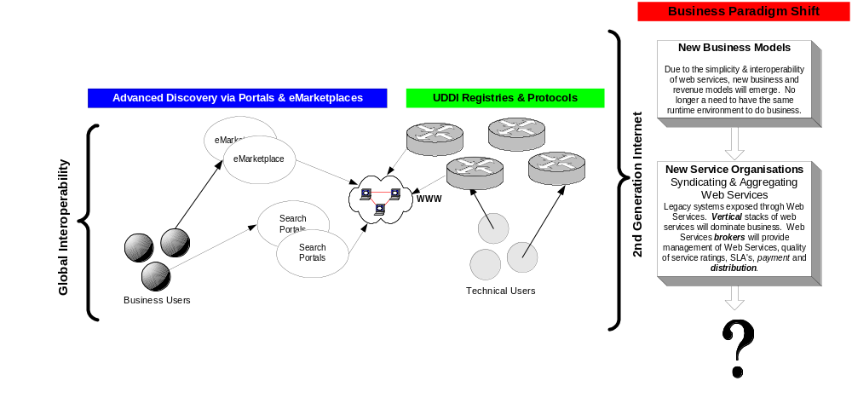
External Business Models – New Service Organisations

Slide 46
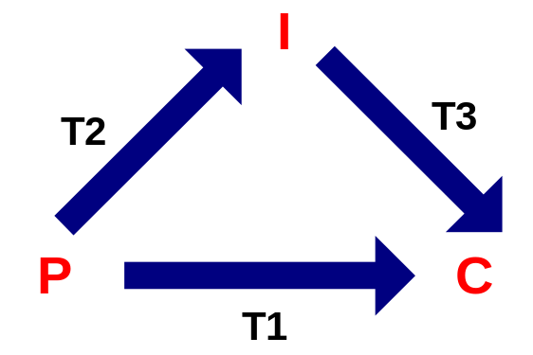
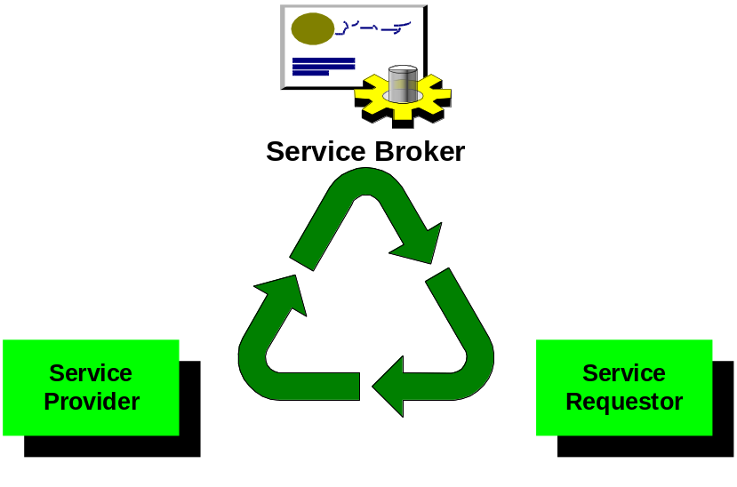

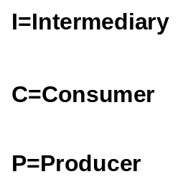
External Business Models – Role of the Intermediary
Intermediaries exist when T1 > T2 + T3
=
UDDI.org Web Services Model

Slide 47
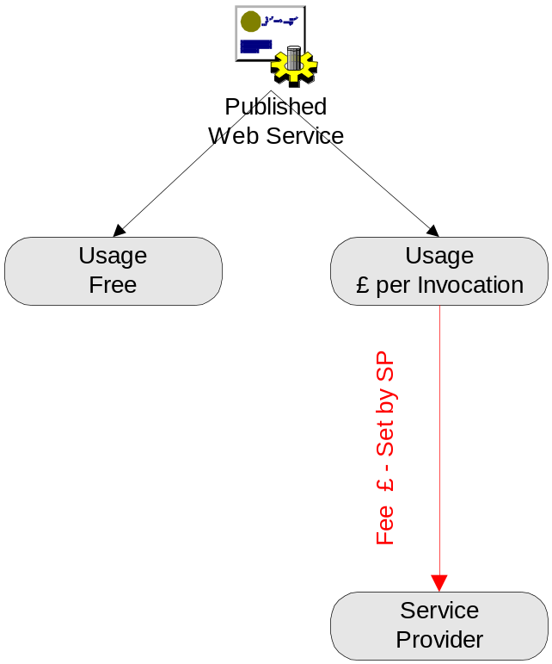
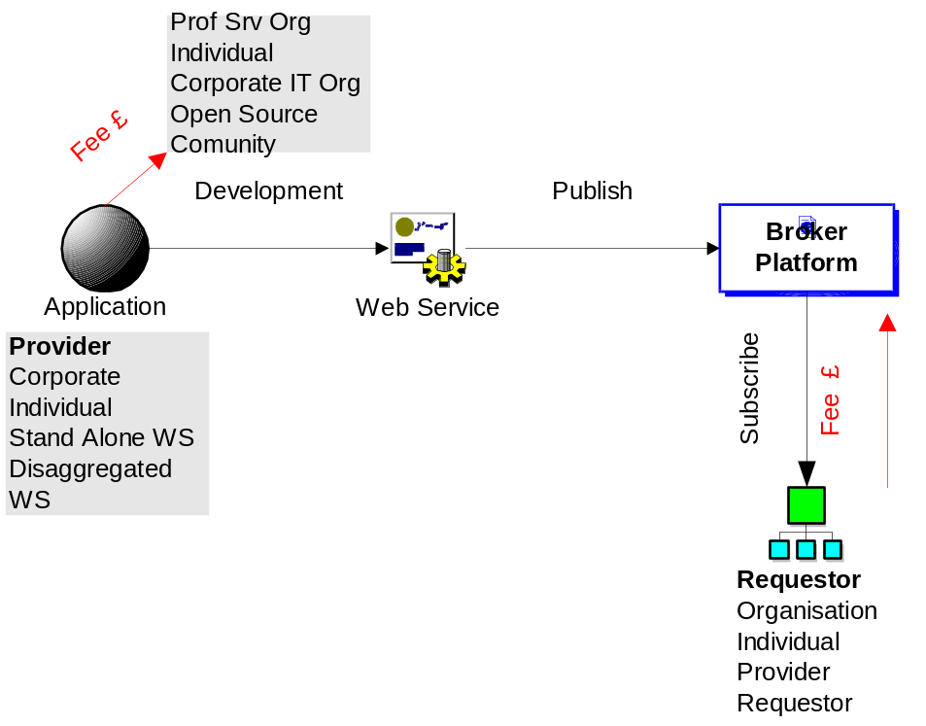
Web Services Revenue Models

Slide 48
External Business Models – New Service Organisations
…..And finally…..think about this
Within 5 years Web Services will appear on corporate balance sheets
  They will have capital value
  And Revenue associated with them
And they will be traded as commodities
  Like Bonds but with no maturity date
Unlikely? 5 years ago it seemed ridiculous that network bandwidth could be traded on open markets
  Take a look at www.rateXchange.com
  I need 2Gbps London to Paris for 2 days – what am I bid?

Slide 49
Summary & Conclusions

Slide 50
Summary & Conclusions
Ecosystem based business models are emerging
Intermediaries and brokers will catalyse the conversion to these new models
Think of your existing digital assets as tradable commodities and an integral component of your balance sheet – and how you get there!
ANYONE can become an Intermediary or Broker!
Reputation, Trust and Collaboration is everything
“Change comes from within”

Slide 51
Thank You
Graeme Burnett, Domain Expert Team

