Slide 1
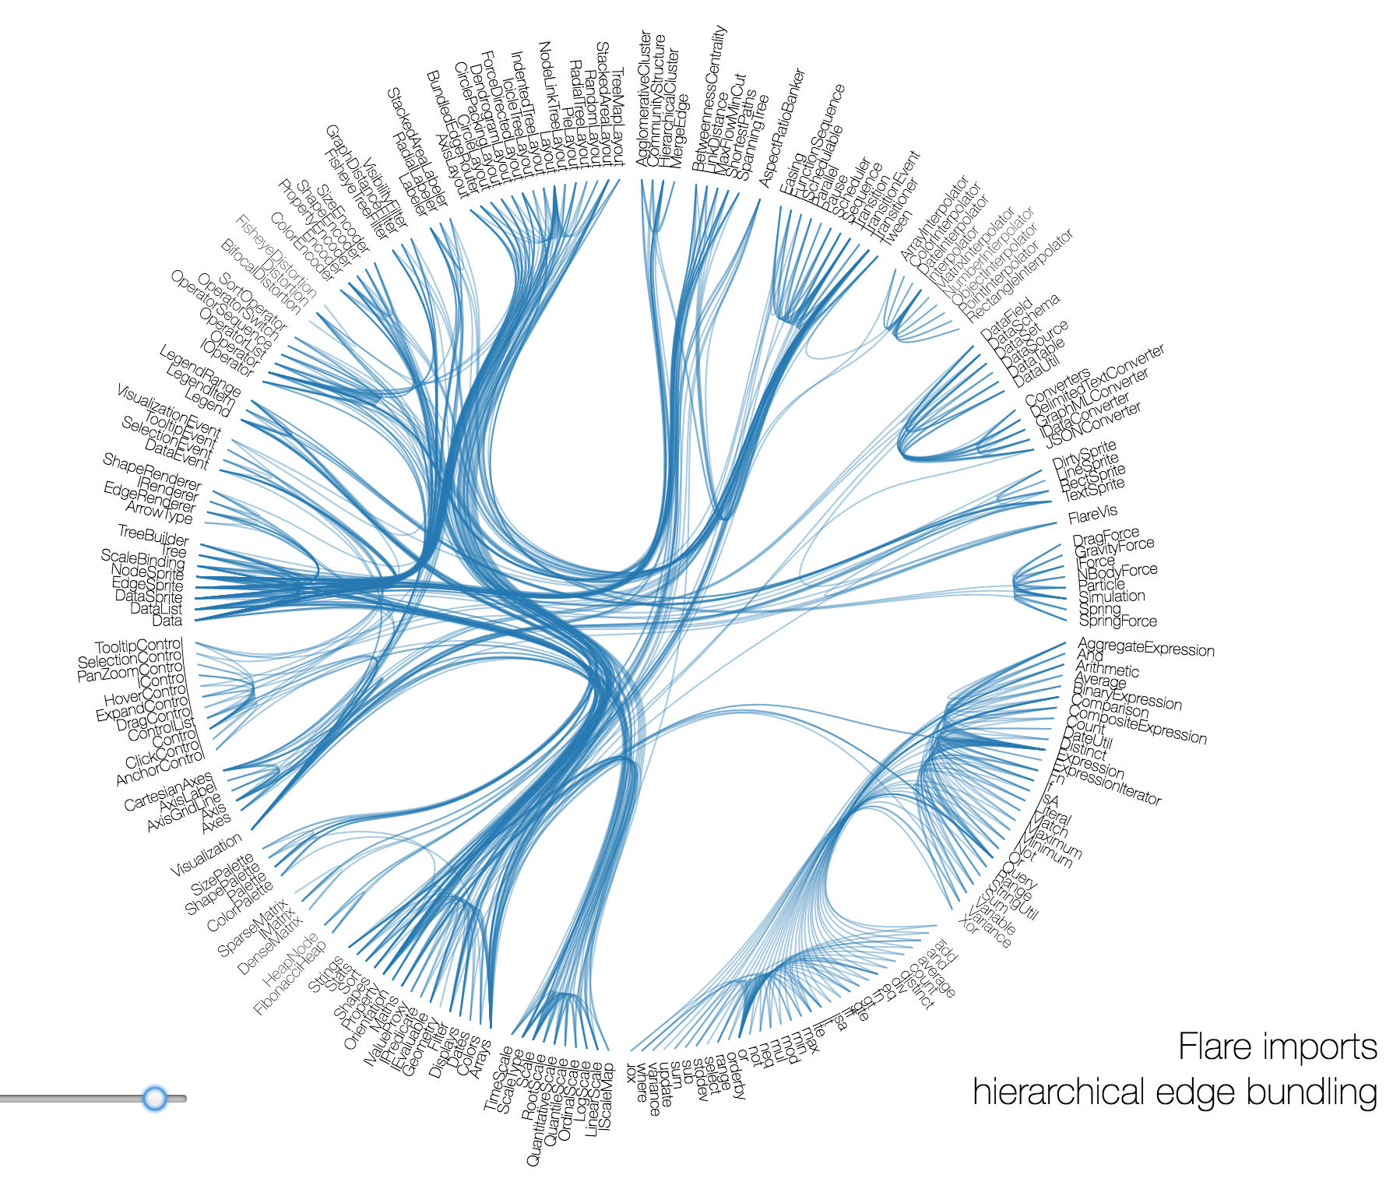
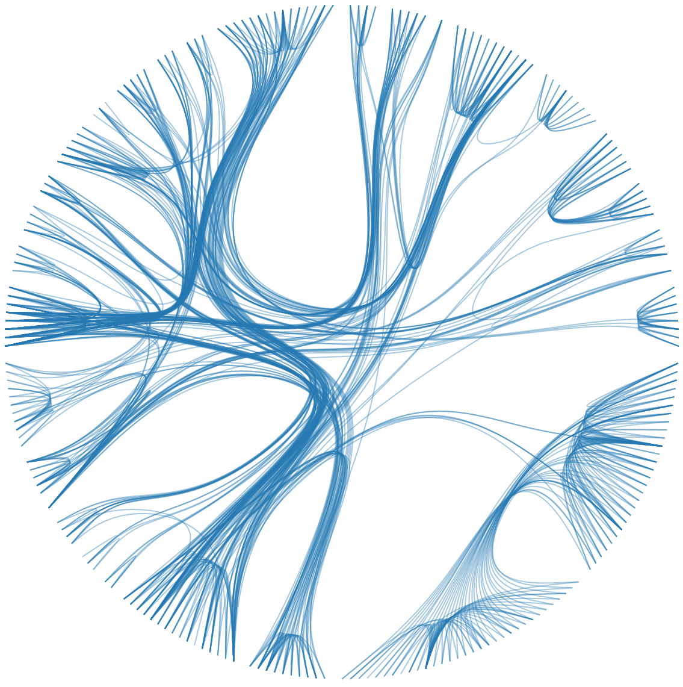
Zika
Lassa
Ebola
USA
AMRO
CANADA
AMRO
PERU
Vaccine
Funder
Lab
Epi

