Slide 1
Experimental Design
Malu

Slide 2
Amazon Review Experiment
Personal Information
Age
Gender M F
Have you ever used Amazon.com to make a purchase? Y N
Do you generally read users’ reviews before making a purchase? Y N
NEXT

Slide 3
Amazon Review Experiment
Welcome! You are going to take part in an experiment about Amazon reviews. In this experiments you will see 10 products followed by 6 reviews each. So, you will see 60 reviews in total. Such reviews have been written by real users of Amazon. Your task is to evaluate the reviews in term of their helpfulness from 1 to 5 where 1 means not helpful at all, and 5 means very helpful. Before starting, you need to agree on taking part in such an experiment and give us your consent to store and analyze your data. The data collected is not personal identity data. A random user’s ID will be generated for you, so we won’t ask you to provide your name or any personal information that may be used to identify you.
I agree to take pert in the experiment and I give my consent for the collection of the data
NEXT

Slide 4
The following 10 pages display 10 products with 6 reviews for each product. Imagine you are interested in these products. Please look at the picture and read the product description. Your task is to evaluate the reviews in term of their helpfulness from 1 to 5 where 1 means not helpful at all, and 5 means very helpful. You should rate each review in relation to the others. You can use any visual clues (e.g., tags) in the review to help with your judgement.

Slide 5
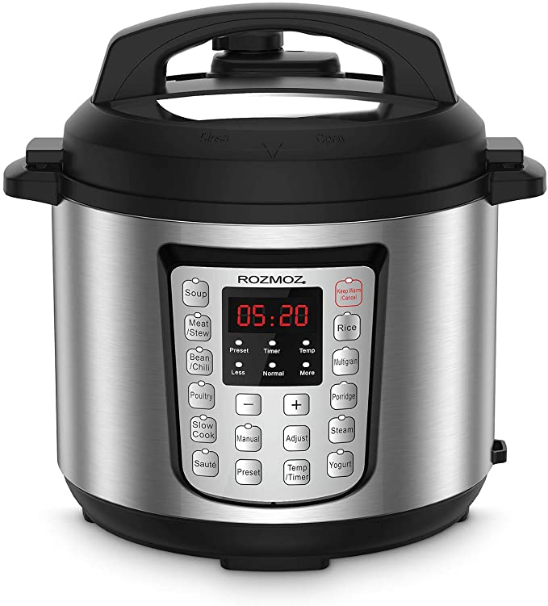
Product 1
Imagine you are interested in this product. Please, look at the picture and read the product description. After pressing the button NEXT below you will see 6 reviews related to this product. Your task is to evaluate the reviews in term of their helpfulness from 1 to 5 where 1 means not helpful at all, and 5 means very helpful. You should rate each review in relation to the others. You can use any visual clues (e.g., tags) in the review to help with your judgement.
Instant Pot Duo 7-in-1 Electric Pressure Cooker, Sterilizer, Slow Cooker, Rice Cooker, Steamer, Saute, Yogurt Maker, and Warmer, 6 Quart, 14 One-Touch Programs
NEXT

Slide 6
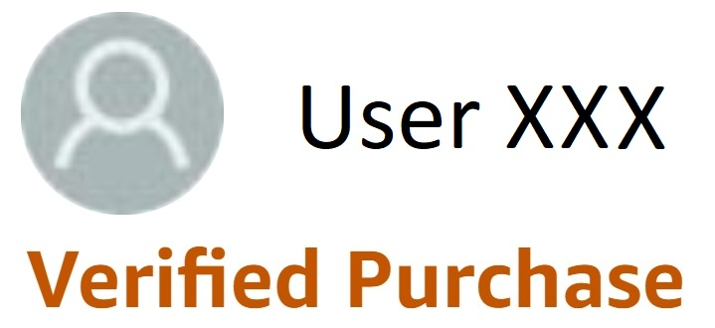
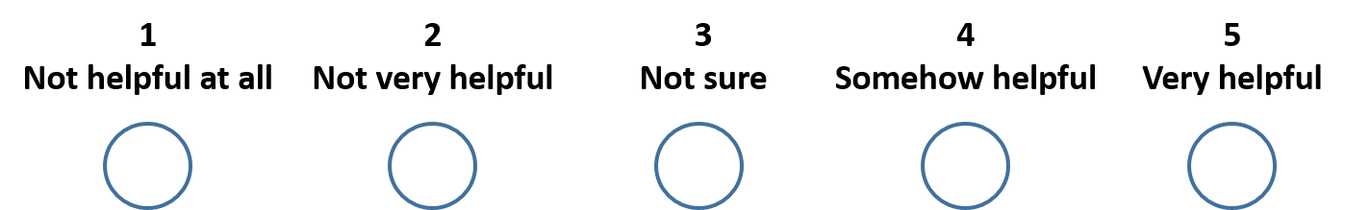
Product 1, Authentic -1, Verify 1
We cook a variety of items in this product, fast, efficient, and bought a book of recipes. Easy to clean, does not take a lot of room to store. We would highly recommend this product.

Slide 7

Product 1, Authentic -1, Verify 0
I purchased this for my son who is on the Keto diet. He was eating a lot of steak which got expensive. I got this for him so he could get less expensive cuts of meat and cook them quickly when he gets home from work. He is really having a good time with his pot and is texting me pictures of very healthy meals that he's making. He loves being able to cook a roast or a chicken quickly and having leftovers for lunch the next day.

Slide 8
Thank you for your participation!

