Slide 1

IMAGE CAPTION
- A DEEP LEARNING APPROACH
Babandeep Singh
Rahul Gera
Robin Beura
Yash Patel
Sanghamitra Muhuri

Slide 2
INTRODUCTION
Image Captioning - Generating customized and personalized captions after learning features of an image and generating captions.
Existing approaches have the key limitation of only describing images with a single high-level sentence - creating an upper-bound on the quantity and quality of information produced.
Our Goal - Generating longer, richer sentences and paragraphs that could convey a story/message rather than just a description of the image.
We explore few of the existing state-of-art techniques for image captioning and image paragraph captioning using the novel data from Instagram.

Slide 3
MODELS USED
Standard MLE based Encoder-Decoder architecture for captioning
Hierarchical RNNs for paragraph captioning (HRNN)
Conditional Generative Adversarial Networks (GANs)
Generative Pre-Trained Transformer (GPT)
Using the above models, we present a novel automatic image caption generation that measures the quality of generated captions by analyzing their semantic content. Our method closely resembles human annotation while offering the additional personal touch.

Slide 4
DATASET DESCRIPTION/PRE-PROCESSING
The novel dataset consists of images and human annotated captions.
43,284 image-caption pairs created by automated web-scraping from three Instagram feeds - Natgeo, Natgeotravel and Natgeoyourshot.
‘Nat-Geo’ group used to capture less variant caption data and structured captions in English.
Extracted Image caption is structured as Photo by @username / caption
For image data, we tried to retain the RGB 3 * H* W and customize images to our H*W constraints.
For text data, the data cleaning process used:
Removed ‘Photo’ by @username / from the caption
Removed any special mentions formatted @username and hashtags
Avoided removing any functional words/punctuation

Slide 5
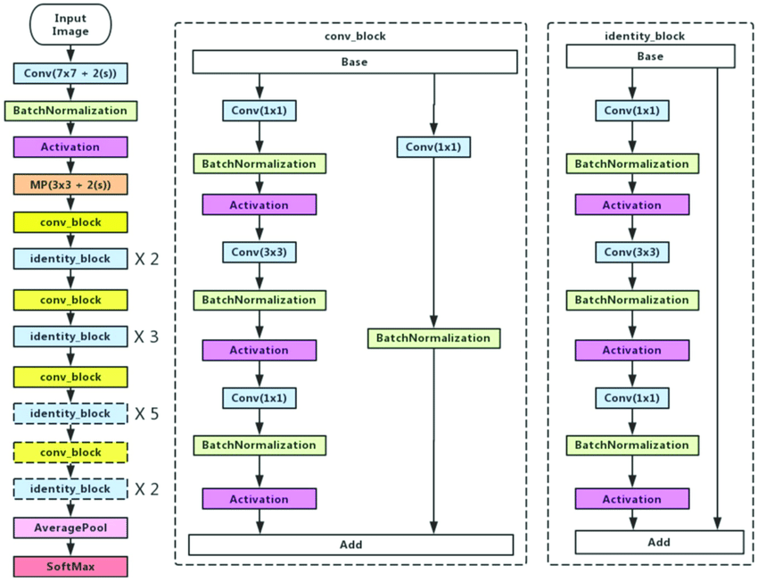
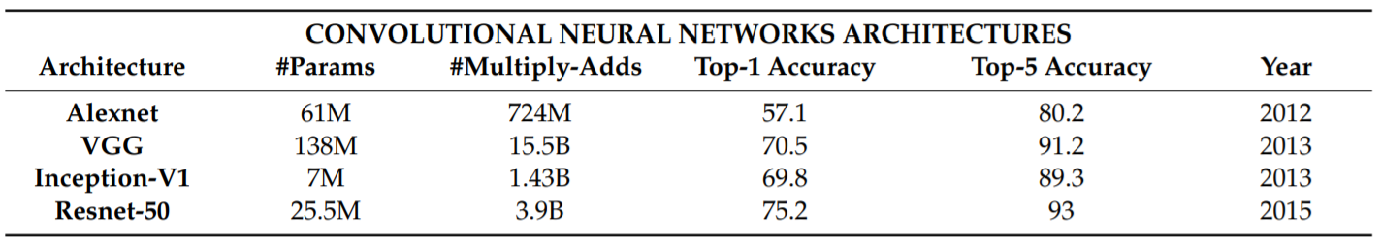
BASELINE MODEL ARCHITECTURE
ENCODER - Convolutional Neural Network (CNN)
“Reads" an image, and extracts a high-level feature representation
Performance of model is highly reliant on CNN deployed.
ResNet model architecture - performs best from both Top-1 and Top-5 accuracy, fewer parameters than VGG.

Slide 6
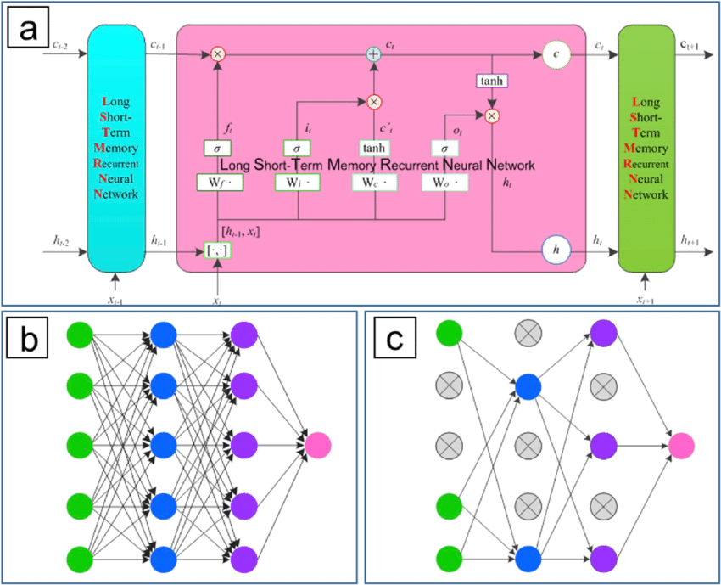
DECODER - RNN
Generates words to represent the image with a full grammatically and stylistically correct sentence.
Extension of RNN - Long-Short Term Memory (LSTM) - memorizes long term dependencies through a memory cell.
Generates a caption by taking one word at every time step conditioned on the context vector, together with the hidden state and the earlier generated words.
Each new word added makes LSTM consume more time and storage, but the rewards are greater than drawbacks.

Slide 7
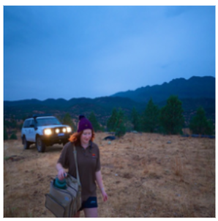
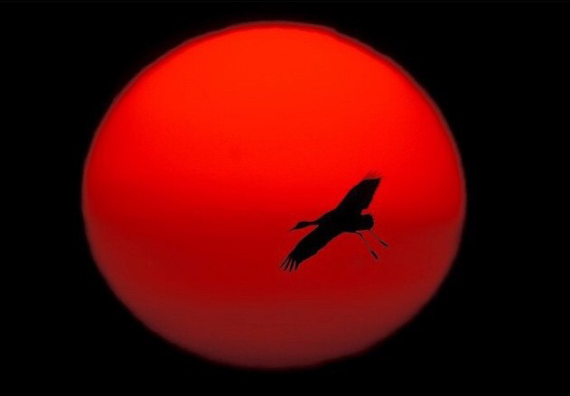
RESULTS AND ISSUES
Ground Truth: a sandhill cranes flies over the platte river in nebraska joelsartore beautiful photooftheday nebraska stands in front of a buddhist temple in seoul south korea discriminator.
Prediction : a sandhill cranes flies across the sandhill atlas in switzerland this is the first aerial photo of this site i have seen although it is a large and very large cranes that are usually very small they fly on the serengeti pillars and can dive into
Ground Truth: a group of dusky leaf is resting after a morning spent feeding.
Prediction: a woman stands in front of a buddhist temple in seoul south korea discriminator.
Model captures nuances of the woman and standing, but fails to capture the regions appropriately and distinguish objects.
BLEU score - 9.418e-232 : More apt overlapping of the words - difficult in this situation.
Generated text detects crane present but misses out the granular details.
BLEU score - 9.20e-232 : many overlapping
instances suggests, model is able to capture the intricacies of the image and language.

Slide 8
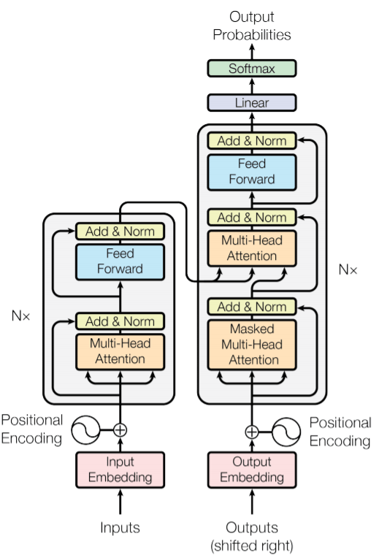
GENERATIVE PRE-TRAINED TRANSFORMER (GPT)
GPT-3 is an autoregressive language model with 125 Billion to 175 Billion parameter variants.
GPT utilizes embedding to capture information within reasonable dimensions and reduces the vectors with zeros.
Positional encoding - captures sequential information of the text - acting as input for attention mechanism.
GPT implements multi-head attention - multiple repeats of the focussing process each with a different learned query, key, value projection weights.
In Feed-Forward block, input is multiplied with learned weights and added with learned bias repetitively to get results and normalized.
Finally, learned sequences are reverse mapped to word encoding.

Slide 9
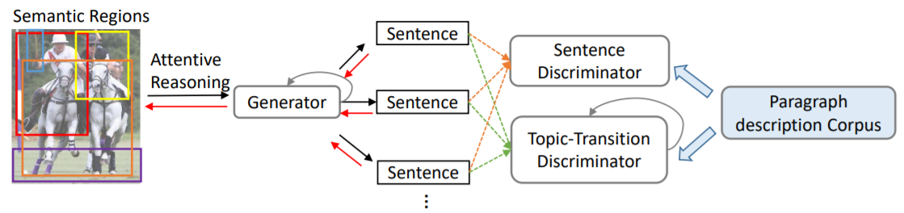
GENERATIVE ADVERSARIAL NETWORKS (GANS)
Generative Adversarial Network (GAN), an adversarial framework between a structured paragraph generator and multi-level paragraph discriminator can establish an image caption generator method.
The paragraph generator generates sentences recurrently by incorporating region-based visual and language attention mechanisms at each step.
The discriminator access the generated sentences from two aspects, namely, plausibility at sentence level and topic-transition coherence at paragraph level or smoothness of semantic transition with preceding sentences.

Slide 10
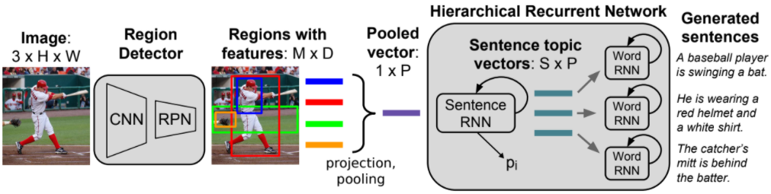
HIERARCHICAL RECURRENT NETWORKS
Due to vanishing gradients, RNNs struggle to learn long-term dependencies. LSTM alleviates this problem through grating mechanism.
Alternatively, in HRNN architecture different parts of the model operate on different time scales.
Input image is decomposed by detecting regions - aggregating features across regions - producing vector representation for image semantics.
Vector is fed as input to HRNN with two levels - Sentence RNN and Word RNN
Sentence RNN receives pooled vector, user defined number of output sentences (S) and produces topic vector (P) which is input of Word RNN and specified size sentences are generated.
Word RNN is similar to the baseline RNN.

Slide 11
CONCLUSION
Explored basic Encoder-Decoder architecture method to generate human like captions and how they can be improved through HRNNs, GANs or GPT3.
All models rely on dense captioning which initially segments the image and captures the regions of image to generate few sentences related to those regions.
Partially generated sentences are fed into the RNN architectures which generates the human-like captions.
Utilizing regions of an image gives more control over variance and correlation with the caption generated.
By building models on top of ideology of object detection and huge vocabulary, one can achieve quality and qualified captions.

Slide 12
FUTURE SCOPE
Exploration of more pre-trained encoders enabling to train a model quickly or without much computational resources.
Alternatively, building a corpora vocabulary of captions for individual users can help in more personalized captions.

Slide 13
THANK YOU
ANY QUESTIONS?

