Slide 1
Amazon Books Recommender System
IDS 561 Analytics for Big Data
FINAL PROJECT
RAHUL GERA
BABANDEEP SINGH
ROBIN BEURA

Slide 2
Objective and Dataset
Building a recommender system that will help the
customers books that suits their choice based on popularity of the book, content and based on previous choices of the customer.
1
From the user’s point of view, it increases experience and creates engagement. For the business, it
generates more revenue.
2
3
Dataset contains about 1 million ratings across 10,000 unique books
In most cases, there are at least 10 books rated by
each user and the rating lies between 0 to 5.
4
Attributes:
5
book_id, user_id, rating, original_title, authors etc.
RAHUL GERA | BABANDEEP SINGH | ROBIN BEURA

Slide 3
Recommender Systems
Various recommender systems incorporated
Popularity based
Content based
Collaborative based
Works on the principle of popularity or latest trend. These systems check about the product or book which are in trend or are most popular among the users and directly recommend those.
Recommends similar content
items. Recommends on similar
books based on similar attributes
like genre, author, publication etc.
Works on the similarity between
different user and item
relationships. It checks about the
taste of similar users and does
recommendations.
RAHUL GERA | BABANDEEP SINGH | ROBIN BEURA

Slide 4
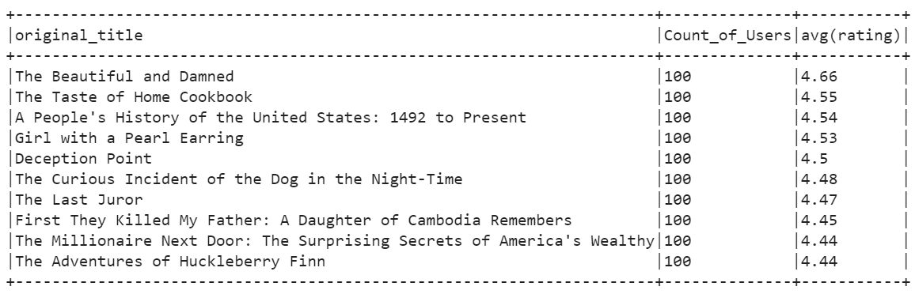
Popularity based recommendation
Based on total number of users who have read the book and their average ratings
For each book, we found out the number of users who read the book and the average rating they gave, and we sorted them in descending order.
Naïve way to recommend books to new users.
Can be utilized to solve the cold start problem.
RAHUL GERA | BABANDEEP SINGH | ROBIN BEURA

Slide 5
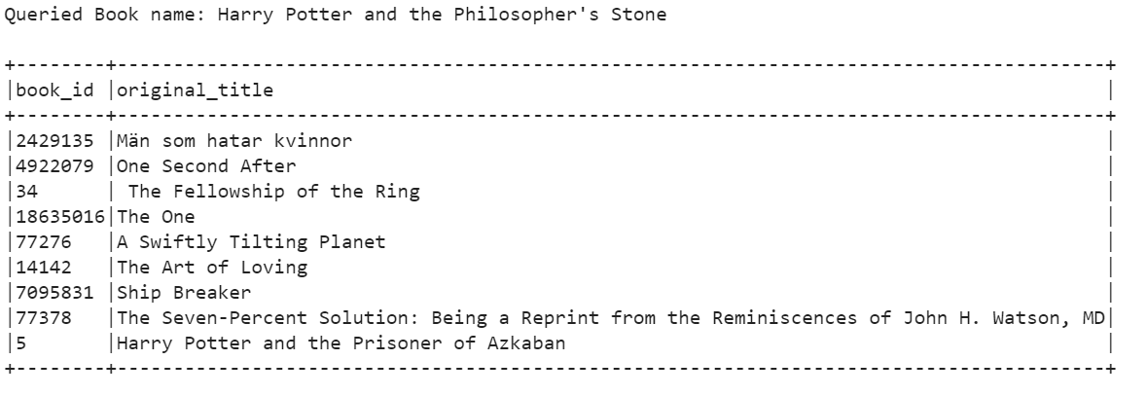
Content based recommendation
These recommendations are based on similar content books
Extracted the features from the book's dataset using tf-idf, countvectorizer.
Found similar books using cosine similarity based on features extracted.
Merit: After user queries the book of interest, we can recommend books based on the book’s attributes.
Demerit: Not personalized
RAHUL GERA | BABANDEEP SINGH | ROBIN BEURA

Slide 6
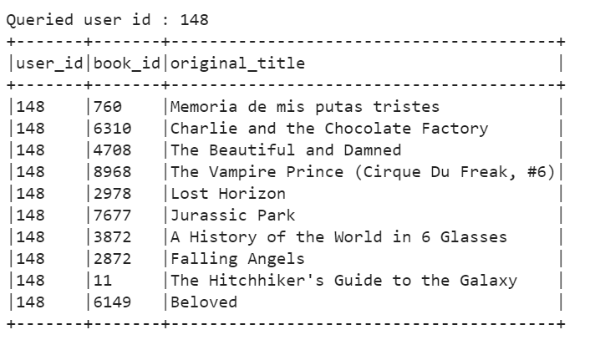
Collaborative filtering-based recommendation
These recommendations are based on user-item matrix
Built the filtering using Alternating Least Squares model.
Metric evaluation using Root Mean Square Error.
Performance improved using 5-fold cross validation (i.e., 13% improvement from baseline on test dataset).
Merit: Provide more personalized recommendation based on user likes and dislikes. It doesn’t mandate item metadata.
RAHUL GERA | BABANDEEP SINGH | ROBIN BEURA

Slide 7
Thank you!!
Questions???
RAHUL GERA | BABANDEEP SINGH | ROBIN BEURA

