Slide 1

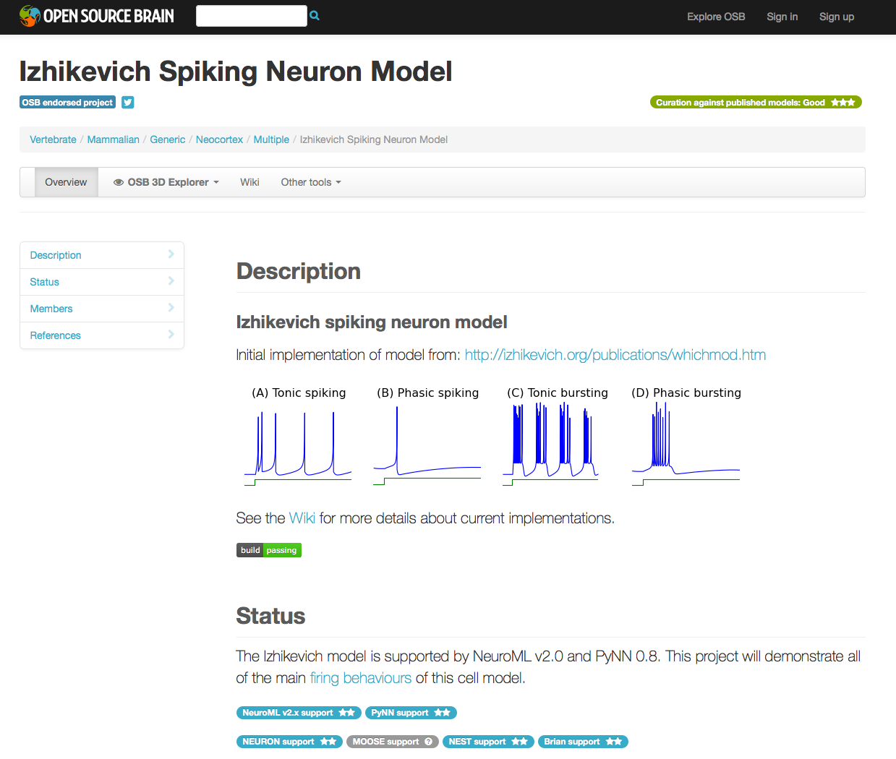
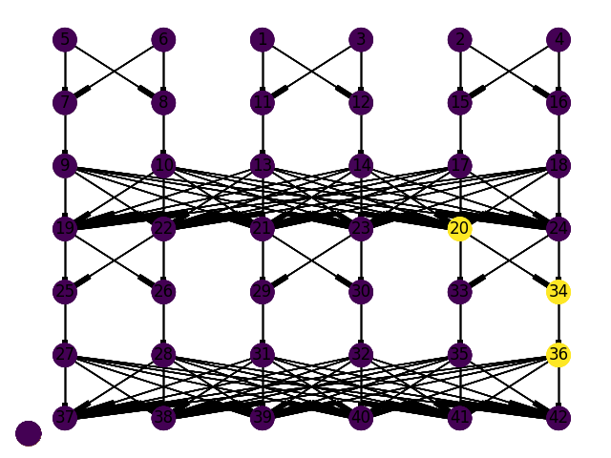

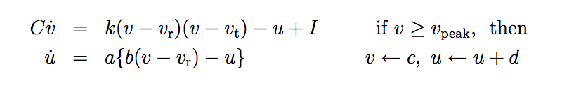
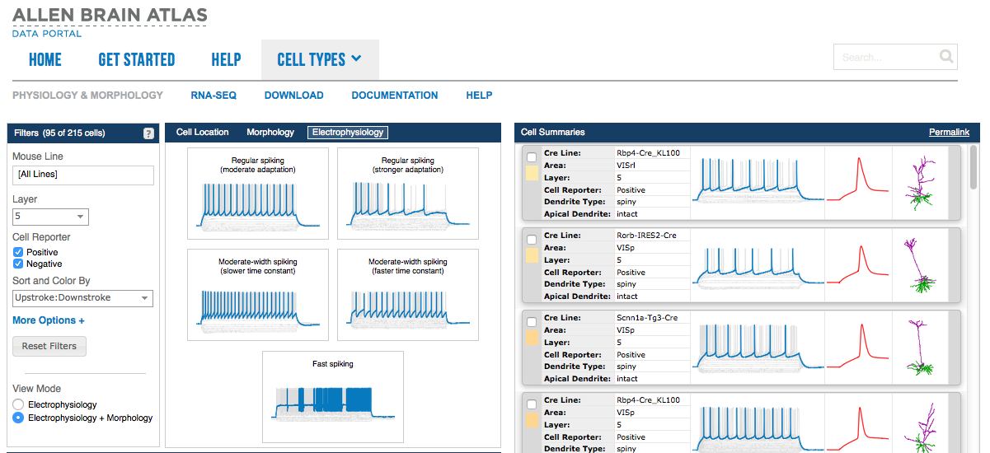

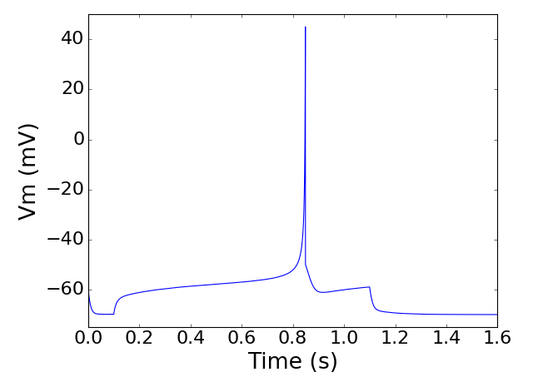

CREATING BETTER REDUCED NEURON MODELS
Sharon Crook, Rick Gerkin, Kael Dai
Laboratory for Informatics and Computation in Open Neuroscience, Arizona State University
http://iconlab.asu.edu
Scientific insight is well-served by the discovery and optimization of abstract models that can reproduce experimental findings. NeuroML (NeuroML.org), a model description language for neuroscience, facilitates reproducibility and exchange of such models by providing an implementation-agnostic model description in a modular format. NeuronUnit (neuronunit.scidash.org) evaluates model accuracy by subjecting models to experimental data-driven validation tests, a formalization of the scientific method. In order to scale such tests to a wide variety of biological neuron types and a range of model classes, computationally efficient techniques for test-driven model optimization are needed. Here we use parallel genetic algorithms to efficiently sample a large model parameter space in the context of NeuronUnit testing of NeuroML models. This is accomplished using the Distributed Evolutionary Algorithm in Python (DEAP) library. We demonstrate the efficiency of this approach for a variety of model types, testing against experimental data from both NeuroElectro.org and the Allen Institute Cell Types database. For each model class and biological neuron type, we obtained an error surface via a Non-Dominated Sort Genetic Algorithm (NSGA), corresponding to plausible subsets of candidate parameter values that respect intrinsic biological diversity.
model
ABSTRACT
METHODS
RESULTS
MODEL SHARING
Model parameters were varied to fit the model neuron against experimental examples of resting potential, action potential count, action potential width, and spike interval distribution. The experimental data and metadata used to construct the tests were taken from both NeuroElectro.org [3] (reflecting literature-wide averages) and from the Allen Institute's Cell Types Database [4] (reflecting specific gold standard recordings). Here we use the layer 5 cortical pyramidal cell as an example cell type.
Genealogy history
Rheobase tests were run first, based on the Allen Cell Types data. Tests for action potential width use rheobase current in simulations so as to evoke one spike. Other tests may use different levels of current, such as 2x or 3x the rheobase, to evoke multiple spikes.
MODEL VALIDATION
Example of results for tests as one parameter is varied. Other parameters are as in panel (a) of example behaviors. Colors show agreement with experimental data (white best).
We have developed a model validation framework, NeuronUnit, that employs suites of “tests” that evaluate model results against experimental data [1]. Model parameters are varied in order to fit experimental data from multiple open source resources. For parameter fitting, model templates are calibrated to experimental data for specific neuron types using gradient descent on the NeuronUnit test suite scores.
Open Source Brain [6] is a resource for sharing and collaboratively developing computational models of neural systems, where use of NeuroML is encouraged to ensure transparency, modularity, accessibility and cross simulator portability. OSB provides advanced facilities to analyze, visualize and transform models and to connect researchers interested in models of specific neurons, brain regions and disease states. Researchers can also obtain individual NeuroML models at NeuroML-DB.org [7] using a simple search tool.
EXAMPLE
Example showing top ten results for variation of four parameters. Other parameters set manually from previous tests.
With this example, we address issues of transparency and validation against experimental data for one type of reduced neuron model -- the Izhikevich model [2].
The goal of the NeuroElectro Project is to mine the literature for information about the electrophysiological properties of diverse neuron types and place it into a centralized database.
REFERENCES
Website: NeuronUnit. http://github.com/scidash/neuronunit
Izhikevich EM: Dynamical Systems in Neuroscience. MIT Press, 2007.
Tripathy SJ, Savitskaya J, Burton SD, Urban NN, Gerkin RC: NeuroElectro: a window to the world’s neuron electrophysiology data. Frontiers in Neuroinformatics, 2014, 8:40.
Website: 2015 Allen Institute for Brain Science, Allen Cell Types Database. http://celltypes.brain-map.org
Gleeson P, Crook S, Cannon R, Hines M, Billings G, Farinella M, Morse TM, Davision A, Ray S, Bhalla U, Barnes SR, Dimitrova YD, Silver RA: NeuroML: a simulator-independent language for describing data-driving models of neurons and networks with a high degree of biological realism. PLoS Computational Biology, 2010, 6: e1000815.
Gleeson P, Piasini E, Crook S, Cannon R, Steuber V, Jaeger D, Solinas S, D'Angelo E, Silver RA: The Open Source Brain Initiative: enabling collaborative modelling in computational neuroscience. BMC Neuroscience 2012, 13(Suppl 1):O7.
Birgiolas J, Dietrich S, Crook S, Rajadesingan A, Zhang C, Velugoti Penchala S, Addepalli V: Ontology-assisted keyword search for NeuroML models. In A Gupta and S Rathbun, Eds, Proceedings of the 27th International Conference on Scientific and Statistical Database Management, ACM, New York, NY.
Allen Institute for Brain Science Cell Types database is available online.
Parameter sweeps of two parameters where color map shows ensemble score across all experimental characteristics.
Both the model parameters and the specific details of each simulation were identified and manipulated using NeuronUnit to create simulations of instantiated Izhikevich model neurons undergoing specific simulation protocols. Simulations were performed by creating NeuroML documents to describe the details of the Izhikevich model and then using jNeuroML to automatically generate and run simulation code [5].
ACKNOWLEDGEMENTS
This work was supported in part by grant R01EB021711 from the National Institute of Biomedical Imaging and Bioengineering and by grant R01MH106674 from the National Institutes of Mental Health.
<izhikevich2007Cell id= “my_cell_model” v0 = “-60mV” C= “100pF” k= “0.7nS_per_mV” vr= “-55mV” vt= “-40mV” vpeak= “35mV” a= “0.03per_ms” b= “-2nS” c= “-50mV” d= “100pA” />
Plot from the Injected Current Action Potential Width Test for the best model.
Electronic version and reproduction permissions freely available at www.izhikevich.com.

