Slide 1


The Cupcake Shop
Website presentation by Team 2
Annette, Dimitry & Rémy

Slide 2

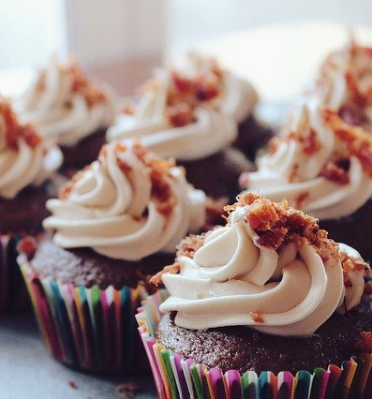




Concept
Create an e-shop website with full functionality
Sell cupcakes -> focus on one product!
Great UX design
Attraction to increase sale

Slide 3
Logo and colors
Simple logo
Focus on mission
Classical colors for cupcakes and sweets
Matching colors throughout the website
Color Palette

Slide 4
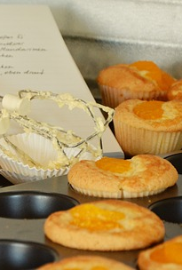
Teamwork
One team
Complementary skills
Front-end
Back end
Help out when needed

Slide 5
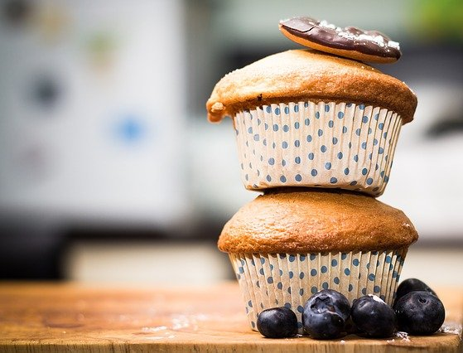
Challenges
Solving merge conflicts
ASP.net suitability
Time

Slide 6
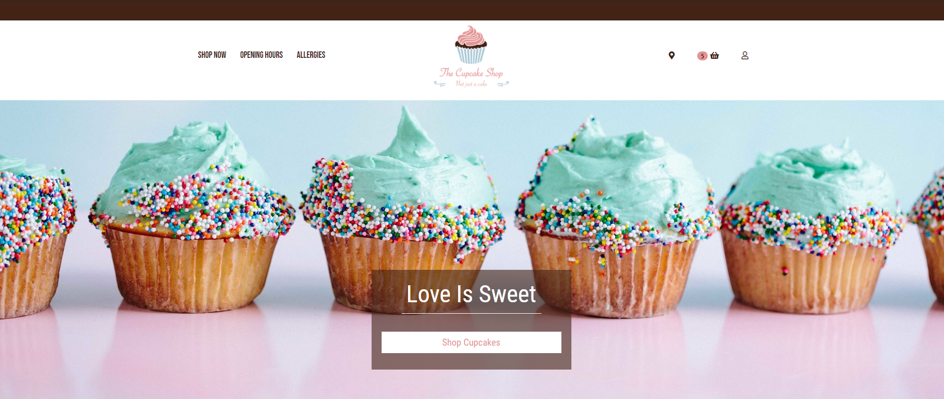
Let’s look at cupcakes

