Slide 1
Contest #1 Presentation
Presented by:
Riddhimoy Ghosh & Zach Mazgaj
STAT 8456 – Machine Learning & Data Mining
Contest #1

Slide 2
Details about Data Set
id: row ID.
orderDate: Order date
deliveryDate: Delivery date (with NA).
itemID: Item ID
size: Size of the item
color: Color of the time (with NA)..
manufacturerID: Manufacturer ID
price: Price of the item
customerID: Customer ID
salutation: Salutation of the customer
dateOfBirth: Customer’s date of birth. (with NA).
state: Federal state of the customer
creationDate: Date of customer’s account creation
return: If the item is returned or not. 1: yes. 0: no
Only ~21.90% of the train data Customers are present in test
~57% Customers in the test set are unseen
Average Order per Customer ~ 6
~ 3% of Manufacturer Item Ids were new in the test set.
~13% of the Customers in training have 100% return rates, ~29% have a 0 return.
Event Rate in training data ~ 48.33%
Return Rate ~ 54% Company , ~ 47% Mrs.

Slide 3
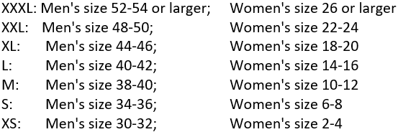
Data Cleaning Strategy
Zach
All dates converted to datetime dtypes
Orders placed in December were dropped
Customers more likely to return items ordered around holidays.
Led to slight increase in model performance.
Size column
Letter designations were replaced with numbers based on general guidance of which letter sizes equated to which numbers.
If the salutation was Mr. it was replaced with the lower corresponding men’s size. Likewise, if the salutation was Mrs.
+ Signs were removed
Sizes with four digits – Last two digits were dropped. So, 3436 became 34.
Any salutations not Mr. or Mrs. became 99999
Riddhi
Did not drop December Orders
Removal of White Spaces, Special Characters like ‘+’ and converting to lower cases for categorical variables like color, size, salutation and state
Noting '1990-12-31’ date in delivery date, and missing values in the birth dates but no direct drop/ replacement taken here.

Slide 4
Data Cleaning
Zach
Checking for Null Values
orderDate | 0
deliveryDate | 16246
itemID | 0
size | 0
color | 88
manufacturerID | 0
price | 0
customerID | 0
salutation | 0
dateofBirth | 23178
state | 0
creationDate | 0
return | 0
Null values in deliveryDate and dateofBirth were replaced with the mean/ median of the column.
Null values in Color column were replaced with the mode of the column.
Riddhi
Null values in Color column were imputed with the mode manufacturer id, item id and salutation column and moving up the hierarchy if not imputed.
Null values in deliveryDate & dateofBirth not imputed directly here, as these columns would not be used as features as is.

Slide 5
Feature Engineering
Return rates were added for:
Customer ID
Manufacturer ID
Item ID
Added columns for if delivery / birthdates were provided
Time between order and delivery date
Age of customer
Age in system
Time between order date and account creation date.
Dummy variables were created for categorical variables
Color
Salutation
State
Order day of the Week

Slide 6
Notes on Feature Engineering:
Riddhi
Age in Customer at Order was imputed grouping by salutation and filling in with respective medians
Time to Delivery Nulls owing to deliveryDate '1990-12-31’ and Null were imputed by 9999 and 99999 respectively to help glean some information by making them quite different.
Customer and Manufacturer Items are tricky to make in the test set , we need to join with train and populate available ones from train, the rest were filled by -1 in this case, to make them stand out from the usual range (0,1)
One hot encoding of the Categorical Variables made, dropping the first and setting the unknown handling in the test set to ‘ignore’
The number of features drastically increase after this step, so decisions need to be made which ones to use during modeling approach
Zach Notes
Data set began with 13 predictors
Model was trained on 104 predictors

Slide 7
Notes on Modeling Approach/ Design Matrix:
Riddhi
After Initial efforts, it was soon realized that using 'manufacturerID','customerID’ or ‘itemID’ as categorical variables cursed us with dimensionality problem.
Two approaches were streamlined:
[['price’, time_to_delivery','age_at_order','age_in_system', 'customer_return_rate’, 'manufacturer_item_return_rate’, 'salutation','state’, 'order_day_of_week’, 'color’, 'product_size’]]
[['itemID','manufacturerID','price','customerID', 'time_to_delivery','age_at_order','age_in_system’]] * In the second approach the IDs were kept numeric and thought process is that the newer customer, manufacturer and product ids unseen in the training set would have larger IDs and the tree models can make splits. * Adding the rate features were tried in the second approach but did not provide any significant improvement.
Zach Notes
Data set began with 13 predictors
Model was trained on 104 predictors

Slide 8
Notes on Validation and Parameter Tuning:
Methods of Validation was used:
Keeping a random 20% Validation Set ( with a set seed for replication)
Finding the Customers who are also in the test set and keeping 1/4th of that population as a validation set and checking model performance on it. * No significant benefits were able to made from the second approach Two methods of Validation was used:
Methods of Validation was used:
Random Search and Grid Search Over the Hyperparameter Space were both tried out.
An example parameter space searched within through Rndom search for Decision Tree Classifier:param_dist = {"max_depth": [3,5,7,None],"max_features": randint(1, 8), "criterion": ["gini", "entropy"]}

Slide 9
Results / Findings
Highest accuracy (77-78%) in training/ validation models came from :
Random Forest
Gradient Boosting
XGBoost
Naïve Bayes and KNN resulted in lower accuracy models (~58%-62%).
SVC was too computationally expensive.
Accuracy in training set didn’t generalize well to test set.
Best submission was a Decision Tree classifier with public leaderboard score of .63584
Parameter tuning created marginal benefits on training set.

Slide 10
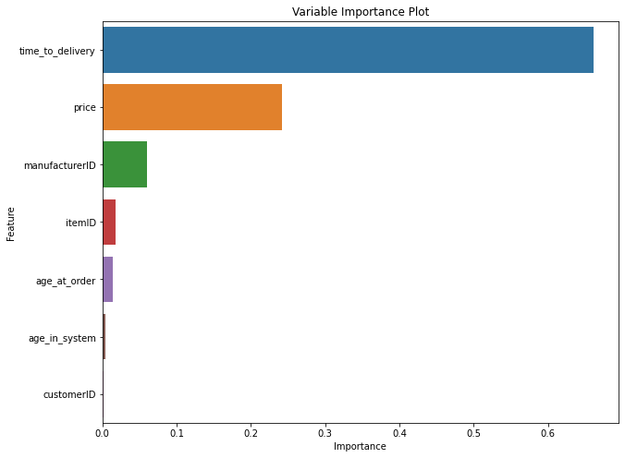
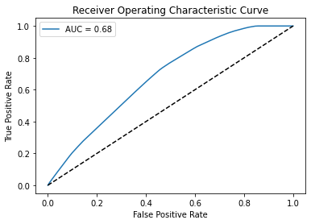
Details on the Final Model:
Best submission was a Decision Tree classifier with public leaderboard score of .63584
DecisionTreeClassifier(criterion='entropy',max_depth=7,max_features=6)
We used a custom threshold of 0.48533 ( based on the event rate)

Slide 12
Result table for all models & parameters
We have tried multiple models with different feature combinations and validation strategies. Starting from a Logistic Regression Model , Naïve Bayes, KNN all the way up to XGBoost. Out of the numerous attempts , we try to report a few:
Model | Parameters | Training Accuracy | Public Test Accuracy
Logistic Regression | 'C': 8.483428982440725e-05 | ~62% | ~60%
Decision Tree Classifier | criterion='entropy',max_depth=7,max_features=6 | ~ 65% | ~63.5%
RandomForestClassifier | criterion='entropy',max_features='log2',min_samples_leaf=5,n_estimators=350 | ~ 67% | ~ 57%
RandomForestClassifier | n_estimators=100, random_state=42, min_samples_split=16, min_samples_leaf=4, max_depth = 17, bootstrap=True, criterion='gini', max_features='sqrt' | ~78.1% | 61.2%
GraidentBoostingClassifier | n_estimators=100, random_state=42, learning_rate=0.1, max_depth=10, min_samples_split=5, min_samples_leaf=5 | 78.1% | 56.9%

Slide 13
Result table for all models & parameters
We have tried multiple models with different feature combinations and validation strategies. Starting from a Logistic Regression Model , Naïve Bayes, KNN all the way up to XGBoost. Out of the numerous attempts , we try to report a few:
Model | Parameters | Training Accuracy | Public Test Accuracy
XGBoost | n_estimators=100, learning_rate=0.1, max_depth=3, min_child_weight=1 | 56.2% | Not Submitted due to under performance
KNN | N_neighbors = 5 | ~ 62.2% | Not Submitted due to under performance
Naïve Bayes |  | ~ 58.1% | ~ 57%
XGBoost | eval_set=[(X_train,y_train),(X_validate1,y_validate1)],eval_metric='auc',early_stopping_rounds=10 | ~82% | ~59%
RandomForestClassifier | n_estimators=100,min_samples_leaf=0.1 | ~80% | ~60.10%

Slide 14
Takeaway: Hyperparameter tuning is an Art
what-is-artistic-about-hyperparameter-tuning
the-fine-art-of-hyperparameter-tuning

