Slide 1
Contest #3 Presentation
Presented by:
Riddhimoy Ghosh
STAT 8456 – Machine Learning & Data Mining

Slide 2
Details about the Data Set
• recordID: Row ID.
• orderID: Different rows may have the same order ID.
• orderDate: Order date.
• itemID: One order may have multiple items.
• colorCode: Color code of the item.
• sizeCode: Size code of the item.
• typeCode: Type code of the item.
price: Price of the item.
• recommendedPrice: Recommended retail price.
• voucherID: Voucher ID.
• voucherAmount: Voucher value PER ORDER.
• customerID: Customer ID.
• deviceCode: Device type.
• paymentCode: Payment type.
• return: If the item is returned or not. 1: yes. 0: no.
Only ~21.90% of the train data Customers are present in test
~ 66.05% Customers in the test set are unseen
Average Order per Customer ~ 1.56 in Training Set and ~ 1.39 in Test Set
Average Number of Items in an Order ~ 2.50 in Training Set and ~ 2.61
~ 21.61% of Item Ids were new in the test set.
~ 21.29 % of the Customers in training have 100% return rates, ~ 32.35% have a 0 return.
Event Rate in training data ~ 53.15%

Slide 3
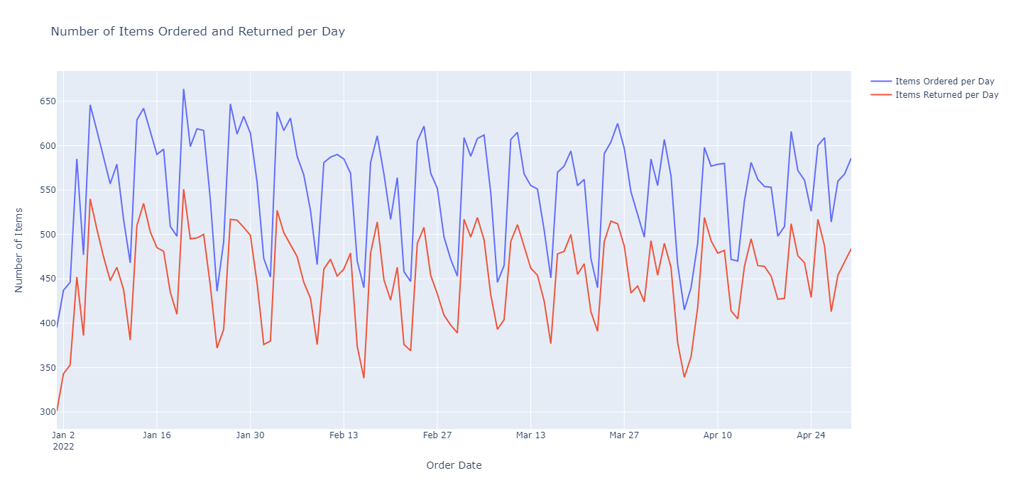
Exploratory Visualization
No Sudden Change in Pattern Observed over time
Slight Decreasing Trend in Number of Items ordered / returned in observed

Slide 4
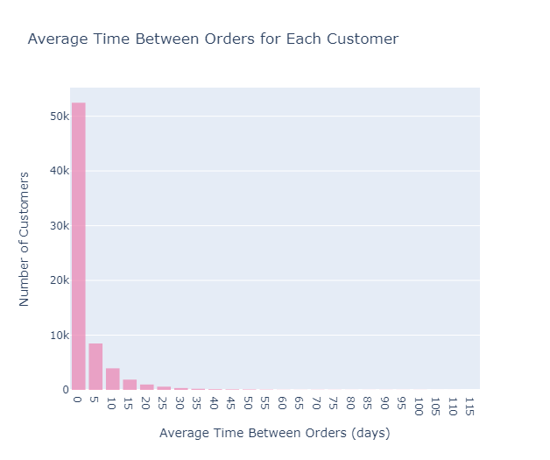
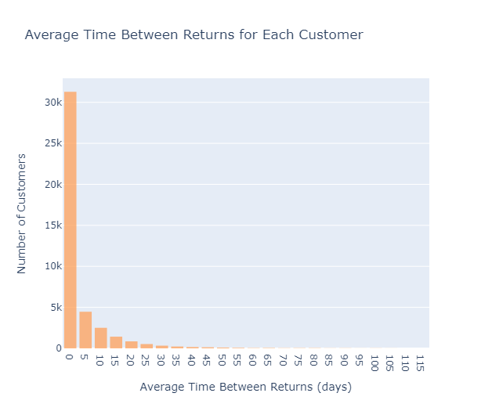
Exploratory Visualization
Interestingly, we can observe many near same day orders and returns. Could it be they ordered wrong Items and returned them immediately?

Slide 5
Feature Engineering
1. `orderMonth`: Extracted from the `orderDate` column, it represents the month of the order.
2. `orderWeek`: Extracted from the `orderDate` column, it represents the week number of the order.
3. `orderDayOfWeek`: Extracted from the `orderDate` column, it represents the day of the week of the order.
4. `items_in_order`: Represents the number of items in each order.
5. `duplicates_in_order`: Indicates whether there are duplicate items in an order.
6. `previous_returns`: Represents cumulative number of returns made by a customer prior to each order.
7. `used_voucher`: Indicates whether a voucher was used in the order.
8. `previous_voucher_returns`: represents the cumulative count of previous returns made with the voucher used in the order.

Slide 6
Design Matrix of Final Model:
Feature Name | Data Type
itemID | Categorical
sizeCode | Categorical
voucherID | Categorical
deviceCode | Categorical
paymentCode | Categorical
customerID | Categorical
colorCode | Categorical
typeCode | Categorical
price | Numeric
recommendedPrice | Numeric
voucherAmount | Numeric
used_voucher | Indicator
previous_voucher_returns | Numeric
previous_returns | Numeric
duplicates_in_order | Indicator
items_in_order | Numeric (Int)
*Engineered Features

Slide 7
Final Model Algorithm & Hyper Parameter Tuning:
CatBoost Classifier : Due to Efficient Handling of Categorical Variables and GPU Implementation
General Hyperparameters: od_type= 'Iter’, od_wait=100, loss_function= ‘Logloss’, eval_metric='Accuracy’, task_type='CPU’ / ‘GPU’
Tuned Hyperparameters:
Hyper parameter | Type | Range
iterations | Random Integer | (1000, 2000)
depth | Random Integer | (3, 10)
learning_rate | Random Float | (0.001, 0.1)
l2_leaf_reg | Random Integer | (1, 10)
border_count | Random Integer | (32, 256)

Slide 8
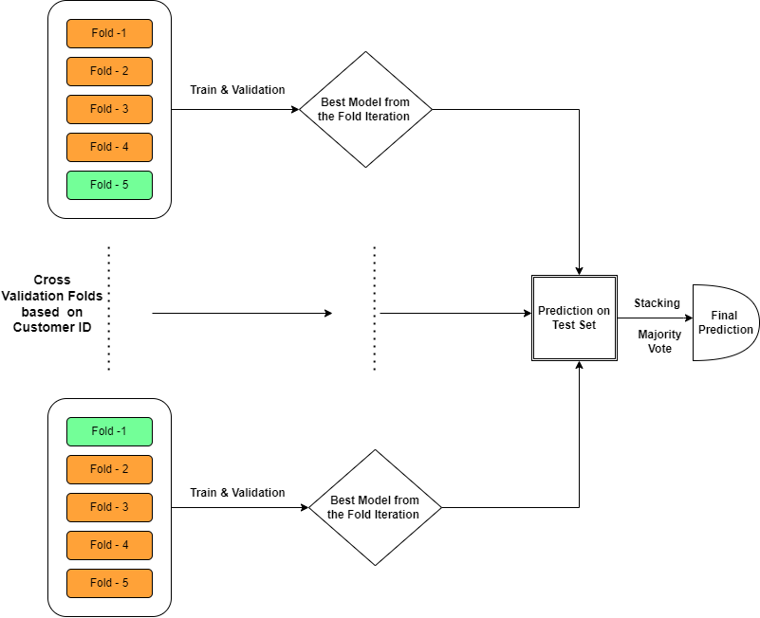
Cross - Validation Approach:
Five folds based on 'customerID'. For each split, the model is trained on 4 folds and validated on the remaining fold. The best model from each fold with best validation Accuracy is stored (in terms of hyperparameters) and predictions are made on the test set.
Time Series based 5-fold cross validation (where the train set contains all observations up to a certain point in time, and the validation set contains observations from that point onwards) was also tried, but was outperformed in Kaggle by the above Customer ID based validation.

Slide 9
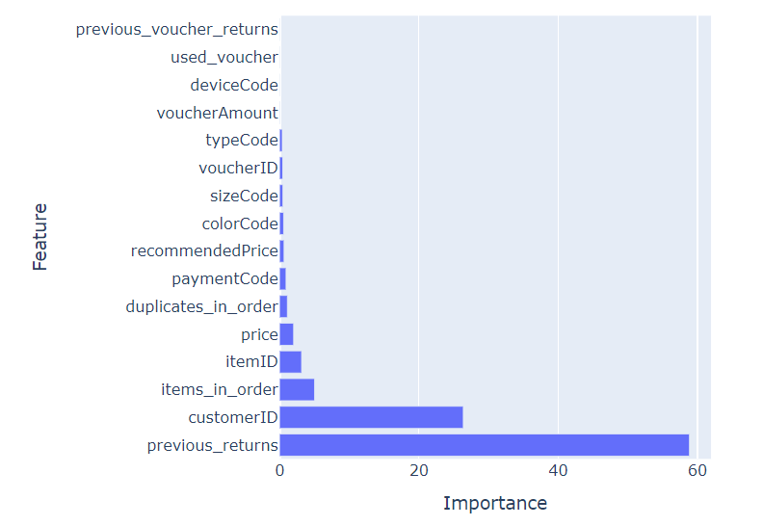
Best Models & Feature Importance:
Model 1: Best parameters found: {'border_count': 111, 'depth': 8, 'iterations': 1876, 'l2_leaf_reg': 6, 'learning_rate': 0.07316780045630092} Best accuracy found: 0.6818207285391177 CatBoost Model Accuracy (Test Set): 66.45%
Model 2: Best parameters found: {'border_count': 200, 'depth': 7, 'iterations': 1997, 'l2_leaf_reg': 2, 'learning_rate': 0.09155878374744814} Best accuracy found: 0.6808771014133765 CatBoost Model Accuracy (Test Set): 66.07%
Model 3: Best parameters found: {'border_count': 99, 'depth': 5, 'iterations': 1851, 'l2_leaf_reg': 5, 'learning_rate': 0.0911405270608734} Best accuracy found: 0.6821931854135624 CatBoost Model Accuracy (Test Set): 66.37%
Model 4: Best parameters found: {'border_count': 55, 'depth': 7, 'iterations': 1743, 'l2_leaf_reg': 6, 'learning_rate': 0.10074634586449373} Best accuracy found: 0.68060 CatBoost Model Accuracy (Test Set): 66.47%
Model 5: Best parameters found: {'border_count': 187, 'depth': 6, 'iterations': 1340, 'l2_leaf_reg': 7, 'learning_rate': 0.06893874499981703} Best accuracy found: 0.6810 CatBoost Model Accuracy (Test Set): 66.68%

Slide 10
Summary, Findings and Learnings
A Stacked CatBoost Model with Customer ID based Validation Approach with Internal RandomSearch based Hyper-parameter tuning was my best model in terms of Kaggle Public Test Score Accuracy of 0.64879. This model achieved Rank 3 in Public Test but went down to Rank 5 in Private Test Board.
CatBoost was again the go-to model that enabled efficient Category Variable Handling and GPU Implementation. It is important to know that CatBoost does not do One-Hot Encoding for all the categorical variables but employs different approaches with Target Encoding being one of them, mainly based on the distribution of the categories of the specific predictor. Reference: CatBoost Encoding
The surprising finding for me was Time Series based Model Validation Approach ( for example TimeSeriesSplit from scikitlearn was not able to achieve the highest Kaggle Score for me but a Customer ID based Validation was able to.
It was interesting to see Higher Rank Participants were able to get better scores with just Random K – Fold cross validation or even just a Random Train – Test Split.
An important step would have been building separate Models for Previously Seen Customers in the Train Set and another one for the Unseen Ones in Test Set. In this case we would expect a Time Series Based Cross Validation would work better for seen customers and a Customer ID based validation would be useful for the previously unseen Customers.

Slide 11
Result table for all models & parameters
We have tried multiple models with different feature combinations and validation strategies, starting from a Decision Tress, Random Forest to CatBoost. Out of the numerous attempts , we try to report a few:
Model | Parameters | Training Accuracy | Public Test Accuracy
Decision Tree Classifier (Only Numeric Columns) | {'criterion': 'gini', 'max_depth': 9, 'max_features': 12} | ~65% | ~60%
RandomForestClassifier (Only Numeric Columns) | {'n_estimators': 500, 'min_samples_split': 35, 'max_features': 'log2'} | ~ 67% | ~60.9%
RandomForestClassifier | n_estimators=500, random_state=42, min_samples_split=16, min_samples_leaf=4, max_depth = 17, bootstrap=True, criterion='gini', max_features='sqrt' | ~ 67% | ~ 61%
GraidentBoostingClassifier | n_estimators=100, random_state=42, learning_rate=0.1, max_depth=10, min_samples_split=5, min_samples_leaf=5 | ~73% | ~ 61.3%
XGBoost | eval_set=[(X_train,y_train),(X_validate1,y_validate1)],eval_metric='auc',early_stopping_rounds=10 | ~ 78% | ~59%

Slide 12
Result table for all models & parameters
We have tried multiple models with different feature combinations and validation strategies, starting from a Decision Tress, Random Forest to CatBoost. Out of the numerous attempts , we try to report a few:
Model | Parameters | Training Accuracy | Public Test Accuracy
Cat Boost Stack Time Series Validation | {'iterations': sp_randInt(1000, 2000), 'depth': sp_randInt(3, 10), 'learning_rate': sp_randFloat(0.001, 0.1), 'l2_leaf_reg': sp_randInt(1, 10), 'border_count': sp_randInt(32, 256)} | ~65% | ~63%
Cat Boost Stack Time Series Validation | 'iterations': sp_randInt(1000, 2000),n'depth': sp_randInt(3, 10), 'learning_rate': sp_randFloat(0.001, 0.1),'l2_leaf_reg': sp_randInt(1, 10), 'border_count': sp_randInt(32, 256), 'bagging_temperature': sp_randFloat(0, 10) | ~ 67% | ~63.3%
Cat Boost Stack Customer ID Validation | {'iterations': sp_randInt(1000, 2000), 'depth': sp_randInt(3, 10), 'learning_rate': sp_randFloat(0.001, 0.1), 'l2_leaf_reg': sp_randInt(1, 10), 'border_count': sp_randInt(32, 256)} | ~ 66% | ~ 64.8%
Cat Boost Stack Customer ID Validation With 'orderMonth','orderWeek','orderDayOfWeek' | {'iterations': sp_randInt(1000, 2000), 'depth': sp_randInt(3, 10), 'learning_rate': sp_randFloat(0.001, 0.1), 'l2_leaf_reg': sp_randInt(1, 10), 'border_count': sp_randInt(32, 256)} | ~ 67% | ~ 63.5%
Cat Boost Stack Customer ID Validation + Time Series Validation (Majority Vote out of All) | 'iterations': sp_randInt(1000, 2000),n'depth': sp_randInt(3, 10), 'learning_rate': sp_randFloat(0.001, 0.1),'l2_leaf_reg': sp_randInt(1, 10), 'border_count': sp_randInt(32, 256), 'bagging_temperature': sp_randFloat(0, 10) | ~ 67% | ~ 63.3%
Due to Multiple Models being stacked, single exact parameters could not be provided.

