Slide 1
TECH TALK:
Oracle Cloud Foundations for Researchers
Friday, October 2, 2020
10:300 AM US EDT
Rajib Ghosh
Global Solutions Architect
Oracle for Research

Slide 2
TECH TALK HOUSEKEEPING
Today’s webinar is being recorded. We will share the link to the recording with you via email after the event. The recording will also be made available to the Oracle for Research community.
We invite your comments and questions, both about the tech topic being discussed and about the series more generally. Questions may be submitted using the Q&A box on your screen or you may ask questions directly using your microphone. When not asking a question, please mute your microphone.
Questions may be asked during the presentation and we will also have a Q & A time at the end of the presentation when you can ask questions directly and engage in discussion.
At Oracle for Research, we believe that research and innovation happen best when a diverse and thoughtful community is free to engage in respectful, compassionate, and open dialog. To that end, when asking a question or providing feedback, we ask that all participants be respectful, collaborative, and constructive.

Slide 3

Oracle for Research Tech Talk Series Will Cover:
Technology training
Reference architectures
Best practices
Tools and automation
Cost control
Collaboration
Q & A Live discussions
Tips and tricks library
Community forum
Meet Oracle experts
Product announcements
OFR technology updates
OCI product updates
Images and containers
Public data
Researcher for researchers
Technology Innovations
Researcher publications
Benchmarks
Lessons learned

Slide 4
Oracle for Research Tech Talk Oracle Cloud Topics
Foundational
Oracle cloud – Getting you started and running
Cloud instances and cloud storage options
Migrating data and running computations
Architecture
Reference architecture patterns for researchers
New features updates and recommended practices
Performance benchmarks and data
Tools and automation
Tool selection, version and guidance
Image repositories, Terraform and interfaces
HPC and cluster
High performance computing, workload classification, parallelization
Cluster setup, utilization and monitoring
Machine and Deep
Learning
Model selection guidance
Researcher guidance
Functional and data guidance and curation support
Industry models with research computing

Slide 5
Agenda for today

Slide 6
Agenda (Foundational)
Compute
Key components
Short demo
Images
Image types and their purpose
Key Question : Should I choose an Oracle provided image or build myself?
Hardware shapes
Cloud shapes , specifications and categories
Key Question : How to choose the appropriate shape for my computational needs?
Cloud storage
Storage types, specifications and their usage
Key Question : How to choose an appropriate storage
Useful links
Getting started links
Technical links of importance
Q & A
Q & A and collaboration
Feedback from Researchers

Slide 7
Oracle cloud image sources for Researchers
Platform
Images
Oracle
Images
Marketplace & github
Images
Custom
Images
Operating system images supported by the Oracle cloud platform
Linux
Oracle Linux 7.x /8.x
Centos 6.x / 7.x
Ubuntu 16.x/18.x/20.x
Windows
Windows 2012 R2 DC
Windows 2012 R2 STD
Windows 2016 R2 DC
Windows 2016 R2 STD
Windows 2019 DC
Windows 2019 STD
Oracle pre-built images tested and optimized for Oracle cloud and are available for use today.
Data Science, AI & GPU
AI (All in one) Data science image
Julia AI HPC GPU Image
NVIDIA GPU cloud machine image
HPC
OL7 HPC Cluster Networking
OL7 BeeGFS parallel filesystem
OL7 DBRD,Corosync & Pacemaker
NVIDIA GPU cloud machine image
Research
Genome analysis toolkit
Folding@Home GPU
Infrastructure
OL Storage Appliance
OL8.1 ARM
Oracle secure global desktop
Oracle and third-party images available through Oracle marketplace and github today
Data Science, AI & GPU
AI (All in one) Data science image
AI/ML Runbook
GPU Workshop
Driverless AI
HPC
OL7 HPC Cluster with Slurm
Lustre and GlusterFS Quickstart
OCI HPC Filesystem
BeeGFS-beeond RDMA
PBS Professional
Spectrum scale
Molecular dynamics
NAMD Runbook
GROMACS Runbook
Infrastructure
OCI learning library
OCI Terraform base
Terraform Jupyter GPU build
Any custom images (VM) created by you in campus or cloud
Characterized by
Researcher created
Any operating system
Researcher software
Sharable across tenancy
Import as-is to OCI
Download to campus
Share with other clouds
Licensing support
Open source
BYOL
Object store images
Any OCI images (mostly in development) sharable via custom object store links

Slide 8
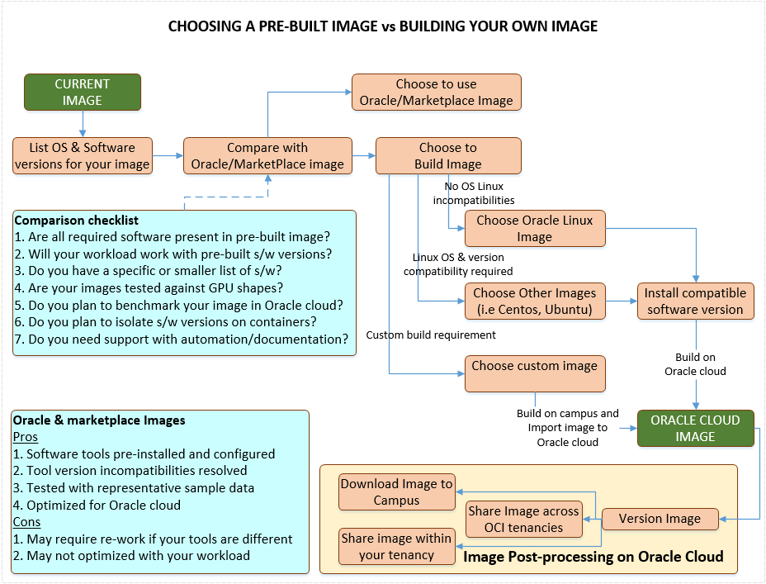
Notes:
Data science Image - https://console.us-ashburn-1.oraclecloud.com/marketplace/application/78643201/usageInformation
Oracle-Linux-7.8-Gen2-GPU-2020.05.26-0 Image Family: Oracle Linux 7.x • Operating System: Oracle Linux • Kernel Version: kernel-uek-4.14.35-1902.302.2.el7uek.x86_64. • CUDA Version: 10-2-10.2.89-1 • cuDNN Version: 7.3.1 • Release Date: June 1, 2020
Genome analysis toolkit - https://console.us-ashburn-1.oraclecloud.com/marketplace/application/81390072/usageInformation Release Notes:

Slide 10
Instance Type | Shape series | Shape | Purpose
Virtual | Always Free | VMStandardE2.1Micro | Automation control, gateway,configurations
 | Standard | VMStandard1.1~1.16 | Low workload testing / Image builds / installs
 | AMD (Gen 2) | VMStandardE2.1~2.8 | Prototype workload testing
 | DenseIO | VMDenseIO2.x (NVMe) | Heavy IO workload testing
 | GPU (P100) | VM.GPU2.1 | AI / ML or other GPU prototype testing
 | GPU (V100) | VM.GPU3.1~3.4 | Tensor core AI / DL workloads
 | Intel Skylake (Fixed) | VM.Standard2.1~2.24 | Workloads to save on credits
 | AMD Rome (Flex) | VM.StandardE3.Flex | Benchmarking / price-performance
Bare metal | HPC | BM.HPC2.36 (NVMe) | CPU+high throughput for HPC workloads
 | AMD (Gen 3) | BM.StandardE3.128 | High CPU/throughput workloads
 | Standard | BM.Standard1.36/B1.44 | Low CPU/RAM utilization at lowest BM cost
 | AMD (Gen 2) | BM.StandardE2.52 | Best price-performance for BM workloads
 | AMD (Gen 3) | BM.StandardE2.64 | Best Gen3 price-performance for BM workloads
 | DenseIO | BM.DenseIO2.52 (NVMe) | Best price performance for IO intensive workloads
 | GPU (P100) | BM.GPU2.2 | Benchmarking pascal based GPU workloads
 | GPU (V100) | BM.GPU3.8 | Best price performant for large GPU workloads
 | GPU (A100) | BM.GPU4.8 | Fastest GPU – large DL applications (pre-GA)

Slide 11
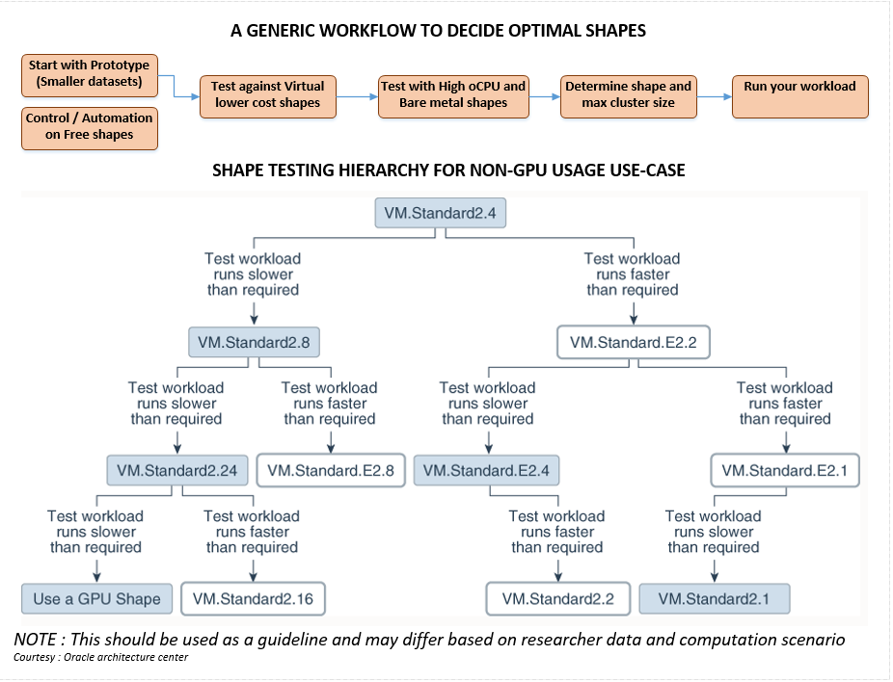

Slide 12
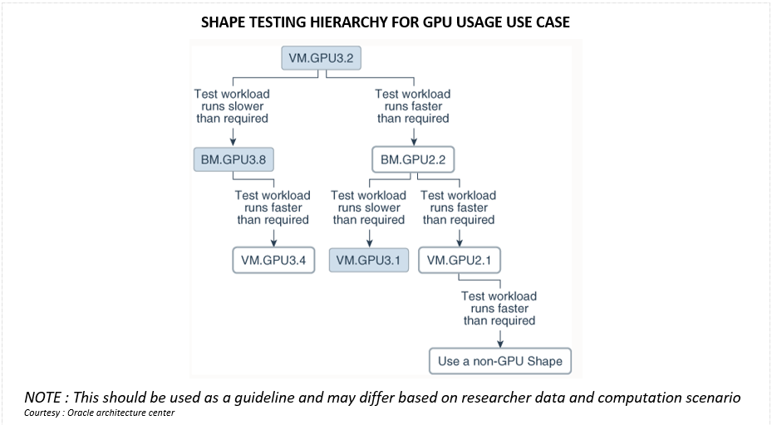

Slide 13
Oracle cloud storages
Storage type | Features | Recommended usage
On Campus storage
Good for on-campus data processing requirements
Data could be distributed (laptops) or centralized
Quick data retrieval for on-campus computations
Store data for on-campus computational purpose
Store data if storage is available and it is already paid for
Object storage archive
Unlimited data storage in Oracle cloud
Low cost ($0.0026/GB/Month) by consumption
Better if cost/GB is lower than on-campus storage
Not so good for frequent large data retrievals
Not readily available for computational purpose
Object storage standard
Unlimited data storage with faster access than OS archive
Costs (0.0255/GB/Month) by consumption
Good for frequently accessed data across cloud tenancies
Secured and encrypted data at rest and in transit (https)
Store data backups for quick downloads in cloud / campus
Store large data volumes at relatively lower cost
Store data that is infrequently processed
Block volume
Most common storage for compute/databases
Mountable across multiple instances within an AD
Cost (0.0255/GB/month) – based on total volume in GB
Supports parallel filesystem & best price performance
Leverage to store computational data for most loads
Extend storage / instance as needed
Fill up allocated capacity to save on costs
File system storage
NFSv3 unlimited file system storage mountable across AD
Higher cost (0.3/GB/month) on consumption
Good for file sharing across tenancies and OS
Performs linearly or better with higher data set size
Not good for cross AD data transfer in computational cycle
Good for moving large volumes of data quickly across AD
Use sparingly
Local NVMe
Highest IOPS and throughput & good for IO intensive loads
Higher cost (built into compute)
Non-persistent data
Part of DenseIO and HPC shapes
Use for IO intensive parallel CPU workloads

Slide 14
Useful links
Getting Started
Key concepts and terminology
Signing in to console, Sign-in options and changing your password
Setting up your tenancy
Tutorial – Launching your first Linux instance
Tutorial – Launching your first windows instance
Object storage and Pre-authenticated access
Image import and export
File storage system concepts
OCI Hands on labs
New features and navigation updates
Oracle cloud Free tier and FAQ
Custom key generation with puttygen or ssh-keygen
Frequently asked Questions
Getting help and contacting support
Identity federation
Federated identity for single sign-on
Migrating from on-premise to Oracle identity service
Databases and moving data
Oracle Autonomous databases and Tools
MySQL and NoSQL Services
Key concepts and terminology
Migrating databases to cloud
Loading data to autonomous with OCI Functions
Single-click move to autonomous
Data science and AI/ML
Oracle Data science platform and Tutorials
Genome analysis toolkit
Julia AI/HPC GPU Image
NVIDIA images and NVIDIA GPU image
Building a ML sandbox on Oracle cloud
Setting up an open-source ML and AI Environment
Machine learning autonomously
High performance computing (HPC)
Oracle HPC Cluster and Oracle HPC File system
NVIDIA GPU Cloud machine image
Oracle Linux 7 Cluster Networking Image
Oracle marketplace slurm image (HPC + Slurm combo)
Oracle cloud slurm image
Github OCI-HPC
Enabling HPC Cluster networking
Deploy High performance computing on Oracle cloud Infrastructure
Deploy scalable and distributed file system using Lustre
Deploy BEEGFS parallel file system
UoB Cluster in the cloud
Cluster in the cloud - github
Molecular dynamics NAMD runbook and GROMACS runbooks
Usage, billing and credit control
Oracle cloud storage costs
Resource billing for stopped instances
Oracle cloud universal credit PaaS and IaaS service descriptions

Slide 15
TECH TALK:
Oracle Cloud Foundations for Researchers
Questions, Answers & Discussion

Slide 16
TECH TALK:
Oracle Cloud Foundations for Researchers
Questions? Comments? Feedback?
Contact us!
Website: oracle.com/oracle-for-research/
Twitter: @OracleResearch
Email: OracleForResearchTech_ww@oracle.com
Next Tech Talk: October 23, 2020, 10:30AM EDT

