Slide 1
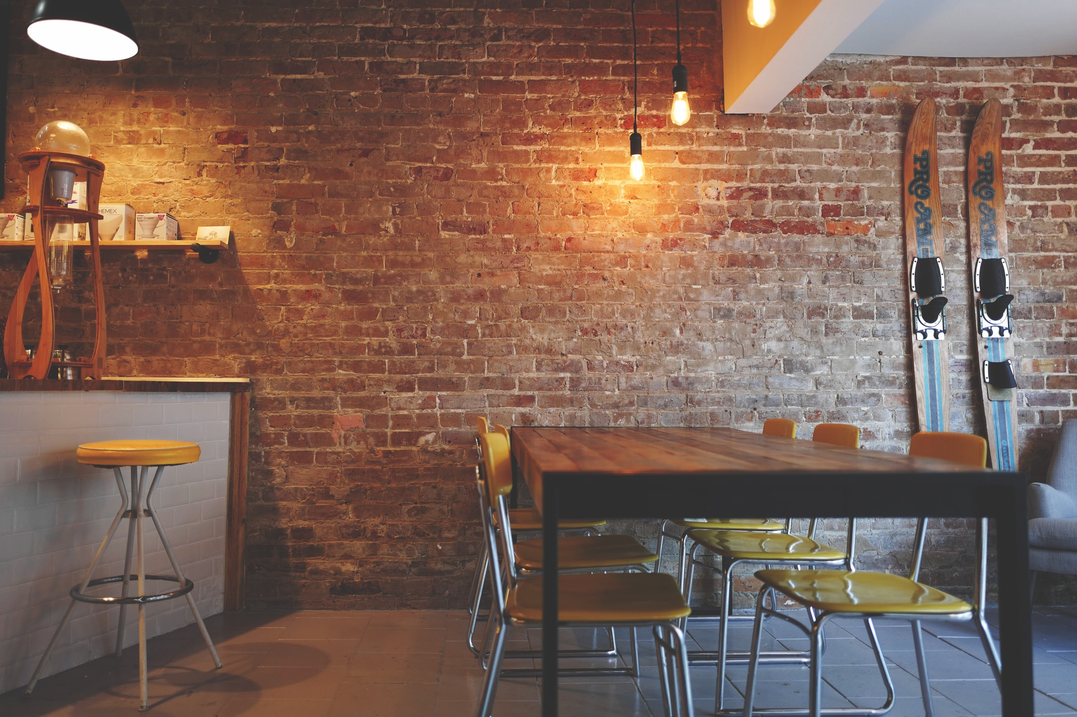
study spots
Alexander Davidson
Oliver Hubbard
Rashi ghosh
Hunter lowery
Notes:
(Zander - 15 sec)

Slide 2
PRESENTATION OUTLINE
1. Problem
2. Objective
3. Demo
4. Design
5. Testing
6. Reflections
Notes:
(Zander - 15 sec)

Slide 3
PROBLEM
Hard to find consistently available locations for studying
Most students seek places other than their dorms or apartments to complete their work
Locations for studying reach capacity at crucial periods during semester, like midterms and finals
Very limited options for students to complete their work efficiently
Notes:
(Hunter – 45 sec)

Slide 4
OBJECTIVE
Create an application that will aid students in finding a place to study, based on how crowded the location is at certain times.
Addresses some of the shortcomings of existing venue locating services offered by Yelp and Google, and optimize student performance while promoting local businesses.
Notes:
(Hunter – 30 sec)

Slide 5
BACKGROUND implementation key concepts
Organization
GitHub
Trello
Teams
Application
React front end
Redux state container
Google Firebase/Firestore
Heroku hosting
Other Services
Google Places API
Popular Times
Notes:
(Oliver – 45 sec)

Slide 6
DEMO.
Notes:
*3 mins!
1. Land into spotlight page as guest
- show key features of Spotlight, show filter, click spot to show
2. Create an account on Sign Up page
3. Go back to Spotlight, save/remove a few Spots
4. Go to My Spots page, click on card to redirect to Spot Page
5. In Spot Page: - show ratings (CRU) and comments (CRUD)

Slide 7
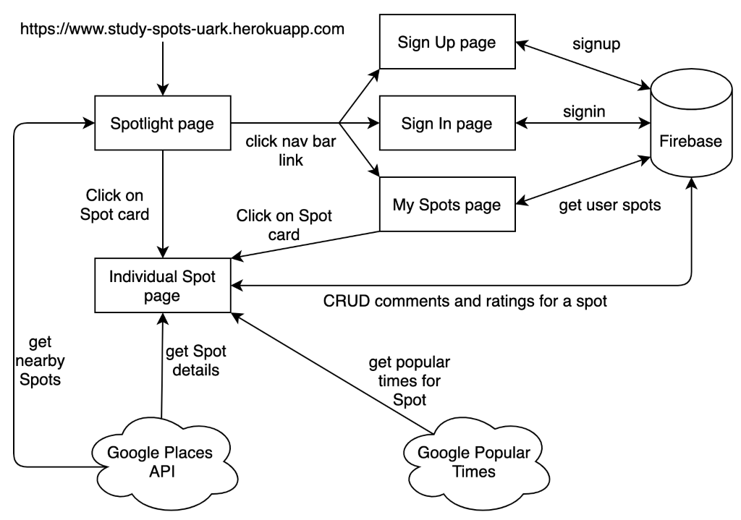
DESIGN high level architecture
Notes:
(Zander – 1 min)
- React is used to write front end components for the app
- Components call Redux actions for data retrieval and updates
- Redux actions make requests to Firebase/Firestore to signup/signin users, and CRUD data for ratings/comments
- Redux actions also make requests to APIs

Slide 8
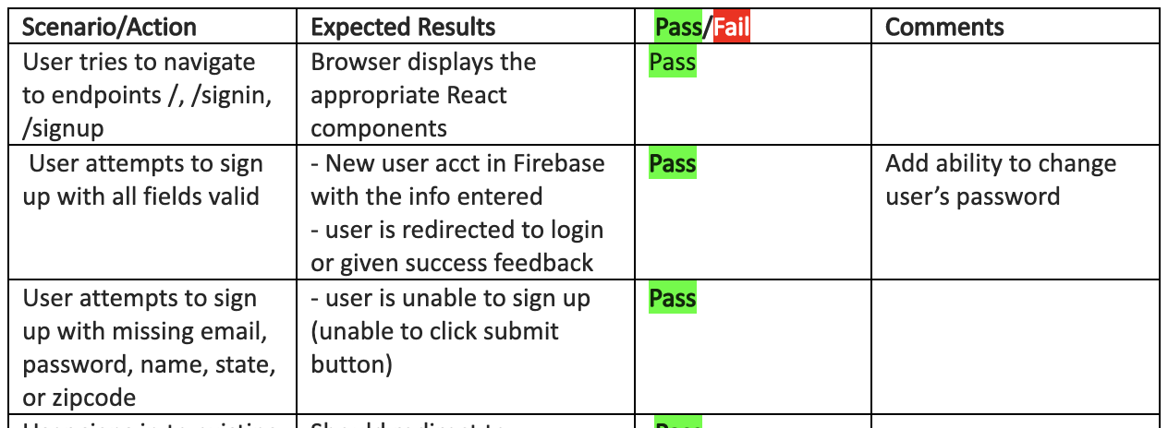
TESTING
Local testing before pull requests
Integration testing between pull requests
Front end testing after feature implementation:
Notes:
(Oliver – 45 sec)

Slide 9
CONCLUSION
Architecture
Separation between React/Redux very effective for team development
Redux became complex, dedicated backend server may have been better
Schedule
Spotlight page development caused delays
Fell behind by 2-3 weeks
Result: no mobile app, less time for testing
Future Improvements
Change email/password
User preferences
Google Maps
Overall: Success!
All original requirements and use cases implemented
Final product: https://study-spots-uark.herokuapp.com
Notes:
(Zander – 45 sec)

Slide 10
SOURCES
[1] Google Firebase, https://firebase.google.com/
[2] Google Maps, https://www.google.com/maps
[3] Google Places API, https://cloud.google.com/maps-platform/places
[4] Popular Times API, https://github.com/m-wrzr/populartimes
[5] React Native, https://reactnative.dev/
[6] Redux, https://redux.js.org/

