Slide 1
Machine Learning
Application of AI/Machine Learning to Biological Problems

Slide 2
What is machine learning?
We want to create predictive models for properties
If we have known, annotated training data: supervised learning
If not, we have to perform unsupervised learning
Models generally are parametric systems of equations
Parameters are tuned during training

Slide 3
What are challenges in machine learning?
Availability of training data (e.g. only a few data points are known)
Input data is often messy: missing data, incorrect data (e.g. wrong order of magnitude), irrelevant data
Models have many parameters, often more parameters than data points (this is particularly true for CNNs)
Overfitting to the training set is a serious concern

Slide 4
How does (supervised) machine learning work?
Classification: Yes?/No?, What category?, Multiple Categories?
Regression: Predict a target value
We iteratively change our parameters and accept better (more predictive) models
We need a measure for the quality of our model
This measure is usually called a loss function

Slide 5
A simple ML model
Celestial Body
<Threshold
>Threshold
Moon
Planet

Slide 6
Loss Functions
Classification
Balanced Accuracy
True positive rate
Sensitivity
etc…
Regression
Mean unsigned error (MUE)
Mean squared error
etc…

Slide 7
Optimization
Generally, we have a high-dimensional plane (dimension equal to number of parameters + 1) that represents the value loss function at each set of parameters
We want to find the parameters that minimize the loss function
Usual numerical optimization strategies, e.g. steepest descent, conjugate gradient, etc…

Slide 8
Hyperparameters
Hyperparameters describe your model, whereas parameters live within a model
E.g. different kernel functions, different cutoffs, etc…
Can also be systematically optimized, but each attempt needs a full training session of the underlying model, so computationally expensive
The choice of model and its hyperparameters are key to get best performance
Some models are better for specific conditions, e.g. sparse data, binary vs multi-class classification etc…

Slide 9
Machine Learning
Today’s Problems

Slide 10
Scikit-Learn
Scikit-Learn (sklearn) implements many machine learning models
Supervised Learning
Unsupervised Learning
Classification
Regression

Slide 11
Predicting Molecular Properties
Useful for lead optimization, identification of drug compounds, toxicity etc.
We are going to try to predict CNS permeability and logP for molecules
We will use molecular descriptors as an input

Slide 12
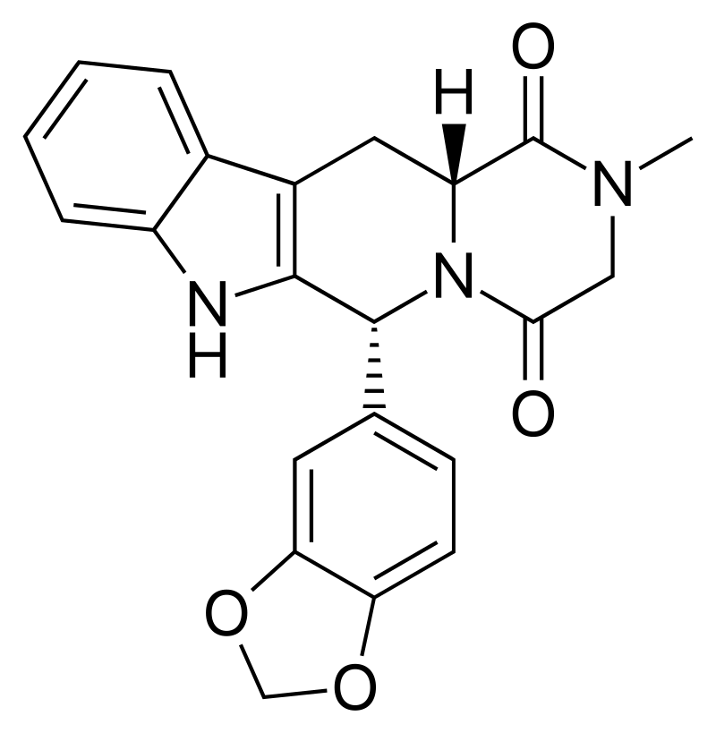
What are molecular descriptors?

Slide 13
Machine Learning
Code at: https://github.com/rghuber/ml_class

