Slide 1
Conversation AI

Slide 2

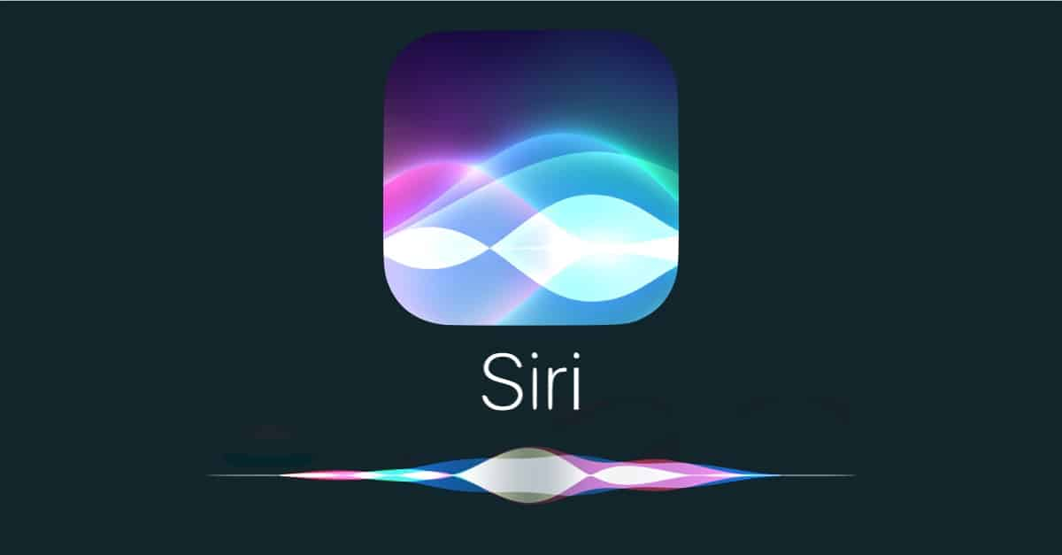
聊天機器人種類
social chatbot
Conversation AI
Information consumption
e.g. 今天天氣如何?
Task oriented chatbot
Task Completion
e.g. 幫我訂下午兩點的電影票
Decision support
e.g. 你覺得這家餐廳好吃嗎?

Slide 3
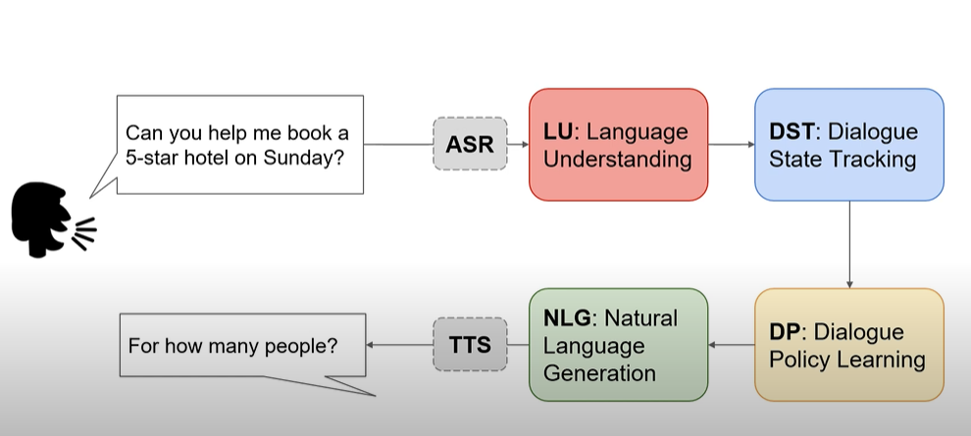
Task oriented chatbot

Slide 4
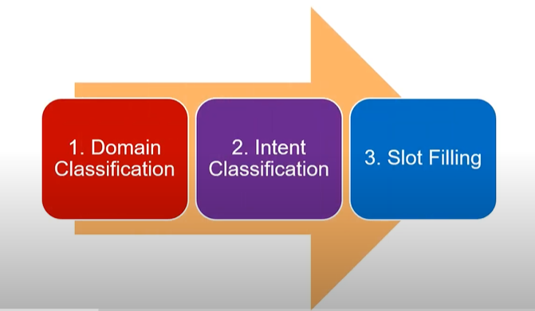
NLU Pipeline

Slide 5

NLU Pipeline
Find a good eating place for taiwanese food
Domain Classification
Movie DB
Food DB
Taxi DB
意圖分類
Find Restaurant
Find
Price
Find Type

Slide 6
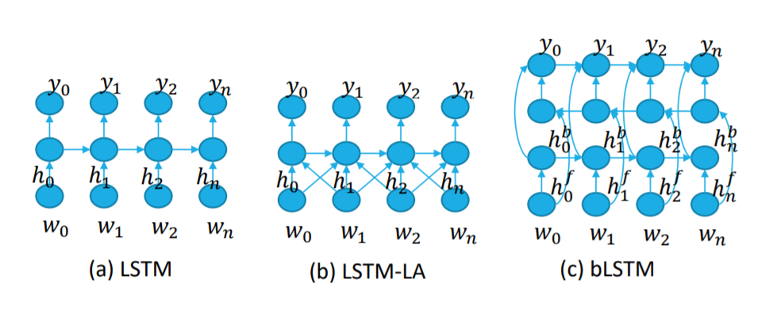
NLU Pipeline
Restaurant | Rating | Type
restaurant1 | good | Taiwanese
restaurant2 | bad | Thai
O O Rating O O O Type O
Find a good eating place for taiwanese food
Domain Classification
Movie DB
Food DB
Taxi DB
意圖分類
Find Restaurant
Find
Price
Find Type

Slide 7

DST(Dialogue State Tracking)
DST就是根據過去的對話紀錄去推估當下的狀態
How can I help you?
slot | Value
people | 5(0.5)
time | 5(0.5)
Book a table at Sumiko for 5
How many people?
slot | Value
people | 3(0.8)
time | 5(0.5)
3

Slide 8
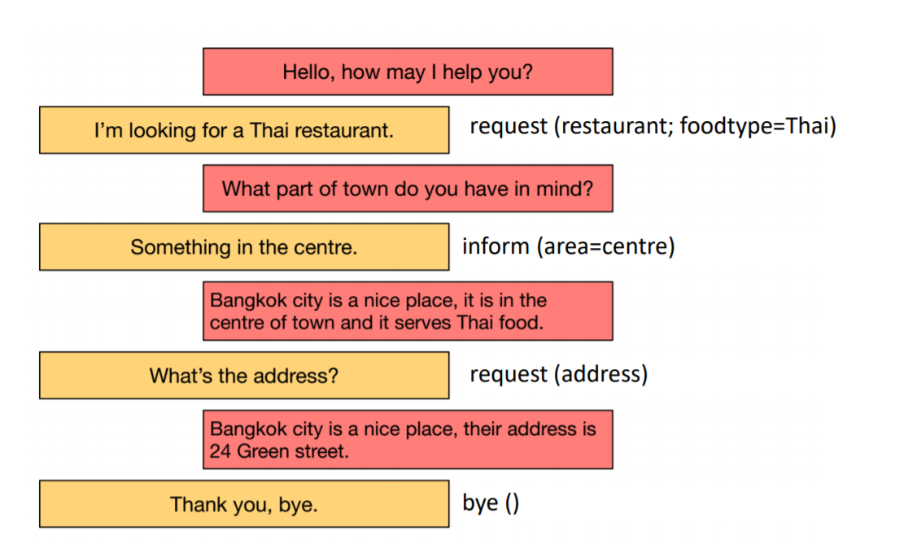
DP(Dialogue Policy Learning)

Slide 9
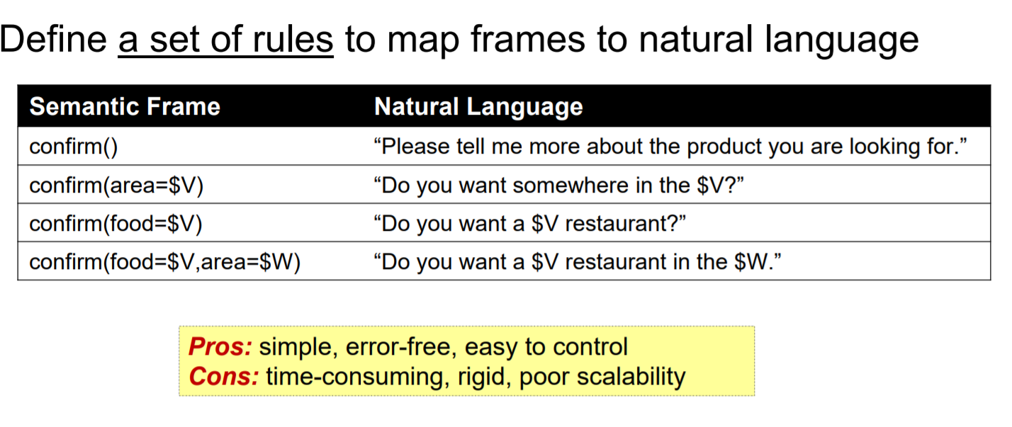
NLG-template

Slide 10
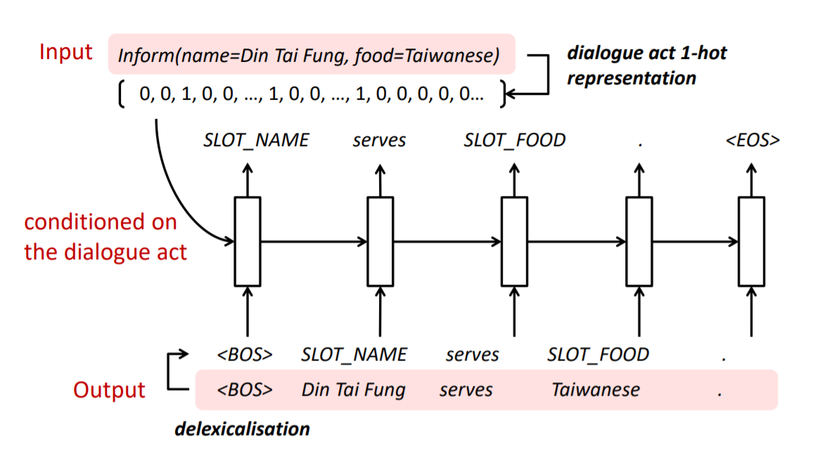
NLG-model

Slide 11
Task oriented chatbot
但是訓練整個流程會需要大量的標註資料

Slide 12
需要用戶模擬器(User simulator)的原因
缺乏數據
有些行為訓練資料沒有收集到
和真實用戶交互成本很高
數據收集時間很長
用戶模擬器分成以下幾種類型
Agent based
Seq2Seq based
Reinforcement learning based

Slide 13
User Goal
假設今天的任務是要幫顧客訂電影票
在任務導向的聊天機器人的設定中，第一步就是去定義使用者的目標
Inform slot: 用來限制使用者對話可以在一定範圍內的鍵值對
{date : tomorrow, moviename: risen, numberofpeople:2, theater: regency commerce 14}
Request slot: 使用者不知道，需要和機器人(Agent)互動來得到答案
{ticket: UNK, starttime: UNK}
為了讓整個任務擬真，
強制每個人的目標都是買電影票

Slide 14
Intent
為對話語句設定了11種意圖
Request
Inform
Confirm question
Confirm answer
Greeting
Closing
Mutliple choices
Thanks
Welcome
Deny
Not Sure

Slide 15
模擬開始
第一輪對話
在電影的對話任務中使用者會是說第一句話的那一方
隨機抽取一個使用者的目標
第一輪使用者要問的問題
goal: {
'request_slots': {'ticket': 'UNK’},
'diaact': 'request’,
'inform_slots’:
{'city': 'seattle’,
'numberofpeople': '2’,
'theater': 'regal meridian 16’,
'starttime': '9:00 pm’,
'date': 'tomorrow’,
'moviename': 'spotlight’}
}
sample_action:
{'diaact': 'request’,
'inform_slots’:
{'city': 'seattle', 'moviename': 'spotlight’},
'request_slots': {'ticket': 'UNK’},
'turn’: 1,
}
訂一張票

Slide 16
產生使用者對話
預設樣板
sample_action:
{'diaact': 'request’,
'inform_slots’:
{'city': 'seattle', 'moviename': 'spotlight’},
'request_slots': {'ticket': 'UNK’},
'turn’: 1
'nl': "b'Can I buy tickets for spotlight at seattle?'
}
sample_action:
{'diaact': 'request’,
'inform_slots’:
{'city': 'seattle', 'moviename': 'spotlight’},
'request_slots': {'ticket': 'UNK’},
'turn’: 1
}
NLG Model
預設樣板
{
"request_slots": [],
"nl": {
"agt": "$moviename$ is available.",
"usr": "I want to watch $moviename$."
},
"inform_slots": [
"moviename"
]
},

Slide 17
基於規則的Agent回復方式
Usr: Can I buy tickets for spotlight at seattle
moviename
{'turn': 1, 'speaker': 'agent', 'diaact': 'request', 'inform_slots': {}, 'request_slots': {'moviename': 'UNK'}}
Agt: What movie are you interested in?
Usr: I want to watch spotlight.
starttime
Agt: What time would you like to see it?
Usr: I want to watch at 9:00 pm.
city
Agt: Which city would you like?
Usr: I want to watch at seattle.
date
Agt: What date would you like to watch it?
Usr: I want to set it up tomorrow
theater
Agt: Which theater would you like?
Usr: I want to watch at regal meridian 16.
numberofpeople
Agt: How many tickets do you need?
Usr: I want 2 tickets please!

Slide 18
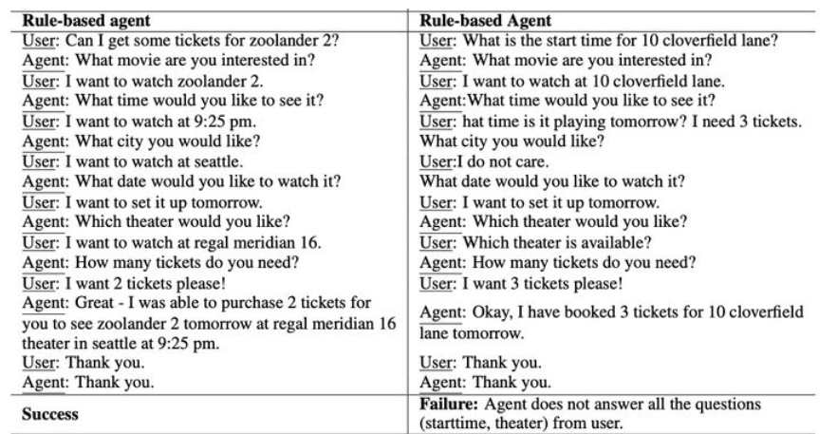
評估用戶模擬器質量方法
Success Rate
Average Reward
Average turns
一個好的用戶模擬應該會有較高的任務成功率、較高的平均獎勵以及較低的平均輪數

