Slide 1
8086 & Z80 µP
Lec note 2

Slide 2
Outline
Microprocessors
History
Data width
8086 vs 8088
8086 pin description
Z80 Pin description

Slide 3
Microprocessors
Microprocessors come in all kinds of varieties from the very simple to the very complex
Depend on data bus and register and ALU width µP could be 4-bit , 8-bit , 16-bit, 32-bit , 64-bit
We will discuss two sample of it
  Z80 as an 8-bit µP
  and 8086/88 as an 16-bit µP
All µPs have
  Address bus
  Data bus
  Control Signals: RD, WR, CLK , RST, INT, . . .

Slide 4
History
Bus width Company | 4 bit | 8 bit | 16 bit | 32 bit | 64 bit
intel | 4004 4040 | 8008 8080 8085 | 8088/6 80186 80286 | 80386 80486 | 80860 pentium
zilog |  | Z80 | Z8000 Z8001 Z8002
Motorola |  | 6800 6802 6809 | 68006 68008 68010 | 68020 68030 68040

Slide 5
Internal and External Bus
Internal bus is a pathway for data transfer between registers and ALU in the µPs
External bus is available externally to connect to RAM, ROM and I/O
Int. and Ext. Bus width may be different
For example
  In 8088 Int. Bus is 16-bit , Ext. bus is 8-bit
  In 8086 Int. Bus is 16-bit , Ext. bus is 16-bit
Notes:
Data Width is the width of the ALU. An 8-bit ALU can add/subtract/multiply/etc. two 8-bit numbers, while a 32-bit ALU can manipulate 32-bit numbers. An 8-bit ALU would have to execute four instructions to add two 32-bit numbers, while a 32-bit ALU can do it in one instruction. In many cases, the external data bus is the same width as the ALU, but not always. The 8088 had a 16-bit ALU and an 8-bit bus, while the modern Pentiums fetch data 64 bits at a time for their 32-bit ALUs.

Slide 6
8086 vs 8088
Only external bus of 8088 is 8_bit
8_bit Data Bus
20_bit Address
16_bit Data Bus
20_bit Address
8086
8088

Slide 7
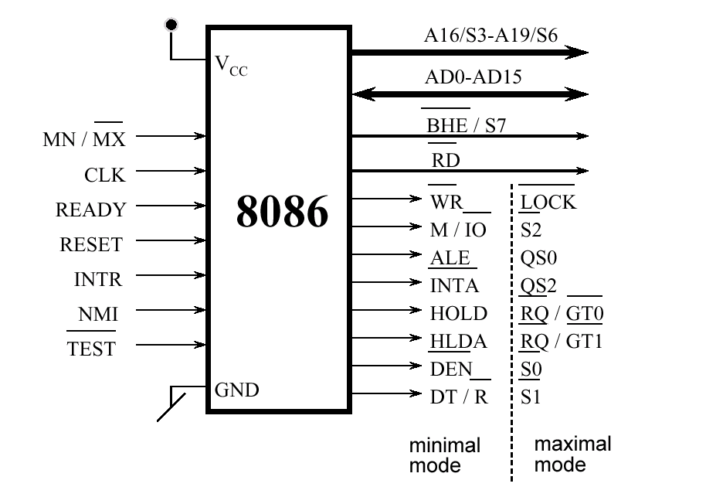
8086 Pin Assignment

Slide 8
8086 Pin Description
Vcc (pin 40) : Power
Gnd (pin 1 and 20) : Ground
AD0..AD7 , A8..A15 , A19/S6, A18/S5, A17/S4, A16/S3 : 20 -bit Address Bus
MN/MX’ (input) : Indicates Operating mode
READY (input , Active High) : take µP to wait state
CLK (input) : Provides basic timing for the processor
RESET (input, Active High) : At least 4 clock cycles Causes the µP immediately
terminate its present activity.
TEST’ (input , Active Low) : Connect this to HIGH
HOLD (input , Active High) : Connect this to LOW (BR)
HLDA (output , Active High) : Hold Ack (BG)
INTR (input , Active High) : Interrupt request
INTA’ (output , Active Low) : Interrupt Acknowledge
NMI (input , Active High) : Non-maskable interrupt

Slide 9
8086 Pin Description
DEN’ (output) : Data Enable. It is LOW when processor wants to
receive data or processor is giving out data (to74245)
DT/R’ (output) : Data Transmit/Receive.
When High, data from µP to memory
  When Low, data is from memory to µP (to74245 dir)
IO/M’ (output) : If High µP access I/O Device.
If Low µP access memory
RD’ (output) : When Low, µP is performing a read operation
WR’ (output) : When Low, µP is performing a write operation
ALE (output) : Address Latch Enable , Active High
Provided by µP to latch address
When HIGH, µP is using AD0..AD7, A19/S6,
A18/S5, A17/S4, A16/S3 as address lines

Slide 10
Z80 CPU Pin Assignment

Slide 11
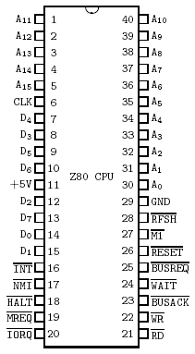
Z80 Pin Description
A15-A0 :
Address bus (output, active high, 3-state).
Used for accessing the memory and I/O ports
During the refresh cycle the I is put on this bus.
D7-D0 :
Data Bus (input/output, active high, 3-state). Used for data exchanges with memory, I/O and interrupts.
RD:
Read (output, active Low, 3-state) indicates that the CPU wants to read data from memory or I/O
WR:
Write (output, active Low, 3-state) indicates that the CPU data bus holds valid data to be stored at the addressed memory or I/O location.

Slide 12
Z80 Pin Description
MREQ
Memory Request (output, active Low, 3-state). Indicates memory read/write operation. See M1
IORQ
Input/Output Request(output,active Low,3-state) Indicates I/O read/write operation. See M1
M1
Machine Cycle One (output, active Low).
Together with MREQ indicates opcode fetch cycle Together with IORQ indicates an Int Ack cycle
RFSH
Refresh (output, active Low).
Together with MREQ indicates refresh cycle.
Lower 7-bits address is refresh address to DRAM

Slide 13
Z80 Pin Description
INT’
  Interrupt Request (input, active Low).
  generated by I/O devices.
  Checked at the end of current instruction
  If flip-flop (IFF) is enabled.
NMI’
  Non-Maskable Interrupt
  (Input, negative edge-triggered).
  Checked at the end of current Instruction
  Higher priority than INT.
  Independent from IFF Status
  Forces CPU restart at 0066H.

Slide 14
Z80 Pin Description
BUSREQ’
  Bus Request (input, active Low).
  higher priority than NMI
  recognized at the end of current machine cycle
  forces the CPU address bus, data bus, and
  MREQ, IORQ, RD, and WR to high-imp.
BUSACK’
  Bus Acknowledge (output, active Low)
  indicates to the requesting device that
  address, data, and control signals
  have entered their high-impedance states.

Slide 15
Z80 Pin Description
RESET’
  Reset (input, active Low).
  Must be active for three clock cycles
  Initializes the CPU as follows:
    Resets the IFF
    Clears the PC and I and R
    Sets the interrupt to Mode 0
  During reset time:
    address and data go high-impedance
    all control (out) signals go inactive state

Slide 16
Z80 CPU

Slide 17
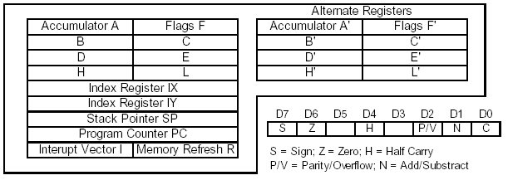
Z80 Programming Model

Slide 18
Register Set
A : Accumulator Register
F : Flag register
Two sets of six general-purpose registers
  may be used as 8-bit A F B C D E H L (A’ F’ B’ C’ D’ E’ H’ L’)
  or in pairs as 16-bit AF BC DE HL (AF’ BC’ DE’ HL’)
The Alternative registers (A’ F’ B’ C’ D’ E’ H’ L’) not visible to the programmer but can access via:
  EXX (BC)<->(BC') , (DE)<->(DE') , (HL)<->(HL')
  EX AF, AF ’ (AF)<->(AF')
  what is this instruction useful for?

Slide 19
Register Set(cont)
4 (16-bit) registers hold memory address (pointers)
  index registers (IX) and (IY) are 16-bit memory pointers
  16 bit stack pointer (SP)
  Program counter (PC)
Program counter (PC)
  PC points to the next opcode to be fetched from ROM
  when the µP places an address on the address bus to fetch the byte from memory, it then increments the program counter by one to the next location
Special purpose registers
  I : Interrupt vector register.
  R : memory Refresh register

Slide 20
Flag Register
S Sign Flag (1:negativ)*
Z Zero Flag (1:Zero)
H Half Carry Flag (1: Carry from Bit 3 to Bit 4)**
P Parity Flag (1: Even)
V Overflow Flag (1:Overflow)*
N Operation Flag (1:previous Operation was subtraction)**
C Carry Flag (1: Carry from Bit n-1 to Bit n,
with n length of operand)
*: 2-complement number representation
**: used in DAA-operation for BCD-arithmetic

Slide 21
DAA - Decimal Adjust Accumulator
Adjusts the content of the Accumulator A for BCD addition and subtraction
operations such as ADD, ADC, SUB, SBC, and NEG according to the table:
 | before DAA |  |  |  |  | after DAA
Op | N | C | Bits 4-7 | H | Bits 0-3 | A=A+.. | C
ADD ADC | 0 | 0 | 0-9 | 0 | 0-9 | 00 | 0
 | 0 | 0 | 0-8 | 0 | A-F | 06 | 0
 | 0 | 0 | 0-9 | 1 | 0-3 | 06 | 0
 | 0 | 0 | A-F | 0 | 0-9 | 60 | 1
 | 0 | 0 | 9-F | 0 | A-F | 66 | 1
 | 0 | 0 | A-F | 1 | 0-3 | 66 | 1
 | 0 | 1 | 0-2 | 0 | 0-9 | 60 | 1
 | 0 | 1 | 0-2 | 0 | A-F | 66 | 1
 | 0 | 1 | 0-3 | 1 | 0-3 | 66 | 1
SUB SBC NEG | 1 | 0 | 0-9 | 0 | 0-9 | 00 | 0
 | 1 | 0 | 0-8 | 1 | 6-F | FA | 0
 | 1 | 1 | 7-F | 0 | 0-9 | A0 | 1
 | 1 | 1 | 6-F | 1 | 6-F | 9A | 1

Slide 22
Instruction cycles, machine cycles and “T-states”
Instruction cycle is the time taken to complete the execution of an instruction
Machine cycle is defined as the time required to complete one operation of accessing memory, accessing IO, etc.
T-state = 1/f (f:Z80 Clock Frequency)
  f= 4MHZ → T-state=0.25 uS

Slide 23
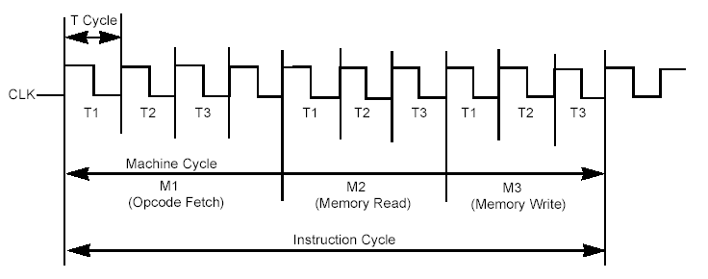
Basic CPU Timing Example

Slide 24
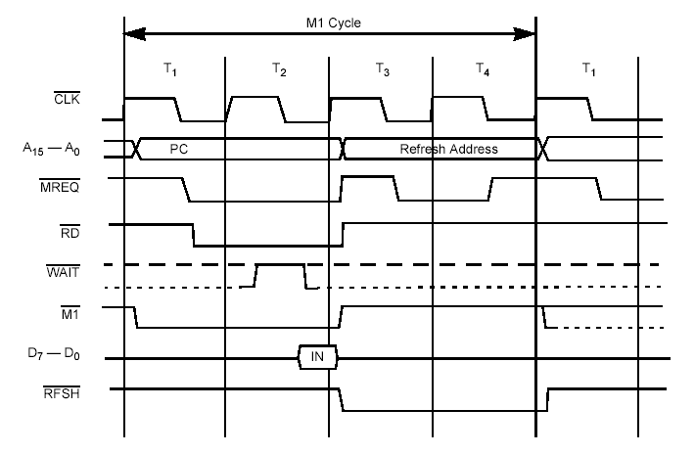
Opcode Fetch
Bus Timings (M1 Cycle)

Slide 25
The R register
Is increased at every first machine cycle (M1).
Bit 7 of it is never changed by this; only the lower 7 bits are included in the addition. So bit 7 stays the same
Bit 7 can be changed using the LD R,A instruction.
LD A,R a nd LD R,A access the R register after it is increased
R is often used in programs for a random value, which is good but of course not truly random.
the block instructions decrease the PC with two, so the instructions are re-executed.

Slide 26
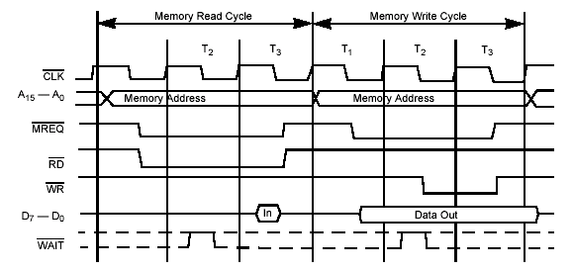
Memory read/write cycle

Slide 27
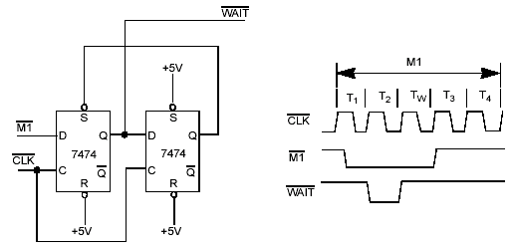
Adding One Wait State to an M1 Cycle

Slide 28
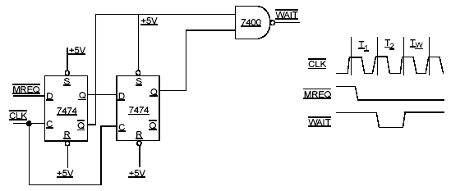
Adding One Wait State to Any Memory Cycle

Slide 29
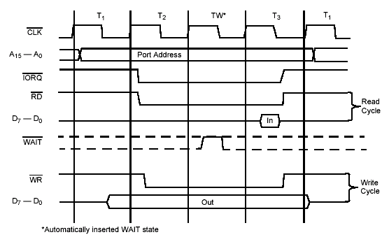
IO read/write cycle
During I/O operations a single wait state is automatically inserted

Slide 30
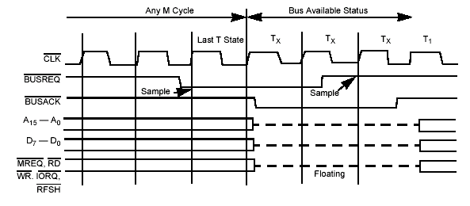
Bus Request/Acknowledge Cycle

Slide 31
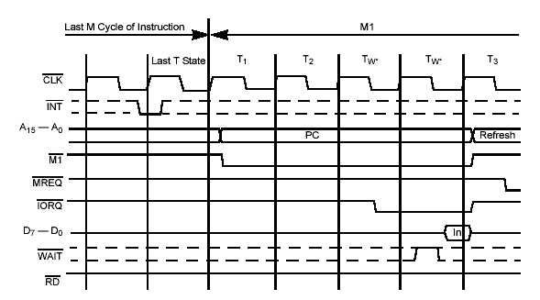
Interrupt Request/Acknowledge Cycle
Two wait states are automatically added to this cycle

Slide 32
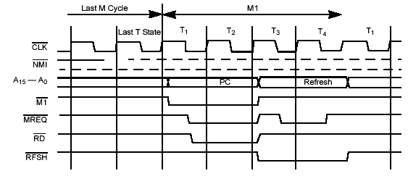
Non-Maskable Interrupt Request Operation

Slide 33
M1 Refresh Cycle
Takes 4T to 6Ts
Z80 includes built in circuitry for refreshing DRAM
This simplifies the external interfacing hardware
DRAM consists of MOS transistors, which store Information as capacitive charges; each cell needs to be periodically refreshed
During T3 and T4 (when Z80 is performing internal ops), the low order address is used to supply a 7-bit address for refresh

Slide 34
Wait Signal
the Z80 samples the wait signal during T2 if low then Z80 adds wait
states to extend the machine cycle
used to interface memories with slow response time
Slow memory is low cost

Slide 35
Interrupts
There are two types of interrupts:
non mask-able (NMI)
  Could not be masked
  Jump to 0066H of memory
mask-able(INT)
  Has 3 mode
  Can be set with the IM x Instruction
  IM 0 sets Interrupt mode 0
  IM 1 sets Interrupt mode 1
  IM 2 sets Interrupt mode 2

Slide 36
Interrupt Modes
Mode 0:
  An 8 bit opcode is Fetched from Data BUS and executed
  The source interrupt device must put 8 bit opcode at data bus
  8 bit opcode usually is RST p instructions
Mode 1:
  A jump is made to address 0038h
  No value is required at data bus
Mode 2:
  A jump is made to address (register I × 256 + value from interrupting device that puts at bus)
  I is high 8 bit of interrupt vector
  Value is low 8 bit of interrupt vector

Slide 37


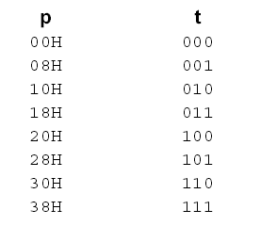
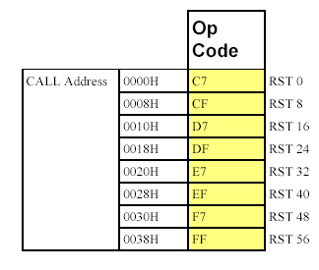

Slide 38
Z80 CPU Instruction Description
158 different instruction types
Including all 78 of the 8080A CPU.
Instruction groups
  Load and Exchange
  Block Transfer and Search
  Arithmetic and Logical
  Rotate and Shift
  Bit Manipulation (Set, Reset, Test)
  Jump, Call, and Return
  Input/Output
  Basic CPU Control

Slide 39
Addressing Modes
Immediate
Immediate Extended
Modified Page Zero Addressing (rst p)
Relative Addressing
  Jump Relative (2 byte)
    One Byte Op Code
    8-Bit Two’s Complement Displacement (A+2)
Extended Addressing
  Absolute jump
    One byte opcode
    2 byte address
Indexed Addressing
  (Index Register + Displacement) (IX+d)
  2 byte opcode
  1 byte displacement

Slide 40
Addressing Modes(cont.)
Register Addressing
  LD C,B
Implied Addressing
  Op Code implies other operand(s)
  ADD E
Register Indirect Addressing
  16-bit CPU register pair as pointer (such as HL)
  ADD (HL)
Bit Addressing
  set, reset, and test instructions.
  SET 3,A
  RES 7,B

