Slide 1


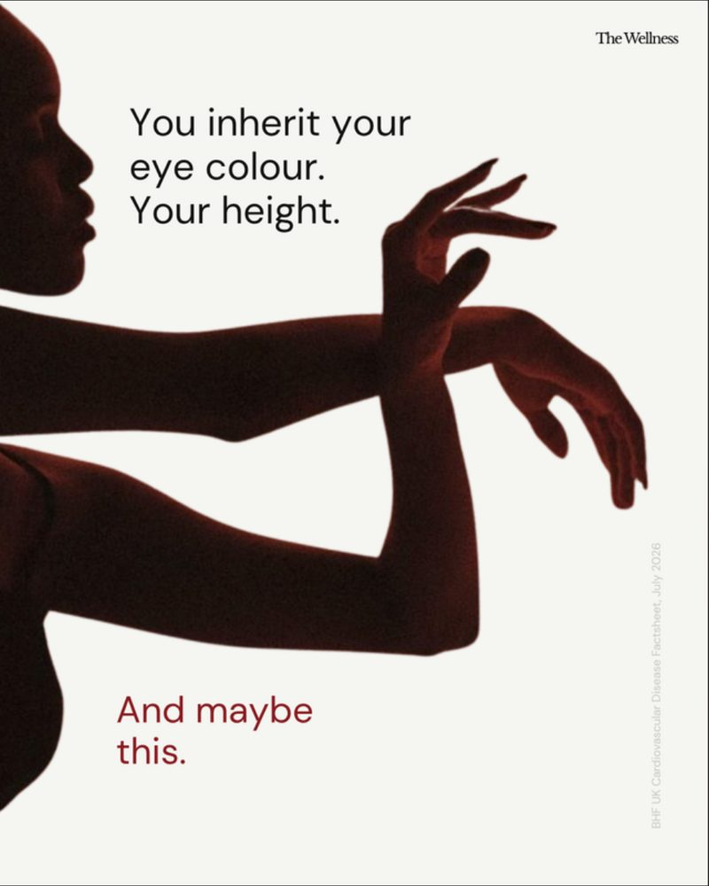
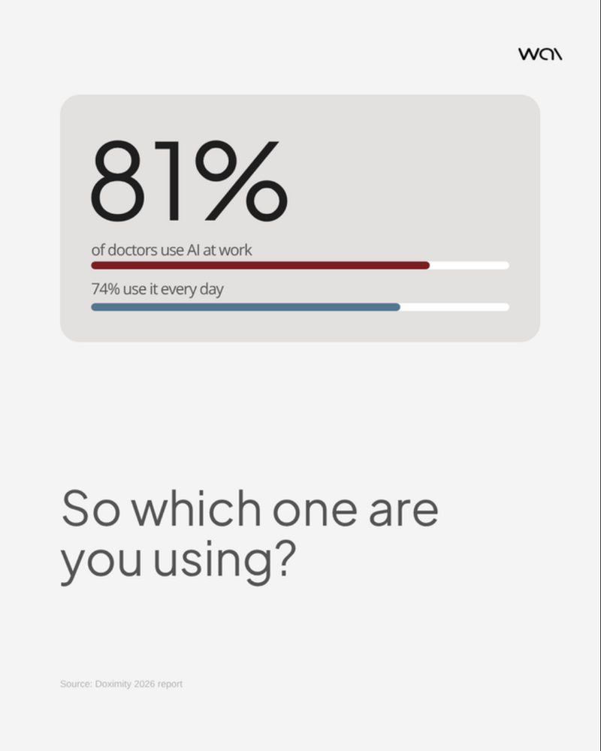
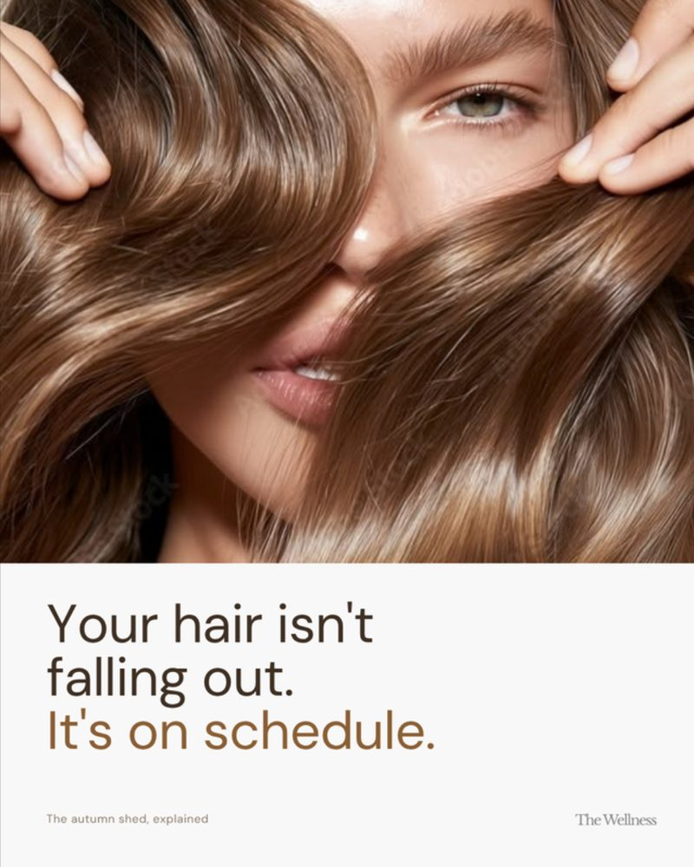
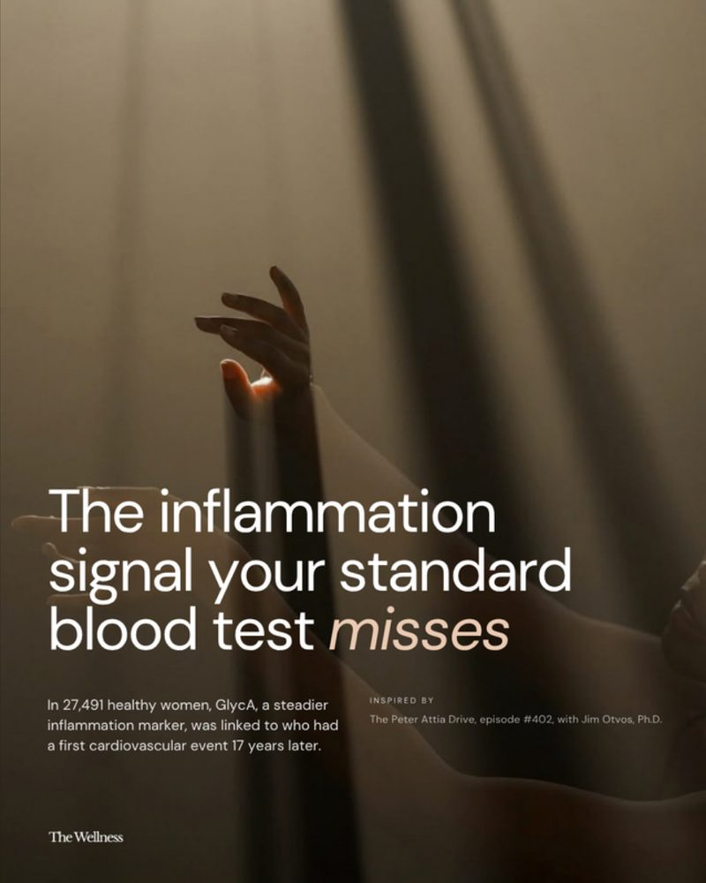
r
River Geoff
portfolio-26.canvas
Work
Motion
About
Get in touch
Social campaigns that hold a scroll.
Frame 01
Open to freelance work
I design social campaigns and brand systems for health and wellness companies. Most of my work turns clinical ideas into posts people stop for.
9 projects · 52 frames · 2 clients
RIVER GEOFF · PORTFOLIO '26 · DAVAO CITY, PHILIPPINES

Slide 2
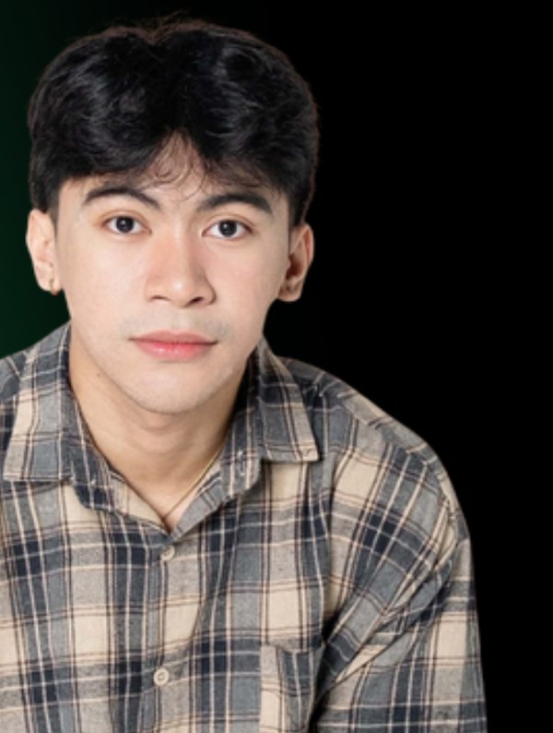
r
River Geoff
portfolio-26.canvas
Work
Motion
About
Get in touch
About
DETAILS · EDIT ME
I'm a designer who works best when the brief is clear and the audience is specific. Lately that has meant carousels for a private health clinic and launch content for a medical AI product.
I care about pacing: what the first frame promises, what each swipe adds, and where the reader lands. Good design doesn't shout. It flows, connects, and leaves something behind.
BASED IN
FOCUS
EDUCATION
AVAILABLE
Davao City, PH
Social carousels, brand identity
BS Psychology, Mapúa MCM
Remote · part-time
Experience
4 ROLES
Skills
2025 – now
Graphic designer
Social carousels
Brand identity
Layout & editorial
Freelance — The Wellness, Wai
Infographics
Motion & video editing
Mock-ups
Art direction
2023
Creative head
River Geoff
MaPsyA
Graphic designer · social & brand
2022
Creative committee
Get in touch
MMCM College of Arts & Sciences
Open to freelance work
hello@yourname.com
2020 – 2021
Layout artist
EMAIL
DAVAO CITY, PHILIPPINES
The Revolver
+63 900 000 0000
PHONE
TOOLS
INSTAGRAM
@yourhandle
Canva
Figma
Photoshop
Illustrator
Premiere Pro
CapCut
BEHANCE
behance.net/yourname

Slide 3
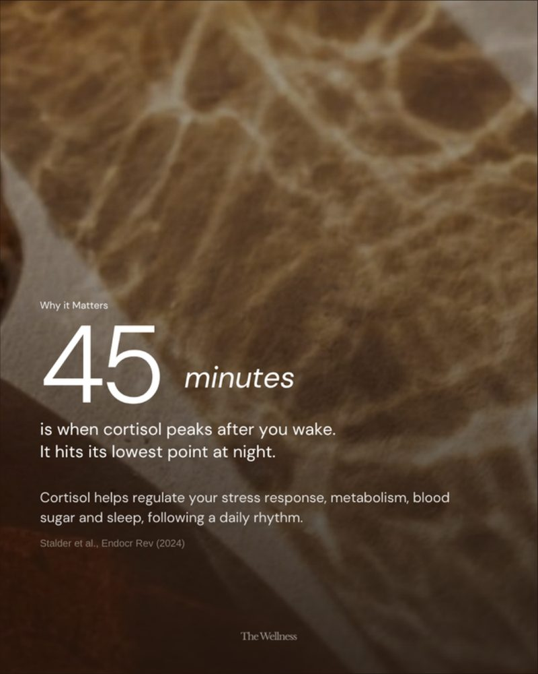
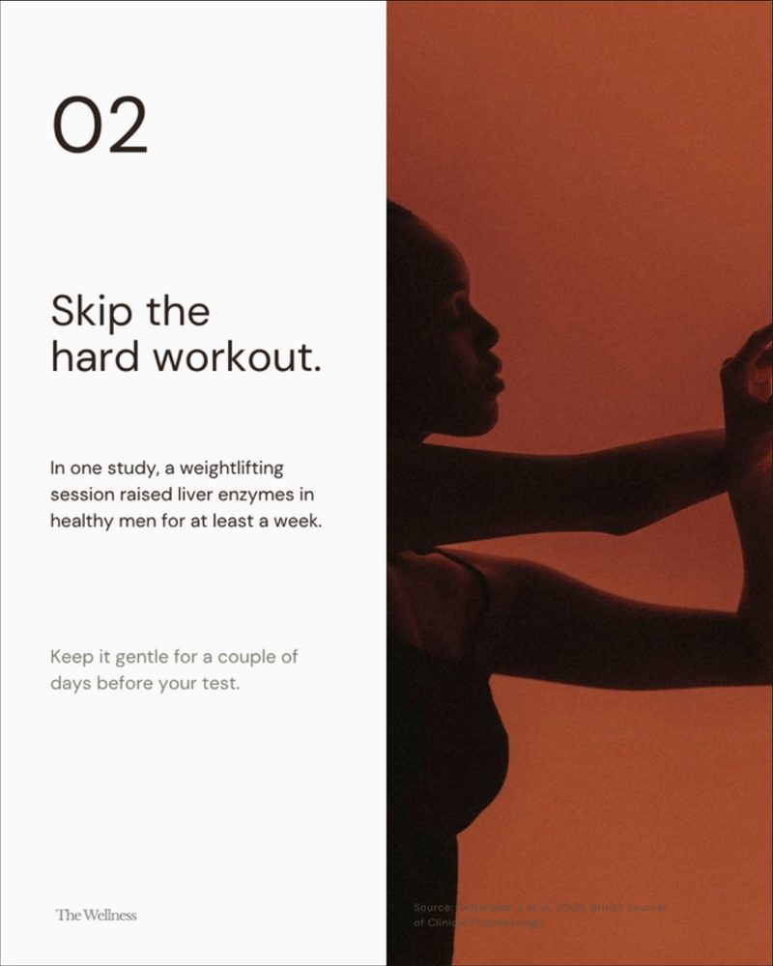
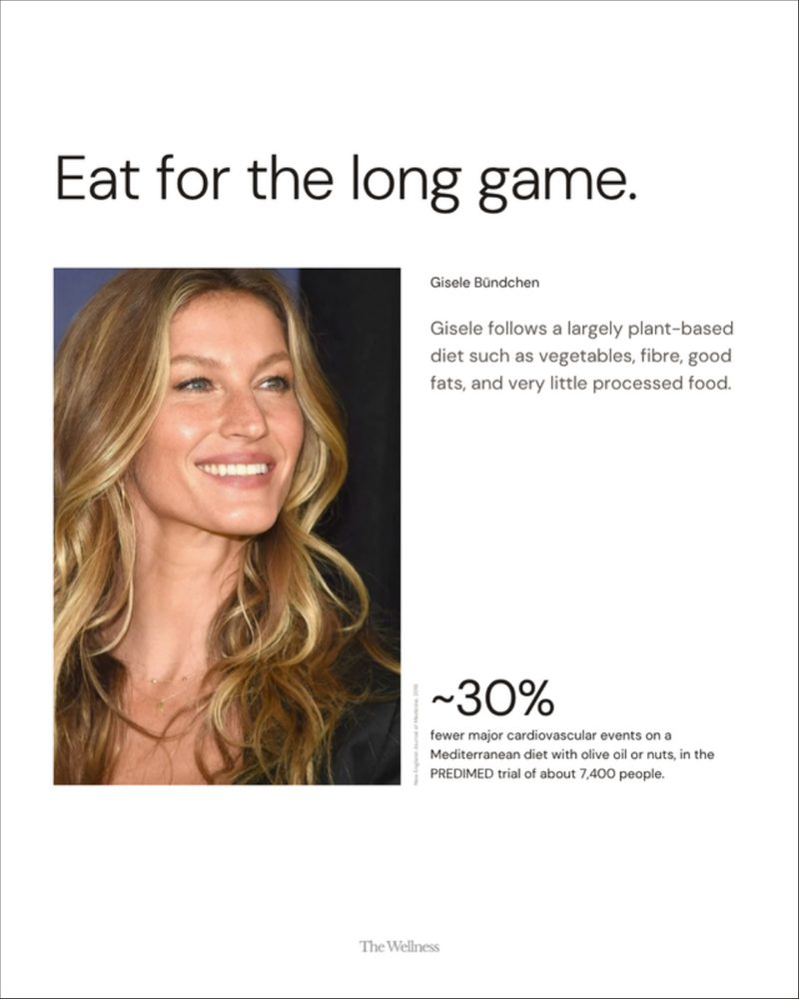
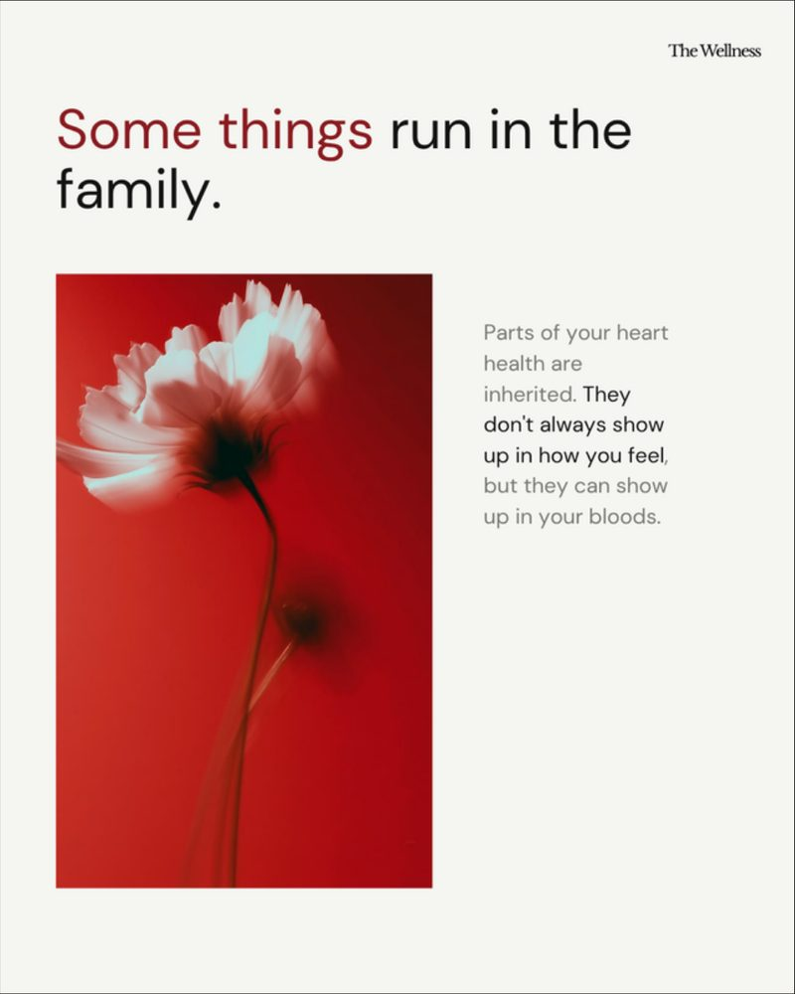
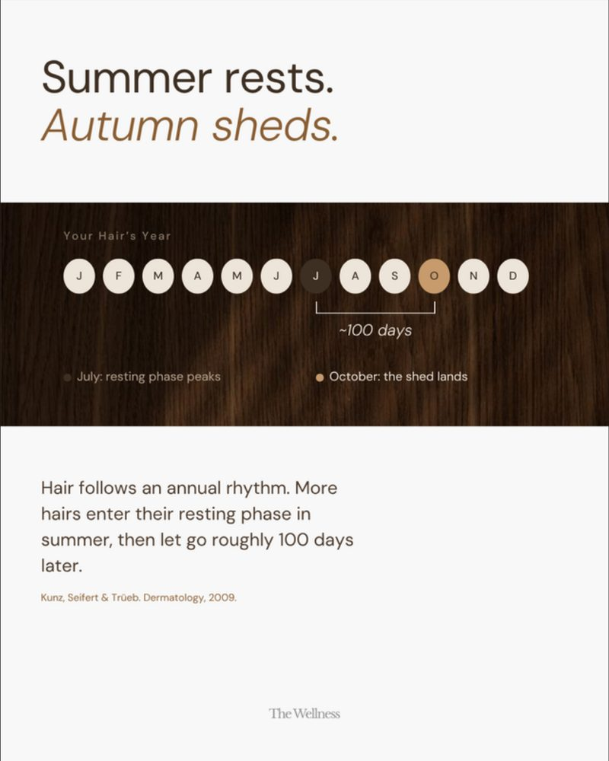
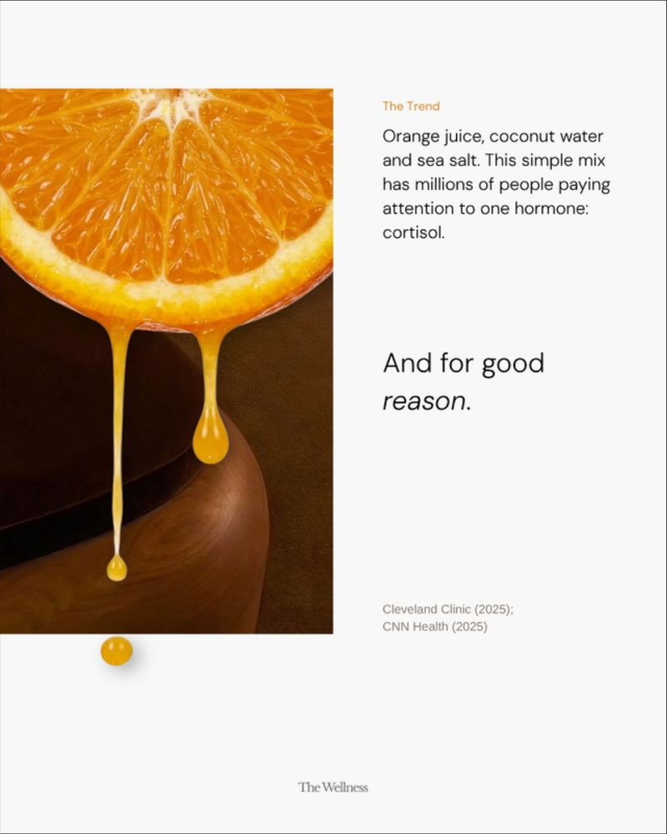
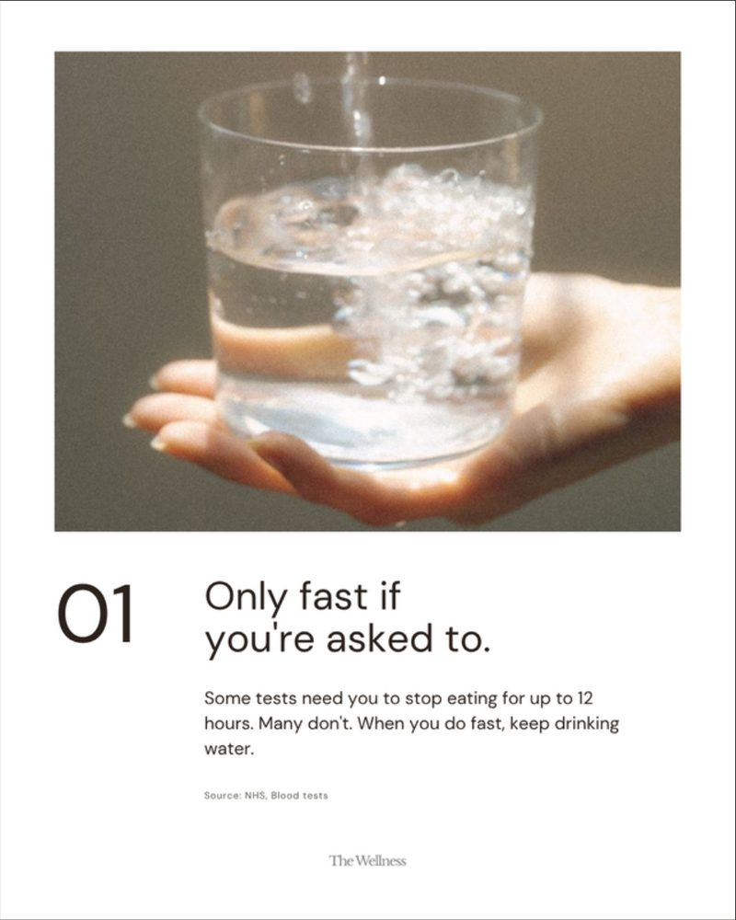
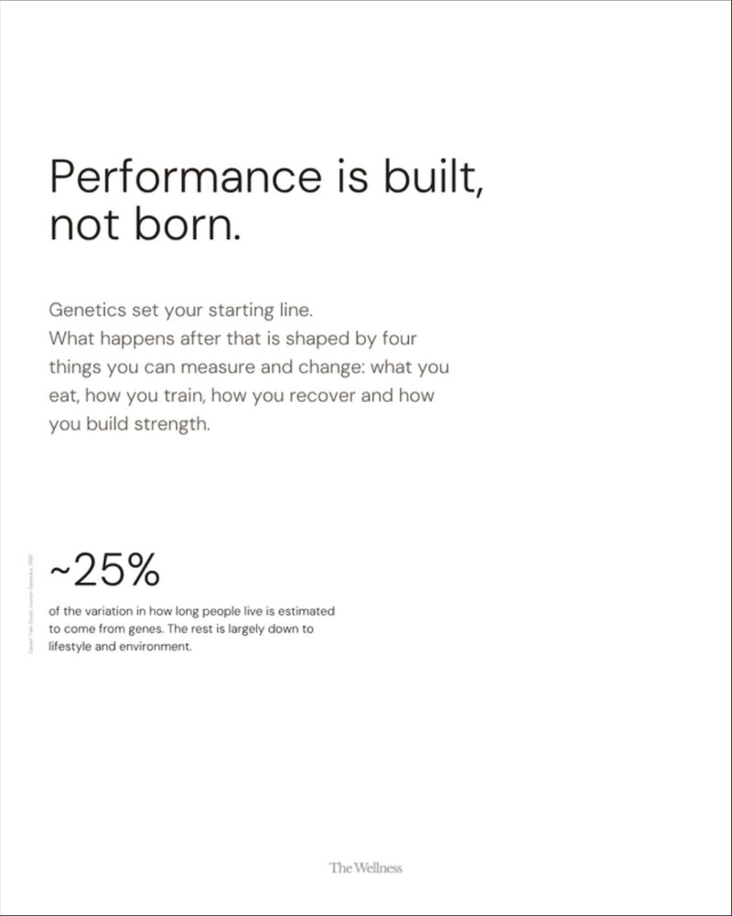
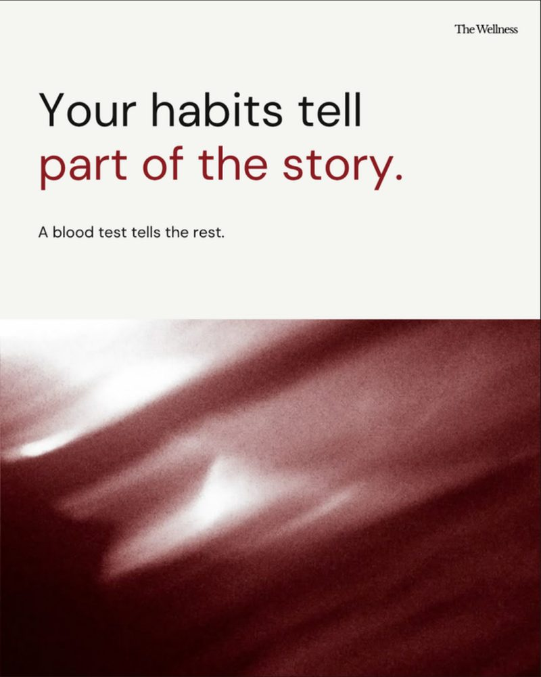


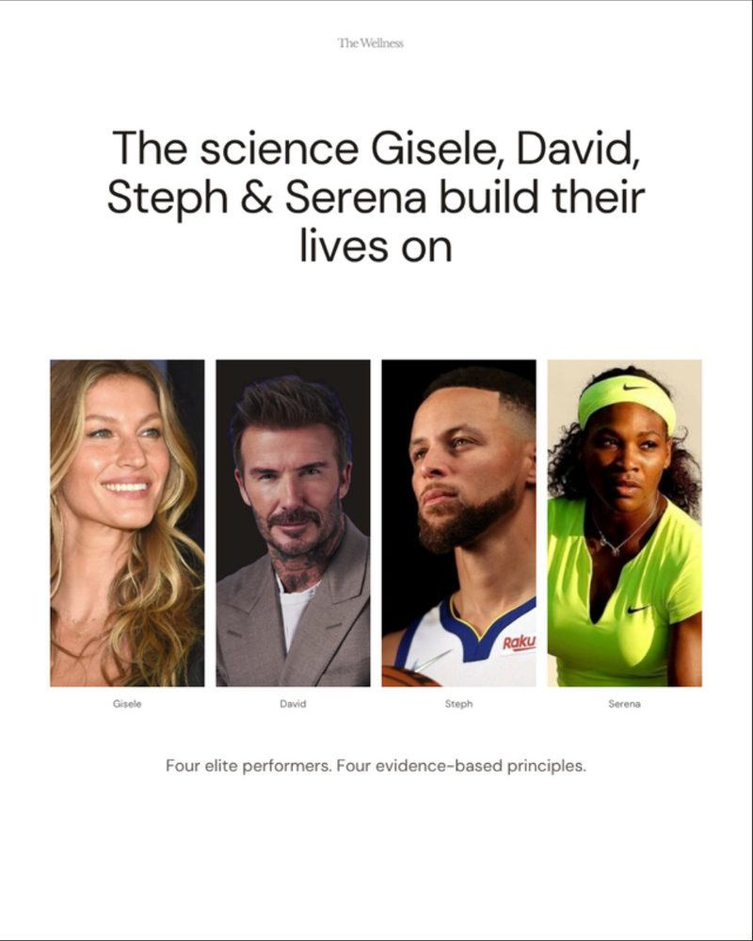
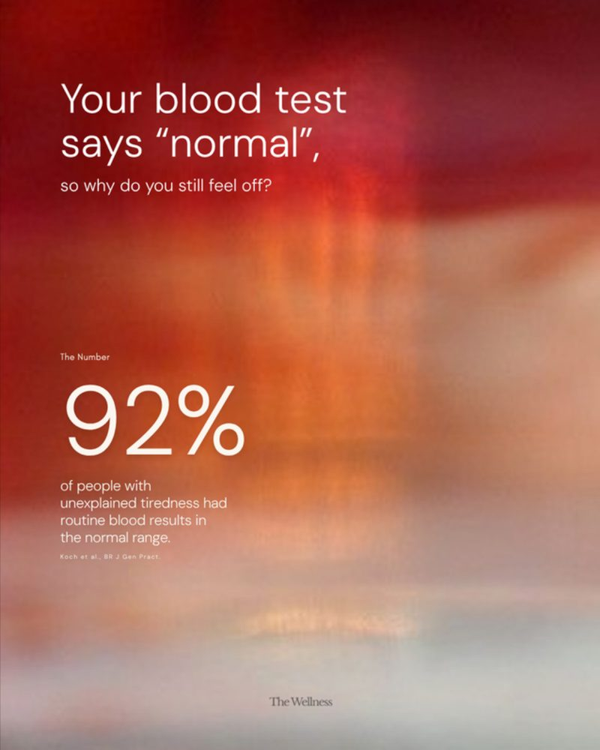
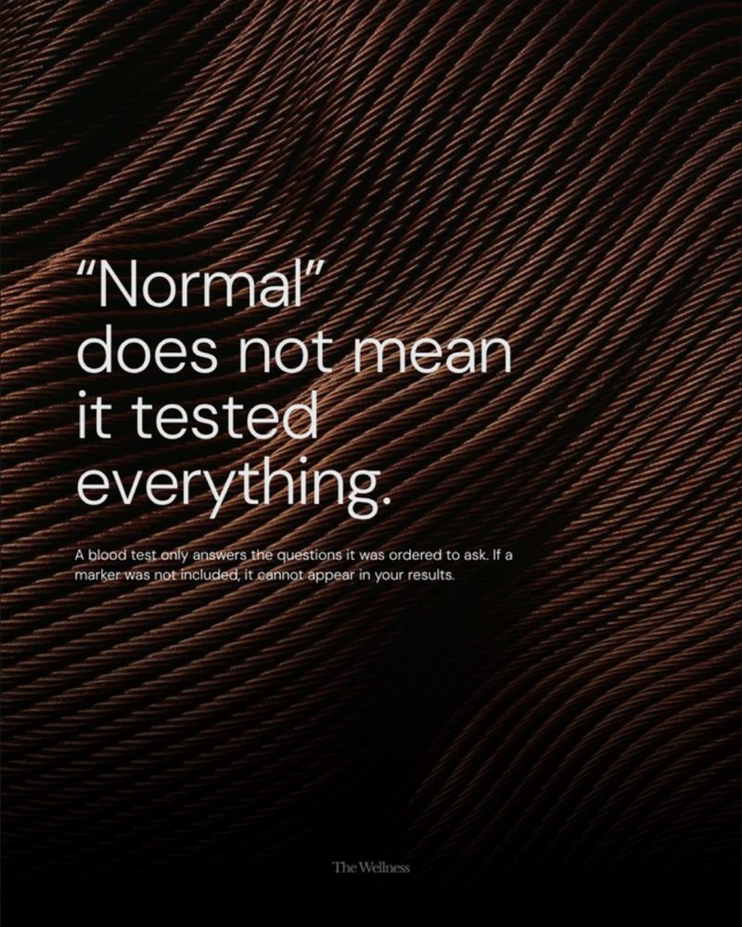
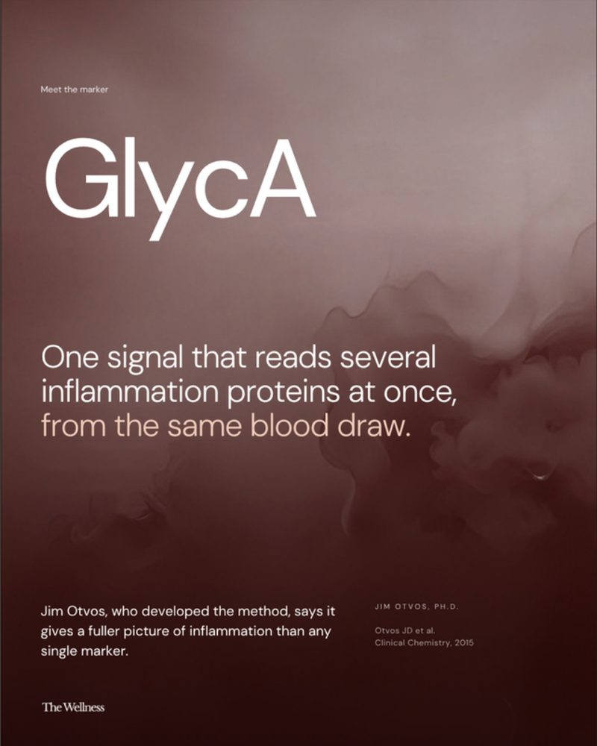
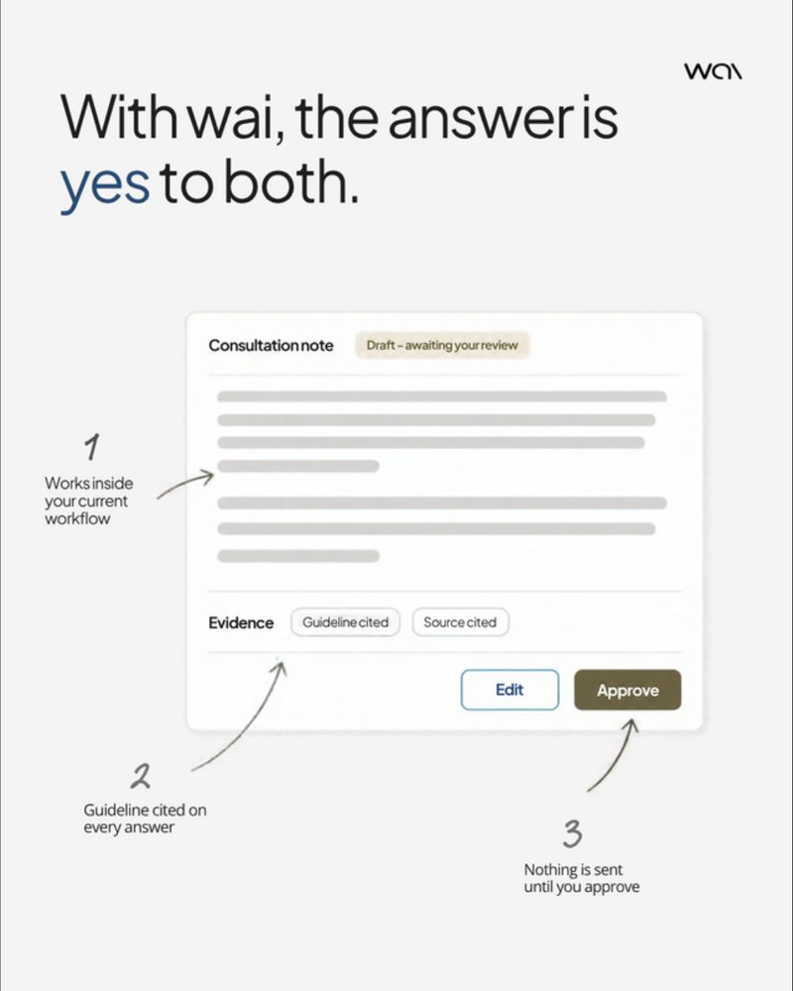
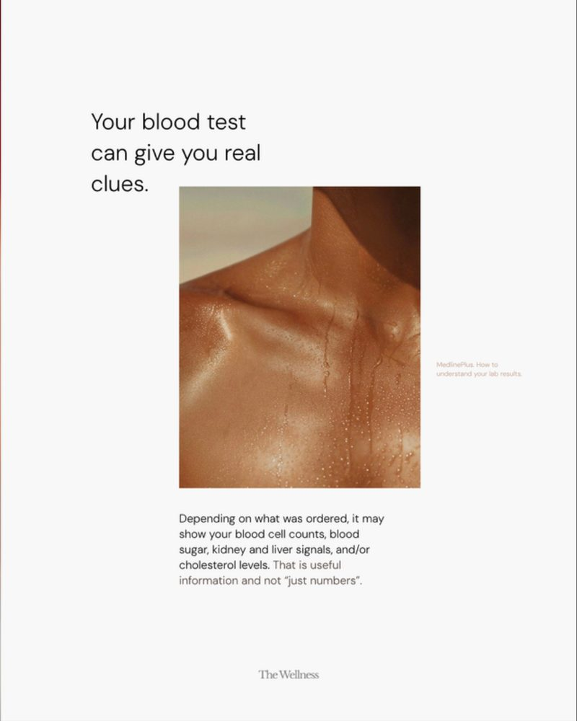
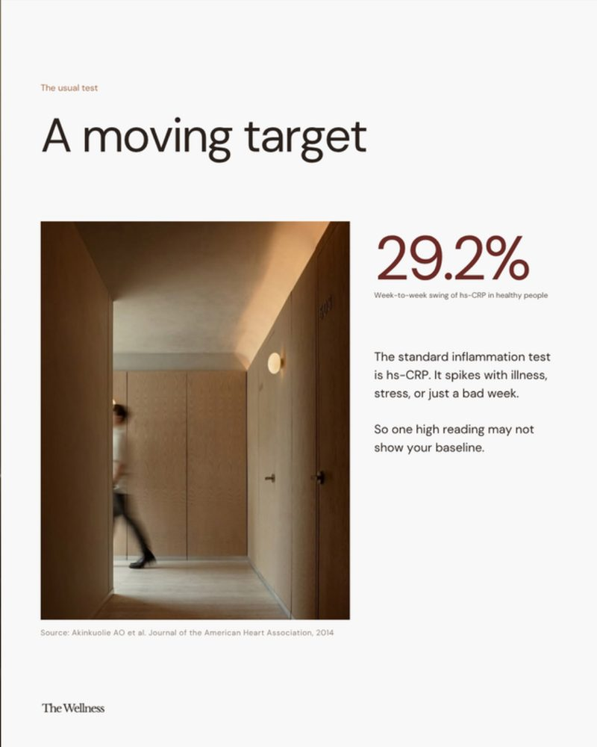
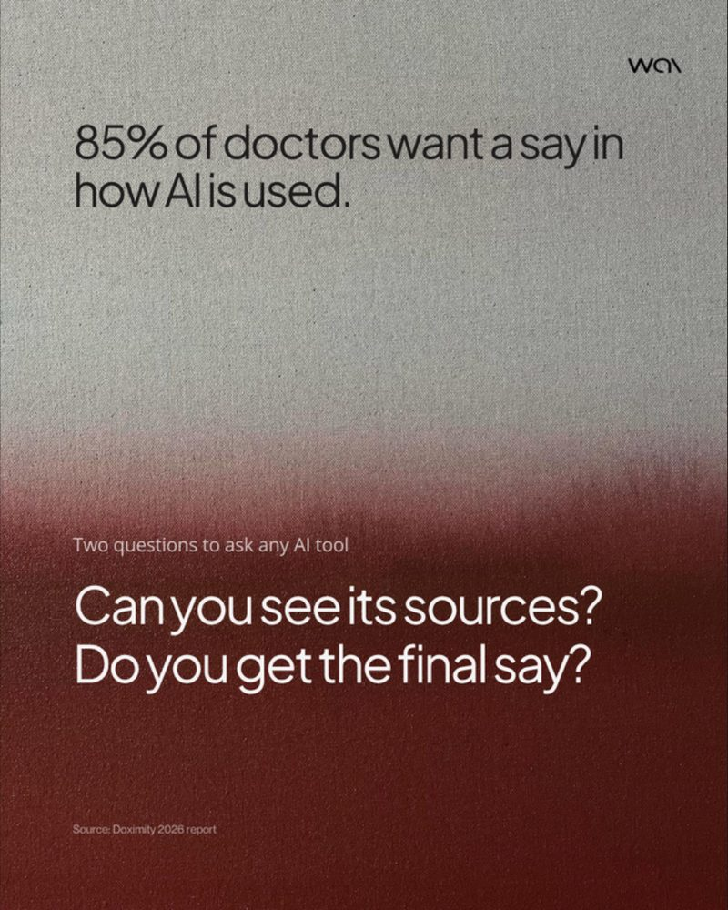
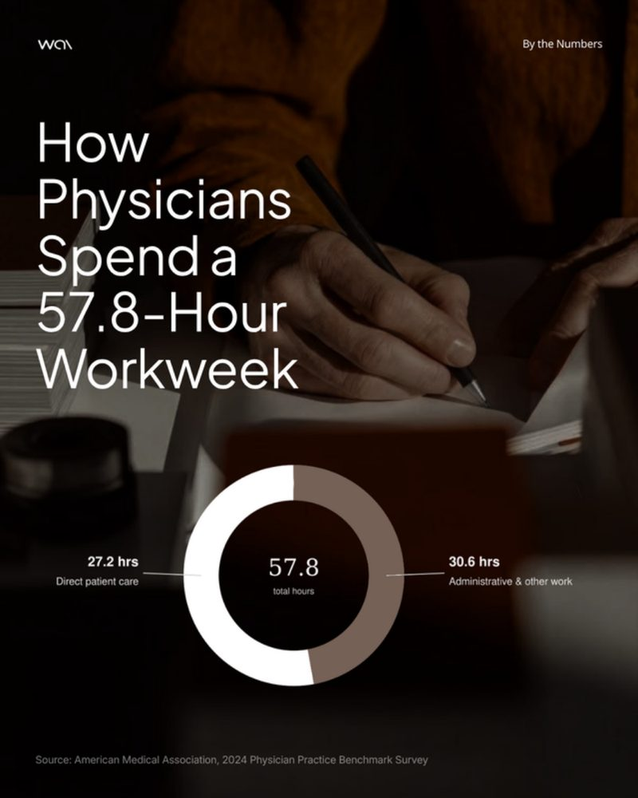
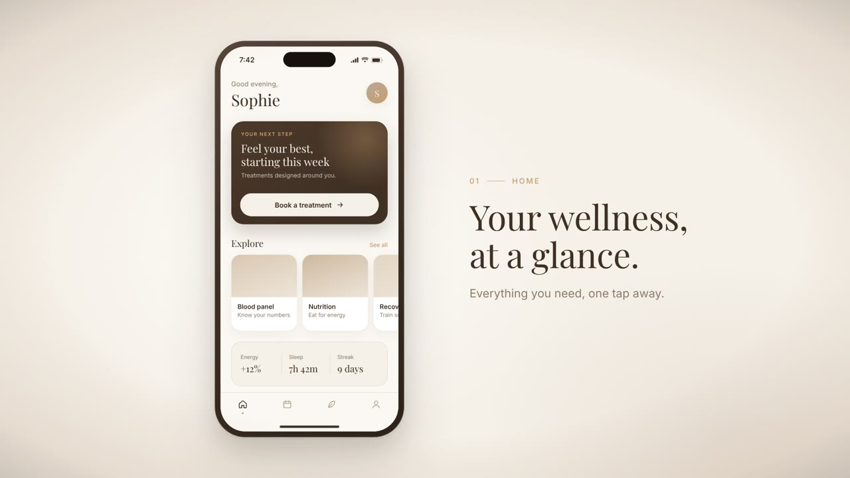
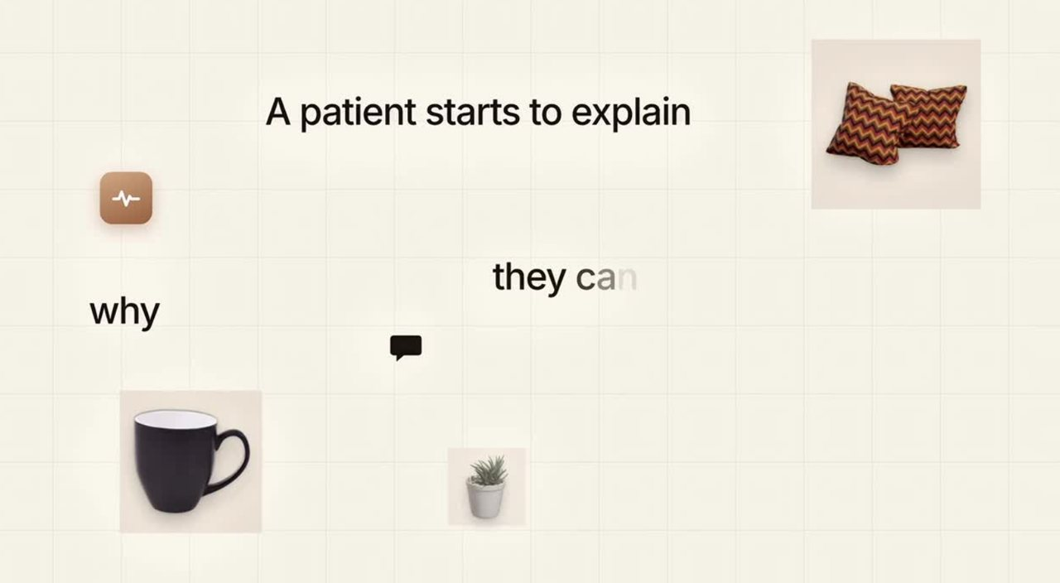
r
River Geoff
portfolio-26.canvas
Work
Motion
About
Get in touch
Filter projects
All work
9
All work
52
THE WELLNESS
All
The Wellness
Wai
Carousel
Infographic
9 PROJECTS · 52 FRAMES
Have you tried the cort…
7
5 things to get right b…
7
The science Gisele, Dav…
7
You inherit your eye co…
6
Your hair isn't falling…
7
Your blood test says “n…
7
The inflammation signal…
6
WAI
Have you tried the cortisol cocktail?
5 things to get right before your next bloo…
The science Gisele, David, Steph & Serena b…
You inherit your eye colour. And maybe this.
Your hair isn't falling out. It's on schedu…
81% of doctors use AI a…
4
The Wellness · Carousel · 7 frames
The Wellness · Carousel · 7 frames
The Wellness · Carousel · 7 frames
The Wellness · Carousel · 6 frames
The Wellness · Carousel · 7 frames
How physicians spend a…
1
MOTION
The Wellness · App walkthrough
Wai · Brand film stills
Motion
App walkthrough and brand film stills
Your blood test says “normal”. So why do yo…
The inflammation signal your standard blood…
81% of doctors use AI at work. Which one ar…
How physicians spend a 57.8-hour workweek
See motion work →
The Wellness · Carousel · 7 frames
The Wellness · Carousel · 6 frames
Wai · Carousel · 4 frames
Wai · Infographic · 1 frame

Slide 4
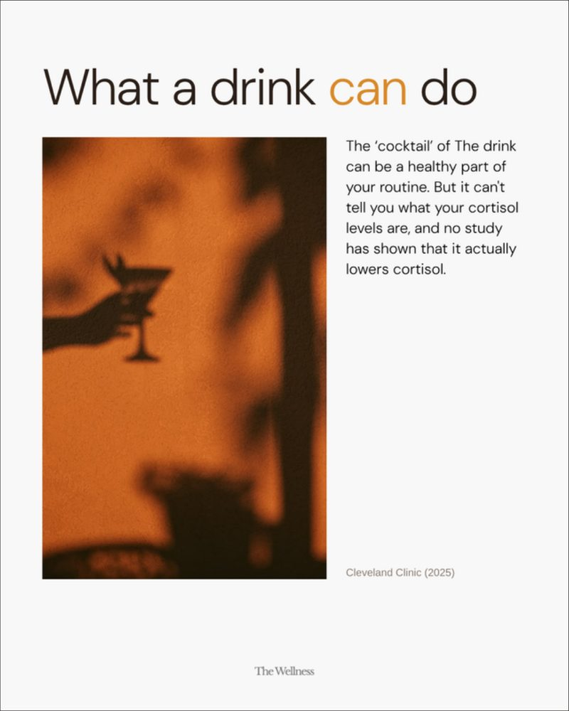
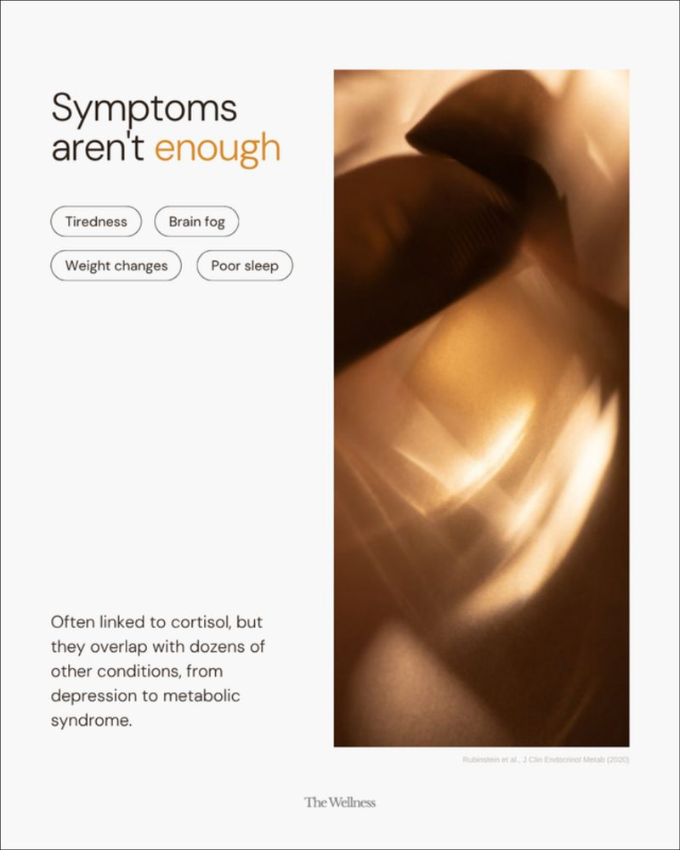
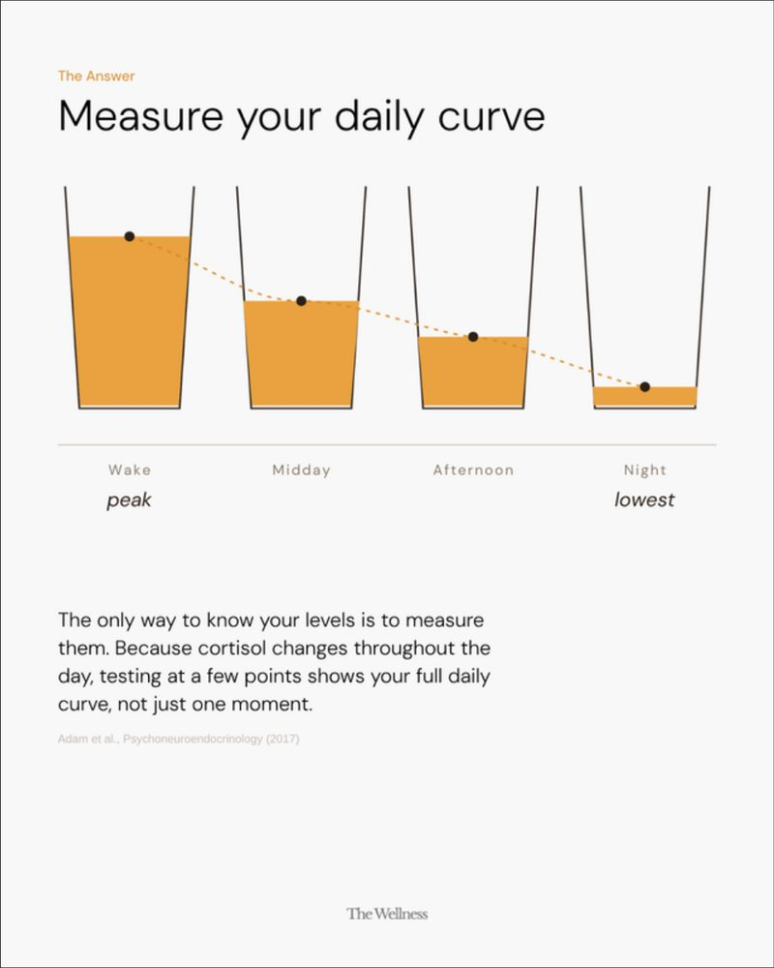
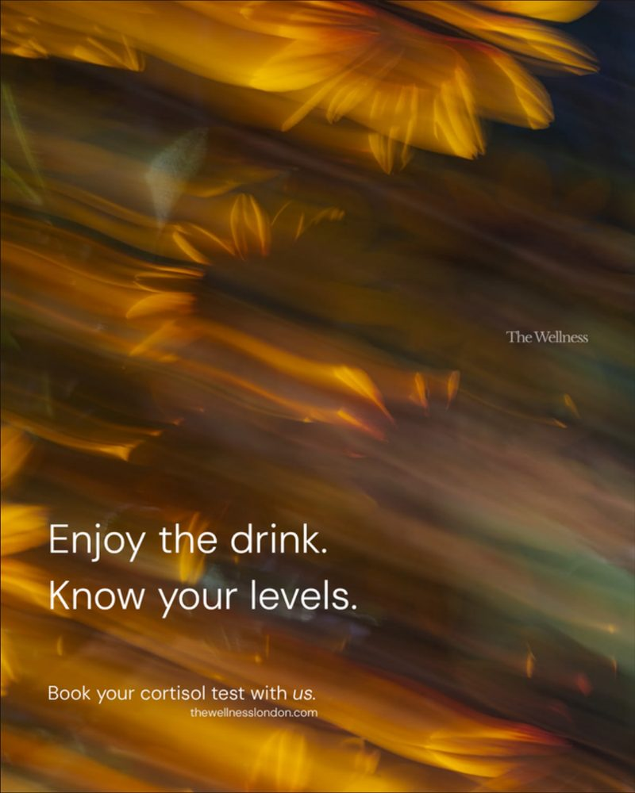
r
River Geoff
portfolio-26.canvas
Work
Motion
About
Get in touch
Filter projects
The Wellness · Carousel · 2026
PROJECT
9
All work
52
Have you tried the cortisol cocktail?
‹ 01 / 07 ›
Client
The Wellness
Type
Carousel
THE WELLNESS
Frames
7
Have you tried the cort…
7
Format
1080 × 1350 · 4:5
Frame 01
Year
2026
5 things to get right b…
7
The science Gisele, Dav…
7
BRIEF
A trend-response carousel that meets a viral drink on its own terms, then explains what cortisol actually does across the day and ends on a booking prompt.
You inherit your eye co…
6
Your hair isn't falling…
7
Your blood test says “n…
7
The inflammation signal…
6
COLOUR
WAI
81% of doctors use AI a…
4
#F7F5F1
#E8A032
#9A5A1C
#3A2414
How physicians spend a…
1
TAGS
MOTION
Health education
Trend response
The Wellness · App walkthrough
Wai · Brand film stills
1080 × 1350
ALL FRAMES · 7

Slide 5
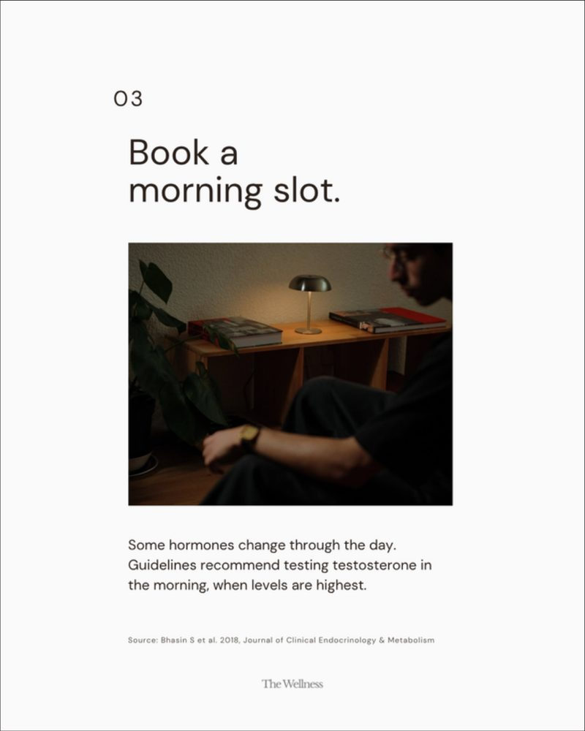
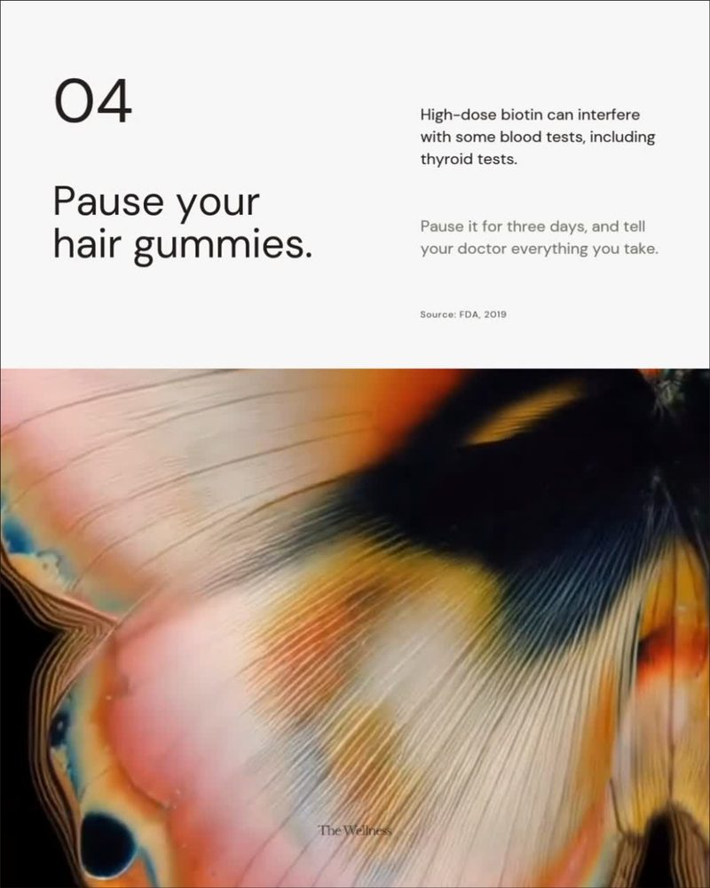
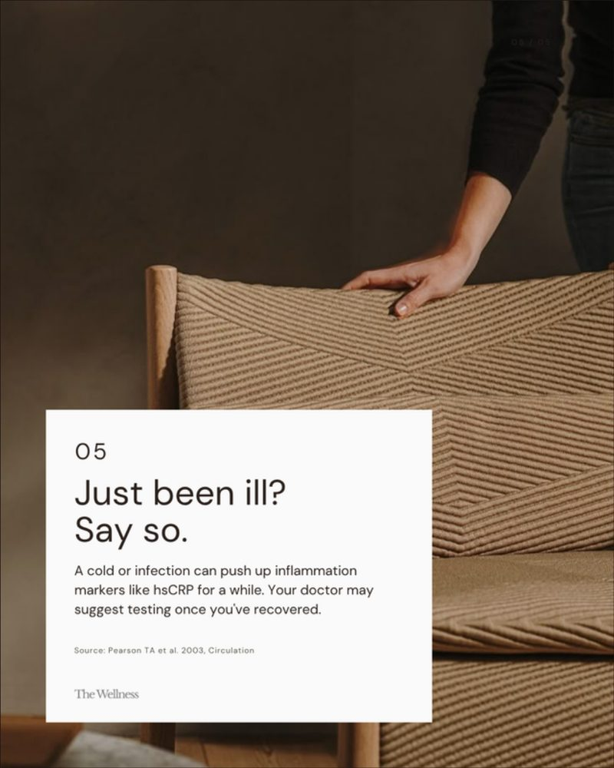
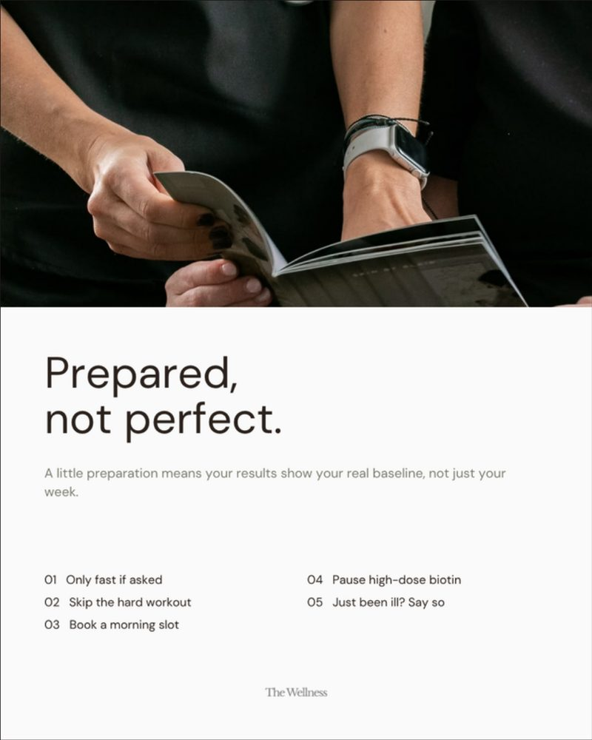
r
River Geoff
portfolio-26.canvas
Work
Motion
About
Get in touch
Filter projects
The Wellness · Carousel · 2026
PROJECT
9
All work
52
5 things to get right before your next blood test
‹ 01 / 07 ›
Client
The Wellness
Type
Carousel
THE WELLNESS
Frames
7
Have you tried the cort…
7
Format
1080 × 1350 · 4:5
Frame 01
Year
2026
5 things to get right b…
7
The science Gisele, Dav…
7
BRIEF
A numbered checklist carousel. Each frame carries one instruction with the reason behind it, and the last frame collects all five as a save-for-later summary.
You inherit your eye co…
6
Your hair isn't falling…
7
Your blood test says “n…
7
The inflammation signal…
6
COLOUR
WAI
81% of doctors use AI a…
4
#F6F5F3
#C4552A
#6B5646
#1D1512
How physicians spend a…
1
TAGS
MOTION
Checklist
Patient prep
The Wellness · App walkthrough
Wai · Brand film stills
1080 × 1350
ALL FRAMES · 7

Slide 6
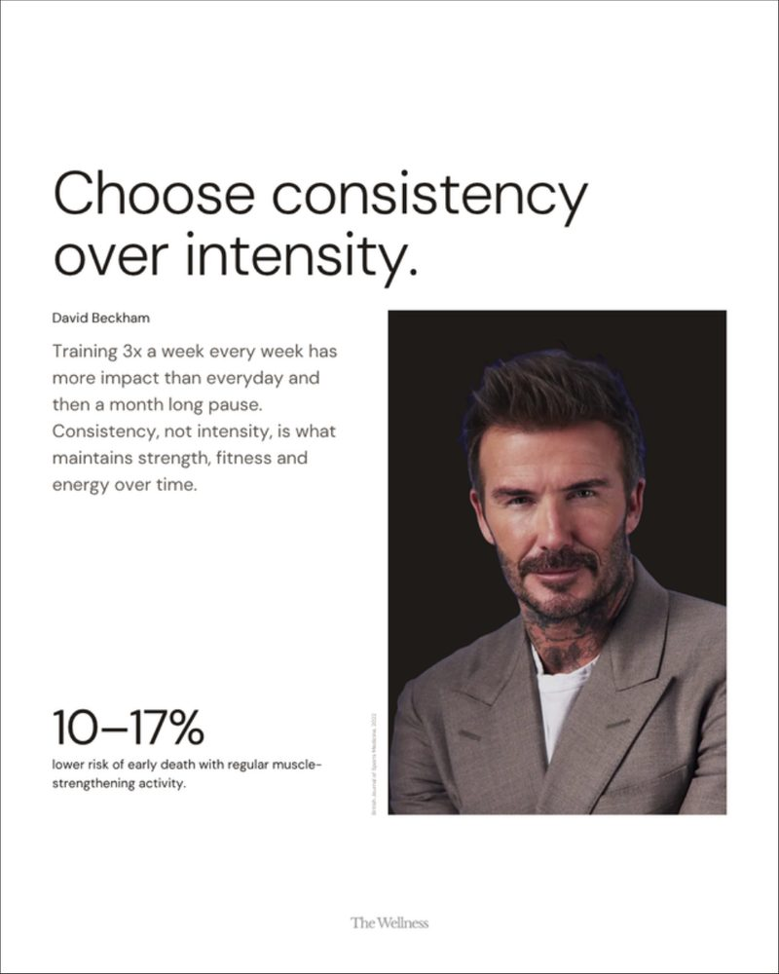
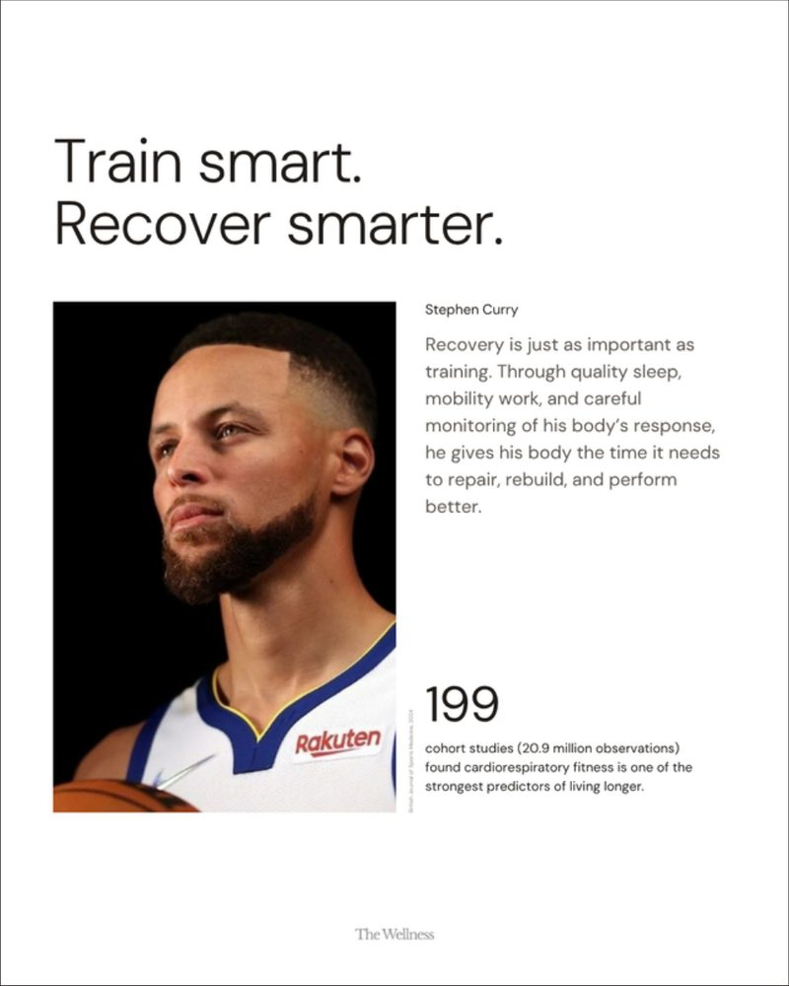
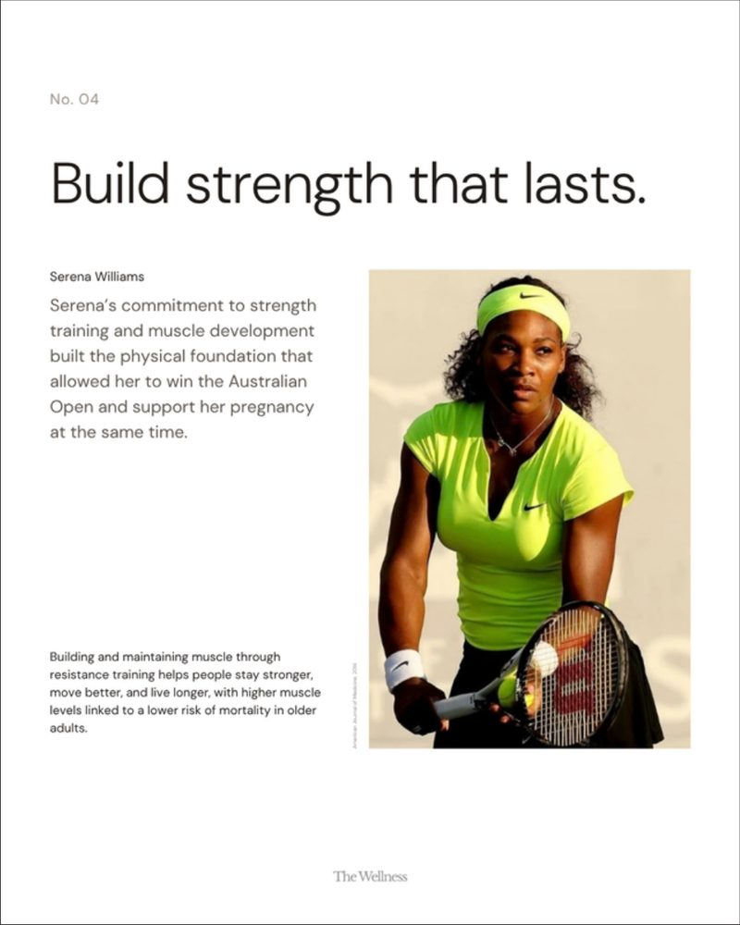
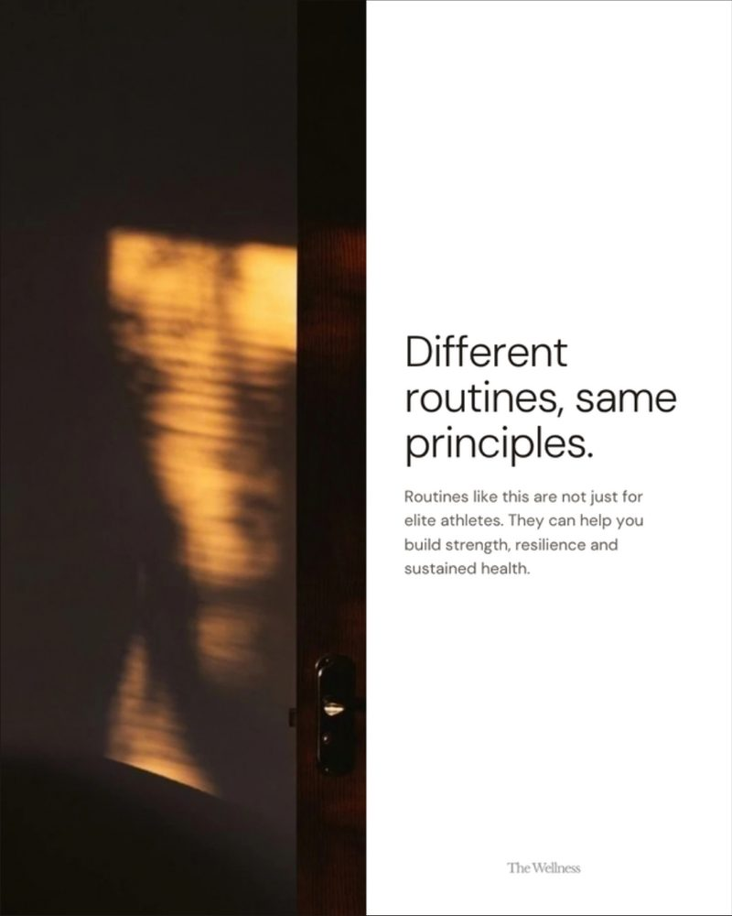
r
River Geoff
portfolio-26.canvas
Work
Motion
About
Get in touch
Filter projects
The Wellness · Carousel · 2026
PROJECT
9
All work
52
The science Gisele, David, Steph & Serena build their lives on
‹ 01 / 07 ›
Client
The Wellness
Type
Carousel
THE WELLNESS
Frames
7
Have you tried the cort…
7
Format
1080 × 1350 · 4:5
Frame 01
Year
2026
5 things to get right b…
7
The science Gisele, Dav…
7
BRIEF
Four elite performers, four evidence-based habits. Each athlete gets one frame with a principle and a single research-backed number.
You inherit your eye co…
6
Your hair isn't falling…
7
Your blood test says “n…
7
The inflammation signal…
6
COLOUR
WAI
81% of doctors use AI a…
4
#FFFFFF
#D7E84A
#AF9577
#35261F
How physicians spend a…
1
TAGS
MOTION
Editorial
Data callouts
The Wellness · App walkthrough
Wai · Brand film stills
1080 × 1350
ALL FRAMES · 7

Slide 7
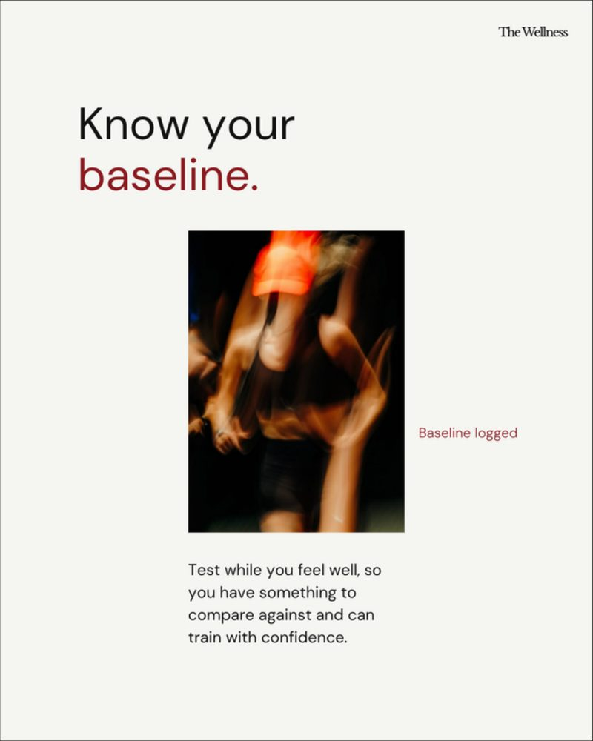
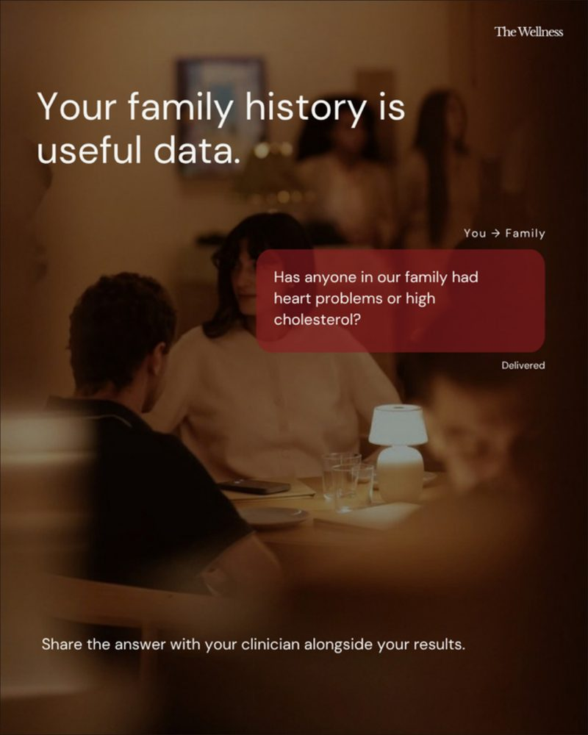
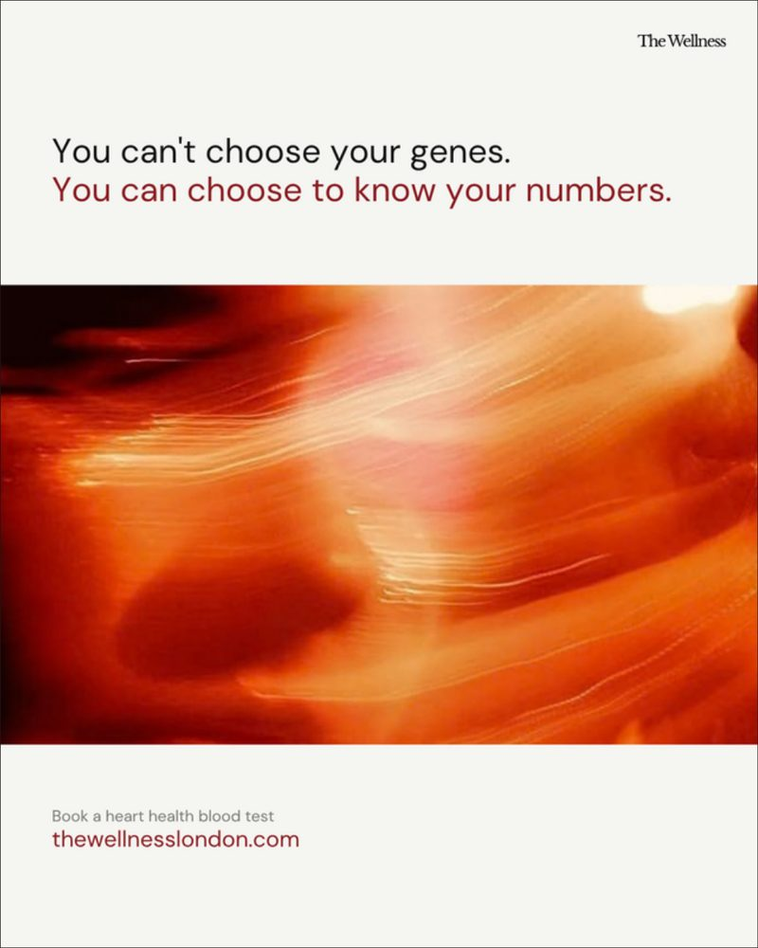
r
River Geoff
portfolio-26.canvas
Work
Motion
About
Get in touch
Filter projects
The Wellness · Carousel · 2026
PROJECT
9
All work
52
You inherit your eye colour. And maybe this.
‹ 01 / 06 ›
Client
The Wellness
Type
Carousel
THE WELLNESS
Frames
6
Have you tried the cort…
7
Format
1080 × 1350 · 4:5
Frame 01
Year
2026
5 things to get right b…
7
The science Gisele, Dav…
7
BRIEF
A heart-health carousel about family history. Deep reds carry the theme of inheritance, and a mock chat frame turns the ask into something readers can send home.
You inherit your eye co…
6
Your hair isn't falling…
7
Your blood test says “n…
7
The inflammation signal…
6
COLOUR
WAI
81% of doctors use AI a…
4
#F5F4F0
#B2262A
#6E1210
#E9772E
How physicians spend a…
1
TAGS
MOTION
Heart health
Conversation starter
The Wellness · App walkthrough
Wai · Brand film stills
1080 × 1350
ALL FRAMES · 6

Slide 8
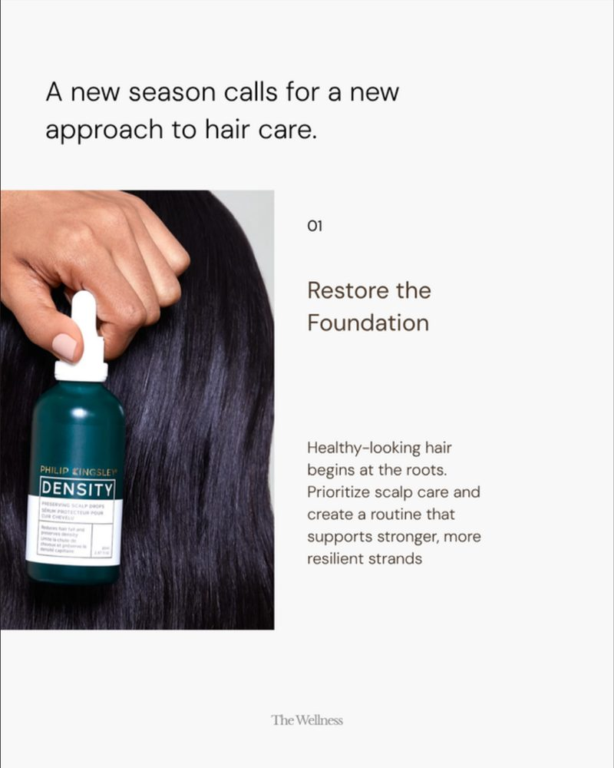
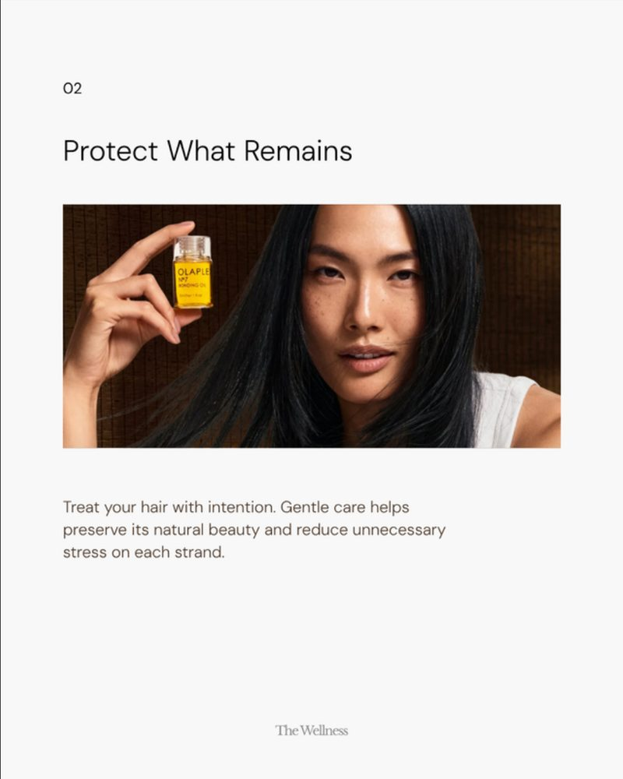
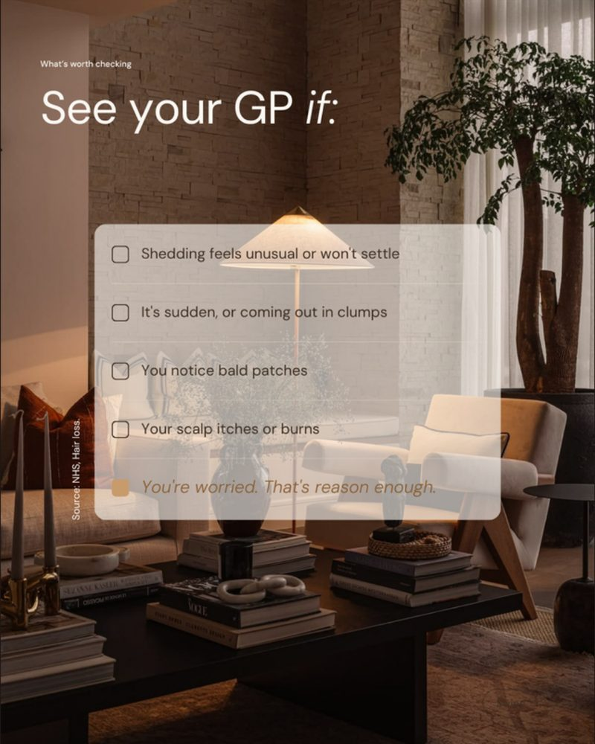
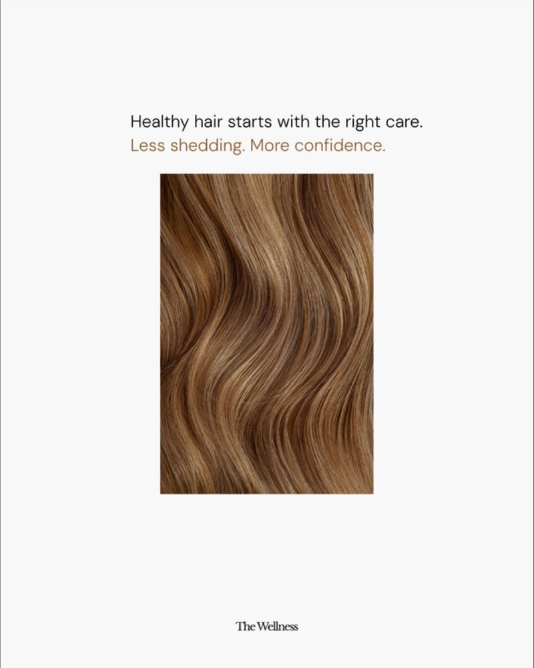
r
River Geoff
portfolio-26.canvas
Work
Motion
About
Get in touch
Filter projects
The Wellness · Carousel · 2026
PROJECT
9
All work
52
Your hair isn't falling out. It's on schedule.
‹ 01 / 07 ›
Client
The Wellness
Type
Carousel
THE WELLNESS
Frames
7
Have you tried the cort…
7
Format
1080 × 1350 · 4:5
Frame 01
Year
2026
5 things to get right b…
7
The science Gisele, Dav…
7
BRIEF
Seasonal shedding explained as a calendar. A 100-day timeline frame shows the hair cycle, followed by care steps and a checklist for when to see a GP.
You inherit your eye co…
6
Your hair isn't falling…
7
Your blood test says “n…
7
The inflammation signal…
6
COLOUR
WAI
81% of doctors use AI a…
4
#F8F7F5
#B98252
#785E4E
#1C120B
How physicians spend a…
1
TAGS
MOTION
Seasonal
Timeline
The Wellness · App walkthrough
Wai · Brand film stills
1080 × 1350
ALL FRAMES · 7

Slide 9
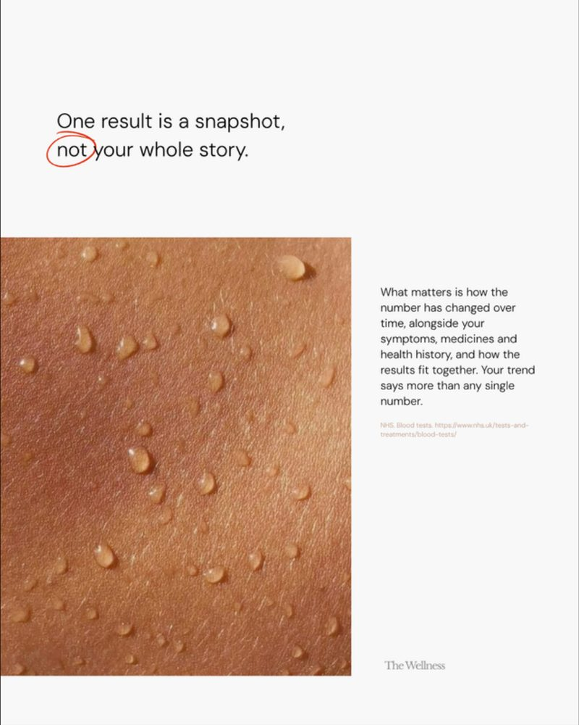
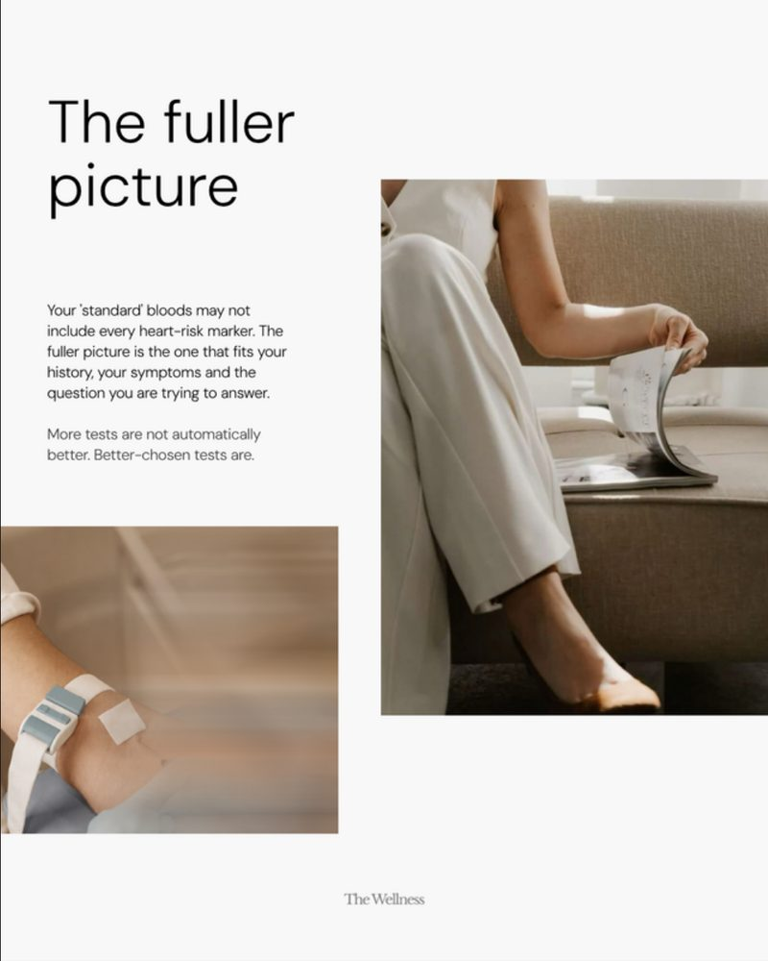
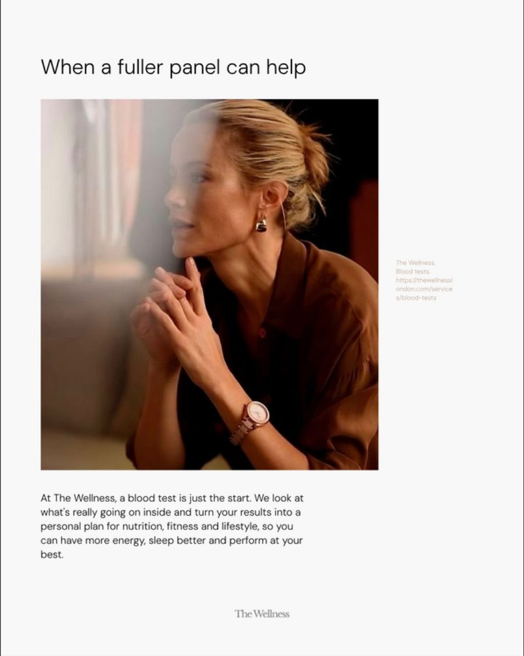

r
River Geoff
portfolio-26.canvas
Work
Motion
About
Get in touch
Filter projects
The Wellness · Carousel · 2026
PROJECT
9
All work
52
Your blood test says “normal”. So why do you still feel off?
‹ 01 / 07 ›
Client
The Wellness
Type
Carousel
THE WELLNESS
Frames
7
Have you tried the cort…
7
Format
1080 × 1350 · 4:5
Frame 01
Year
2026
5 things to get right b…
7
The science Gisele, Dav…
7
BRIEF
Leads with a 92% statistic and moves from snapshot to trend, making the case for a fuller panel and a personal plan in the app.
You inherit your eye co…
6
Your hair isn't falling…
7
Your blood test says “n…
7
The inflammation signal…
6
COLOUR
WAI
81% of doctors use AI a…
4
#F8F8F8
#D2452A
#8F5E47
#270F0C
How physicians spend a…
1
TAGS
MOTION
Statistic-led
Product tie-in
The Wellness · App walkthrough
Wai · Brand film stills
1080 × 1350
ALL FRAMES · 7

Slide 10
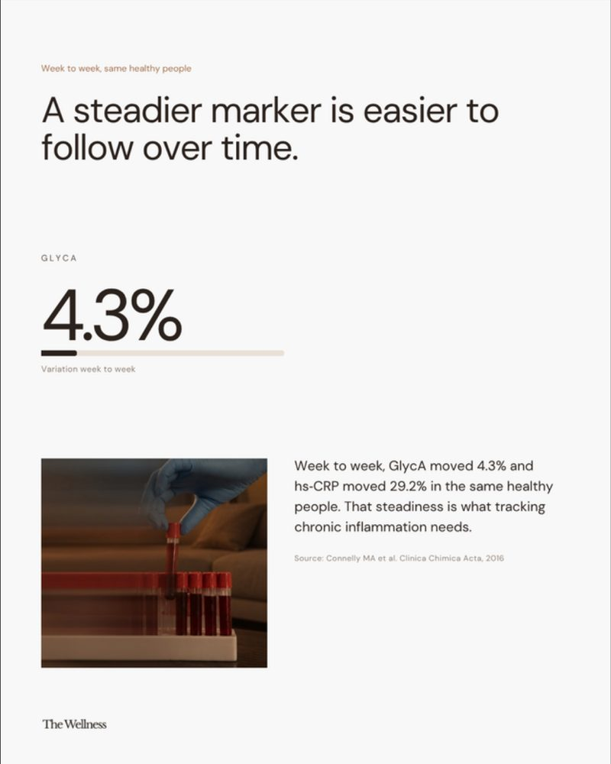
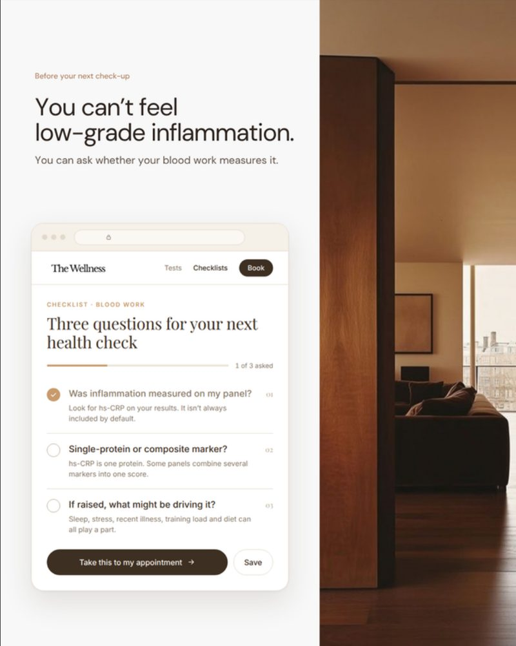
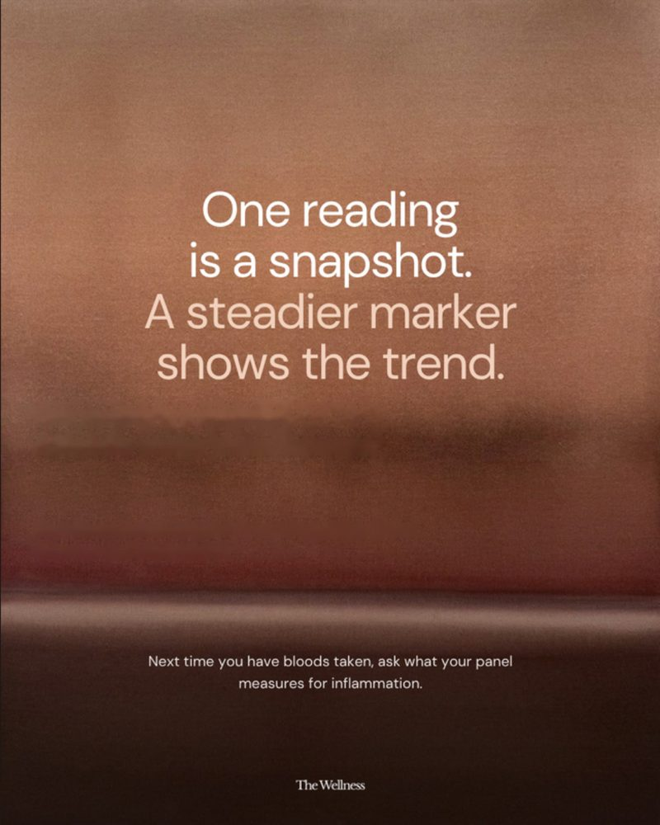
r
River Geoff
portfolio-26.canvas
Work
Motion
About
Get in touch
Filter projects
The Wellness · Carousel · 2026
PROJECT
9
All work
52
The inflammation signal your standard blood test misses
‹ 01 / 06 ›
Client
The Wellness
Type
Carousel
THE WELLNESS
Frames
6
Have you tried the cort…
7
Format
1080 × 1350 · 4:5
Frame 01
Year
2026
5 things to get right b…
7
The science Gisele, Dav…
7
BRIEF
Introduces GlycA, a steadier inflammation marker. Includes a UI-style frame of three questions to bring to your next health check.
You inherit your eye co…
6
Your hair isn't falling…
7
Your blood test says “n…
7
The inflammation signal…
6
COLOUR
WAI
81% of doctors use AI a…
4
#F7F6F4
#B4A195
#745543
#361F17
How physicians spend a…
1
TAGS
MOTION
Science explainer
UI frame
The Wellness · App walkthrough
Wai · Brand film stills
1080 × 1350
ALL FRAMES · 6

Slide 11

r
River Geoff
portfolio-26.canvas
Work
Motion
About
Get in touch
Filter projects
Wai · Carousel · 2026
PROJECT
9
All work
52
81% of doctors use AI at work. Which one are you using?
‹ 01 / 04 ›
Client
Wai
Type
Carousel
THE WELLNESS
Frames
4
Have you tried the cort…
7
Format
1080 × 1350 · 4:5
Frame 01
Year
2026
5 things to get right b…
7
The science Gisele, Dav…
7
BRIEF
Launch content for a medical AI assistant. Two questions to ask any AI tool, then an annotated product frame showing sources and doctor approval.
You inherit your eye co…
6
Your hair isn't falling…
7
Your blood test says “n…
7
The inflammation signal…
6
COLOUR
WAI
81% of doctors use AI a…
4
#F3F3F1
#8C2B24
#3B5BAB
#1E1A19
How physicians spend a…
1
TAGS
MOTION
Product launch
Annotated UI
The Wellness · App walkthrough
Wai · Brand film stills
1080 × 1350
ALL FRAMES · 4

Slide 12
r
River Geoff
portfolio-26.canvas
Work
Motion
About
Get in touch
Filter projects
Wai · Infographic · 2026
PROJECT
9
All work
52
How physicians spend a 57.8-hour workweek
‹ 01 / 01 ›
Client
Wai
Type
Infographic
THE WELLNESS
Frames
1
Have you tried the cort…
7
Format
1080 × 1350 · 4:5
Frame 01
Year
2026
5 things to get right b…
7
The science Gisele, Dav…
7
BRIEF
A single-frame infographic: a donut chart splitting direct patient care from admin work, set over a warm photographic backdrop.
You inherit your eye co…
6
Your hair isn't falling…
7
Your blood test says “n…
7
The inflammation signal…
6
COLOUR
WAI
81% of doctors use AI a…
4
#F3F0EC
#9C8A80
#382C24
#0B0503
How physicians spend a…
1
TAGS
MOTION
Infographic
Data viz
The Wellness · App walkthrough
Wai · Brand film stills
1080 × 1350

Slide 13


r
River Geoff
portfolio-26.canvas
Work
Motion
About
Get in touch
Filter projects
Motion · 2 pieces
9
All work
52
Product films and brand motion
THE WELLNESS
Have you tried the cort…
7
the-wellness-app.mp4
Wai · Brand film stills
5 things to get right b…
7
VERTICAL FILM · KEY FRAMES
The science Gisele, Dav…
7
You inherit your eye co…
6
Your hair isn't falling…
7
Your blood test says “n…
7
▶
The inflammation signal…
6
WAI
81% of doctors use AI a…
4
How physicians spend a…
1
MOTION
The Wellness · App walkthrough
The Wellness · App walkthrough
Wai · Brand film stills
A 30-second product film for the clinic app: home, booking calendar, treatment detail and confirmation, with 300 ms ease-out UI transitions.

Slide 14
r
River Geoff
portfolio-26.canvas
Work
Motion
About
Get in touch
river-geoff.jpg
Let’s make
something that flows.
Open to freelance work
EMAIL
hello@yourname.com
PHONE
+63 900 000 0000
INSTAGRAM
@yourhandle
River Geoff · Portfolio '26
BEHANCE
behance.net/yourname

