Slide 1
Q&A CHATBOT PROJECT
KANNAN RAVIKUMAR GIRIJA

Slide 2
CONTENT
Project
Overall Approach
Data

Slide 3
mention what the assignment was

Slide 4
DATA
Financial report considered for the project is 10-K Report which is a comprehensive report filed annually by public companies to showcase their financial performance.
The 10-K includes five distinct sections:
Business: Overview of the company’s main operations, including its products and services.
Risk Factors: Risks the company faces or may face in the future.
Selected Financial Data: Financial information about the company over the last five years (mention yr). This section presents more of a near-term view of the company’s recent performance.
Management’s Discussion and Analysis: Explain its business results from the previous fiscal year. This section is where the company can tell its story in its own words.
Financial Statements and Supplementary Data: Audited financial statements including the income statement, balance sheets, and statement of cash flows.
Sample size: 10-K Report (PDF format) of 10 firms are considered. mention the firms and how you arrived at considering these firms. why not same sector

Slide 5
OVERALL APPROACH
RAG (Retrieval-Augmented Generation) approach is used.
Data source (PDF) is extracted, processed and stored as a vector store.
The required data for answering the question is retrieved from the vector store.
The retrieved data is passed as context to LLM from which the answer is found, if present.

Slide 6
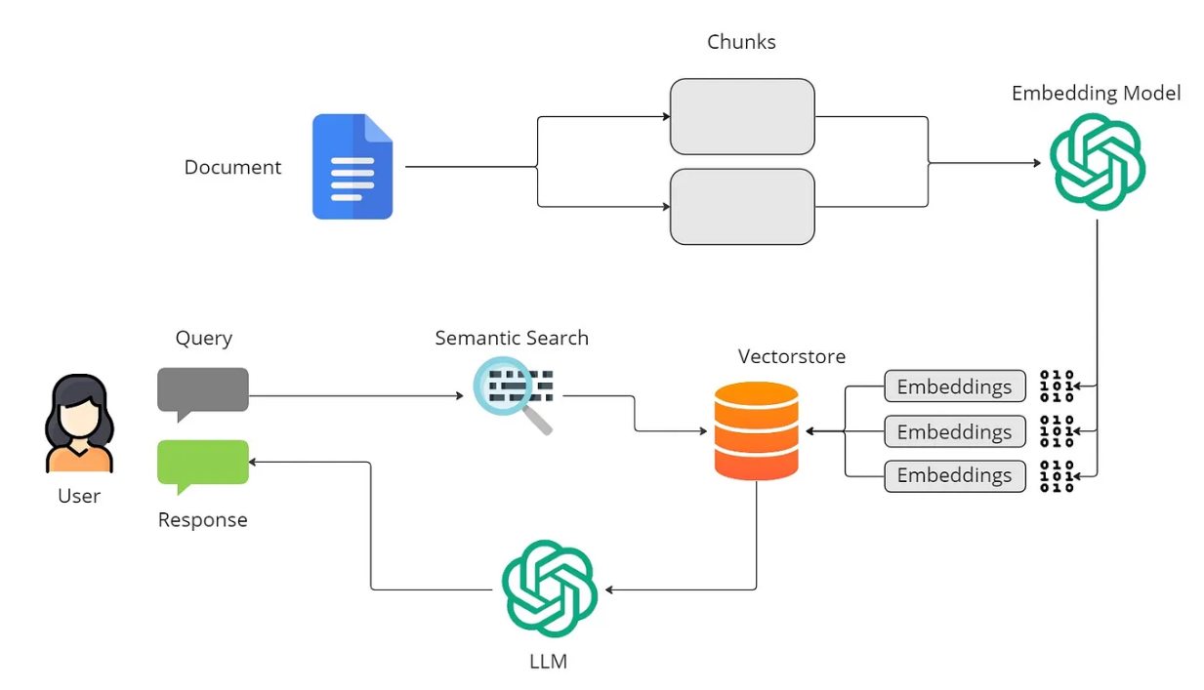
FLOW DIGRAM
Credits: mention website link

Slide 7
FLOW DIAGRAM - INDEXING
PDF extracted to markdown format using LlamaParse API.
Extracted text split to multiple chunk sizes using Langchains RecursiveCharacterTextSplitter
The text chunks are converted to vector store by FAISS using OpenAI Embeddings.
The created vector store are saved for next step.

Slide 8
RETRIEVAL
The user question is formatted to avoid spelling and grammar mistakes.
NER operation is performed to get all of the organization's names from the question. Organizations should be from 10 supported ones.
Corresponding vector stores of organizations present in the question are loaded to memory.
FAISS similarity_search is used to retrieve the docs that are most similar to the question. The retrieved docs will be used in the next step.

Slide 9
GENERATION
Langchain ‘load_qa_chain’ designed for retrieval-based QA is used.
The model used in Open AI "gpt-3.5-turbo"
A prompt is created with details like context and input. The “Do not makeup answers” clause is mentioned to avoid hallucinations
Retrieved docs + chat history is passed as context to LLM
LLM generates answers with data in the provided context.

Slide 10
CHATBOT - Q&A EXAMPLES

Slide 11
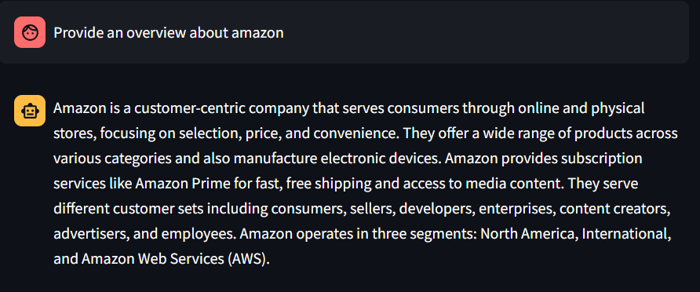
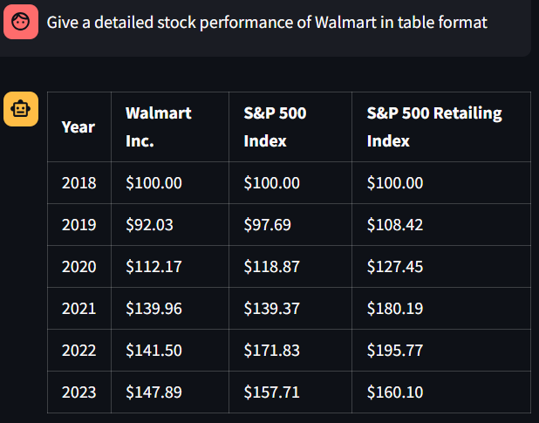
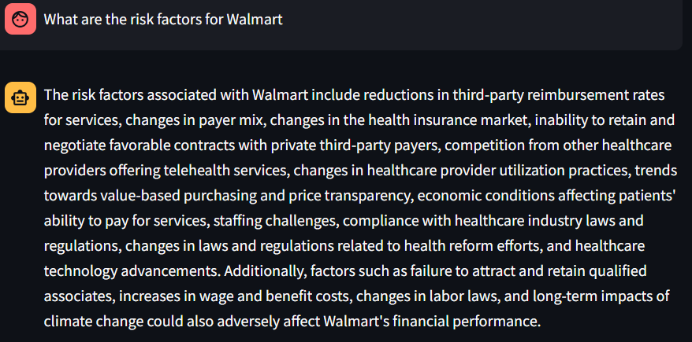
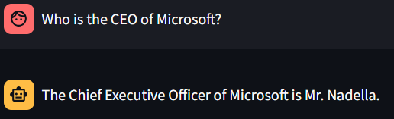

Slide 12
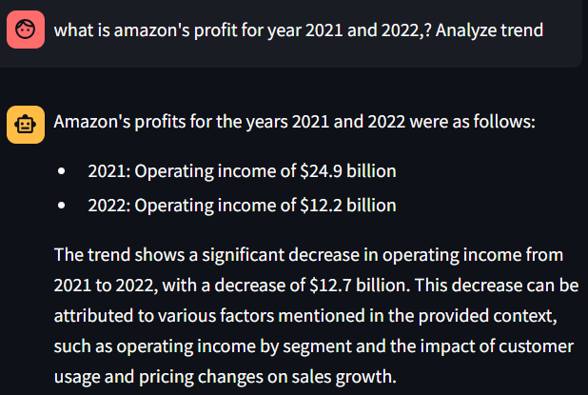
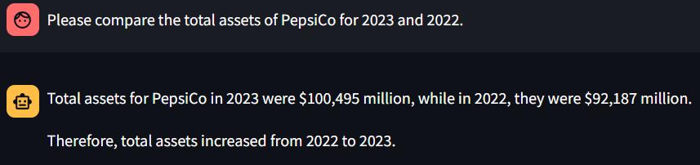
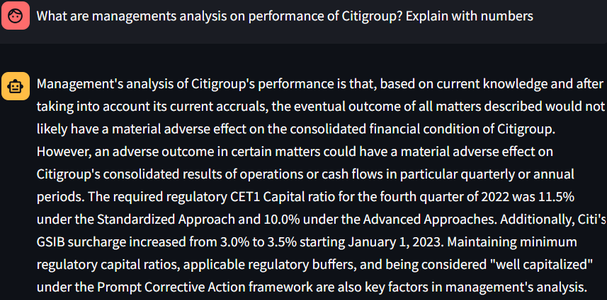
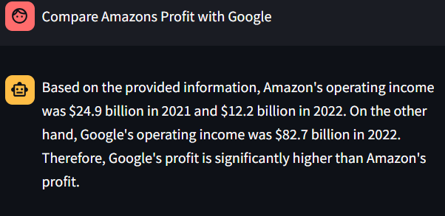

Slide 13
Chatbot Deployment Information

Slide 14
RESOURCES USED
StreamLite : Used for creating Chat Web UI
LlamaParse : To Extract Text From PDF
Open AI : For LLM model and Embeddings
FAISS(Facebook AI Similarity Search) : For Creating VectorStore and Checking Similarity
LangChain - For various extraction retrieval and generative utilities

Slide 15
Challenges and Limitations

Slide 16
Q&A

