Slide 1
Q&A CHATBOT PROJECT
KANNAN RAVIKUMAR GIRIJA

Slide 2
CONTENT
Project Objective
Data
Overall Approach
Flow Diagram
Indexing
Retrieval
Generation
Chatbot Examples
Chatbot Deployment Information
Tools Used
Challenges
Scope for Future Enhancement
Q&A

Slide 3
PROJECT OBJECTIVE
Develop a generative Q&A Chatbot capable of answering questions related to the financial reports of large public companies.
The chatbot must reference a knowledge base created from the provided PDF files of financial reports.
It should be grounded in this knowledge base to minimize hallucinations and ensure accurate information.
Deliver a working prototype of the chatbot along with the source code.

Slide 4
DATA
The financial report used for this project is the 10-K Report, a comprehensive document filed annually by public companies to detail their financial performance.
The 10-K includes five distinct sections:
Business : Overview of the firm, including products and services.
Risk Factors: Risks the firm faces or may face in the future.
10K
Selected Financial Data: Financial information of past years to analyze recent performance.
Management’s Discussion and Analysis: Explain the business results of the previous fiscal year.
Financial Statements and Supplementary Data: Audited financial statements like income statement, balance sheets, and cash flows.

Slide 5
DATA
The 10-K reports (in PDF format) of ten firms have been selected for this project
The chosen firms are:
Amazon
Apple
Citigroup
FedEx
Ford
Google
Microsoft
PepsiCo
Tesla
Walmart.

Slide 6
OVERALL APPROACH
The RAG (Retrieval-Augmented Generation) approach is used.
Data source (PDF) is extracted, processed and stored as a vector store.
The required data for answering the question is retrieved from the vector store.
The retrieved data is passed as context to LLM from which the answer is found, if present.

Slide 7
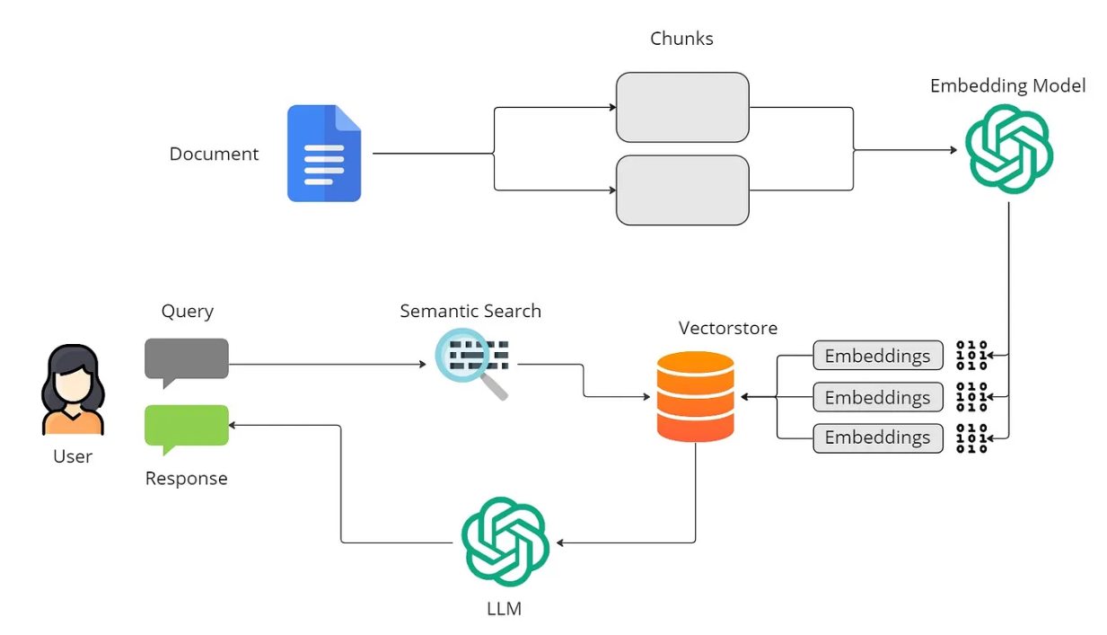
FLOW DIAGRAM
Credits: prasadmahamulkar

Slide 8
FLOW DIAGRAM - INDEXING
PDFs are converted to Markdown format using the LlamaParse API.
The extracted text is segmented into multiple chunks using Langchains RecursiveCharacterTextSplitter.
These text chunks are then transformed into vector stores using FAISS with OpenAI Embeddings, and are saved for subsequent steps.

Slide 9
FLOW DIAGRAM - RETRIEVAL
The user question is formatted to ensure accuracy in spelling and grammar.
Named Entity Recognition (NER) is then employed to extract names of organizations mentioned in the question, limited to ten supported ones.
The vector stores corresponding to these organizations are loaded into memory.
FAISS similarity_search is utilized to retrieve documents most closely related to the question, which will be used in the subsequent step.

Slide 10
FLOW DIAGRAM - GENERATION
Utilizes the Langchain 'load_qa_chain' specifically designed for retrieval-based QA.
The model employed is OpenAI's "gpt-3.5-turbo".
A prompt is meticulously crafted, incorporating contextual details and inputs, with a strict adherence to the "Do not makeup answers" clause to prevent hallucinations.
Retrieved documents and chat history are combined and passed as context to the large language model (LLM), which generates answers based on the data within the provided context.

Slide 11
CHATBOT - Q&A EXAMPLES

Slide 12
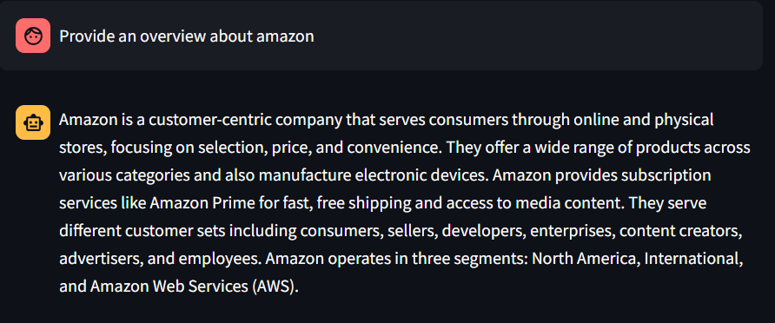
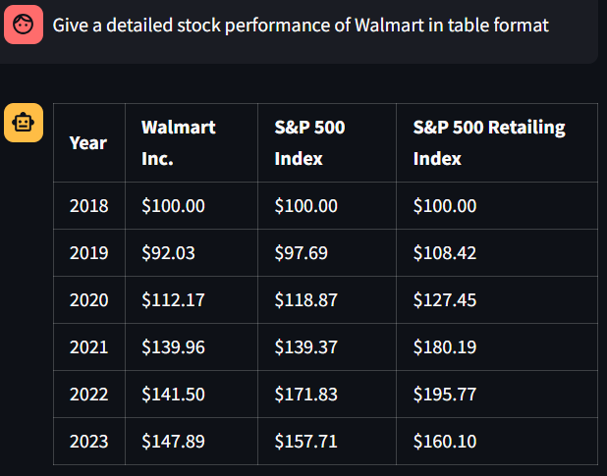
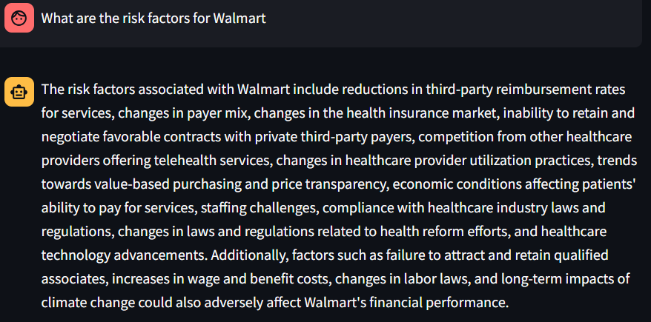
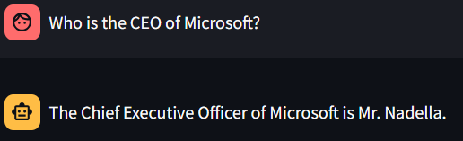

Slide 13
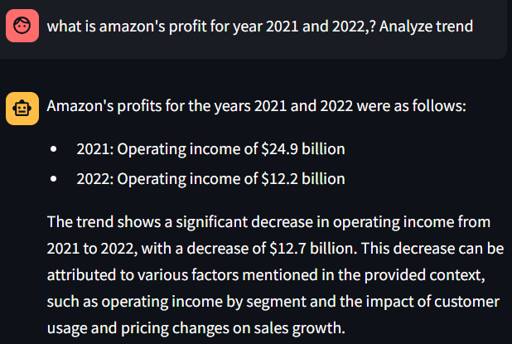
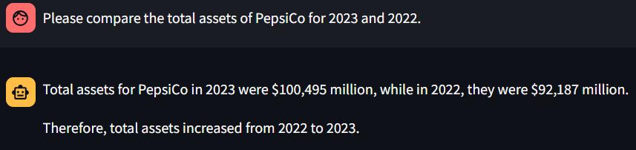
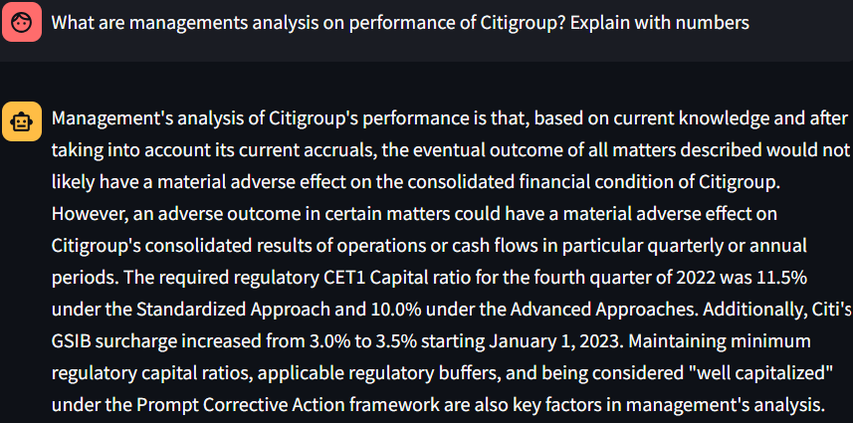
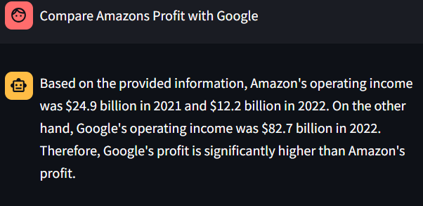

Slide 14
CHATBOT DEPLOYMENT INFORMATION
The chatbot is hosted on Heroku, a leading platform as a service (PaaS) in the cloud.
The source code is uploaded to Git and deployed directly using Heroku's configuration files.
Chatbot can be accessed via the link : https://financial-qa-chatbot-e9c4c697cc92.herokuapp.com/

Slide 15
TOOLS USED
StreamLite : Used to create the chat web UI.
LlamaParse : For extracting text from PDFs.
Open AI : For the LLM model and embeddings
FAISS(Facebook AI Similarity Search) : For creating vector stores and checking similarity.
LangChain - For various extraction, retrieval, and generative utilities.

Slide 16
CHALLENGES
After testing several tools for PDF extraction, many proved ineffective at extracting data from tables.
Due to time constraints, further research and testing of additional tools were limited.
Responses from the LLM for some questions did not meet the expected format or provide the desired level of usefulness.
Some complex table data extracted from PDFs occasionally leads to errors in the answers.
Accuracy metrics cannot be calculated as test data has not been generated; manual testing will be relied upon instead.

Slide 17
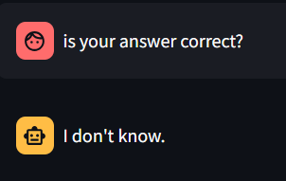
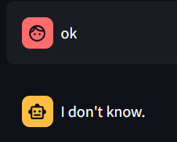
SCOPE FOR FUTURE ENHANCEMENT
The current static PDF data source can be enhanced by enabling users to upload new files directly through the user interface (UI), thereby increasing interaction dynamism.
To make the bot more human-like, we can aim to improve responses, especially in scenarios where current responses are inadequate.
Add additional data sources like Internet to get more detailed data.
Optimize the bot to provide streaming replies rather than waiting for complete answers, enhancing user interaction speed and efficiency.

Slide 18
Q&A

