Slide 1
Multiway search trees and the (2,4)-tree

Slide 2
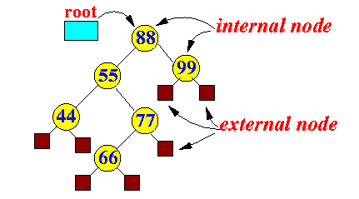
Multiway Trees
With binary trees, each internal node has at MOST two internal children
With multiway trees, each internal node has at MORE THAN two internal children (unless it has 0).

Slide 3
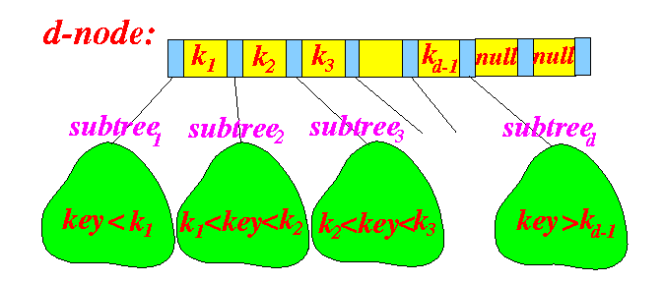
Multiway Trees
Well call a node that has d internal children a d-node
Each d-node has d-1 ordered entries (key-value) pairs. These are represented by the yellow rectangles
Also, has d references to another node. These are represented by the blue rectangles

Slide 4
Node Code
Multiway search trees typically use arrays to list their contents
public static class Node
{
public Entry[] e; // Keys and its associated values
public Node[] child; // Subtrees
public Node parent; // the parent node
...
}

Slide 5
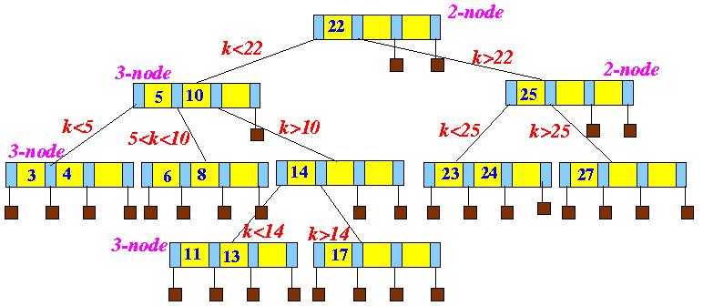
How do we search?

Slide 6
Search Psuedocode
/* -----------------------------------------------------------
keySearch(k, p): find entry with key "k"
starting at node "p" of the search tree
----------------------------------------------------------- */
Entry keySearch(Key k, Node p)
{
for ( j = 1; j ≤ d-1; j++ )
{
if ( (p.key_{j} != null) && (k < p.key_{j}) )
{ /* ------------------------------------------------
Key is found in the "left" tree of key p.key_{j}
------------------------------------------------ */
return( keySearch( k, p.child[j] );
}
if ( (p.key_{j} != null) && (k == p.key_{j}) )
{
return( p.entry[j] ); // Found !!!
}
if ( j == d-1 || p.key_{j+1} == null )
{ /* --------------------------------------
This this the right most subtree !
--------------------------------------- */
return( keySearch(k, p.child[j+1]) );
}
}
}

Slide 7
(2,4) Trees
Also known as the 2-4 tree or 2-3-4 tree
Properties:
  Each internal node has at most 4 children.
  For every pair of internal nodes who only have external node children (we'll call it a leaf node) have the same depth.

Slide 8
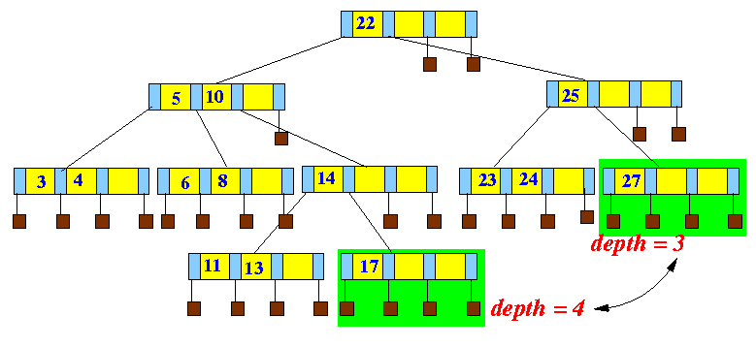
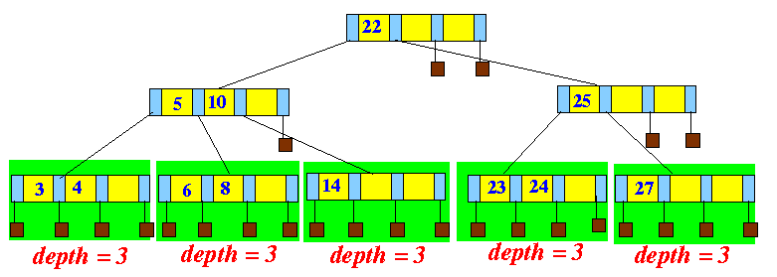
Examples
BAD:
GOOD:

Slide 9
Tree Height
Given n entries, we'd like the tree height h to be O(log(n)), but is it?
If it is, then our search time is also O(log(n))

Slide 10
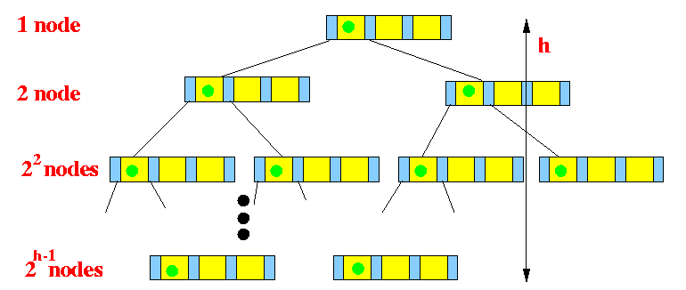
Minimal Density

Slide 11
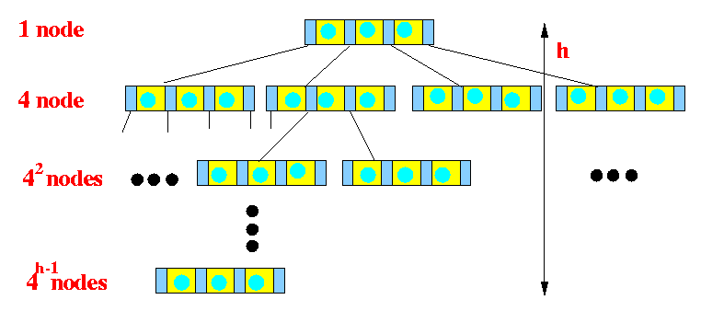
Maximum Density

Slide 12
Other Multiway Trees
There are other kinds of multiway trees, which are all balanced
A common type is called a B-Tree
  (No one know what the B stands for, some people think it stands for Boeing since it was discovered at Boeing Research Labs)
  B-Trees were created to work well with real-life, block-based IO.
We can work on them much like (2,4) trees

Slide 13
Insertion
When we insert, we need to
  Use the search algorithm to find which node the entry should be put in.
    This is always a leaf node, just like a binary tree
  Insert it in that leaf node in the correct order.

Slide 14
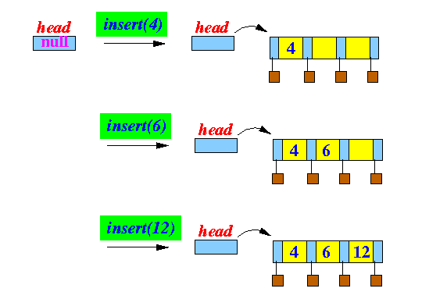
Simple Insertion Case

Slide 15
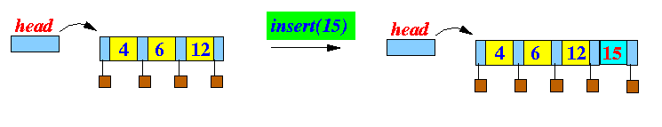
Overflow
Our nodes cannot fit 4 entries!

Slide 16
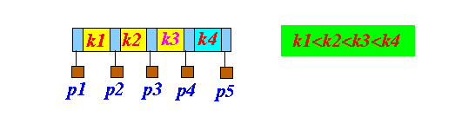
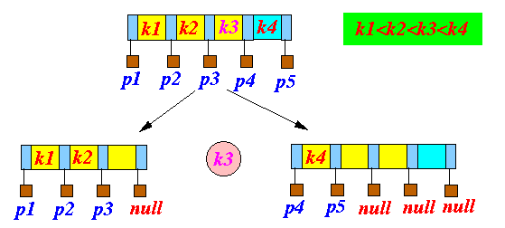
How to Handle Overflow
Name the ordered entries and their subtrees as follows:
Split the node into two nodes, leaving out k3

Slide 17
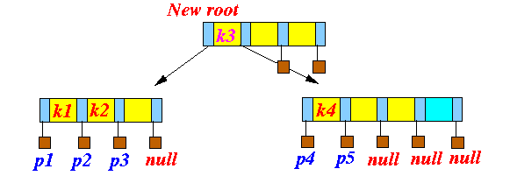
If the Node is the Root
A new node containing only k3 becomes the new root

Slide 18
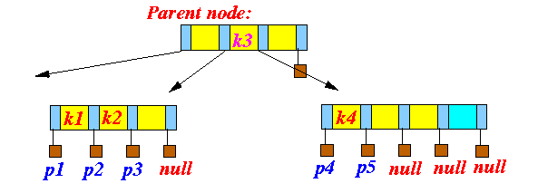
Otherwise
Add k3 to the parent node
This operation is called splitting
We may need to perform splitting more than once if the parent node has
overflow

Slide 19
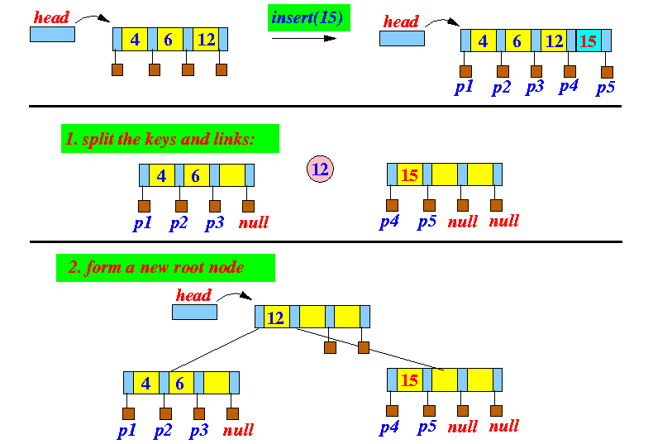
Simple Insertion Example

Slide 20
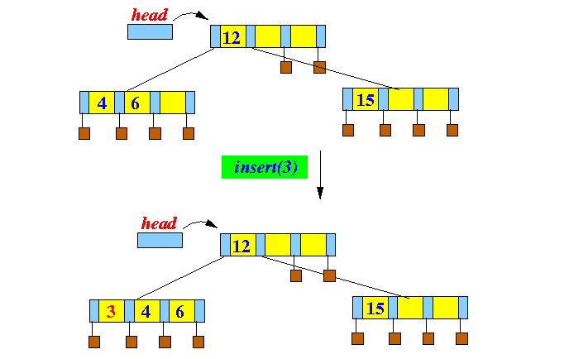
Non-Root Insertion

Slide 21
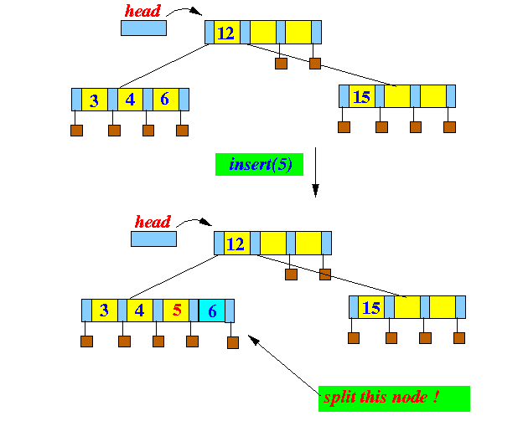
Non-Root Insertion

Slide 22
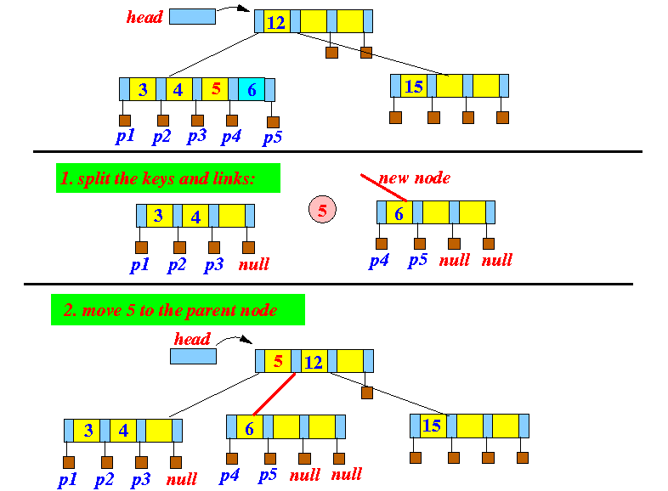
Non-Root Insertion

Slide 23
Implementation Note:
Even though we say we “split” our node into 2 nodes, in reality we only create a new one.
Notes:
(on blackboard)

Slide 24
Deletion
If we want to delete an entry, you must find the node it exist in first.
So our delete entry would look something like:
Entry remove(Key k)
{
e = keySearch(k, root); // Find entry containing key k
// starting with the root node
if ( e == null )
return; // Not found, exit...
//Delete the entry e from the node that contains e.
}

Slide 25
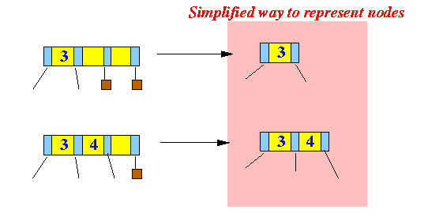
New Representation

Slide 26
The very simplest delete
If we find our entry in a node that
  Has >1 entry
  If a leaf node
Then we delete the entry, and rearrange the entries of the node.

Slide 27
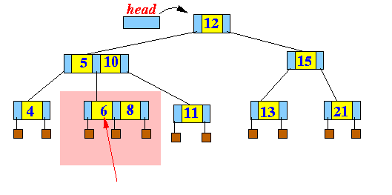
Simple Example

Slide 28
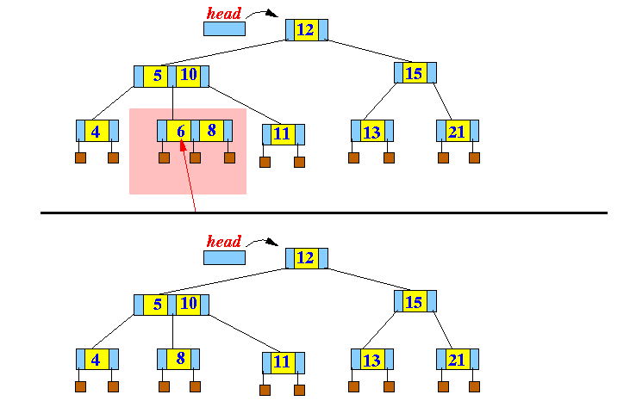

Slide 29
More complex deletion
What if our entry exists in a node that:
  Still has >1 entry
  But if not a leaf node

Slide 30
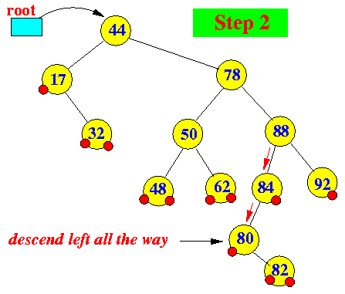
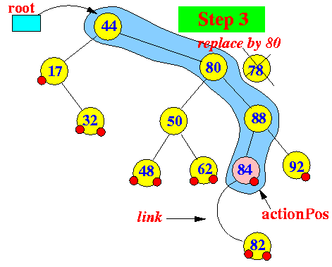
Binary Review
When we delete from a binary tree node with 2 children, we replace it with the successor or the predecessor.
Similarly, we would replace the deleted entry with its successor or predecessor.

Slide 31
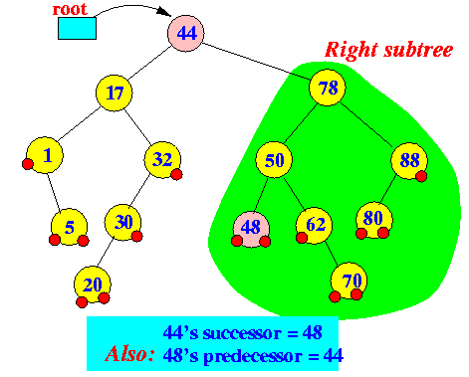
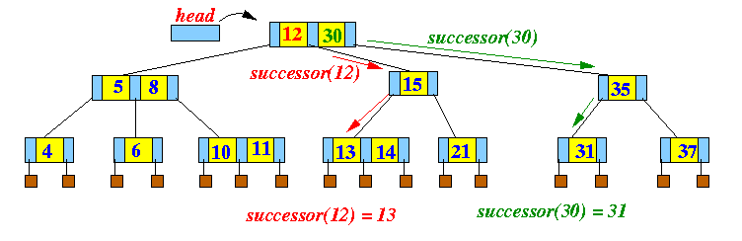
Finding the Successor

Slide 32
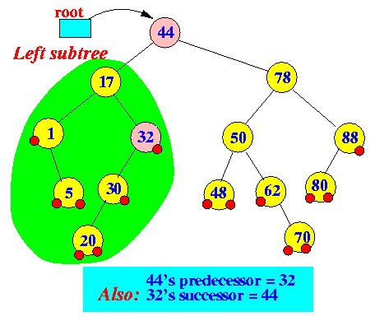
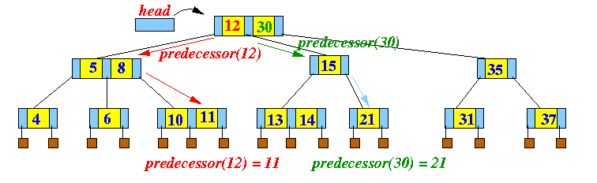
Finding the Predecessor

Slide 33
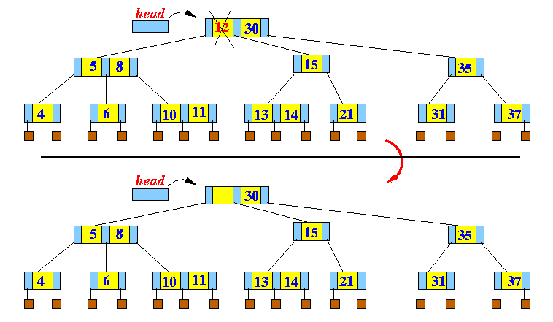
Deletion Example
We delete without rearranging

Slide 34
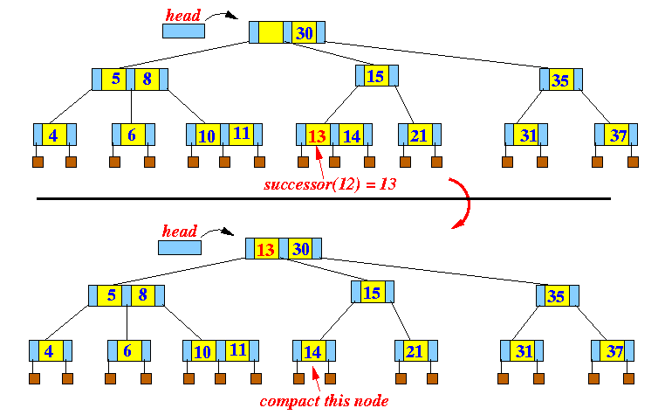
Then replace with successor

Slide 35
So, an entry will always be removed from a leaf node.
So, when we do even more complex deletes we can always assume we are deleting from a leaf node.

