Slide 1
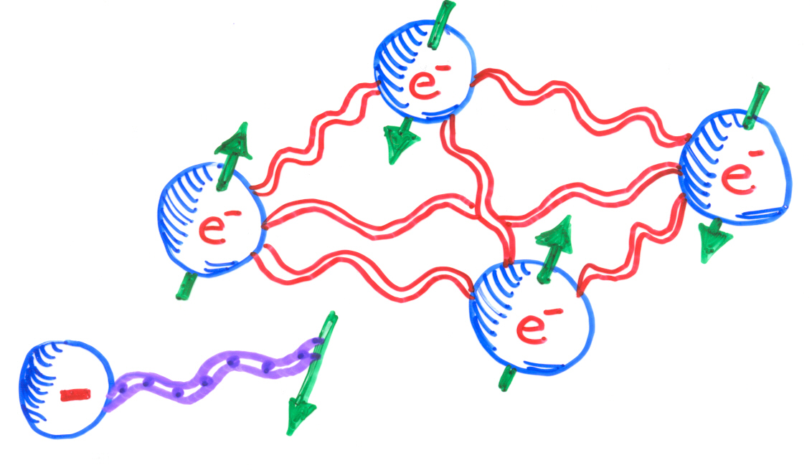
Frustration and Quantum Magnetism:
(Dis)Order from Disorder,
Valence Bonds, and Spin Liquids
John Berlinsky
McMaster University
Frustration, Quantum Fluctuations and Order from Disorder
Singlet Ground States, Spin Liquids, and Spinons

Slide 2
Why study frustration and quantum magnetism?
Cuprate Phase Diagram
temperature
Mott insulating parent state at zero doping, with AFM order
Consider holes in AFM state →
Pseudogap
AFM insulator
d-wave SC
doping

Slide 3
Holes in AFM
Hole motion leaves trail of defects
Holes “confined” in ordered (solid) states
Would be free to move in a “spin liquid” state – a strongly correlated but uniform state of spins and holes

Slide 4
Spin Liquids – Exotic States
Fractionalized quasiparticles
Spinons – neutral, spin ½
Holons – charged, no spin
Topological Order
Distinct degenerate ground states depending on topology

Slide 5
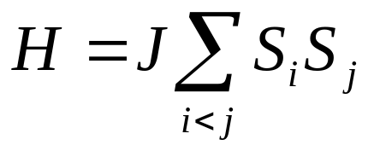

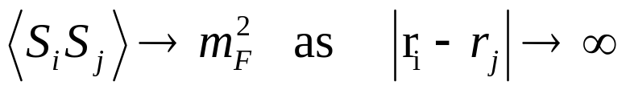
Basic Ingredients of Magnetism
Ising spins: ↑,↓ S_{i}=±1 Classical
Interactions → Long Range Ordered States:
Ferro:
Order Parameter m_{F}

Slide 6
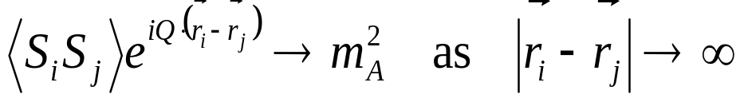
Antiferro: J > 0
Order Parameter m_{A}
In the absence of frustration
m_{F}, m_{A} → 1 as T → 0
for classical ordered spins.

Slide 7
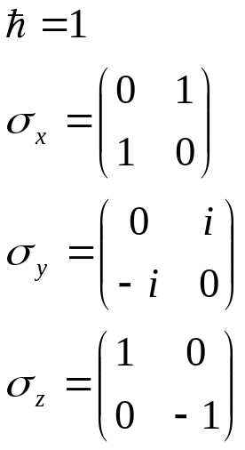
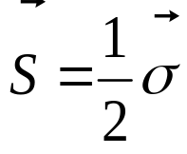
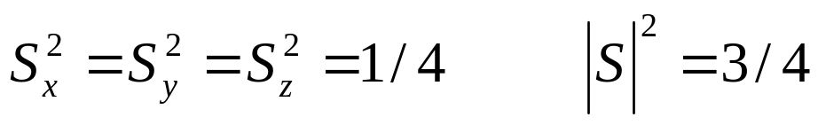
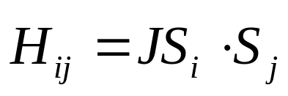
Quantum Spins
s=1/2 quantum spins:
Pair interaction
, J > 0 antiferro
J < 0 ferro

Slide 8
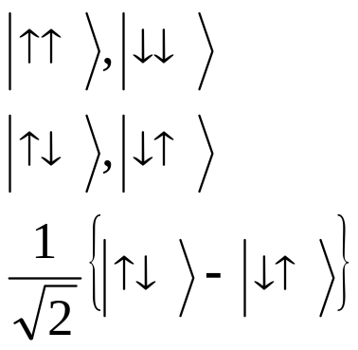
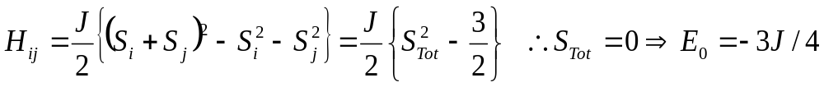
Quantum Spins
Pair interaction
J < 0 ferro, J > 0 antiferro
Ferro states: E_{Ferro} = J/4
Antiferro states: E_{Antiferro} = -J/4
Singlet state: E_{Singlet} = -3J/4

Slide 9
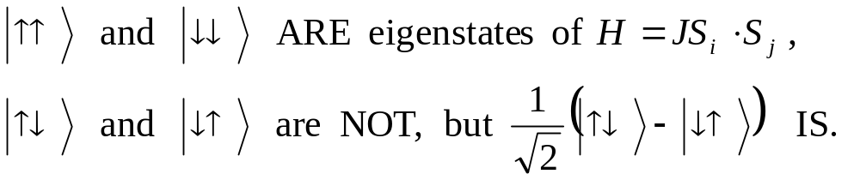
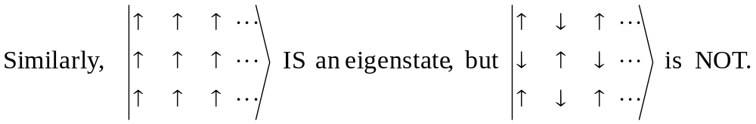
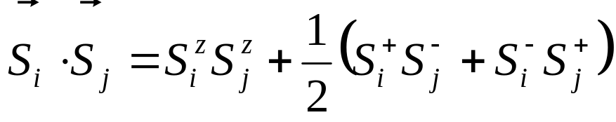
Singlet states put the “Quantum” into Quantum Magnetism
Neel or classical ground state of AFM
Valence bond paired singlet states
Flip nn antiparallel spins

Slide 10
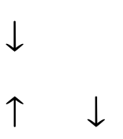
Compare Neel energy to Valence Bond energy for a square lattice
2 bonds per site
2 spins per VB
E_{N} = 2(-J/4) = -J/2 per site
E_{VB} = 1/2(-3J/4) = -3J/8 per site
Neel order wins in lowest order for the square lattice.
For more on the ordered state of the square lattice AFM, see: S. Chakravarty, B. I. Halperin and D. R. Nelson, Phys. Rev. Lett. 60, 1057 (1988); Phys. Rev. B 39, 2344 (1989).

Slide 11

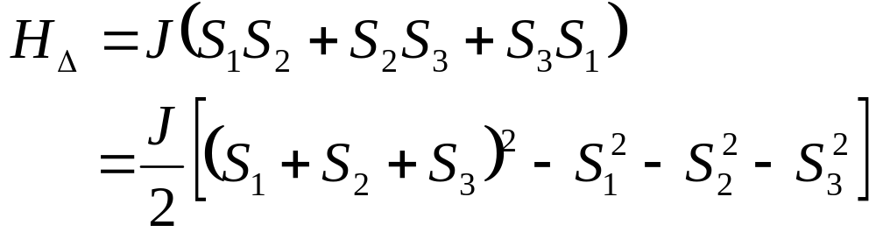
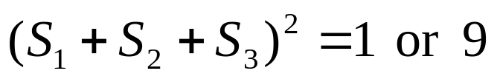
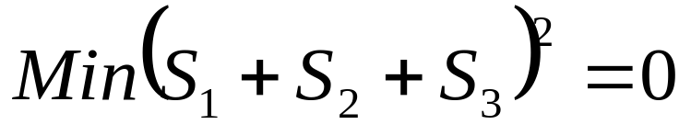
Frustration
?
Ising spins →
Classical Vector Spins:
120° state

Slide 12
AF Spins on Triangular Lattice
Ising
T_{C}
Wannier PR 1950
S(H=T=0)=0.3383R
H
XY or Heisenberg
Ground State Degeracy
XY: 2 x global rotation
Heisenberg: global (4π) rotation x 2π rotation

Slide 13
Spin Waves
ω_{q}
Finite stiffness (spin wave velocity)
Ground state entropy = 0
q
Compare Neel Energy to VB energy for s=½ HAFM
E_{Neel} = 3(-J/8) = -3J/8 E_{VB} = ½(-3J/4) = -3J/8
3 bonds/site 2 spins/VB
Anderson (1973) and Fazekas & Anderson (1974)

Slide 14
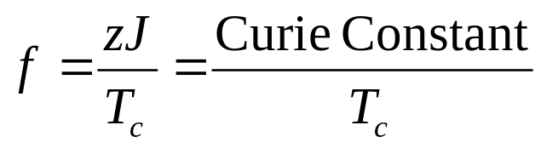
Two meanings of “Frustration”
All pairwise interactions can not simultaneously be maximally satisfied
Competing interactions lead to non-zero ground state entropy per spin
Measure of frustration is:
2 or 200?

Slide 15
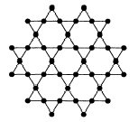
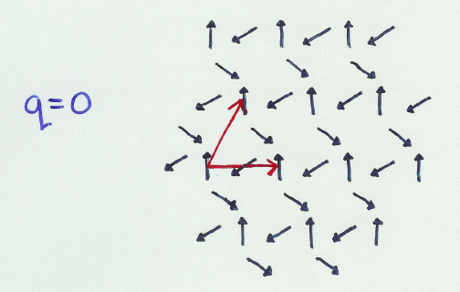
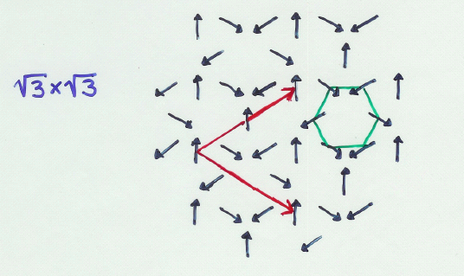
AF Spins on Kagome Lattice
(Corner-sharing triangles)
Two Special States

Slide 16
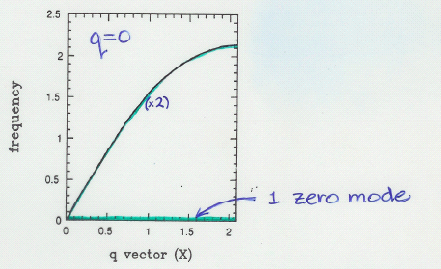
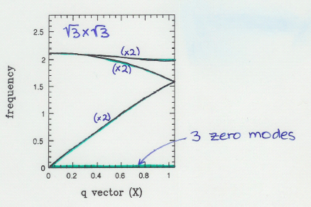
Spin Wave Spectra and Zero Modes

Slide 17
Spin Origami
Zero Modes of the Kagome HAFM
Each spin shared by two triangles
Free to rotate about shared spin
Maximal number of zero modes for co-planar states
co-planar states favoured by entropy [Chalker, Holdsworth and Shender 1992]
Order from Disorder

Slide 18
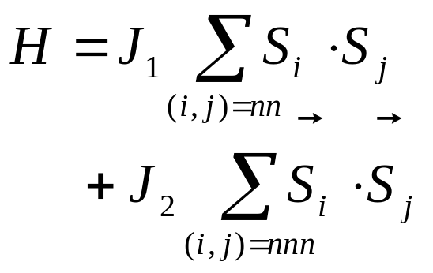
Ordering Due to Disorder in a Frustrated Vector Antiferromagnet [C. Henley PRL 1989]
(Villain et al 1980 and Shender 1982)
J₁ ←→ Nearest Neighbours
J₂ ←→ 2nd Neighbours

Slide 19
Conventional AF State
E_{AF} = -2J₁ + 2J₂ per spin
Two independent AF sublattices
E’_{AF} = -2J₂ per spin
E’_{AF} < E_{AF} → -2J₂ < -2J₁ + 2J₂
or J₁ < 2J₂
In the latter case, what determines angle φ between up spins on two sublattices?

Slide 20
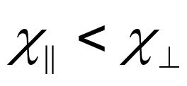
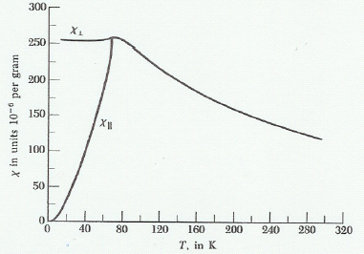
Fluctuations About Ground State with Angle φ
Handwaving argument:
Fluctuations of a given sublattice are transverse
For either sublattice
Coupling of transverse fluctuations via transverse susceptibility most effective when longitudinal directions are aligned
Calculation →

Slide 21
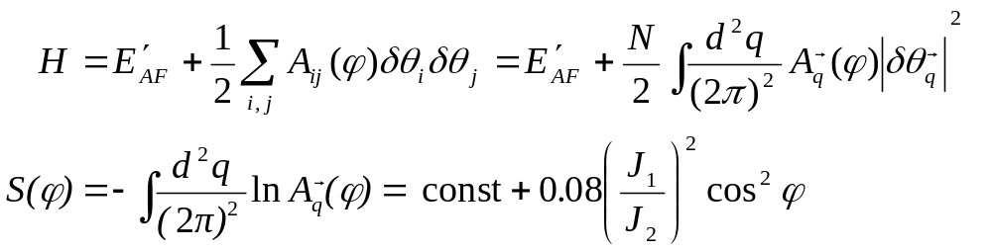

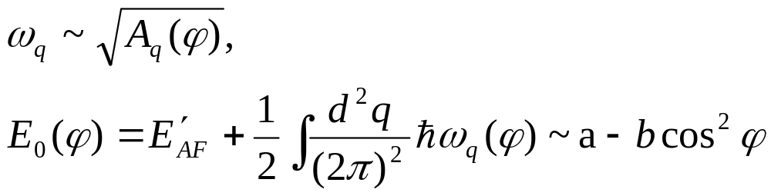

Calculation:
A. Classical
B. Quantum
Also a minimum for

Slide 22

Fluctuations couple sublattices driving an ordered state with φ = 0 or π.
Similarly fluctuations drive co-planar order (a type of liquid crystal order) in Heisenberg spins on the Kagome lattice

Slide 23
Order from Disorder in a Frustrated Ising Model Villain, Bidaux, Carton, and Conte, J. Physique (1980) Domino Model
A
B
A
B
A
A
B
A
B
A
Many Ground States for J_{AA}, J_{AB} Ferro, J_{BB} Antiferro |J_{AA}| > J_{BB} > |J_{AB}|
Excitations of B chains for parallel A chains have lower energy than excitations for antiparallel A chains

Slide 24
Order from Disorder for Frustrated Ising Spins
Lower energies of excitations for parallel A chains leads to an effective ferromagnetic interaction between spins on A chains and an effective Tc given by:
sinh(2β_{c}|J_{AA} + J_{BB}|) sinh(4 β_{c}J_{AB}) = 1
to a Ferrimagnetic state.

Slide 25
Summary
Quantum exchange favours singlet pairing.
Frustration leads to massively degenerate ground states.
Fluctuations can select subclasses of states with lower free energy (order from disorder).
Next lecture: How quantum fluctuations can stabilize solid- and liquid-like states of frustrated spin systems

Slide 26
The End

