Slide 1
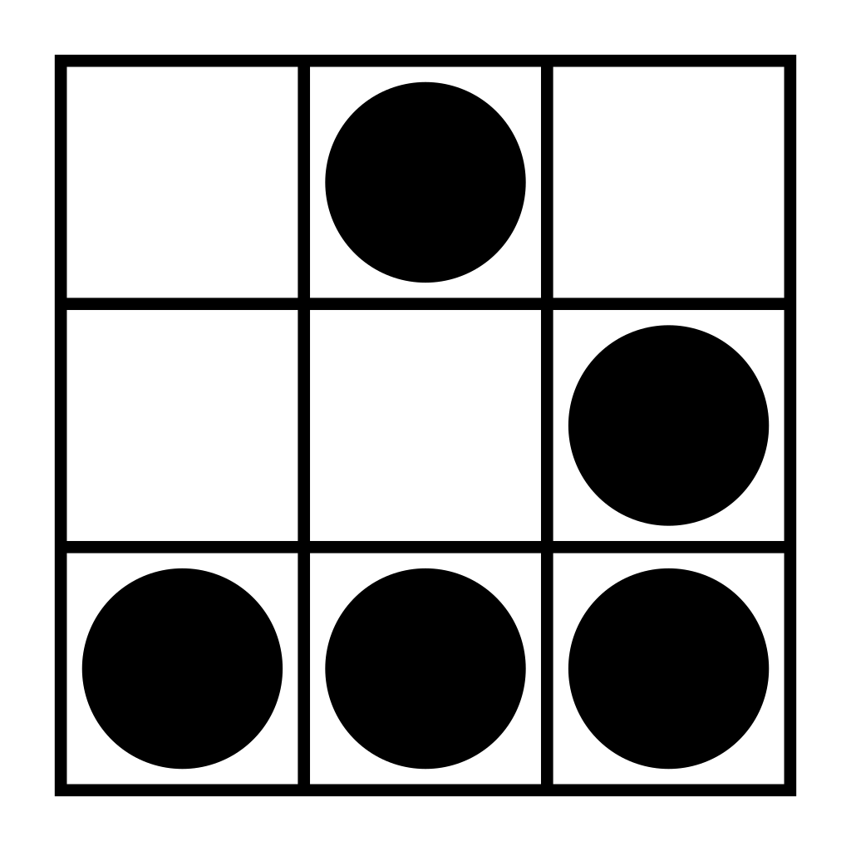
Introducción a Python
Happy Hacking

Slide 2
Función map

Slide 3
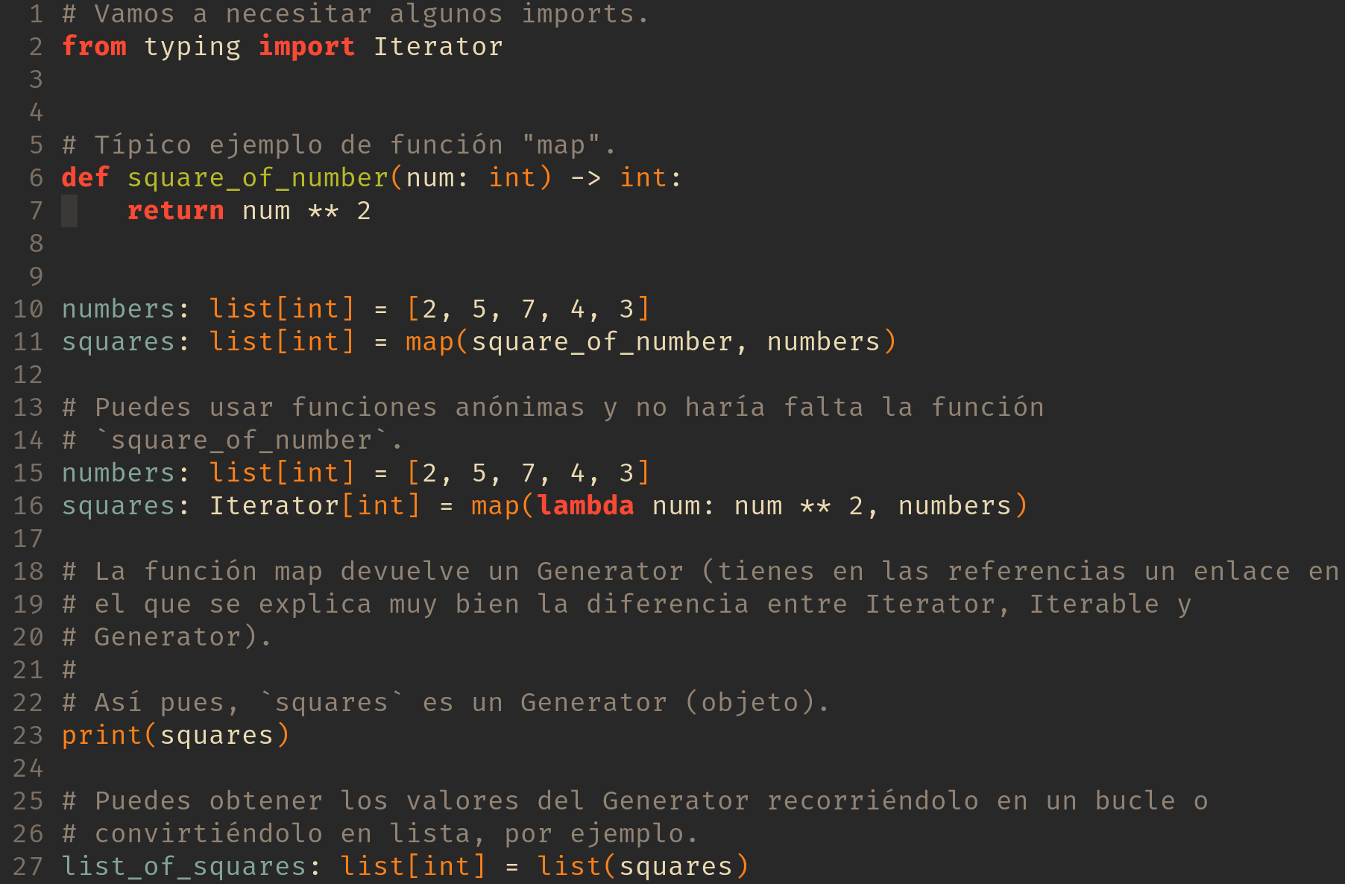

Slide 7
Función filter

Slide 8
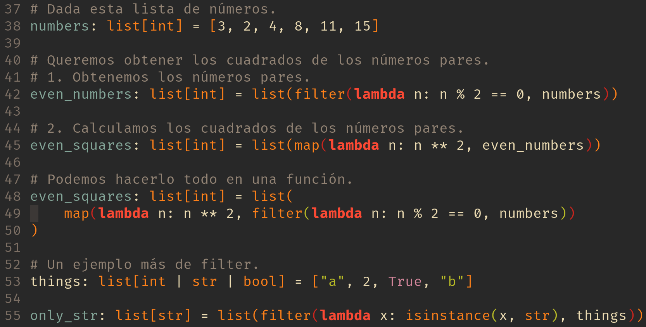

Slide 12
Función reduce

Slide 13
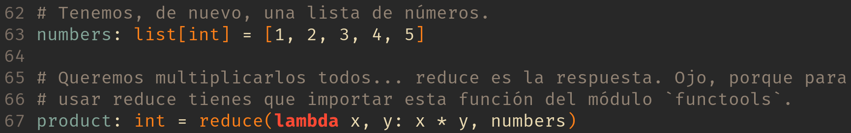

Slide 14

Ninja Training
cinturón blanco
map_filter_reduce

Slide 15
Referencias
https://medium.com/analytics-vidhya/python-iterators-vs-iterables-vs-generators-e15b9403292e
https://docs.python.org/3.6/library/typing.html#typing.Generator
https://book.pythontips.com/en/latest/map_filter.html

