Slide 1
Option Pricing: A Simplified approach
Cox, Ross, Rubinstein
Journal of Financial Economics
專題生：b04303117
Notes:
教授好，很抱歉，我原本說想要報告一篇二階可微分的報酬函數可以用out of the money put and call 複製的論文
但是後來我才發現我的數學程度和財務的先備知識還不足以讀懂，
所以我才改報這篇選擇權定價的論文，我目前的財務和數學能力也還只能讀懂這種程度的論文。
教授應該是很熟悉這篇論文了，所以我報這篇可能會佔用教授時間，如果教授覺得我講太慢可以請我跳過太慢的部分。

Slide 2
Introduction
Fischer Black and Myron Scholes (1973) presented the first satisfactory equilibrium option pricing model
In this article the author presented a simple discrete-time option pricing formula
Notes:
定價公式存在於幾乎每個財務的領域，例如幾乎所有的證券都可以被puts and calls 複製
在1973 年 BS 的定價公式被導出，但是他們用到了比較難的數學，也因此使得沒有明確的經濟意義。
在這篇中，作者提出了簡單的離散的定價公式，而且這篇較有經濟意義。

Slide 3
Introduction
Sections 2 and 3 illustrate and develop this model for a call option on a stock which pays no dividends.
Section 4 shows exactly how the model can be used to lock in pure arbitrage profits if the market price of an option differs from the value given by the model.
In section 5, we will show that their approach includes the Black- Scholes model as a special limiting case.
Notes:
接下來開始講目錄
在Sections 2 and 3 講了如何用導出這個公式，在這邊先假定沒有股利
在Section 4 講了如果市場的選擇權價格不同於這個模型的理論價格，我們可以套利
在Section 5 講了這個模型在極限的情況下可以導出BS 的公式，另外在極限的情況下也可以推導出) jump process model

Slide 4
Introduction
Section 6 introduces their numerical procedures and extends the model to include puts and calls on stocks which pay dividends.
Section 7 concludes the paper by showing how the model can be generalized in other important ways and discussing its essential role in valuation by arbitrage methods.
Notes:
在Section 6 講了如何計算有股利的puts and calls
在Section 7 總結了這個模型的重要性，以及如何被改得適用於一般情況

Slide 5
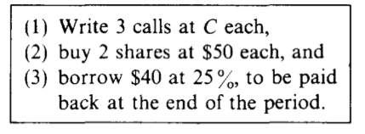
The basic idea
S = 50, S* = 25 or S* = 100 borrow and lend at r = 25%
a call with K = 50.
If no riskless profitable arbitrage opportunity, the value of the call can be derived.
Notes:
接下來開始最基本的模型，
首先先做了上面那些假設，
接下來他們宣稱，如果在沒有套利的情況下， call 的價值可被導出。
首先先假設投資者做了如下1~3的事情

Slide 6
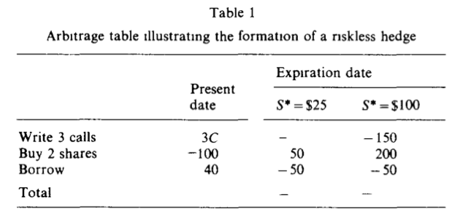
The basic idea
3C – 100 +40 = 0
C = 20
Notes:
這是剛剛做的事情產生的報酬，可以發現在每個情況下報酬都是零。因此 portofolio 的期初價格也應該是零，也因此 call 的價格應該是 20
如果不是的話， 將會產生套利的機會，

Slide 7
The basic idea
In view of this, it should seem less surprising that all we needed to determine the exact value of the call was its striking price, underlying stock price, range of movement in the underlying stock price, and the rate of interest.
We do not need to know the probability that the stock price will rise or fall!
Notes:
所以我們發現，只要知道上面那些資訊，call 的價格即可以被決定出來，特別注意的是，我們不用知道股票上升或下降的機率。
在接下來中我們會使這個簡單模型推廣到現實的應用

Slide 8
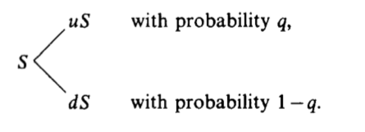
The binomial option pricing formula
We begin by assuming that the stock price follows a multiplicative binomial process over discrete periods.
We also assume that the interest rate is constant.
Notes:
我們先假設股價會服從一個重複的binomial process，
我們也假設利率是不變的，個人可以在這個利率借貸
因此股票報酬率有probability q 是 u- 1 ，也有 probability l-q 是 d - 1
我們也假設沒有税、交易成本、margin requirements、
因此個人可以short sell 任何的證券

Slide 9
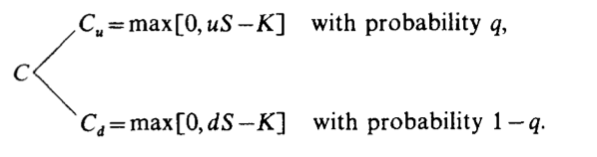
The binomial option pricing formula
Letting r denote one plus the riskless interest rate over one period, we require u > r >d.
Notes:
R 代表一期的無風險利率加上ㄧ，如果要沒有套利機會的話，我們必須要求u > r >d
Let C be the current value of the call, C, be its value at the end of the period if the stock price goes to US, and C, be its value at the end of the period if the stock price goes to dS.

Slide 10
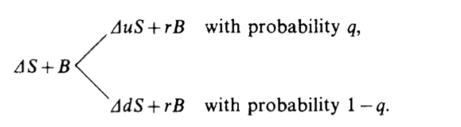
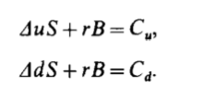
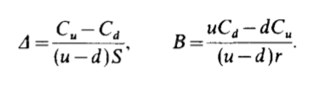
The binomial option pricing formula
Suppose we form a portfolio containing d shares of stock and the dollar amount B in riskless bonds
Notes:
我們做了一個portfolio，含有$Δ$ 的股票和 B 的現金 ，讓這個portfolio 去複製 call option 的價值，可以得到如上的公式

Slide 11
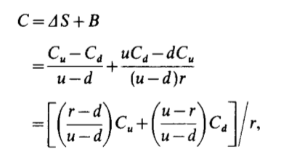
The binomial option pricing formula
If there are to be no riskless arbitrage opportunities, the current value of the call, C, cannot be less than the current value of the hedging portfolio
If C > S-K, it must be true that
Notes:
如果要沒有套利機會的話， call 的價格一定不能小於那個portfolio 的現值。
在C > S-K的情況下， call 的價格也不能大於那個portfolio 的現值，因此 call 的價格就是那個式子。
If I do not exercise now, I will receive the same payoff as a portfolio with AS in stock and B in bonds. If I do exercise now, I can take the proceeds, S-K, buy this same portfolio and some extra bonds as well, and have a higher payoff in every possible circumstance.
Consequently, no one would be willing to hold the calls for one more period.
and if not, C=S-K.’

Slide 12
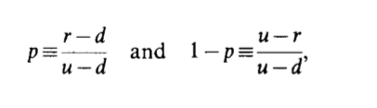

The binomial option pricing formula
It is easy to see that in the present case, with no dividends, this will always be greater than S-K as long as the interest rate is positive.
This formula has a number of notable features.
p is the value q would have in equilibrium if investors were risk-neutral.
Notes:
也因此我們可以得到 p 和 1-p
我們可以證出，如果利率是正的， c 一定會大於 S-K
To confirm this, note that if uSsK, then S<K and C=O, so CBS-K. Also if dSzK, then C= S- (K/r)> S-K. The remaining possibility is uS>K>dS. In this case, C=p(uS-K)/r. This is greater than S-K if (1 -p) dS> (p- r)K, which is certainly true as long as r> 1.
這個公式有幾個值得注意的特色，
第一，q 沒有出先在公式中，這代表即便投資者對未來股票上升和下降有不同的主觀的機率，他們還是可以得到同樣的選擇權價格
第二，選擇權的價格也不會因為投資者的風險偏好而改變。我們對投資者做的假設只有他們喜歡多的財富，因此願意去套利。
第三，call 的價格只單單被股票價個這個隨機變數影響。Call 的價格不會被其他證券或是portfolios 影響。如果有其他的定價公式是由其他證券或是portfolios決定出來，我們即可以產生套利，進而證明定價公式是錯誤的。
投資者對於風險的偏好，以及其他資產的特性的確會影響 call 的價格，但是是由間接影響的。
如果投資者是風險中立的話，p 就是 q

Slide 13
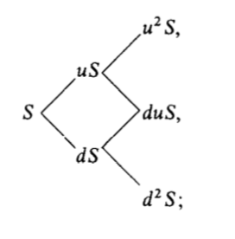
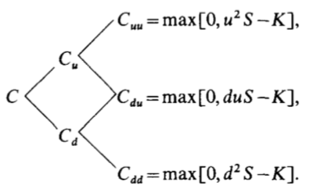


The binomial option pricing formula
Notes:
這是兩期的模型。

Slide 14
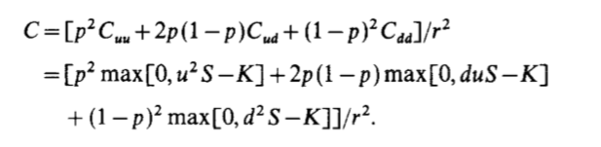

The binomial option pricing formula
Let a stands for the minimum number of upward moves which the stock must make over the next n periods for the call to finish in-the-money.
Notes:
得到的 call 的價格就是那樣。
A 是代表最小的可以讓 call 在期末是 in the money 的上升的步，因此call 的步數可以改成那樣

Slide 15




The binomial option pricing formula
Thus a will be the smallest non-negative integer such that
Therefore, if j < a,
If j >= a,
Notes:
也因此 a 要符合上面的式子

Slide 16
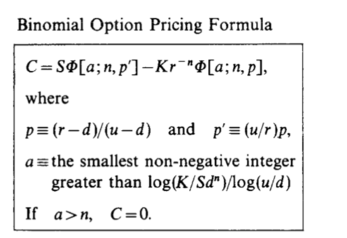
The binomial option pricing formula
Notes:
也因此我們可以得到定價公式

Slide 17
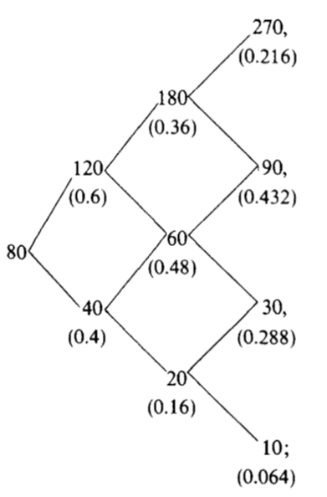
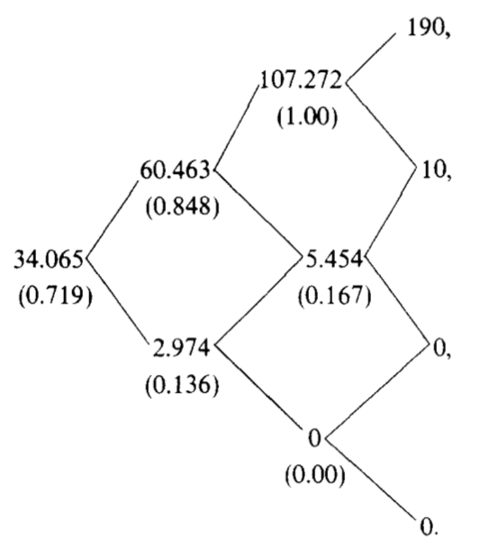
Riskless trading strategies
C=0.751[0.064(0)+0.288(0)+0.432(90- 80)+0.216(270-go)] = 34.065.
Notes:
接下來我們來看無風險的交易策略。
先假設股票是左邊那樣子，括號是機率
右邊那樣子是對應的call 的價格，括號中是$∆$
Call 的價格可以由前面的公式導出來，在期初是34多

Slide 18
Riskless trading strategies
Suppose that when n=3, the market price of the call is 36.
The option is overpriced, so we could plan to sell it and assure ourselves of a profit equal to the mispricing differential.
Notes:
假設call的價格被高估成36。我們可以有套利的策略

Slide 19
Step 1 (n=3): Sell the call for 36, buy 0.719 shares of stock by borrowing 0.719(80) - 34.065 =23.455. lend the remainder 36- 34.065 = 1.935
Step 2 (n=2): Suppose the stock goes to 120. Buy 0.848 -0.719 =0.129 more shares of stock at 120 per share for a total expenditure of 15.480. Owe 25.801 + 15.480=41.281.
Step 3 (n= 1): Suppose the stock price now goes to 60. Sell 0.848 -0.167 =0.681 shares at 60 per share, taking in 0.681(60)=40.860. 45.409 -40.860=4.549.
Step 4d (n=O): Suppose the stock price now goes to 30. The call is worthless. You own 0.167 shares of stock selling at 30 per share for 0.167(30)= 5. Sell the stock and repay the 4.549(1.1)= 5 that you now owe on the borrowing
Notes:
假設第一步是往上，第二步是往下，第三步也是往下。我們分別做那些步驟，可以得到1.935(1.1)3 =2.575.
23.455(1.1)=25.801.
1.281(1.1) =45.409,
1.935(1.1)3 =2.575.

Slide 20
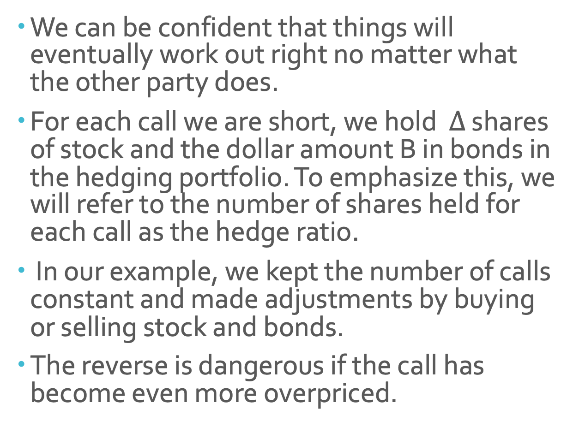
Riskless trading strategies
We can be confident that things will eventually work out right no matter what the other party does.
For each call we are short, we hold $∆$ shares of stock and the dollar amount B in bonds in the hedging portfolio. To emphasize this, we will refer to the number of shares held for each call as the hedge ratio.
In our example, we kept the number of calls constant and made adjustments by buying or selling stock and bonds.
The reverse is dangerous if the call has become even more overpriced.
Notes:
我們叫$∆$ 為 hedge ratio，因為股票和 call 的價格的變動是互相抵銷的，
不論交易對手做什麼，我們可以得到確定的利潤
要注意的是，我們是維持call的數量不變，並且買賣股票來維持hedge ratio，如果我們做相反操作，可能反而會賠錢，因為call 可能被overpriced

Slide 21
Riskless trading strategies
To adjust a hedged position, never buy an overpriced option or sell an underpriced option.
By choosing the right side of the position to adjust at intermediate dates, at a minimum we can be assured of earning the original differential and its accumulated interest, and we may earn considerably more.
Notes:
也因此我們只選擇買賣股票。
如果我們的交易對手沒有在對的時間做我們預期他們做的事情，我們還可以賺得更多。

Slide 22
Limiting cases
We could have taken time interval to be a much shorter - say an hour - or even a minute.
However, if we do this, we have to make some other adjustments to keep the probability small in case that the stock price will change by a large amount over a minute.
Notes:
接下來我們使我們的模型更貼近現實。
因為一天的股價不只兩種可能，一天也不會只交易一次，
因此我們把time interval 縮短，
而每次變動的比例也要因此調整。

Slide 23
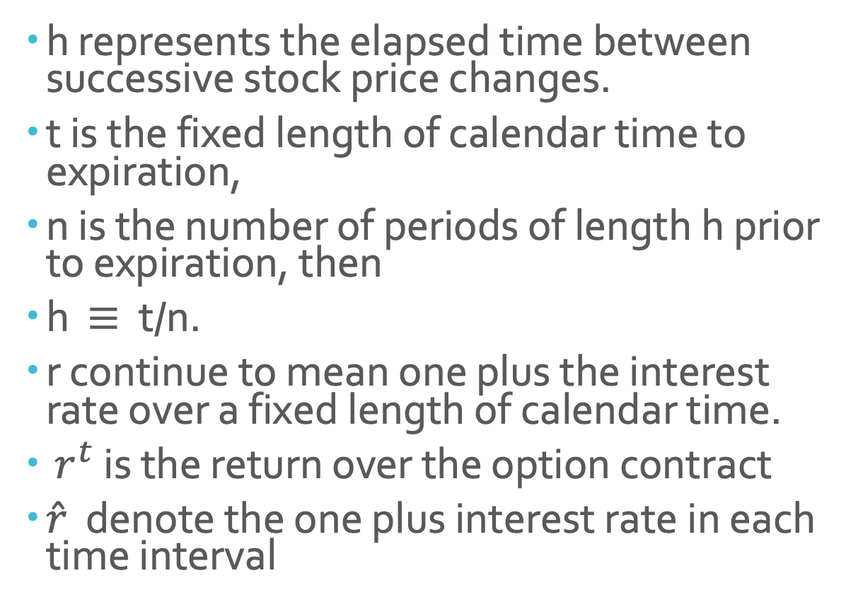
Limiting cases
h represents the elapsed time between successive stock price changes.
t is the fixed length of calendar time to expiration,
n is the number of periods of length h prior to expiration, then
h $≡$ t/n.
r continue to mean one plus the interest rate over a fixed length of calendar time.
$r^{t}$ is the return over the option contract
$\hat{r}$ denote the one plus interest rate in each time interval
Notes:
h t n r $r^{t}$ $\hat{r}$ 分別如上面的定義。

Slide 24
Limiting cases
as n getting large, we can have either a continuous or a jump stochastic process.
We examine in detail only the continuous process which leads to the option pricing formula originally derived by Fischer Black and Myron Sholes.
logu or logd gives the continuously compounded rate of return on the stock over each period.
Notes:
我們可以選擇 continuous or a jump stochastic process 來描述股價短時間的波動。
對於continuous stochastic process來說，每個小區間都會有小的股價變動。這也可導出BS的公式
也因此logu or logd 是continuously compounded rate of return on the stock over each period.

Slide 25

Limiting cases
Over n periods,
j is the random number of upward movement in n periods
Notes:
在n 期中，股價的變動是第一行那樣
也因此我們可以導出期望值和標準差

Slide 26
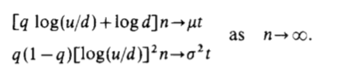
Limiting cases
We would want the mean and variance of the continuously compounded rate of return of the assumed stock price movement to coincide with that of the actual stock price as n getting large
Then we would want to choose u, d, and q, so that
Notes:
我們會希望導出的期望值和標準差會趨近於真實的期望值和標準差

Slide 27


Limiting cases
This satisfies our initial requirement that the limiting means and variances coincide, but we still need to verify that we are arriving at a sensible limiting probability distribution of the continuously compounded rate of return.
Notes:
因為要滿足前一頁的要求，所以產生上兩行。
但是我們還要要求我們得到的distribution 是好的。

Slide 28
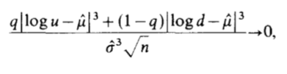
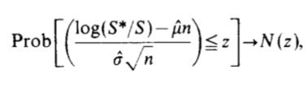
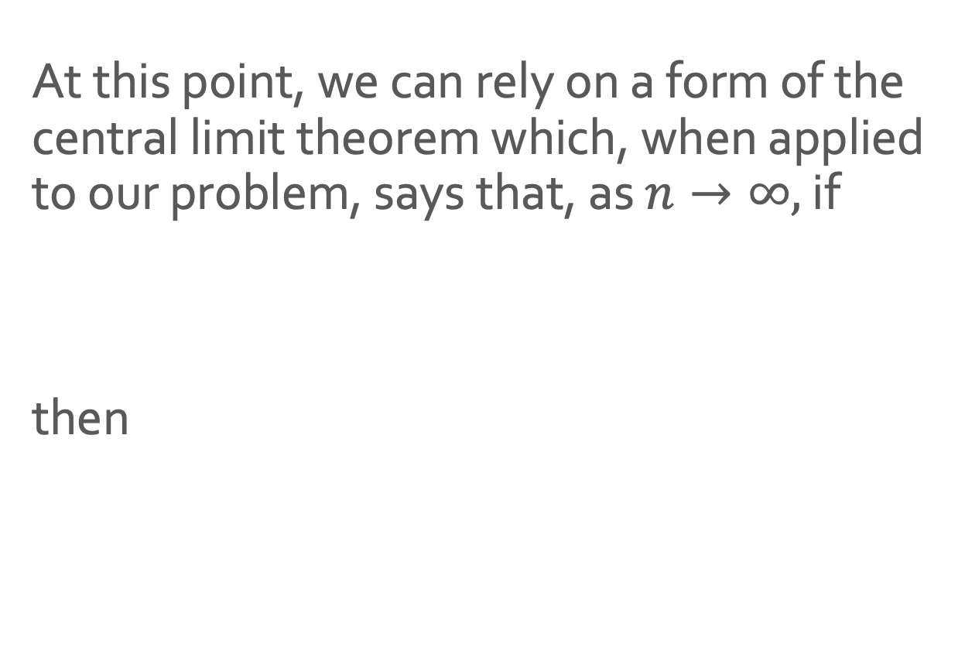
Limiting cases
At this point, we can rely on a form of the central limit theorem which, when applied to our problem, says that, as $n→∞,$ if
then
Notes:
N(z) is the standard normal distribution function.
藉由中央極限定理，
當n增加時，標準化後的連續複利的報酬率會是 log normal

Slide 29
Limiting cases
Black and Scholes begin directly with continuously trading and the assumption of lognormal distribution for stock prices.
Since their approach make the same assumption, the two resulting formula should then coincide.
Notes:
BS 的模型一開始就假設報酬率是 log normal
也因此，因為他們的模型假設都一樣，所以他們得到的公式也應該一樣。

Slide 30
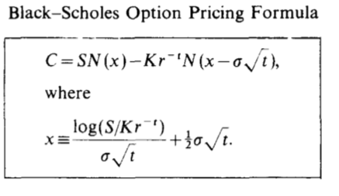

Limiting cases
Notes:
我們要證明上下兩個公式是一樣的。
Therefore to show the two formulas converge, we need only show that as n -> $∞$ 下面的會趨近於上面的
因為我看不懂，也覺得太繁瑣，所以我略過這段證明
文章中也提到 continuous jump process 也可以被 下面的導出

Slide 31
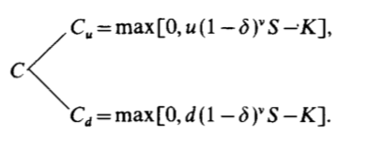
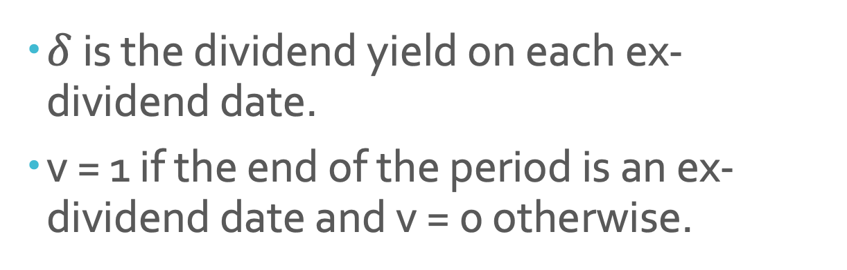
Dividends and put pricing
$δ$ is the dividend yield on each ex-dividend date.
v = 1 if the end of the period is an ex-dividend date and v = 0 otherwise.
Notes:
接下來是 dividend 的部分，我們先假設我們知道dividend yield 以及什麼時候發股利，
也因此call 的價值變成上面那樣

Slide 32

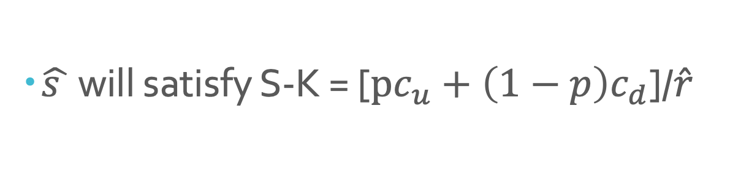
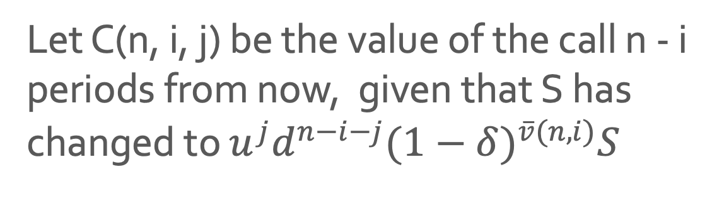
Dividends and put pricing
$\hat{s }$ will satisfy S-K = [$pc_{u}+\left(1−p\right)c_{d}$]/$\hat{r}$
Let C(n, i, j) be the value of the call n - i periods from now, given that S has changed to $u^{j}d^{n−i−j}{(1−δ)}^{\overline{v}(n,i)}S$
Notes:
$\hat{s}$ 是 critical stock price
如果 S > $\hat{s}$, call 會被提早執行
$\overline{v}\left(n,i\right) 在下個n−i 期$ 中會發放的股利次數
j = o,1,2 ,..., n-i.

Slide 33
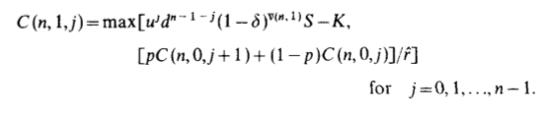
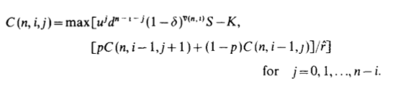
Dividends and put pricing
Notes:
也因此，n-1 的call 等於 當下call 被執行的價格 與 沒被執行放到 n 期的價格的折現
也由此可以推出 C(n,i,j)

Slide 34
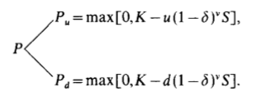

Dividends and put pricing
$\hat{P} satisfy that$ $\frac{pP_{u}+\left(1−p\right)P_{d}}{\hat{r}}=K −S$
Notes:
Put 在有dividend 的情況也是一樣的方法處理，
唯一的區別是我們要改變成k - s
Reversing the difference between the stock price and the striking price at each stage is the only change.

Slide 35
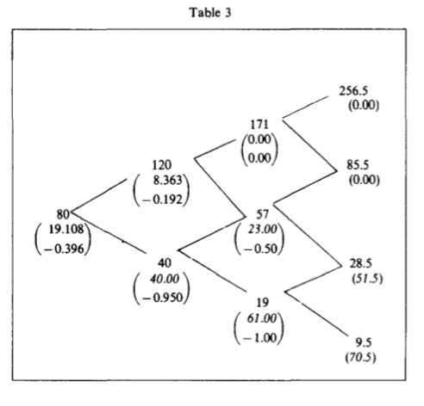
Dividends and put pricing
Put values in italics indicate that immediate exercise is optimal.
Notes:
這是股票的價格
括號內分別是put 的價值和hedge ratio

Slide 36
Conclusion
Options can be priced solely on the basis of arbitrage considerations.
To price an option by arbitrage methods, there must exist a portfolio of other assets which exactly replicates in every state of nature the payoff received by an optimally exercised option.
The simple two- state process is really the essential ingredient of option pricing by arbitrage methods.
Notes:
也因此經由這個模型，我們可以發現可以用無風險套利來定價選擇權。
要定價一個選擇權時，一定要有一個 portfolio 可以複製 option。
而這個定價模型有經濟意義並且數學用得比較少，
在無風險定價中佔了很重要的部分！

