Slide 1
A GEO STUDY · 40 AI ANSWERS · 09.10.2026
Favoured Banks
Which Indonesian banks ChatGPT and Gemini recommend, and which web pages they lean on
Rahmananda Ridho Gamawan
Notes:
A study of how two AI engines answer everyday banking questions in Indonesia, and which sources they cite. Everything here is built from public code and data in the repo named on the last slide.

Slide 2
FAVOURED BANKS
COLD OPEN
One question, two answers
“Saya freelancer dengan penghasilan tidak tetap, butuh rekening tanpa saldo minimum dan bisa pisah kantong. Bank apa yang cocok?”
I'm a freelancer with irregular income. I need an account with no minimum balance that lets me split money into pockets. Which bank fits?
CHATGPT NAMED
GEMINI NAMED
BCA
Bank Jago
SeaBank
BCA
Bank BTPN (Jenius)
Bank Jago
Prompt 13 of 20 · run on 09.10.2026 · source: data/interim/mentions.csv
09.10.2026 · 40 ANSWERS · SCENE 02
Notes:
A freelancer asks which bank fits irregular income. Both engines answer with a short list of banks. There is no results page to compete on: a bank is either in the answer or it is not.

Slide 3
People now ask for answers. A strong Google rank is a weak guide to who gets cited.
14% → 24%
12%
share of ChatGPT conversations that seek information, a year apart
of URLs cited by AI assistants rank in Google's top 10 for the same query
OpenAI usage study, via Search Engine Journal
Ahrefs, 15,000 prompts
Notes:
Two outside numbers set the scene. Information-seeking is a growing share of ChatGPT use, and the pages AI assistants cite are mostly not the pages that rank on Google.

Slide 4
FAVOURED BANKS
COLD OPEN
Three questions
01
Which banks does each engine name, how early, and in what tone?
02
Which sources does each engine cite, and do the two engines agree?
03
Where does a bank's share of the answers differ from its share of the cited pages?
09.10.2026 · 40 ANSWERS · SCENE 04
Notes:
The rest of the deck answers these three questions in order.

Slide 5
PART I
Method
20 prompts, 2 engines, one day

Slide 6
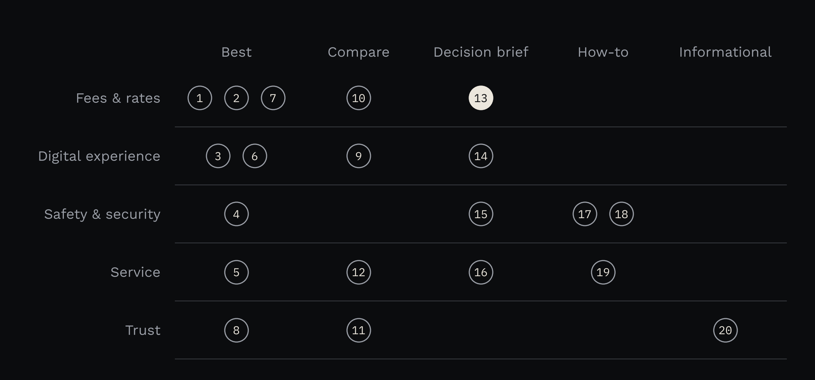
FAVOURED BANKS
PART I · METHOD
20 everyday banking questions, asked in Bahasa Indonesia
5 customer needs by 5 question types. Only 3 prompts name a bank, all of them comparisons.
Each prompt was asked once in ChatGPT and once in Gemini, with a request for 10 sources.
The lit circle is prompt 13, the cold open.
source: data/interim/answers.csv
09.10.2026 · 40 ANSWERS · SCENE 06
Notes:
The prompt set is written to be unbranded so share of voice is fair. Only the head-to-head comparisons name banks.

Slide 7
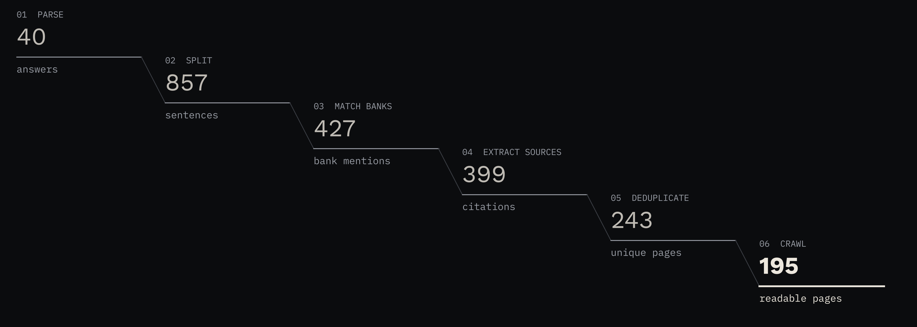
FAVOURED BANKS
PART I · METHOD
From 40 answers to 195 readable source pages
Each step is code in the public repo, covered by tests. Only links under each answer's source list count as citations.
code and data: github.com/rgmwnn/geo-bank-visibility
09.10.2026 · 40 ANSWERS · SCENE 07
Notes:
Parse the answers, split them into sentences, match bank names, extract the listed sources, deduplicate the pages, then crawl them from GitHub's servers while respecting robots.txt.

Slide 8
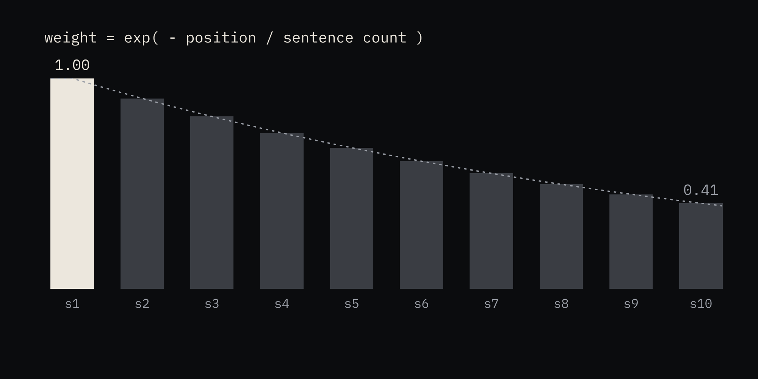
FAVOURED BANKS
PART I · METHOD
What is measured
Mention rate
share of answers that name the bank
AI share of voice
the bank's share of bank mentions, each answer weighted equally
Brand PAWC
how much of an answer is about the bank, earlier sentences weighted more
Source share of voice
the bank's share of bank mentions in the readable cited pages
SOV gap
AI share of voice minus source share of voice
VIS
0 to 100: equal mix of PAWC, source authority, sentiment and coverage of both engines
PAWC adapted from Aggarwal et al., GEO: Generative Engine Optimization, KDD 2024
09.10.2026 · 40 ANSWERS · SCENE 08
Notes:
Brand PAWC uses the position-adjusted word count from the GEO paper, applied to banks instead of sources. The chart shows the weight each sentence gets in a ten-sentence answer.

Slide 9
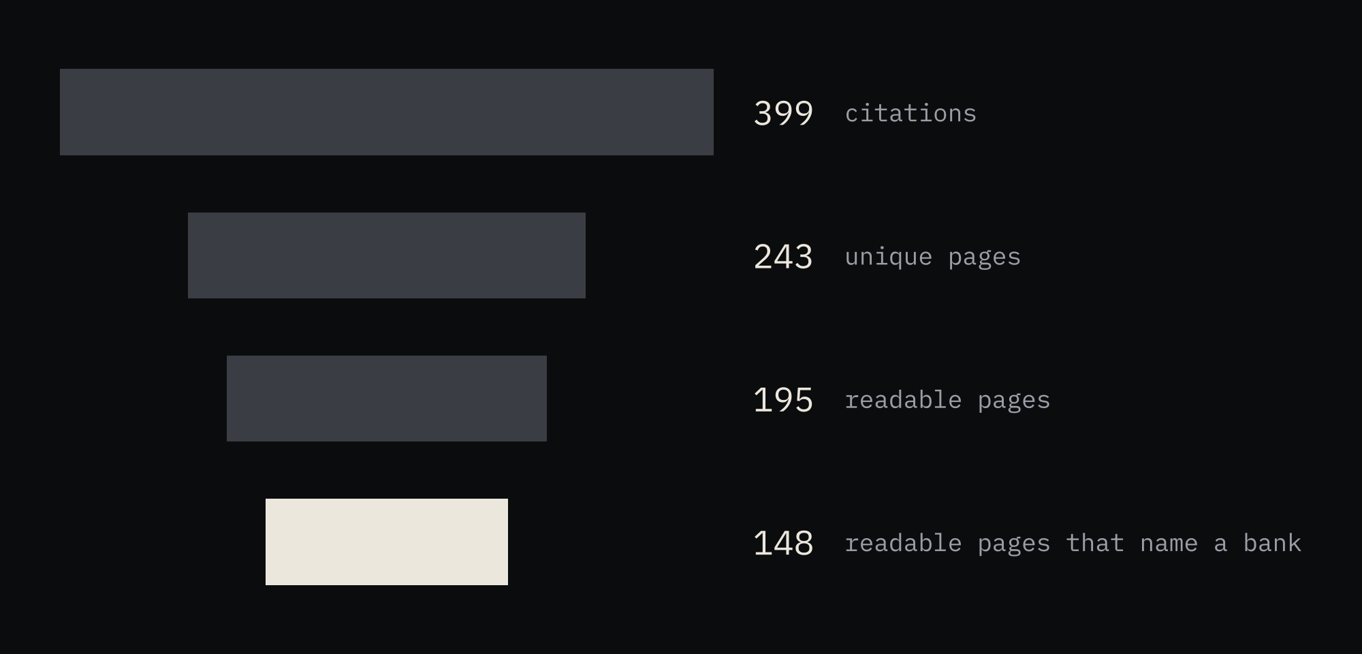
FAVOURED BANKS
PART I · METHOD
The evidence, and what it cannot show
· One run per prompt per engine: a snapshot.
· Asking for 10 sources makes both engines cite more than usual.
· 10 of 20 prompts lean digital: they name digital banks or ask about apps.
· Claude labelled sentiment and site types; RG spot-checked a sample.
· Pages that blocked the crawler drop out of page-level measures.
· Banks named in fewer than 3 answers are marked low n.
source: data/interim/pages.csv, page_brand_counts.csv
09.10.2026 · 40 ANSWERS · SCENE 09
Notes:
The funnel shows how much of the cited web could be read. The list is what the data cannot tell you.

Slide 10
PART II
The answers
Who gets named, how early, and in what tone

Slide 11
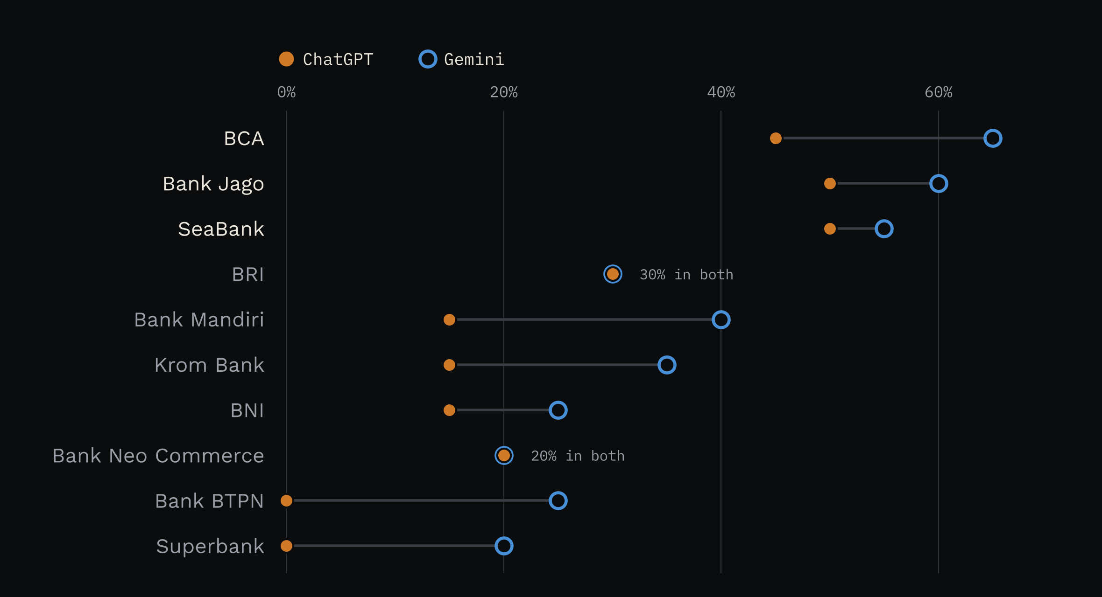
FAVOURED BANKS
PART II · THE ANSWERS
BCA, Bank Jago and SeaBank are each named in more than half of all answers
BCA and Bank Jago appear in 22 of 40 answers, SeaBank in 21, BRI in 12.
source: data/processed/brand_engine.csv · top 10 banks
09.10.2026 · 40 ANSWERS · SCENE 11
Notes:
One dot per engine. The line between the dots is the gap between the engines for that bank.

Slide 12
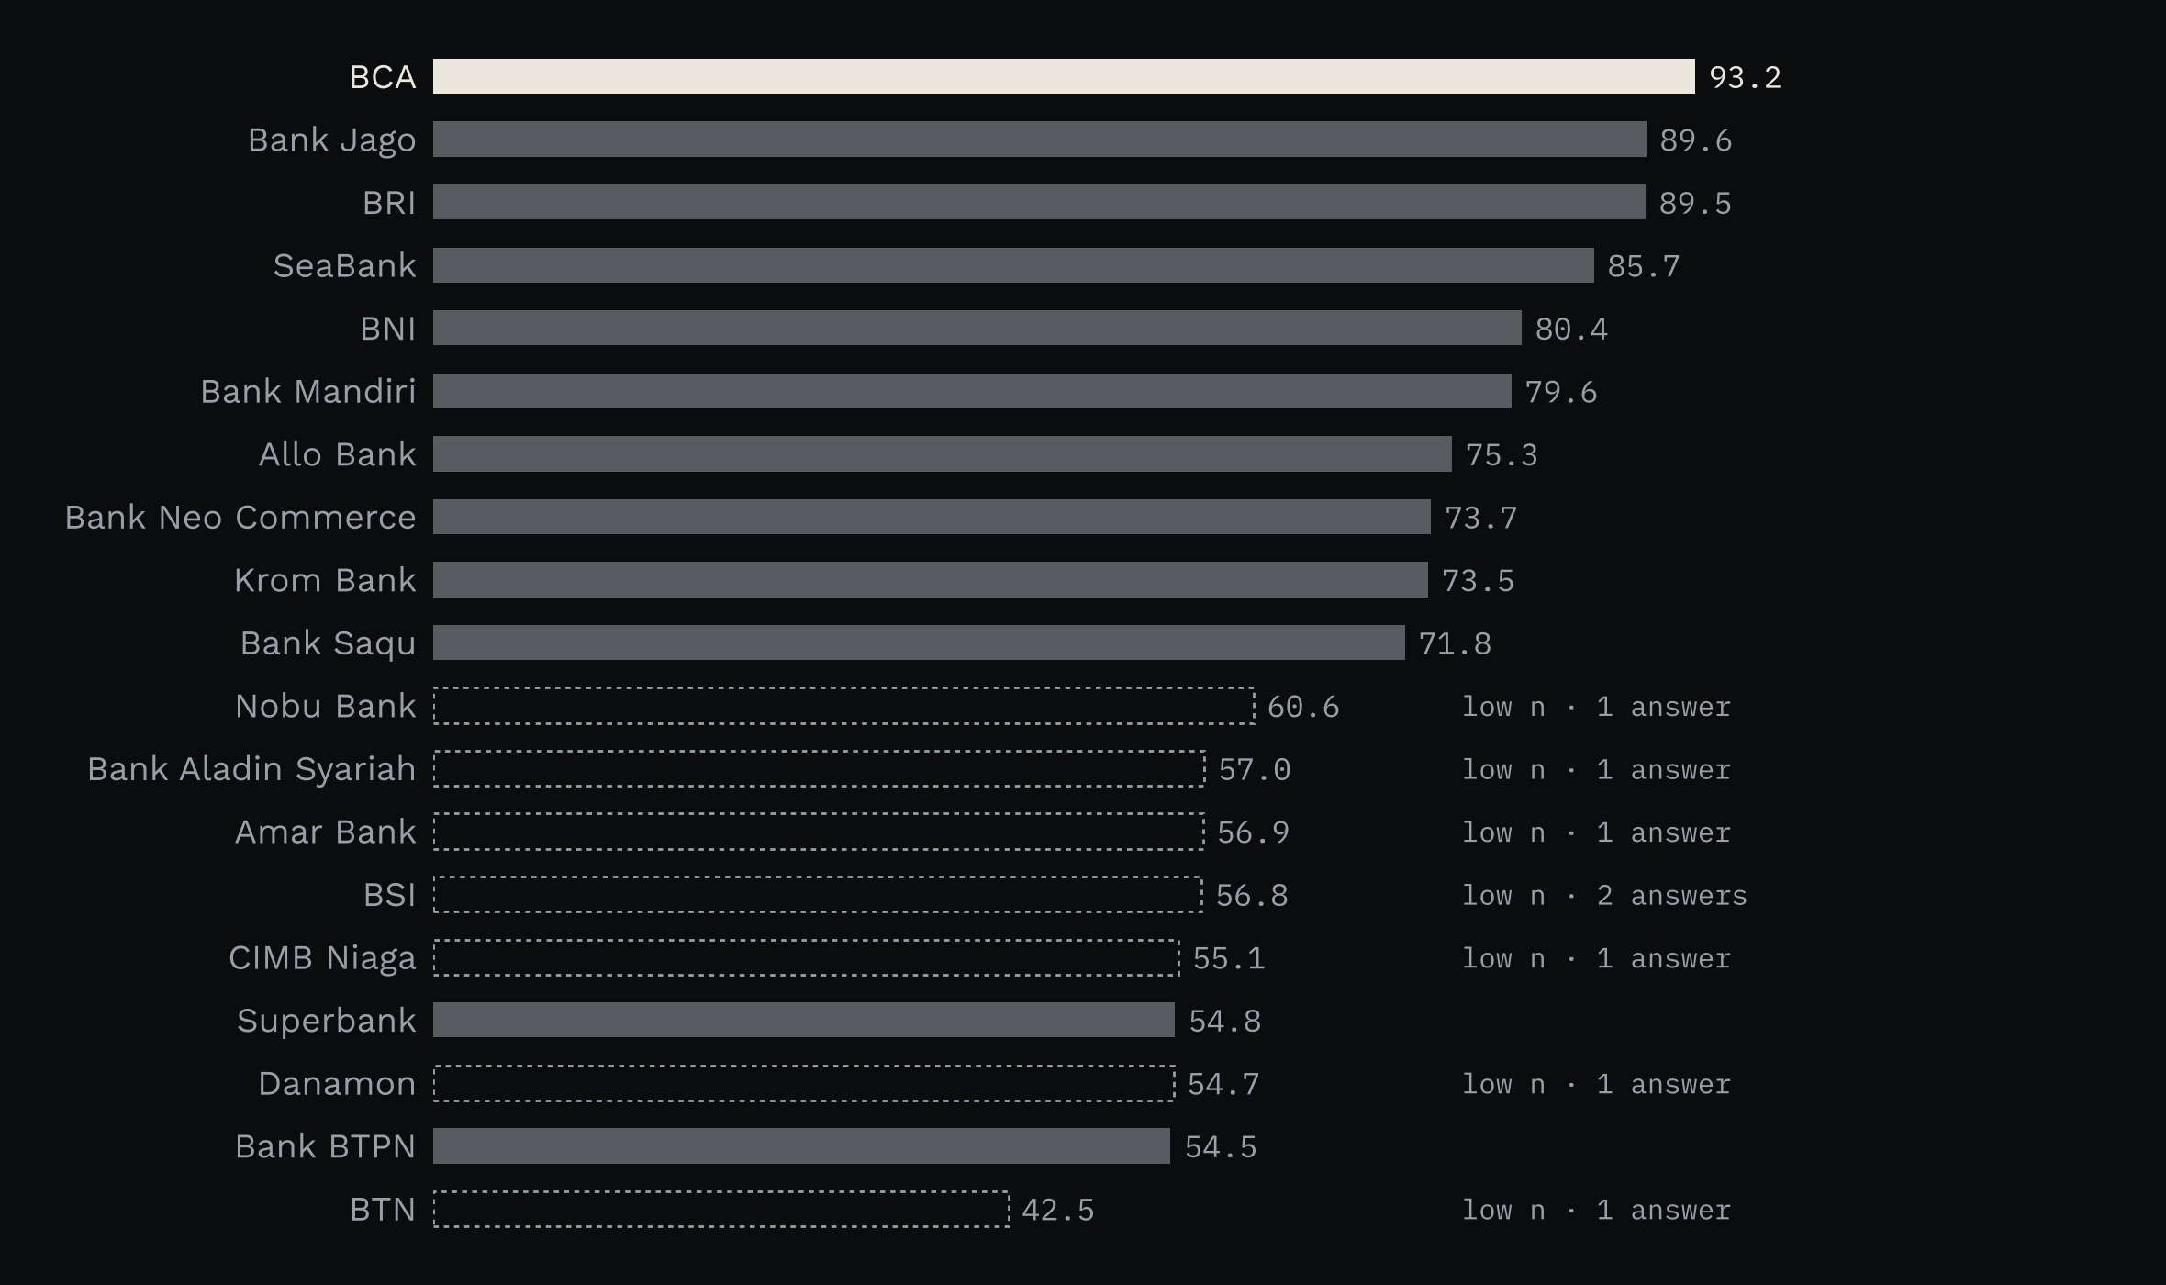
FAVOURED BANKS
PART II · THE ANSWERS
BCA has the highest visibility score
VIS 93.2 for BCA, then Bank Jago 89.6, BRI 89.5 and SeaBank 85.7.
Dashed bars are banks named in fewer than 3 answers. Read those as unranked.
source: data/processed/vis.csv
09.10.2026 · 40 ANSWERS · SCENE 12
Notes:
VIS combines prominence in the answer, the authority of the pages cited alongside the bank, sentiment and whether both engines name it.

Slide 13
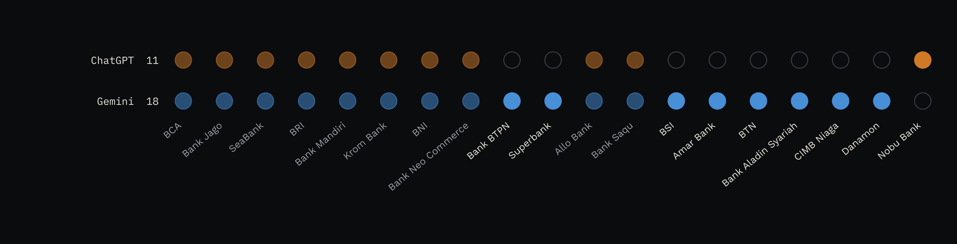
FAVOURED BANKS
PART II · THE ANSWERS
Gemini names a wider field: 18 banks against ChatGPT's 11
Bright marks are banks only one engine named. Gemini alone named Bank BTPN (Jenius) in 5 answers and Superbank in 4.
source: data/processed/brand_engine.csv
09.10.2026 · 40 ANSWERS · SCENE 13
Notes:
Apps and subsidiaries credit their parent bank, so Jenius counts for Bank BTPN and blu for BCA.

Slide 14
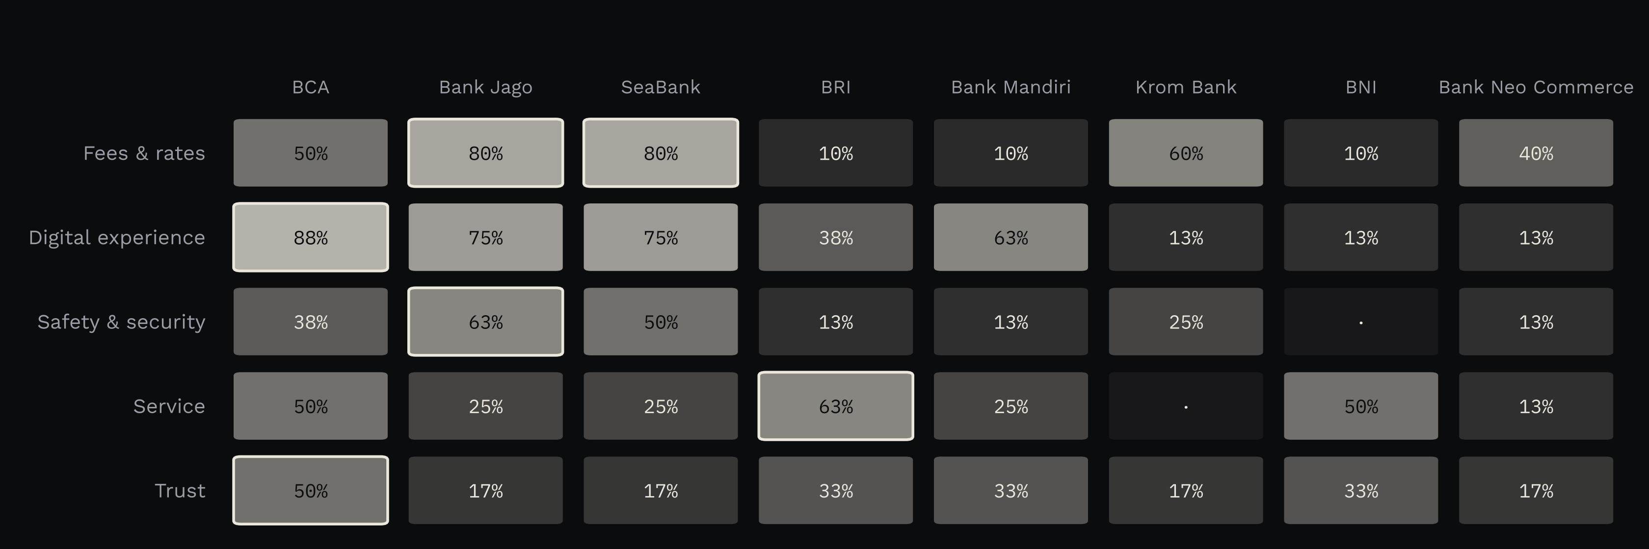
FAVOURED BANKS
PART II · THE ANSWERS
Each customer need has its own leading bank
Fees and rates: Bank Jago and SeaBank (80%). Digital experience: BCA (88%). Safety: Bank Jago (63%). Service: BRI (63%). Trust: BCA (50%).
source: data/processed/brand_pillar.csv · share of answers in each pillar that name the bank
09.10.2026 · 40 ANSWERS · SCENE 14
Notes:
Outlined cells are the leader in each row. BCA's digital lead comes largely through its apps.

Slide 15
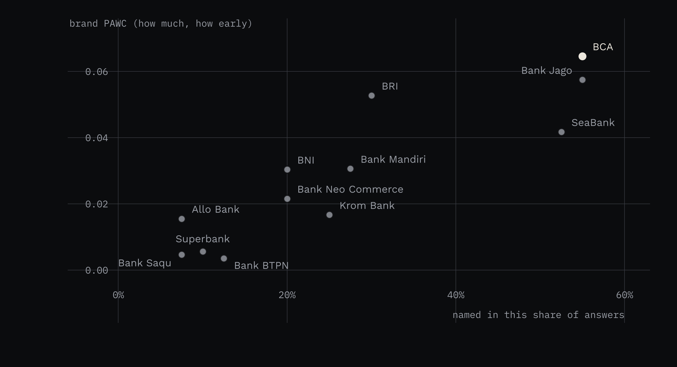
FAVOURED BANKS
PART II · THE ANSWERS
Named often and named early go together
BCA and Bank Jago lead on both measures.
BRI scores higher on PAWC than SeaBank while appearing in fewer answers: when BRI is named, it takes up more of the answer.
source: data/processed/brand_engine.csv · banks named in at least 3 answers
09.10.2026 · 40 ANSWERS · SCENE 15
Notes:
Brand PAWC rises when a bank is named early and talked about at length.

Slide 16
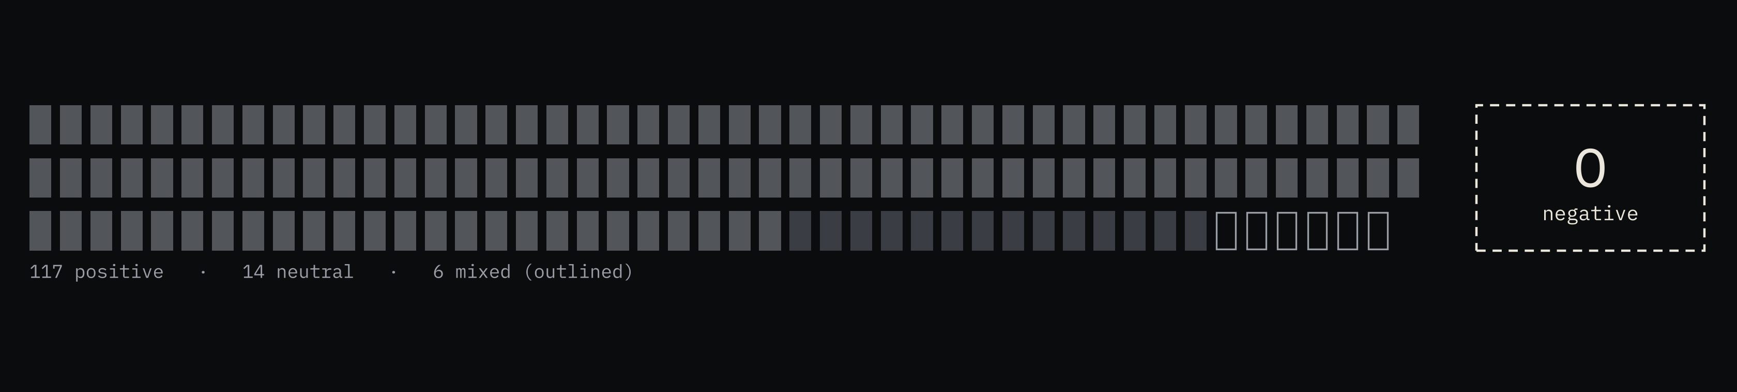
FAVOURED BANKS
PART II · THE ANSWERS
No answer was negative about a bank
Of 137 answer and bank pairs, 117 are positive. The 6 mixed labels attach a condition, such as a minimum balance for free transfers. Being named at all is what to measure.
source: data/labels/sentiment.csv · labelled by Claude, spot-checked by RG
09.10.2026 · 40 ANSWERS · SCENE 16
Notes:
Each mark is one bank in one answer.

Slide 17
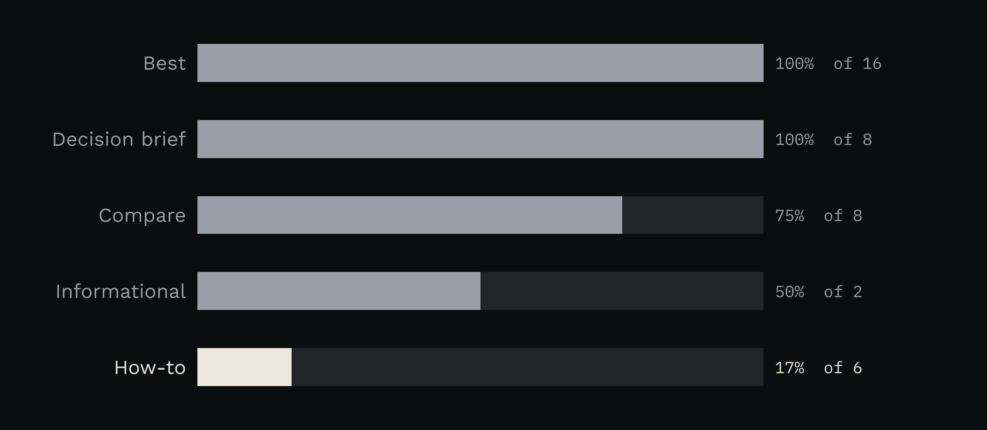
FAVOURED BANKS
PART II · THE ANSWERS
How-to answers rarely name a bank
Every best and decision-brief answer named at least one bank.
Only 1 of 6 how-to answers did. Explainers on deposit insurance, scams and complaints are a gap for banks.
source: data/processed/no_brand_rate.csv
09.10.2026 · 40 ANSWERS · SCENE 17
Notes:
Questions about how something works get general answers without bank names.

Slide 18
PART III
The sources
Which pages the engines lean on

Slide 19
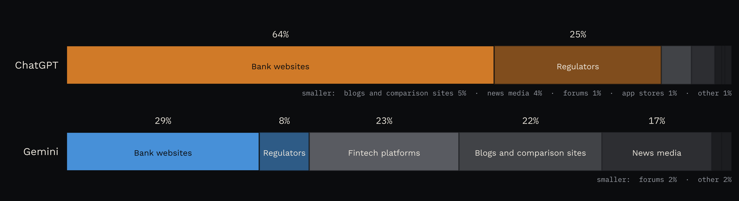
FAVOURED BANKS
PART III · THE SOURCES
ChatGPT cites banks and regulators. Gemini cites fintech, blog and news sites.
89% of ChatGPT's citations go to bank and regulator sites. 61% of Gemini's go to fintech platforms, blogs and news.
source: data/processed/domain_type_mix.csv
09.10.2026 · 40 ANSWERS · SCENE 19
Notes:
Site types were labelled per domain. Percentages are rounded.

Slide 20
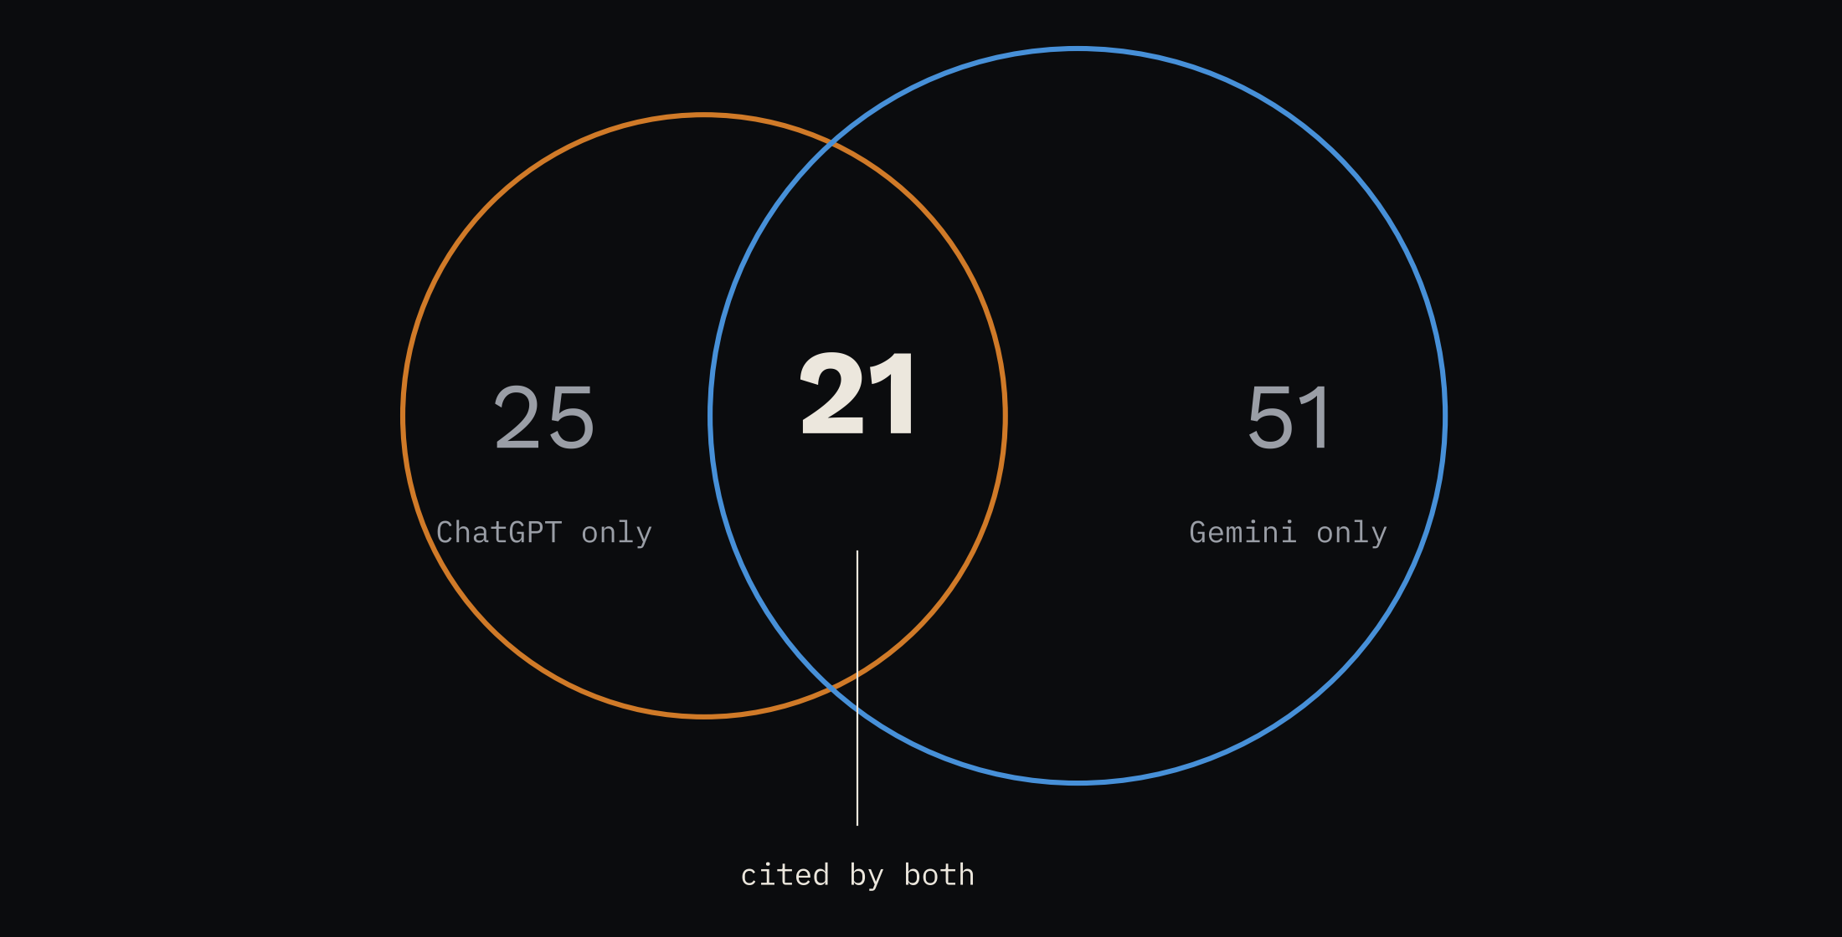
FAVOURED BANKS
PART III · THE SOURCES
The two engines barely share a source
21 of 97 sites and 11 of 243 pages are cited by both. That is a Jaccard overlap of 0.22 for sites and 0.05 for pages.
Writesonic found 0.119 between ChatGPT and Gemini across 88,969 prompts, without saying whether it compared pages or sites.
source: data/interim/citations.csv · Writesonic, AI citation source overlap study
09.10.2026 · 40 ANSWERS · SCENE 20
Notes:
A bank that wants to appear in both engines cannot rely on one set of pages.

Slide 21
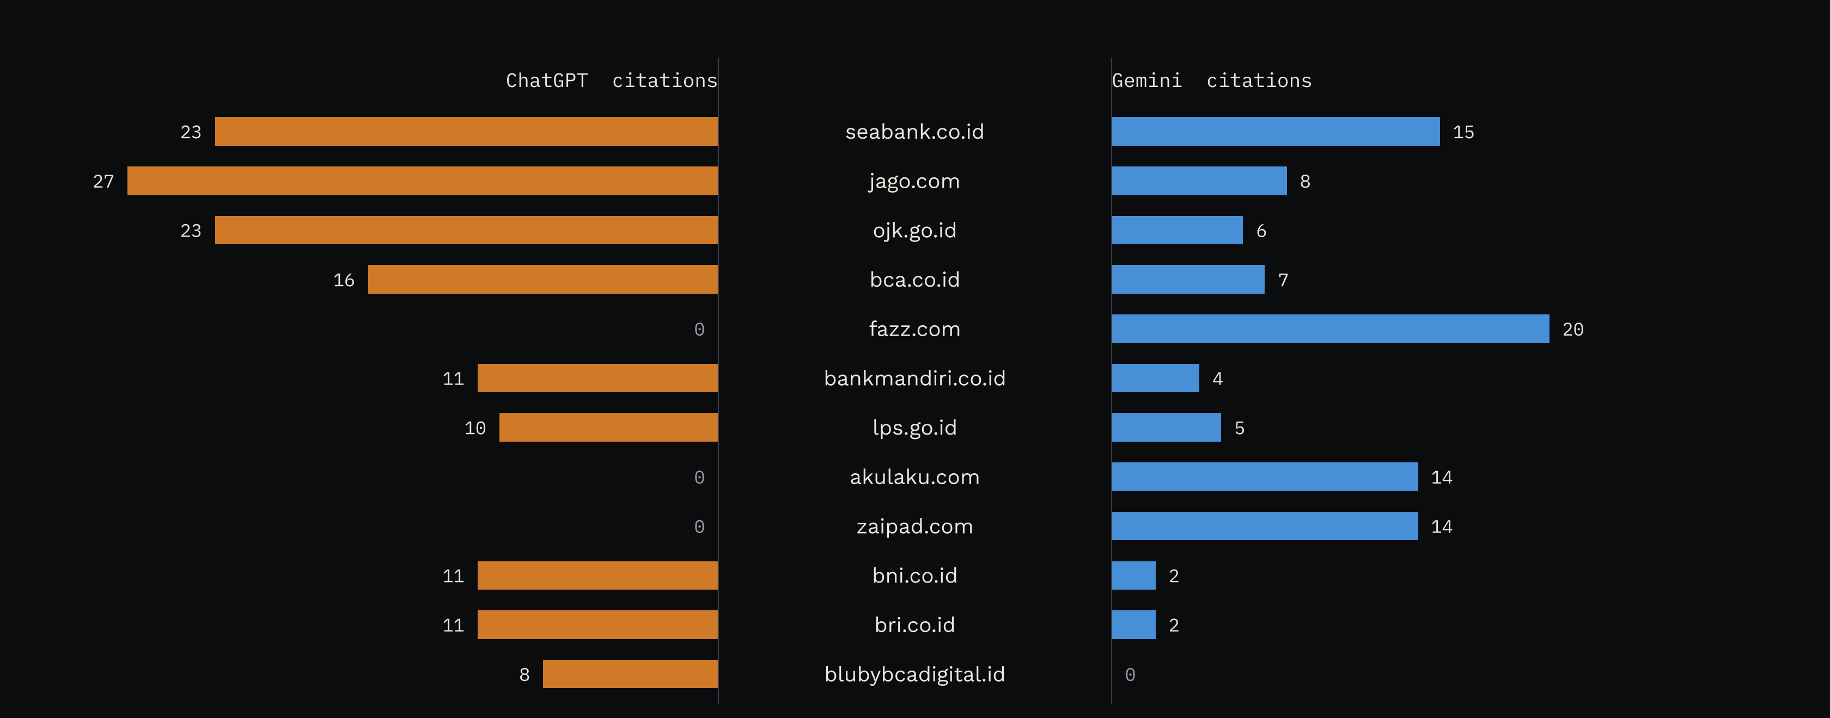
FAVOURED BANKS
PART III · THE SOURCES
Most cited sites: ChatGPT on the left, Gemini on the right
Bank and regulator sites lead for ChatGPT. Fazz, Akulaku and Zaipad are cited only by Gemini.
source: data/processed/domains.csv · top sites by citations
09.10.2026 · 40 ANSWERS · SCENE 21
Notes:
The fold in the middle is the comparison: the same sites, two very different weights.

Slide 22
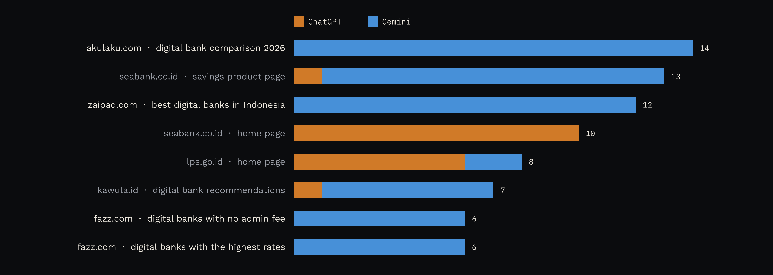
FAVOURED BANKS
PART III · THE SOURCES
A few comparison articles appear across Gemini's answers
One Akulaku article is cited in 14 of Gemini's 20 answers, one Zaipad article in 12, and Fazz articles 20 times across 15 answers. ChatGPT cites none of them.
Akulaku held 27.24% of Bank Neo Commerce in May 2023 (Bisnis). The article has not been checked for bias.
source: data/processed/pages_top.csv · most cited pages
09.10.2026 · 40 ANSWERS · SCENE 22
Notes:
If Gemini keeps citing the same few articles, a bank's place in them could carry into many answers.

Slide 23
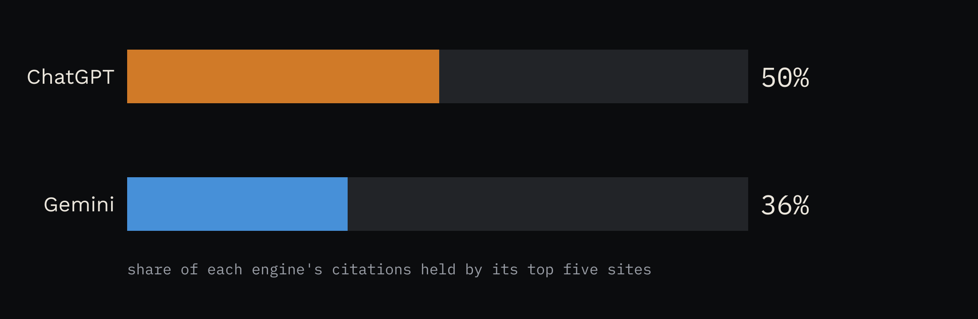
FAVOURED BANKS
PART III · THE SOURCES
ChatGPT leans on fewer sites
Its top five sites hold 50% of its citations. Gemini's top five hold 36%.
source: data/processed/concentration.csv
09.10.2026 · 40 ANSWERS · SCENE 23
Notes:
Higher concentration means a few sites carry more of the answers.

Slide 24
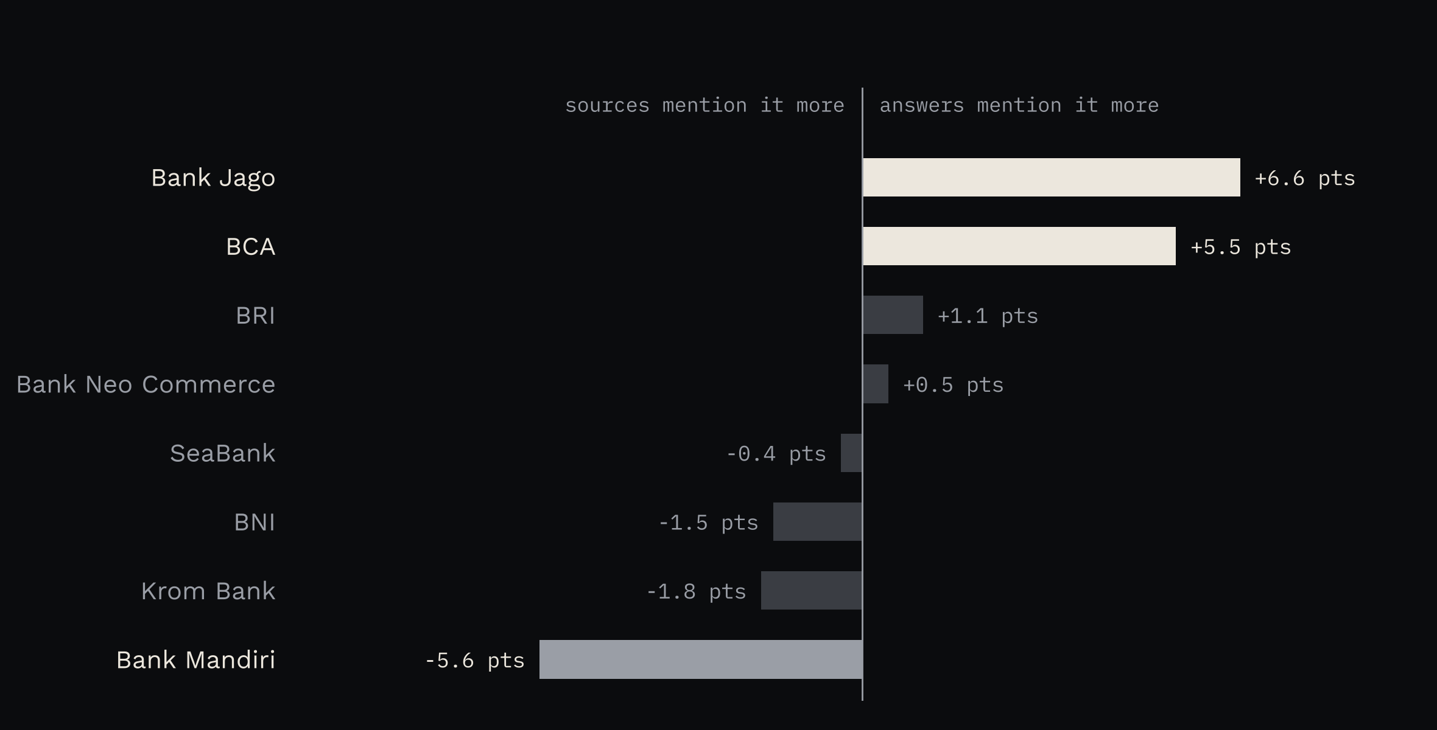
FAVOURED BANKS
PART III · THE SOURCES
Bank Jago and BCA take more of the answers than of their sources
Bank Jago holds 20.2% of bank mentions in the answers and 13.6% in the pages they cite.
Bank Mandiri runs the other way: 11.5% in the pages, 5.9% in the answers.
source: data/processed/source_sov.csv · answers weighted equally, pages weighted equally
09.10.2026 · 40 ANSWERS · SCENE 24
Notes:
A positive gap means the engines talk about the bank more than the cited pages do.

Slide 25
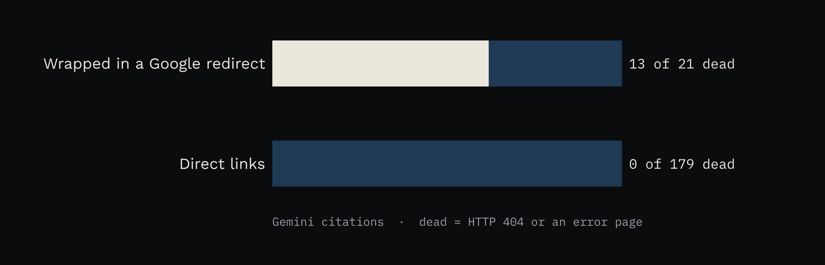
FAVOURED BANKS
PART III · THE SOURCES
Gemini's dead links come from links it wrapped in a Google search
13 of its 21 links wrapped in google.com/search were dead. None of its 179 direct links were.
The Tow Center found Gemini gave more fabricated links than correct ones in its 2025 tests (Nieman Lab).
source: data/interim/citations.csv, pages.csv
09.10.2026 · 40 ANSWERS · SCENE 25
Notes:
The redirect wrapper is where Gemini's broken links concentrate in this data.

Slide 26
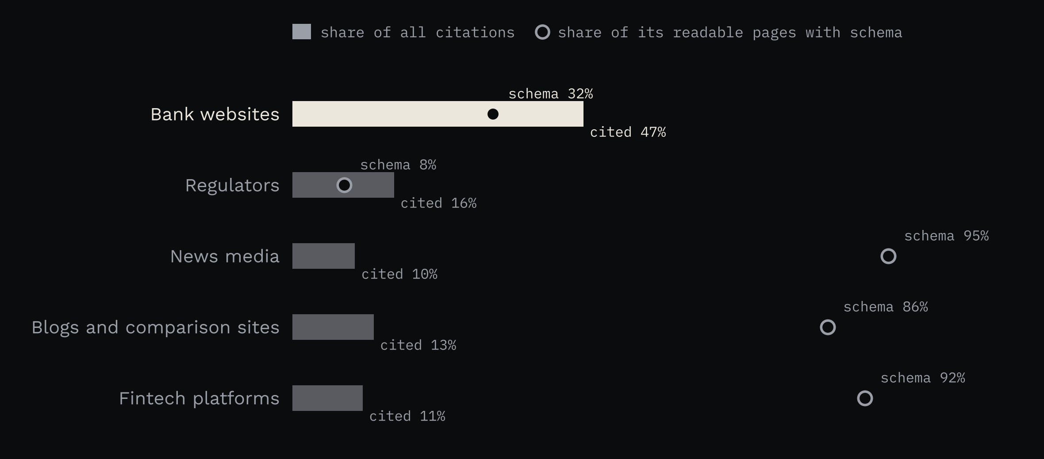
FAVOURED BANKS
PART III · THE SOURCES
Pages without schema still get cited
Bank sites carry schema on 32% of cited pages, against 95% for news and 86% for blogs, yet they are the most cited type.
Only 133 of 333 readable citations point to a page with a structured publish date.
Google: “there's also no special schema.org structured data that you need to add.”
source: data/processed/schema.csv, recency.csv · Google Search Central, AI features and your website
09.10.2026 · 40 ANSWERS · SCENE 26
Notes:
This suggests schema did not decide which pages got cited. It is a pattern, not a test.

Slide 27
PART IV
What it means
For banks, and for people who measure AI search

Slide 28
FAVOURED BANKS
PART IV · WHAT IT MEANS
For banks
01
Plan for each engine. ChatGPT cites bank and regulator pages; Gemini cites comparison sites, blogs and news.
02
Fee and rate pages look like the most direct route. ChatGPT cites SeaBank's and blu's fee pages by name.
03
Know what the comparison articles say about you. Akulaku, Zaipad and Fazz appear in 13 to 15 of Gemini's 20 answers.
04
No answer was negative. Measure whether you are named at all.
05
Write the explainers. Only 1 of 6 how-to answers named a bank.
09.10.2026 · 40 ANSWERS · SCENE 28
Notes:
These are likely levers based on one snapshot, not tested interventions.

Slide 29
FAVOURED BANKS
PART IV · WHAT IT MEANS
For GEO practitioners: what building this taught me
01
Count only the listed sources. Inline links and source chips inflate citation counts.
02
Unwrap redirects and normalise URLs before counting pages.
03
Render pages built with JavaScript. 19 cited pages needed a headless browser to be read.
04
Weight pages equally in source share, or one long annual report can dominate it.
05
Weight answers equally in answer share, so one long answer does not count many times.
06
Per-source PAWC needs inline citation markers. Neither engine gave them, so only brand PAWC is reported.
09.10.2026 · 40 ANSWERS · SCENE 29
Notes:
Each of these came from a bug or a check during the build. The fixes and tests are in the repo history.

Slide 30
FAVOURED BANKS
PART IV · WHAT IT MEANS
One run is a snapshot
SparkToro and Gumshoe ran 12 prompts nearly 3,000 times. The same brand list came back less than 1 in 100 times (Search Engine Land, January 2026).
Read gaps of a few points here as ties: BCA and Bank Jago at 55%, SeaBank at 52.5%.
09.10.2026 · 40 ANSWERS · SCENE 30
Notes:
Repeat runs would turn each number into a range.

Slide 31
FAVOURED BANKS
PART IV · WHAT IT MEANS
Next steps
01
Run the same 20 prompts at least four more times, so every number has a range.
02
Add Perplexity, Microsoft Copilot and Google AI Mode.
03
Read the top Gemini comparison articles and record how each one describes each bank.
04
Put the tables in a public dashboard that refreshes after each run.
09.10.2026 · 40 ANSWERS · SCENE 31

Slide 32
Favoured Banks in ChatGPT and Gemini
Data, code and method: github.com/rgmwnn/geo-bank-visibility
SOURCES
Aggarwal et al. (2024). GEO: Generative Engine Optimization. KDD 2024. arXiv 2311.09735
Writesonic. AI citation source overlap study
Ahrefs. AI search overlap with Google results
Search Engine Land. AI recommendation lists rarely repeat (SparkToro and Gumshoe)
Nieman Lab (2025). Tow Center study of AI search citations
Google Search Central. AI features and your website
Search Engine Journal. OpenAI usage study
Bisnis (2023). Akulaku stake in Bank Neo Commerce
Rahmananda Ridho Gamawan · data analyst, Indonesia

