Slide 1
40 answers, collected on 9 October 2026
Favoured Banks
Which Indonesian banks ChatGPT and Gemini recommend, and which web pages they cite
Rahmananda Ridho Gamawan, data analyst

Slide 2
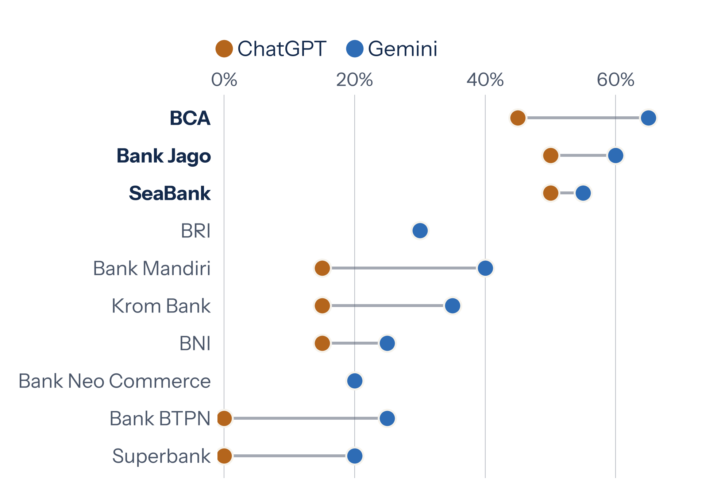
Part II: The answers
BCA, Bank Jago and SeaBank are each named in more than half of all answers
BCA and Bank Jago appear in 22 of 40 answers, SeaBank in 21 and BRI in 12.
Source: data/processed/brand_engine.csv. Top 10 banks, n = 20 answers per engine
11 / 33

Slide 3
Favoured Banks
Which Indonesian banks ChatGPT and Gemini recommend, and which web pages they cite
Rahmananda Ridho Gamawan, data analyst. 40 answers, collected on 9 October 2026

Slide 4
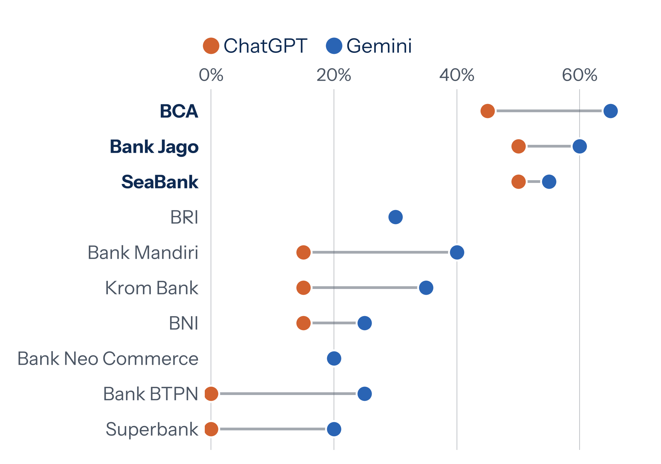
Part II: The answers
BCA, Bank Jago and SeaBank are each named in over half of all answers
BCA and Bank Jago appear in 22 of 40 answers, SeaBank in 21 and BRI in 12.
Source: data/processed/brand_engine.csv. Top 10 banks, n = 20 answers per engine
11 / 33

Slide 5

40 answers, collected on 9 October 2026
Favoured Banks
Which Indonesian banks ChatGPT and Gemini recommend, and which web pages they cite
Rahmananda Ridho Gamawan, data analyst

Slide 6
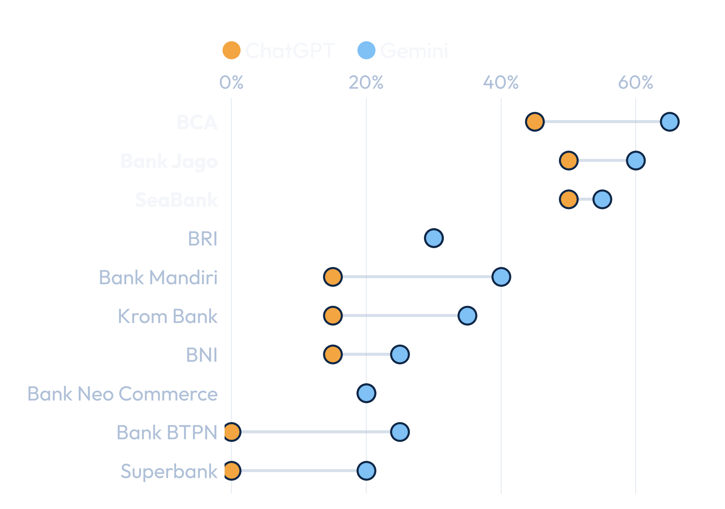
Part II: The answers
BCA, Bank Jago and SeaBank are each named in more than half of all answers
BCA and Bank Jago appear in 22 of 40 answers, SeaBank in 21 and BRI in 12.
Source: data/processed/brand_engine.csv. Top 10 banks, n = 20 answers per engine
11 / 33

