Slide 1
MACHINE LEARNING COURSE PROJECT
Multi-Objective PPO-Based Receiver Energy- and SIC-Complexity-Aware NOMA Scheduling
Learning to schedule NOMA users with an RL agent that balances speed, battery life, and receiver complexity
Ranga Charvik Battagiri | Student ID: 2520040108 | Batch 2025-2029
A. Dhanush | Student ID: 2520040109 | Batch 2025-2029
R. Gnaneshwar | Student ID: 2520040076 | Batch 2025-2029
Department of Electronics and Communication Engineering • KL Deemed to be University (KLH), Hyderabad

Slide 2


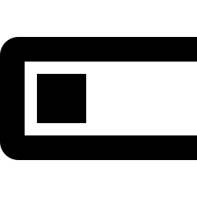
Why This Project Matters
Networks are getting crowded — and existing solutions ignore device battery limits
5G/6G Density
NOMA's Trade-off
The Missing Piece
Massive numbers of connected IoT devices, wearables, and sensors now share the same limited spectrum.
NOMA packs more users per channel using power-domain sharing — but receivers must "unmix" combined signals via SIC.
More users per cluster means more SIC decoding stages — draining battery on devices that existing schedulers ignore.

Slide 3
How NOMA Works
Multiple users share the same time-frequency slot, separated by power level instead
User A — weak channel
High power share
Superimposed
signal (power-multiplexed)
User B — medium channel
Medium power share
Base Station
User C — strong channel
Low power share
Key idea: weak-channel users get more transmit power so their signal survives the interference; strong-channel users get less, since they can still be decoded through it.

Slide 4

SIC: The Hidden Cost of NOMA
Every receiver must peel apart the combined signal — and that costs time, compute, and battery
1
2
3
4
Decode strongest
signal
Subtract it from
the mix
Decode next
strongest
Repeat until your
signal is isolated
More users in a cluster → more SIC stages → more decoding delay + energy drain
The Core Tension This Project Addresses
Bigger NOMA clusters improve spectral efficiency, but increase SIC stages — draining battery on devices that can least afford it (IoT sensors, wearables). Most existing schedulers optimize only throughput and ignore this cost entirely.

Slide 5
The Research Gap
What existing NOMA scheduling literature focuses on — and what it leaves out
What's Been Studied
What's Missing
• Q-learning for power allocation after channel-gain clustering
• Almost all approaches optimize a single objective — usually just throughput
• Object Migration Automata for the user-grouping sub-problem
• SIC energy cost is treated as a fixed system parameter, not something to optimize against
• Joint RL-based user pairing + power allocation in MIMO-NOMA
• No scheduler adapts clustering decisions based on individual users' remaining battery level
• Power-consumption models that account for SIC energy overhead
→ This project's contribution: a scheduler that is explicitly rewarded for battery- and SIC-aware decisions.

Slide 6
Project Objectives
1
Model a simplified NOMA downlink system in Python — throughput, SIC stages, and receiver energy cost
2
Formulate scheduling as a Markov Decision Process (state, action, reward)
3
Train a PPO agent with a multi-objective reward balancing throughput, energy, and SIC complexity
4
Implement random, fixed, and greedy baseline schedulers for comparison
5
Evaluate PPO vs. baselines across throughput, energy, SIC stages, and fairness

Slide 7



Formulating It as an RL Problem
Scheduling is a repeated decision problem — a natural fit for reinforcement learning
State
Action
Reward
Policy
Channel gain + remaining battery level of every user
Which NOMA cluster each user is assigned to
Weighted combination of throughput, energy cost, and SIC stages
The PPO agent's learned scheduling strategy
Multi-Objective Reward Function
Reward = w₁ · Throughput − w₂ · Energy Cost − w₃ · SIC Stages
Used weights: w₁ = 1.0 (throughput) w₂ = 2.5 (energy) w₃ = 1.0 (SIC complexity)

Slide 8
System Model in Detail
The three formulas that drive every scheduling decision in the simulation
Throughput (Shannon capacity)
Rᵢ = B · log₂(1 + SINRᵢ)
Higher SINR (signal vs. interference+noise) means a higher achievable rate for user i.
SIC stages per user
SICᵢ = cluster_size − 1
Every extra user sharing a cluster adds one more decoding stage the receiver must perform.
Battery-weighted energy cost
Eᵢ = (E_base + SICᵢ·E_stage) × (1 + 3·urgencyᵢ)
urgencyᵢ = 1 − batteryᵢ — a near-empty battery multiplies the penalty up to 4×.

Slide 9
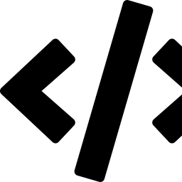



Project Workflow
From simulation to a validated, comparable result
1
2
3
4
Build Environment
Multi-Seed Training
Baseline Comparison
Evaluate & Compare
Custom Gymnasium NOMA simulation: throughput, SIC, battery-weighted energy
Train 3 independent PPO agents; keep the best by evaluation score
Run Random, Fixed, and Greedy schedulers on the same environment
30-episode averages across throughput, energy, SIC stages, fairness
Why multi-seed training? PPO can land in different quality outcomes depending on random initialization. Training several seeds and keeping only the best is standard practice for a trustworthy result, not a lucky one-off run.

Slide 10

Implementation
Built entirely in Python, using standard, well-tested RL tooling
Gymnasium
Stable-Baselines3
NumPy
Matplotlib
Custom NOMA environment: reset(), step(), reward
PPO algorithm implementation
SINR / throughput / energy formulas
Comparison charts
Training Setup
Baseline Schedulers
• 6 users, 3 NOMA clusters
• Random — no information used
• 3 seeds × 200,000 timesteps, best model kept
• Fixed — equal-sized clusters, static
• 128×128 policy network, decaying learning rate
• Greedy — channel-gain based, still battery-blind

Slide 11
Results: PPO vs. Baselines
Combined multi-objective score (throughput − 2.5×energy − 1.0×SIC stages), averaged over 30 episodes
−0.613
PPO combined score
best overall trade-off
+51%
vs. Greedy baseline
improvement in combined score
0.82
Value fn. explained variance
up from ~0 before tuning

Slide 12
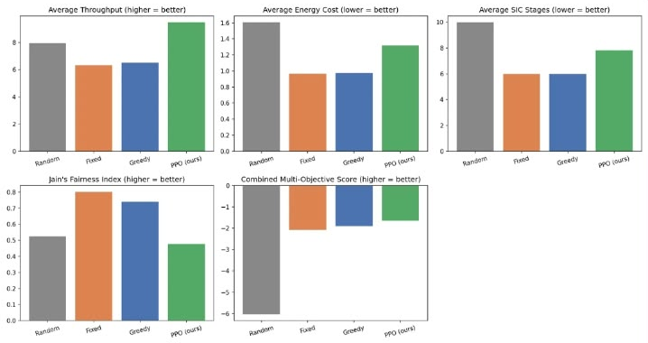
Detailed Metric Comparison
Five evaluation metrics for Random, Fixed, Greedy and PPO — green bars are our PPO scheduler
Highest throughput
PPO clearly leads on average throughput, ahead of Random, Fixed and Greedy.
Best combined score
Highest multi-objective score of all four schedulers — the trade-off PPO was trained for.
Honest trade-off
Fixed and Greedy keep energy, SIC stages and fairness lower — PPO trades some for throughput.
Metrics: average throughput ↑ • energy cost ↓ • SIC stages ↓ • Jain’s fairness index ↑ • combined score ↑

Slide 13
Why the PPO Scheduler Wins
PPO is the only scheduler that sees battery level
None of the baselines observe remaining energy at all, so they cannot protect low-battery users from being placed in large, SIC-heavy clusters — PPO can, because it's directly rewarded for it.
Honest trade-off, not a clean sweep
1
Greedy/Fixed achieve lower SIC stage counts and higher fairness — they build perfectly even clusters by construction
2
PPO achieves the highest throughput and the best combined score, but with less even cluster sizes
3
No single method should dominate every axis in a genuine multi-objective problem — what matters is the weighted trade-off PPO was trained on

Slide 14
Conclusion & Future Work
A PPO-based scheduler that jointly optimizes throughput, receiver energy, and SIC complexity achieves a better overall trade-off than fixed heuristic rules — by being the only approach that adapts to individual users' battery levels.
Future Directions
→ Multi-cell interference and imperfect channel state information
→ True Pareto-front multi-objective RL, beyond weighted-sum
→ Model imperfect SIC / error propagation effects
→ Scale up to more users and clusters for realism
→ Add an explicit fairness term to the reward function
Ranga Charvik Battagiri • A. Dhanush • R. Gnaneshwar • Machine Learning (25SC2107E) • KLH

