Slide 1
2022 NFL Draft Model
How predictive are combine metrics to draft placement?

Slide 2
Overview of Project
Data scraped from Sports Reference and Pro Football Reference.
Split into 4 datasets:
3 datasets with on-field collegiate stats and combine metrics (QB, WR, RB).
1 main dataset with all players and only combine metrics.
Number of features and rows varies by dataset:
12 features, 7335 rows for main dataset.
16 features, 401 rows for QBs.
16 features, 634 rows for RBs.
16 features, 1018 rows for WRs.

Slide 3
Machine Learning Issues
Target = predicting when a player is drafted, by round.
What can combine measurables alone tell us?
Subjective target: bias toward outliers.
Limited data: combine metrics are red herrings.

Slide 4
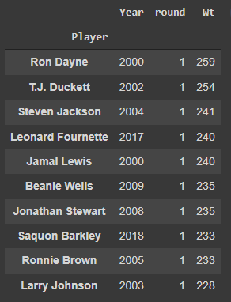
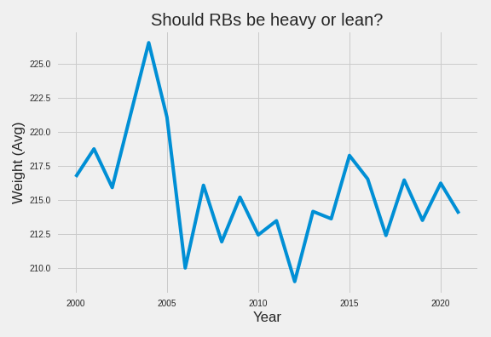
How heavy should a running back be?

Slide 5
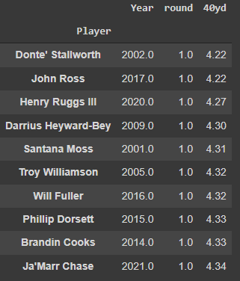
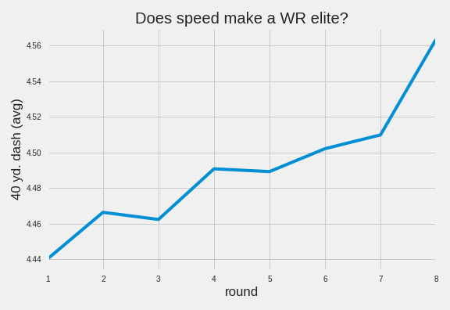
How fast should a wide receiver be?

Slide 6
Predictive Model: Random Forest Regression
Why regression?
Why this model?
How did it do?
Multi-class classification + limited data = bad model
Imbalanced target
It performed the best.
Linear regression underfit by a lot.
LightGBM performed slightly worse on each table..
Table R2 RMSE
Main .66 1.45
QBs .71 1.39
WRs .71 1.37
RBs .65 1.41

Slide 7
Recommendations
Combine metrics not sufficient.
Beware the outlier.
Already-hyped players should skip the combine.

