Slide 1
NFL Combine Data Project
Building a predictive model for the 2022 NFL Draft

Slide 2
Background of the Project
Datasets scraped from Pro Football Reference and Sports Reference.
Features: Combine metrics from 2000-2021, NCAAF metrics from 1999-2020.
Target: Draft round for each player in the 2022 NFL Draft.

Slide 3
Data Preparation Steps
Adding on-field stats for skill positions
Splitting and merging the datasets into positional groups
Non-participants and the undrafted (nulls)
Adjusting column formats

Slide 4
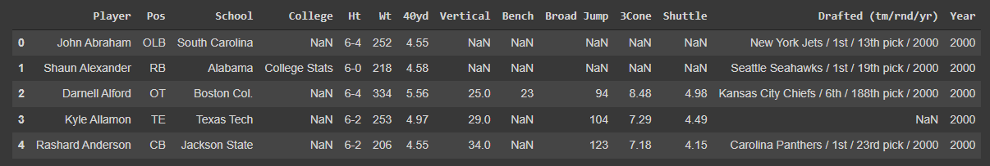
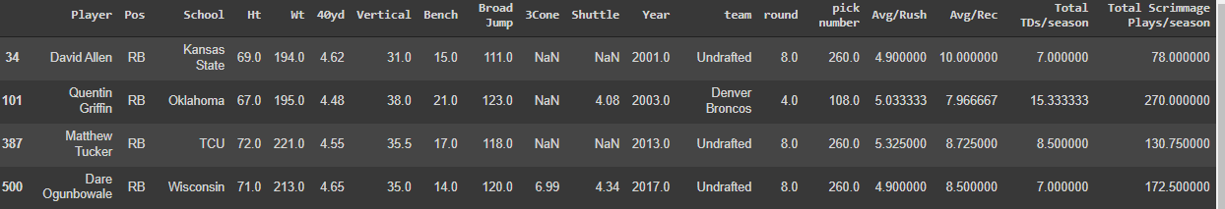
Original vs. Prepared Dataset

Slide 5
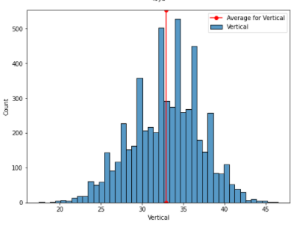
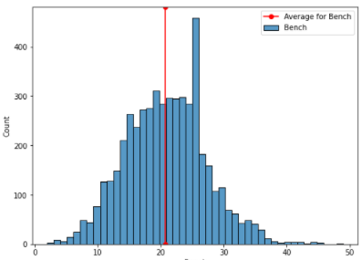
Histographical Data
Top: 'Vertical' ; Bottom 'Bench'
Each column follows a Gaussian distribution
This supports use of the mean to impute for null values

Slide 6
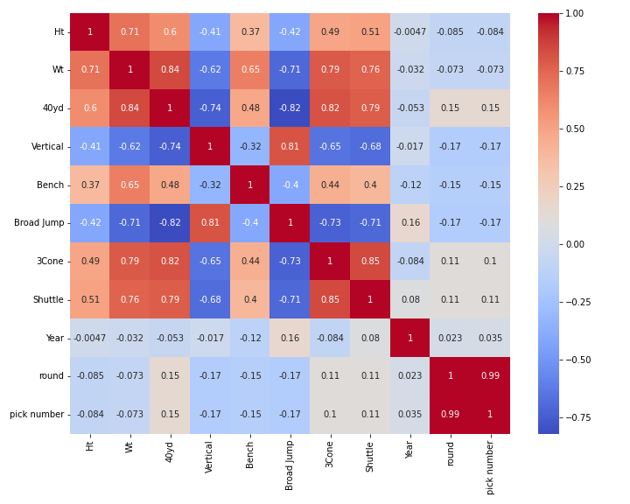
Overall Combine Metric Correlations

Slide 7
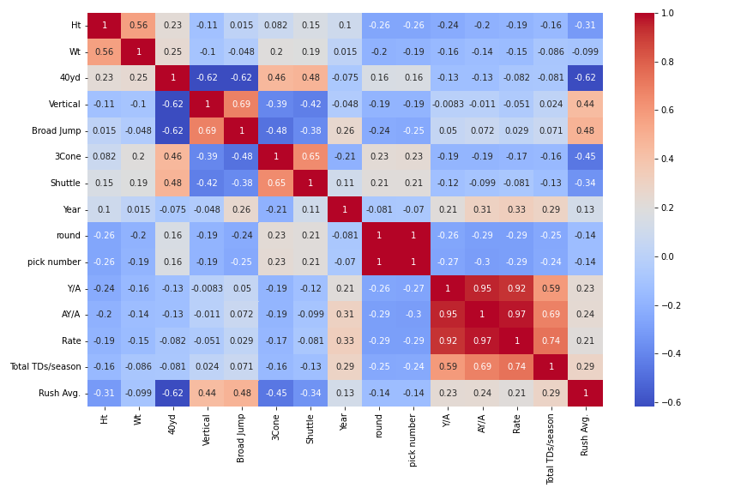
Correlations with On-field Metrics

Slide 8
Unique Challenges with this Project
Dealing with different positions
Finding good supplemental data

