Slide 1
Changes made to run Grey Titan

Slide 2
- Changed a ‘month’ to be 30 Titan ‘days’
Length of day is ~16 Earth days = 1379678 seconds
This means there are 22 Titan ‘months’ in a Titan ‘year’ of ~29.6 Earth years
In the script…
diag.add_file('atmos_monthly', 30*1379678, 'seconds', time_units='days’)
'main_nml': {
'dt_atmos': 178,
'days': 0.,
'seconds': 30.*1379678,
'calendar': 'no_calendar’
Note that the no. of seconds in a ‘day’ was calculated from a script from Stephen which makes sure an integer no. of days go into a Titan year. As a result ‘day’ and ‘year’ length are not precisely 16 days and 29.6 years, but the variation from the true values is pretty small.
Note also then that a ‘month’ is an arbitrary unit of time, it’s just 30 Titan days

Slide 3
- 'mixed_layer_nml': {
'tconst’ : 186.,
'prescribe_initial_dist':True,
'evaporation':False,
'albedo_value': 0.3,
The top two variables set the initial surface temperature profile
Having tconst closer to the actual equilibrium temperature value (93.65K measured at the surface by the Huygens probe, 186K at the stratosphere) should decrease spin-up time?
- 'damping_driver_nml': {
'do_rayleigh': True,
'trayfric': -0.125, # neg. value: time in *days*
'sponge_pbottom': 1.1205,
1.1205 Pa is the pressure value 3 model layers from the top of the atmosphere to impose a sponge layer
A sponge layer causes dissipation to stop reflection off the “top” of the atmosphere

Slide 4
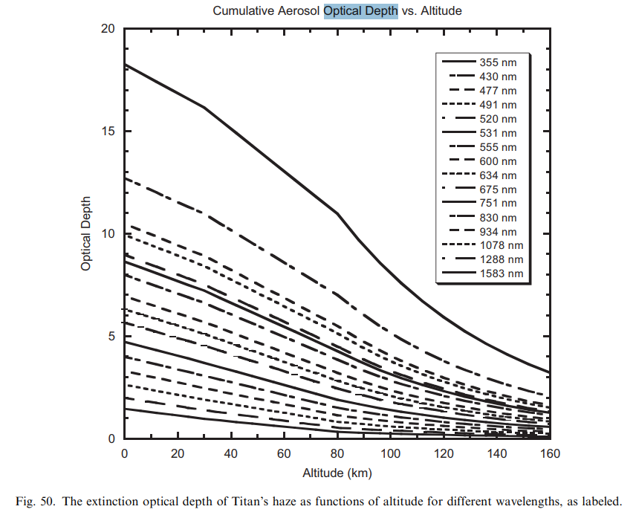
- 'two_stream_gray_rad_nml': {
'rad_scheme': 'frierson',
'do_seasonal': True,
'atm_abs': 10,
'sw_diff':0.0,
'ir_tau_eq':4,
'ir_tau_pole':4,
'linear_tau': 1.0,
'equinox_day':0.0,
'use_time_average_coszen':True,
'solar_constant':15.078,
‘solar_exponent’:1.7
},
Short wave optical depth
Long wave optical depths
See next slide for more on the solar exponent
Mean solar constant for Titan – actually used to infer the Sun-Titan Distance from S = S_{E} x 1/D² where D is in AU
“A model of Titan's aerosols based on measurements made inside the atmosphere” (2008)

Slide 5
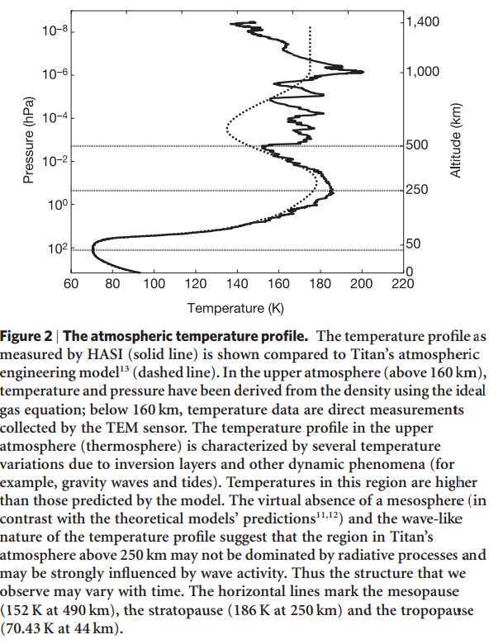
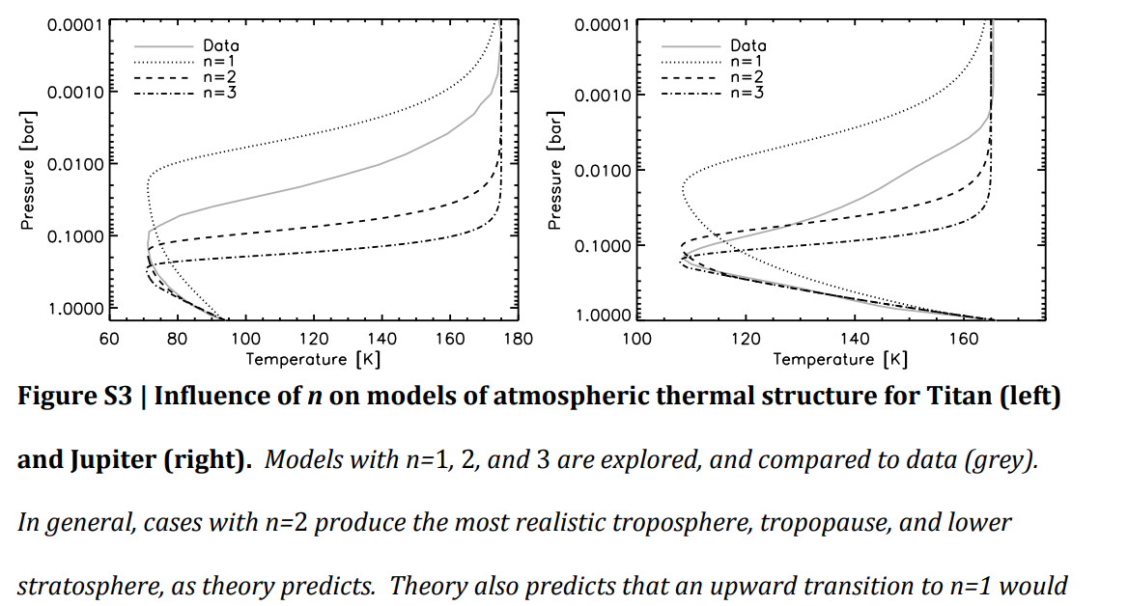
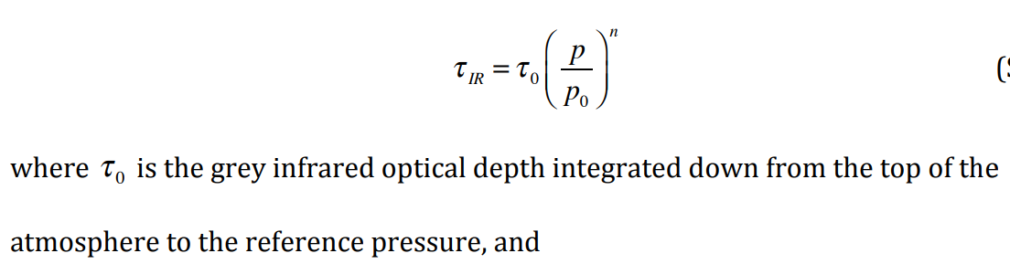
I was struggling to get back the correct temperature profile for Titan (using Huygens probe data from Fulchignoni et al. see right images) Stephen Thomson suggested “changing the value of `solar_exponent` here:
https://github.com/sit23/Isca/blob/master/src/atmos_param/two_stream_gray_rad/two_stream_gray_rad.F90#L485
That number is changing the pressure dependence of your short-wave optical depth. It may be that you want it to increase more rapidly with pressure so that you achieve a high optical depth higher in the atmosphere.”
“Common 0.1 bar tropopause in thick atmospheres set by pressure-dependent IR transparency” (2014)
See notebook for more detailed calculations, but using Huygens values for pressure at the surface and tropopause (Fulchignoni et al.), and IR optical depths from this paper, I think I found a value for n = 1.68
“Titan has a very shallow convective region up to only ~1.3 bar because significant shortwave absorption in its upper hazy troposphere causes stability against convection.”
The supplementary material also had some useful stuff:
“Typically, n takes a value between 1 and 2”
The change I made can be seen on the previous slide.

Slide 6
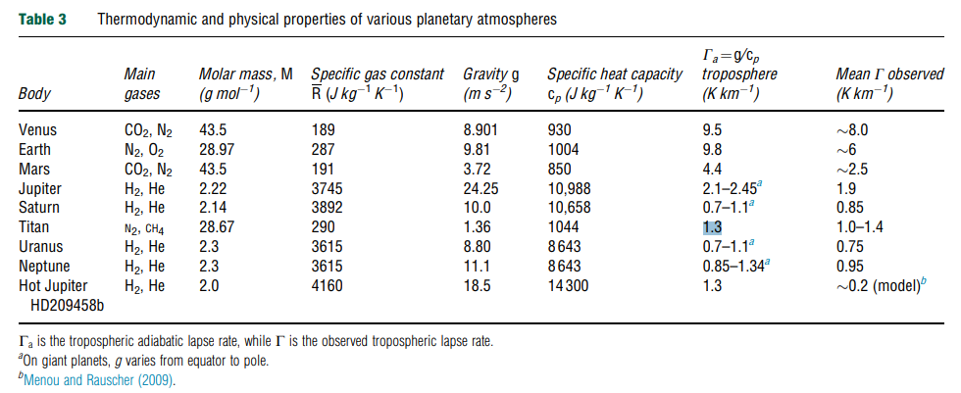
- 'astronomy_nml': { #Titan Values
'ecc':0.054,
'obliq':26.7,
'use_mean_anom_in_rrsun_calc':True,
'use_old_r_inv_squared':False
Eccentricity of Saturn’s orbit around the Sun
Obliquity of Saturn wrt the Sun
These are involved in accounting for the change in solar constant while Titan orbits (found that solar constant changes by 20% between aphelion and perihelion)
- 'constants_nml': { #Titan Values
'orbital_period': 928523294,
'solar_const':15.078,
'radius':2575.0e3,
'rdgas':290,
'kappa':0.2727,
'rotation_period':1377631,
},
29.6 Earth year orbital period and 16 Earth day rotation period in seconds calculated from aforementioned script
Specific gas constant and kappa = specific gas constant/specific heat capacity are taken from “Planetary Atmospheres” (2015) page 8 – see table above

Slide 7
if __name__=="__main__":
conv_schemes = ['none']
depths = [2.]
pers = [93] #changed from Stephen's value (339.392) but need to still confirm actual value
scale = 1.
for conv in conv_schemes:
for depth_val in depths:
for per_value in pers:
exp = Experiment('grey_titan_180219_2xtmstp_5titanyr_sw10_ir4', codebase=cb)
exp.clear_rundir()
exp.diag_table = diag
exp.namelist = namelist.copy()
exp.namelist['constants_nml']['grav'] = scale * 1.354
exp.namelist['constants_nml']['pstd'] = scale * 14670000.0 #100 times bigger than below values
exp.namelist['constants_nml']['pstd_mks'] = scale * 146700.0 #Pa
exp.namelist['spectral_dynamics_nml']['reference_sea_level_press'] = scale * 146700.0 #Pa
exp.namelist['idealized_moist_phys_nml']['convection_scheme'] = conv
exp.namelist['mixed_layer_nml']['depth'] = depth_val
exp.namelist['astronomy_nml']['per'] = per_value
# with exp_progress(exp, description='o%.0f d{day}' % scale):
exp.run(1, use_restart=False, num_cores=NCORES)
for i in range(2, 111):
# with exp_progress(exp, description='o%.0f d{day}' % scale):
exp.run(i, num_cores=NCORES)
notify('top down with conv scheme = '+conv+' has completed', 'isca')
Angular distance from NH autumn equinox (set by Stephen to be the zero point) to point of perihelion (longitude of perihelion). Papers suggest perihelion occurs at SH summer solstice for Titan. I think Saturn’s longitude of perihelion should be ~90º - see next slide!
Gravity on Titan from A. Coustenis book ‘Titan’
Surface pressure is 1467 hPa
No. of ‘months’ it runs for, where 2 to 111 (i.e. 110 months) is 5 Titan years

Slide 8
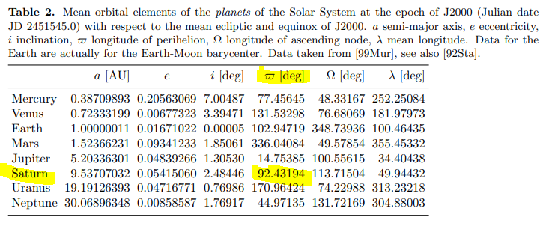
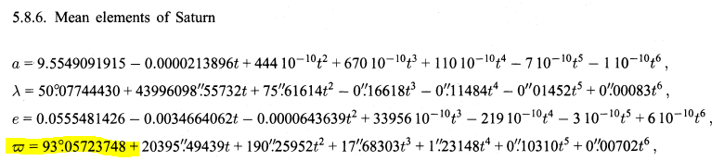
Cont. from previous slide, the below is taken from 4.2.2 Basic data of planetary bodies which is for J2000 and we are 19 years after that … how much of a difference will that make?
This paper has this equation:
t is time from J2000 I think?
9. Add the following namelist into the script. Default is 264 K so setting to a colder temperature should reduce spin up 'spectral_init_cond_nml’: {
'initial_temperature’: 100.

Slide 9
Inclusion of topography:
Things that were changed in the model run script to include topography:
import os
'spectral_dynamics_nml': {
'ocean_topog_smoothing': 0.8
'spectral_init_cond_nml’: {
'topog_file_name' : 't42_mola_mars.nc', #!!! Name of land input file, which will also contain topography
'topography_option' : 'input', #!!! Tell model to get topography from input file
'initial_temperature': 100.
},
In the main body:
exp.inputfiles = [os.path.join(GFDL_BASE,'input/land_masks/t42_mola_mars.nc')] #!!! add location of files
Additional change made to the topog_regularization.F90 script so that ‘land’ topography of Titan could run in the model:
integer, parameter :: itmax=1000
real, parameter :: tolerance = 5.e-2
Tolerance was increased from 1.e-5 to 5.e-2 which appeared to be the lowest it would go and still run

Slide 10
These changes aren’t to do with modelling a realistic Titan, but were additional options to decrease run times:
Running with half the horizontal resolution
At the top of the script:
RESOLUTION = 'T21', 25 # T21 horizontal resolution, 25 levels in pressure
In the main body of the script:
exp.set_resolution(*RESOLUTION)
By default resolution is set to T42 resolution (128 x 64 gridpoints) but by switching to T21 (64 x 32) the model should run ~8 times faster
This could decrease realism and should definitely only really be used for flat Titan. A T21 Titan with topography may be far too coarse to pick out details and features?
T42 and T21 are actually to do with the fact Isca is a spectral model, which represents the “grid” via spherical harmonics
- Changed timestep to be 178 seconds, which is less than twice the original timestep, but causes the model to run faster
178 is a factor of 1379678
Using a restart file from a model run that has already reached equilibrium
In the main body:
exp.run(1, restart_file='/mnt/storage/home/rm15856/scratch/Isca-Bristol/output/grey_titan_blahblah/restarts/res0106.tar.gz’, use_restart=True, num_cores=NCORES)
for i in range(2, 111):
exp.run(i, num_cores=NCORES)
notify('top down with conv scheme = '+conv+' has completed', 'isca')

