Slide 1
Potential Plots

Slide 2
List of plots I’ve made so far:
Titan-Sun distance with time
Incoming radiation time series
Temperatures at different heights in the atmosphere time series
Wind speed at different heights in the atmosphere time series
Temperature profile ft Huygens
Zonal wind speed profile ft Huygens
Zonal wind speed at a location with season
Surface T (lon-lat)
Surface P (lon-lat)
Incoming SW (lon-lat)
Zonal T (approx. altitude/pressure vs lat)
Zonal wind speed (approx. altitude/pressure vs lat)
Meridional mass stream function (approx. altitude/pressure vs lat with uneven levels colorbar)
Difference plots for the above
Topography @ original, T42 and T21 resolutions
Note: I also have a script for finding locations.

Slide 3
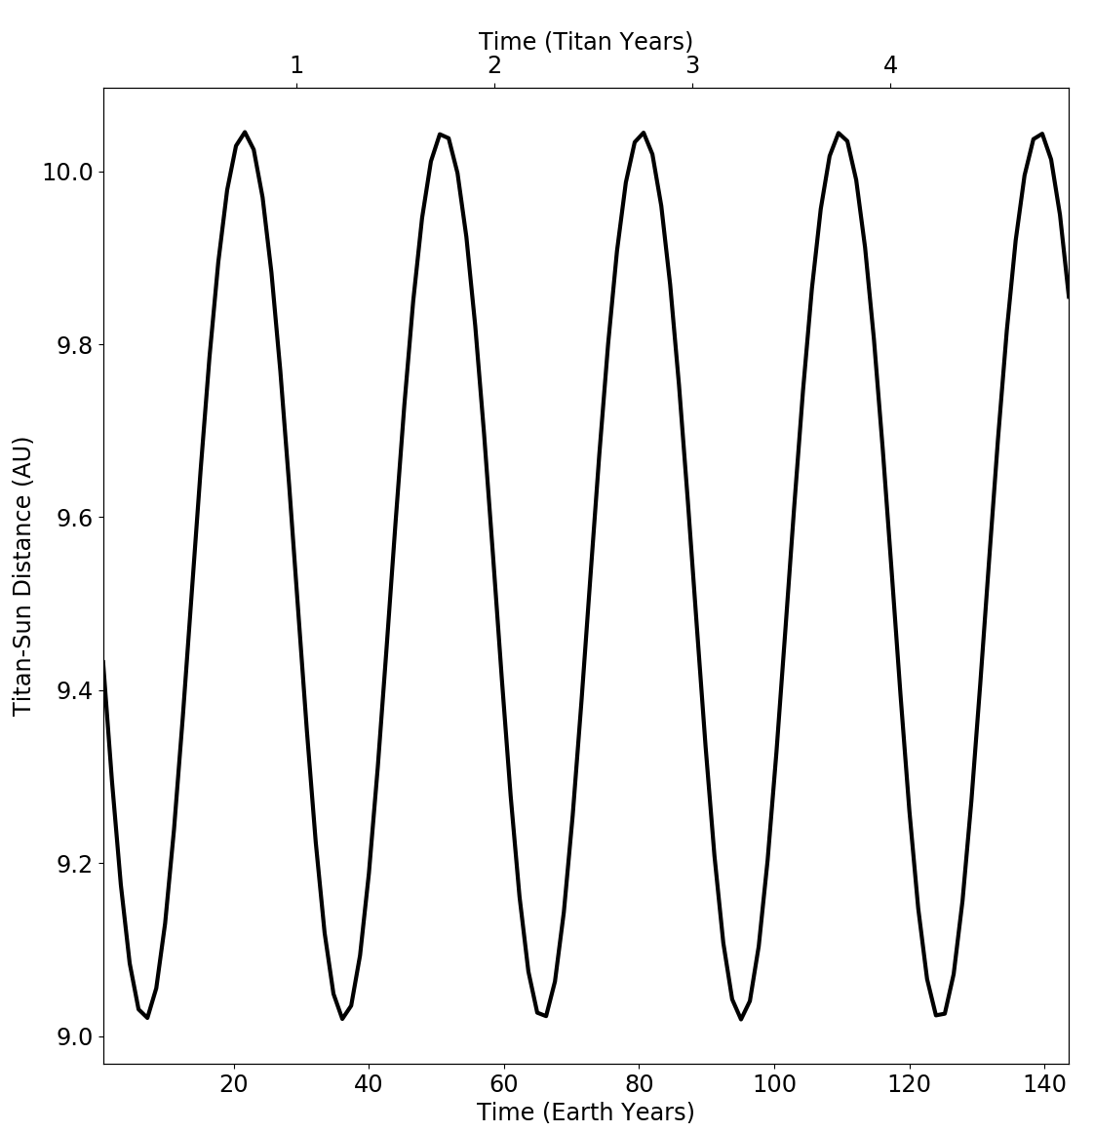
I calculated that between aphelion and perihelion the solar constant (and hence insolation) varies by about 20%.
The model takes inputs of orbit eccentricity (0.054 for the Saturn-Titan system about the Sun), the solar constant (calculated to be ~15 for Titan at semi-major axis of ~9.6 AU), and angle of perihelion (~93º).
The solar constant input is then used to give the model a value of semi-major axis (D) using S_{titan}=S_{earth}/D²
The angle of perihelion tells the model when the point of greatest insolation should occur. The zero point is NH autumn equinox and, for Titan, greatest insolation is reported to occur at SH summer solstice, i.e. after travelling ~90 degrees from the starting point and thus after a quarter of a Titan year.
This plot confirms that Titan is reaching aphelion of ~10 AU and perihelion of ~9 AU as expected for the Saturn system. It also confirms that Titan is reaching closest approach to the Sun at the correct point in the orbit.
Titan-Sun distance (r) was calculated using the output of the normalised distance from the Sun (rrsun) in r = (1/sqrt(rrsun))*sqrt(S_{Earth}/S_{Titan})
Titan-Sun distance with time

Slide 4
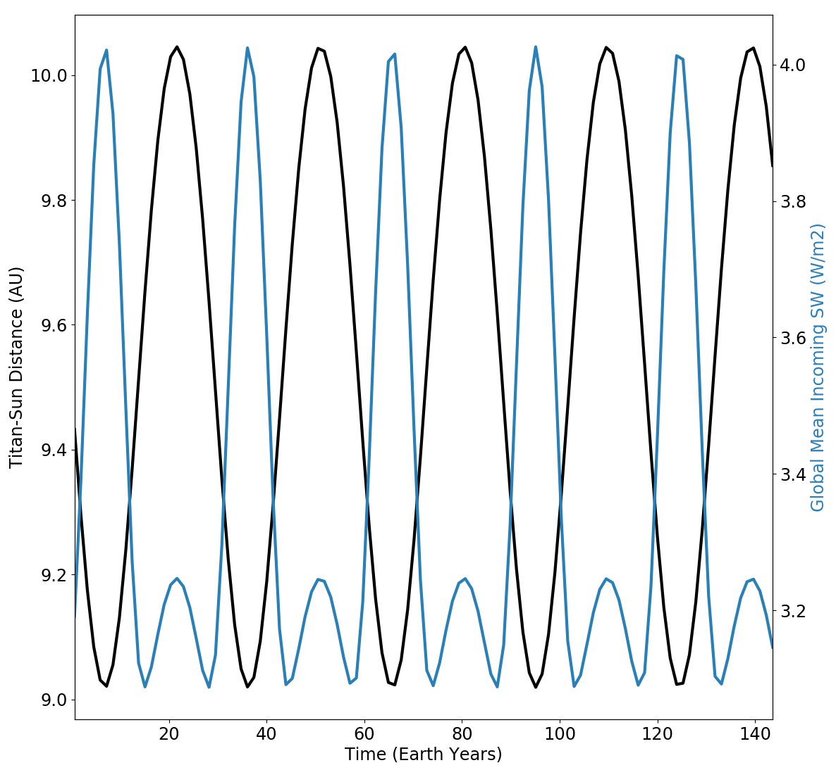
I calculated that between aphelion and perihelion the solar constant (and hence insolation) varies by about 20%.
The model takes inputs of orbit eccentricity (0.054 for the Saturn-Titan system about the Sun), the solar constant (calculated to be ~15 for Titan at semi-major axis of ~9.6 AU), and angle of perihelion (~93º).
The angle of perihelion tells the model when the point of greatest insolation should occur.
This plot confirms that Titan is reaching closest approach to the Sun at the correct point in the orbit and that the incoming short wave radiation at the top of the atmosphere is maximum at perihelion, as expected. It also shows that from the lowest to the highest point, incoming SW varies by ~20%, as was predicted.
Titan-Sun distance (r) was calculated using the output of the normalised distance from the Sun (rrsun) in r = (1/sqrt(rrsun))*sqrt(S_{Earth}/S_{Titan})
Titan-Sun distance and incoming sw time series

Slide 5
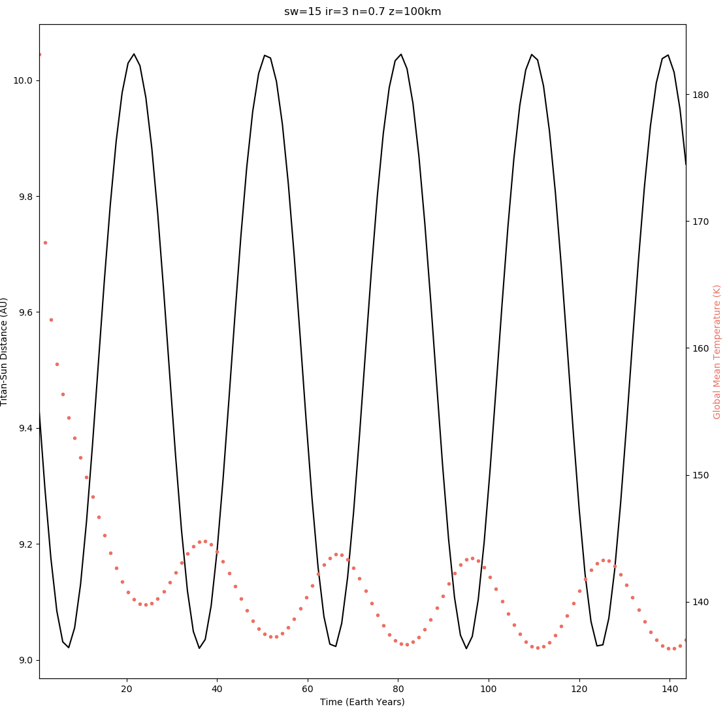
Time series of Titan-Sun distance and temperature at level in the atmosphere with temperature maximum
Lag between temperature and insolation is typically a strong function of surface heat capacity, so it is expected the lag would decrease at levels higher in the atmosphere (i.e. at lower pressures). At ~100 km altitude the lag is just a couple of Earth years.
The lag clearly still exists at this lower pressure (and is much clearer at some pressures greater than this), lasting just a couple of Earth years. This could be due to long heating and cooling timescales existing for Titan, as a result of its thick (haze) atmosphere…?
[if I were to include the above I can look up those timescales as in the literature. I already looked at some papers about this.]

Slide 6
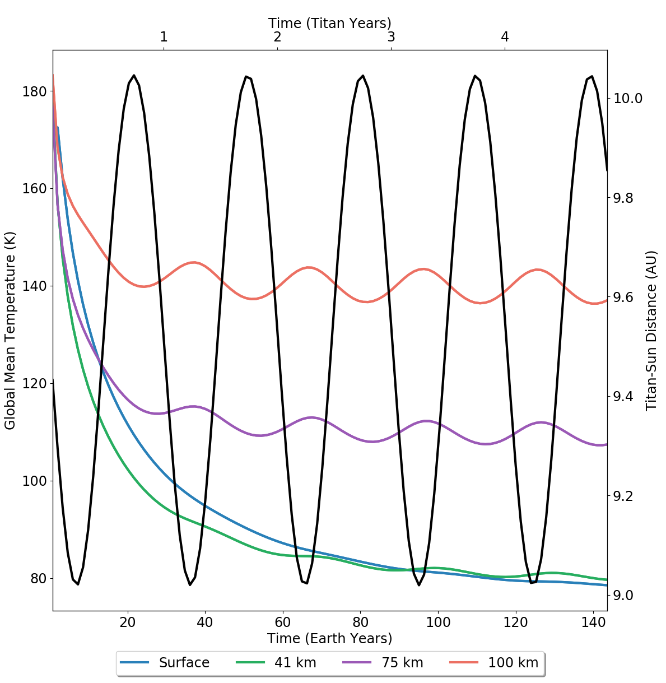
Temperature time series at different points in the atmosphere
Lag between temperature and insolation is typically a strong function of surface heat capacity. Since radiative time scales are faster higher in the atmosphere, it is expected the lag would decrease at higher altitudes, where the atmosphere can more quickly adjust to insolation variations. This plot does show fluctuations at higher altitudes (lower pressure) leading those at lower altitudes, as expected.
[I can look up those timescales as in the literature. I already looked at some papers about this.]
This plot also demonstrates “spin up” of the model, or time for the model to reach equilibrium from inputs of initial temperatures. As time increases, the trend of the surface temperature is seen to tend to steady state, with a mean surface temperature of ~90K after 3 Titan years. [This is actually lower than expected]

Slide 7
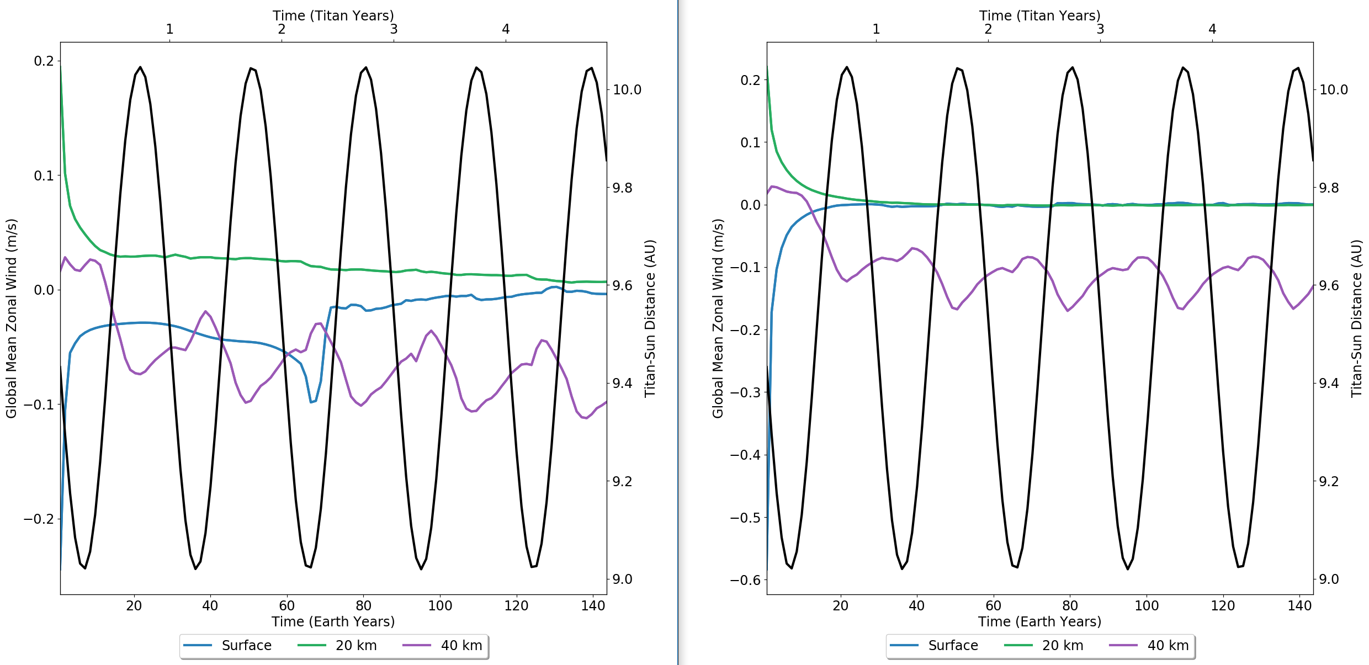
Zonal wind time series at different points in the atmosphere
WRITE
With (L) and without (R) topography

Slide 8
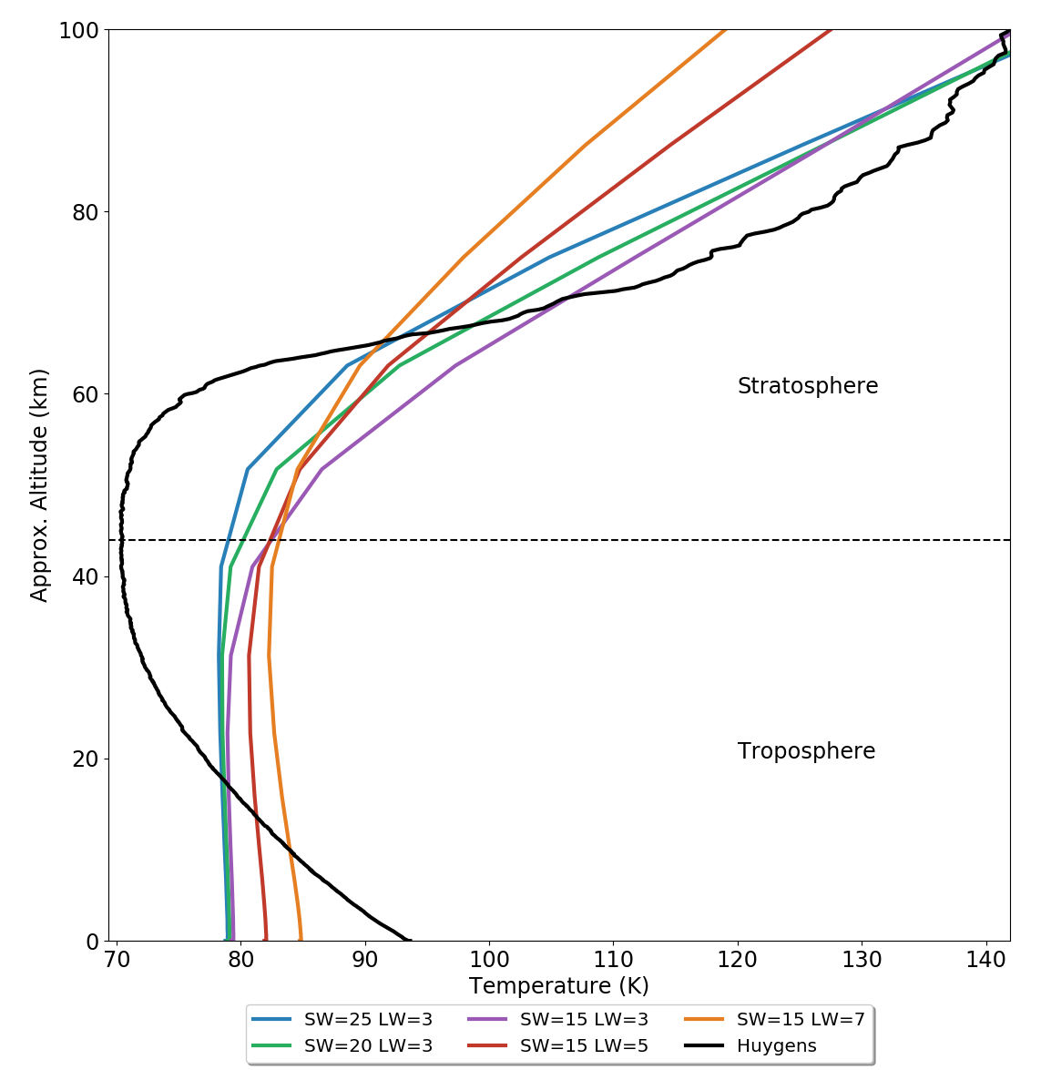
Temperature profile
Left is the model temperature profile in the lower 100 km of Titan’s atmosphere, plus the temperature profile of Titan as measured by the Huygens probe (black line).
Fulchignoni et al. (2005) reported a tropopause at 44km with T=70.43 K and T=93.65K at Titan’s surface. Currently my temperature profile displays a slight troposphere (decreasing T with height) up to ~40 km and a stratosphere (increasing T with height), though with too low temperatures. I wonder if varying t_ir will affect this.
The altitude of the inversions is achieved by changing the solar exponent in the model, which describes how the pressure dependence of the short-wave optical depth changes.
[Same everything EXCEPT tau_SW – vary b/n 10 and 25 (steps of 5) DONE. Same everything EXCEPT n – vary b/n 0.5 and 1.5 (steps of 0.2) NOT YET DONE. Same everything EXCEPT tau_IR – vary b/n 0.5 and 10 SUBMITTED. So to be able to say e.g. decreasing n has caused a high optical depth to occur higher in the atmosphere etc.]
The magnitudes of the temperatures comes from the values of the short- and long-wave optical depths? Gradient of tropospheric profile comes from long-wave optical depth?

Slide 9
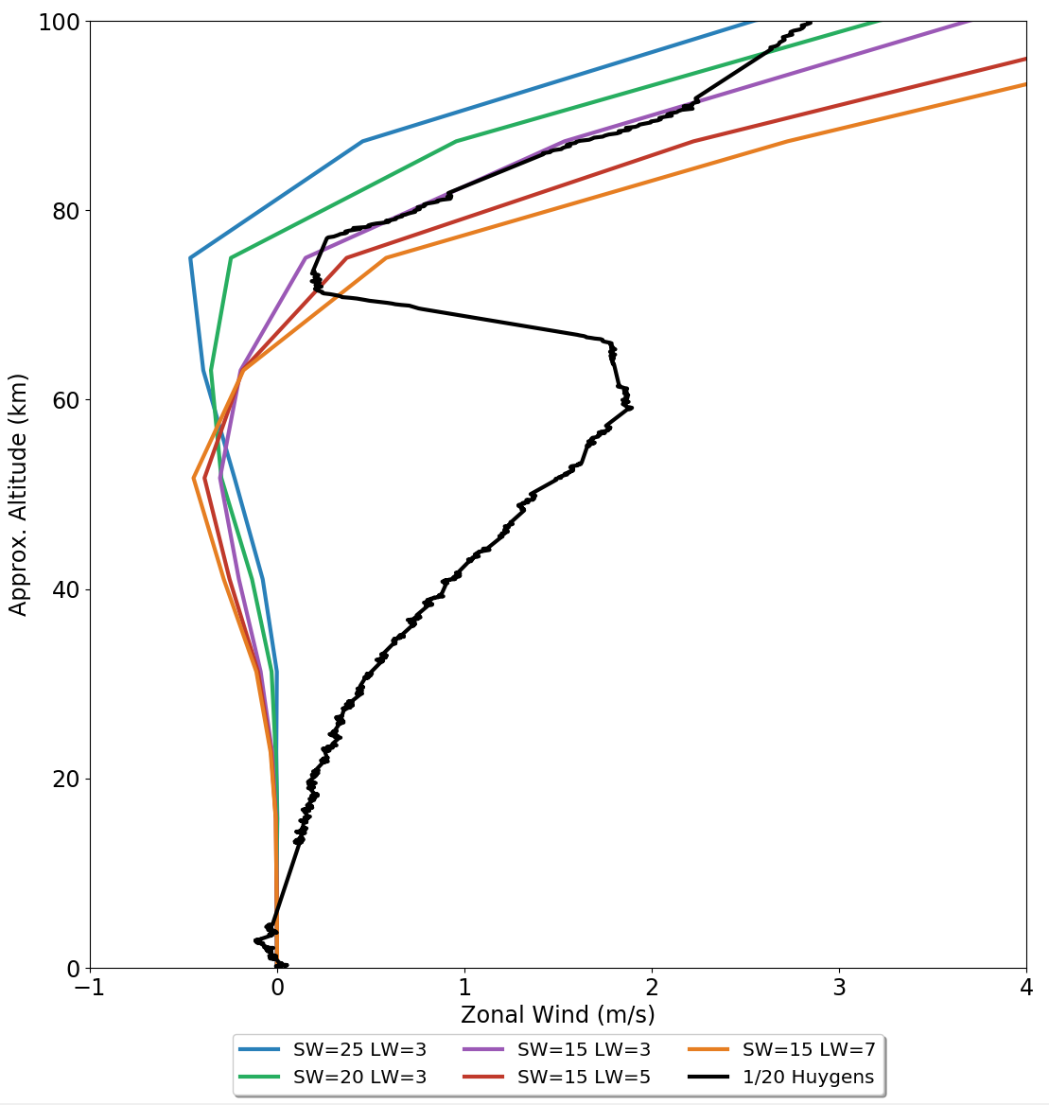
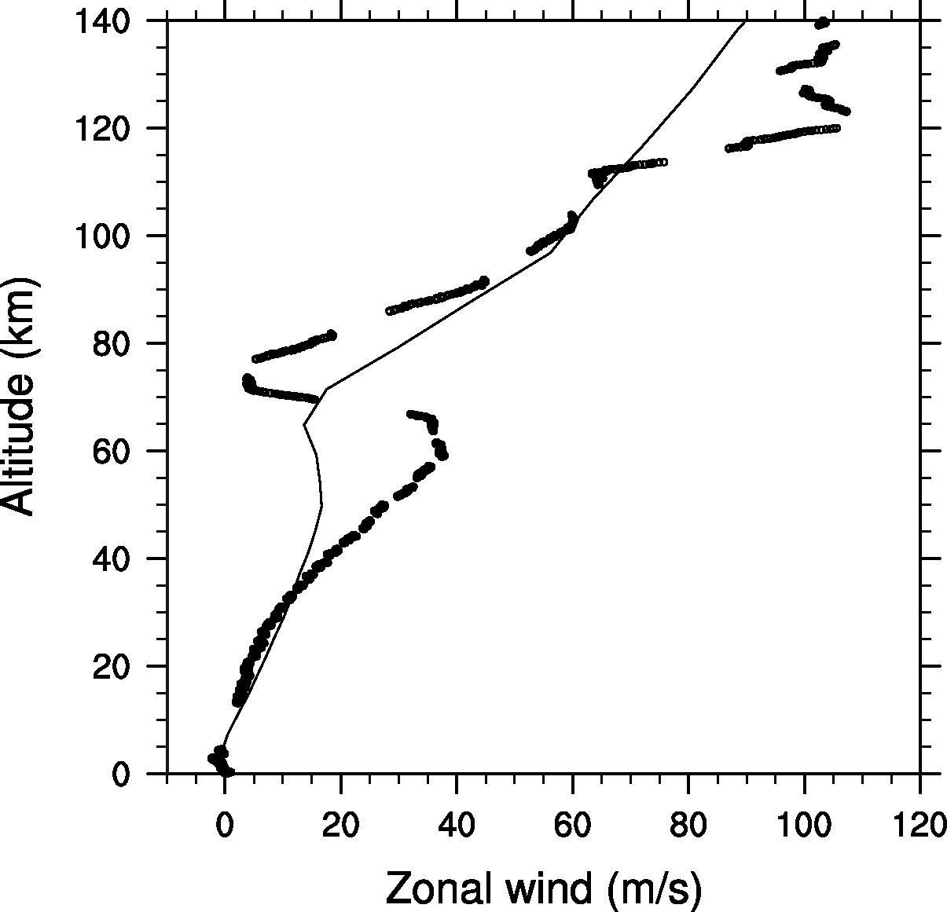
Zonal wind profile
Left is the model zonal wind profile in the lower 100 km of Titan’s atmosphere, with the profile of Titan as measured by the Huygens probe (black line) divided by 20. Figure below is actual, from Lebonnois et al. (2005).
Currently my wind profile is too slow but inversions are occurring at approximately the right point, when compared to observation. In the below plot, the grey solid line is the model line produced by Lebonnois et al. and I would say mine could end up being similar if the velocities were faster… ?

Slide 10
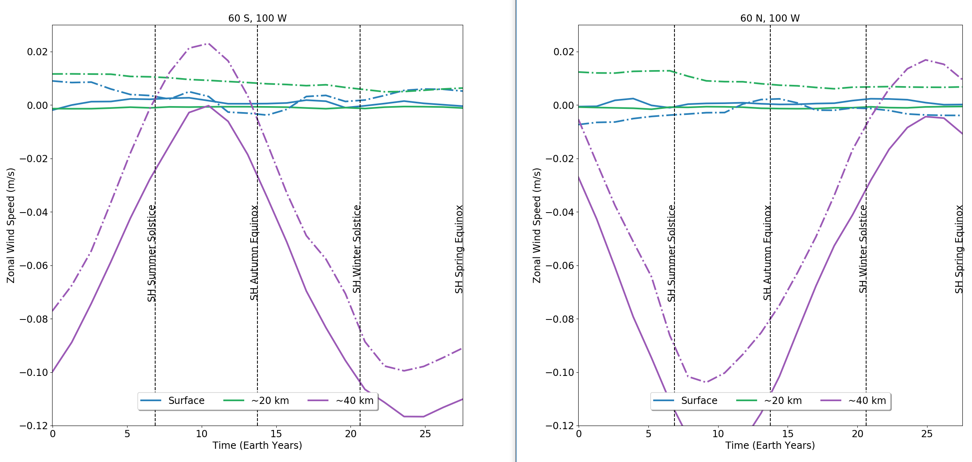
Zonal wind speed at a location with season
WRITE

Slide 11
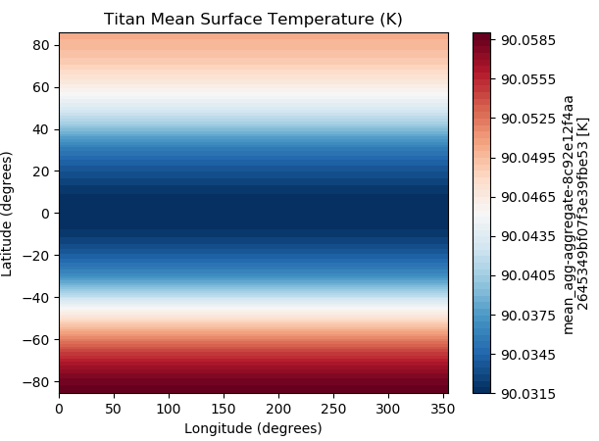
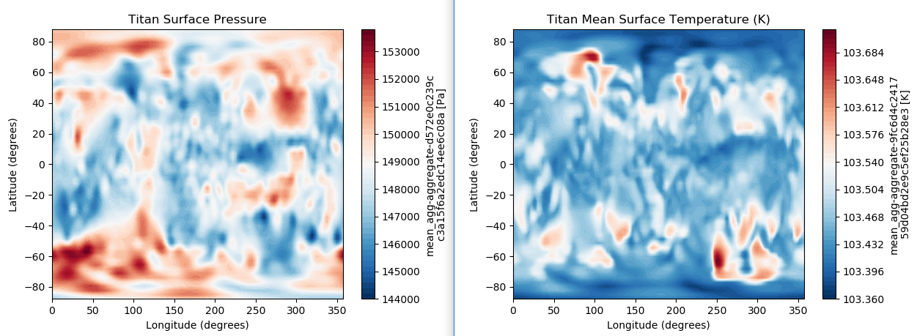
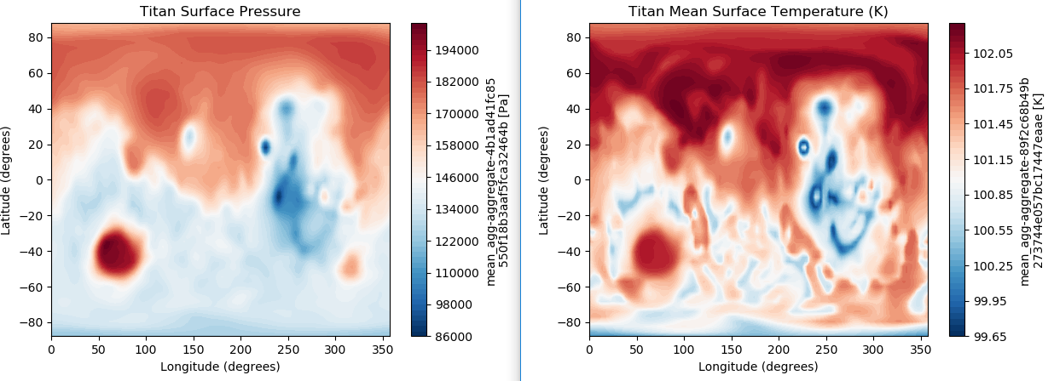
Surface temperature
Mean surface temperature (over some period of time).
[Colour scale is pretty misleading, as the variations over the surface is ~0.02K. Probably far more interesting when it comes to putting in topography (see below) and should definitely try to produce “difference plots” once topography is working]

Slide 12
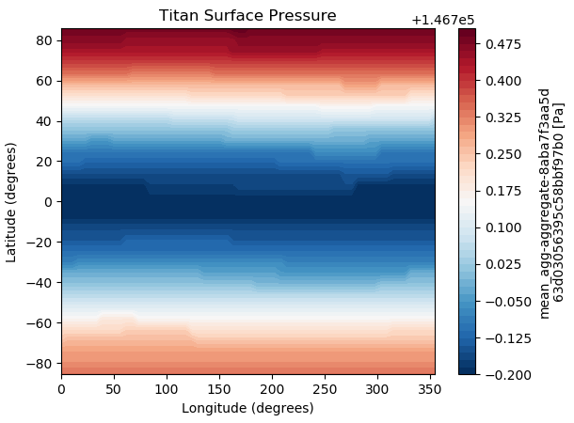
Surface pressure
Mean surface pressure (over some period of time).
[Again, probably far more interesting when it comes to putting in topography (see below) and should definitely try to produce “difference plots” once topography is working]

Slide 13
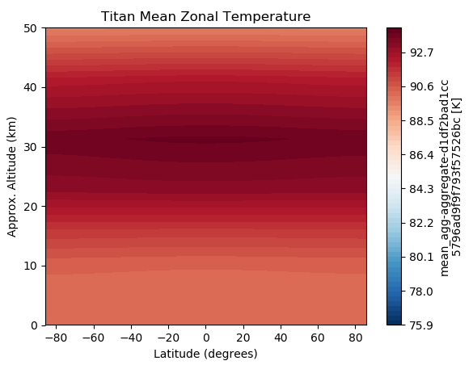
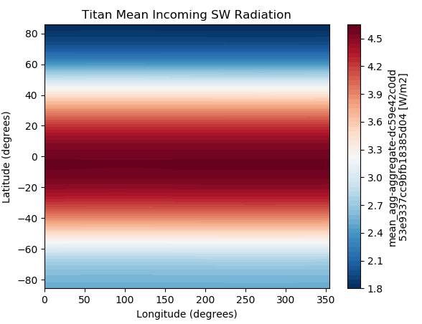
Zonal temperature
Incoming SW
Mean incoming SW at the top of the atmosphere (over some period of time).
Mean zonal temperature (over some period of time).

Slide 14
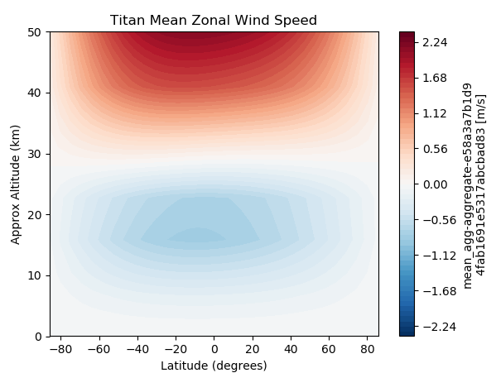
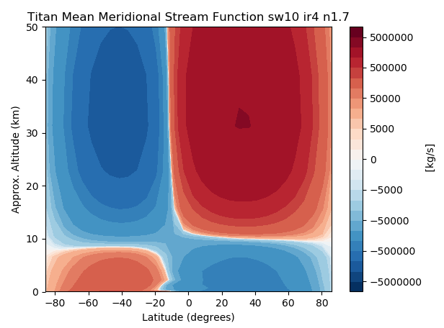
Zonal wind speed
Meridional mass stream function
Mean meridional mass stream function(over some period of time – in this case it is averaged over one half of a Titan year).
[Again, probably best to produce seasonal average plots of this kind of thing? Want to show that overturning of the atmosphere is happening as we’re expecting and even confirm the hypotheses/observations of the one-two-one cycle of circulatory cells.]
Mean zonal wind speed (over some period of time – in this case it is averaged over one half of a Titan year).
[Could attempt to locate jet centres? Probably best to produce seasonal average plots of this kind of thing?]

Slide 15
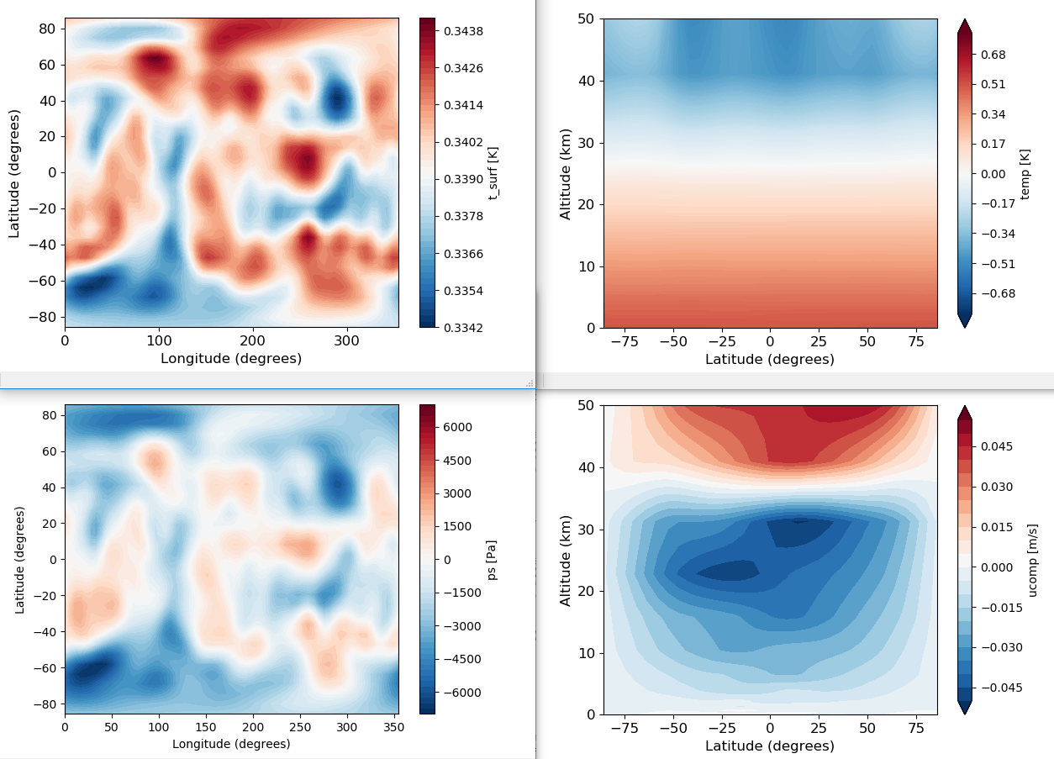
Difference plots (with & without topo, @ NH Winter)
WRITE

Slide 16
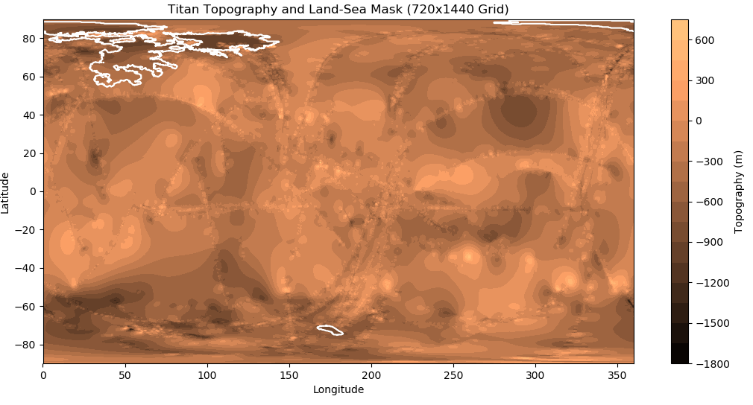

Topography
[I think it’s at least worth showing the comparison between the two plots to say that this is what effect re-gridding has. In some ways, it’s maybe good that the regridding ‘smooths out’ some of the artefacts of the map that Corlies et al. produced (e.g. you can see the ‘tracks’ from the SarTOPO observations on the original)? But you can see that the extremes of the topography have been reduced from the colorbar?]

