Slide 1


Hadoop QA Training.
Big DaTA / Hadoop Architecture details.

Slide 2

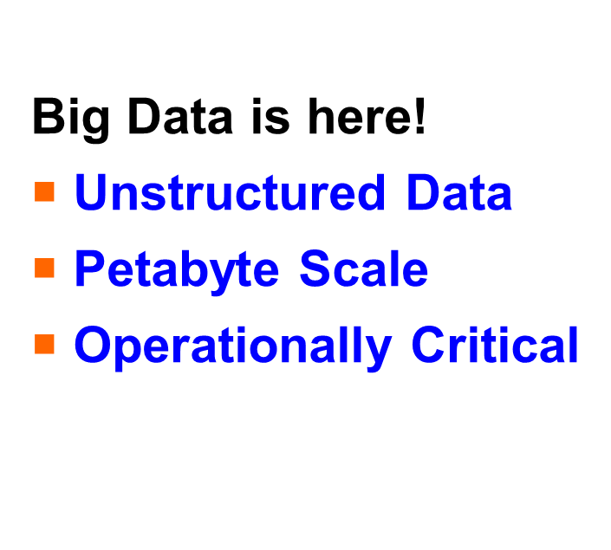
What’s Happening

Slide 3
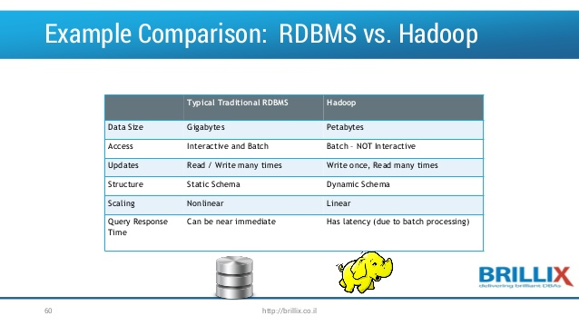
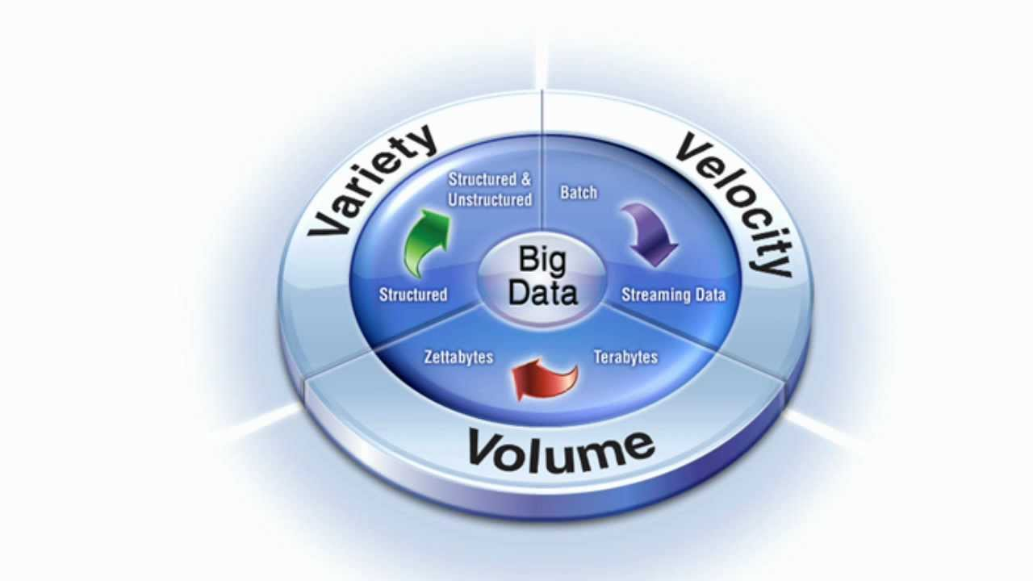
Big Data Buzzword
Big data has become buzzword in the industry. Huge volume of data is being created day by day.
RDBMS : Series of commands to be executed and user interactive.

Slide 4
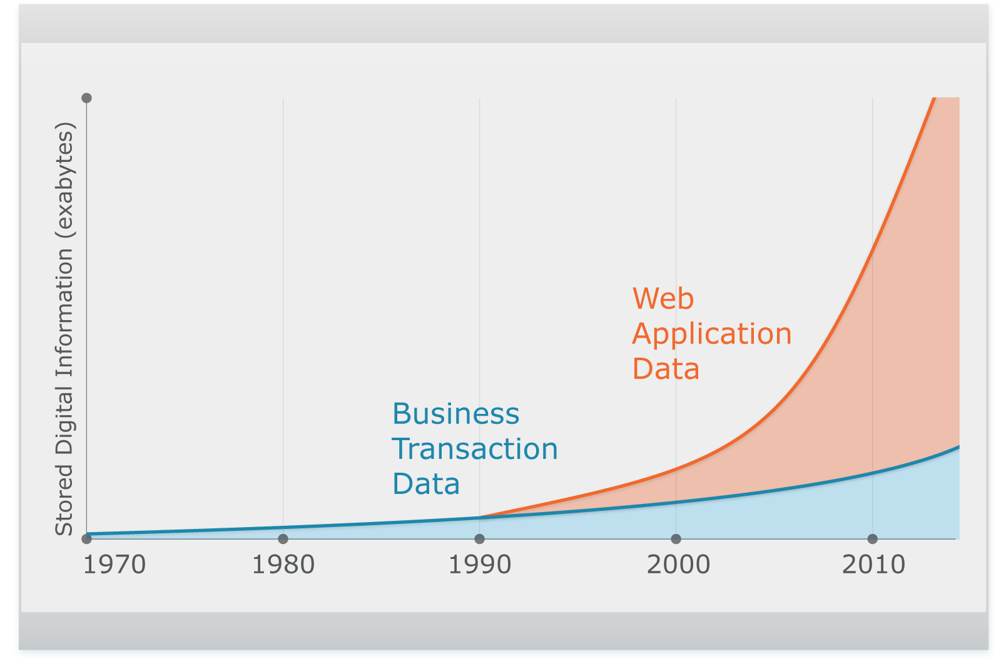
Why “Big Data” Now
Complex, Unstructured
Relational
2,500 exabytes of new information in 2012 with Internet as primary driver
Most of the data are unstructured and can be used for analytics which contains business related informations.

Slide 5
Traditional distributed system
Programming Model is complex
Data exchange requires synchronization
Failures are expensive and needs to be managed
Does not scale for Large volumes of data – network interconnects in a datacenter are expensive!
Shared Everything architecture.

Slide 6
New Approach to Distributed System
Data is Local and does not have to move across network
Shared Nothing Architecture
No synchronization requirement among the nodes
Designed for failure – Multiple copies of data
Consistent Architecture – individual failures does not fail the job

Slide 7
Shared Nothing Architecture
Process
Process
Process
Data
Data
Data
Processor
Processor
Processor
Data
Data
Data
Data is sharded(partitioned) amongst the nodes
Computation is local to the nodes – no need to get the data from elsewhere
No synchronization, Simple implementation

Slide 8



What is Apache Hadoop
Manage complex data – relational and non relational – in a single repository
CORE HADOOP COMPONENTS
Self Healing Distributed Storage
Fault Tolerant Distributed Computing
+
Abstraction for Parallel Processing
Store source data forever and analyze as and when needed
Process at source – eliminate data movement.
It’s a open source software framework build in java for distributed storage and processing very large datasets on clusters build from commodity hardware.
HADOOP RELATED PROJECTS

Slide 9
Hadoop Cluster
NameNode
Secondary
NameNode
JobTracker
DataNode
DataNode
DataNode
DataNode
Distributed File System
DataNode
DataNode
DataNode
DataNode
DataNode
DataNode
DataNode
DataNode

Slide 10
HDFS Overview
Designed for number of Large files (millions instead of billions)
Sequential access not Random access
Write Once, Read Many
Data is split into chunks and stored in multiple nodes as blocks
Namenode maintains the block locations
Blocks get replicated over the data nodes
Single namespace and accessible universally
Computation is moved to the data – data locality

Slide 11
Map Reduce Overview
Tasks are distributed to multiple nodes
Each node processes the data stored in that node
Consists of two phase:
Map – Reads input data and output intermediate keys and values
Reduce – Values with the same key are sent to the same reducer for further processing

Slide 12
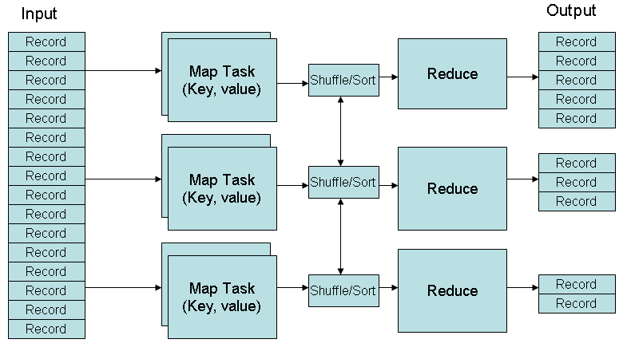
Map Reduce Architecture

Slide 13
Map Reduce Processing
Map Node
Reduce Node
Input
Format
Your Map
Code
Your
Reduce
Code
Output
Format
Partitioner
Sort
Distributed File System

Slide 14
Key Hadoop FS Command
hadoop fs –ls
hadoop fs –mkdir
hadoop fs –rm
hadoop fs –copyFromLocal
hadoop fs –copyToLocal
hadoop fs –moveToLocal
hadoop fs –tail
hadoop fs –put
hadoop fs -get
hadoop fs -cat

Slide 15
Hadoop Architecture

Slide 16
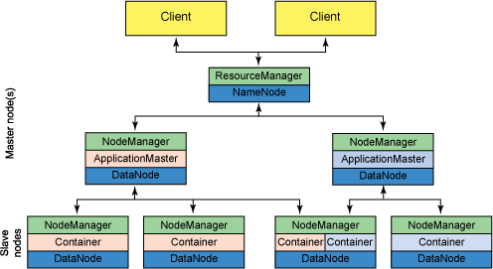
Topology of a Hadoop Cluster.

Slide 17
Running Hadoop
Run a set of daemons on the different servers in your network.
These daemons have specific roles
Some exist only on one server, some exist across multiple servers.
Namenode
Datanode
Secondarynamenode
ResourceManager
NodeManager

Slide 18
Traditional Hadoop Architecture

Slide 19
Traditional Hadoop Cluster.
Files are Broken into blocks
Distributed across data nodes
Name Node holds (in memory)
Directory, Files Listing
Block replica locations
Data Nodes
Host and serve blocks
All operations go to NN
No idea of files / directory
Secondary Name Node
Assists Name Node
Client
NameNode
Secondary
NameNode
DataNode
DataNode
DataNode
DataNode

Slide 20
HDFS : NameNode.
Hadoop employs a master/slave architecture for both distributed storage and distributed computation.
The NameNode is the master of HDFS
NameNode is the bookkeeper of HDFS Metadata
Single namenode stores all metadata
It is maintained entirely in RAM for fast lookup

Slide 21
Name Node Terms :
Inode : Represents the directories / records attributes as permission, modifications, access time, disk space.
Image : The Inodes and the list of blocks that define the metadata of the name system are called the image. It keeps every thing in RAM.
Checkpoint : Persistent record of the image stored in the Name Node's local native filesystem is called a checkpoint.
Journal : Each client-initiated transaction is recorded in the journal, and the journal file is flushed and synced before the acknowledgment is sent to the client.

Slide 22
HDFS : Secondary Name Node.
Assistant daemon for monitoring the state of the cluster HDFS.
The SNN differs from the NameNode
Doesn’t receive or record any real-time changes to HDFS.
Communicates with the NameNode to take snapshots of the HDFS metadata at intervals defined by the cluster configuration.

Slide 23
HDFS : Data Node
Each slave machine in the cluster will host a DataNode daemon to perform the grunt work of the distributed file system
Stores actual HDFS data blocks
DataNodes constantly report to the NameNode

Slide 24
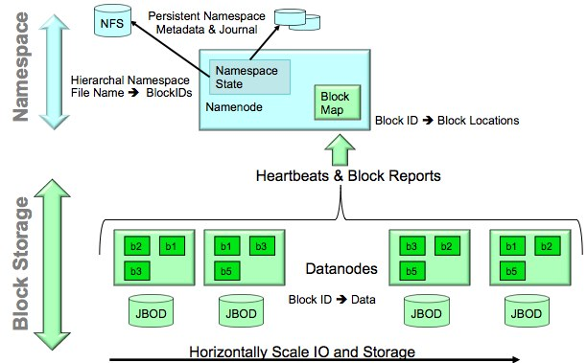
HDFS : Storage Details

Slide 25
HDFS : Data Distribution
Data is conceptually record-oriented in the Hadoop programming framework
HDFS splits large data files into chunks (default size is 64 MB)
Chunks are spread over multiple nodes in the cluster. They are also replicated across the cluster for fault tolerance
Shared nothing architecture
Chunks form a single namespace and are accessible universally
Moving computation to data allows Hadoop framework to achieve high data locality and avoid strain on network bandwidth

Slide 26
HDFS : Data Distribution
Although files are split into 64Mb or 128Mb blocks, if a file is smaller than this the full 64Mb/128Mb will not be used
Blocks are stored as standard files on the DataNodes, in a set of directories specified in Hadoop’s configuration files
Without the metadata on the NameNode, there is no way to access the files in the HDFS cluster

Slide 27
HDFS: Read Data
When a client application wants to read a file:
Client communicates with the NameNode to determine which blocks make up the file, and which DataNodes those blocks reside on
The NameNode will not be a bottleneck
Client then communicates directly with the DataNodes to read the data

Slide 28
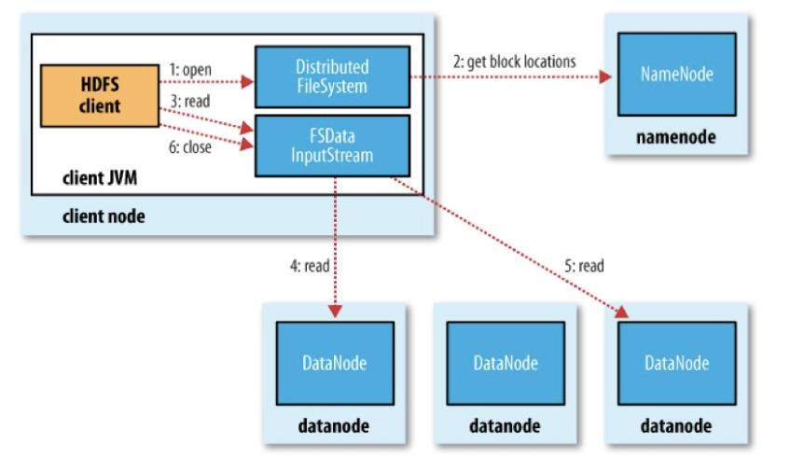
HDFS: Data Read Flow

Slide 29
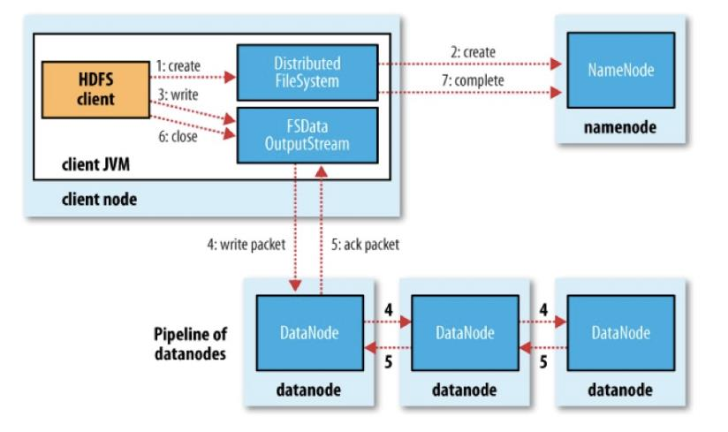
HDFS: Data Write Flow

Slide 30
HDFS: Data Write
When a client application wants to write a file:
Creates an RPC call to namenode to create a new file in the namespace
Namenode performs validation on path and permissions
Creates a new record of the new file
Namenode determines which block have to be written to which datanodes (with replication)
Client retrieves a list of DataNodes on which to place replicas of a block
Client writes block to the first DataNode
The first DataNode forwards the data to the next DataNode in the Pipeline
When all replicas are written, the Client moves on to the next block
Takes into consideration the network topology of hadoop cluster

Slide 31
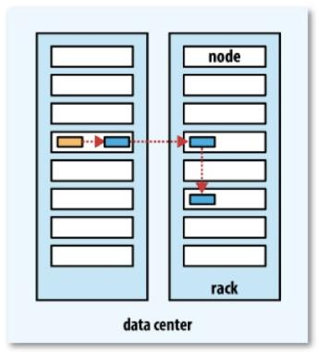
HDFS: Block Placement
One replica on local node (if client on same node, else picked at random)
Second replica on a remote rack (off rack)
Third replica on same rack as second (random node)
Additional replicas are randomly placed

Slide 32
HDFS: Data Pipelinening
Client retrieves a list of DataNodes on which to place replicas of a block
Client writes block to the first DataNode
The first DataNode forwards the data to the next DataNode in the Pipeline
When all replicas are written, the Client moves on to the next block in file

Slide 33
Thank You

