Slide 1





APP DETAIL
Unload your burden
By The Ambiverts
~Gokul R
~Gokul Krishnan C

Slide 2

Programmers Doom
Android studio has a ocean of libraries
But there isn’t a proper one to get the meta data of current app and the rest
Programmers spend drastic time to get the permissions, network usage, media content
We provide the solution in AppDetail library

Slide 3




App Detail
STORAGE
Get access to the media content of any app and RAM usage
PERMISSION
Get dynamic permissions swiftly
A faster way to have details about the data used by the app
NETWORK
Get the update history of any app instantly
UPDATES

Slide 4









Functions of App Detail Library
getPermission
appDetail .getPermission( ACCESS_FINE_ LOCATION, getLocation);
getDoc
appDetail.Media .getDoc();
getImg
appDetail.Media .getImg();
getStorage
appDetail.Media .getStorage();
networkUsage
appDetail .networkUsage();
getTxt
appDetail.Media .getTxt();
getVid
appDetail.Media .getVid();
updateHistory
appDetail.updateHistory();
ramUsage
appDetail.ramUsage();

Slide 5
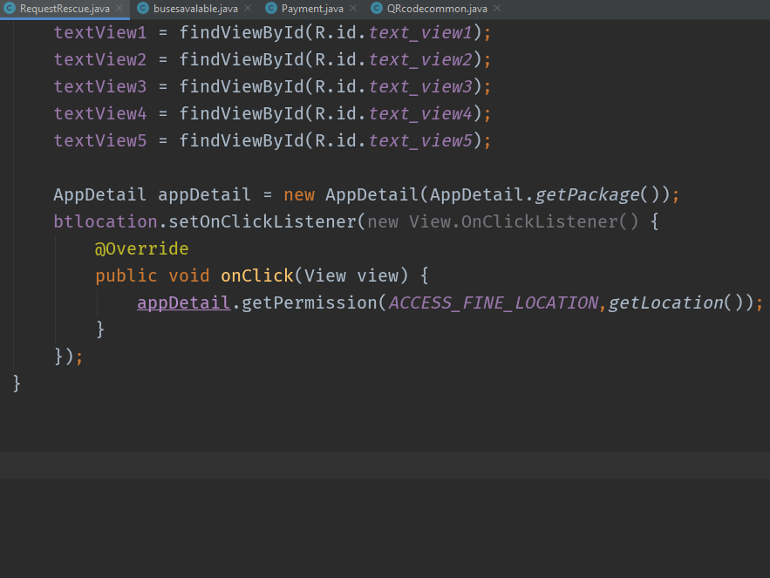
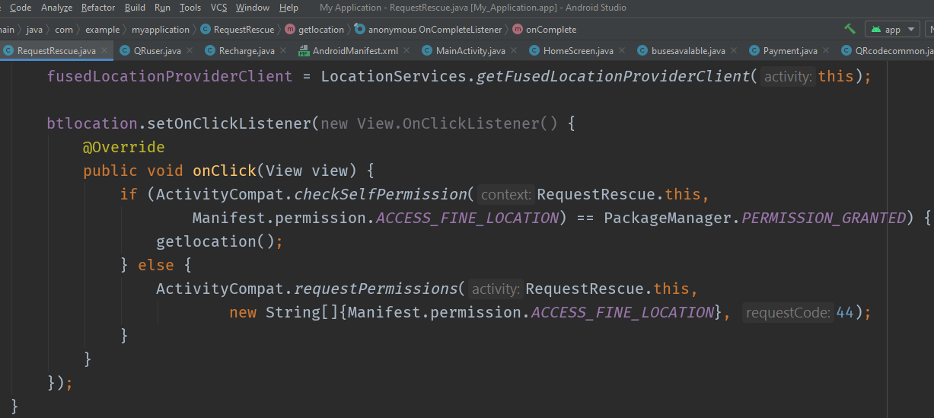


Get On With The New Format

Slide 6
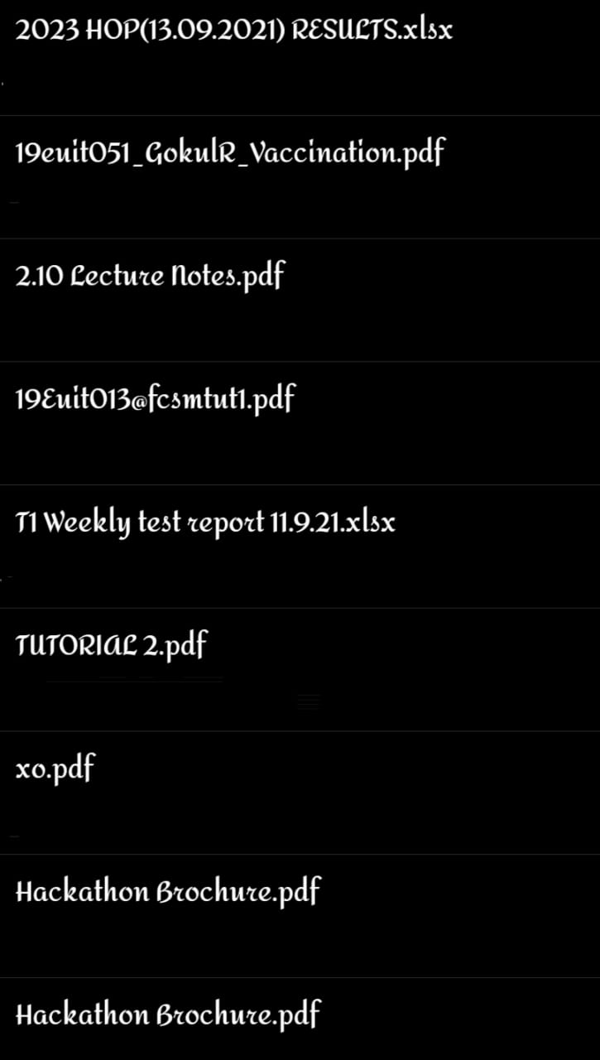
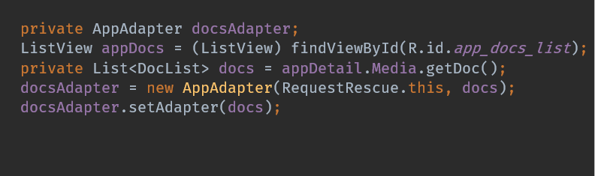

Sample Use of AppDetail

Slide 7
Android was intended to be very customizable. And we welcome innovations.
Sundar Pichai

