Slide 1

LegalEase
AI-Powered Legal Document Generator
Internship / Academic Project • FastAPI (8000) + Streamlit (8501) + Gemini (google-genai) • Demo mode + live fallback • 63 tests, 17 screenshots, 2 videos • 24 September 2026
LegalEase • FastAPI :8000 • Streamlit :8501 • Demo mode with live Gemini fallback • v1.0.0

Slide 2
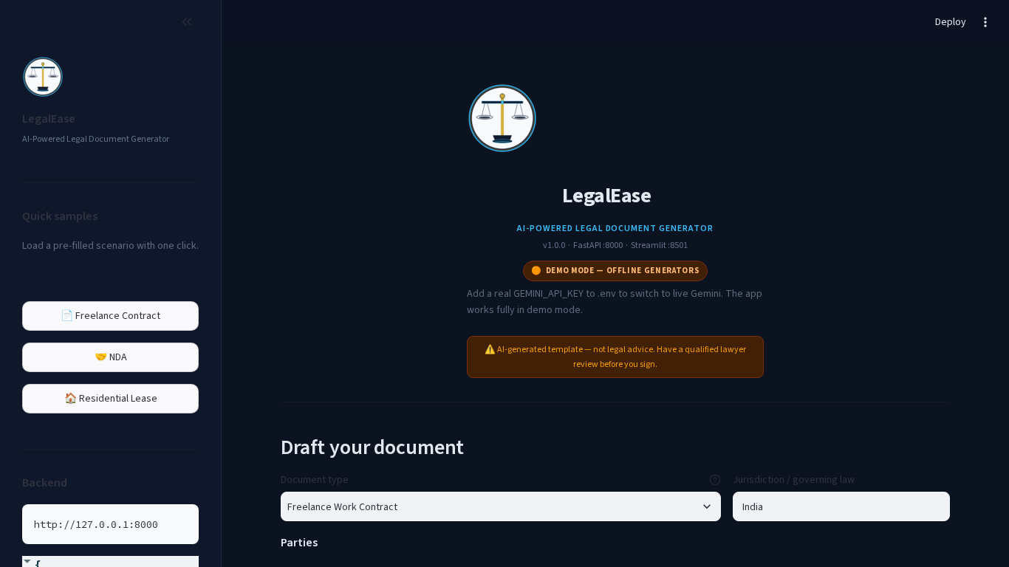
Problem — Why this matters
• Freelancers, small firms & landlords need written contracts but copying random templates is risky (wrong jurisdiction, invented numbers)
• Verbal deals → unpaid invoices, scope creep, unenforceable promises
• A freelance/NDA/lease is mostly boilerplate + specific terms — ideal for a constrained LLM + offline fallback
• Goal: one form → numbered, editable template with disclaimer, always works (demo mode)
Home — demo badge, pre-filled sample, never empty
LegalEase — AI-generated templates, not legal advice — have a lawyer review

Slide 3
Solution — What LegalEase does
• One catalogue in doc_types.py drives prompt, demo generator and validation — live and demo never drift
• FastAPI validates (Pydantic), calls Gemini (gemini-2.5-flash via GEMINI_MODEL, temp 0.25) or demo, validates, falls back with a notice
• Streamlit: dark, centered logo, pre-filled, scrollable preview, edit-in-place, TXT/DOCX/PDF from edited text (bug fixed)
• Health at /health shows mode/model; Swagger at /docs; ports 8000/8501 exactly as spec
LegalEase — AI-generated templates, not legal advice — have a lawyer review

Slide 4
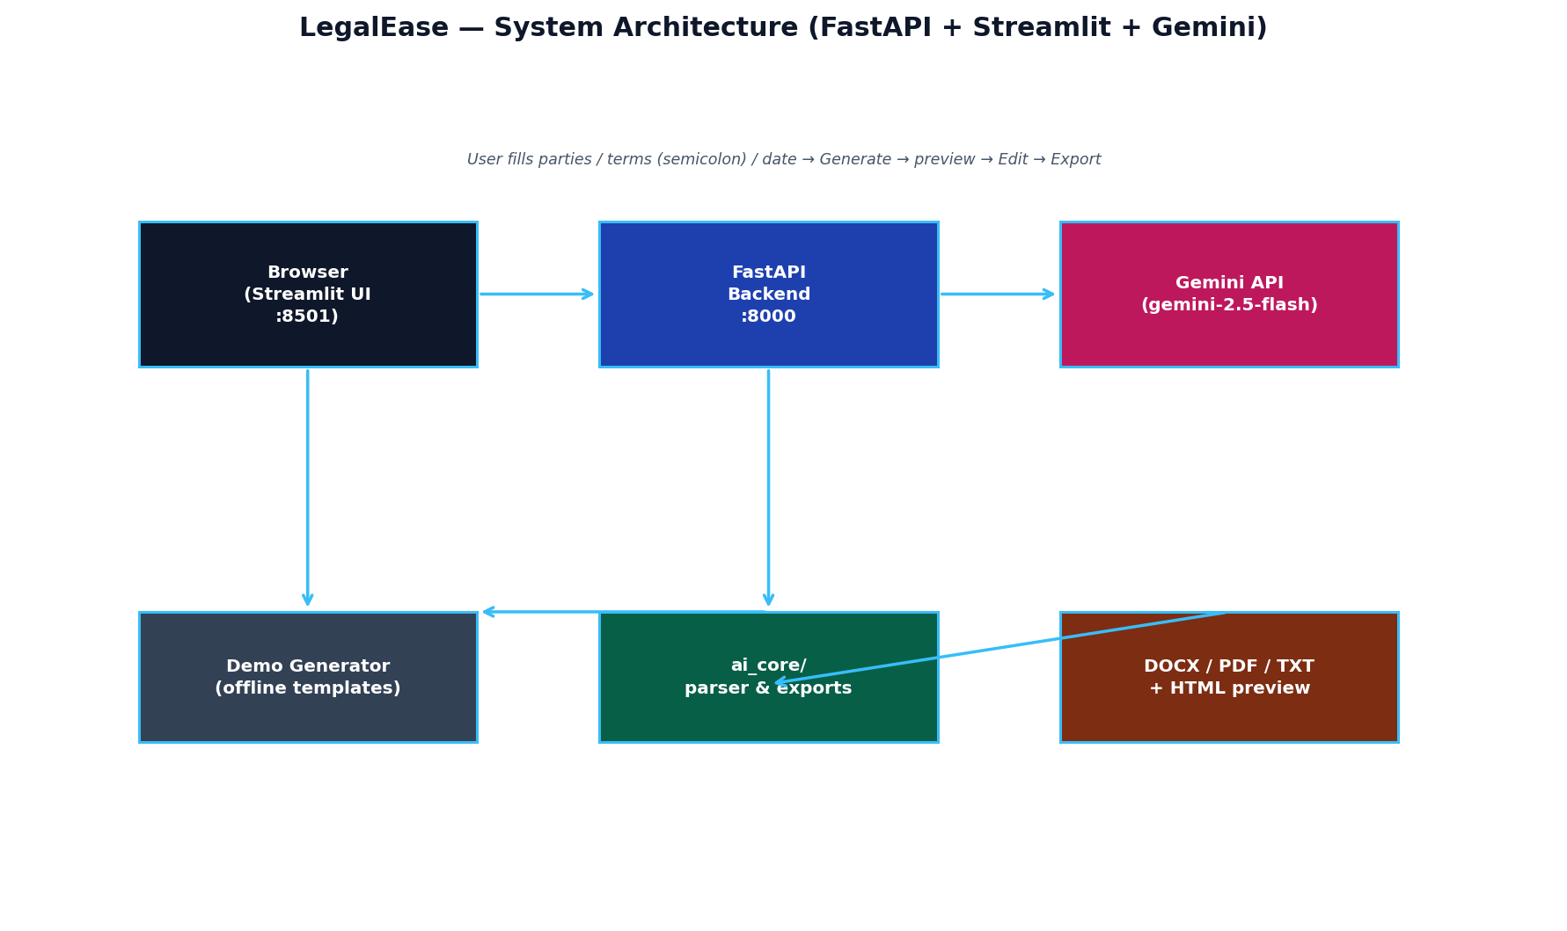
Architecture — Two services, one parser, one config
• config.py is the single knob: GEMINI_MODEL / FLASH / PRO, demo detection, ports, disclaimer
• ai_core/structure parses both Gemini and demo identically → exports tested once
• Exports: TXT UTF-8, DOCX (Times New Roman, table, logo, footer), PDF (fpdf2+DejaVu, header/footer every page)
• No DB — stateless, no persistence, .env.example empty, .gitignore excludes .env
Architecture: Streamlit ↔ FastAPI ↔ Gemini/Demo → Parser → Exports
LegalEase — AI-generated templates, not legal advice — have a lawyer review

Slide 5
Tech Stack
• Python 3.13, FastAPI 0.115 + Uvicorn, Pydantic 2.11, google-genai 1.19 (gemini-2.5-flash default)
• python-docx, fpdf2 (+ DejaVuSans for —, “”, •, ₹), Pillow (logos), Streamlit 1.49
• pytest 63 + httpx TestClient, Playwright 1.54 (chromium), ffmpeg + libass, LibreOffice/pymupdf
• python-docx / openpyxl / python-pptx / matplotlib for phase docs
LegalEase — AI-generated templates, not legal advice — have a lawyer review

Slide 6
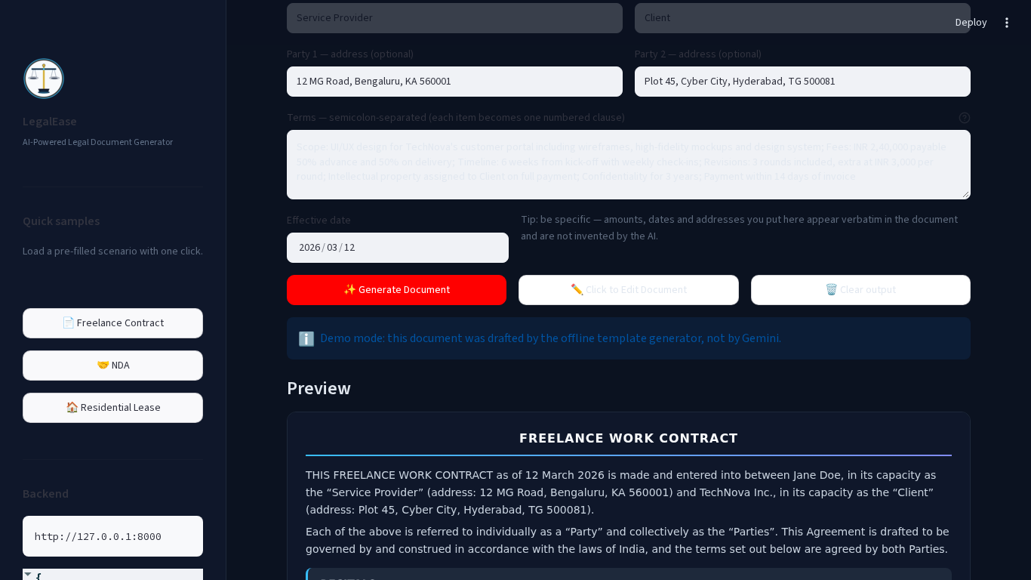
Features — 3 scenarios you will see live
• 1. Freelance Work Contract — Jane Doe (Service Provider) + TechNova Inc. (Client), 7 terms → 9 sections + Signatures
• 2. NDA — Purpose, Definition, Exclusions, Obligations, Term; same parser, different sections
• 3. Residential Lease — R. Kumar / S. Priya, Premises, Rent Rs.28k, Deposit, Term; rent inference demo
• 4. Edit → Downloads use edited text (spec bug fixed) — live preview + TXT/DOCX/PDF with disclaimer
Freelance preview — scrollable HTML with numbered clauses
LegalEase — AI-generated templates, not legal advice — have a lawyer review

Slide 7
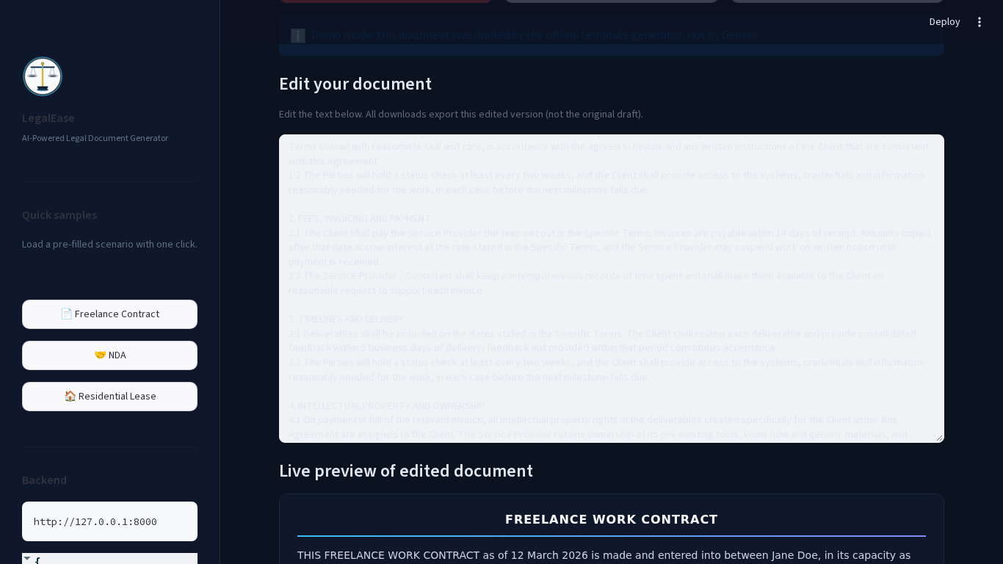
Live Demo — What to click (5 min)
• Quick samples in sidebar: Freelance → Generate (demo mode banner) → scroll preview → Edit → Downloads
• NDA → Generate → Lease → Generate (same form, different sections — catalogue drives it)
• Health & Swagger: GET /health (mode/demo/model) and /docs
• If Gemini 429 during live, fallback banner appears — it is a feature (allow_fallback=1)
Downloads use edited text — TXT/DOCX/PDF from the textarea
LegalEase — AI-generated templates, not legal advice — have a lawyer review

Slide 8
Testing — 63 tests, zero mocks for screenshots
• pytest: 63 passed (test_models 17 + test_structure 7 + test_generator 10 + test_exports 11 + test_api 18)
• 24 cases in Test_Cases.xlsx + Traceability matrix (FR→TC); bugs found & fixed (5)
• Edge: empty, duplicate parties, single party, long, unicode, backend down (friendly banner), fallback 429→demo and 503
• Evidence: docs/evidence/pytest_output.log is verbatim; numbers in docs match it
LegalEase — AI-generated templates, not legal advice — have a lawyer review

Slide 9
Challenges & How We Solved Them
• 1.5 model IDs 404 → env vars with 2.5 defaults (config single source)
• Streamlit selectors flaky (two 'Generate' texts) → data-testid + force clicks (17 screenshots)
• PDF unicode crash → DejaVuSans.ttf, italic fallback (— “ ” ₹ café now safe)
• DOCX→PNG headless → PIL fallback ensures preview always
• Video must be 3 min wall-clock → padded Playwright waits + ffmpeg slideshow fallback
LegalEase — AI-generated templates, not legal advice — have a lawyer review

Slide 10
Future Work
• Clause-level risk review (prompt built, UI hook next)
• Saved drafts + auth (needs DB)
• Multilingual prompts, DOCX track-changes, PDF signatures
• Upload → analyse existing contracts
• Production: tighten CORS, rate-limit, structured logging
LegalEase — AI-generated templates, not legal advice — have a lawyer review

Slide 11
Conclusion
LegalEase delivers a usable, editable first draft in seconds, works without a key, never crashes on API failure, exports from the edited text, handles unicode, and proves it with 63 tests, 17 live screenshots and two MP4s. It is templates, not legal advice — and it says so on every page.
Thank you — Questions? (Viva_Questions.docx has 25 Q&A)

