Slide 1

First studies with VBSMELA in ZZ → 4ljj
Riccardo Bellan, Roberto Covarelli,
Raquel Gomez Ambrosio, Gian Luca Pinna

Slide 2
Concept of MELA
Well-known method in HZZ4l analysis
  For a given event (= 4-lepton four-momenta) construct probabilities P for this event to be coming from a specific production/decay process
  P defined using matrix elements computed from MC calculators (JHUGen, MCFM …) or analytical parameterizations
Use a signal/background kinematic discriminant:
  sig and bkg are two production/decay processes one wants to separate
  P are assumed normalized to 1: otherwise there is a d.o.f in choosing the relative normalization of the two (C-constant)
  For a given 4l total mass there are 7 independent variables for which P are aggregated probabilities taken correlations into account
Notes:
Make general use of KD (also for spin/CP see later)

Slide 3
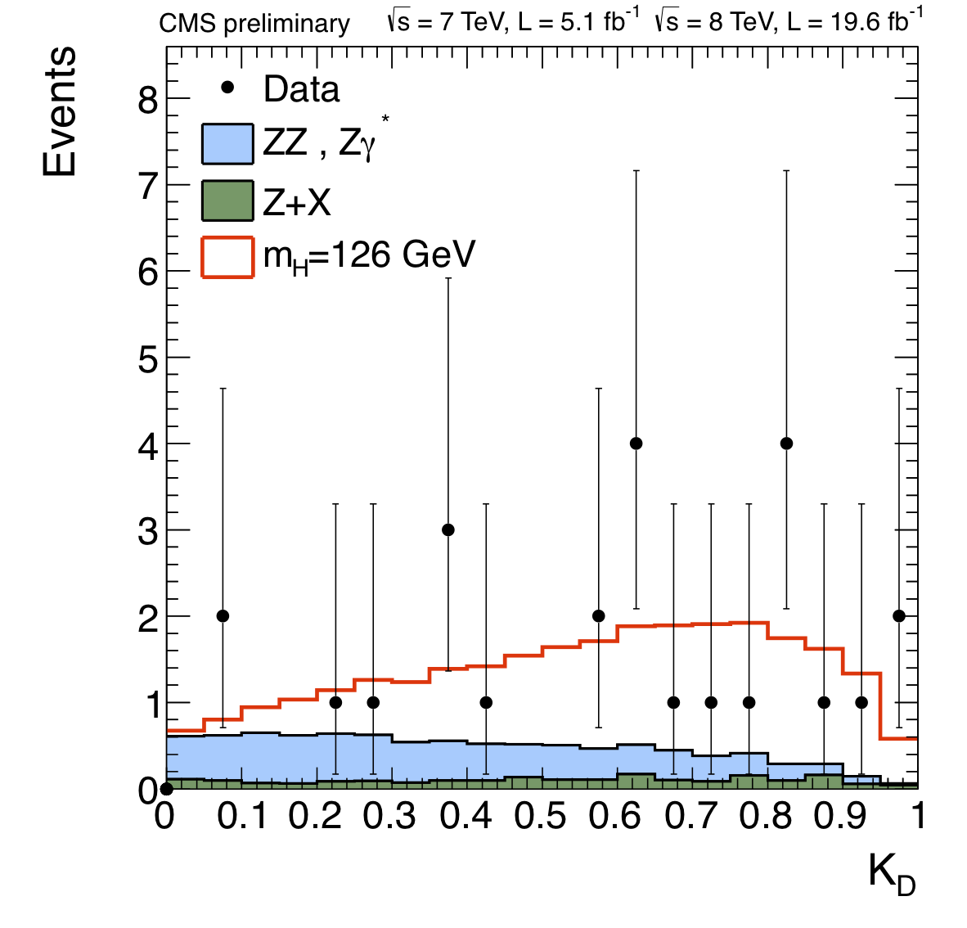
Well-known method in HZZ4l analysis

Slide 4
Status of MELA
MELA V2
  Complete rewrite of interface/methods
  Addition of Mes up to 6-fermions: additional particles in the event (other leptons/jets) can be used to target specific production modes, e.g. WH → 4l jj)
V2.0.1 released very recently
  Includes MCFM probabilities (LO QCD) for a ZZ+2jets event to come from:
    QCD + 2 jets production
    VBS production
    EW production
  Needs 4-lepton and 2-jets input four-momenta
    Not computed if njets < 2
    Not computed (apparently) if one of the mll is offshell → to be clarified with authors
  Results shown here are based on a « beta » version of V2.0.1 adapted to obtain probabilities in the ROOT trees produced by the CJLST framework
Notes:
Make general use of KD (also for spin/CP see later)

Slide 5
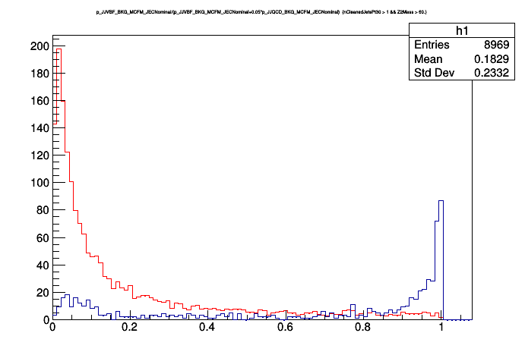
First MELA results
HZZ baseline selection
njets >= 2
60 < mZ1, mZ2 < 120 GeV
K_{VBS} = P_{VBS} / (P_{VBS} + c*P_{QCD}) → c = 0.02 (arbitrary)
Arbitrary normalization
ZZ POWHEG
VBF Phantom B+S+I (4mu)
Notes:
Make general use of KD (also for spin/CP see later)

Slide 6
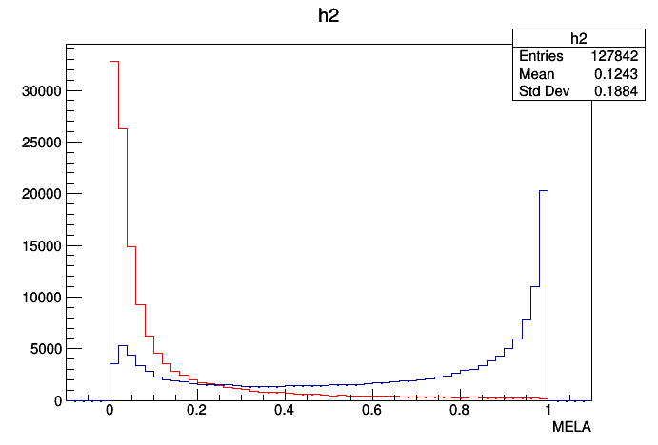
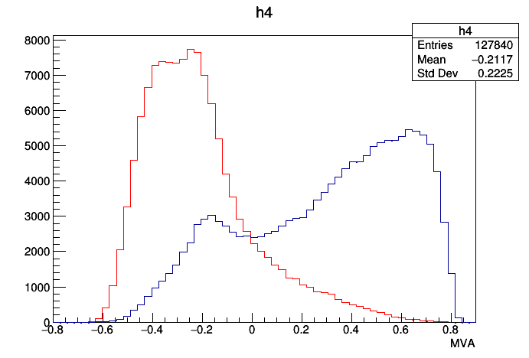
MELA and MVA
HZZ baseline selection
njets >= 2
60 < mZ1, mZ2 < 120 GeV
K_{VBS} = P_{VBS} / (P_{VBS} + 0.2*P_{QCD})
Sum of backgrounds
Signal

Slide 7
First MELA results
|DEtaJJ| > x && mJJ > y | TOTAL | x = 2 y = 250 GeV | x = 2 y = 300 GeV | x = 3 y = 300 GeV
sig | 632 (100%) | 411 (65%) | 400 (63%) | 307 (48%)
bkg | 8929 (100%) | 2095 (23%) | 1707 (19%) | 1323 (15%)
K_{VBS} > w | TOTAL | w = 0.25 | w = 0.5 | w = 0.75
sig | 632 (100%) | 478 (76%) | 423 (67%) | 377 (60%)
bkg | 8929 (100%) | 2134 (24%) | 1039 (12%) | 477 (5%)
The advantage over typical C&C analysis seems clear, especially at efficiencies of 50-60%
Notes:
Make general use of KD (also for spin/CP see later)

Slide 8
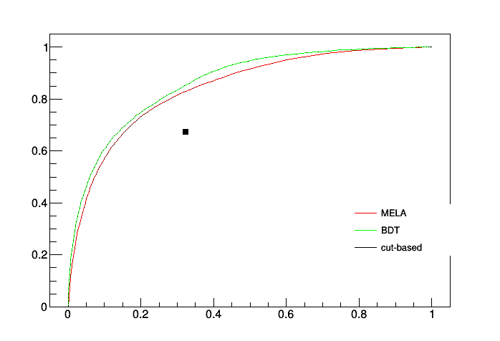
ROC Curve

Slide 9
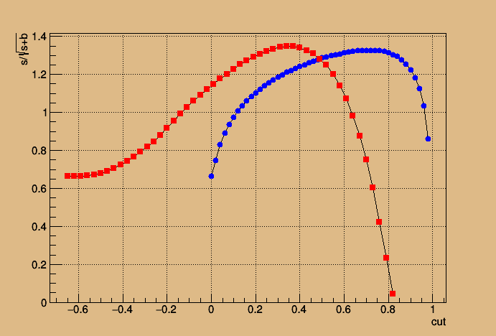
Finding the optimal discriminant
Curve of signal/Sqrt(Signal + Bkg) wrt the cuts. Optimal values found to be: MELA > 0.66 and BDT > 0.34
MAX: ### Cut MELA at 0.66 : pass bkg = 4.18936 : pass sig = 3.72493 FoM = 1.32407
MAX: ### Cut MVA at 0.34 : pass bkg = 3.10582 : pass sig = 3.45895 FoM = 1.35000

