Slide 5

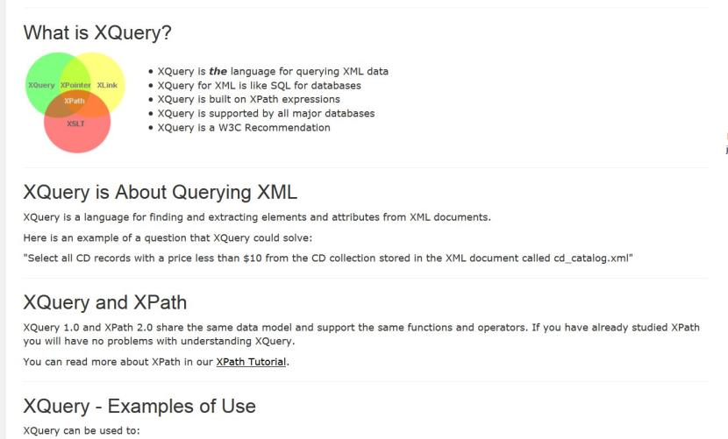

Slide 6
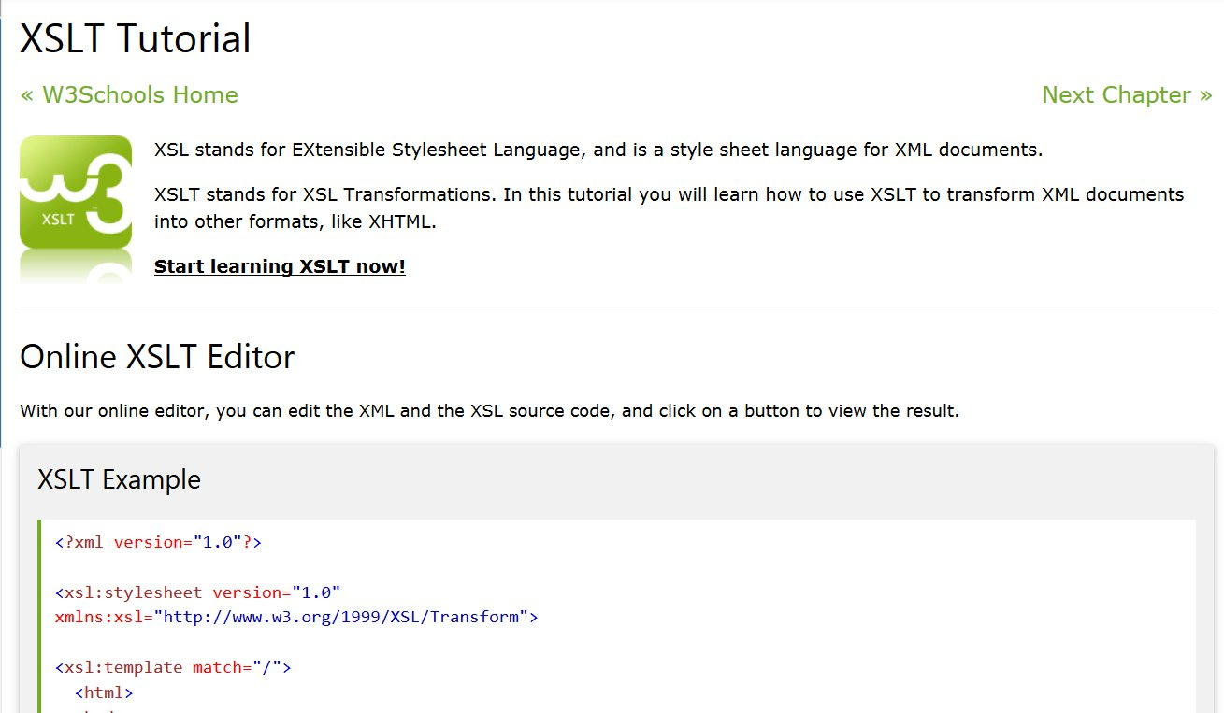

Slide 7
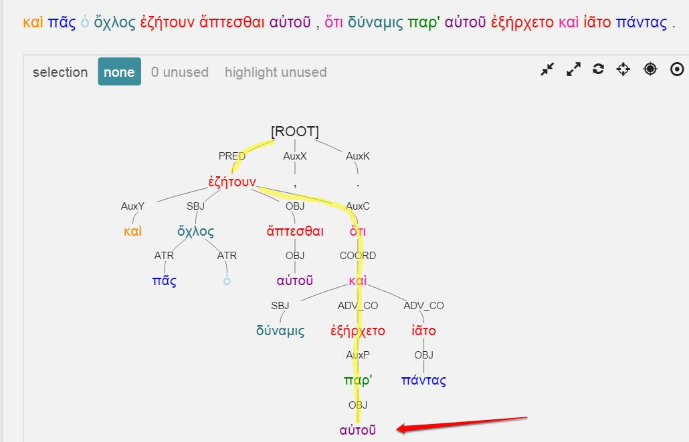


Slide 8
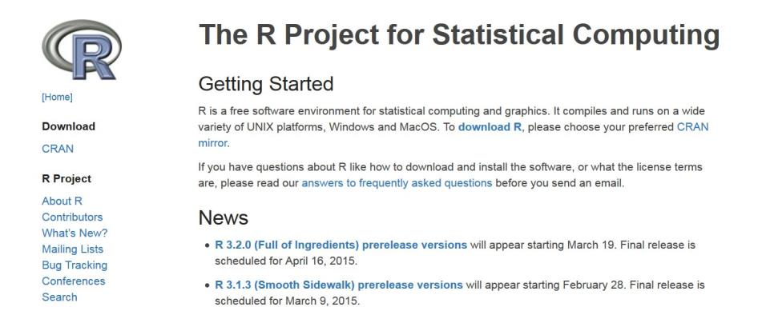

Slide 9

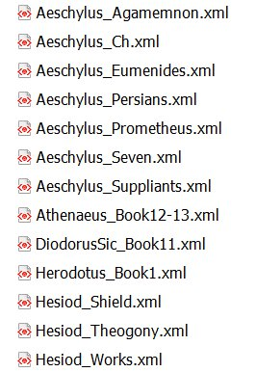
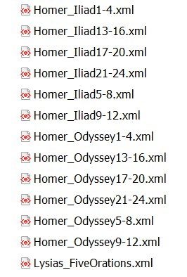
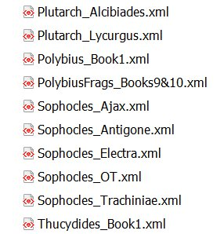

Slide 10
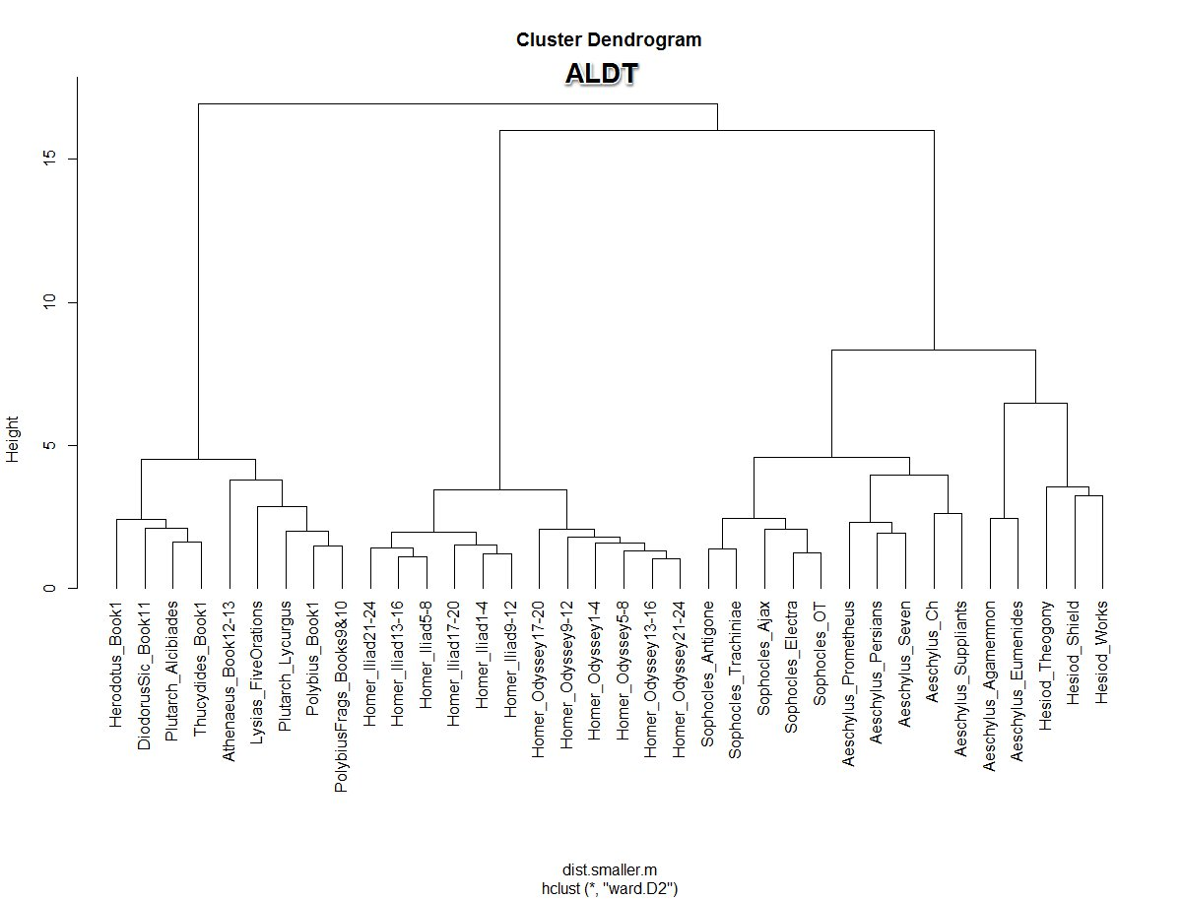

Slide 11
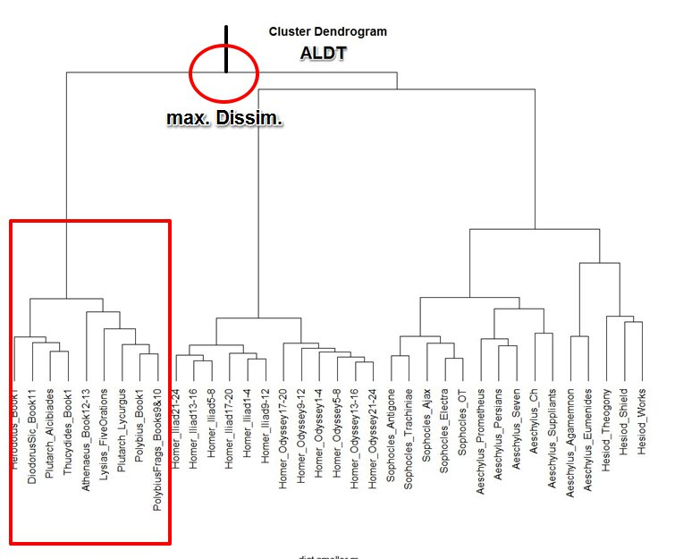

Slide 12
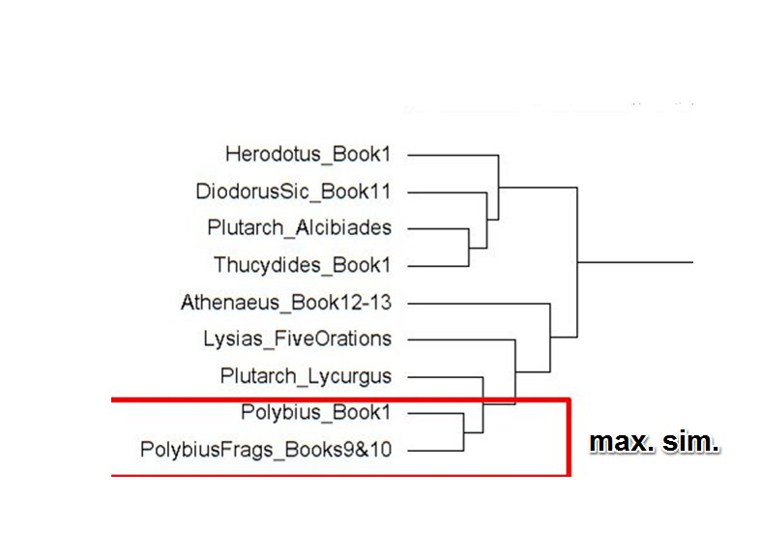

Slide 13
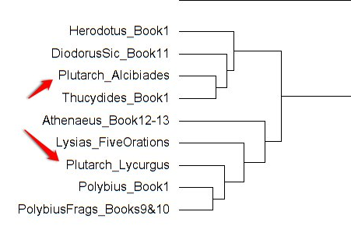

Slide 14
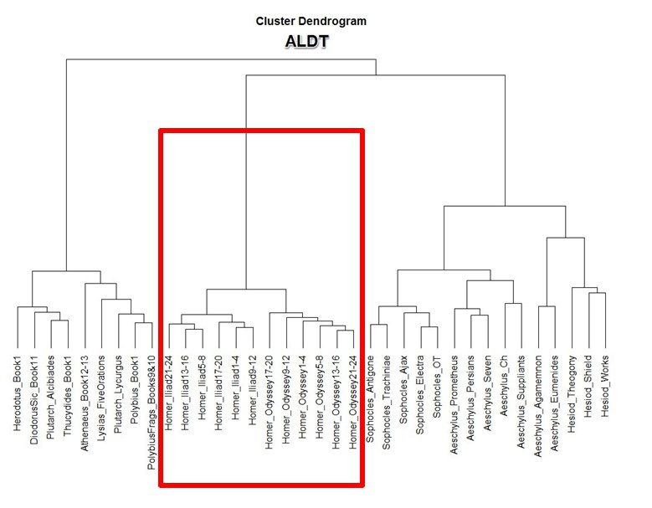
Homeric Verse
Non-Homeric
Verse

Slide 15
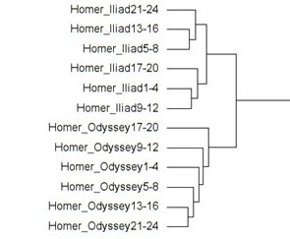

Slide 16
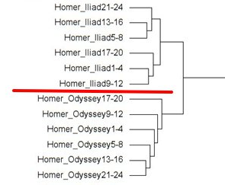

Slide 17
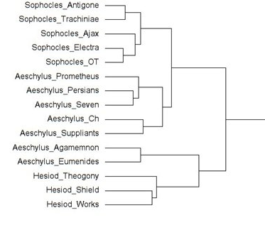

Slide 18
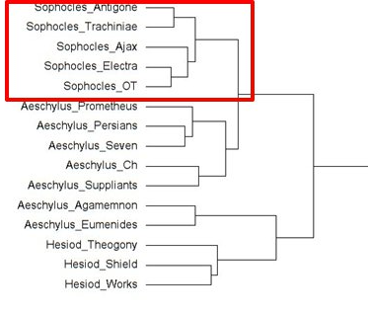

Slide 19
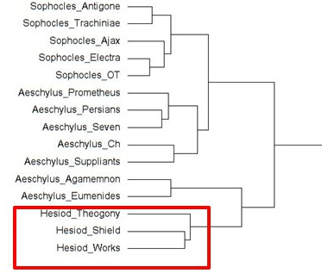

Slide 20
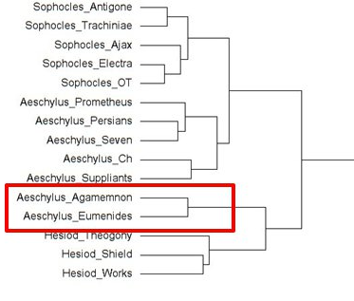

Slide 21
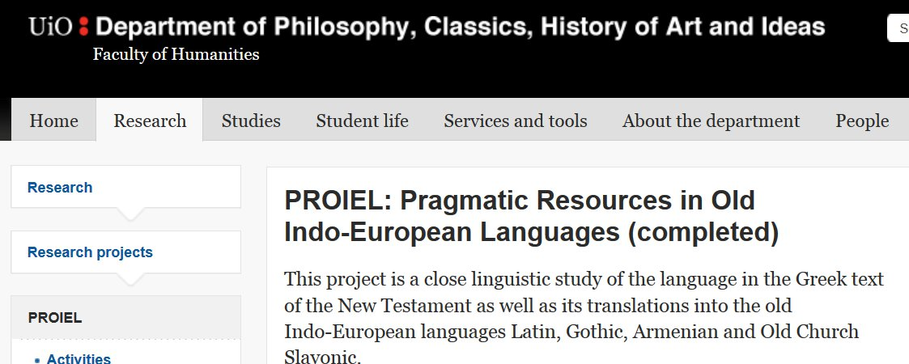
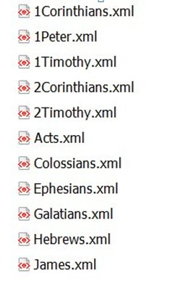
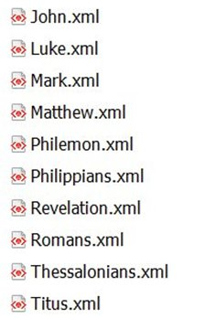

Slide 22

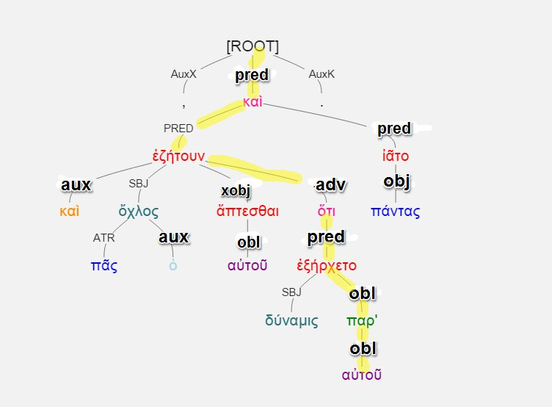


Slide 25
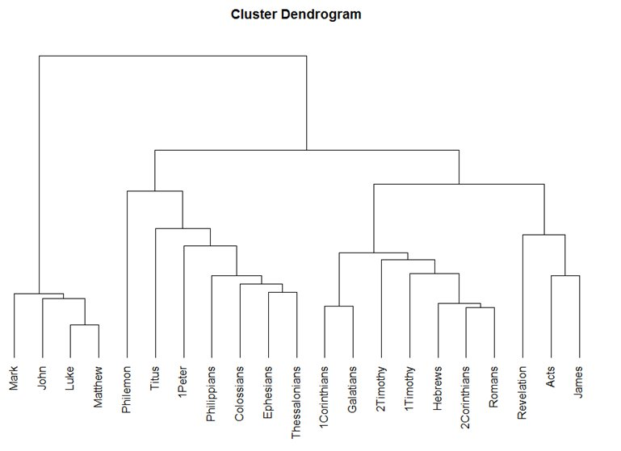

Slide 26
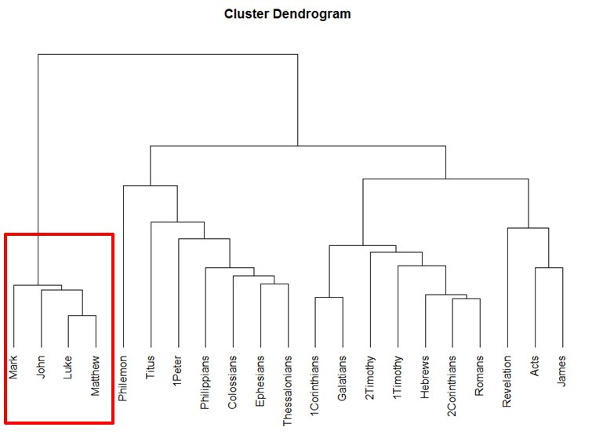

Slide 27
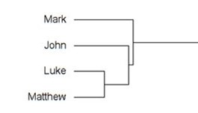

Slide 28
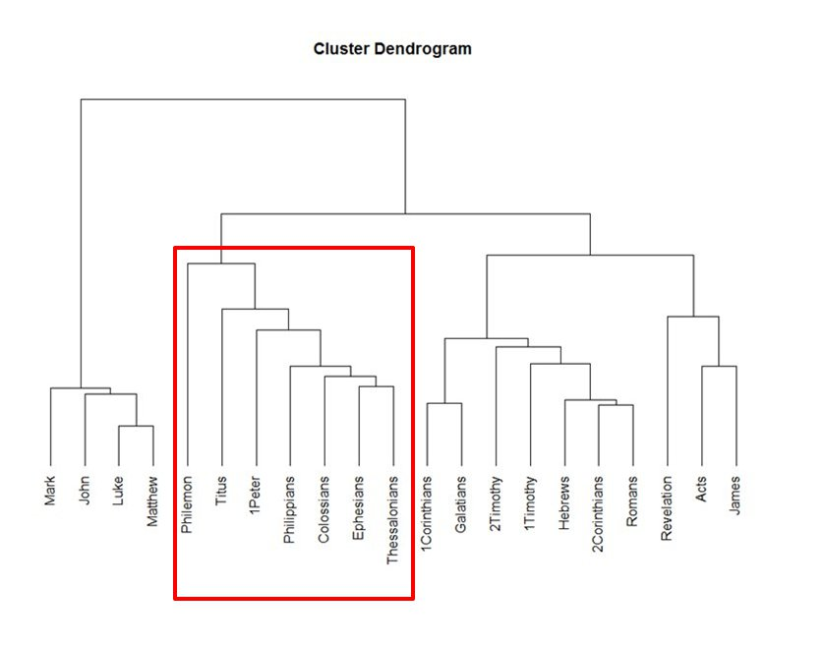

Slide 29
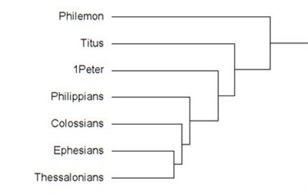

Slide 30
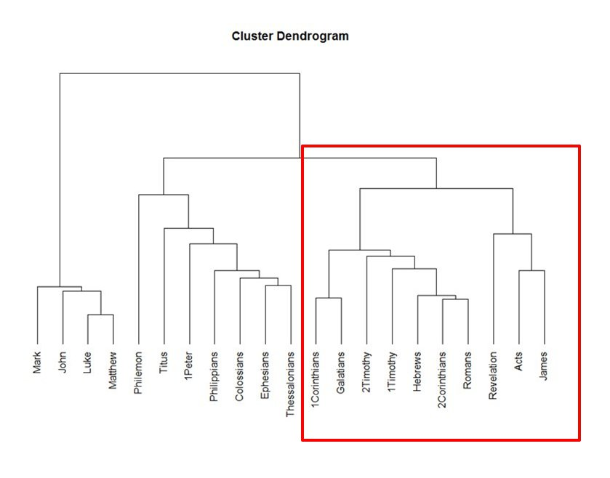

Slide 31
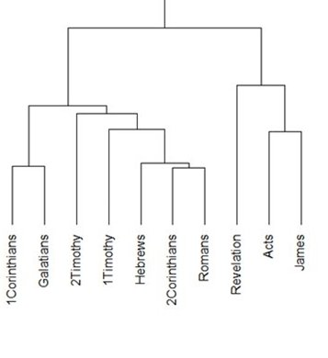

Slide 32
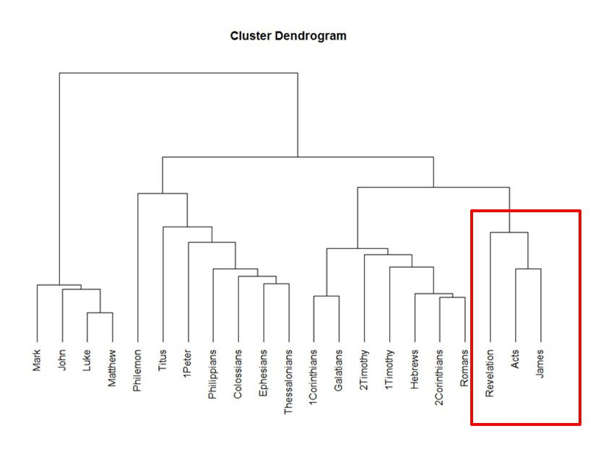

Slide 33
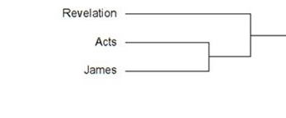

Slide 35
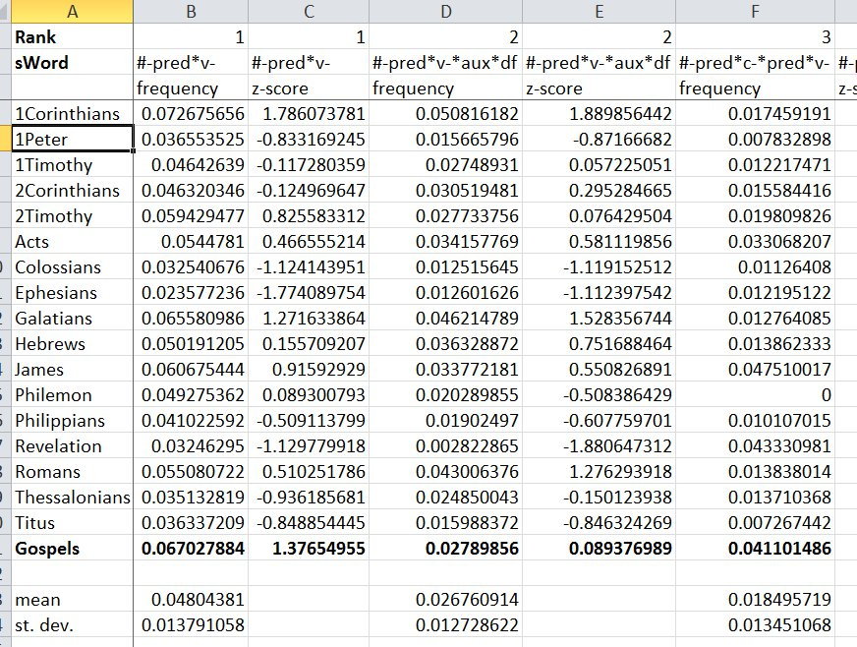

Slide 36
#-pred*v-*obl*pp
Freq. Rank # 18
Gospels: 938 occurrences / 71,529 tokens
Others: 112 / 65,152
Frequency per #-pred*v-
Gospels: 19.59%
Others: 6.04%

Slide 37
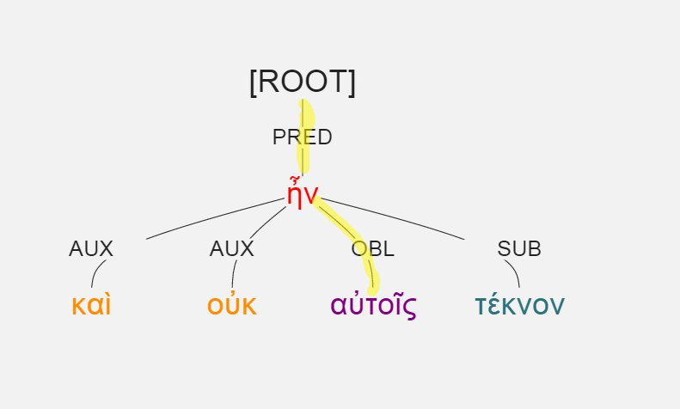
#-pred*v-*obl*pp
Luke 1:7, καὶ οὐκ ἦν αὐτοῖς τέκνον.

Slide 38
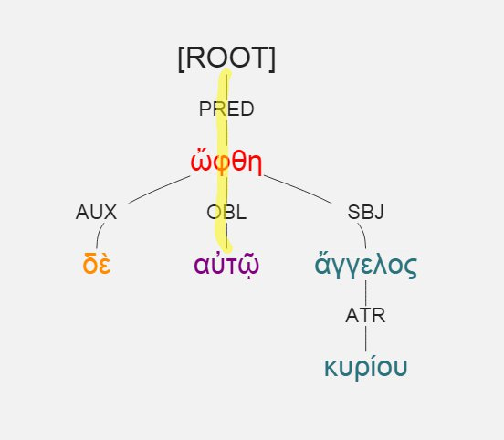
#-pred*v-*obl*pp
Luke 1:11, ὤφθη δὲ αὐτῷ ἄγγελος κυρίου.

Slide 39
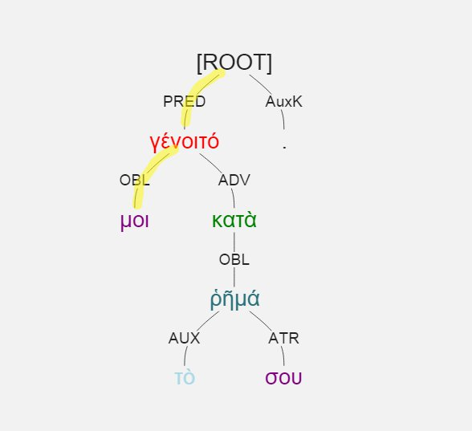
#-pred*v-*obl*pp
Luke 1:38, γένοιτό μοι κατὰ τὸ ῥῆμά σου.

Slide 40
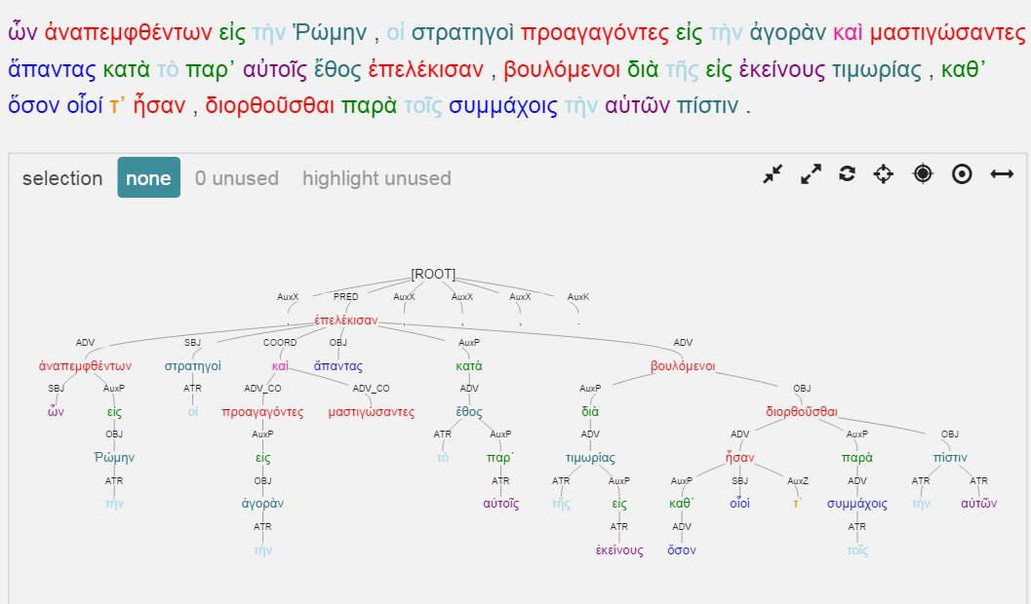
Polybius 1.7

Slide 41
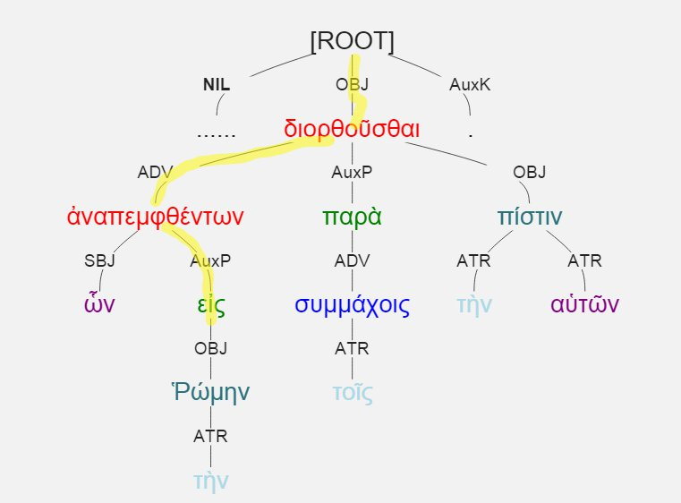
#-pred-v-adv-v-auxp

Slide 42
#-pred-v-adv-v-auxp
Representative of “heavy” circumstantial participle
Distinctive of historical prose, e.g.:
Polybius 1: frequency = 24.9% of #-pred-v (178 times / 26,894 tokens)
Aeschylus: frequency = 3% of #-pred-v (14 times / 45, 682 tokens)

