Slide 1
Syntactic Stylometry on the Basis of Ancient Greek Treebanks
Robert Gorman
Univ. of Nebraska-Lincoln
Global Education and Research Technology
SBL
Atlanta, GA
November 22, 2015

Slide 2
Starting point: how to evaluate ancient reuse of lost texts?
Athenaeus 12.41, Θεόπομπος δ' ἐν πεντεκαιδεκάτῃ Φιλιππικῶν Ἱστοριῶν Στράτωνα φησι τὸν Σιδώνιον βασιλέα ὑπερβάλλειν ἡδυπαθείᾳ καὶ τρυφῇ πάντας ἀνθρώπους. Theopompus in the 15th book of his Philippic Histories says that Straton, the Sidonian king, surpassed all people in extravagance and self-indulgence.

Slide 3
Arethusa at Perseids
http://www.perseids.org/

Slide 4
“Syntax Words”
After
Charles Hollingsworth, “Using Dependency-Based Annotations for Authorship Identification” (2012), introduces “DepWords”
Grigori Sidorov, “Syntactic Dependency-Based N-grams as Classification Features” (2012), introduces “Sn-grams” (“syntactic n-grams)

Slide 6

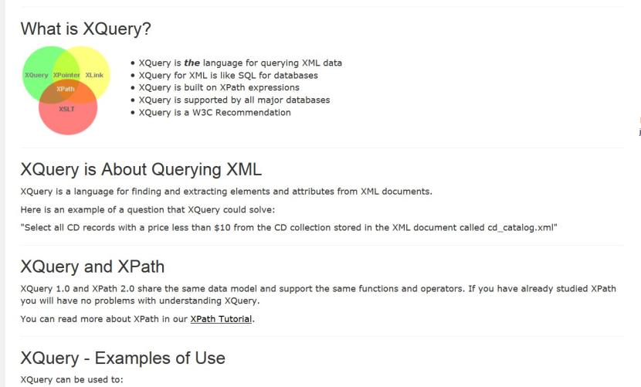

Slide 7
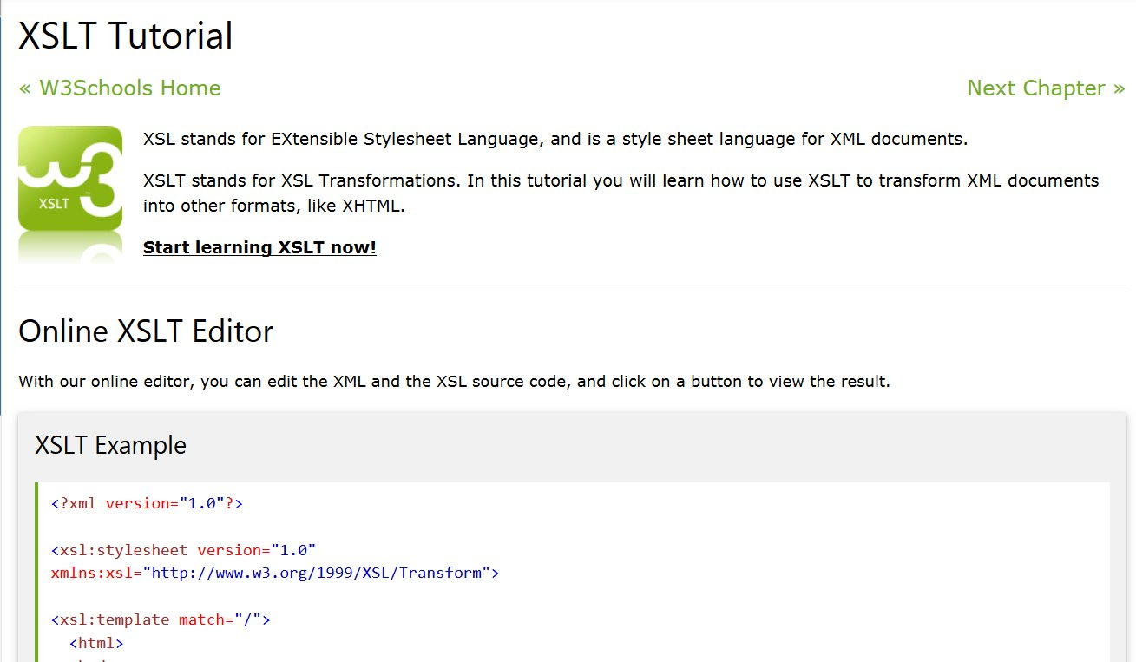

Slide 8
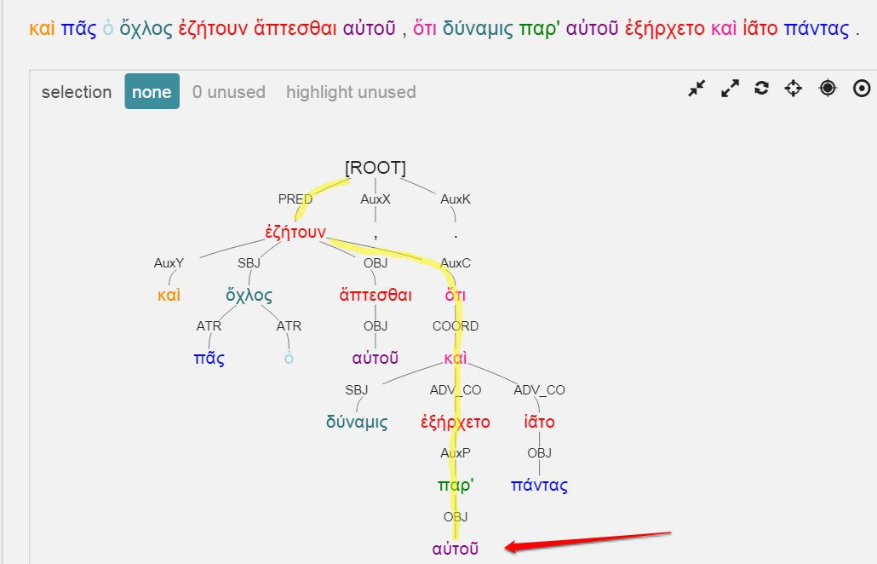
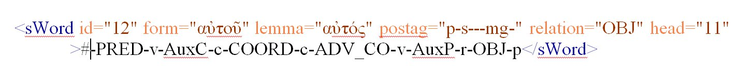

Slide 10
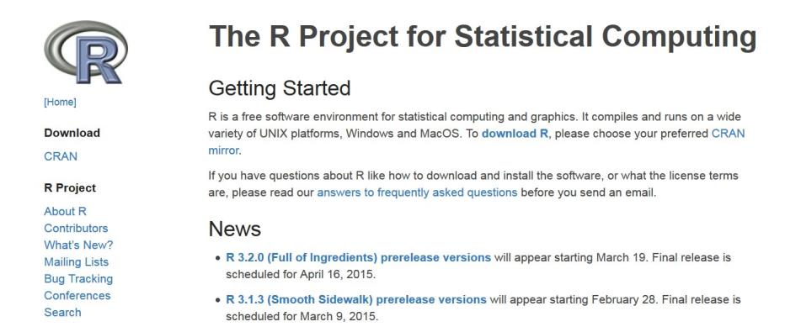

Slide 11
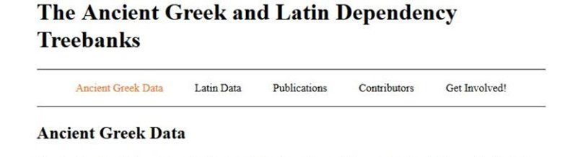
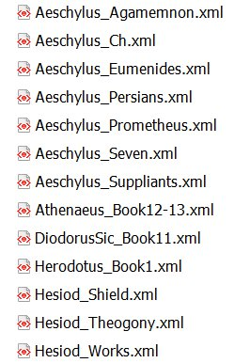
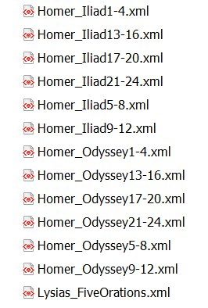
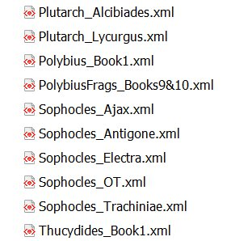

Slide 12
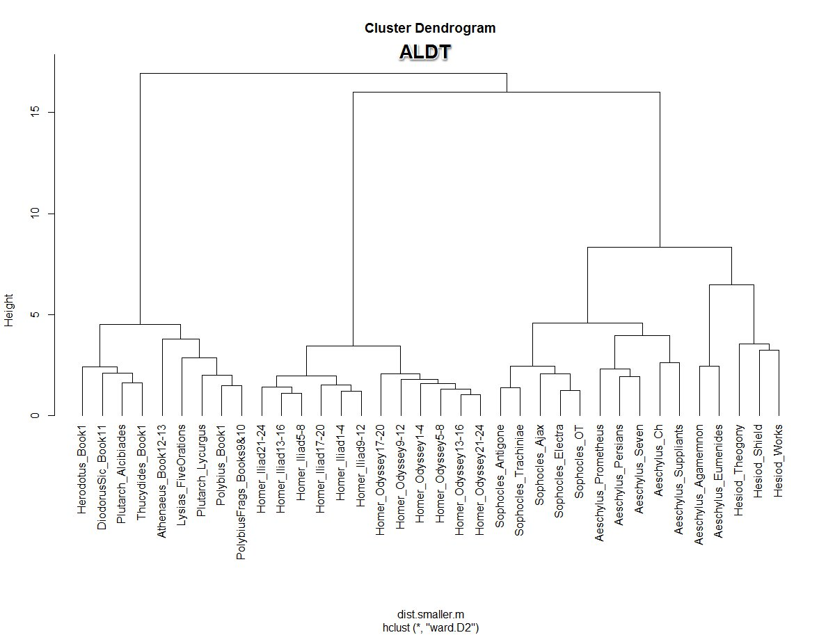

Slide 13
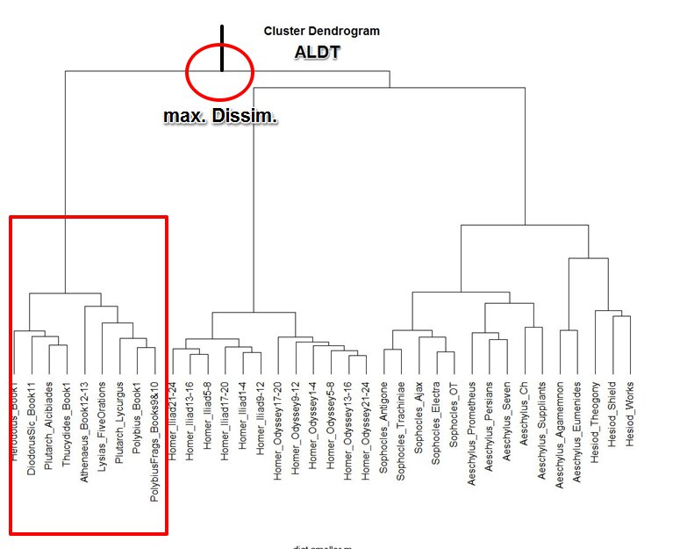

Slide 14
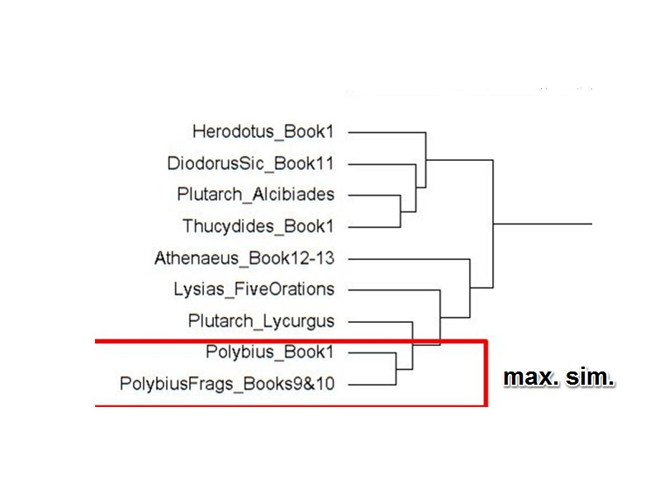

Slide 15
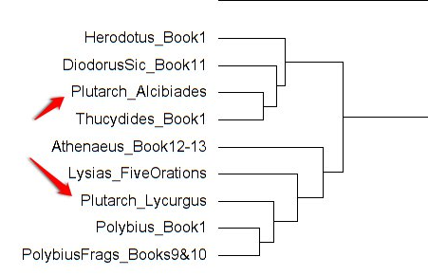

Slide 16
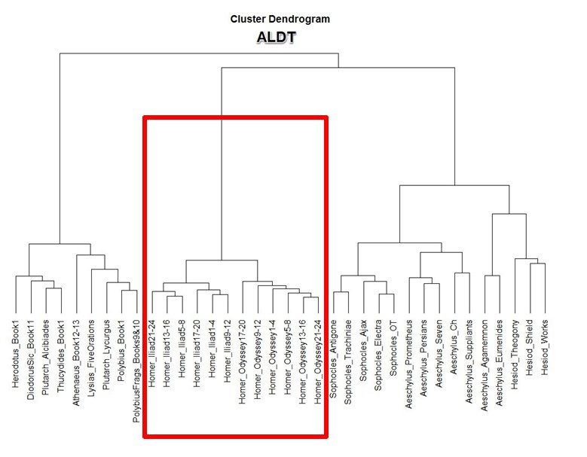
Homeric Verse
Non-Homeric
Verse

Slide 17
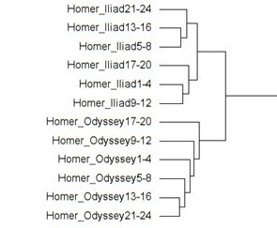

Slide 18
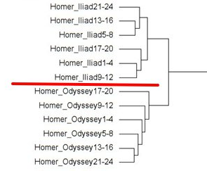

Slide 19
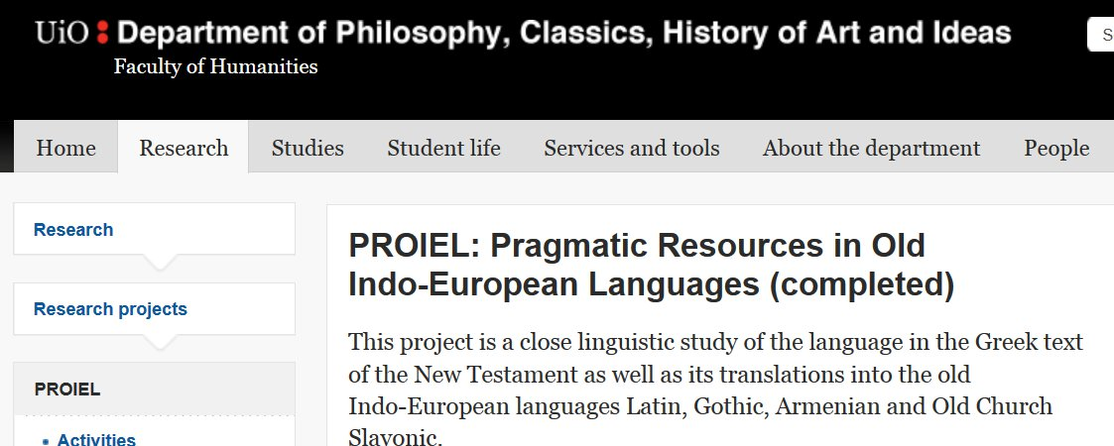
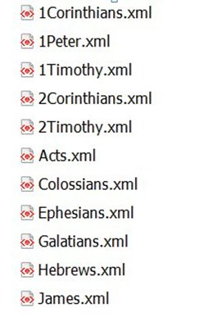
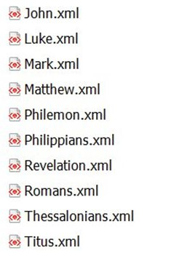

Slide 20
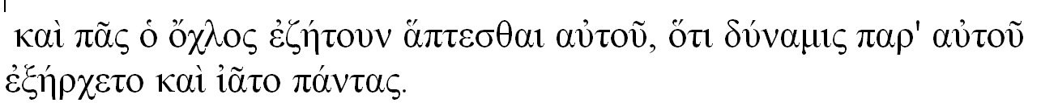
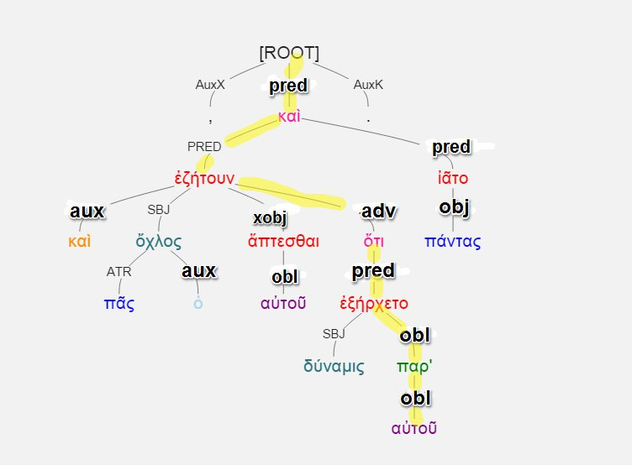
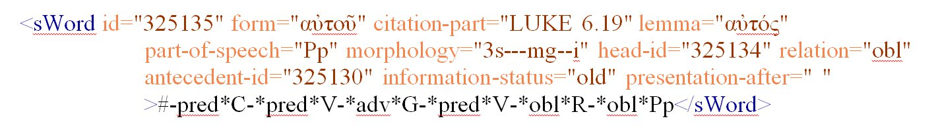

Slide 21
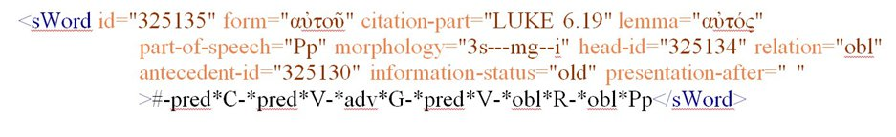

Slide 22
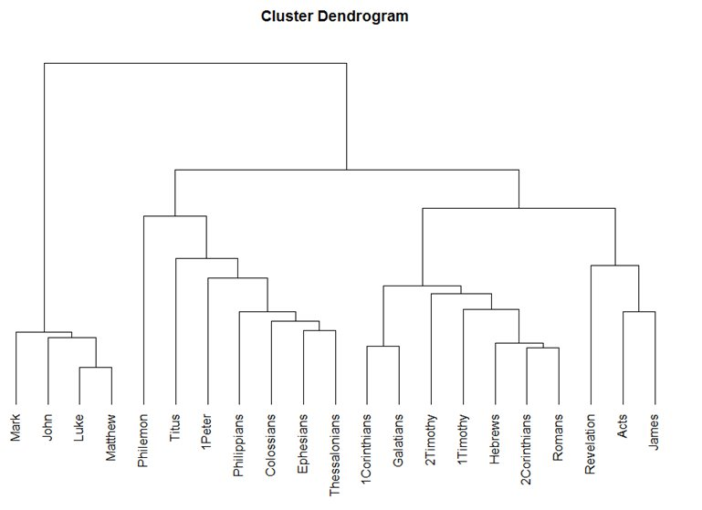

Slide 23
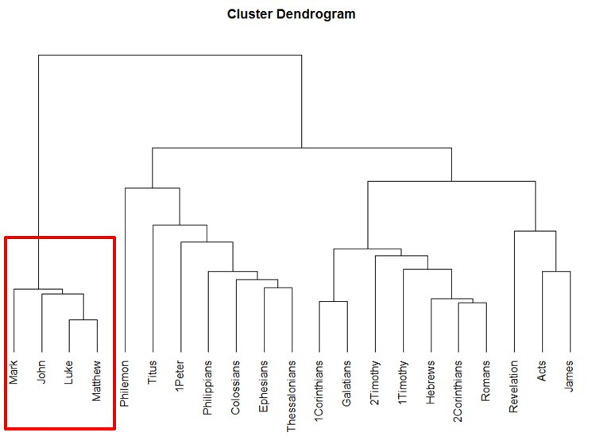

Slide 24
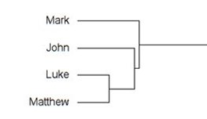

Slide 26
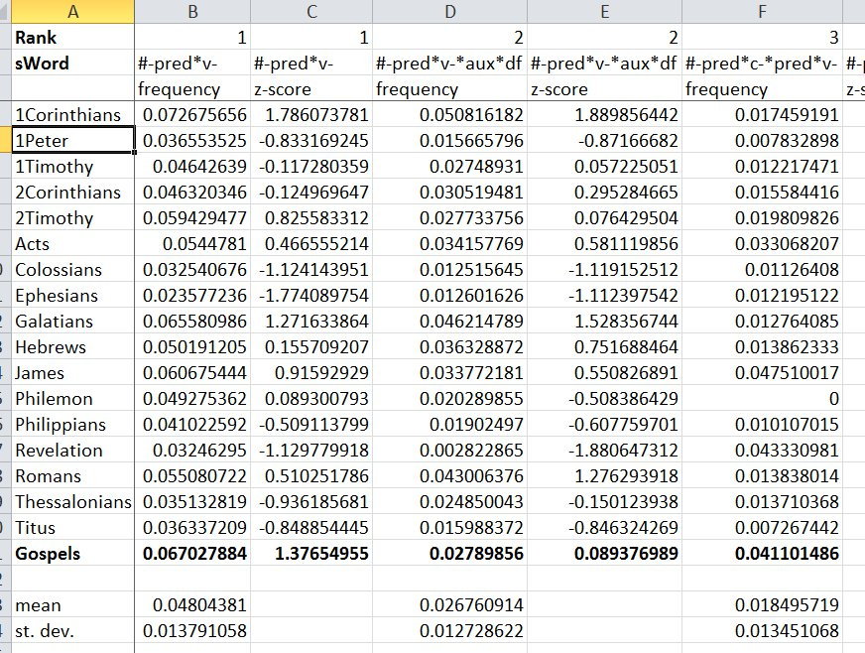

Slide 27
#-pred*v-*obl*pp
Freq. Rank # 18
Gospels: 938 occurrences / 71,529 tokens
Others: 112 / 65,152
Frequency per #-pred*v-
Gospels: 19.59%
Others: 6.04%

Slide 28
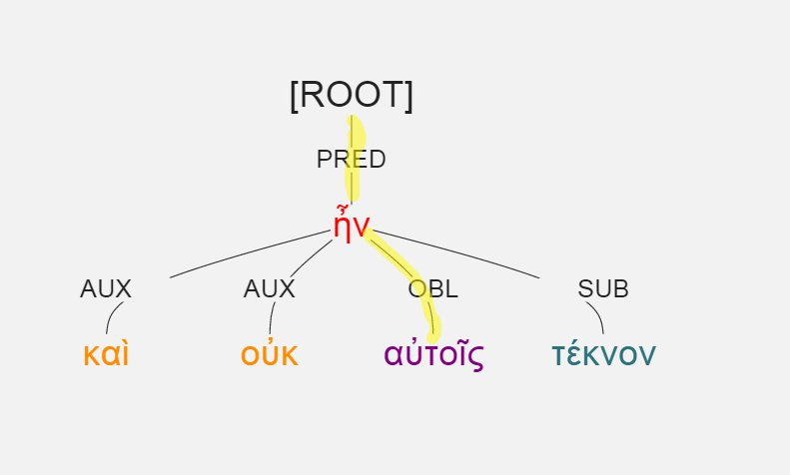
#-pred*v-*obl*pp
Luke 1:7, καὶ οὐκ ἦν αὐτοῖς τέκνον.

Slide 29
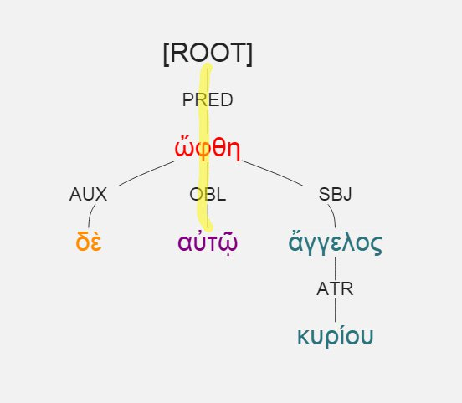
#-pred*v-*obl*pp
Luke 1:11, ὤφθη δὲ αὐτῷ ἄγγελος κυρίου.

Slide 30
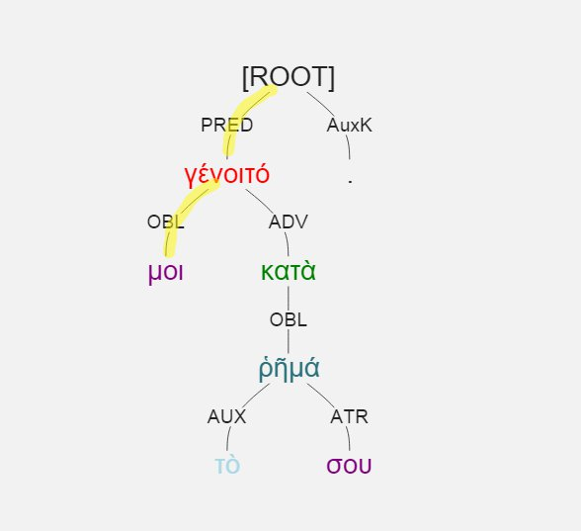
#-pred*v-*obl*pp
Luke 1:38, γένοιτό μοι κατὰ τὸ ῥῆμά σου.

Slide 31
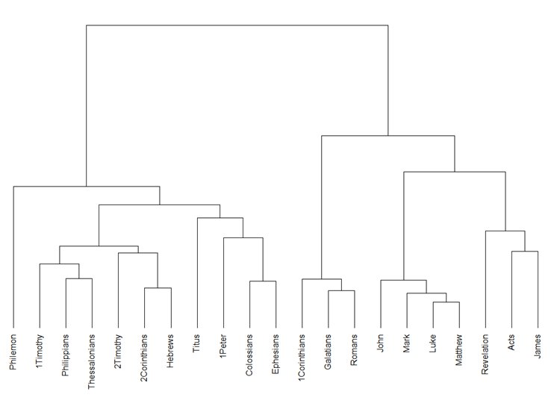

Slide 33
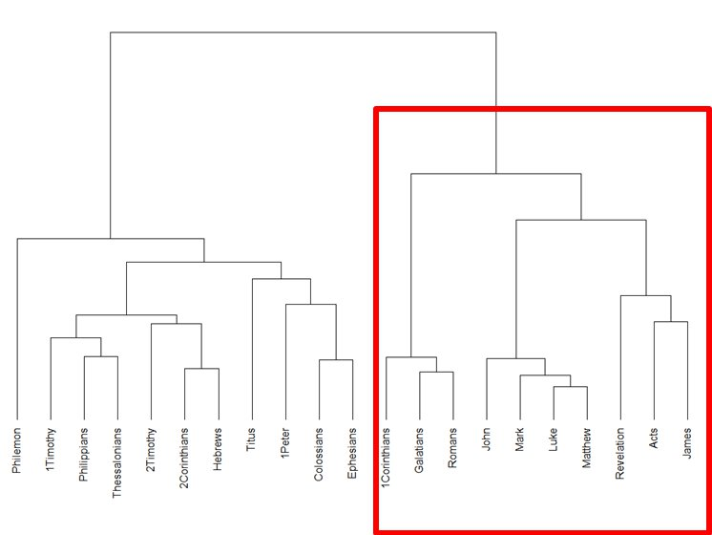
Relation alone

Slide 34
Relation + POS

Slide 35
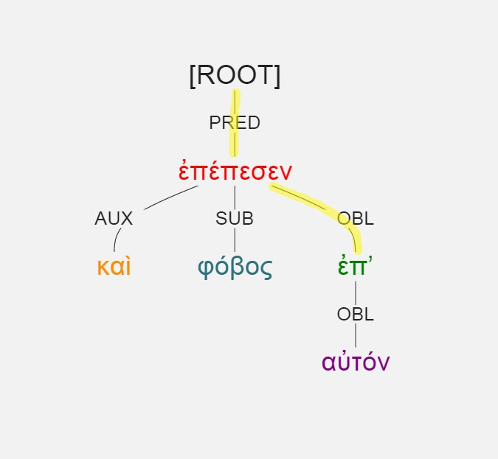
#-pred*obl
Gps.: 1784
Others: 948
Luke 1:12, καὶ φόβος ἐπέπεσεν ἐπ’ αὐτόν.

Slide 36
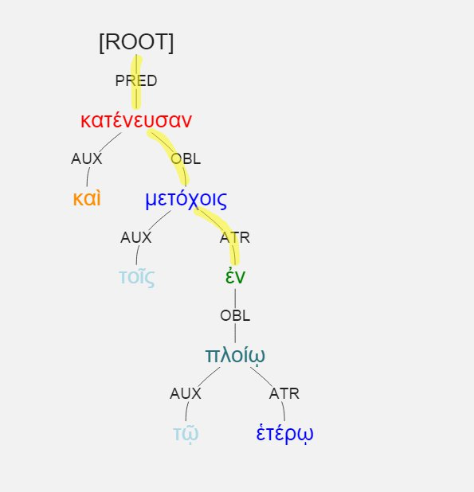
#-pred*obl*atr
Luke 5:7, καὶ κατένευσαν τοῖς μετόχοις ἐν τῷ ἑτέρῳ πλοίῳ

Slide 37
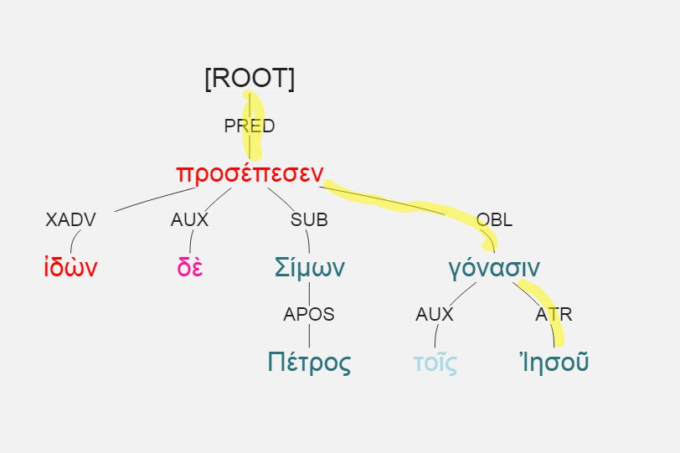
pred*obl*atr
Gosp.: 68 / 1784
Other: 121 / 948
Luke 5:8, ἰδὼν δὲ Σίμων Πέτρος προσέπεσεν τοῖς γόνασιν Ἰησοῦ

Slide 38
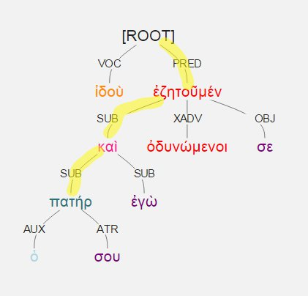
#-pred*sub*sub
Gospels: 6.2%
Other: 11%

Slide 39
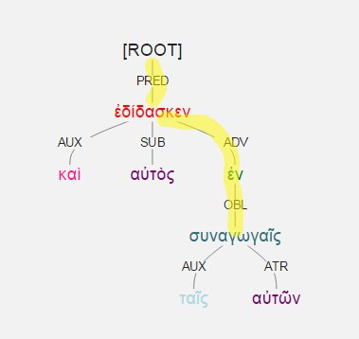
#-pred*adv*obl
Gospels: 10.2%
Other: 22.8

