Slide 1
Syntactic Stylometry on the Basis of Ancient Greek Treebanks
Robert Gorman
Univ. of Nebraska-Lincoln
Global Education and Research Technology
SBL
Atlanta, GA
November 22, 2015

Slide 2
Starting point: how to evaluate ancient reuse of lost texts?
Athenaeus 12.41, Θεόπομπος δ' ἐν πεντεκαιδεκάτῃ Φιλιππικῶν Ἱστοριῶν Στράτωνα φησι τὸν Σιδώνιον βασιλέα ὑπερβάλλειν ἡδυπαθείᾳ καὶ τρυφῇ πάντας ἀνθρώπους. Theopompus in the 15th book of his Philippic Histories says that Straton, the Sidonian king, surpassed all people in extravagance and self-indulgence.

Slide 3
Arethusa at Perseids
http://www.perseids.org/

Slide 4
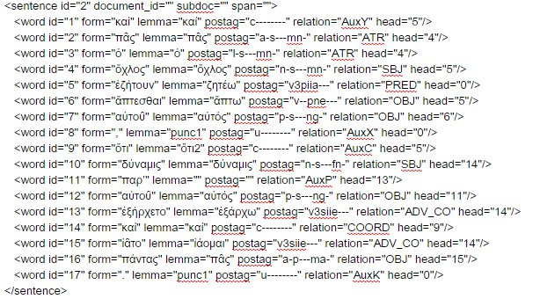

Slide 5
“Syntax Words”
After
Charles Hollingsworth, “Using Dependency-Based Annotations for Authorship Identification” (2012), introduces “DepWords”
Grigori Sidorov, “Syntactic Dependency-Based N-grams as Classification Features” (2012), introduces “Sn-grams” (“syntactic n-grams)

Slide 6
<word id="4" form="ὄχλος" lemma="ὄχλος" postag="n-s---mn-" relation="SBJ" head="5"/>
<word id="5" form="ἐζήτουν" lemma="ζητέω" postag="v3piia---" relation="PRED" head="0"/>

Slide 7
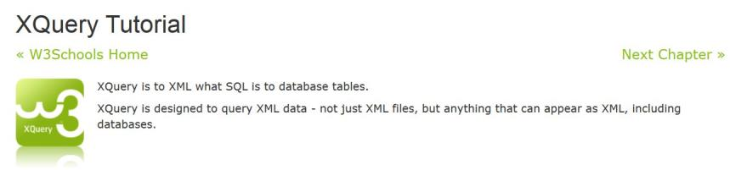
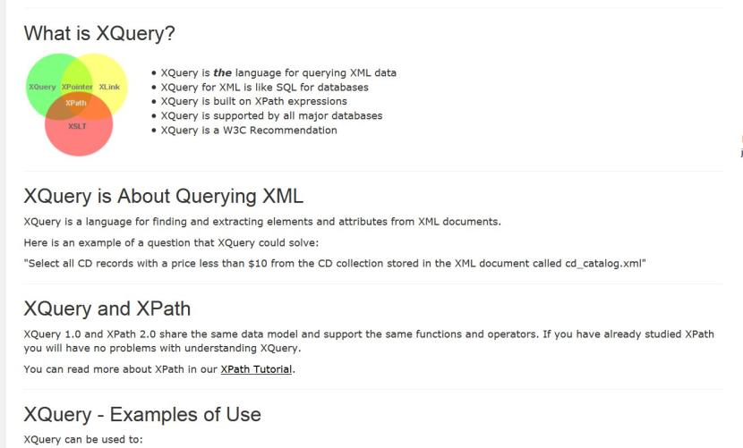

Slide 8
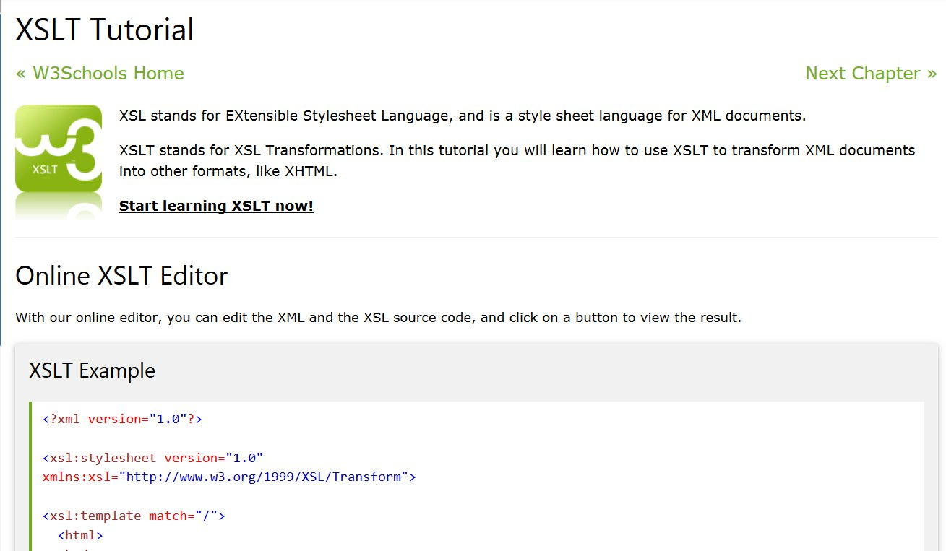

Slide 9
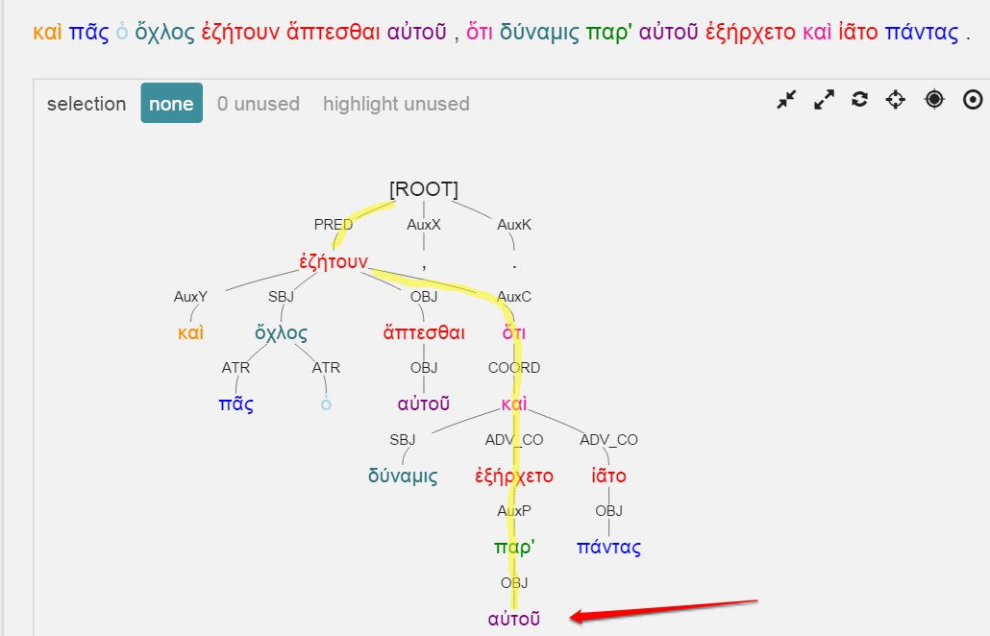
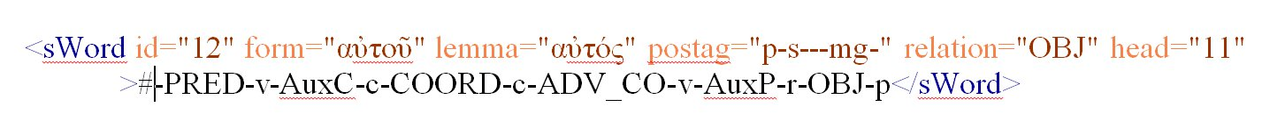

Slide 11
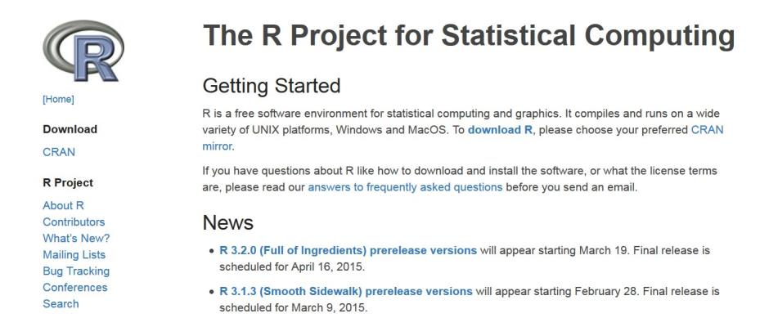

Slide 12
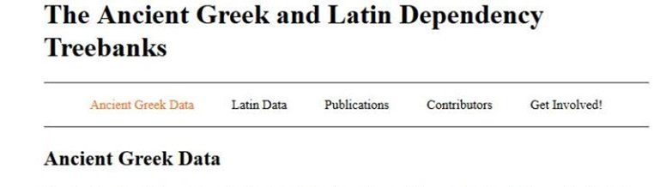
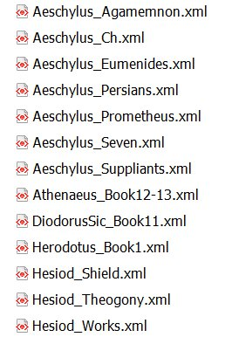
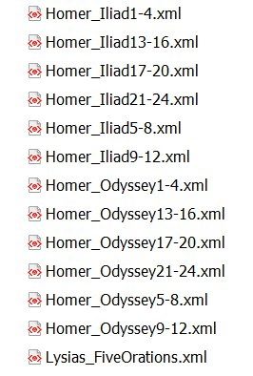
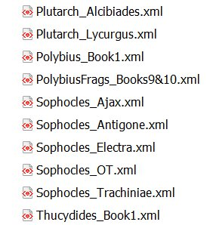

Slide 13
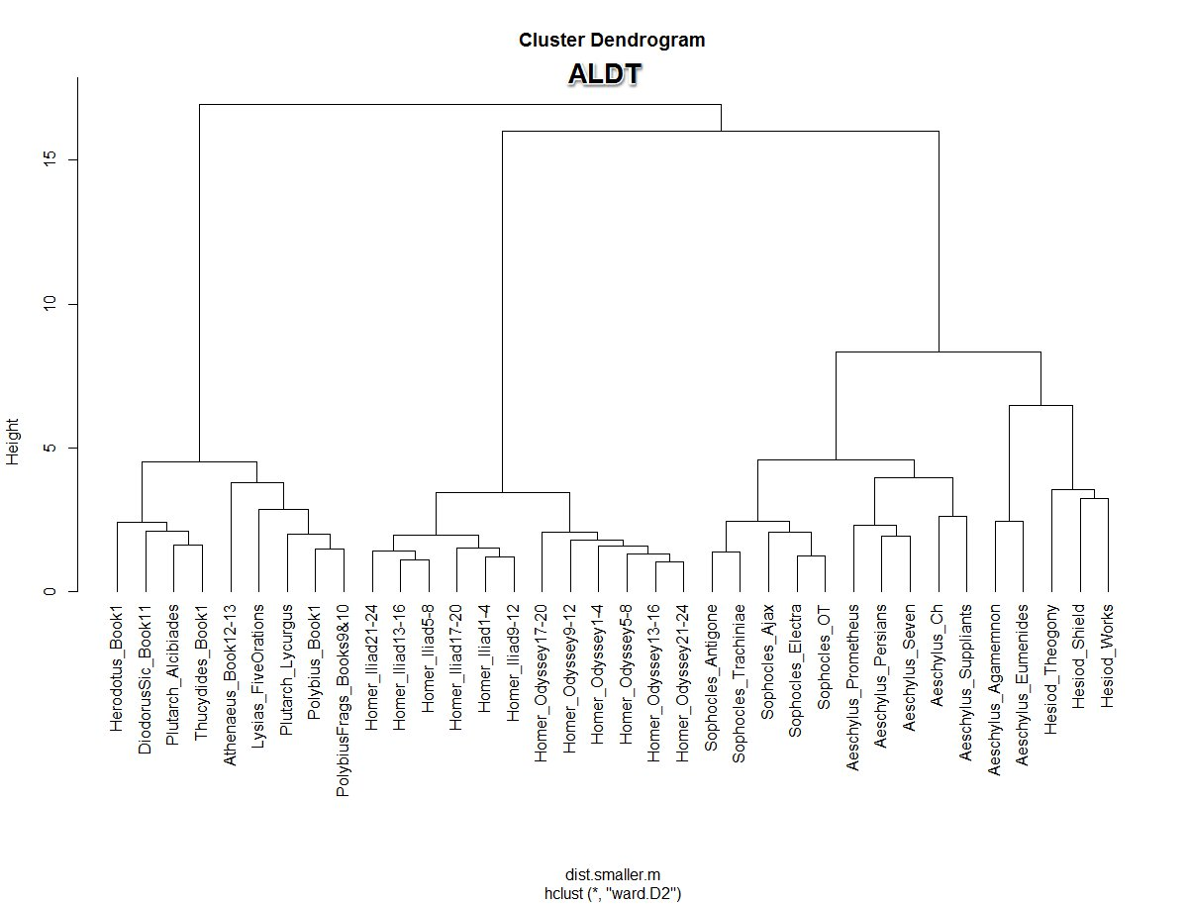

Slide 14
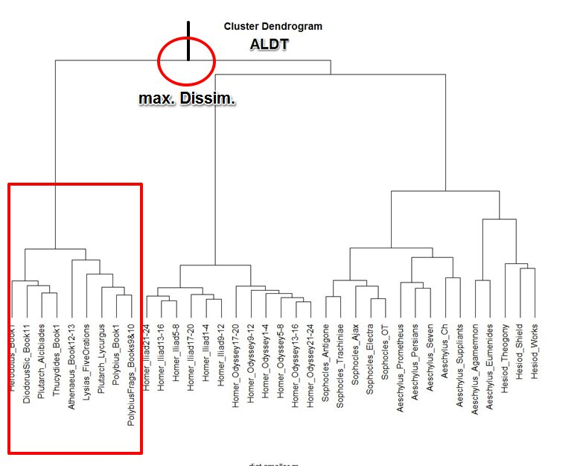

Slide 15
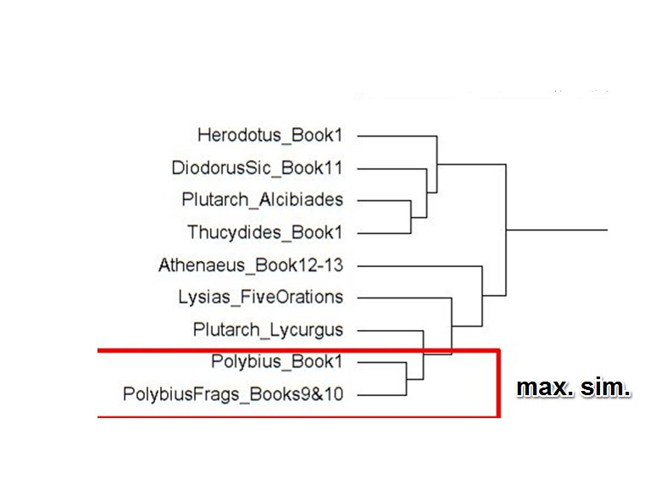

Slide 16
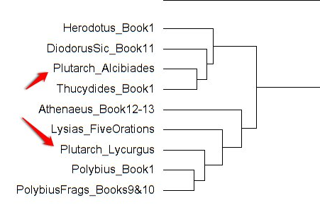

Slide 17
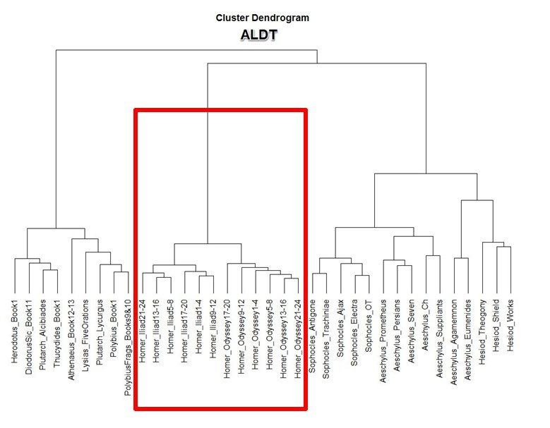
Homeric Verse
Non-Homeric
Verse

Slide 18
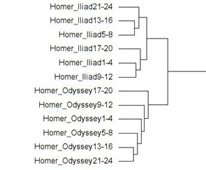

Slide 19
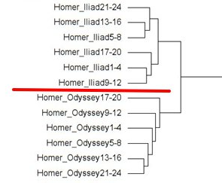

Slide 20
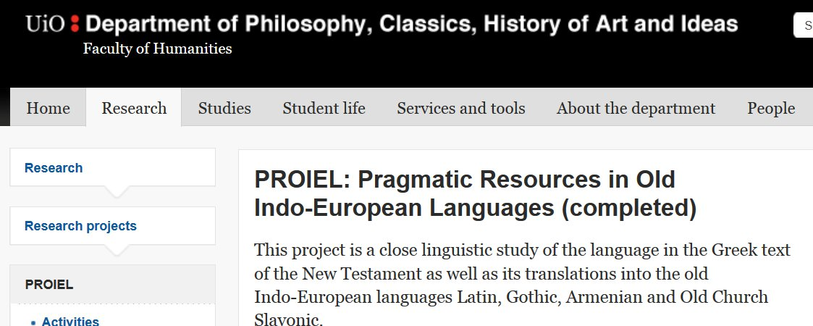
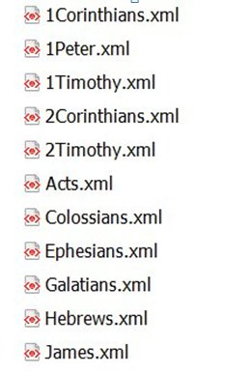
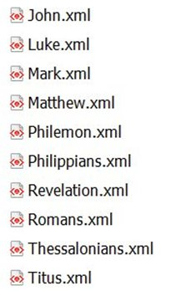

Slide 21
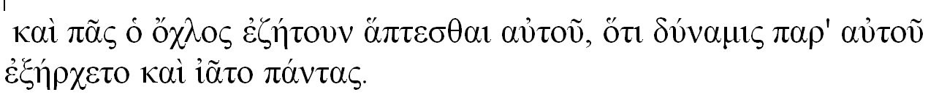
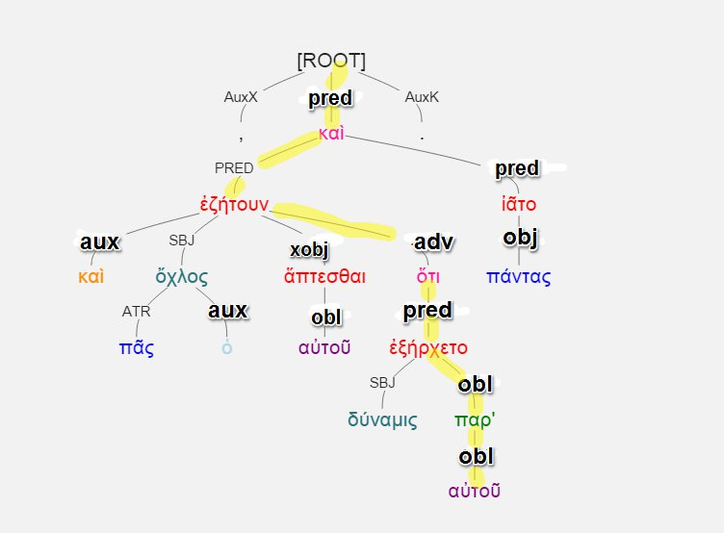
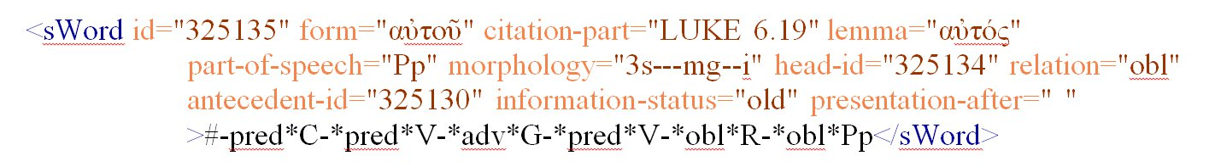

Slide 22
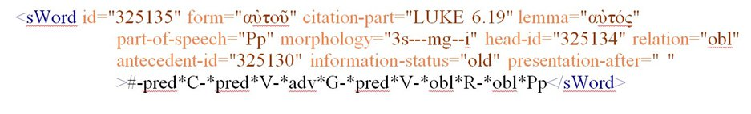

Slide 23
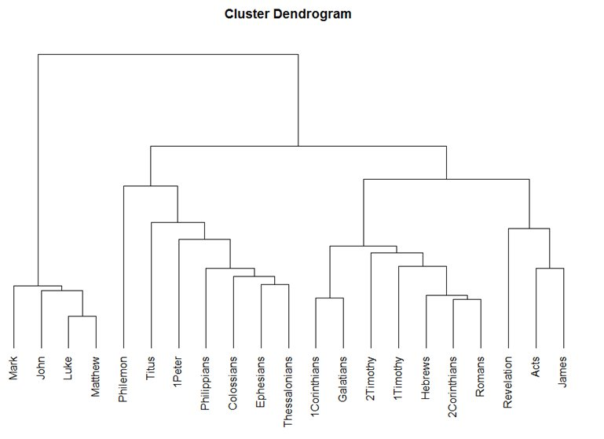

Slide 24
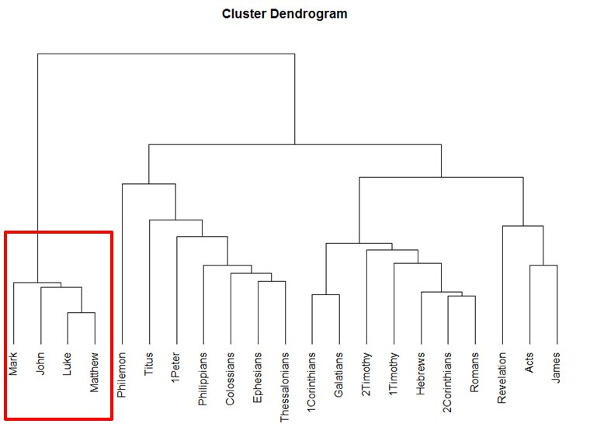

Slide 25
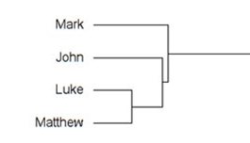

Slide 27
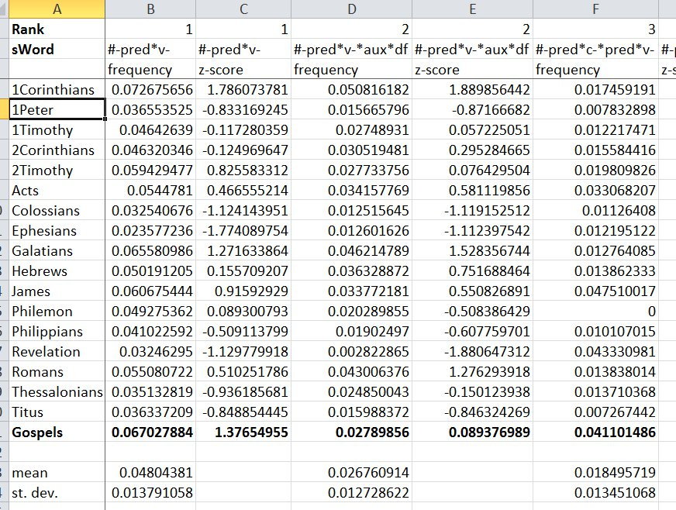

Slide 28
#-pred*v-*obl*pp
Freq. Rank # 18
Gospels: 938 occurrences / 71,529 tokens
Others: 112 / 65,152
Frequency per #-pred*v-
Gospels: 19.59%
Others: 6.04%

Slide 29
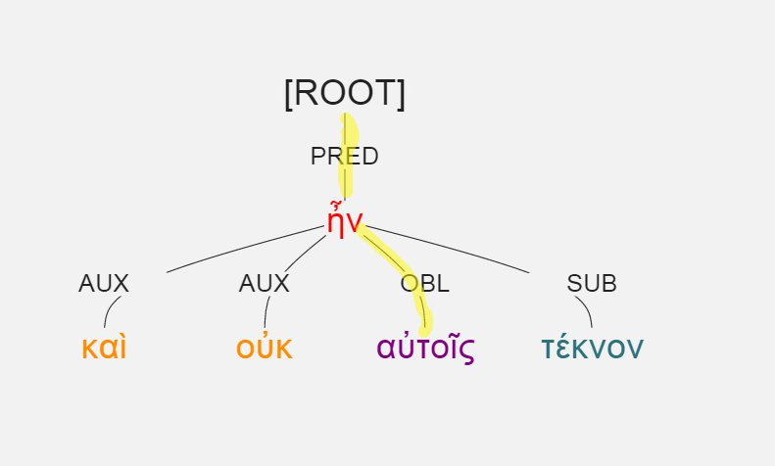
#-pred*v-*obl*pp
Luke 1:7, καὶ οὐκ ἦν αὐτοῖς τέκνον.

Slide 30
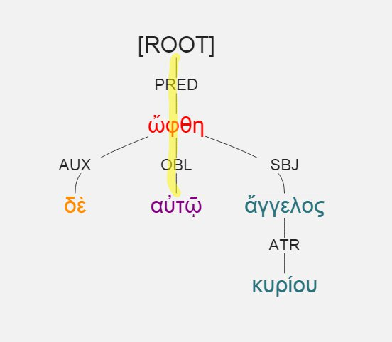
#-pred*v-*obl*pp
Luke 1:11, ὤφθη δὲ αὐτῷ ἄγγελος κυρίου.

Slide 31
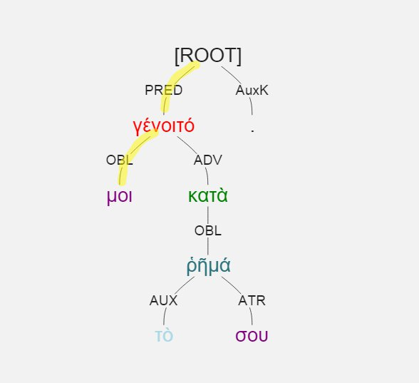
#-pred*v-*obl*pp
Luke 1:38, γένοιτό μοι κατὰ τὸ ῥῆμά σου.

Slide 32
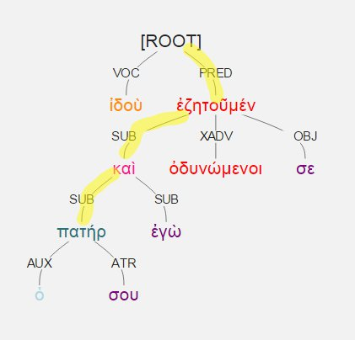
#-pred*sub*sub
Gospels: 6.2%
Other: 11%
Luke 2:48, ἰδοὺ ὁ πατήρ σου καὶ ἐγὼ ὀδυνώμενοι ἐζητοῦμέν σε.

Slide 33
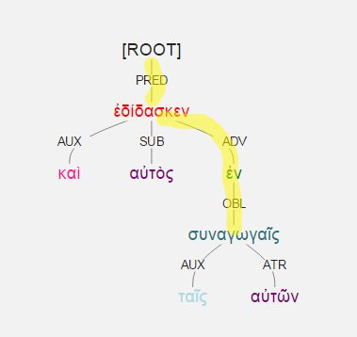
#-pred*adv*obl
Gospels: 10.2%
Other: 22.8
Luke 4:15, καὶ αὐτὸς ἐδίδασκεν ἐν ταῖς συναγωγαῖς αὐτῶν

