Slide 5

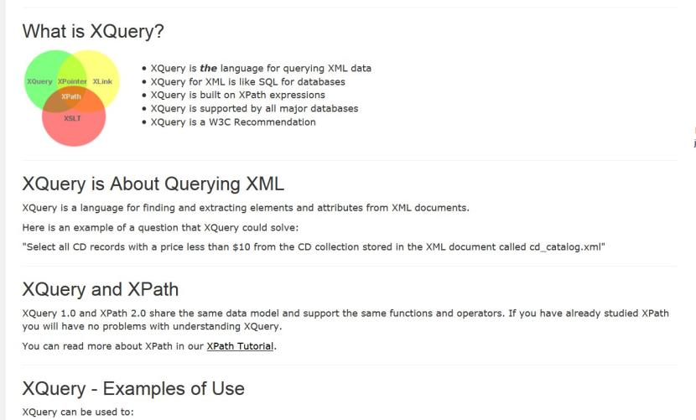

Slide 6
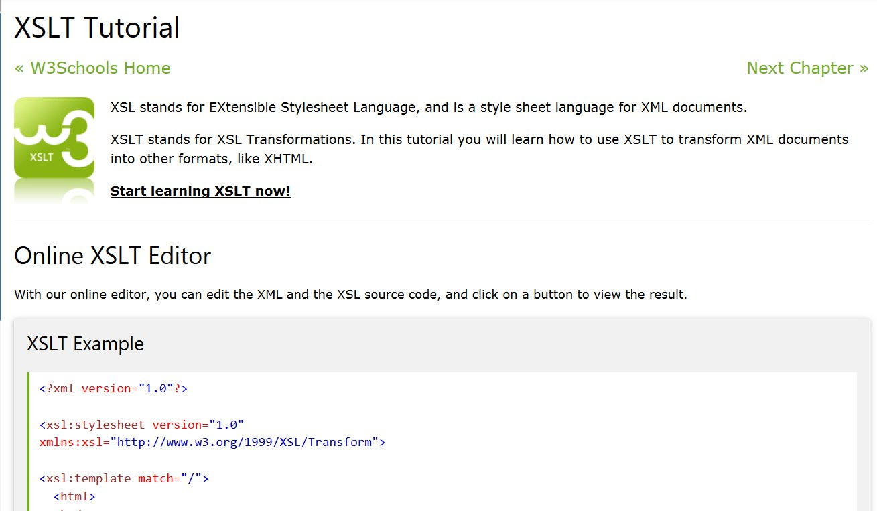

Slide 7
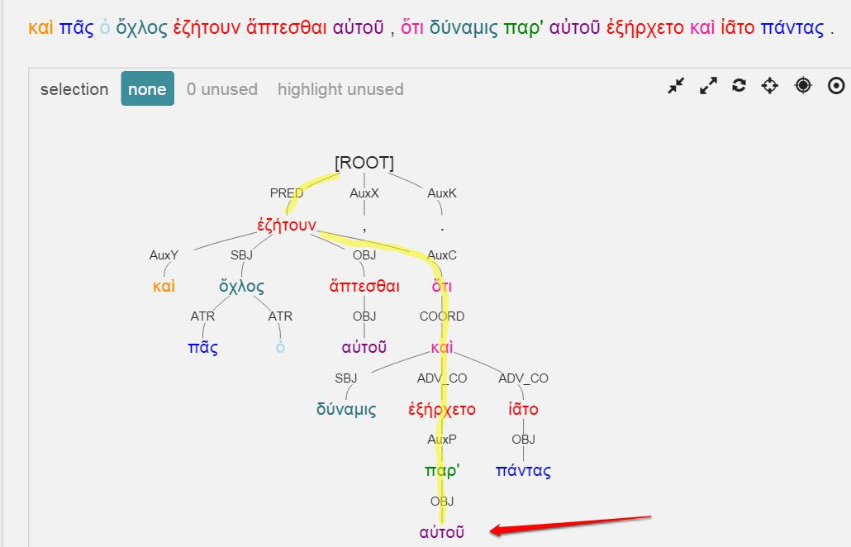


Slide 8
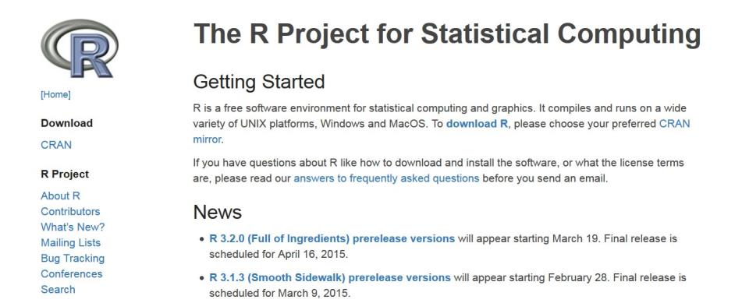

Slide 9

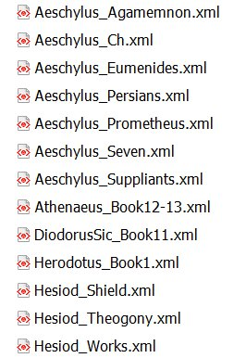
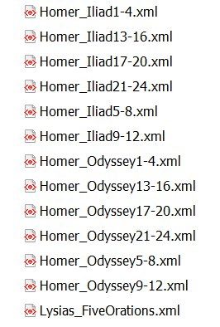
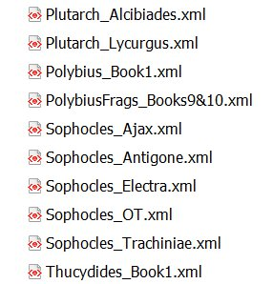

Slide 10
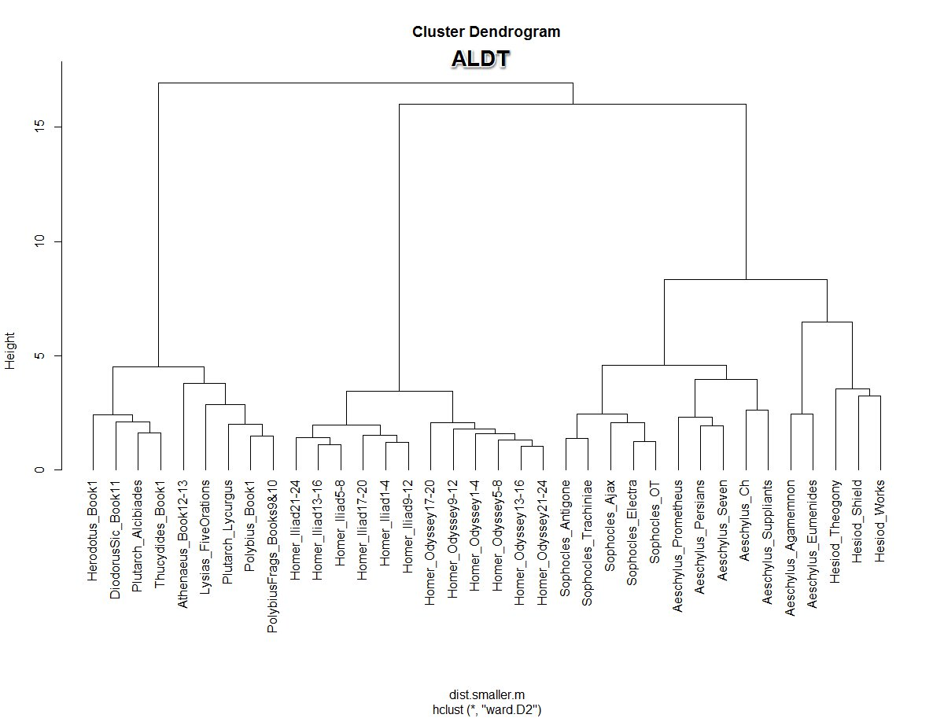

Slide 11
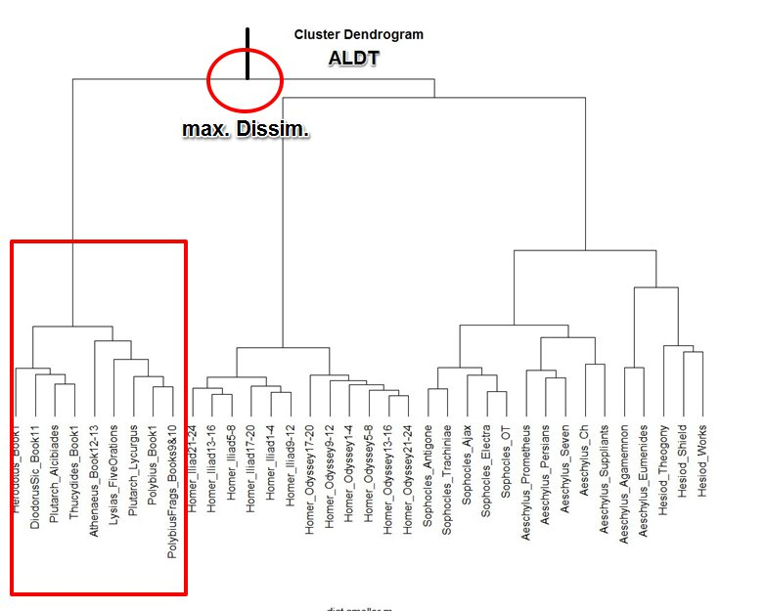

Slide 12
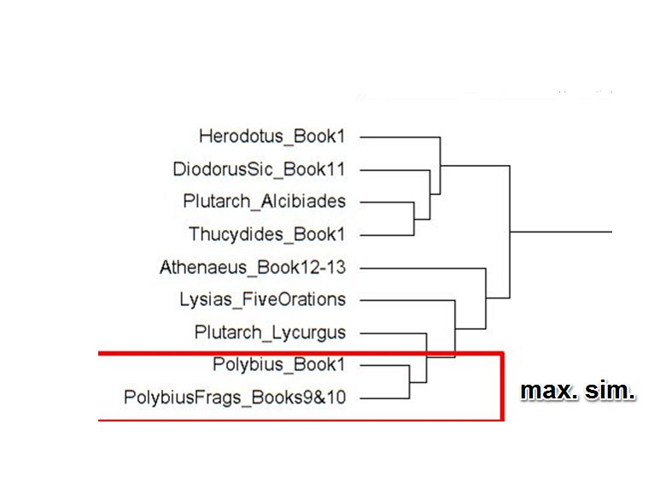

Slide 13
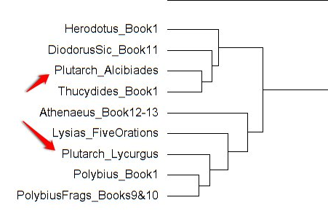

Slide 14
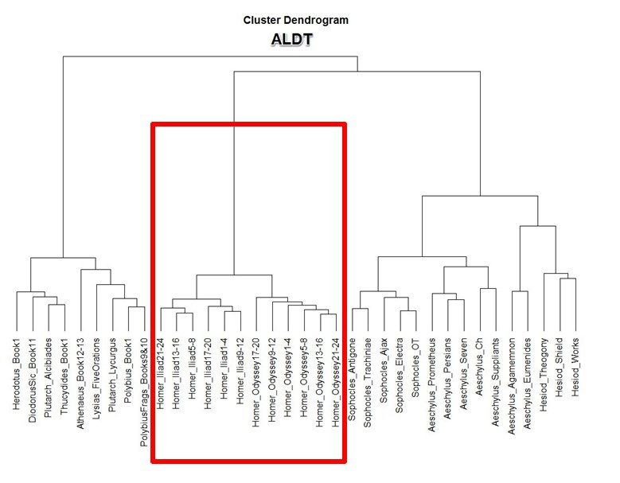
Homeric Verse
Non-Homeric
Verse

Slide 15
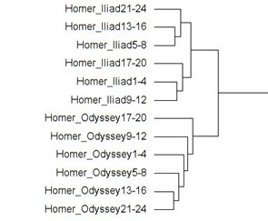

Slide 16
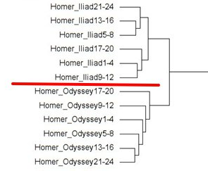

Slide 17
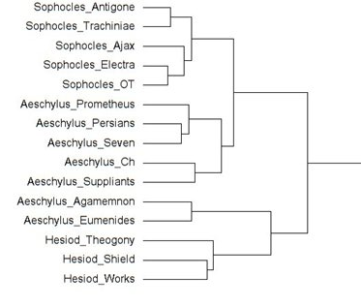

Slide 18
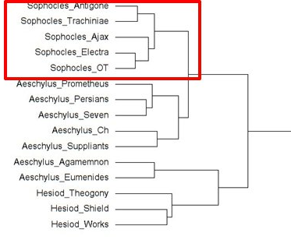

Slide 19
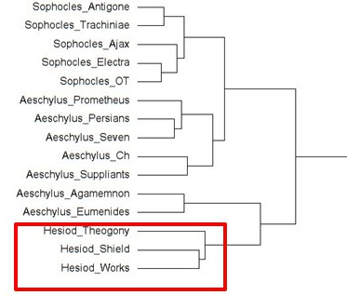

Slide 20
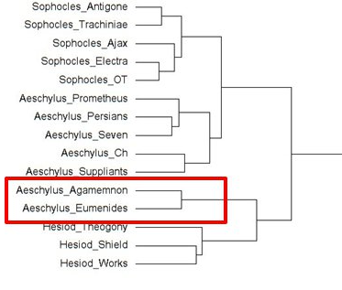

Slide 21
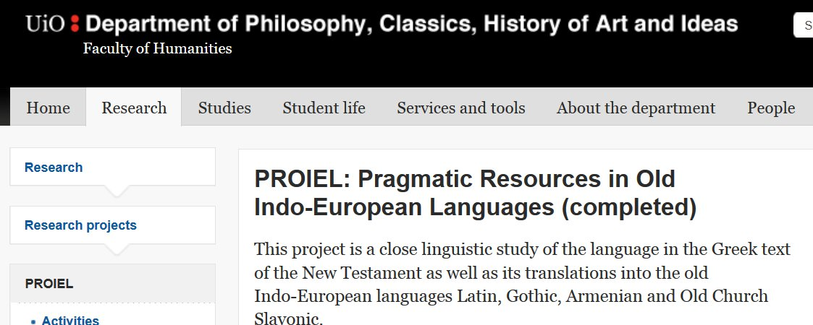
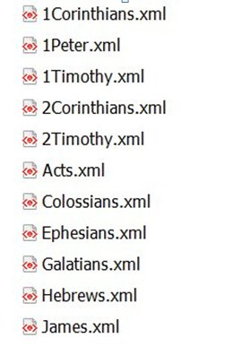
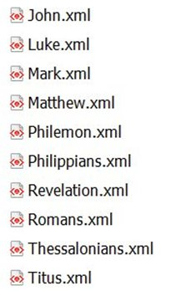

Slide 22

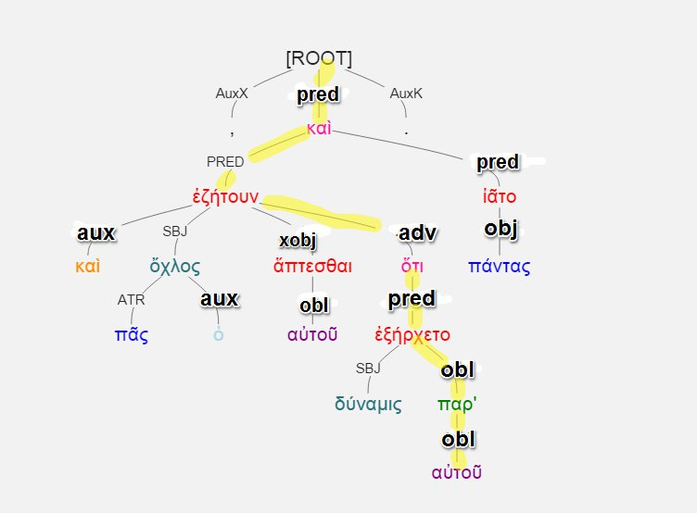


Slide 25


Slide 26
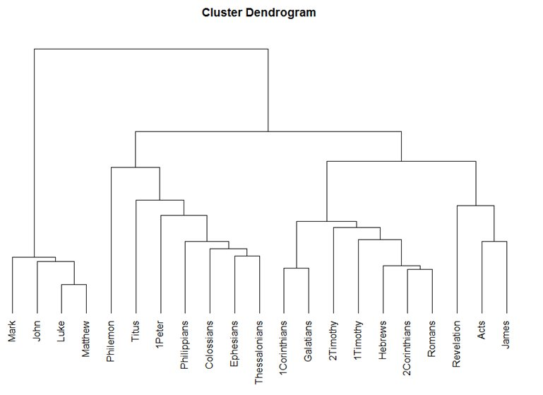

Slide 27
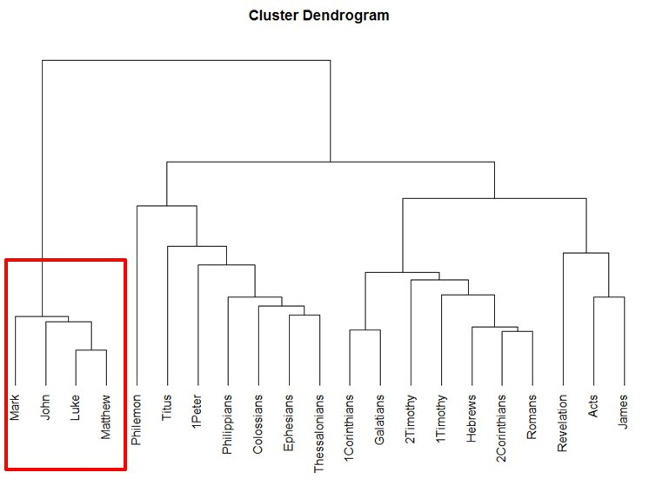

Slide 28
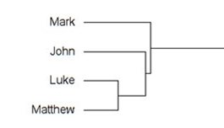

Slide 29
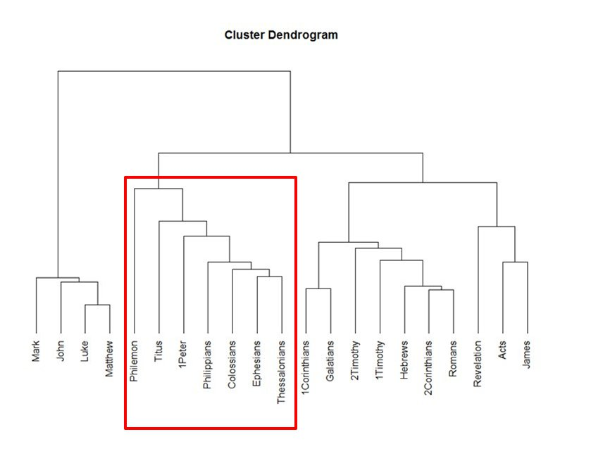

Slide 30
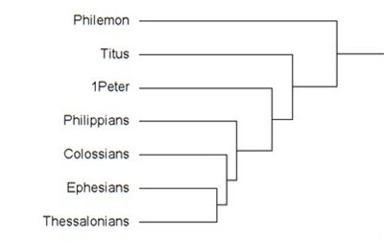

Slide 31
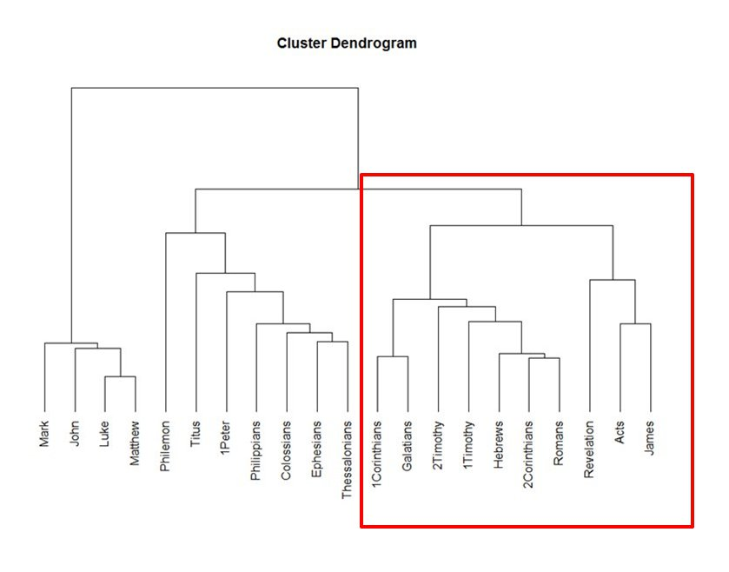

Slide 32
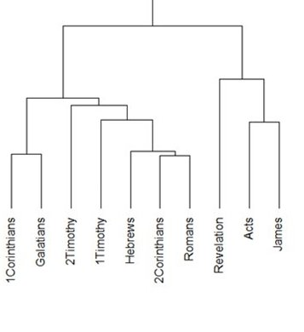

Slide 33
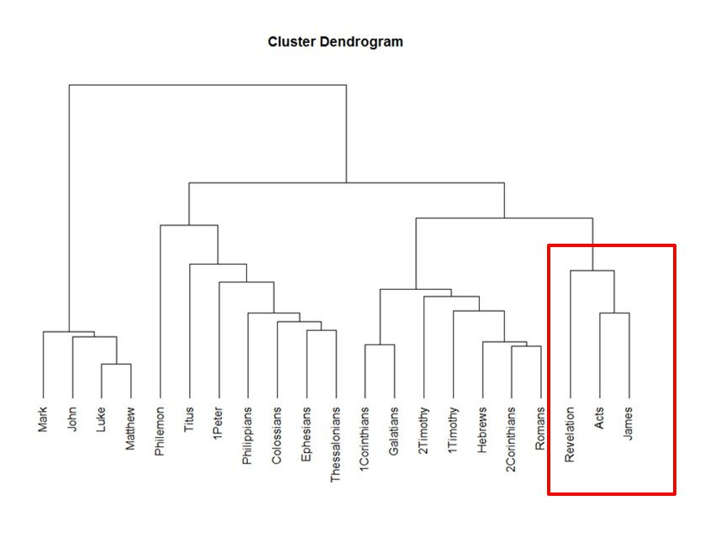

Slide 34
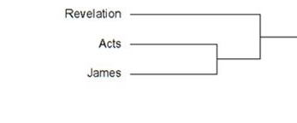

Slide 36
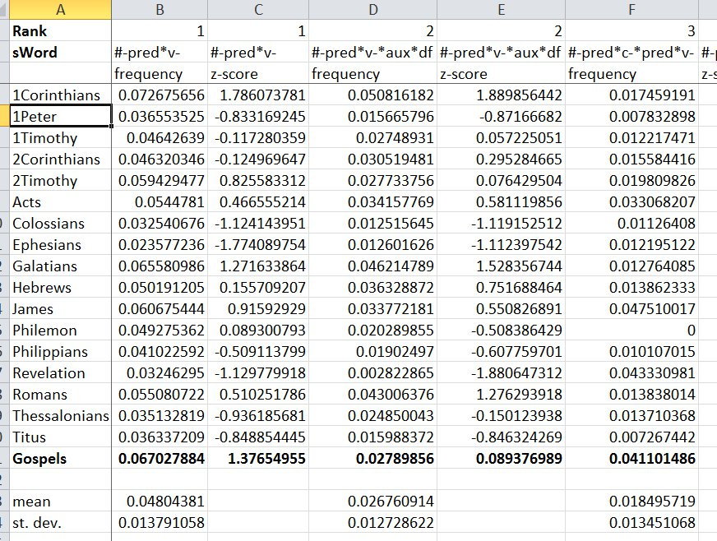

Slide 37
#-pred*v-*obl*pp
Freq. Rank # 18
Gospels: 938 occurrences / 71,529 tokens
Others: 112 / 65,152
Frequency per #-pred*v-
Gospels: 19.59%
Others: 6.04%

Slide 38
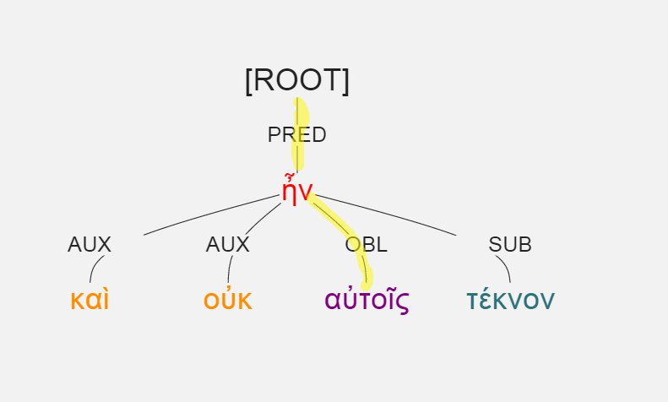
#-pred*v-*obl*pp
Luke 1:7, καὶ οὐκ ἦν αὐτοῖς τέκνον.

Slide 39
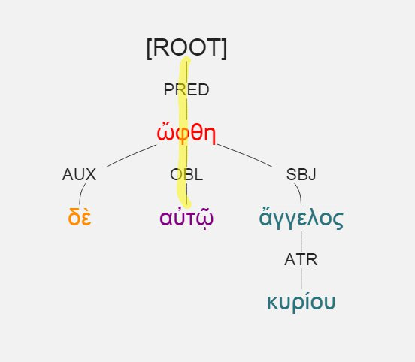
#-pred*v-*obl*pp
Luke 1:11, ὤφθη δὲ αὐτῷ ἄγγελος κυρίου.

Slide 40
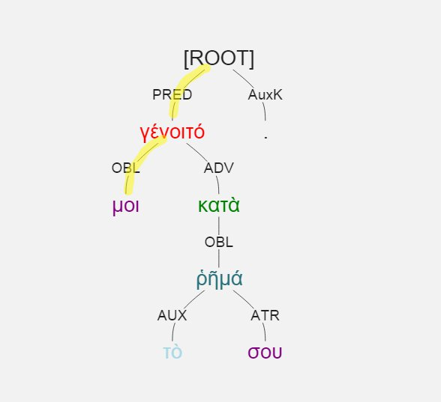
#-pred*v-*obl*pp
Luke 1:38, γένοιτό μοι κατὰ τὸ ῥῆμά σου.

Slide 41
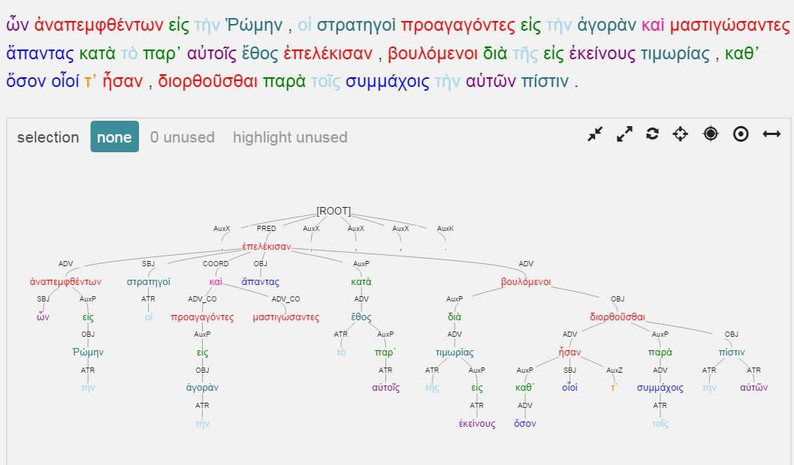
Polybius 1.7

Slide 42
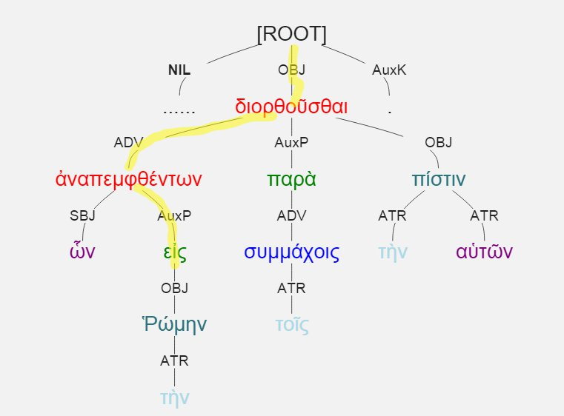
#-pred-v-adv-v-auxp

Slide 43
#-pred-v-adv-v-auxp
Representative of “heavy” circumstantial participle
Distinctive of historical prose, e.g.:
Polybius 1: frequency = 24.9% of #-pred-v (178 times / 26,894 tokens)
Aeschylus: frequency = 3% of #-pred-v (14 times / 45, 682 tokens)

