Slide 1
Syntactic Stylometry on the Basis of Ancient Greek Treebanks
Robert Gorman
Univ. of Nebraska-Lincoln
Global Education and Research Technology
SBL
Atlanta, GA
November 22, 2015

Slide 2
Starting point: how to evaluate ancient reuse of lost texts?
Athenaeus 12.41, Θεόπομπος δ' ἐν πεντεκαιδεκάτῃ Φιλιππικῶν Ἱστοριῶν Στράτωνα φησι τὸν Σιδώνιον βασιλέα ὑπερβάλλειν ἡδυπαθείᾳ καὶ τρυφῇ πάντας ἀνθρώπους. Theopompus in the 15th book of his Philippic Histories says that Straton, the Sidonian king, surpassed all people in extravagance and self-indulgence.

Slide 6

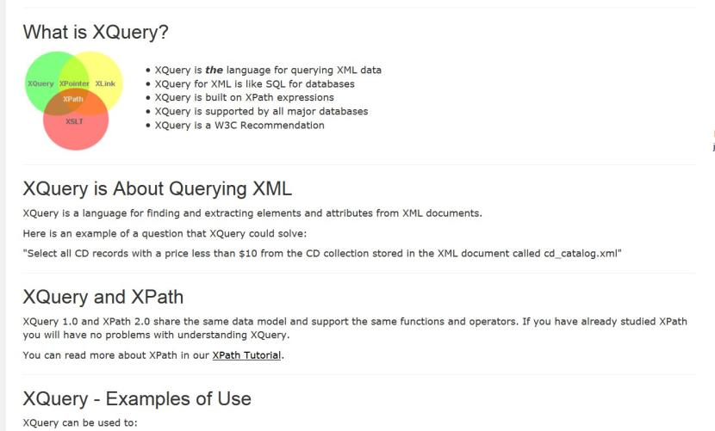

Slide 7
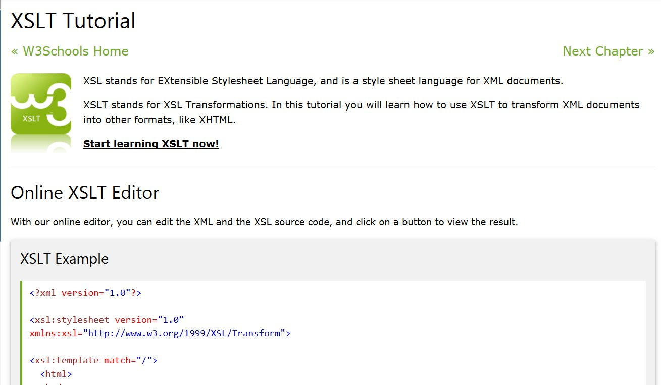

Slide 8
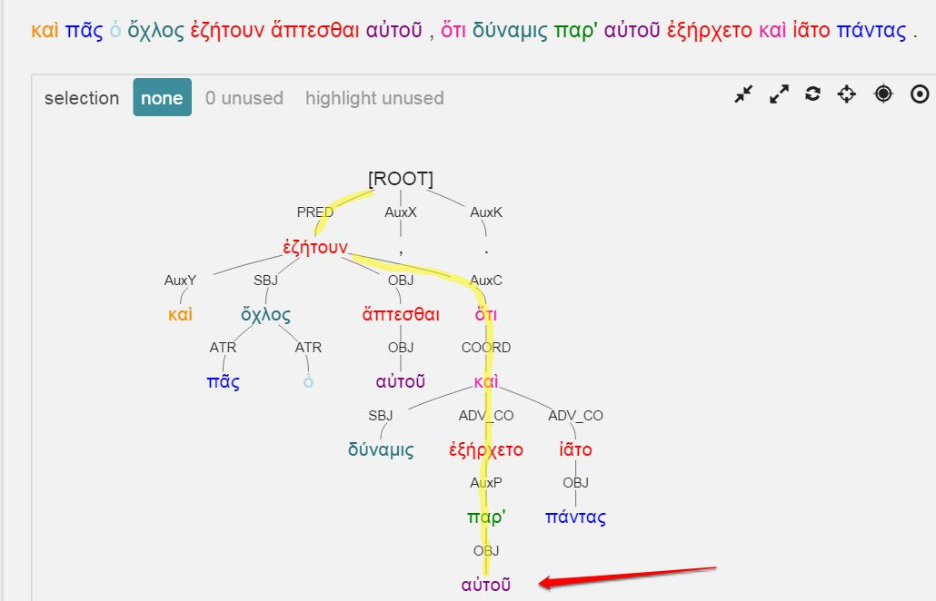
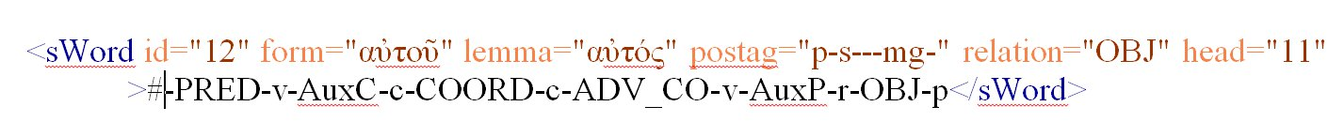

Slide 9
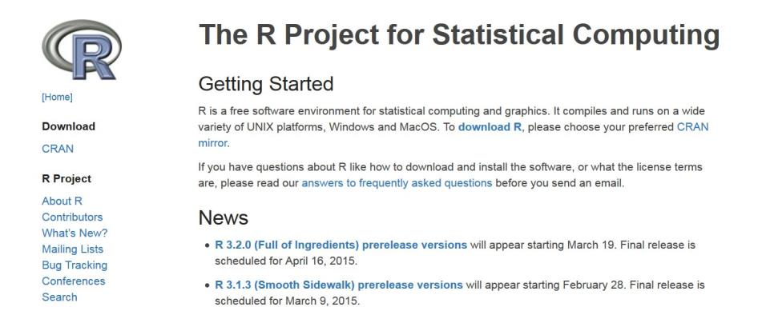

Slide 10
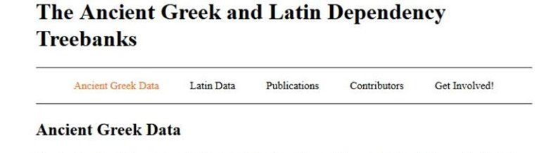
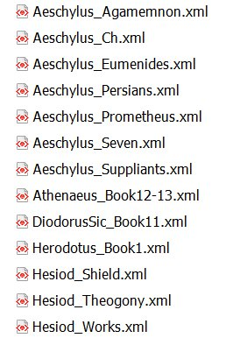
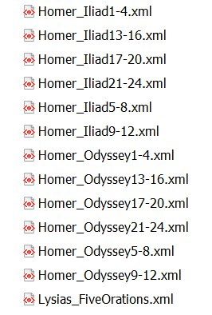
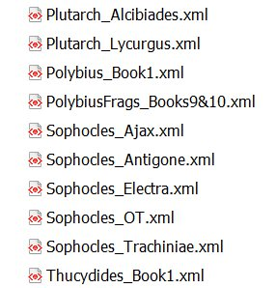

Slide 11
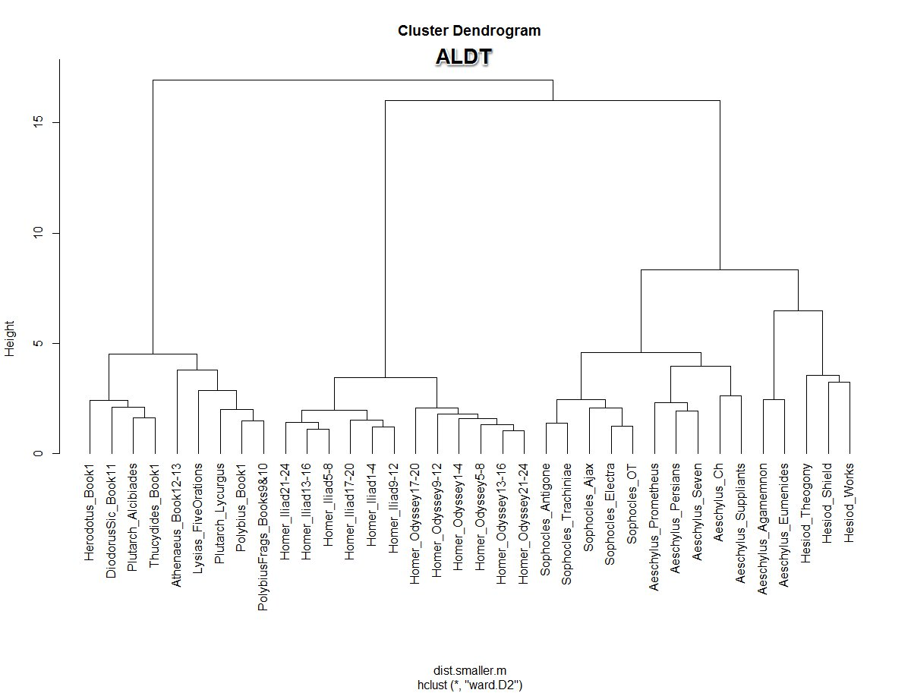

Slide 12
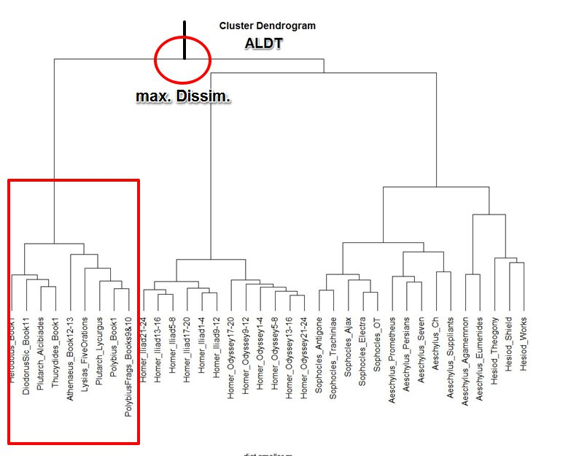

Slide 13
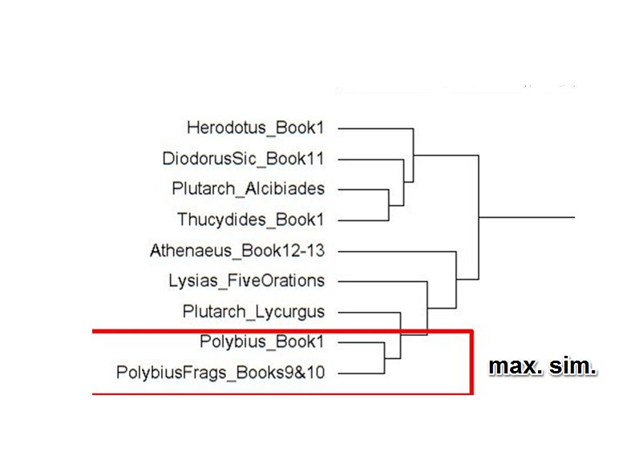

Slide 14
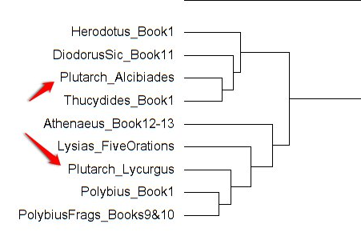

Slide 15
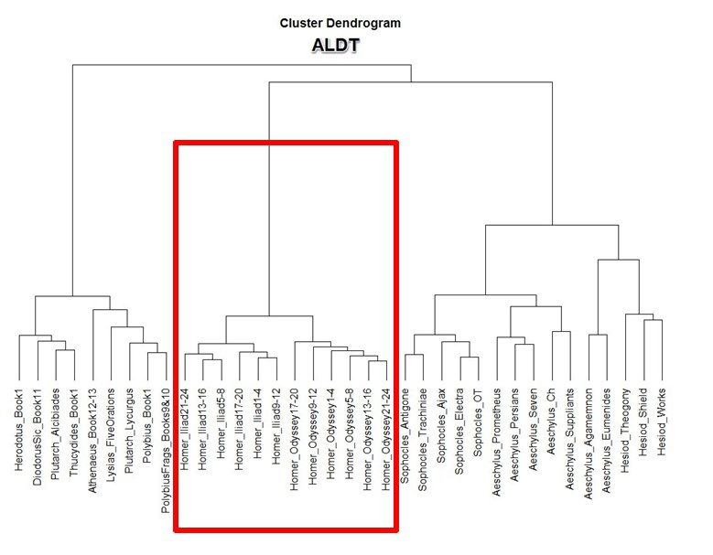
Homeric Verse
Non-Homeric
Verse

Slide 16
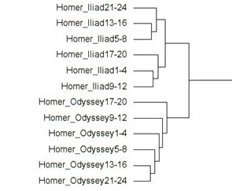

Slide 17
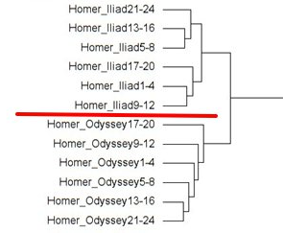

Slide 18
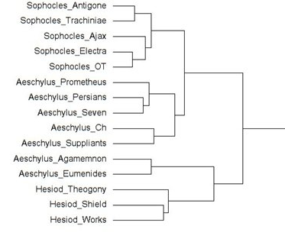

Slide 19
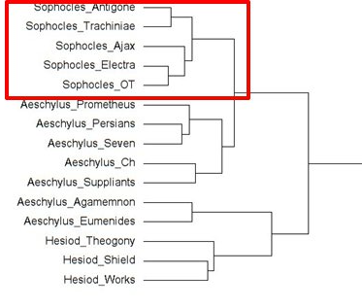

Slide 20
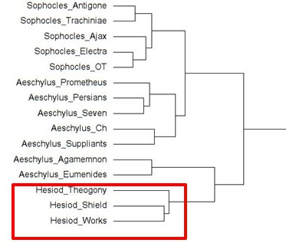

Slide 21
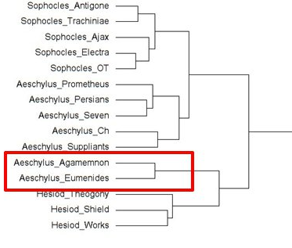

Slide 22
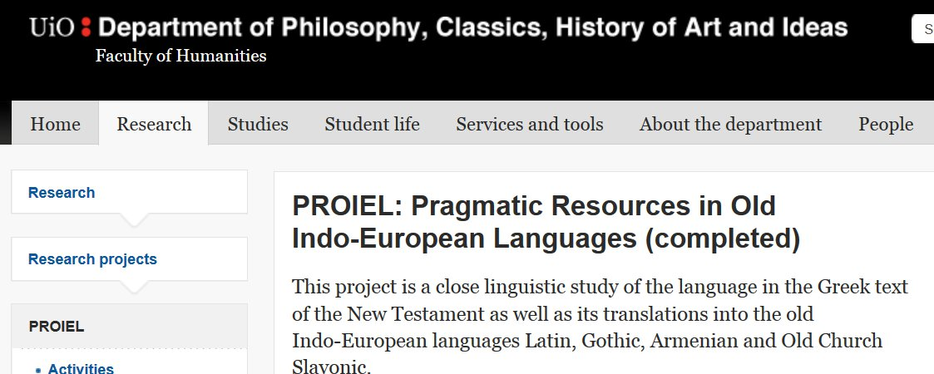
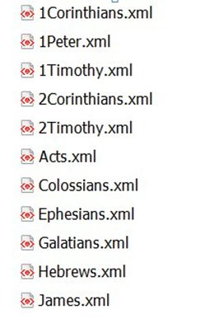
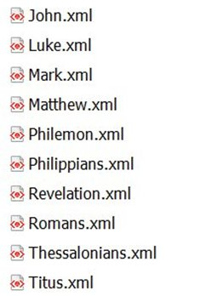

Slide 23
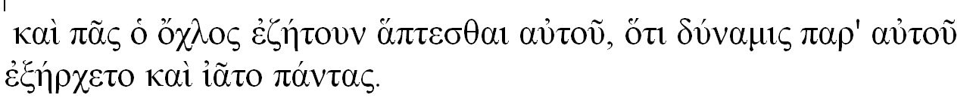
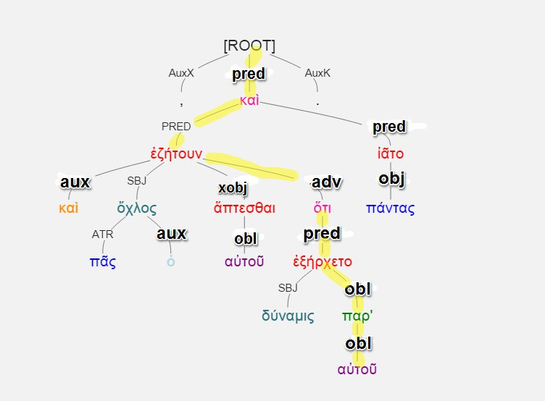
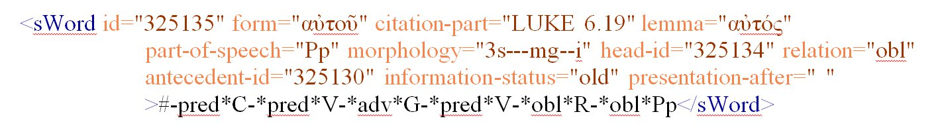

Slide 26
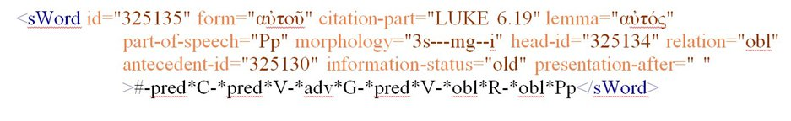

Slide 27
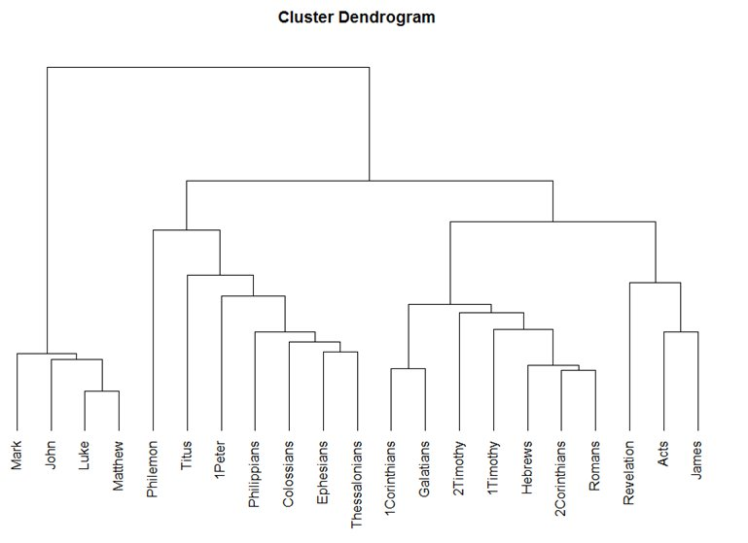

Slide 28
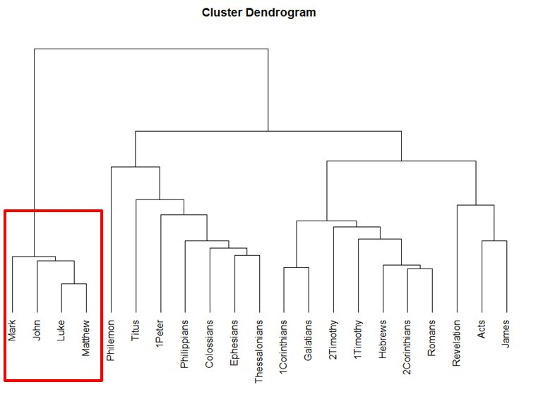

Slide 29
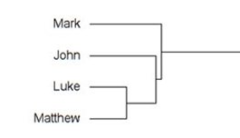

Slide 30
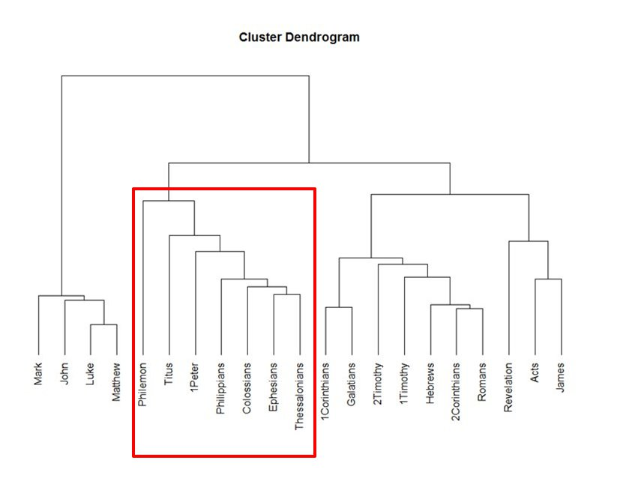

Slide 31
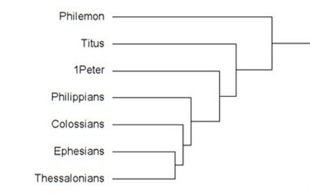

Slide 32
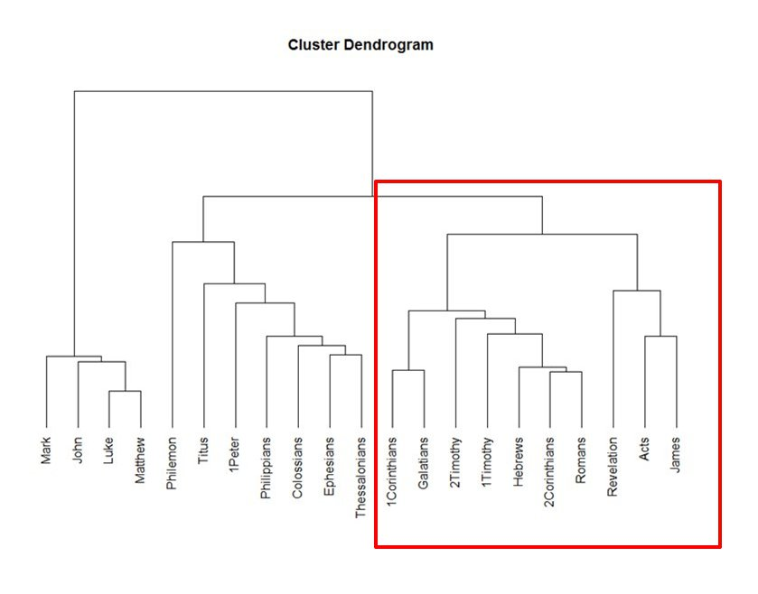

Slide 33
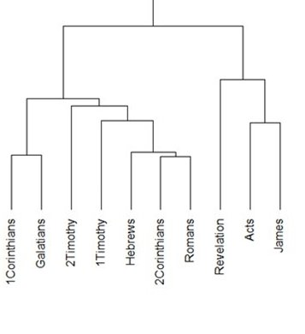

Slide 34
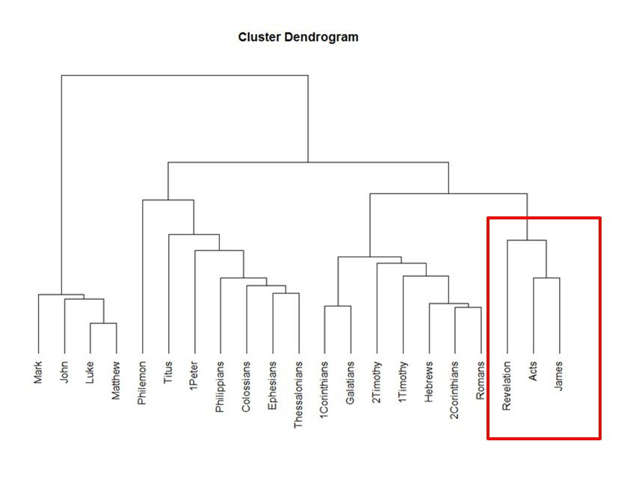

Slide 35
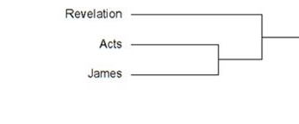

Slide 37
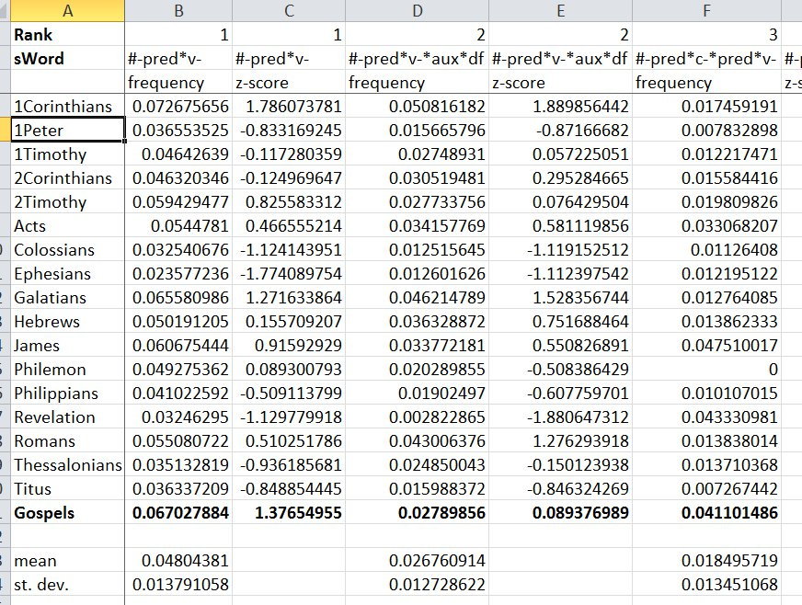

Slide 38
#-pred*v-*obl*pp
Freq. Rank # 18
Gospels: 938 occurrences / 71,529 tokens
Others: 112 / 65,152
Frequency per #-pred*v-
Gospels: 19.59%
Others: 6.04%

Slide 39
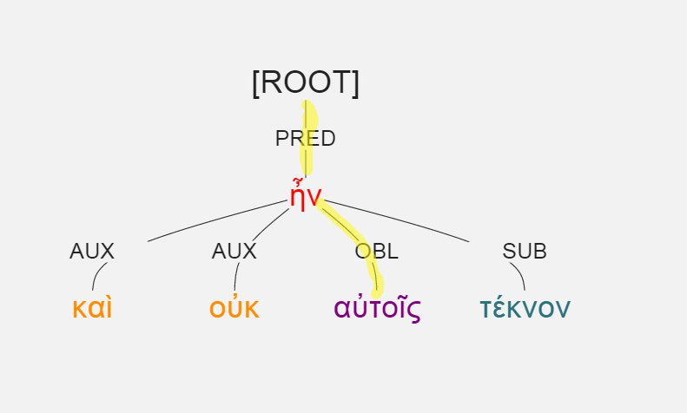
#-pred*v-*obl*pp
Luke 1:7, καὶ οὐκ ἦν αὐτοῖς τέκνον.

Slide 40
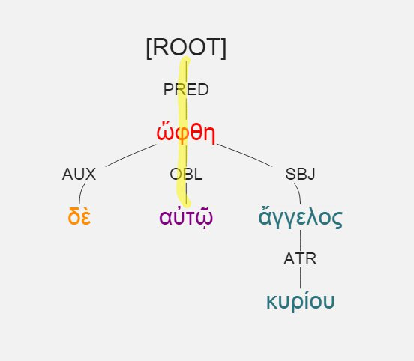
#-pred*v-*obl*pp
Luke 1:11, ὤφθη δὲ αὐτῷ ἄγγελος κυρίου.

Slide 41
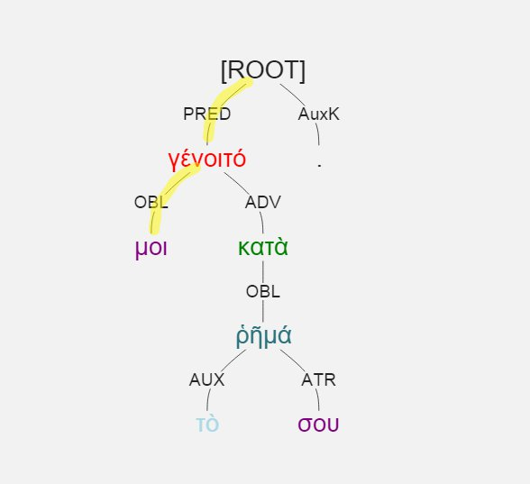
#-pred*v-*obl*pp
Luke 1:38, γένοιτό μοι κατὰ τὸ ῥῆμά σου.

Slide 42
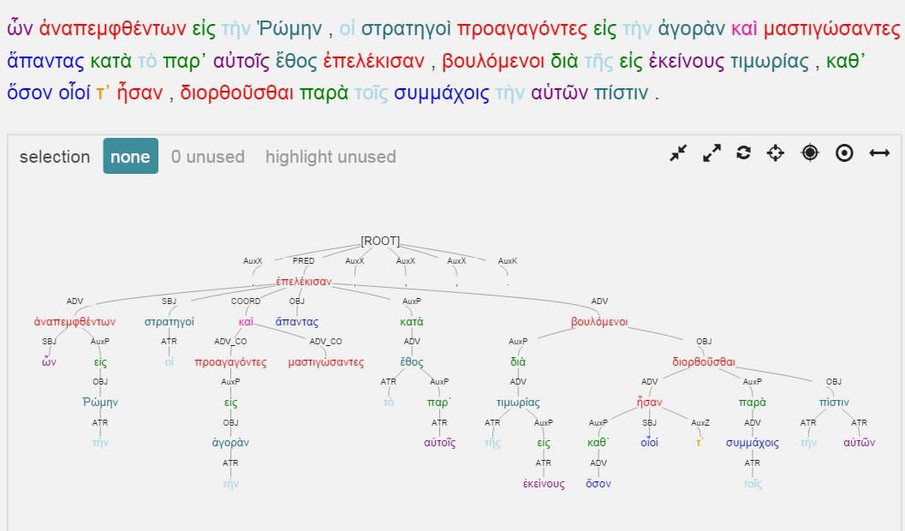
Polybius 1.7

Slide 43
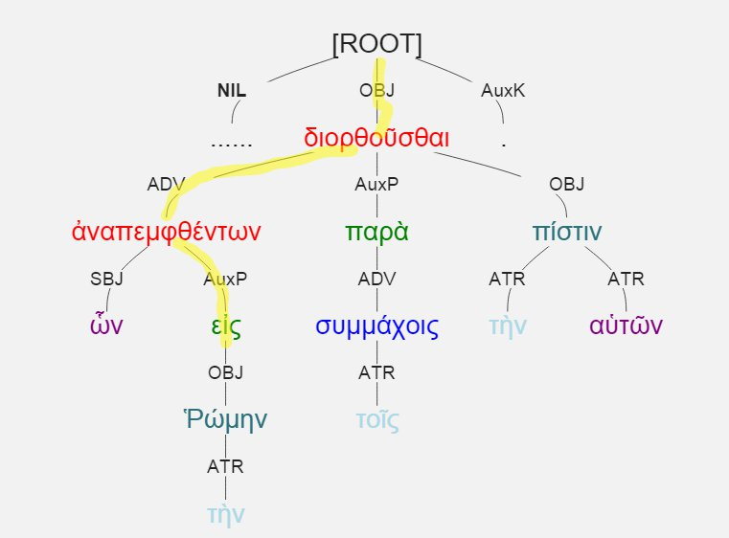
#-pred-v-adv-v-auxp-r

Slide 44
#-pred-v-adv-v-auxp-r
Representative of “heavy” circumstantial participle
Distinctive of historical prose, e.g.:
Polybius 1: frequency = 24.9% of #-pred-v (178 times / 26,894 tokens)
Aeschylus: frequency = 3% of #-pred-v (14 times / 45, 682 tokens)

Slide 45
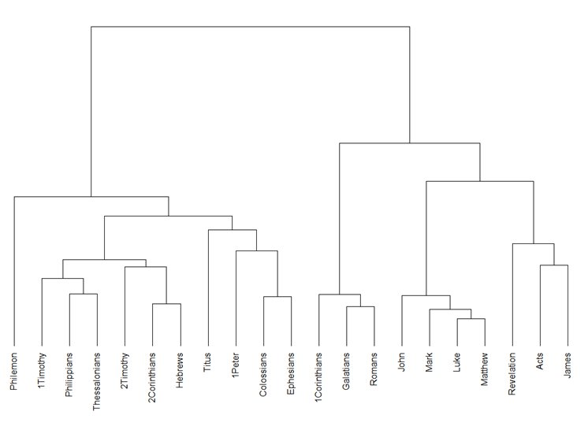

Slide 47
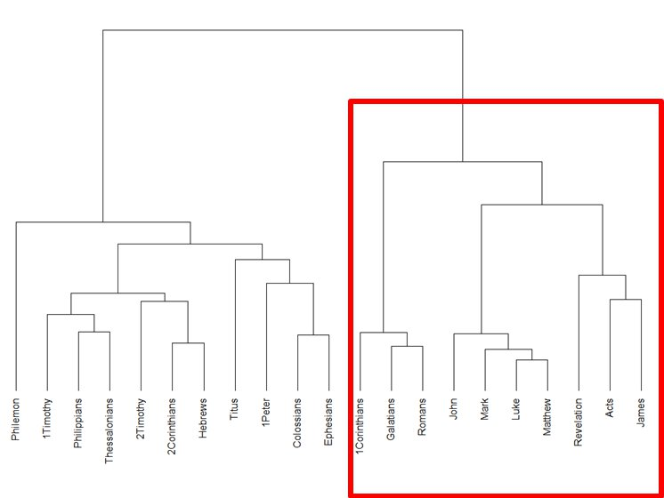
Relation alone

Slide 48
Relation + POS

Slide 49
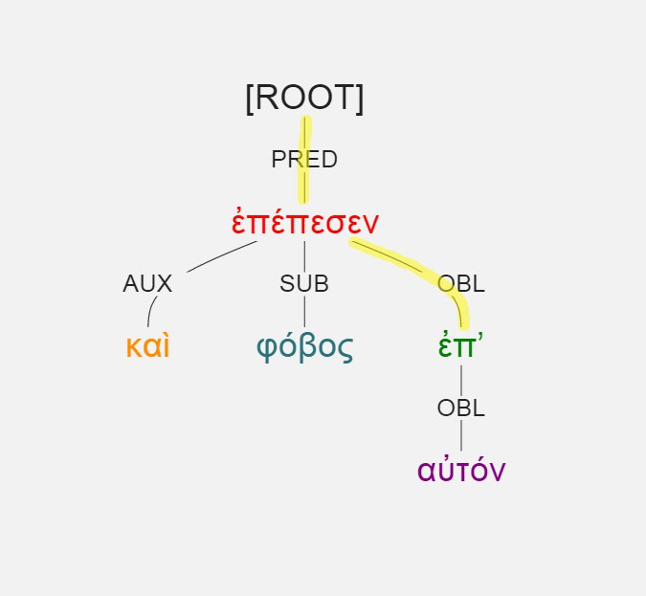
#-pred*obl
Gps.: 1784
Others: 948
Luke 1:12, καὶ φόβος ἐπέπεσεν ἐπ’ αὐτόν.

Slide 50
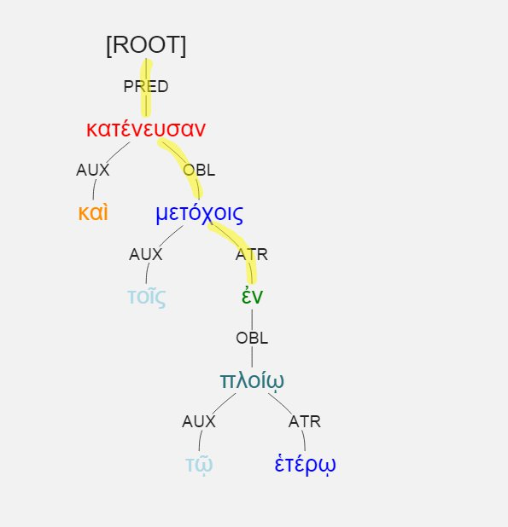
#-pred*obl*atr
Luke 5:7, καὶ κατένευσαν τοῖς μετόχοις ἐν τῷ ἑτέρῳ πλοίῳ

Slide 51
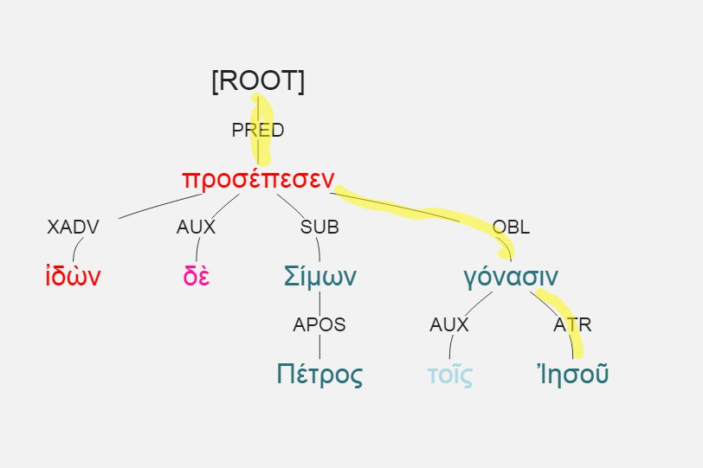
pred*obl*atr
Gosp.: 68 / 1784
Other: 121 / 948
Luke 5:8, ἰδὼν δὲ Σίμων Πέτρος προσέπεσεν τοῖς γόνασιν Ἰησοῦ

