Slide 2
Greek and Latin Treebanks and Research
You are invited to attend the workshop:
January 4-5, 2017
The Westin Harbor Castle, Toronto

Slide 3
Authorship Attribution using syntactic data

Slide 4
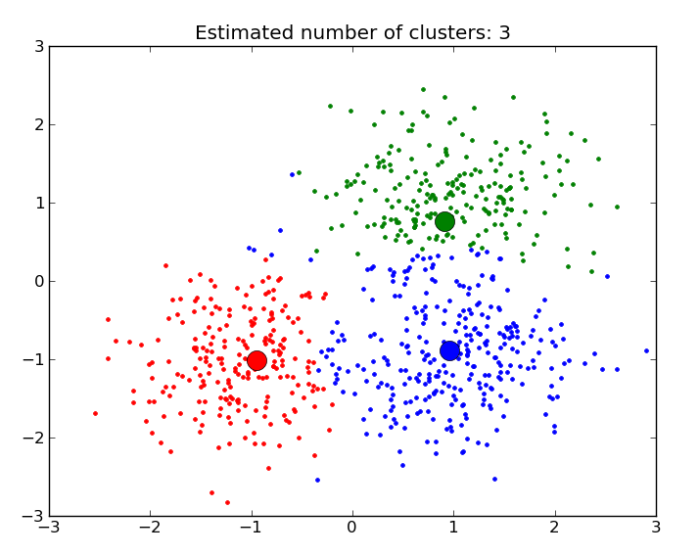
Clustering

Slide 5
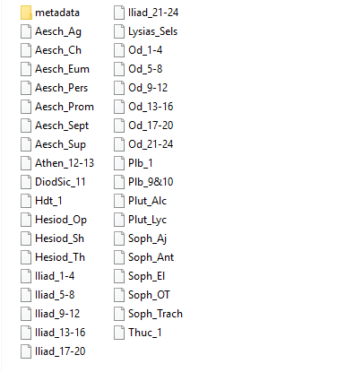
Syntactic data

Slide 6
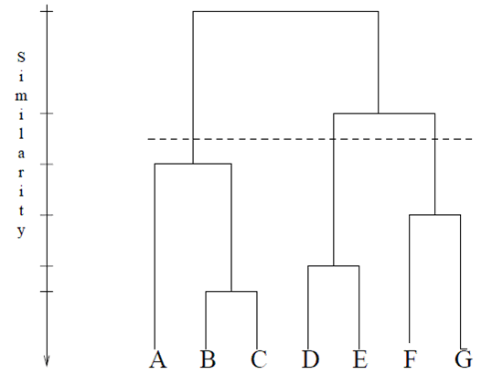

Slide 7
