Slide 1
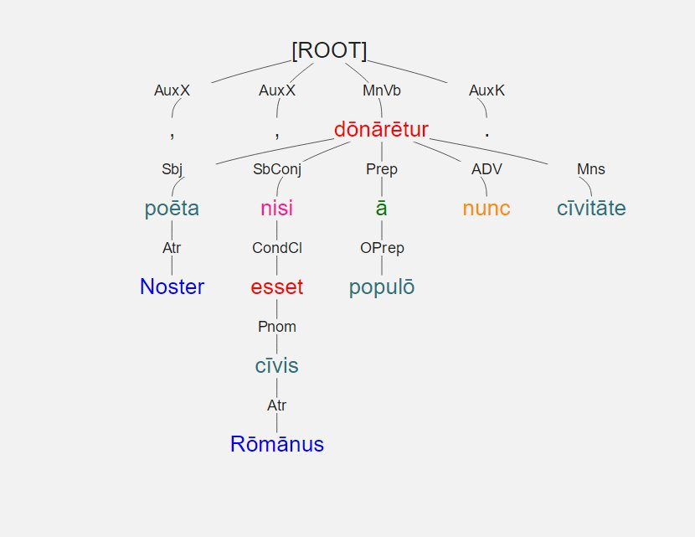
Noster poēta , nisi cīvis Rōmānus esset , ā populō nunc cīvitāte dōnārētur .

Slide 2
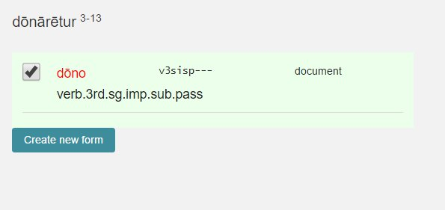
Noster poēta , nisi cīvis Rōmānus esset , ā populō nunc cīvitāte dōnārētur .
Notes:
Students are asked to correctly identify every form
Lemma
All relevant morphological information

Slide 3
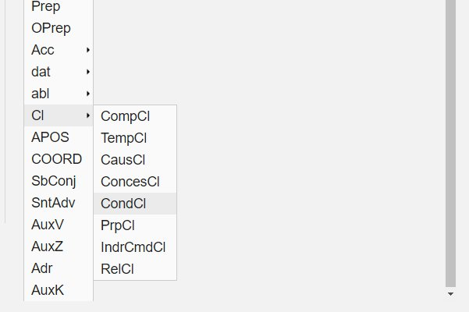
Noster poēta , nisi cīvis Rōmānus esset , ā populō nunc cīvitāte dōnārētur .
Notes:
Students are also asked to specify the dependency relationship
The list can be customized to meet classroom needs
Here is list of clauses known to the students

Slide 4
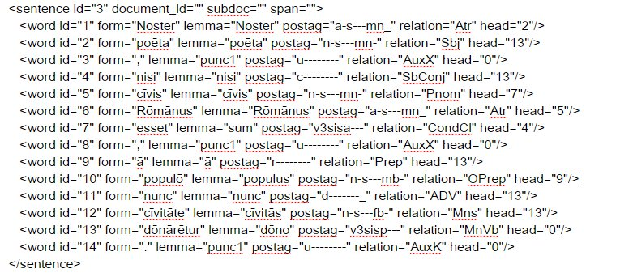
Noster poēta , nisi cīvis Rōmānus esset , ā populō nunc cīvitāte dōnārētur .
Notes:
Underlying XML

Slide 5
Noster poēta , nisi cīvis Rōmānus esset , ā populō nunc cīvitāte dōnārētur .
<word id="5" form="cīvis" lemma="cīvis" postag="n-s---mn-" relation="Pnom" head="7"/>
<word id="6" form="Rōmānus" lemma="Rōmānus" postag="a-s---mn_" relation="Atr" head="5"/>
<word id="7" form="esset" lemma="sum" postag="v3sisa---" relation="CondCl" head="4"/>
Notes:
Underlying XML

Slide 7
Usefulness of data?
Relation
Lemma
Postag
Head??
Notes:
Data so far is interesting and its collection usefully automated.
It is utterly traditional
It is not very “treeish.”
The “head” assigned by a student to a word is somewhat different
it can also be put in traditional terms: a given adjective is and attribute of a given noun, for example
But it is also quite different than the other data examined so far
We understand what it means when a student mislabels a Relationship: SBJ for Poss
But evaluating head data presents difficulties
It cannot be interpreted without looking at the tree as a whole: it is the more treeish part of the data

Slide 8
