Slide 1
Data from Student Treebanking as a Pedagogical Resource
Robert Gorman
University of Nebraska-Lincoln
Notes:
Introductory remarks
Treebanking has been making its way into classrooms around the globe
Like any computational activity, treebanking creates mountains of data
The goal of this paper is to consider how we may use this material for our advantage as teachers and students of language.

Slide 2
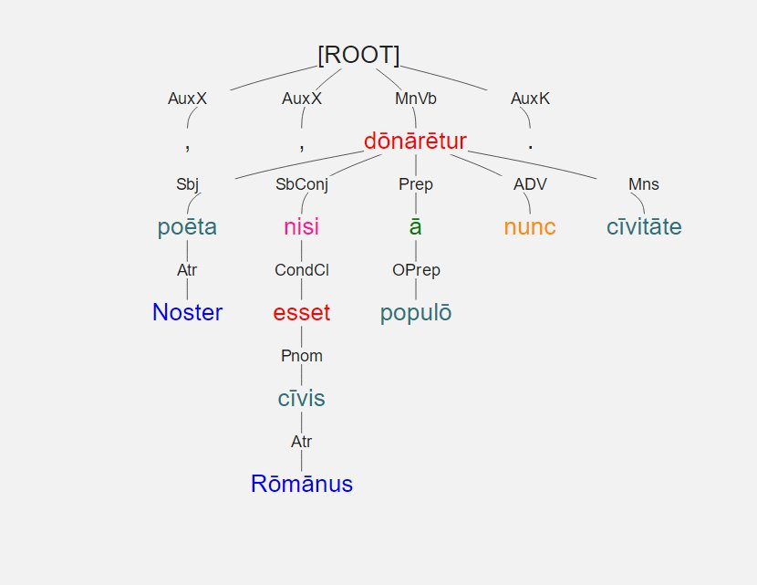
Noster poēta , nisi cīvis Rōmānus esset , ā populō nunc cīvitāte dōnārētur .
Notes:
Dependency Tree of demo sentence.

Slide 3
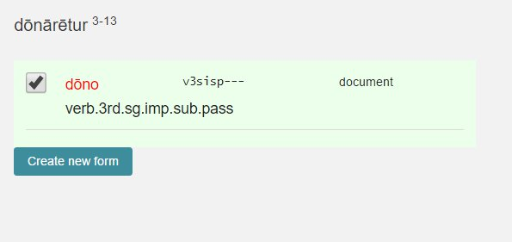
Noster poēta , nisi cīvis Rōmānus esset , ā populō nunc cīvitāte dōnārētur .
Notes:
Students are asked to correctly identify every form
Lemma
All relevant morphological information

Slide 4
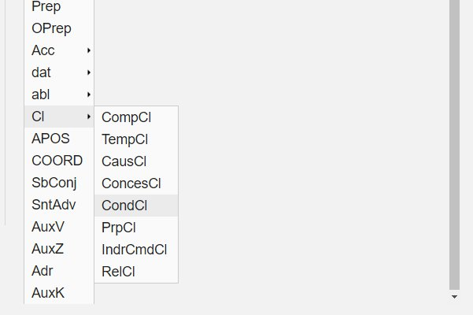
Noster poēta , nisi cīvis Rōmānus esset , ā populō nunc cīvitāte dōnārētur .
Notes:
Students are also asked to specify the dependency relationship
The list can be customized to meet classroom needs
Here is list of clauses known to the students

Slide 5
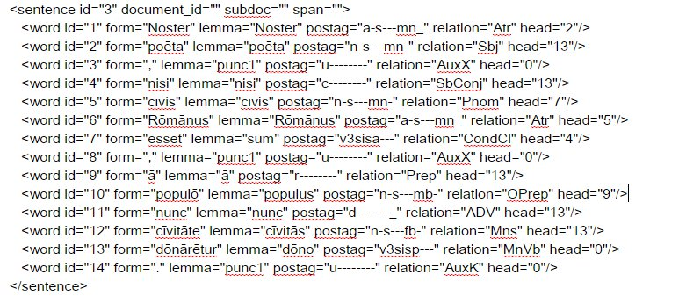
Noster poēta , nisi cīvis Rōmānus esset , ā populō nunc cīvitāte dōnārētur .
Notes:
Underlying XML

Slide 6
Noster poēta , nisi cīvis Rōmānus esset , ā populō nunc cīvitāte dōnārētur .
<word id="5" form="cīvis" lemma="cīvis" postag="n-s---mn-" relation="Pnom" head="7"/>
<word id="6" form="Rōmānus" lemma="Rōmānus" postag="a-s---mn_" relation="Atr" head="5"/>
<word id="7" form="esset" lemma="sum" postag="v3sisa---" relation="CondCl" head="4"/>
Notes:
Data points = lemma, postag, relation, and head.

Slide 7
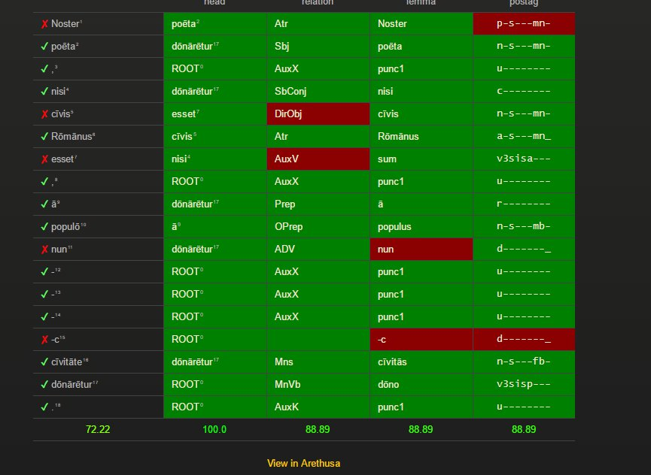
Noster poēta , nisi cīvis Rōmānus esset , ā populō nunc cīvitāte dōnārētur .
Notes:
Arethusa provides a matrix of correct and incorrect answers

Slide 8
Noster poēta , nisi cīvis Rōmānus esset , ā populō nunc cīvitāte dōnārētur.
Notes:
Close up of matrix line

Slide 9
Noster poēta , nisi cīvis Rōmānus esset , ā populō nunc cīvitāte dōnārētur.
Dependency
noster | 59%
poeta | 53%
nisi | 59%
civis | 47%
Romanus | 53%
esset | 59%
a | 76%
populo | 100%
nunc | 94%
civitate | 71%
donaretur | 82%
Relation
noster | 70.59%
poeta | 88.24%
nisi | 70.59%
civis | 41.18%
Romanus | 52.94%
esset | 47.06%
a | 100.00%
populo | 94.12%
nunc | 100.00%
civitate | 58.82%
donaretur | 88.24%
Notes:
Aggregate data for all students

Slide 10
Noster poēta , nisi cīvis Rōmānus esset , ā populō nunc cīvitāte dōnārētur.
Lemma
noster | 94.12%
poeta | 100.00%
nisi | 100.00%
civis | 100.00%
Romanus | 94.12%
esset | 94.12%
a | 100.00%
populo | 88.24%
nunc | 100.00%
civitate | 100.00%
donaretur | 100.00%
Morphology
noster | 52.94%
poeta | 88.24%
nisi | 100.00%
civis | 76.47%
Romanus | 64.71%
esset | 58.82%
a | 94.12%
populo | 82.35%
nunc | 100.00%
civitate | 82.35%
donaretur | 82.35%
Notes:
More aggregate data

Slide 11
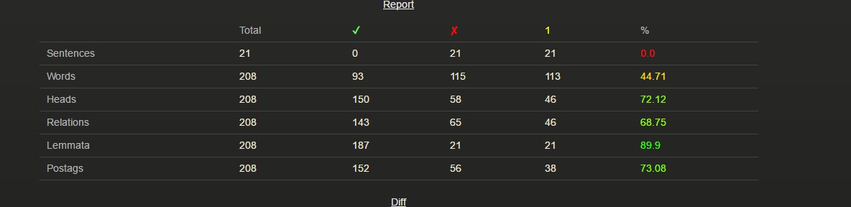
Notes:
Report summarizing individual students

Slide 12
208 words x 5 features x 24 students = 24, 960
 | Word | Head | Relation | Lemma | Morph
Mean | 50.26% | 72.86% | 71.26% | 83.28% | 73.74%
Maximum | 78.85% | 96.15% | 91.35% | 96.63% | 92.79%
Minimum | 23.56% | 43.27% | 46.63% | 62.98% | 46.15%
Notes:
Data points for one set of homework assignments is robust

Slide 13
Adverbial | 100.00%
attribute | 61.70%
Conditional Cl | 80.85%
Dir. Obj. | 93.62%
Main Verb | 80.85%
Pred. Nom. | 53.19%
Poss. | 70.21%
Subject | 51.06%
Notes:
Data can be broken down in various ways
Sample of data calculated by type of grammatical Relationship

Slide 14
Uses?
Some data immediately illuminating
Some less so!
Notes:
Obvious:
students can’t tell subjects from pnoms in the wild
Nor perfect participles from nouns derived from same
Students confused by pronoun / adjective alternation of demonstratives
Not so obvious:
More obscure is how to handle data pertaining to shape of tree (structure of sentence)?
Desideratum is to be able to generalize performance data
Easy for morphological data
Difficult for grammatical relationship (since terminology various)
Most difficult for “head” data: these are sets of numbers with no inherent grammatical reference or significance

Slide 15
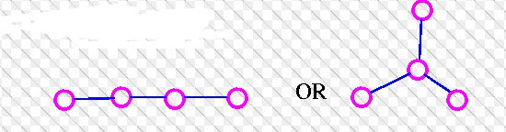
Treeish data: Can tree structure tell us anything?
Notes:
Is there sufficient variety among trees to make their structures useful for classification etc.?
At first we might doubt:
Only two possible shapes for a tree with four vertices.

Slide 16
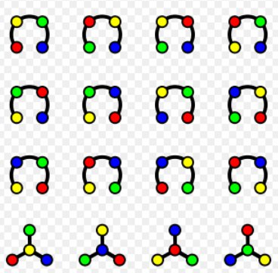
Notes:
Dependency trees have added characteristic: they are labeled;
Not with respect to syntax relations
Rather, each vertex represents an element that is unique in respect to its linear order in a sentence

Slide 17
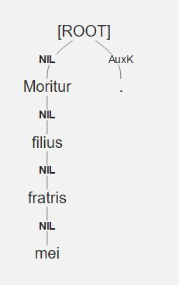
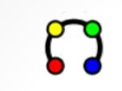
Moritur filius fratris mei
Notes:
Dependency trees are not only labeled, they are rooted.

Slide 18
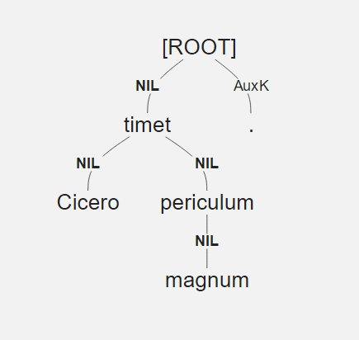
Cicero timet periculum magnum
Notes:
Rotate tree a quarter turn:

Slide 19
Rooted labeled trees on n vertices
Vertices | Unique Trees
1 | 1
2 | 2
3 | 9
4 | 64
5 | 625
6 | 7776
7 | 117,649
8 | 2,097,152
9 | 43,046,721
10 | 1,000,000,000
Notes:
A sentence with 10 words may be represented by any one of a billion trees!
Point: if we find patterns of similar structures given this possible variety, we may suspect that the patterns are significant.
How to proceed?
Much work done on the question of how to describe and quantify similarity and difference among trees.
Many physical and technological systems are represented by tree structures, so serious effort is given to the issue of measurement and comparison
Best for us to stick with a metric that is relatively simple and represents a linguistic phenomenon rather than something that may be purely mathematical.

Slide 20
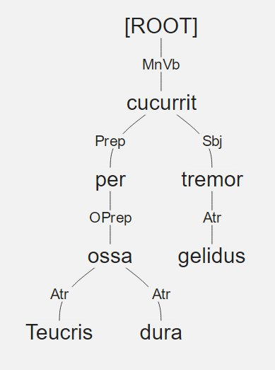
Dependency Distance:
gelidus Teucris per dura cucurrit / ossa tremor
 | word - parent | DD
gelidus | 1-7 | 6
Teucris | 2-6 | 4
per | 3-5 | 2
dura | 4-6 | 2
curcurrit | Root | 0
ossa | 6-3 | 3
tremor | 7-5 | 2
Mean |  | 2.71
Notes:
Dependency Distance
Widely used as measure of sentence complexity
Apparent representation of real linguistic phenomenon
Cognitive cost
Based on dependency and place of words in linear order of sentence
Difference between linear position of target word and that of its parent word.

Slide 21
Average Dependency Distance
Romanian | 1.798
Japanese | 1.805
Danish | 2.136
Italian | 2.190
Dutch | 2.524
English | 2.543
German | 3.353
Chinese | 3.662
From Liu, Journal of Cognitive Science (2008)
Notes:
Note that our example sentence is already larger in DD than the average for a good many languages.
This is remarkable given that the example is only 7 words long

Slide 22
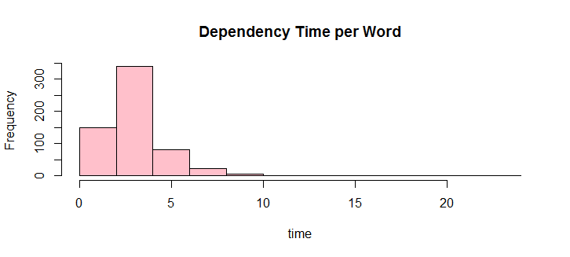
Is DD useful for us?
Min. 1.0, 1st Qu. 2.667, Median 3.323, Mean 3.633, 3rd Qu. 4.212, Max. 28.340
Notes:
DD is an established measure of sentence complexity.
How does it stand as measure of sentence difficulty?
Not feasible to set up large body of texts for students to work on.
These require answer keys
Therefore, they are not easily extensible
So, a workable proxy is to ask tree makers to time and record their efforts
Time recorded for 600 sentences
Dependency
Grammatical label
morphology

Slide 23
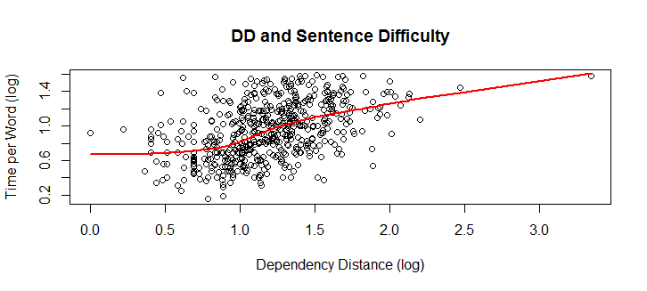
DD x Dependency Time
Notes:
Fairly good correlation of the two variables (0.452)
Much remains unexplained
Linear regression model say that this pattern cannot be due to chance (p-value is essentially 0)
At the same time, DD looks to explain only 20% of the variation evident
Non treeish factors certainly in play
Difficult vocabulary
Participles and infinitives vs. clauses introduced by subordinating conjunctions
What other treeish factors?

Slide 24
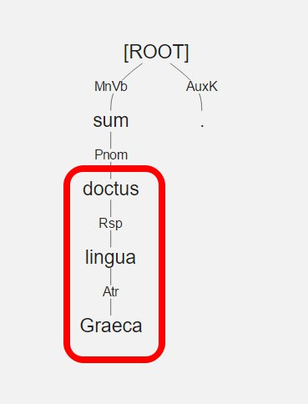
Projectivity
Doctus sum lingua Graeca.
Notes:
Is sentence projective?
Are its sub-trees contiguous in the linear order of the sentence.
Note that the arcs of dependency don’t cross.

Slide 25
Planarity?
Doctus lingua sum Graeca.
Notes:
Planarity is a further refinement of projectivity (or rather non-projectivity).
A non-projective sentence in which dependency arcs cross.

Slide 26
That’s all, folks.

