Slide 1
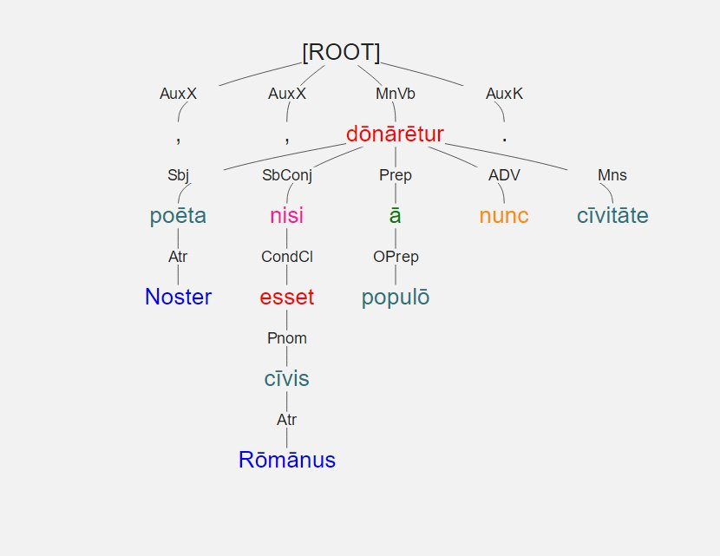
Noster poēta , nisi cīvis Rōmānus esset , ā populō nunc cīvitāte dōnārētur .
Notes:
Dependency Tree of demo sentence.

Slide 2
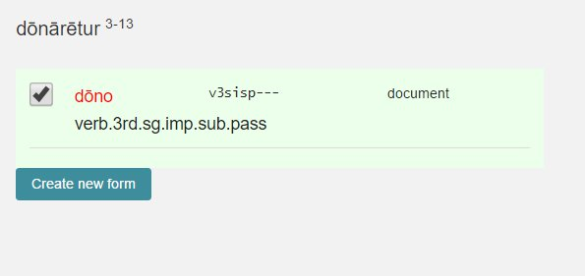
Noster poēta , nisi cīvis Rōmānus esset , ā populō nunc cīvitāte dōnārētur .
Notes:
Students are asked to correctly identify every form
Lemma
All relevant morphological information

Slide 3
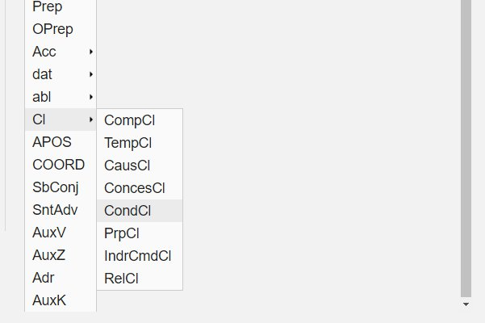
Noster poēta , nisi cīvis Rōmānus esset , ā populō nunc cīvitāte dōnārētur .
Notes:
Students are also asked to specify the dependency relationship
The list can be customized to meet classroom needs
Here is list of clauses known to the students

Slide 4
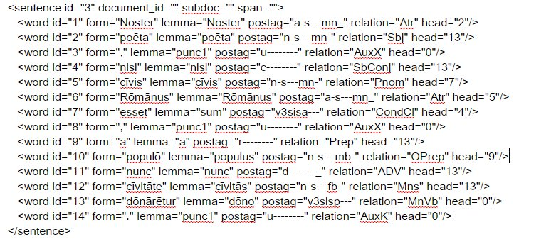
Noster poēta , nisi cīvis Rōmānus esset , ā populō nunc cīvitāte dōnārētur .
Notes:
Underlying XML

Slide 5
Noster poēta , nisi cīvis Rōmānus esset , ā populō nunc cīvitāte dōnārētur .
<word id="5" form="cīvis" lemma="cīvis" postag="n-s---mn-" relation="Pnom" head="7"/>
<word id="6" form="Rōmānus" lemma="Rōmānus" postag="a-s---mn_" relation="Atr" head="5"/>
<word id="7" form="esset" lemma="sum" postag="v3sisa---" relation="CondCl" head="4"/>
Notes:
Data points = lemma, postag, relation, and head.

Slide 6
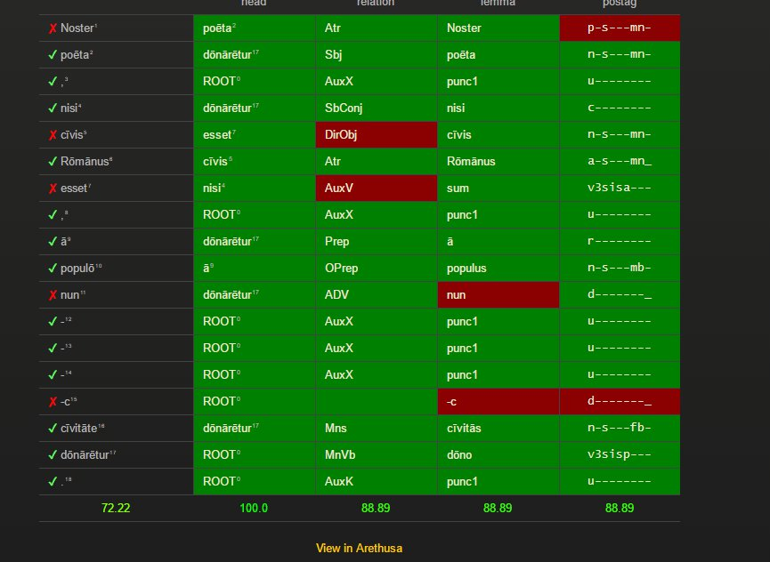
Noster poēta , nisi cīvis Rōmānus esset , ā populō nunc cīvitāte dōnārētur .
Notes:
Arethusa provides a matrix of correct and incorrect answers

Slide 7
Noster poēta , nisi cīvis Rōmānus esset , ā populō nunc cīvitāte dōnārētur.
Notes:
Close up of matrix line

Slide 8
Noster poēta , nisi cīvis Rōmānus esset , ā populō nunc cīvitāte dōnārētur.
Dependency
noster | 59%
poeta | 53%
nisi | 59%
civis | 47%
Romanus | 53%
esset | 59%
a | 76%
populo | 100%
nunc | 94%
civitate | 71%
donaretur | 82%
Relation
noster | 70.59%
poeta | 88.24%
nisi | 70.59%
civis | 41.18%
Romanus | 52.94%
esset | 47.06%
a | 100.00%
populo | 94.12%
nunc | 100.00%
civitate | 58.82%
donaretur | 88.24%
Notes:
Aggregate data for all students

Slide 9
Noster poēta , nisi cīvis Rōmānus esset , ā populō nunc cīvitāte dōnārētur.
Lemma
noster | 94.12%
poeta | 100.00%
nisi | 100.00%
civis | 100.00%
Romanus | 94.12%
esset | 94.12%
a | 100.00%
populo | 88.24%
nunc | 100.00%
civitate | 100.00%
donaretur | 100.00%
Morphology
noster | 52.94%
poeta | 88.24%
nisi | 100.00%
civis | 76.47%
Romanus | 64.71%
esset | 58.82%
a | 94.12%
populo | 82.35%
nunc | 100.00%
civitate | 82.35%
donaretur | 82.35%
Notes:
More aggregate data

Slide 10
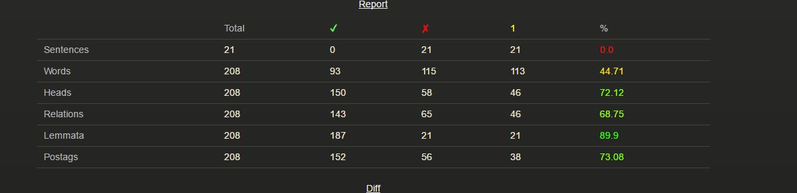
Notes:
Report summarizing individual students

Slide 11
208 words x 5 features x 24 students = 24, 960
 | Word | Head | Relation | Lemma | Morph
Mean | 50.26% | 72.86% | 71.26% | 83.28% | 73.74%
Maximum | 78.85% | 96.15% | 91.35% | 96.63% | 92.79%
Minimum | 23.56% | 43.27% | 46.63% | 62.98% | 46.15%
Notes:
Data points for one set of homework assignments is robust

Slide 12
Adverbial | 100.00%
attribute | 61.70%
Conditional Cl | 80.85%
Dir. Obj. | 93.62%
Main Verb | 80.85%
Pred. Nom. | 53.19%
Poss. | 70.21%
Subject | 51.06%
Notes:
Data can be broken down in various ways
Sample of data calculated by type of grammatical Relationship

Slide 13
Uses?
Some data immediately illuminating
Some less so!
Notes:
Obvious:
students can’t tell subjects from pnoms in the wild
Nor perfect participles from nouns derived from same
Students confused by pronoun / adjective alternation of demonstratives
Not so obvious:
More obscure is how to handle data pertaining to shape of tree (structure of sentence)?
Desideratum is to be able to generalize performance data
Easy for morphological data
Difficult for grammatical relationship (since terminology various)
Most difficult for “head” data: these are sets of numbers with no inherent grammatical reference or significance

Slide 14
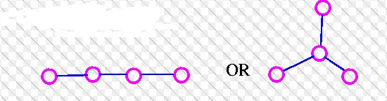
Treeish data: Can tree structure tell us anything?
Notes:
Is there sufficient variety among trees to make their structures useful for classification etc.?
At first we might doubt:
Only two possible shapes for a tree with four vertices.

Slide 15
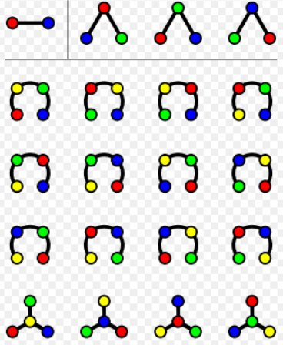
Notes:
Dependency trees have added characteristic: they are labeled;
Not with respect to syntax relations
Rather, each vertex represents an element that is unique in respect to its linear order in a sentence

Slide 16
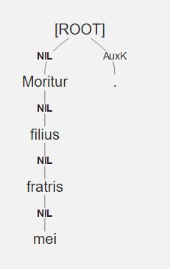

Moritur filius fratris mei
Notes:
Dependency trees are not only labeled, they are rooted.

Slide 17
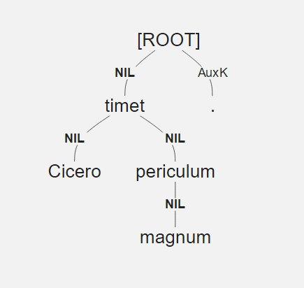
Cicero timet periculum magnum

Slide 18
Rooted labeled trees on n vertices
Vertices | Unique Trees
1 | 1
2 | 2
3 | 9
4 | 64
5 | 625
6 | 7776
7 | 117,649
8 | 2,097,152
9 | 43,046,721
10 | 1,000,000,000
Notes:
A sentence with 10 words may be represented by any one of a billion trees!
Point: if we find patterns of similar structures given this possible variety, we may suspect that the patterns are significant.

Slide 21
Usefulness of data?
Relation
Lemma
Postag
Head??
Notes:
Data so far is interesting and its collection usefully automated.
It is utterly traditional
It is not very “treeish.”
The “head” assigned by a student to a word is somewhat different
it can also be put in traditional terms: a given adjective is and attribute of a given noun, for example
But it is also quite different than the other data examined so far
We understand what it means when a student mislabels a Relationship: SBJ for Poss
But evaluating head data presents difficulties
It cannot be interpreted without looking at the tree as a whole: it is the more treeish part of the data

