Slide 1
Greek and Latin Treebanks and Research
You are invited to attend the workshop:
January 4-5, 2017
The Westin Harbor Castle, Toronto

Slide 2
Authorship Attribution using syntactic data

Slide 3
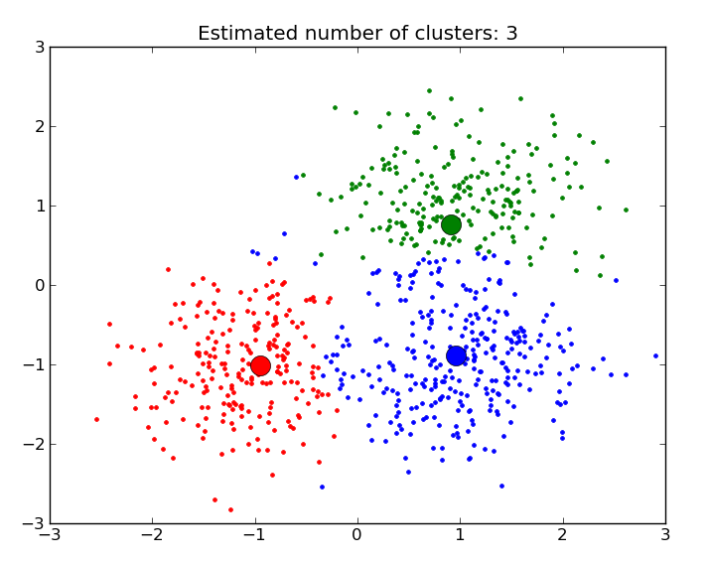
Clustering

Slide 4
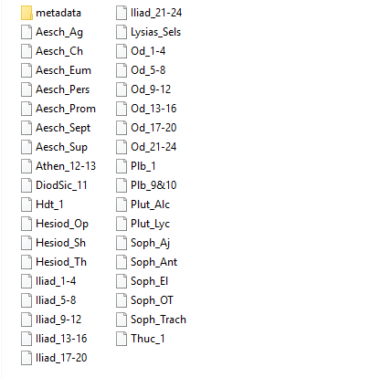
Syntactic data

Slide 5
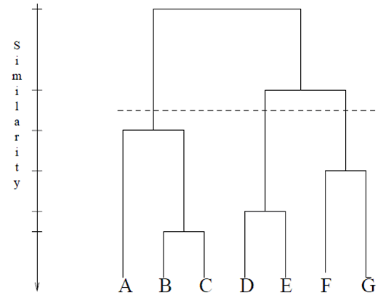

Slide 6
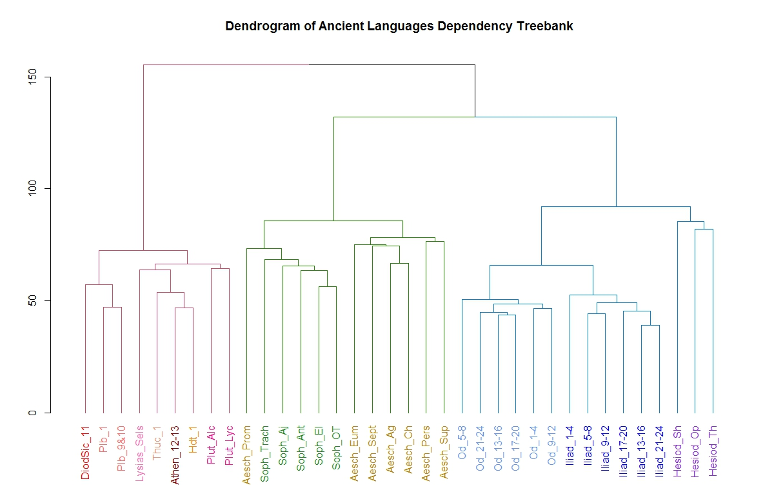

Slide 7
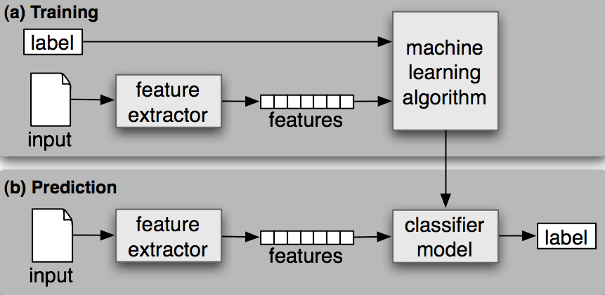
Supervised Classification

Slide 8
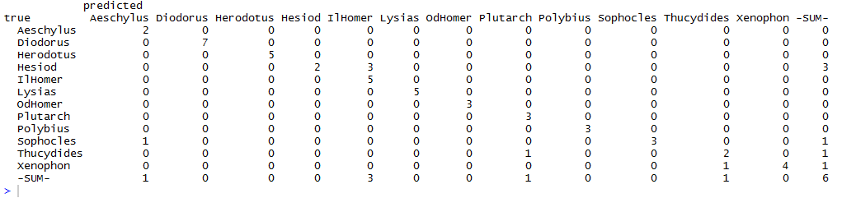

Slide 9
