Slide 1
Dependency Syntax Trees in the Latin 1 Classroom
Robert J. Gorman, Dept. of Classics
University of Nebraska-Lincoln

Slide 2
What is a syntax tree?
A graph of syntactic relationships (specifically, a rooted, directed, connected, acyclic graph)

Slide 3
For example:
Cicero De finibus 1.1, postremo aliquos futuros suspicor, qui me ad alias litteras vocent, genus hoc scribendi, etsi sit elegans, personae tamen et dignitatis esse negent.

Slide 4
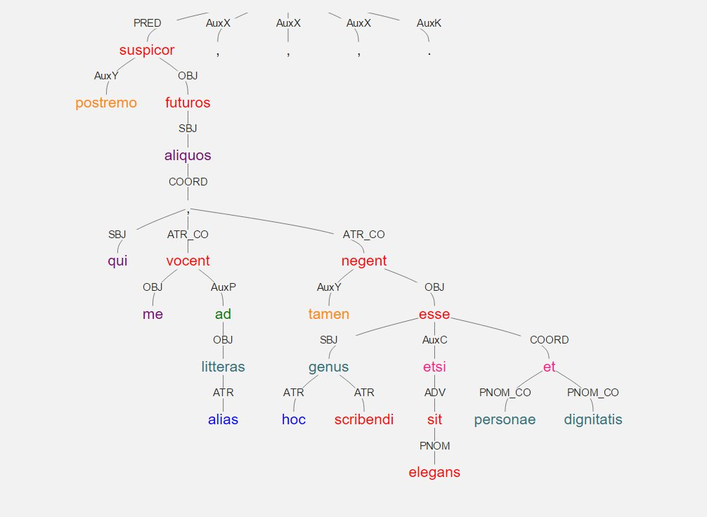

Slide 5
Why Treebanks?
Undergraduate research potential
Student learning data (indirect improvement of teaching/learning)
Student analytical skills (direct improvement of teaching/learning)?

Slide 6
Trees have research potential
They represent a syntactic annotation of a text
An important basis of further analysis (especially computational)

Slide 7
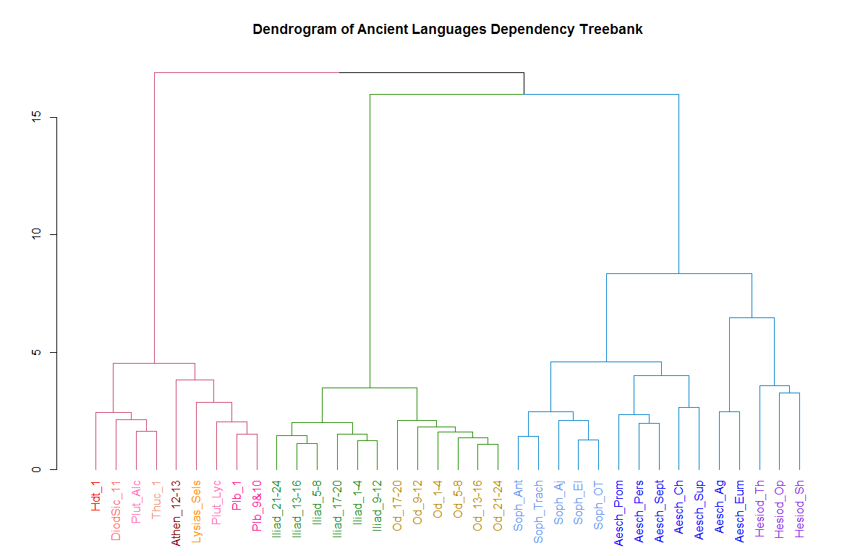

Slide 8
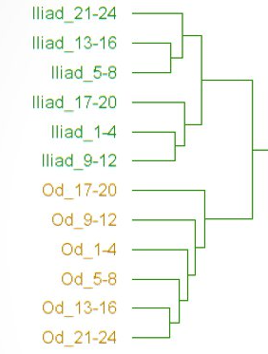
Distinguishing texts by syntactic “profile”

Slide 9
Real undergraduate research
<annotator> <name>Alex Lessie</name> <address>University of Pennsylvania, Philadelphia, PA, USA</address> </annotator> <annotator> <name>James C. D'Amico</name> <address>College of the Holy Cross, Worcester, MA, USA</address> </annotator> <annotator> <name>Viet Luong</name> <address>Tufts University, Medford, MA, USA</address> </annotator>

Slide 10
Why dependency trees?
Unlike phrase constituency trees:
Unit of analysis = individual word
Mirrors traditional grammar of Latin and Greek

Slide 11
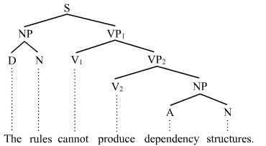
Constituency

Slide 12
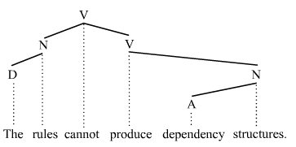
Dependency

Slide 13
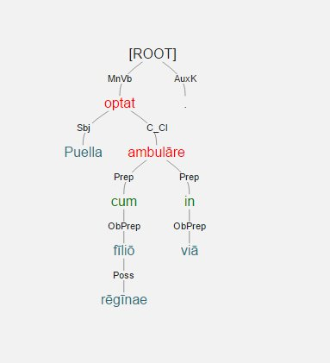
Now for Trees in Latin 1!

Slide 14
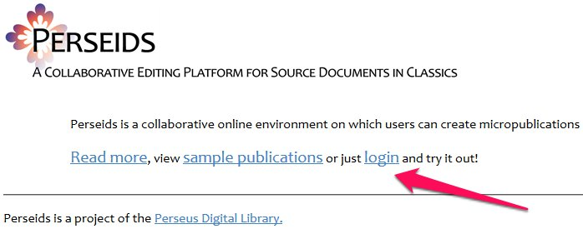
First, Go to the Perseids Platform http://perseids.org/

Slide 15
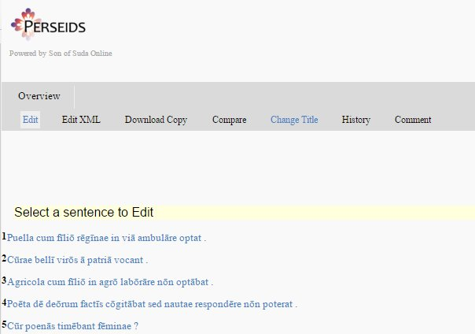
Students navigate to treebanking interface

Slide 16
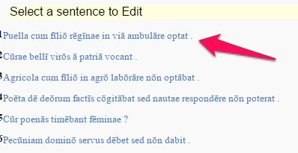
Click a sentence to begin

Slide 17
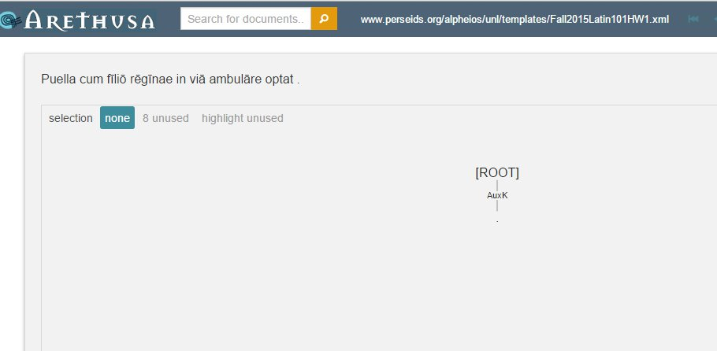
The Arethusa environment

Slide 18
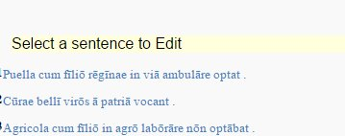

Click a sentence to begin

Slide 19

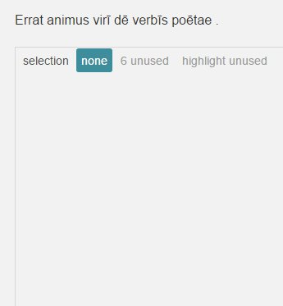
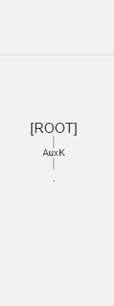
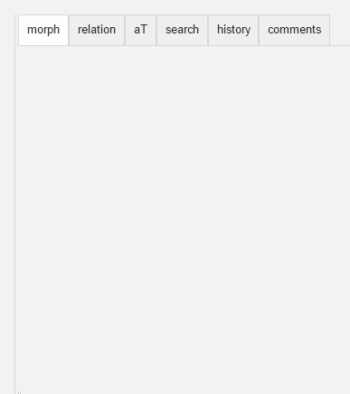
The Arethusa environment

Slide 20
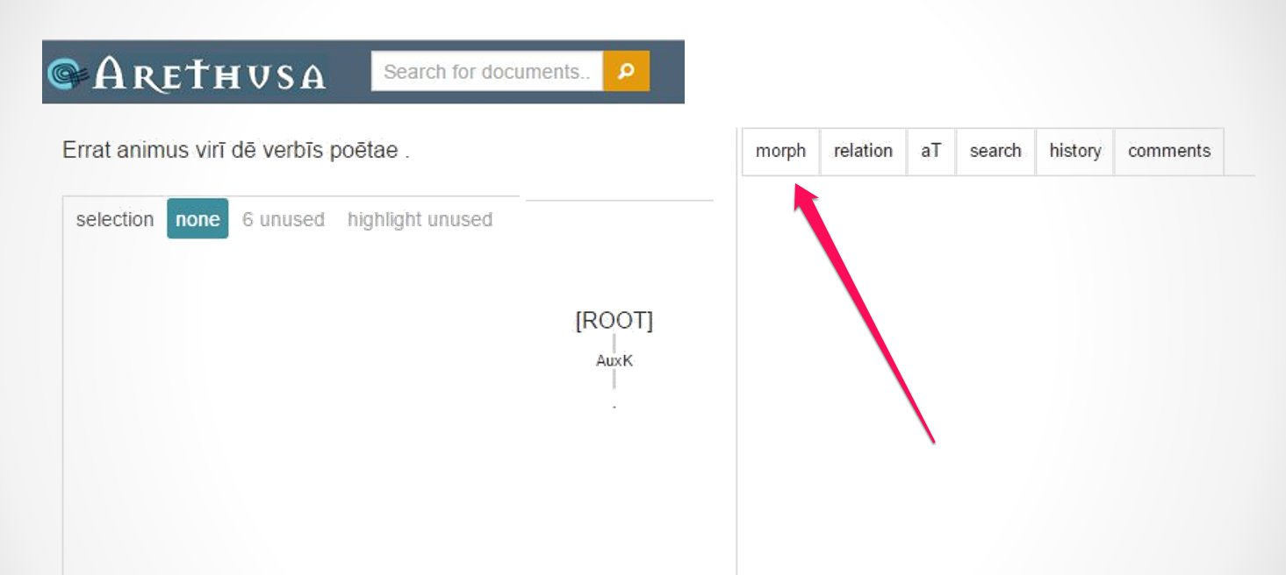
First: morphology

Slide 21
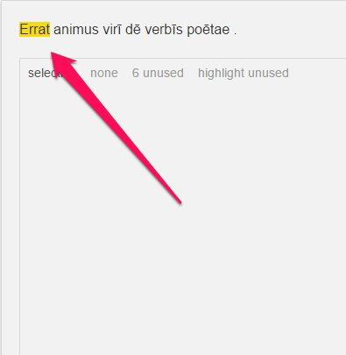
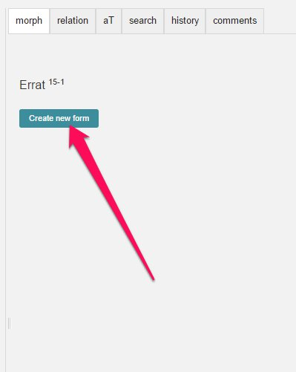
Choose word and identify

Slide 22
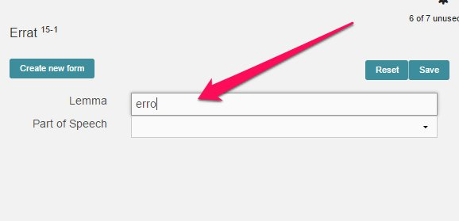
Add lemma

Slide 23
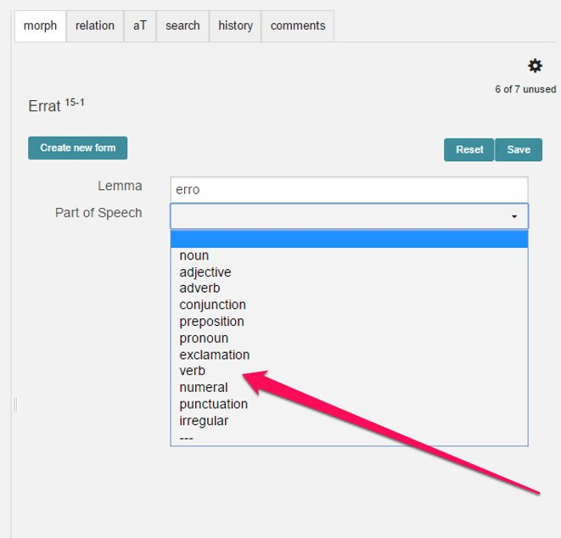
Choose part of speech

Slide 24
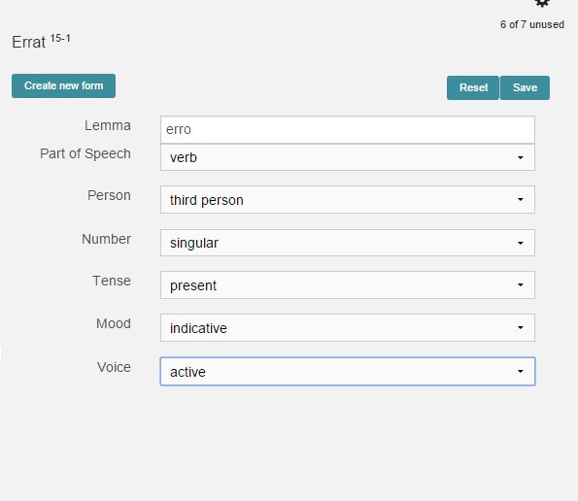
Fill in morphology

Slide 25
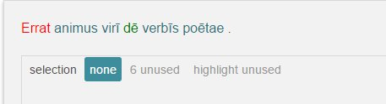
Rinse and repeat!

Slide 26
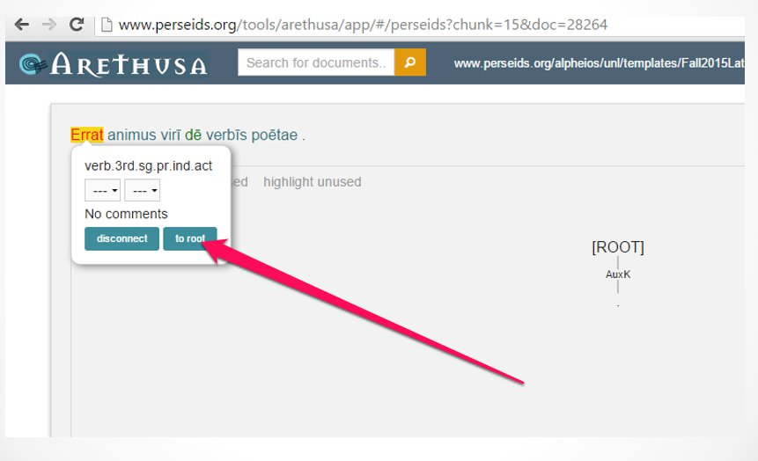
Next, mark the dependencies

Slide 27
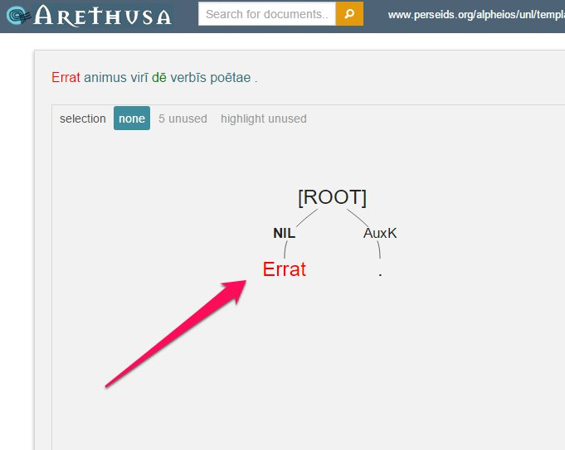

Slide 28
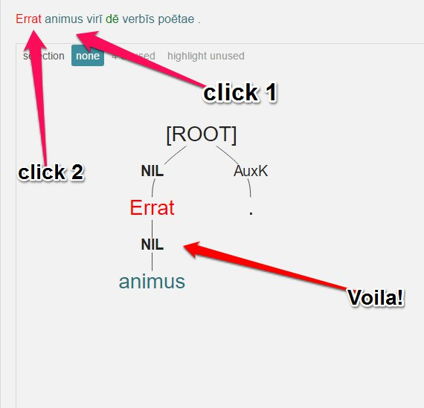
Click “child”, then “parent” to create graph

Slide 29
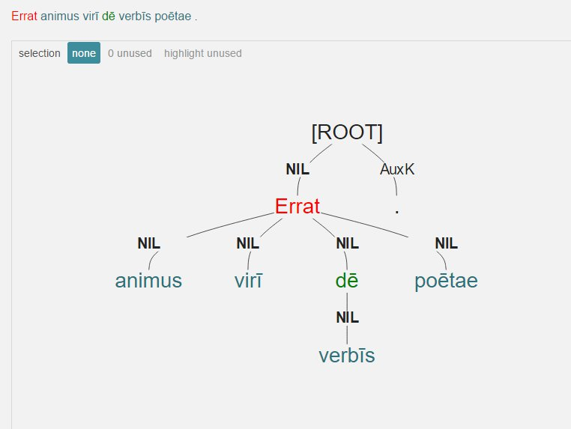
Complete the dependencies

Slide 30
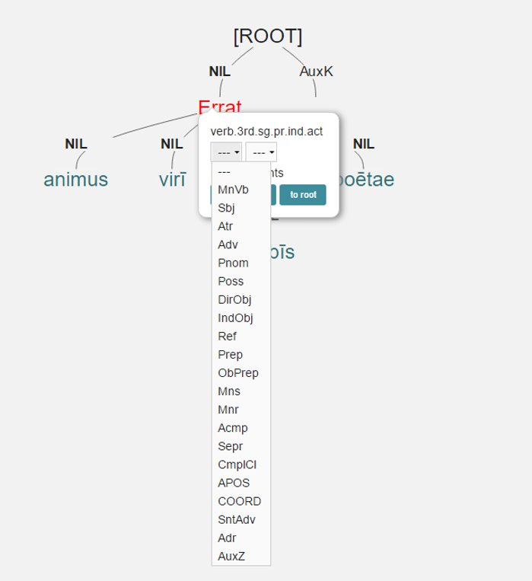
Identify the dependencies

Slide 31
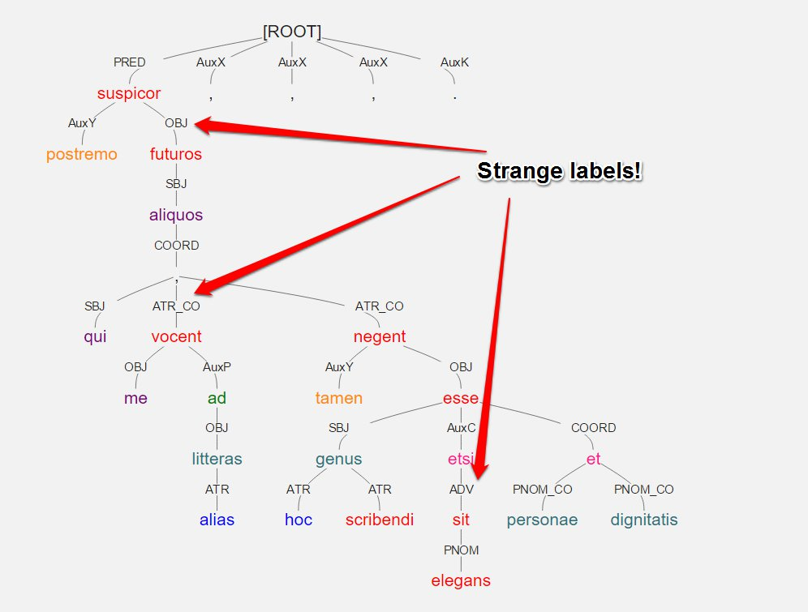
Arethusa allows tag set flexibility

Slide 32
Build your own labels to suit the students

Slide 33
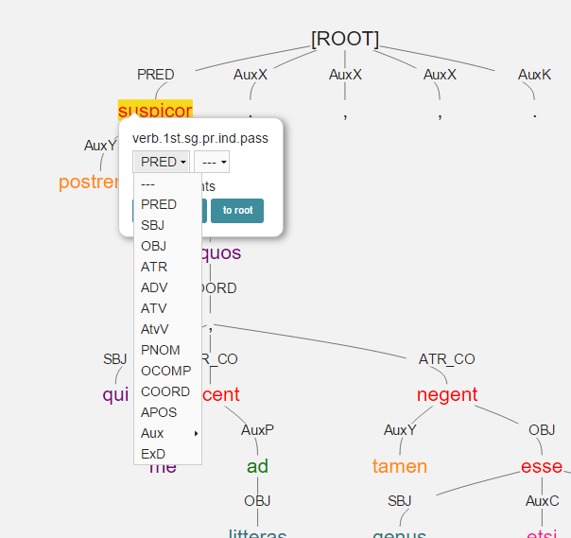
Compare

Slide 34
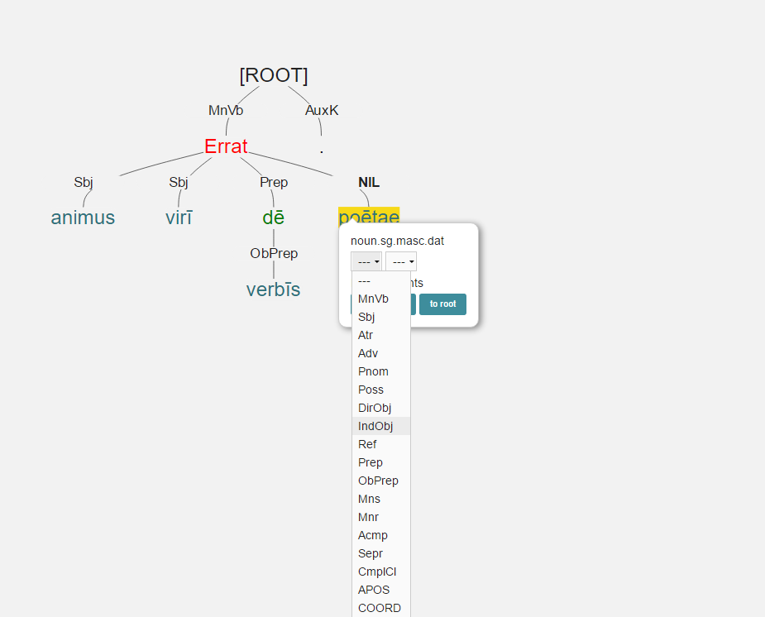
Label dependency relationships with appropriate tags

Slide 35
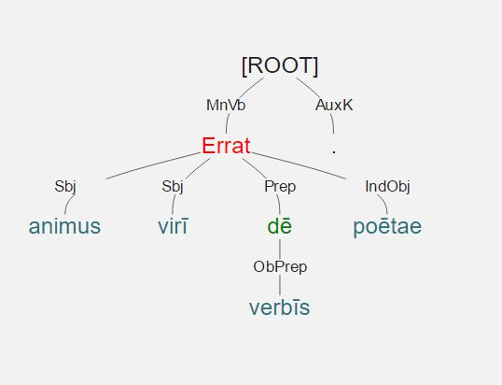
Syntax tree is complete, but is it correct?

Slide 36
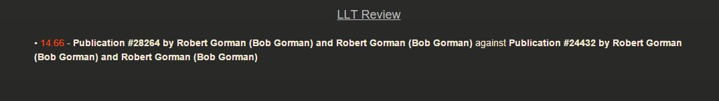
Arethusa will check for mistakes (against your “gold standard” tree)
Navigate to Review interface

Slide 37
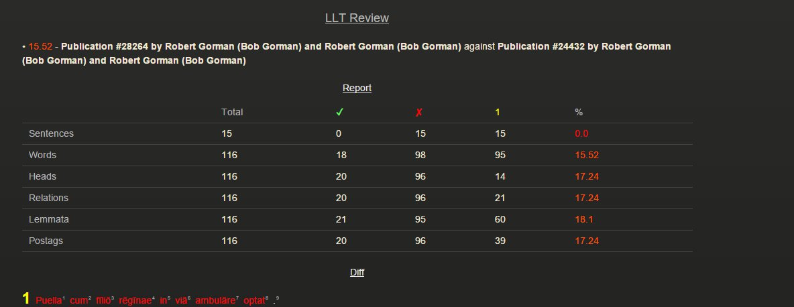
Proceed to Review screen
Summary report:

Slide 38
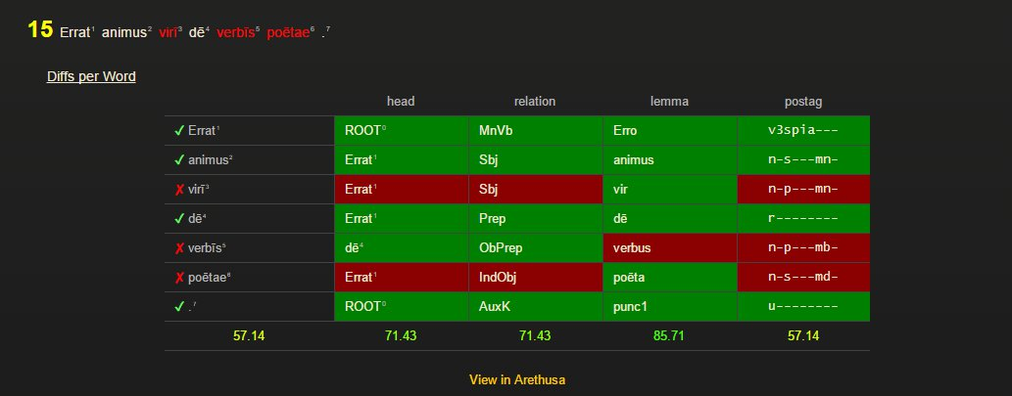
Examine details of each sentence

Slide 39
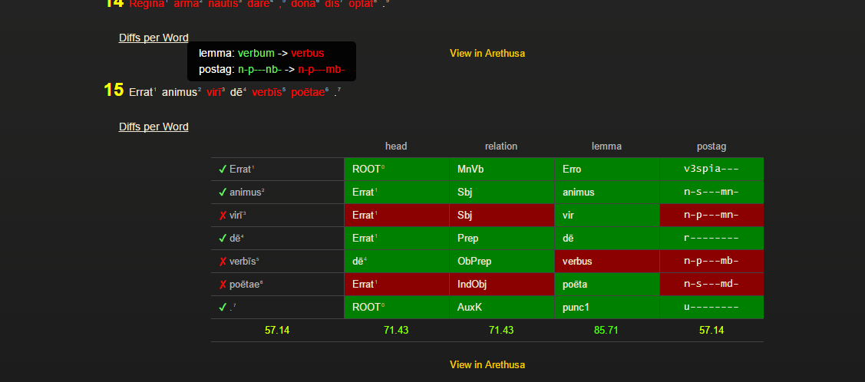
Mouse-over to see correct info

Slide 40
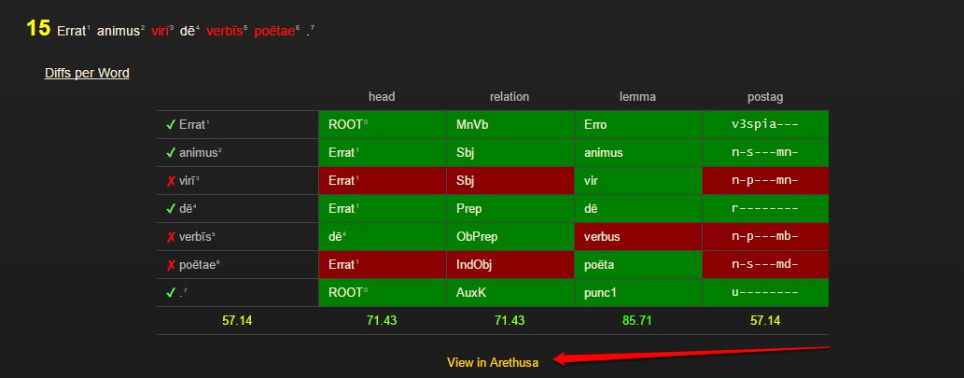
View student’s tree

Slide 41
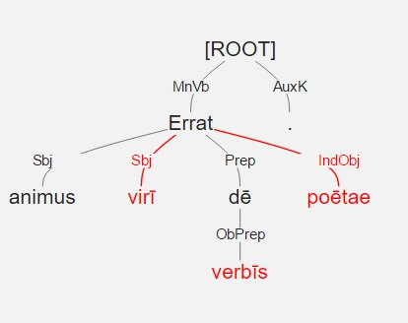
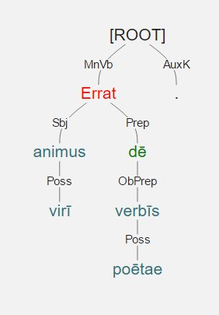
Student work and Gold Standard side by side

Slide 42
Data on student learning should lead (indirectly) to better teaching
4 data points for each word in each sentence:

Slide 43
What about direct improvement?
Structural subtleties are made explicit.
E.g., the slipperiness of prepositional phrases

Slide 44
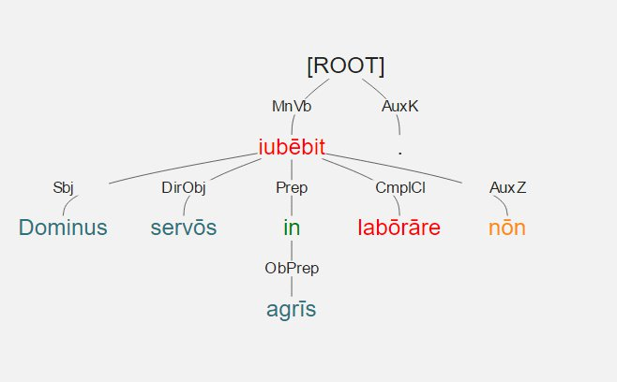
Dominus servōs in agrīs labōrāre nōn iubēbit
Does this answer: where will D. be when he gives his order?

Slide 45
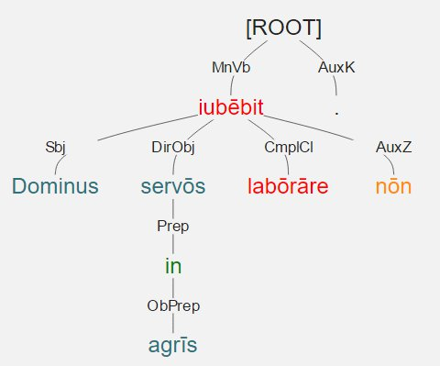
Dominus servōs in agrīs labōrāre nōn iubēbit
Or: which servi will get the order?

Slide 46
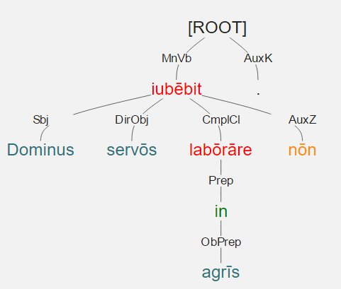
Dominus servōs in agrīs labōrāre nōn iubēbit
Or: where will the servi laborabunt?

Slide 47
Thank you!

