Slide 1
Treebanking and Author Attribution in Greek Prose
Treebanking Ancient Languages
Leipzig University
December 14, 2015
Robert J. Gorman, Dept. of Classics
Vanessa B. Gorman, Dept. of History
University of Nebraska-Lincoln

Slide 2
Can we determine the accuracy of quotes, paraphrases, epitomes, and excerpts of Greek prose authors?

Slide 3
Athenaeus (c. 200 CE) preserves some 2500+ quotes or paraphrases to 800+ writers (verse and prose)

Slide 4
Epitomizers and Excerptors
Polybius (2nd c. BCE) has 5 of 40 books preserved through direct transmission
Others mainly preserved in the excerptors working for Emperor Constantine VII Porphyrogenitus (10th c. CE)
Diodorus Siculus (1st c. BCE) has 15 of 40 books preserved through direct transmission
Others mainly in Photius (9th century CE) and the same Constantine excerptors

Slide 5
Derive Syntactic “Thumbprints”
Create a database of syntactically analyzed Greek prose
Teach the computer to distinguish known authors (proof of concept)
Compare directly-transmitted to epitomized prose by the same author

Slide 6
Fragments of Lost Authors
Compare to fragments of the same author that are preserved elsewhere
Compare to context in Athenaeus and Photius
Does it resemble:
The other fragments of the same author?
The context in Athenaeus?

Slide 7
Why Syntax?
Athenaean fragments are chosen thematically
They share much significant vocabulary
Distinction among fragments needs some other baisis

Slide 8
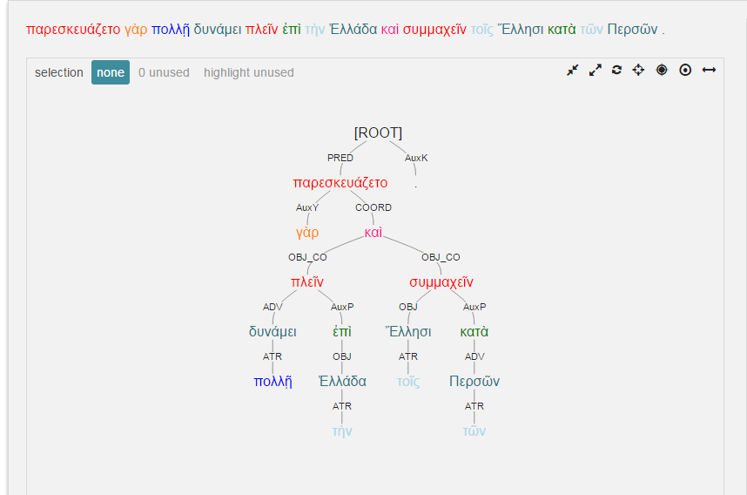
Diodorus 11.26.4

Slide 9
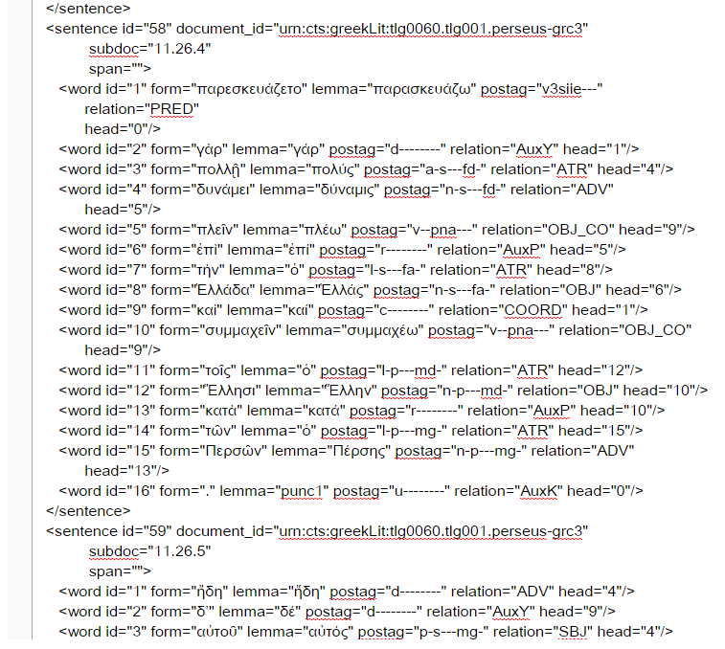

Slide 10
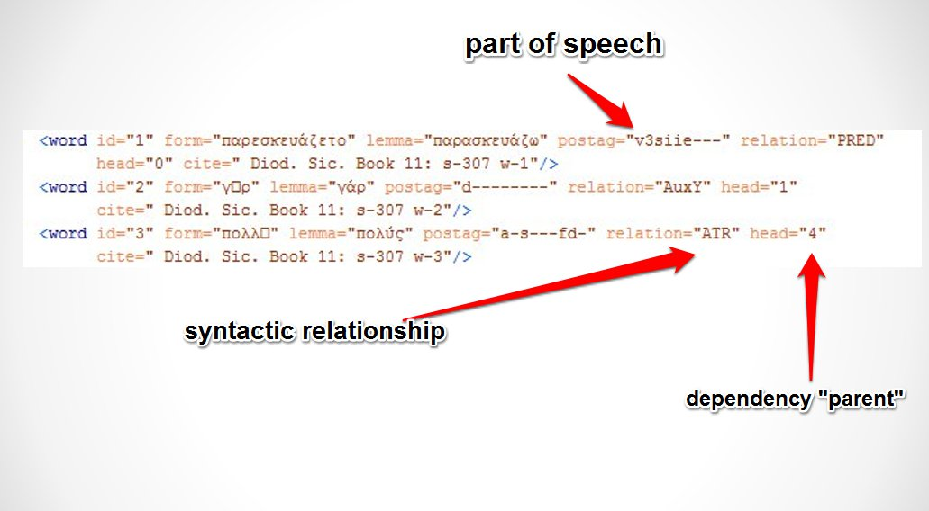
Available data points
Also:
Lemma
Form
Position in sentence

Slide 11
How to proceed?
“Syntax Words” (sWords)
After
Charles Hollingsworth introduces “DepWords” (“Using Dependency-Based Annotations for Authorship Identification,” TSD 2012, 314-19.)
Grigori Sidorov, et al., introduce “Sn-grams” (“syntactic n-grams) (“Syntactic Dependency-Based N-grams as Classification Features,” in Advances in Computational Intelligence, ed. By I. Batyrshin and M. G. Mendoza, Berlin 2012, pp. 1-11.)

Slide 12
Why sWords?
Input for many standard tools (just like lexical words)
Directly incorporate dependency relationships
Immediate significance to user

Slide 13
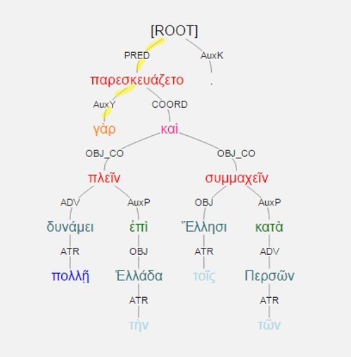
What is it?
sWord for γὰρ: #-pred-auxy

Slide 14
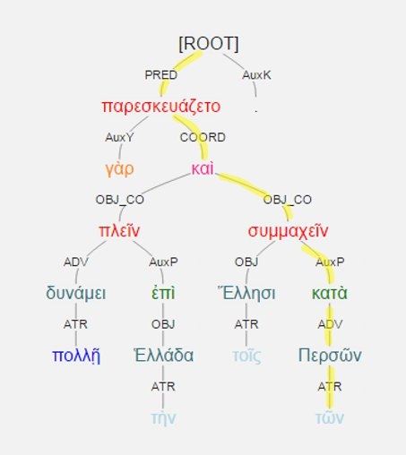
sWord of τῶν: #-pred-coord-obj_co-auxp-adv-atr

Slide 15
Several flavors of sWord available
e.g., add part of speech
sWord of τῶν: #-pred-v-coord-c-obj_co-v-auxp-r-adv-n-atr-l

Slide 16
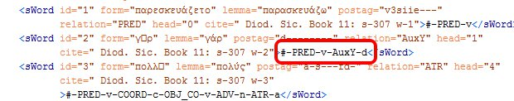
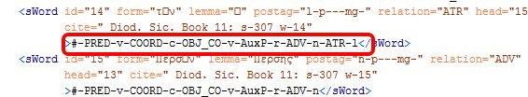
The XML

Slide 17
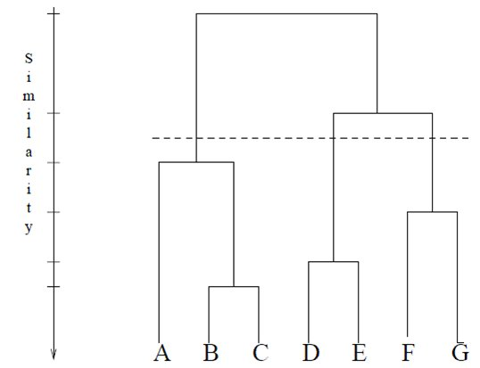
Will sWords work as discriminators?
Try clustering.

Slide 18
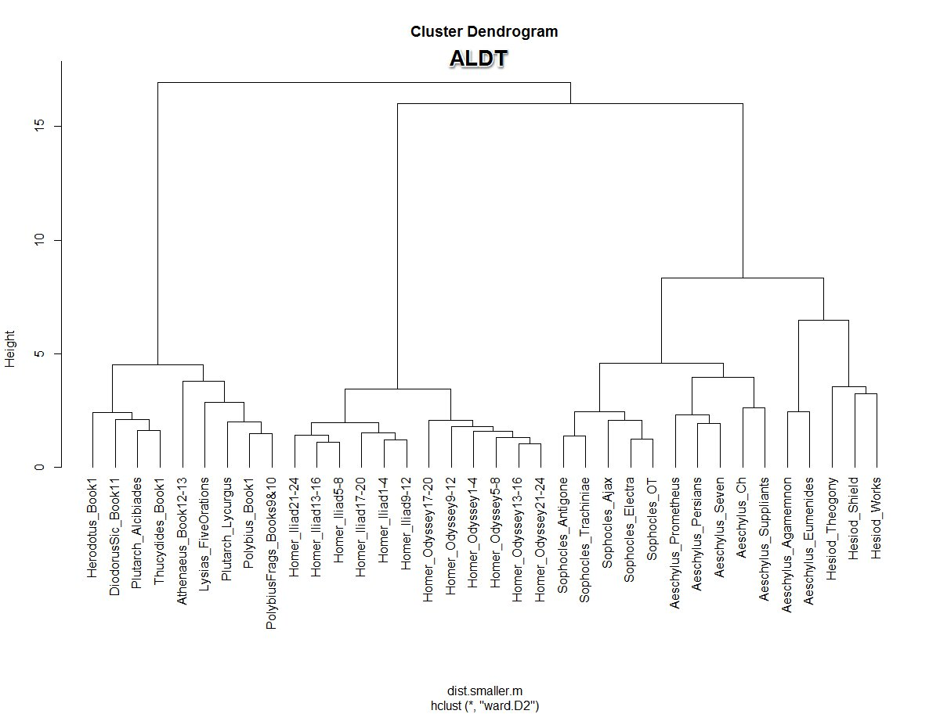

Slide 19
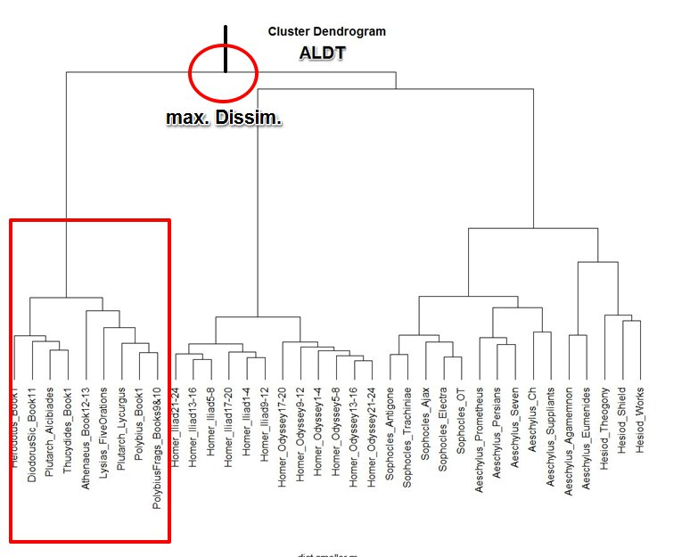
Chief subdivision

Slide 20
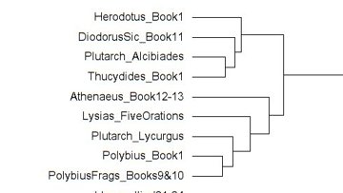
Greatest dissimilarity: prose v. verse

Slide 21
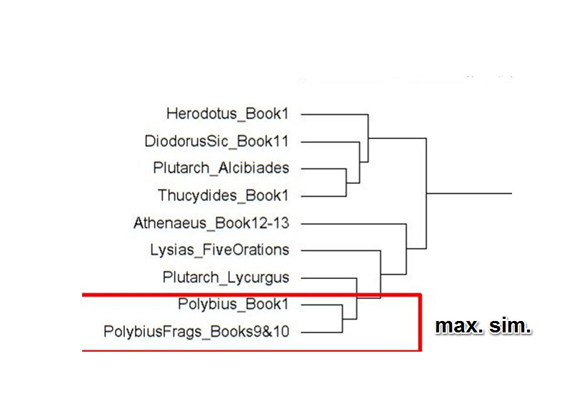
Closest Match

Slide 22
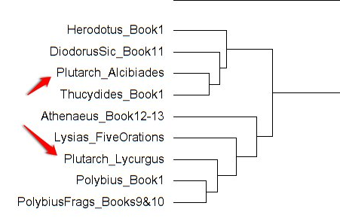
Anomalous Plutarch?

Slide 23
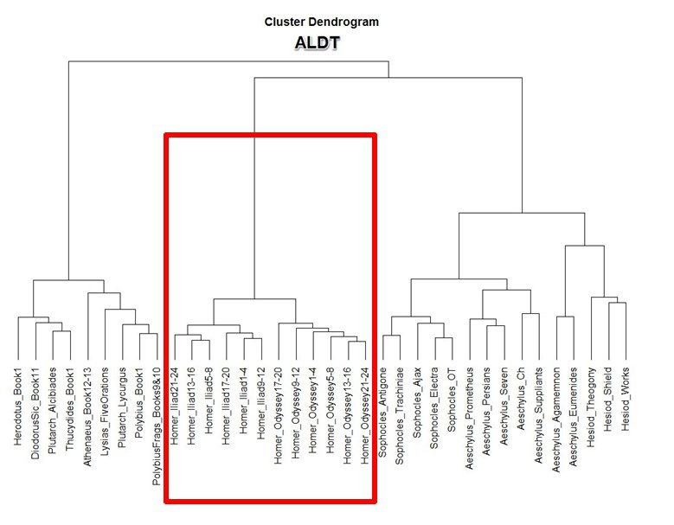
Second major division:
Homeric v. non-Homeric verse

Slide 24
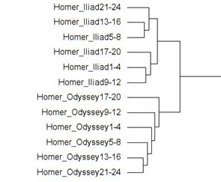
Homer

Slide 25
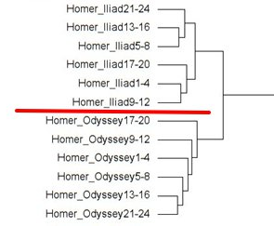
Iliad v. Odyssey

Slide 26
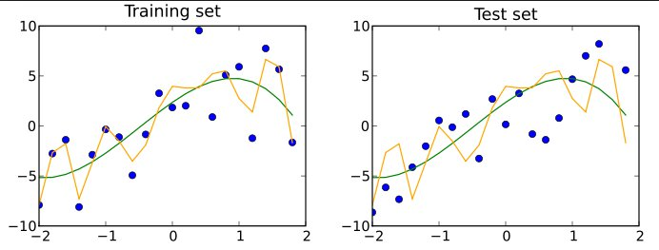
Nest step: classification testing

Slide 27
Classification testing with sWords
Naïve-Bayes & Support Vector Machine:
Both give success rate = c. 85%
Naïve-Bayes sensitive to number of features
Analysis of non-sWord data with same parameters: c. 78%

Slide 28
Type/token ratios
(corpus = 521,817 tokens)
Lemmata: 28,457 unique (0.05453)
sWords: 90,409 (0.17325)
Non-sWord: 457 (0.00090956)

Slide 29
sWords as heuristic tool

Slide 30
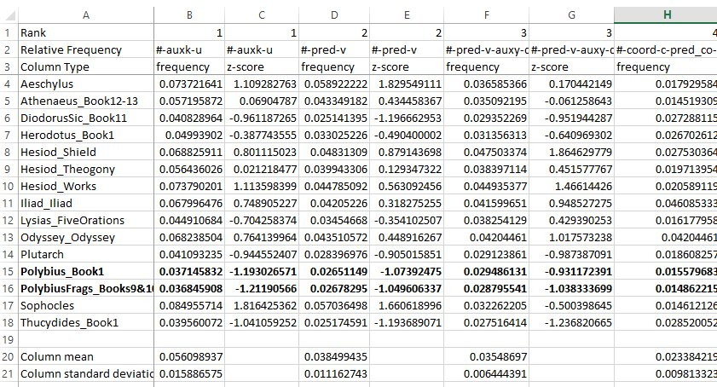
What sWords characterize these two Polybius texts?

Slide 31
Polybius 1 and Fragmentary Polybius
Mostly concordant
When they diverge, they diverge sharply
#-pred-v-adv-v (7th most frequent sWord in corpus)
Polybius 1: Freq. = 0.01758 (z-score = 1.9194) (437 occurrences in 26,894 tokens)
Frag Poly: Freq. = 0.01124 (z-score = -0.6266) (218 in 19,378 tokens)

Slide 32
Remember:
sWords agglutinative constructs
They are not independent variables
Divide #-pred-v-adv-v by #-pred-v
Polybius 1: freq = 0.6633 (z-score = 3.444)
Frag Poly: freq. = 0.42 (z-score = 1.1072)

Slide 33
What is #-pred-v-adv-v anyway?

Slide 34
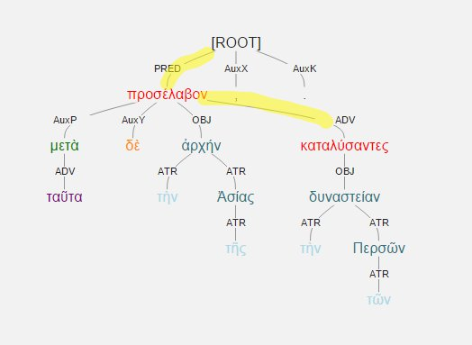
μετὰ δὲ ταῦτα προσέλαβον τὴν τῆς Ἀσίας ἀρχήν, καταλύσαντες τὴν τῶν Περσῶν δυναστείαν
Polybius 1.2.5

Slide 35
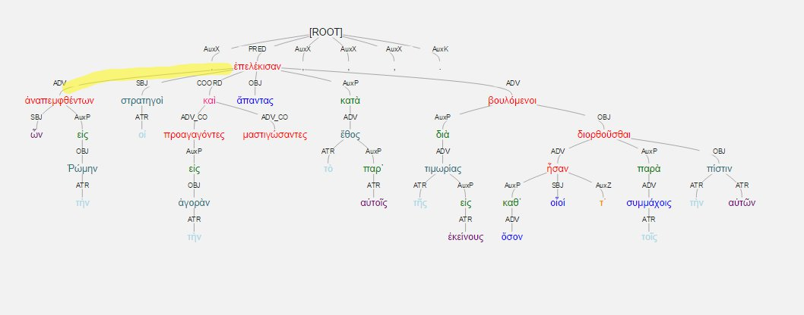
Polybius 1.7.12

Slide 36
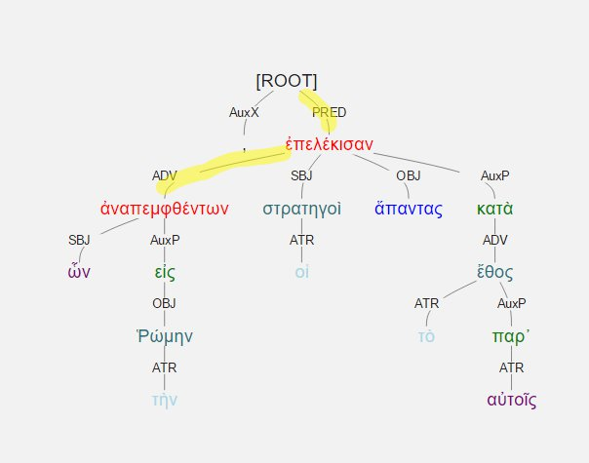
ὧν ἀναπεμφθέντων εἰς τὴν Ῥώμην, οἱ στρατηγοὶ … ἅπαντας κατὰ τὸ παρ' αὐτοῖς ἔθος ἐπελέκισαν ….

Slide 37
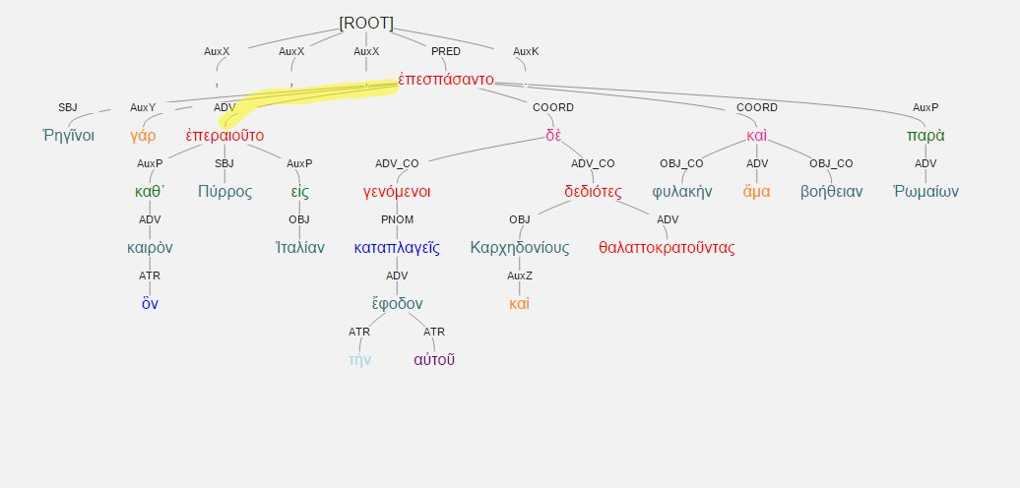
Polybius 1.7.2

Slide 38
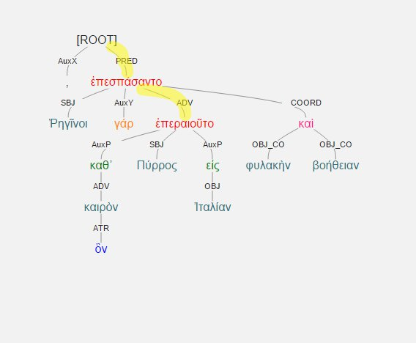
Ῥηγῖνοι γάρ, καθ' ὃν καιρὸν Πύρρος εἰς Ἰταλίαν ἐπεραιοῦτο ... ἐπεσπάσαντο φυλακὴν ἅμα καὶ βοήθειαν. …

Slide 39
Other “distinctive” sWords for Polybius 1 and Frag Poly
#-pred-v-auxp-r (frequency rank # 11)
#-pred-v-coord-c (# 17)
#-pred-v-adv-n (# 36)
#-pred-v-sbj-n-atr-l (# 47)
#-pred-v-pnom-a (# 58)
#-pred-v-sbj-v (# 61)

Slide 40
Playing with sWords
Salient difference between Iliad and Odyssey
#-pred-v-sbj-n-atr-n (# 47)
Iliad: Freq. = 0.0033 (z-score = 0.973) (408 occurrences in 123,727)
Odyssey: Freq. = 0.0021 (z-score = -0.051) (210 in 98,229)

Slide 41
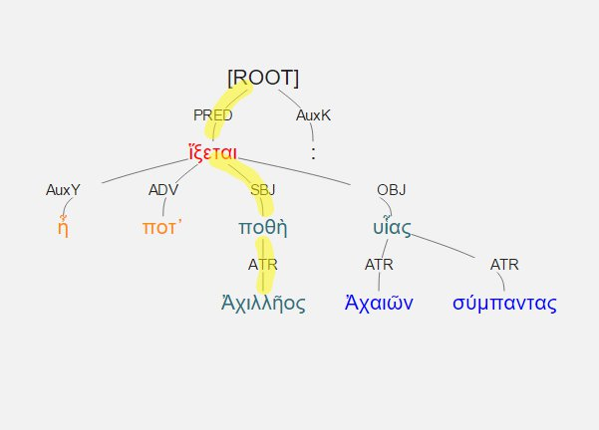
ἦ ποτ' Ἀχιλλῆος ποθὴ ἵξεται υἷας Ἀχαιῶν σύμπαντας
#-pred-v-sbj-n-atr-n
Iliad 1.240

Slide 42
Playing with sWords
Salient distinction between Herodotus and Thucydides
#-coord-c-pred_co-v-coord-c (# 47)
Herodotus: 9.1% of #-coord-c-pred_co-v are further expanded by another coord-c (z-score = 0.350) (76 in 31,158)
Thucydides: 16.4% (z-score = 1.884) (112 in 23,913)

Slide 43
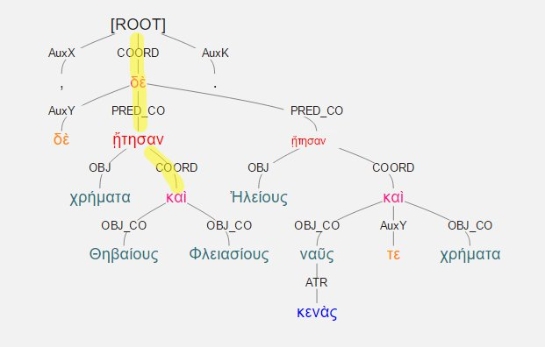
Θηβαίους δὲ χρήματα ᾔτησαν καὶ Φλειασίους, Ἠλείους δὲ ναῦς τε κενὰς καὶ χρήματα
#-coord-c-pred_co-v-coord-c
Thucydides 1.27.2

