Slide 1
Using Greek and Latin Treebanks for research
January 4-5th, 2017, 9AM-5PM
THE WESTIN HARBOUR CASTLE, TORONTO

Slide 2
Can we determine the accuracy of quotes, paraphrases, epitomes, and excerpts of Greek prose authors?

Slide 3
Athenaeus (c. 200 CE) preserves some 2500+ quotes or paraphrases to 800+ writers (verse and prose)

Slide 4
Treebanking and Author Attribution in Greek Prose

Slide 5
Greek and Latin Treebanks and Research Part 2
You are invited to attend the workshop:
January 4-5, 2017
The Westin Harbor Castle, Toronto

Slide 6
Authorship Attribution through syntax

Slide 7
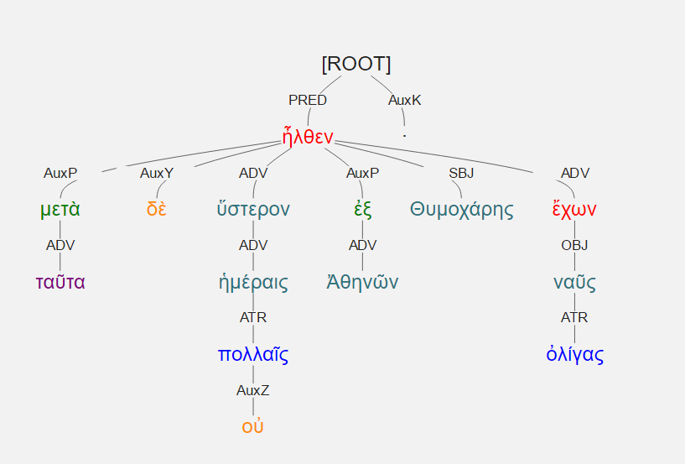
Countable Treebank features?

Slide 8
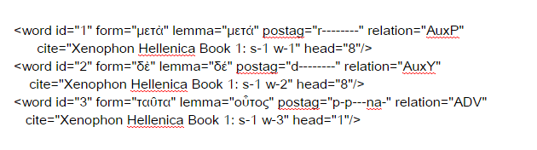
Countable Treebank features?

Slide 9
Countable Treebank features?

Slide 10
Countable Treebank features?

Slide 11

Countable Treebank features? A path from leaf to root.

Slide 12
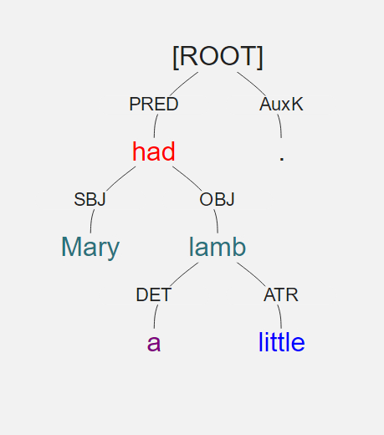
Countable Treebank features? A path from leaf to root.

Slide 13
Countable Treebank features? Syntax Words (sWords)
Mary: SBJ-PRED-ROOT
Had: PRED-ROOT
A: DET-OBJ-PRED-ROOT
Little: ATR-OBJ-PRED-ROOT

Slide 14
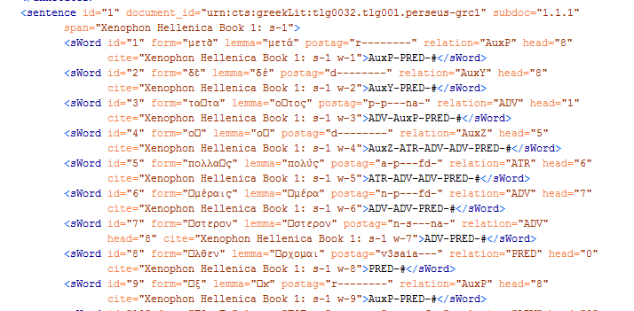
sWords

Slide 15
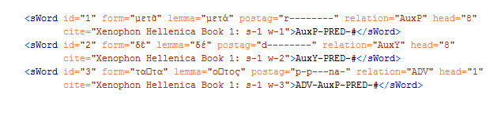
sWords

Slide 19
Epitomizers and Excerptors
Polybius (2nd c. BCE) has 5 of 40 books preserved through direct transmission
Others mainly preserved in the excerptors working for Emperor Constantine VII Porphyrogenitus (10th c. CE)
Diodorus Siculus (1st c. BCE) has 15 of 40 books preserved through direct transmission
Others mainly in Photius (9th century CE) and the same Constantine excerptors

Slide 20
Derive Syntactic “Thumbprints”
Create a database of syntactically analyzed Greek prose
Teach the computer to distinguish known authors (proof of concept)
Compare directly-transmitted to epitomized prose by the same author

Slide 21
Fragments of Lost Authors
Compare to fragments of the same author that are preserved elsewhere
Compare to context in Athenaeus and Photius
Does it resemble:
The other fragments of the same author?
The context in Athenaeus?

Slide 22
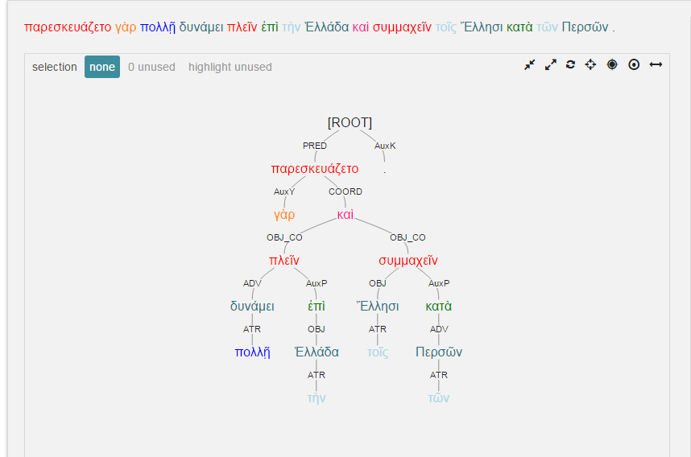
Diodorus 11.26.4

Slide 23
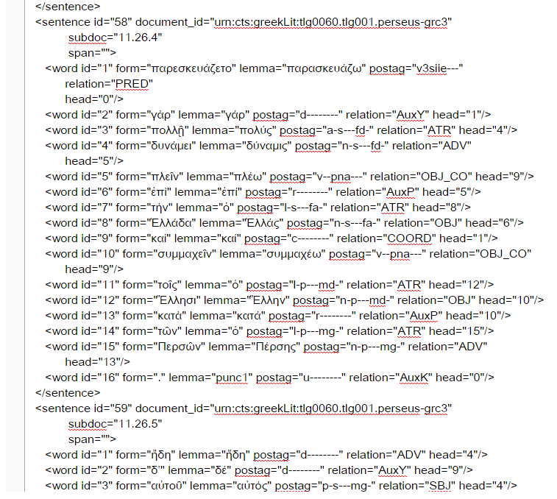

Slide 24
For each word in AGDT we have:
dependency (word’s parent, children)
syntactic relation (grammatical label for dependency)
Lemma
Morphology
Position in sentence

Slide 25
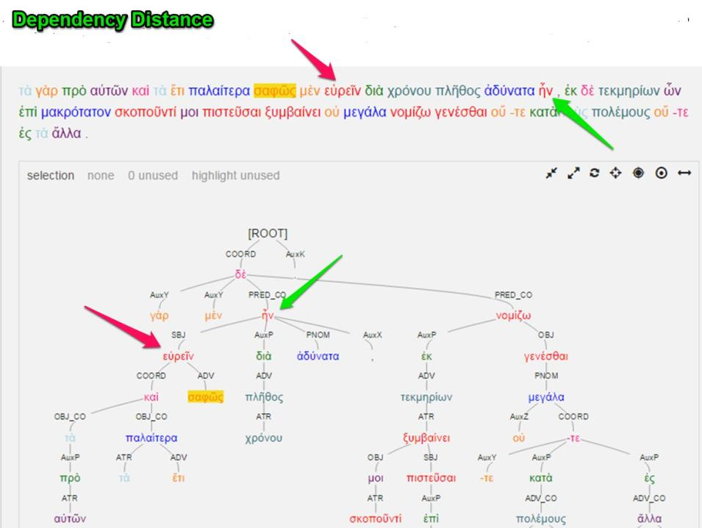

Slide 26
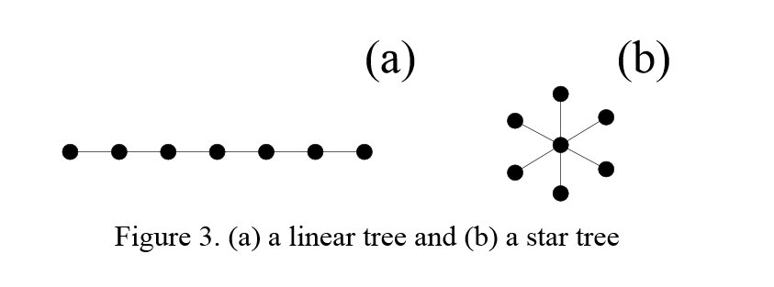
Dependency Degree
Linear vs. hubby structure

Slide 27
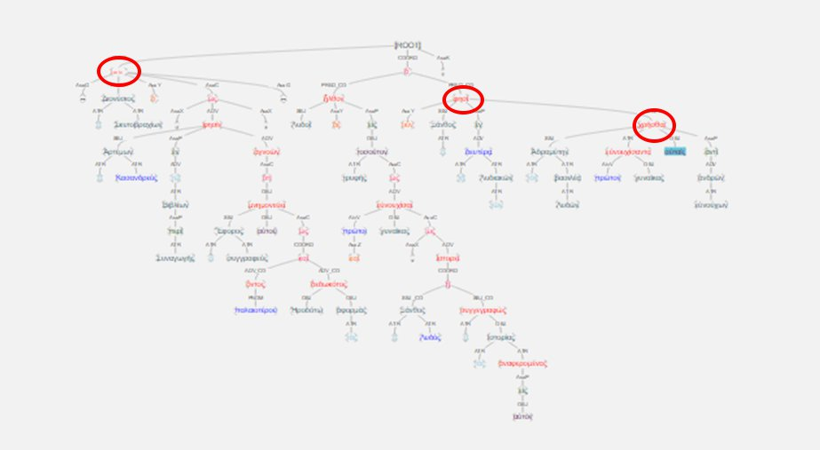

Slide 28
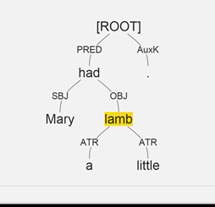

Slide 29
Mary: SBJ-PRED-ROOT
had: PRED-ROOT a: ATR-OBJ-PRED-ROOT little: ATR-OBJ-PRED-ROOT lamb: OBJ-PRED-ROOT

Slide 30
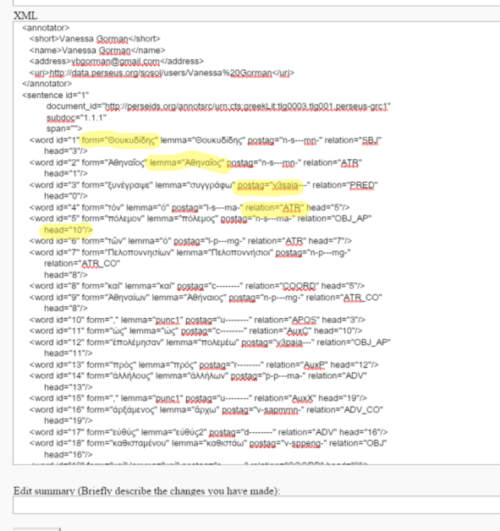

Slide 31
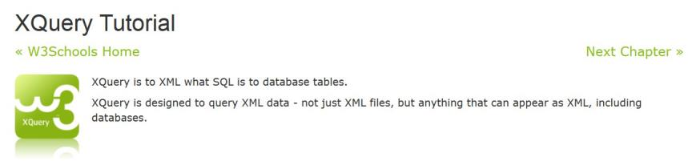
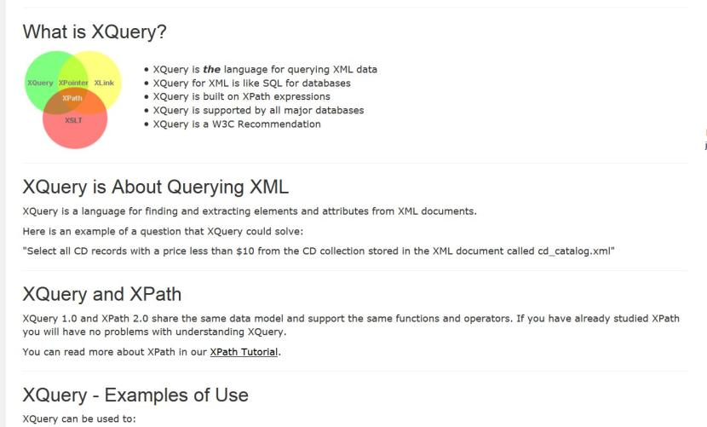

Slide 32
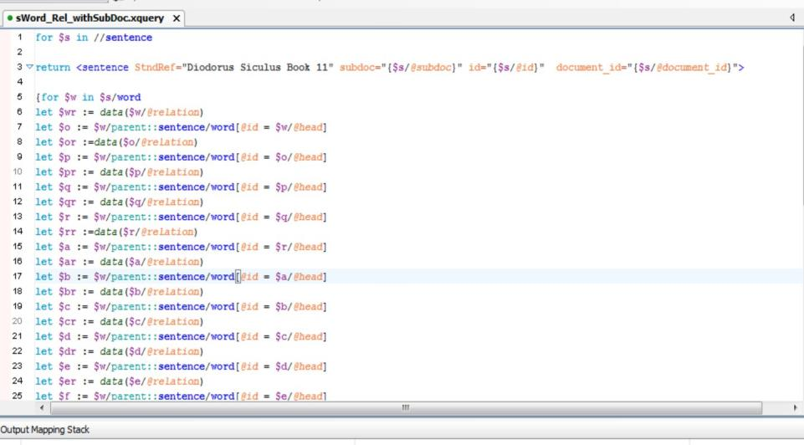

Slide 33
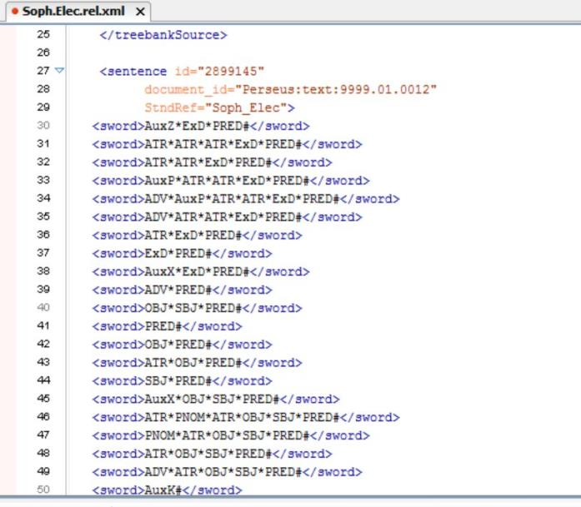
Ὦ τοῦ στρατηγήσαντος ἐν Τροίᾳ ποτὲ / Ἀγαμέμνονος παῖ
"O child of Agamemnon, once leading an army at Troy"

Slide 34
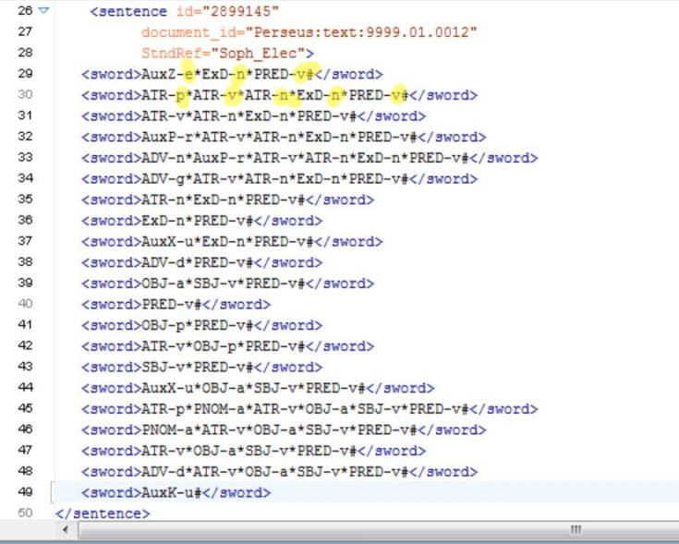
Ὦ τοῦ στρατηγήσαντος ἐν Τροίᾳ ποτὲ / Ἀγαμέμνονος παῖ
"O child of Agamemnon, once leading an army at Troy"

Slide 35
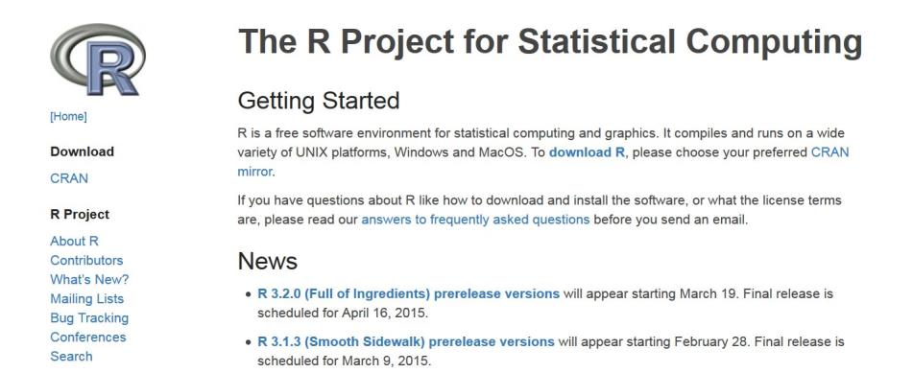

Slide 36
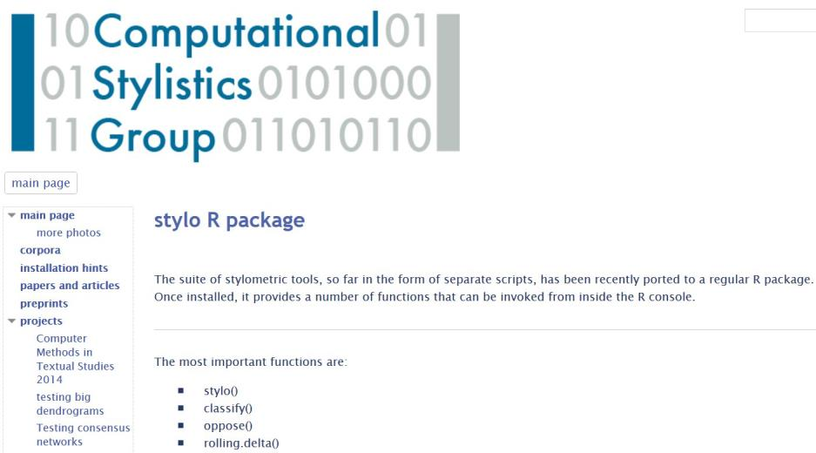

Slide 37
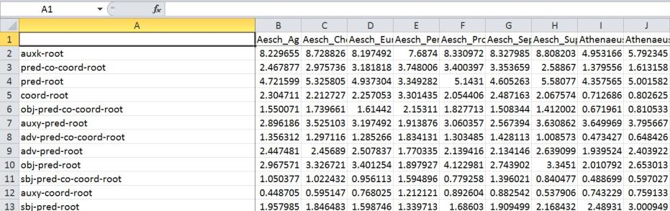

Slide 38
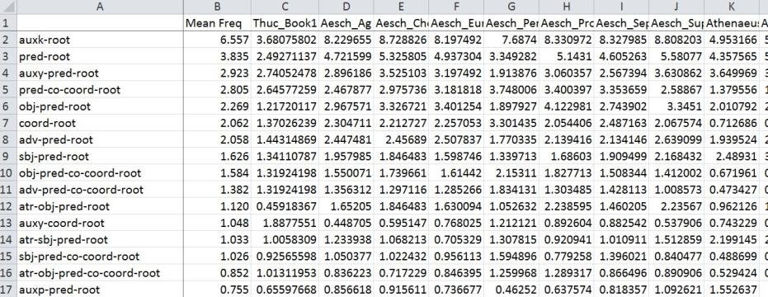

Slide 39
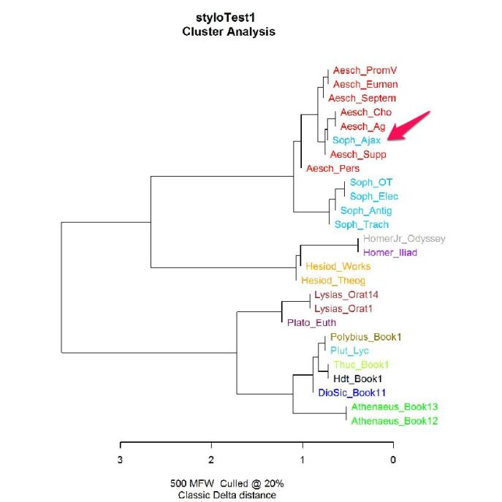

Slide 41
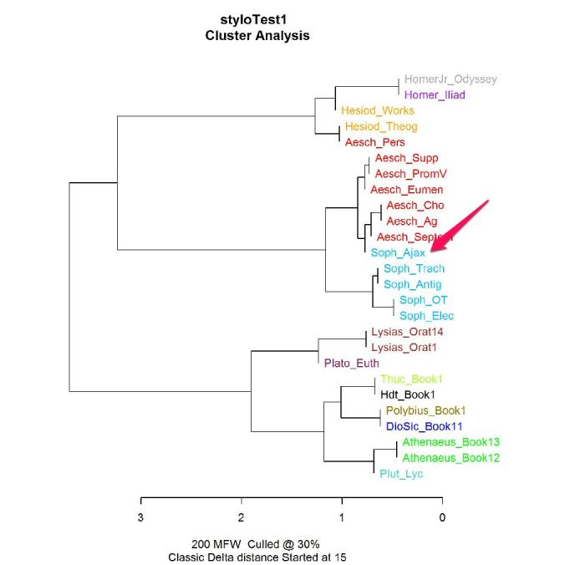

Slide 43
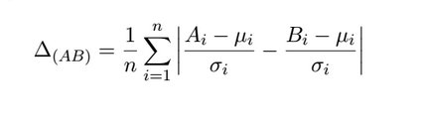
Burrows Delta

Slide 44

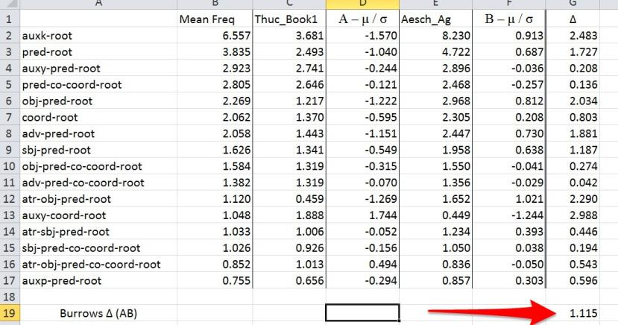

Slide 45
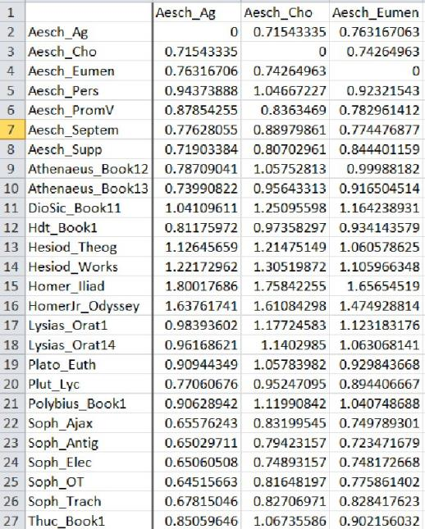

Slide 46
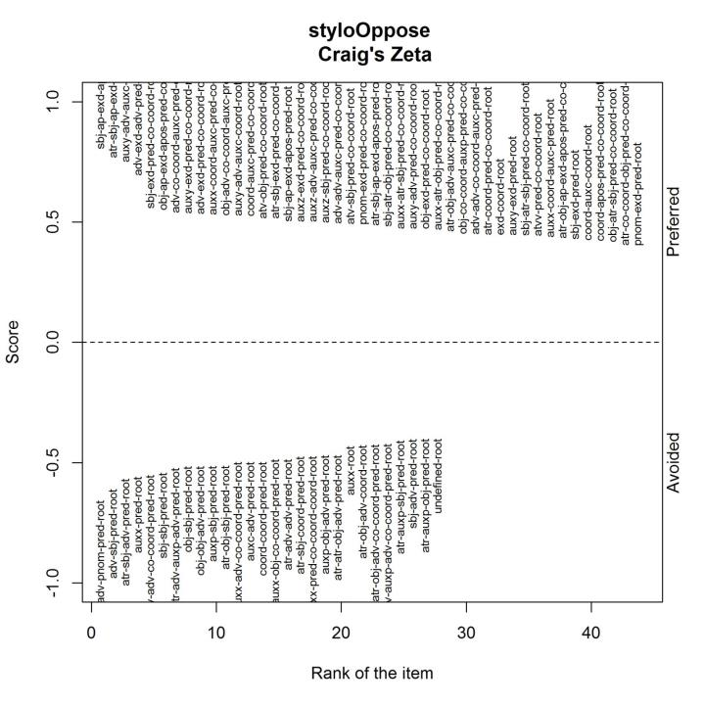

Slide 47
Craig’s Zeta
Divide corpus 1 into segments of equal size (size = n)
Segments with at least 1 example of given feature are hits.
Each hit is worth 1 point.
Hit
Hit
Hit
Hit
Hit
Hit
Hit
Hits/segments = preferred feature score
Divide corpus 2 into segments of size n.
Segments with no examples of feature are misses.
Each miss is worth -1 point.
Miss
Miss
Miss
Miss
Miss
Miss
Miss
Miss
Misses/segments = avoided feature score

Slide 49
Thucydides

Slide 50
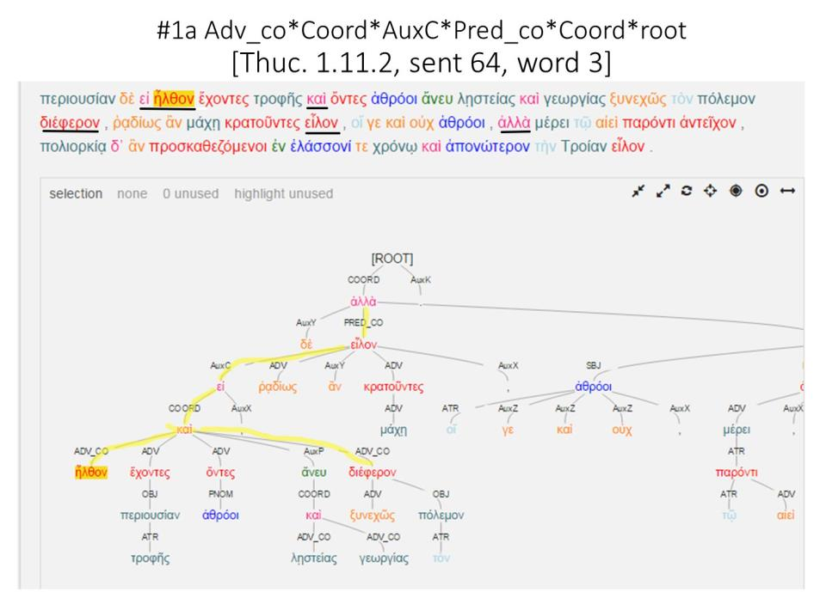

Slide 51
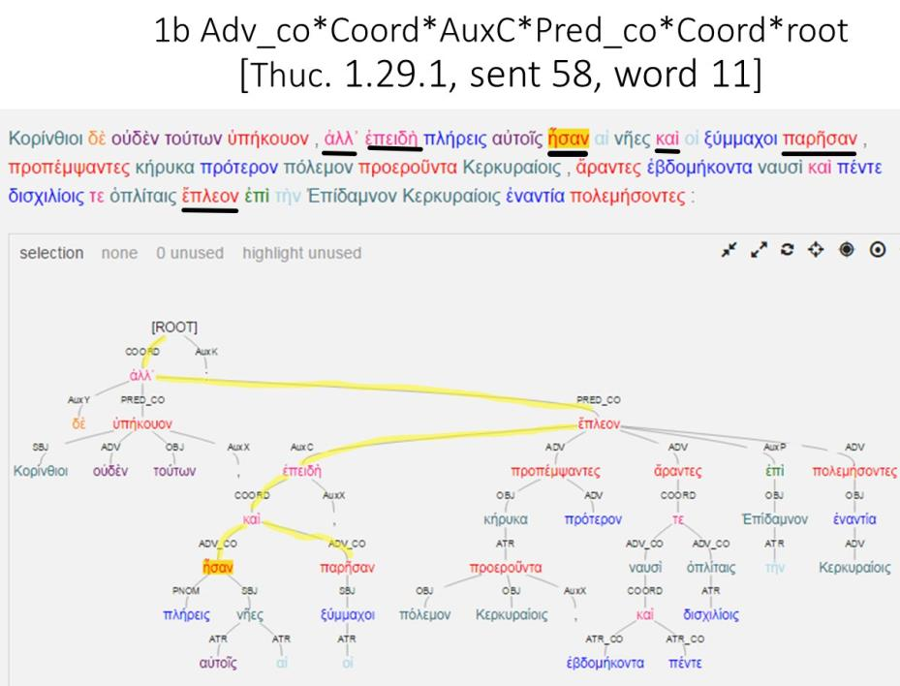

Slide 52
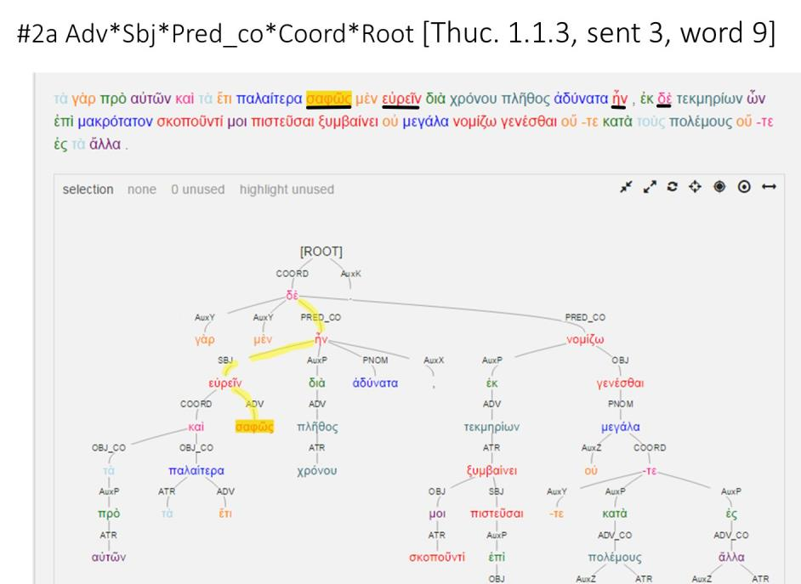

Slide 53
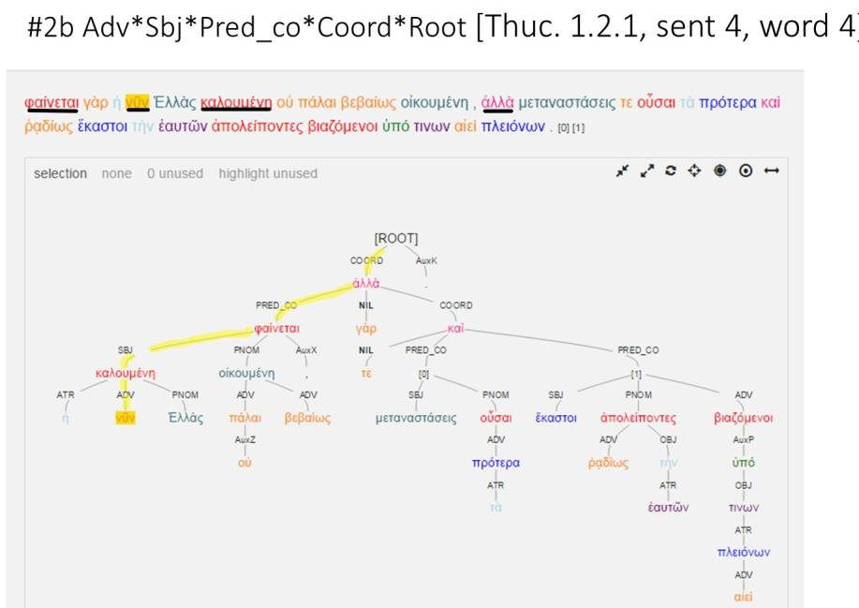

Slide 54
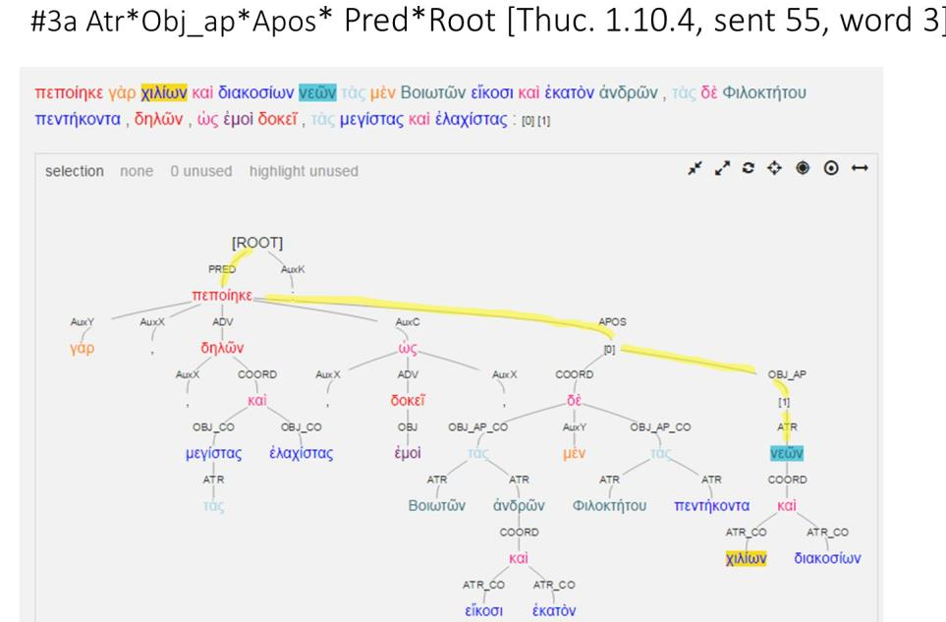

Slide 55
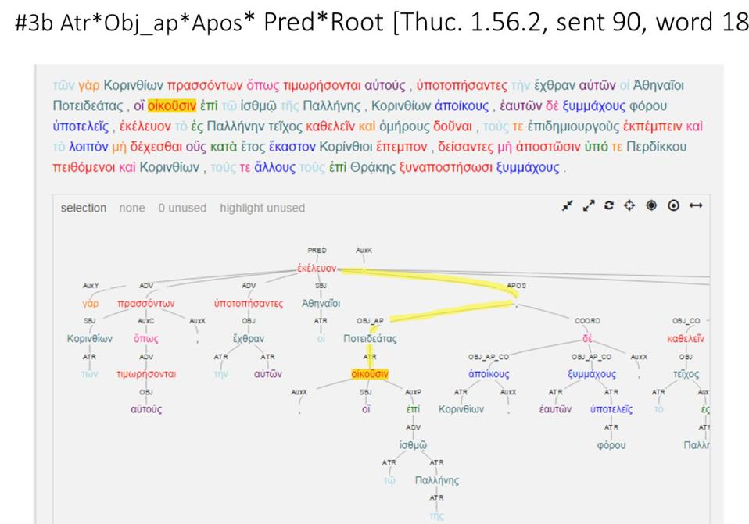

Slide 56
Herodotus

Slide 57
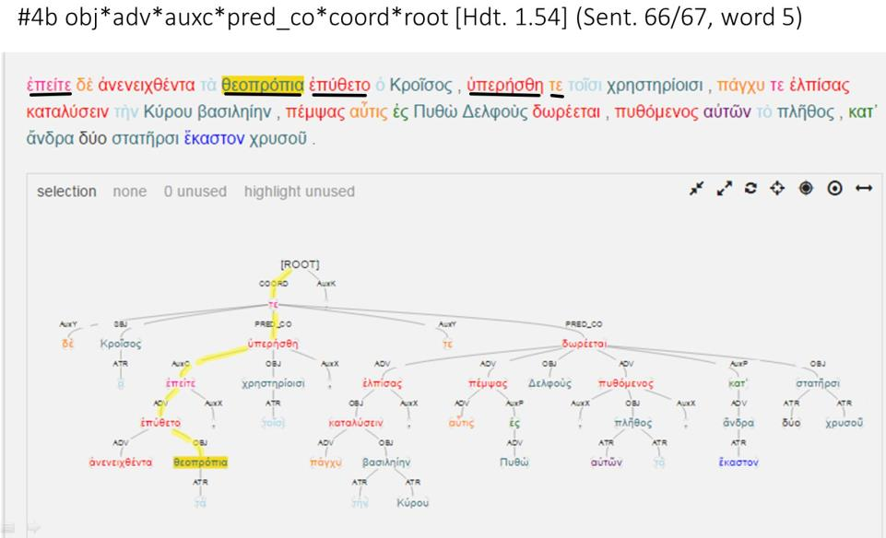

Slide 58
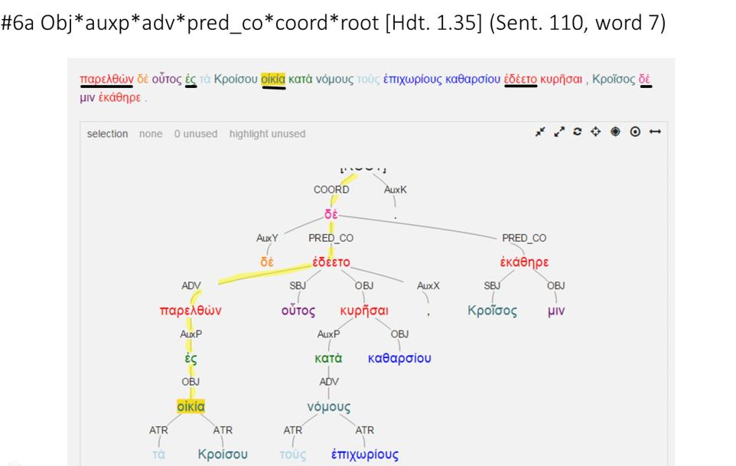

Slide 59
Polybius

Slide 60
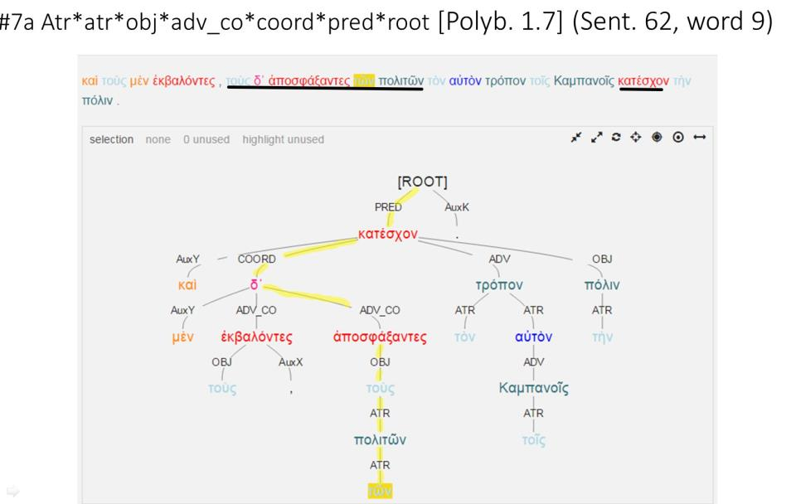

Slide 61
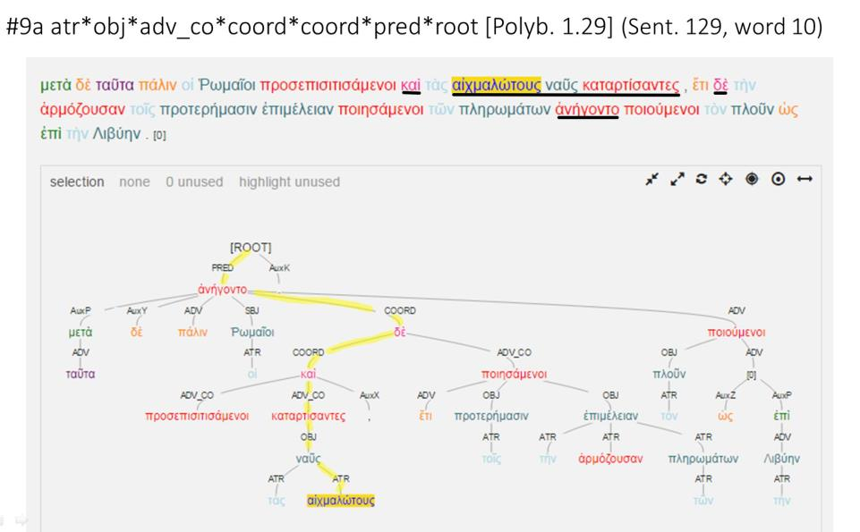

Slide 62
Homer

Slide 63
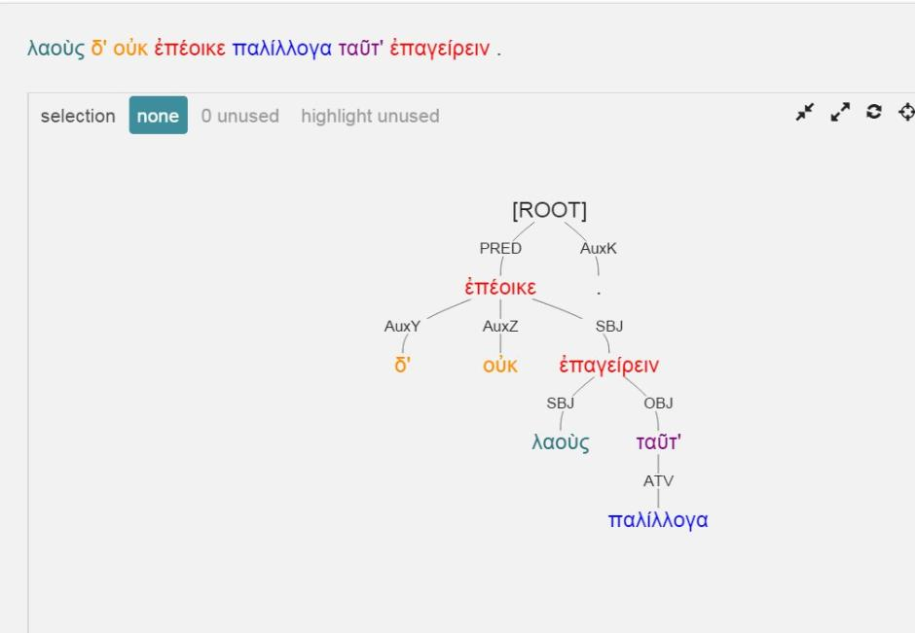

Slide 64
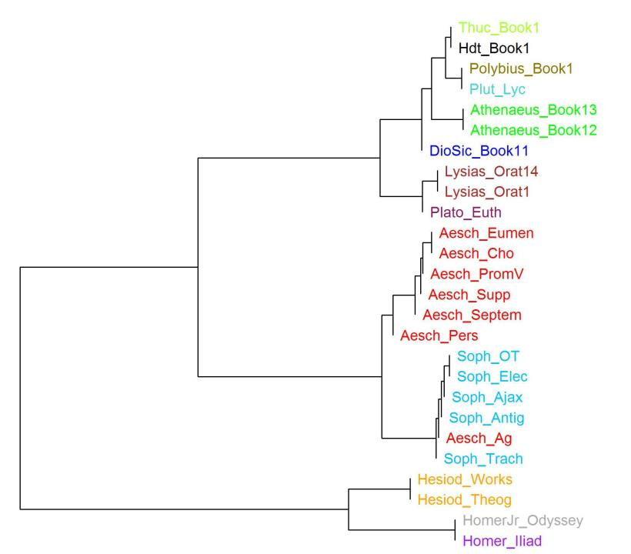

Slide 65


Slide 66
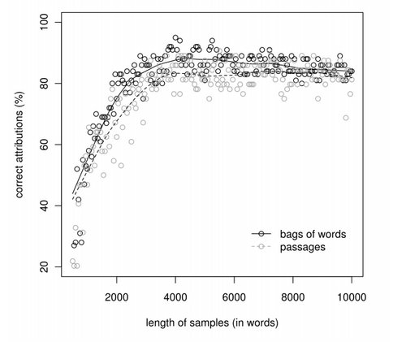
Maciej Eder

Slide 67
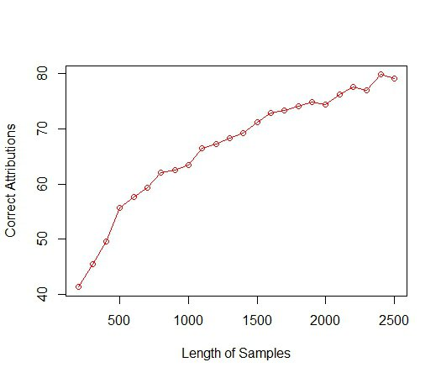

Slide 68
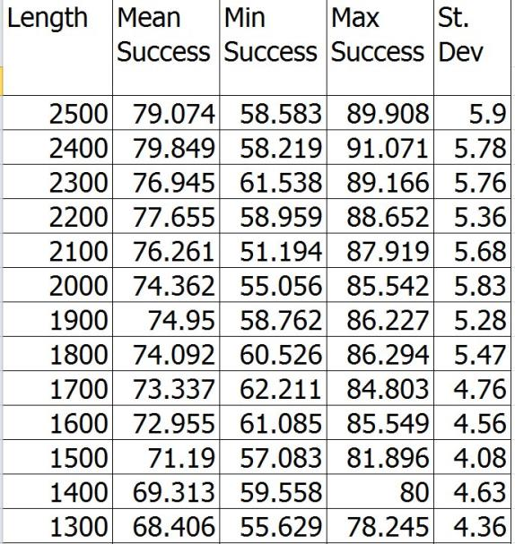

Slide 69
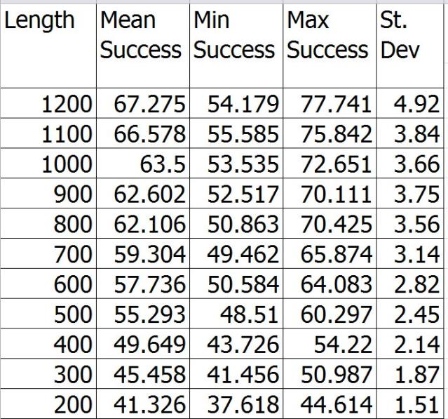

Slide 70
Leipzig Open Philology Project
Digital Athenaeus Project
Perseus and Perseids Projects, Tufts University
Perseus Open Publication Series
University of Nebraska−Lincoln
Dept. of History
Dept. of Classics and Religious Studies

